Slide 1
About Omics Group
OMICS Group International through its Open Access Initiative is committed to make genuine and reliable contributions to the scientific community. OMICS Group hosts over 400 leading-edge peer reviewed Open Access Journals and organize over 300 International Conferences annually all over the world. OMICS Publishing Group journals have over 3 million readers and the fame and success of the same can be attributed to the strong editorial board which contains over 30000 eminent personalities that ensure a rapid, quality and quick review process.

Slide 2
About Omics Group conferences
OMICS Group signed an agreement with more than 1000 International Societies to make healthcare information Open Access. OMICS Group Conferences make the perfect platform for global networking as it brings together renowned speakers and scientists across the globe to a most exciting and memorable scientific event filled with much enlightening interactive sessions, world class exhibitions and poster presentations
Omics group has organised 500 conferences, workshops and national symposium across the major cities including SanFrancisco,Omaha,Orlado,Rayleigh,SantaClara,Chicago,Philadelphia,Unitedkingdom,Baltimore,SanAntanio,Dubai,Hyderabad,Bangaluru and Mumbai.

Slide 3
Sensitive detection of aerosols and gases using Raman scattering
R. L. Aggarwal, S. Di Cecca, L. W. Farrar, T. H. Jeys
2nd Internation Conference & Exhibition on Lasers, Optics and Photonics
September 08-10, 2014
This work was sponsored by the Edgewood Chemical Biological Center portion of this work was sponsored by the Defense Threat Reduction Agency under Air Force Contract FA8721-05-C-0002. Opinions, interpretations, conclusions, and recommendations are those of the authors and are not necessarily endorsed by the United States Government.
Notes:
This work was sponsored by the Edgewood Chemical Biological Center portion of this work was sponsored by the Defense Threat Reduction Agency under Air Force Contract FA8721-05-C-0002. Opinions, interpretations, conclusions, and recommendations are those of the authors and are not necessarily endorsed by the United States Government.

Slide 4
Outline
Introduction to Raman scattering
Schematic of the Raman setup
Detection of aerosols
Detection of gases
Summary
Acknowledgments
Notes:
The outline of my Talk consists of (1) Introduction to Raman scattering, (2) Schematic of the Raman setup, (3) Detection of aerosols, (4) Detection of gases, (5) Summary, and (6) Acknowledgments.

Slide 5
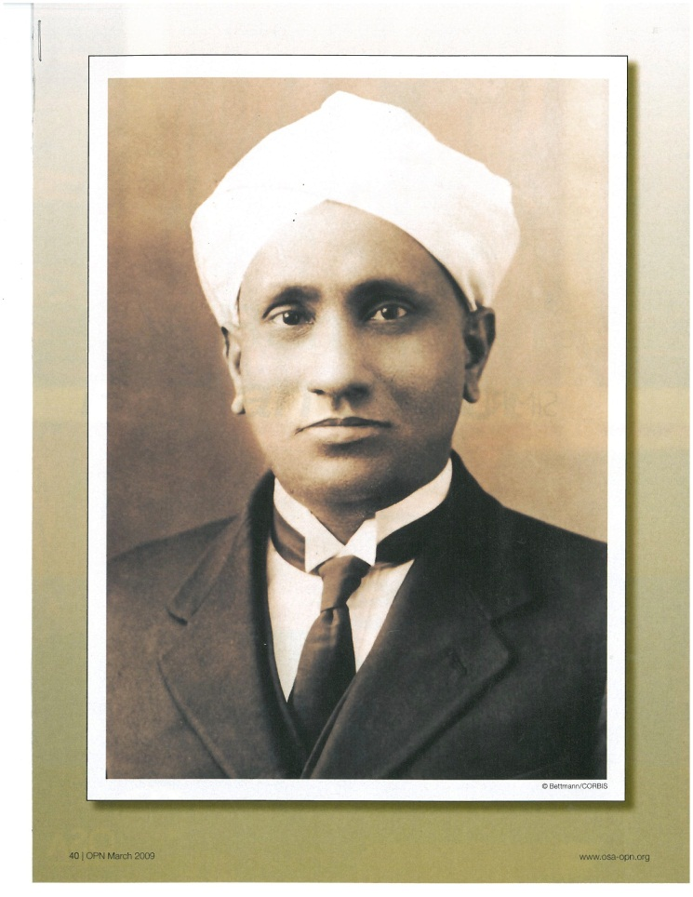
Introduction to Raman Scattering
Raman scattering (inelastic light scattering due to molecular vibrations and/or rotations) was first observed by Prof. C. V. Raman on February 28, 1928 using the light from a Hg arc lamp. The results of this experiment were published on March 31, 1928.
Lasers are now used for Raman scattering experiments.
Raman spectrum of a material is its molecular fingerprint.
Raman cross sections are very very small (1x10⁻³⁰ - 1x10⁻²⁵ cm²).
Sir C. V. Raman (1888 – 1970)
1930 Nobel Prize for Physics
Notes:
Raman scattering is inelastic light scattering due to molecular vibrations and/or rotations. Raman scattering was first observed by Prof. C. V. Raman on February 28, 1928 using the light from a Hg arc lamp. The results of this experiment were published on March 31, 1928, that is, in a month’s time. Professor Raman received the 1930 Noble Prize for Physics for this work.

Slide 6
Raman Signal
Raman signal S_{R} (CCD counts) is given by
  S_{R} = η_{c}η_{q}σ_{R}N_{m}L(P_{L}τ /hν_{L})
  where η_{c} = Collection efficiency
  η_{q} = CCD quantum efficiency
  σ_{R} = Raman cross section (cm²)
  N_{m} = Molecular concentration (cm⁻³)
  L = Laser path length (cm)
  P_{L} = Laser power (W)
  τ = Integration time (s)
  hν_{L} = Laser photon energy (J)
Relative Raman signals for different materials are determined
by the value of the product of σ_{R} and N_{m}.
Notes:
The Raman signal S_{R} in terms of the CCD camera counts is given by the formula shown in red. In this formula, h_{c} is the collection efficiency, h_{q} is the quantum efficiency of the CCD camera, s_{R} is the Raman cross section, N_{m} is the molecular concentration, L is the laser path length, P_{L} is the laser power, t is the integration time, and hn_{L} is the laser photon energy.

Slide 7
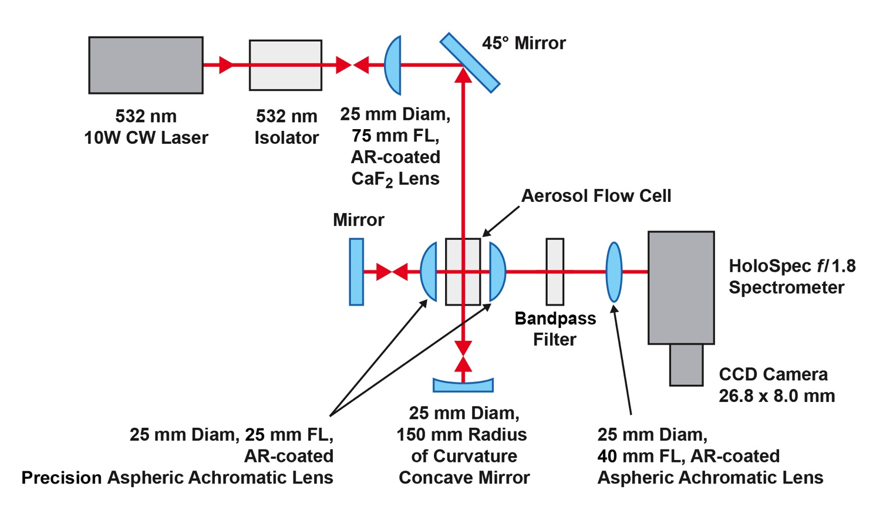
Schematic of the Raman Setup
The spectral resolution is 10 cm⁻¹ using the standard
grating and 4 cm⁻¹ using the high-dispersion grating.
Notes:
Schematic of the Raman setup is shown here. It consists of (1) 10 W 532 nm CW laser as the excitation light source, (2) 532 nm Faraday isolator for blocking the second-pass laser beam, (3) CaF₂ lens for focusing the laser beam into the aerosol flow cell, (4) concave mirror for retro-reflecting the laser beam into the aerosol flow cell, (Precision aspheric achromatic f/1.0 lenses for the collection of the Raman light, (5) aspheric achromatic lens for focusing the Raman light on the slit of the of the HoloSpec f/1.8 Raman spectrometer, and (6) low-noise CCD camera. Bandpass and Raman filters are used to limit the spectral range of the Raman system.
The spectral resolution ~ 10 cm⁻¹ using the standard grating and ~ 4 cm⁻¹ using the high-dispersion grating.

Slide 8
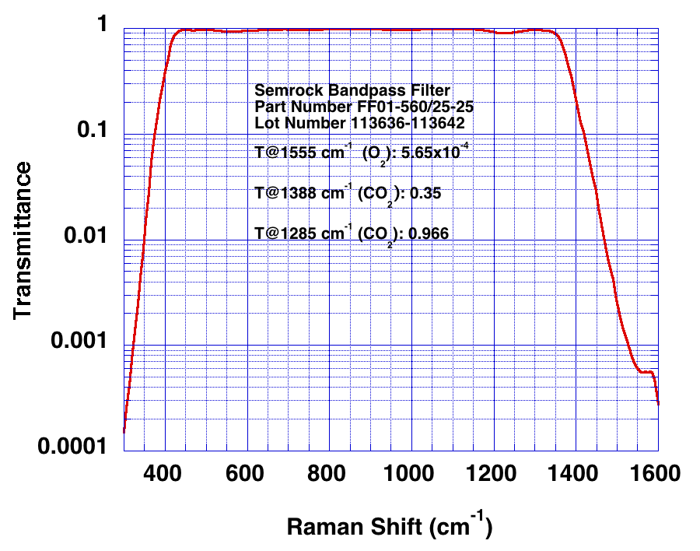
Transmittance of the Bandpass Filter
~ 98% transmittance over the 430-1350 cm⁻¹ spectral range
Notes:
The bandpass filter has ~ 98% transmittance over the 430-1350 cm⁻¹ spectral range. The transmittance for the CO₂ line at 1285 cm-1 is 35%. The transmittance for the O₂ line at 1555 cm-1 is 0.0565%.

Slide 9
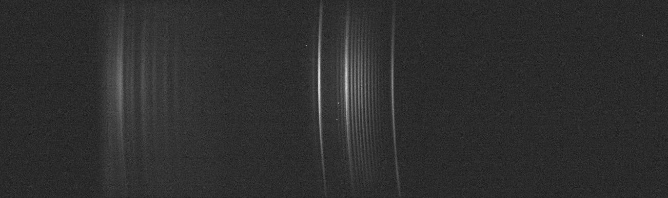
The CCD Image Obtained with Standard Grating and 30 s Integration Time
H₂O
CO₂
O₂
Notes:
The CCD image was obtained with the standard grating and 30 s integration time. This shows the rotational lines of atmospheric water (H₂O) vapors, the vibration lines of atmospheric carbon dioxide (CO₂), and vibrational-rotational lines of atmospheric oxygen (O₂).

Slide 10
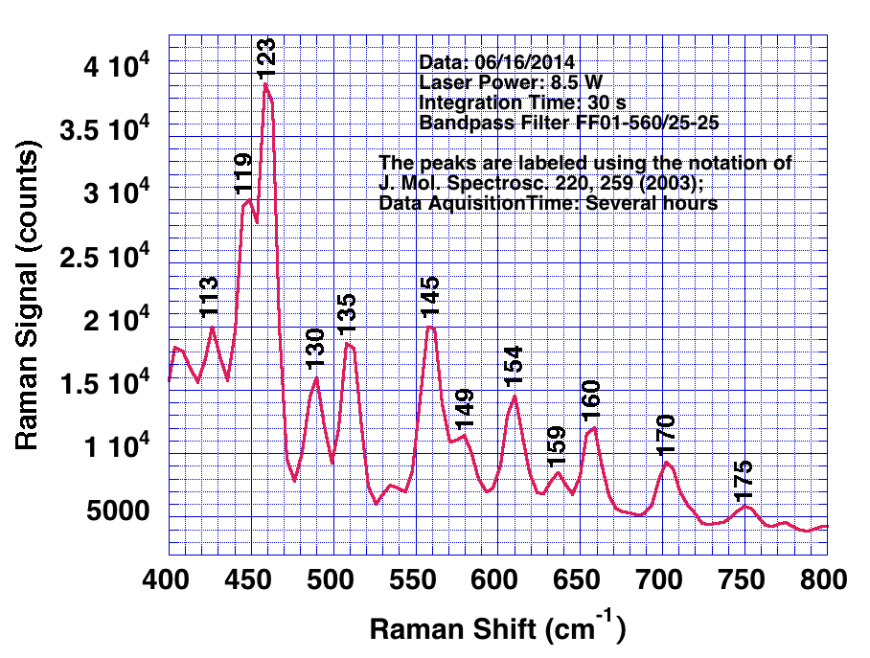
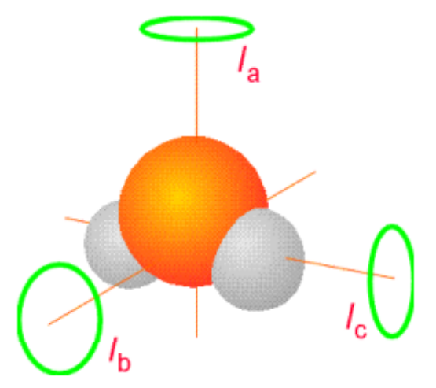
H₂O Rotational Spectrum Using Standard Grating
Rotational constants:
A = h/8π²cI_{a} = 27.9 cm⁻¹
B = h/8π²cI_{b} = 14.5 cm⁻¹
C = h/8π²cI_{c} = 9.3 cm⁻¹
The peaks are labeled using the notation of Avila et al., J. Mol. Spectrosc. 220, 259 (2003).
Notes:
H₂O is a nonlinear molecule, which has three mutually perpendicular axes of rotation. Hence, there are three rotational constants denoted by A, B, and C. A, B, and C are equal to 27.9, 14.5, and 9.3 cm⁻¹, respectively. The observed H₂O rotational peaks are labeled using the notation of Avila et al., published in 2003 in the Journal of Molecular Spectroscopy, Volume 220.

Slide 11
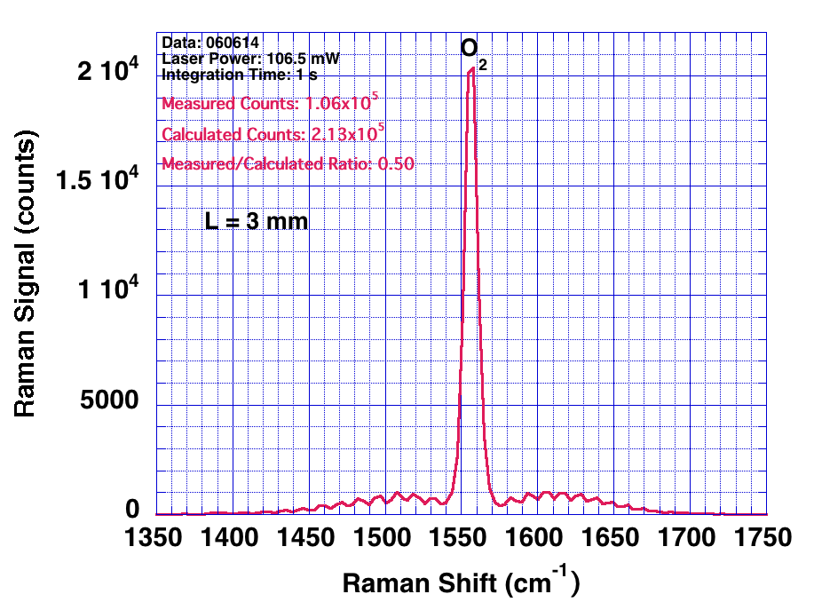
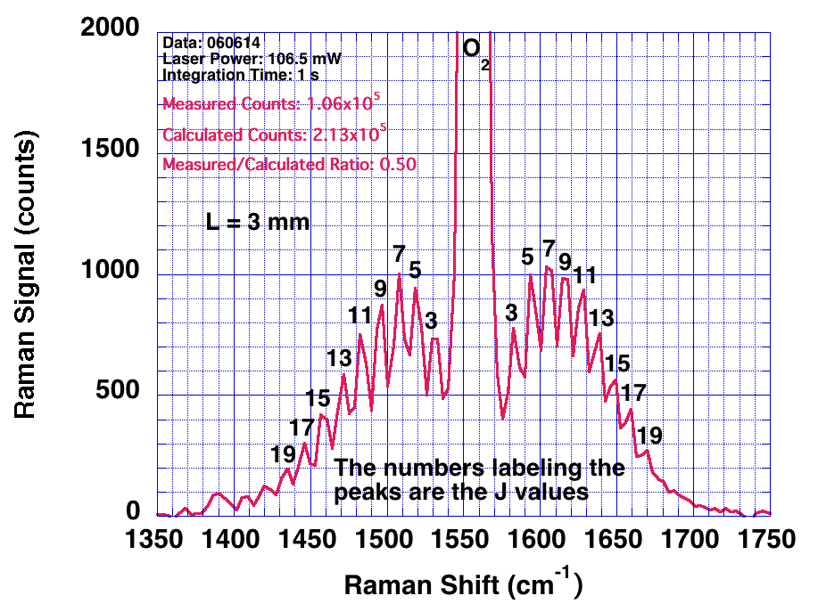
Performance of Our Raman Setup Using the Standard Grating Without Bandpass Filter
No Bandpass Filter
ΔJ = +2 transitions
Initial J-value
ΔJ = -2 transitions
Final J-value
(i) The measured value of the Raman signal is 2x smaller than that of the calculated value, partly due to vignetting of the rays from off-axis points on the laser beam. (ii) The selection rule for rotational transitions is ΔJ = ±2, where J is the rotational quantum number and even J transitions are completely missing. The most populated level at 300 K is J = (kT/2hcB)^{1/2} - 1/2 = 8; B is the rotational constant equal to 1.45 cm⁻¹ for O₂.
Notes:
The performance of our Raman system is determined by the vibrational-rotational spectrum of atmospheric oxygen (O2). The measured value of the Raman signal is 2x smaller than that of the calculated value using the formula shown earlier in Slide 4.
The selection rule for rotational transitions is DJ = ±2, where J is the rotational quantum number and even J transitions are completely missing.

Slide 12
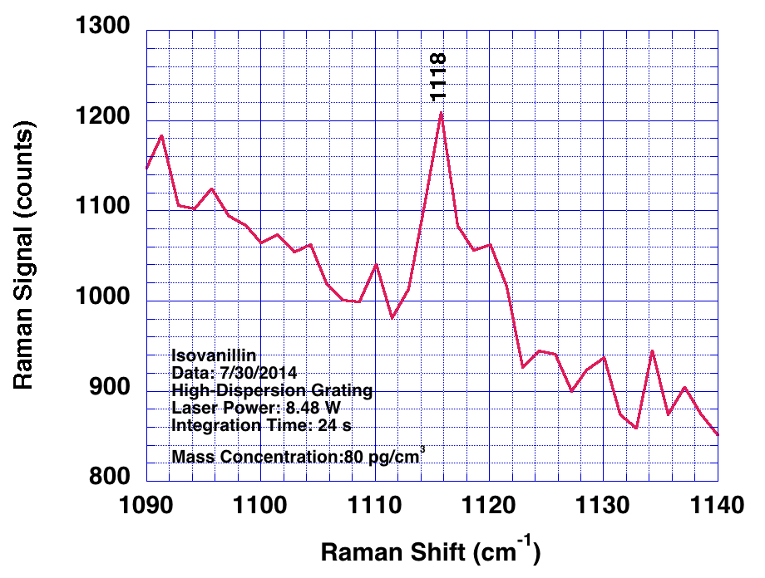
Detection of Isovanillin Aerosol Using High-Dispersion Grating
Limit of detection < 80 pg/cm³
Notes:
Shown is the Raman spectrum of isovanillin aerosol for the 1116 cm-1 mode obtained using the high-dispersion grating. The limit of detection is < 80 pg/cm³ in 24 s. We expect to reduce the limit of detection to < 10 pg/cm³ in 30 s using a concentrator.

Slide 13
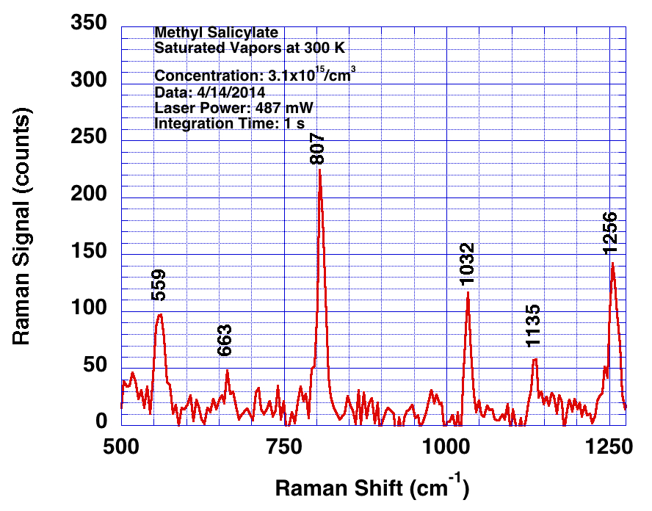
Detection of Methyl Salicylate Vapors Using Standard Grating
Limit of detection deduced to be < 2 ng/cm³ using 10 W laser power and 30 s integration time.
σ_{R} for the 807 cm⁻¹ mode determined to be 2.80±0.17x10⁻²⁹ cm²
Notes:
Shown is the Raman spectrum of methyl salicylate vapors using the standard grating. Limit of detection deduced to be < 2ng/cm³ using 10 W laser power and 30s integration time. The Raman cross section for the 807 cm-1 mode has been determined to be 2.80±0.17x10⁻²⁹ cm².

Slide 14
Summary
Limit of detection < 80 pg/cm³ in 24 s for isovanillin aerosol using the high-dispersion grating. σ_{R} is equal to 3.3x10⁻²⁸ cm² for the 1116 cm⁻¹ mode.
Limit of detection deduced to be < 2 ng/cm³ for methyl salicylate vapors for 10 W laser power and 30 s integration time using the standard grating. The value of σ_{R} has been determined to be 2.80±0.17x10⁻²⁹ cm² for the 807 cm⁻¹ mode.
Notes:
Shown is the summary of the results discussed in this Talk. (1) Limit of detection determined to be < 80 pg/cm3 in 24 s for isovanillin aerosol using the high-dispersion grating. s_{R} is equal to 3.3x10-28 cm² for the 1116 cm⁻¹ mode. (2) Limit of detection deduced to be < 2 ng/cm3 for methyl salicylate vapors for 10 W laser power and 30 s integration time using the standard grating. The value of s_{R} has been determined to be 2.80±0.17x10⁻²⁹ cm² for the 807 cm⁻¹ mode.

Slide 15
Acknowledgments
David Sickenberger (ECBC)
Steven Christensen (ECBC)
Max Howe (MIT Lincoln Laboratory)
Thanks for listening to me.
Notes:
We wish to thank David Sickenberger and Steven Christensen of ECBC for discussions regarding this work We also wish to thank Max Howe of MIT Lincoln Laboratory for getting some of the data for this work.
Thanks for listening to me.

Slide 16
Let Us Meet Again
We welcome all to our future group conferences of Omics group international
Please visit:
www.omicsgroup.com
www.Conferenceseries.com
http://optics.conferenceseries.com/

