Slide 1
Photodistributed hyperpigmentation induced by antihypertensive drugs: two cases report
Dra Rosa Giménez Garcia
Clinical Assitant . Department of Dermatology. Hospital Rio Hortega. Valladolid. Spain
Associate Professor Faculty of Medicine . Valladolid.Spain

Slide 2


Established in the 13th century
it is of the oldest universities in the world
University of Valladolid is a public university in the city of Valladolid in the autonomous región of Castile-Leon .Spain
Notes:
Motto or slogan is:…SAPIENTIA AEDIFICAVIT SIBI DOMUN..“La sabiduría se construyó una casa”..traducción del libro de los Proverbios 9,1
WISDOM HAS BUILT HER HOUSE YOU

Slide 3
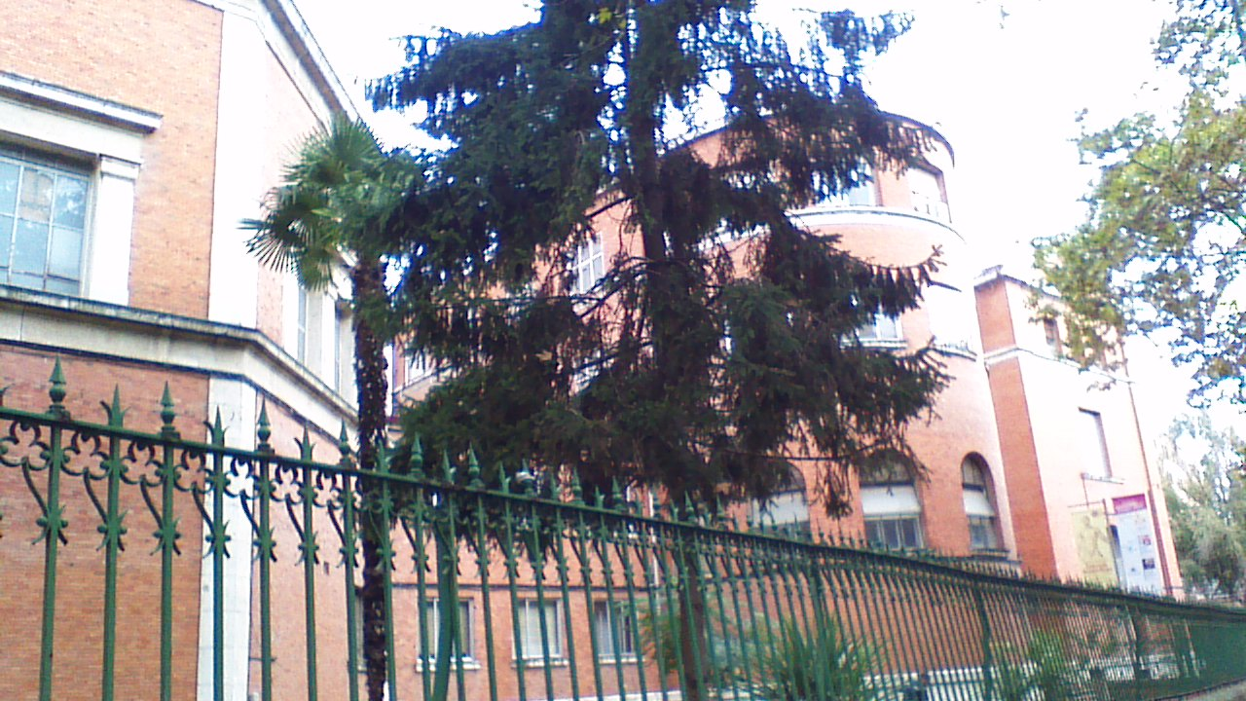

Photodistributed hyperpigmentation induced by antihypertensive drugs: two cases report
Associate Professor .
Department of Medicine, Dermatology and Toxicology.
Faculty of Medicine in Valladolid. Spain
Clinical Assistant. Department Dermatology
Hospital Rio Hortega. Valladolid. Spain

Slide 4
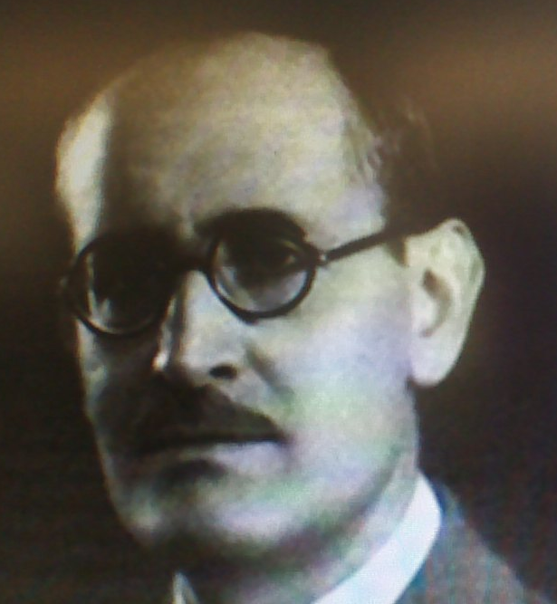

Dr Pio del Rio Hortega
Notes:
Hospital in honor to dr Pio del io Hort3ga

Slide 5
Photodistributed hyperpigmentation induced by antihypertensive drugs: two cases report
Dra Rosa Giménez Garcia
Clinical Assitant . Department of Dermatology. Hospital Rio Hortega. Valladolid. Spain
Associate Professor Faculty of Medicine . Valladolid.Spain

Slide 6
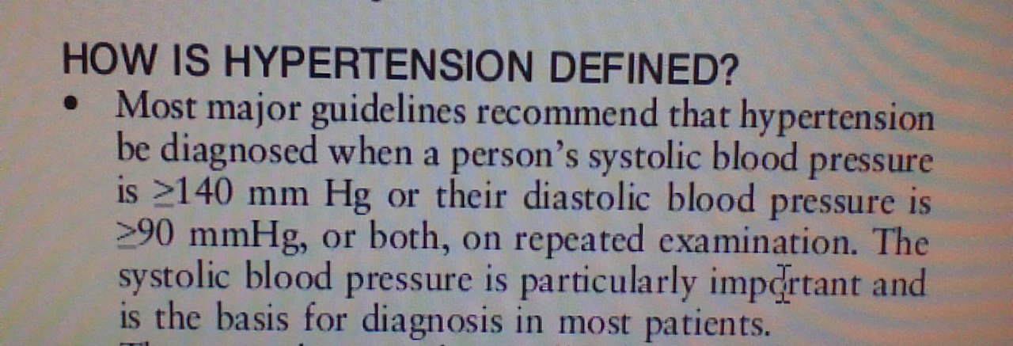
Hypertension
“About one third of adults in most communities in the developed and developing world have hypertension”
Hypertension is the most common chronic condition dealt with by primary care physicians and other health practitioners
Weber et al. ASH hypertension guidelines. J Clin Hypertens 2014;16:14-26
Notes:
Clinical practice guidelines for the management of hypertension in the community . A statment by the american society of hypertension

Slide 7
Hypertension
Systolic blood pressure (SBP) of 140 mm Hg or above and /or diastolic blood pressure (DBP) of 90 mm Hg or above (adults up to 80 years)
Hypertension is an increasing worldwide problem and it is a well recognized risk factor for cardiovascular disease ; stroke and heart failure
Often combined with smoking, obesity, physical inactivity and occurs commonly with diabetes
Notes:
Often combined with other risk factors as smoking, obesity, physical inactivity and occurs commonly with diabetes
HYPERTENSION IS A MAJOR CONTRIBUTOR TO GLOBAL DISEASE BURDEN, OCCURRING AS AN INSIDIUS ACCOMPANIMENT TO AGING POPULATIONS

Slide 8
Hypertension
Treatment with drugs should be started in patients with blood pressures >140/90 mm Hg in whom lifestyle treatments have not been effective
ANTIHYPERTENSIVE DRUGS ARE VERY COMMONLY PRESCRIBED ¡¡
Notes:
ANTIHYPERTENSIVE DRUGS ARE WELL KNOWN TO PREVENT CARDIOVASCULAR MORBIDITY AND MORTALITY. THE RISK OF STROKE AND MYOCARDIAL INFARCTION DRCREASE BY ABOUT 40% AND 15% RESPECTIVILY IN INDIVIDUALS WHO EXPERIENCE LONG-TERM DIASTOLIC BLOOD PRESSURE REDUCTION OF 5-6 MM HG
THE MAJOR ANTIHYPERTENSIVE DRUG CLASSES –DIURETICS,CALCIUM ANATGONISTS, B BLOCKERS, ANGIOTENSINE CONVERTING ENZYME INHIBITORS AND ANGIOTENSIN RECEPTOR BLOCKERS—ARE ALL EFFECTIVE AT LOWERING BLOOD PRESSURE ,SUCH THAT DRUG CHOICE MAY BE GOVERNED BY PARIENTS CHARACTERISTICS (RISK PROFILE, CONCOMITANT DISEASE), DRUG TOLERABILITY,COST OF DRUGS ,,AND THE GROWING REALIZATION OF THE REQUIREMENT FOR COMBINATION THERAPY TO ACHIEVE GOAL BLOOD PRESSURE…Borgui lercanidipine and hypertension vascular health and risk damage 2005;1:173-182

Slide 9
Introduction
We describe the course of two patients who presented to the dermatology department at our hospital, with antihipertensive drugs induced photodistributed hyperpigmentation
The antihypertensive culprit agents were lercanidipine and telmisartan

Slide 10
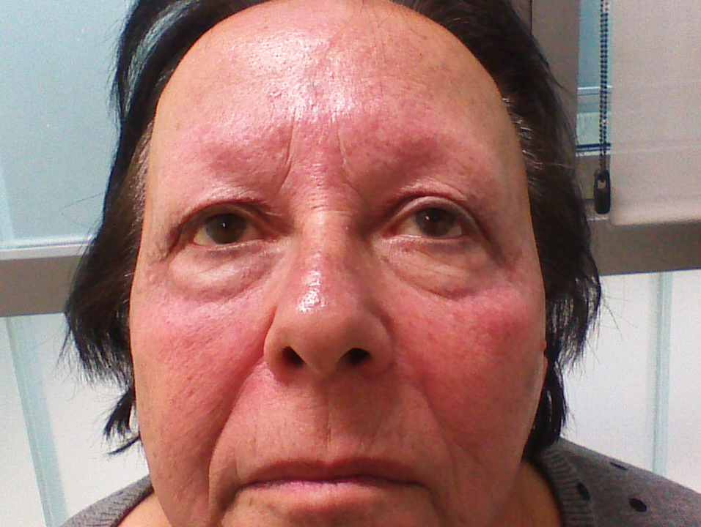
Report of cases. Case 1
A 68-year-old woman with a past medical history of hypertension and frontal fibrosing alopecia, presented with a 3 months history of hyperpigmentation on her face that started in summer after sun exposure
she had taken Lercanidipine approximately 2 years before
Concomitant medications included simvastatin that she had started many years ago
Notes:
She developped hyperpigmentation when she was exposed to sun
After sun EXPOSURE

Slide 11
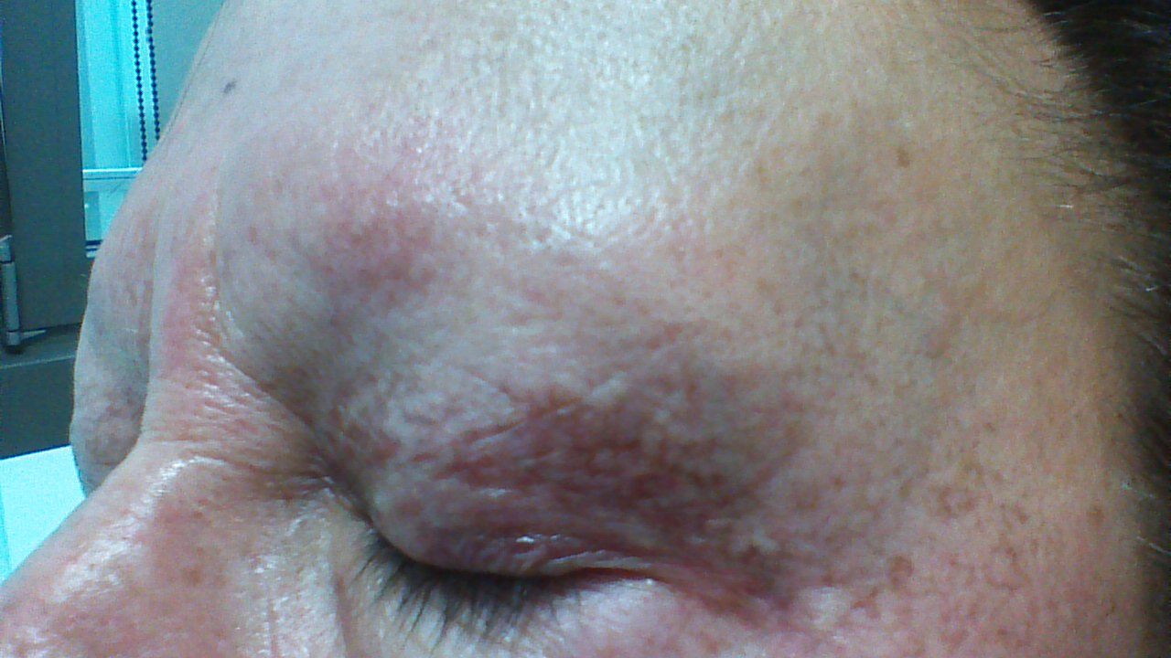
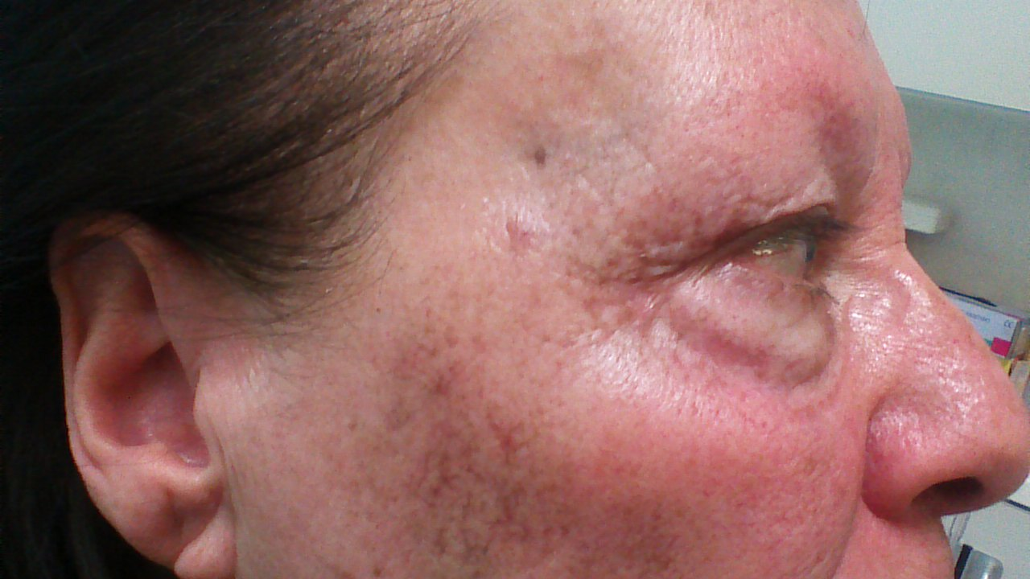
Report of cases. Case 1
Physical examination showed reticulated, slate-gray to brown, pigmentation without infiltration on her face
Notes:
Slate-gray: gris pizarra

Slide 12
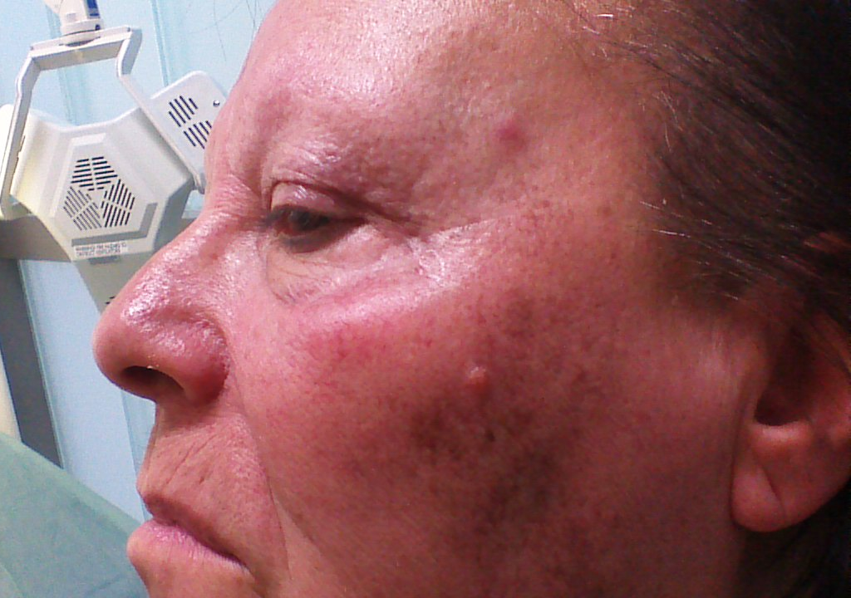
Report of cases. Case 1
Physical examination showed reticulated, gray to brown, pigmentation
On the cheek, temple, nose and eyelids regions

Slide 13
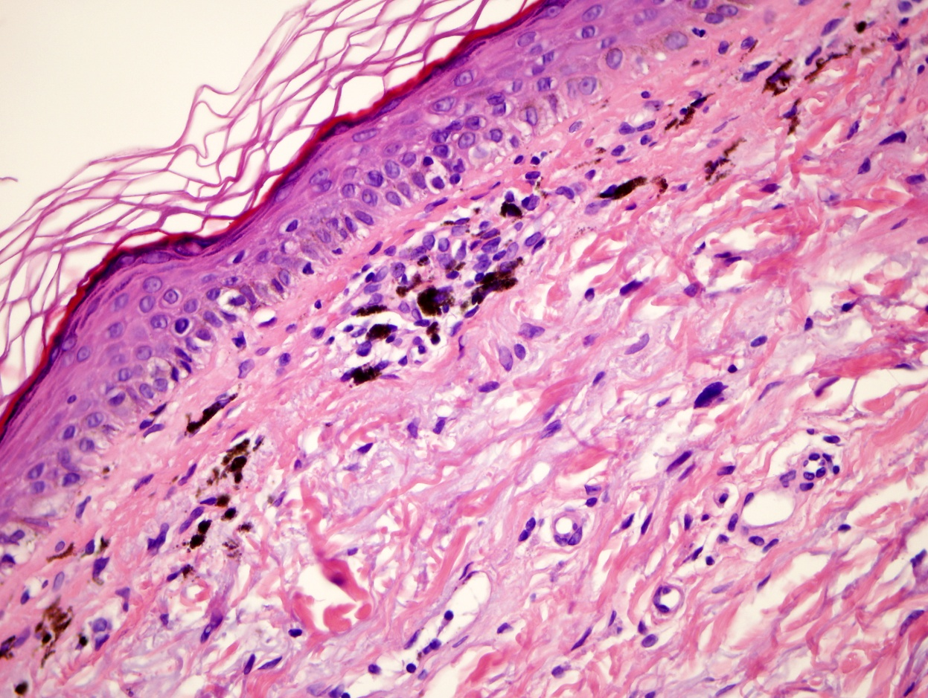
Report of cases. Case 1
Case 1
Histological examination revealed vacuolar alteration of the basal layer and prominent pigmentary incontinence
Laboratory testing included liver function test, complete blood cell count , serum urea and creatinine, serologic test for antinuclear antibodies were normal
Notes:
many melanophages in the dermis close to the epidermis

Slide 14
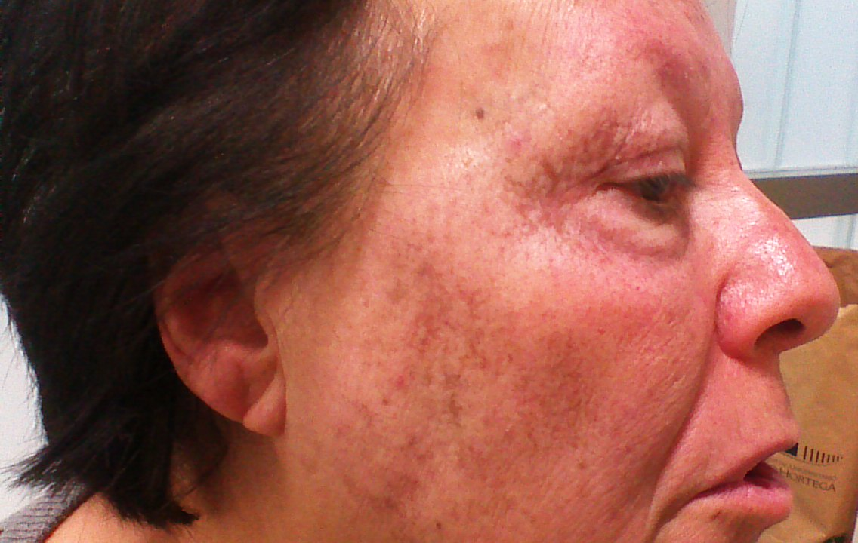
Report of cases. Case 1
Photodistributed hyperpigmentation due to lercanidipine was suspected
Notes:
many melanophages in the dermis

Slide 15
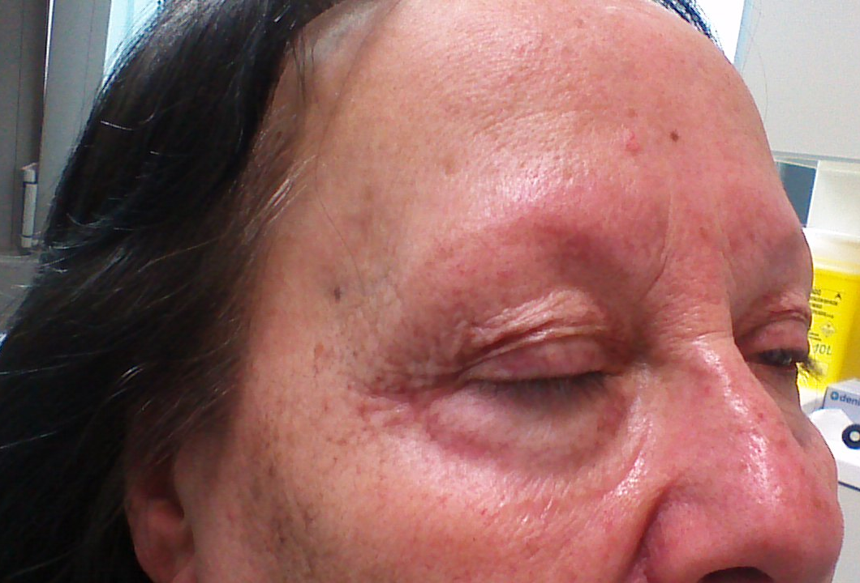
Report of cases. Case 1
She has improved very slowly after discontinuation of lercanidipine
Lercanidipine was replaced with
telmisartan- hydrochlorothiazide combination
Photoprotection was adviced
4 months after cesation of lercanidipine
Notes:
Management of the hyperpigmentation consisted of the replacement of lercanidipine with telmisartan plus hydrochlorothiazide and photoprotection

Slide 16


Slide 17
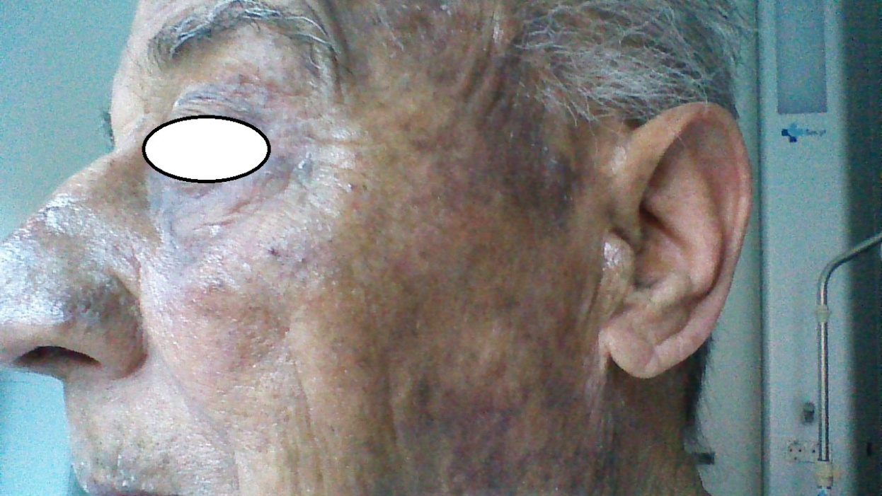
Report of cases. Case 2
A 79-year-old man was referred to us for evaluation of hyperpigmented lesions
His medical history included prostate cancer and severe kidney disease
He had been given telmisartan 80 mg and hydrochlorothiazide 12.5 mg daily for essential hypertension for 3 years

Slide 18
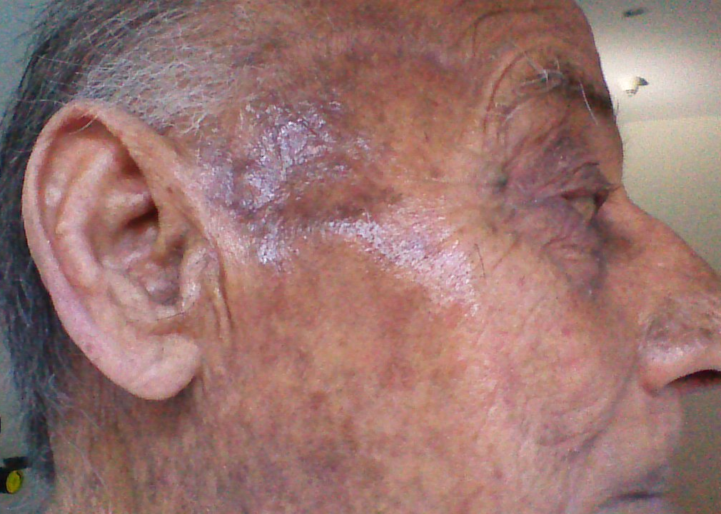
Report of cases. Case 2
He had noticed hyperpigmentation and pruritus on sun exposed áreas a few months after starting antihipertensive therapy
Examination showed slate-gray hyperpigmentation on the face, anterior aspect of his neck and dorsum of his hands

Slide 19
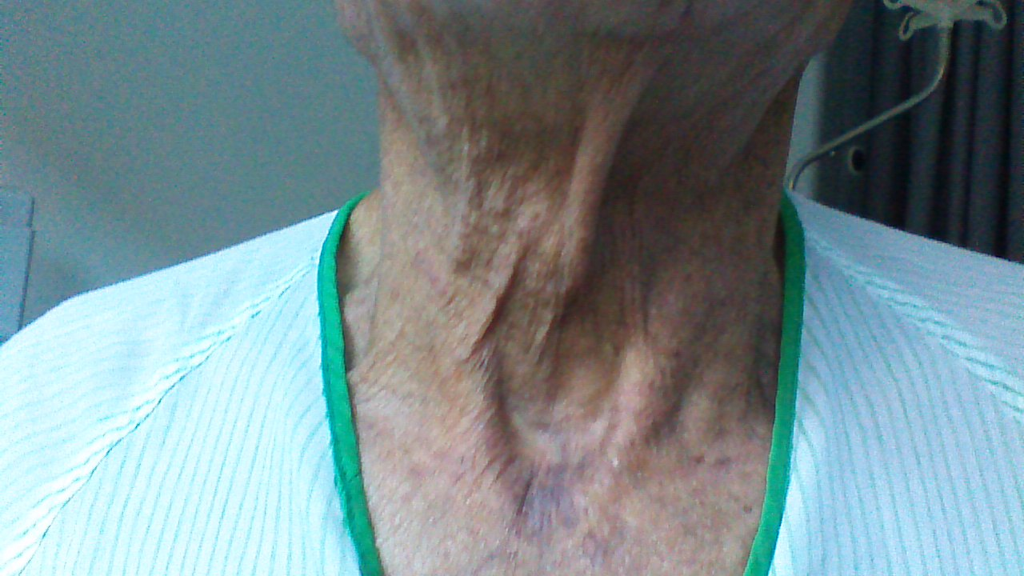
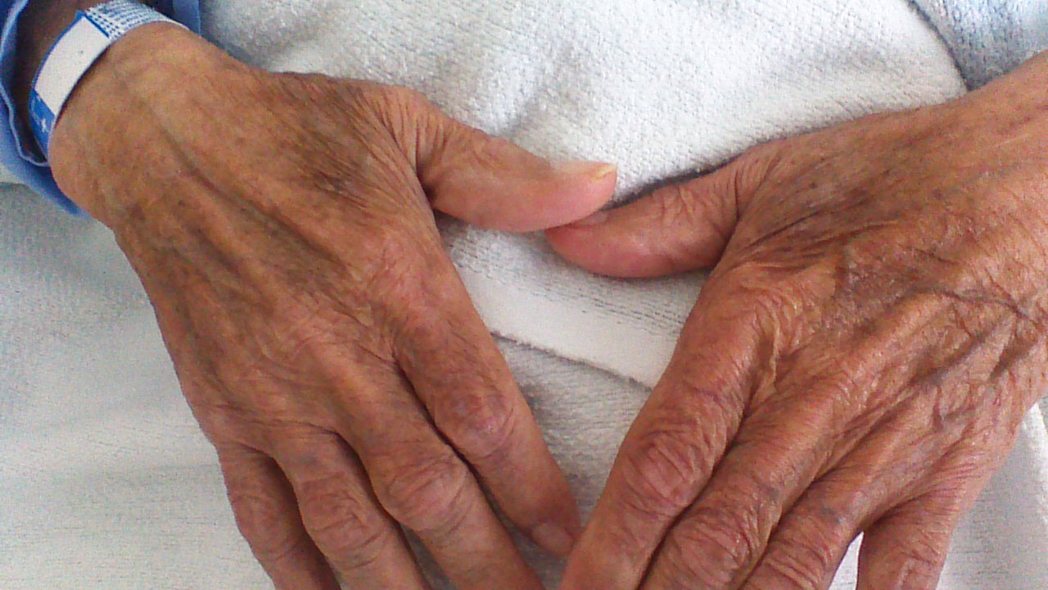
Report of cases. Case 2
Examination showed slate-gray hyperpigmentation on the face, anterior aspect of his neck and dorsum of his hands
Notes:
Hyperpigmented patches on the “V” área of the upper part of the chest

Slide 20
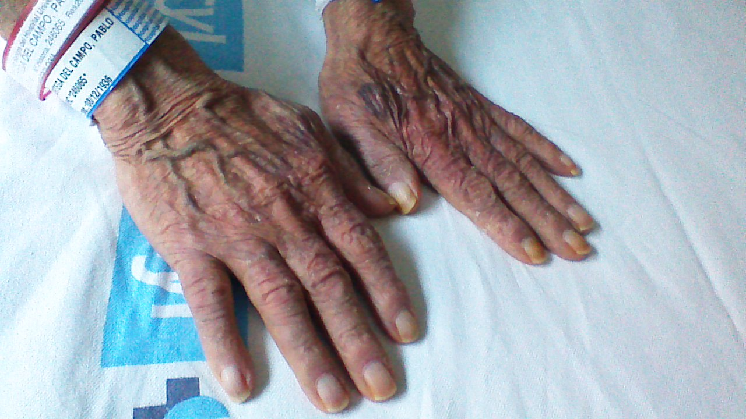
Report of cases. Case 2
Laboratory testing revealed anemia and elevated urea and creatinine levels
Results from liver function test, antinuclear antibodies and colesterol levels were all in normal ranges

Slide 21
Report of cases. Case 2
Photodistributed hyperpigmentation induced by telmisartan was suspected
Discontinuation of the drug and replacement with ramipril along with photoprotection caused gradual reduction of the symptoms and pigmentation had almost entirely faded after 3 months

Slide 22


the house where the novelist, poet and playwright Miguel de Cervantes lived in the year 1605…in Valladolid¡¡¡

Slide 23
Discussion
Drug-induced skin pigmentation is estimated to account for 10% to 20% of all cases of adquired hyperpigmentation
It has been associated with many different types of medications including antimalarials, amiodarone, cytotoxic drugs, tetracyclines, heavy metals and psicotropic drugs (imipramine, phenothiazines)

Slide 24
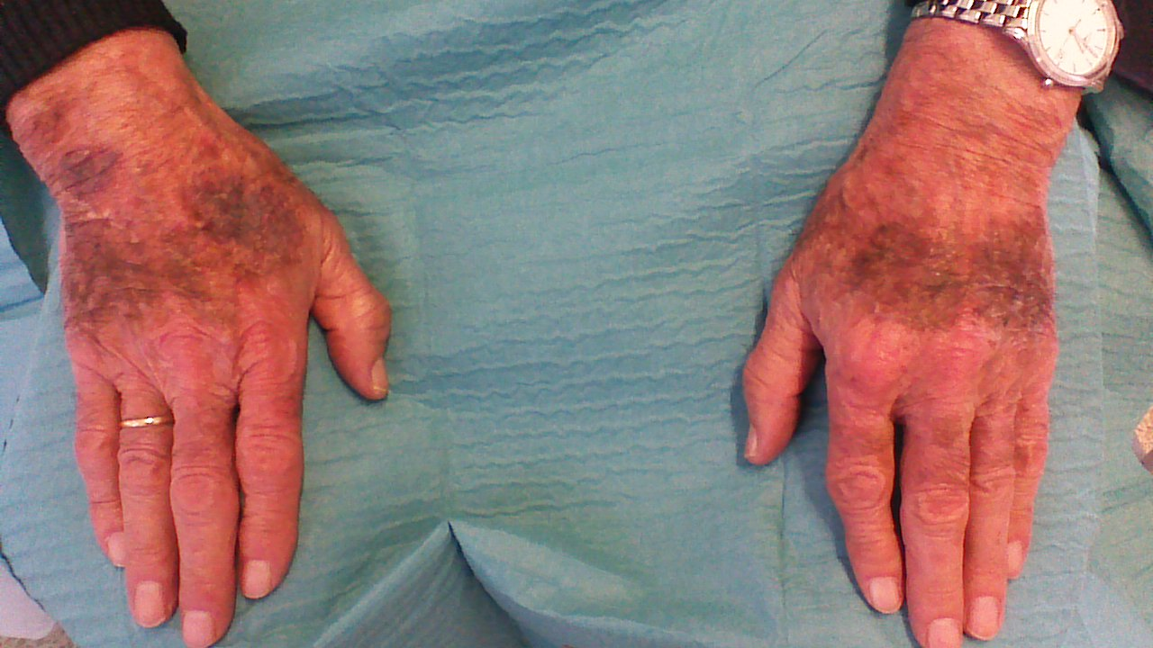
Discussion. Drud-induced pigmentation
Clinical features are variable, with a large range of patterns, colors and distribution
Amiodarone induced blue-gray pigmentation in photoexposed areas

Slide 25
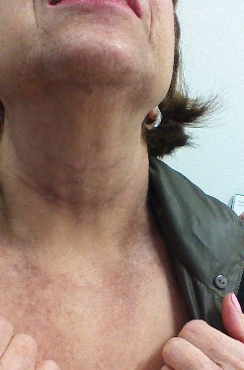
Discussion.
Drud-induced pigmentation
Clinical features are variable, with a large range of patterns, colors and distribution
antimalarials induced pigmentation

Slide 26
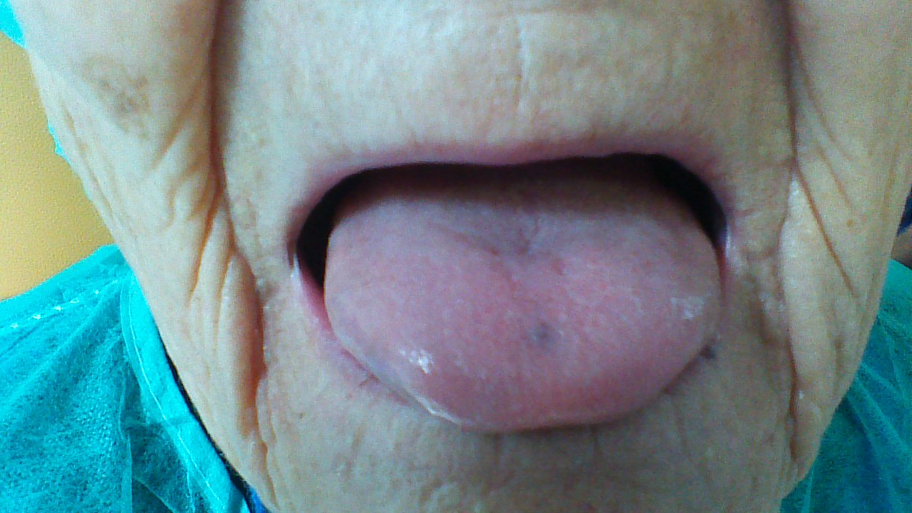
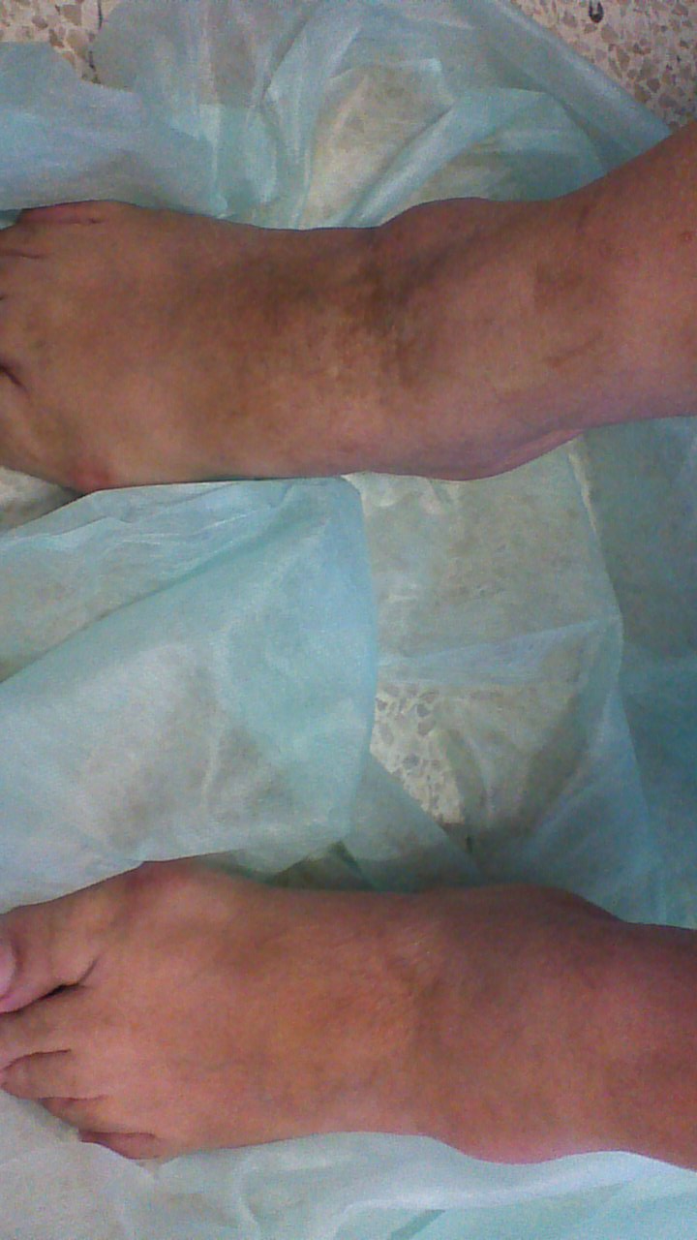
Discussion.
Drud-induced pigmentation
The pathogenesis is still not fully understood
Related to a significant drug or light interaction? Leading to a phototoxic or photolichenoid reaction

Slide 27
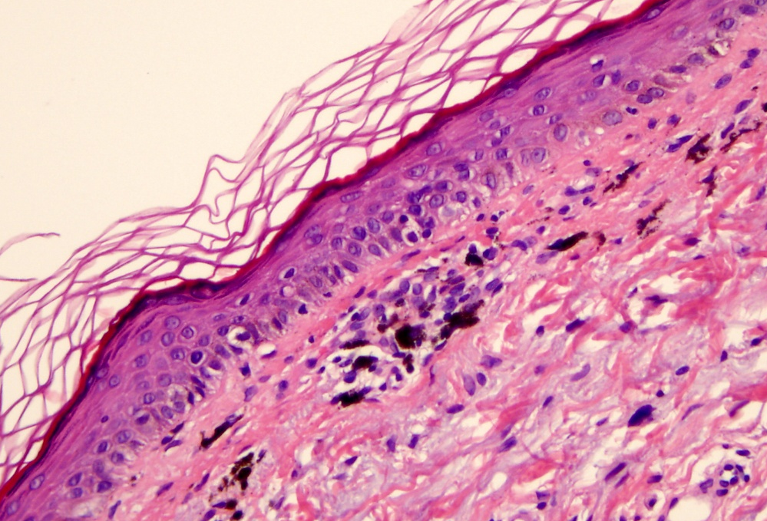
Discussion.
Drud-induced pigmentation
Common histological findings include pigment deposition in dermal macrophages, pigment deposition on elastic fibers, yellow-brown granules deposited on macrophages around blood vessels and dermal lipofuscin found in dermis
pigment deposition in dermal macrophages
Notes:
In amiodarone-induced skin pigmentation histologic examination reveales upper ans mid- dermal deposits of a yellow-black granular pigment (lipofuscin)distributed perivascularly in the cytoplasm of dermal macrophages

Slide 28
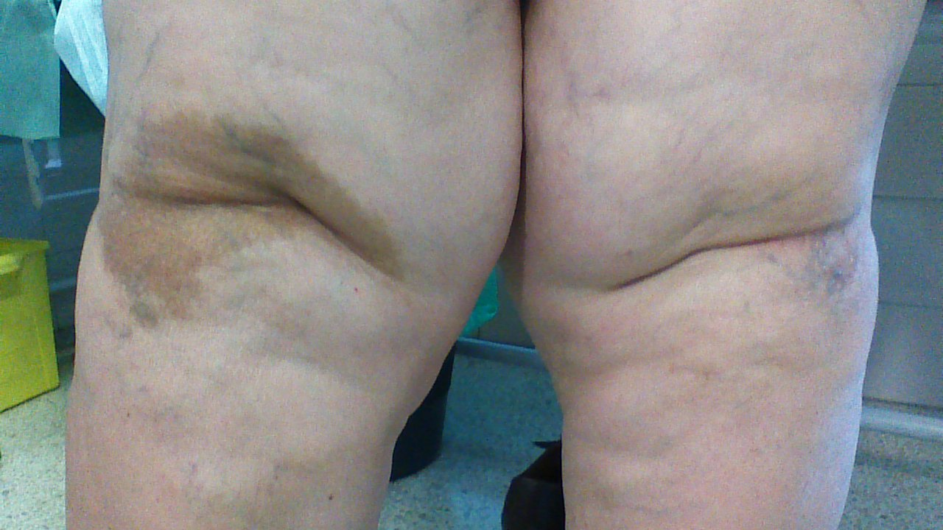
Discussion. Drud-induced pigmentation
Many isolated signals do exist reporting pigmentation disorders with ARBs
Gimenez-Garcia R. Hyperpigmentation induced by combination therapy with telmisartan-hydrochlorothiazide. J Clin Hypertens

Slide 29
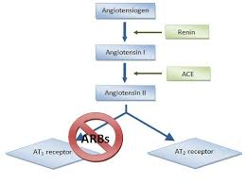
ANGIOTENSIN RECEPTOR BLOCKERS
Angiotensin receptor blockers (ARBs) selectively block the binding of angiotensin II to its subtype AT1 receptor
Used widely in everyday clinical practice because of their well known effectiveness and proven good tolerability
Dezsi CA. A review of clinical studies on angiotensin II receptor
bloquers and risk of cáncer. Int J Cardiology 2014;177:748-53
Notes:
Approximately 25% of hypertensive patients worlwide are taking ARBs…200 million worlwide

Slide 30
ANGIOTENSIN RECEPTOR BLOCKERS
Increasing prescribing rates of these antihypertensive agents are posing an appreciable rise in the amount of queries to pharmacovigilance centres.
  AT1-receptor antagonists and psoriasis. Lareb Nederlands Pharmacovigilance Centre. Febr 2006
Taste disorders ARA II. Lareb Nederlands Pharmacovigilance Centre

Slide 31
ANGIOTENSIN RECEPTOR BLOCKERS
Cutaneous reactions described include life-threatening angioedema, urticaria, pruritus, bullous eruptions, generalized rashes, photosensitivity, lichenoid eruptions, psoriasis, erythema multiforme, pseudolymphomatous eruptions and eczematous reactions.
It has also been described cross reactivity between ACE inhibitors and ARBs.
Tuoraud JP, Louguet C. Collet E, Sgro C. Dalac S. Dutronc Y, Lambert D. Cross-sensitivity between angiotensin-converting enzyme inhibitors and angiotensin II receptor antagonist. Ann Dermatol Venereol 2002; 129:1033-6
Steckelings UM, Artuc M, Wollschläger T, Wiehstutz S. henz BM Angiotensin-converting enzyme inhibitors as inducers of adverse cutaneous reacions. Acta Derm Venereol 2001; 81:321-325
McCabe J, Stork C, Mailloux D, Su M. Penile angioedema associated with the use of angiotensin-coversin-enzyme inhibitors and angiotensin II receptor blockers. Am J Health Syst Pharm 2008; 65:420-1
Vena GA, Cassano N, Coco V, De Simine C. Eczematous reactions due to angiotensin-converting enzyme or angiotensin II receptor blockers. Immunopharmacol. Immunotoxicol. 2013; 35:447-50
Constable S, Farrell J, Naisbii D, King C, Leonard N, Pirmohamed M. Systemis illness with skin eruption, fever and positive lymphocyte transformation test in a patient on irbesartan. Br J Dermatol 2006; 155:491-3
Pfab F, Athanasiadis GI, Kollmar A, Ring J, Ollert M. Lichenoid drug eruption due to an antihypertonic drug containing irbesartan and hydrochlorothiazide. Allergy 2006; 61:786-787
Marquart-Elbaz C, Grosshans E, Alt M, Lipsker D. Sartans, angiotensin II receptor antagonists can induce psoriasis. Br J Dermatol 2002; 147:617-618
Gambini D, Sala F, Gianotti R, Cusini M.Exanthematous reaction to irbesartan. J Eur Acad Dermatol 2003; 17:472-473
Gimenez-Garcia R. Eritema Multiforme inducido por Irbesartan. Emergenciuas 2015;27
Notes:
ACE angiotensin-converting enzyme inhibitors

Slide 32
ANGIOTENSIN RECEPTOR BLOCKERS
Nevertheless, there are very few reported cases of skin eruptions related to Telmisartan
Ferreira O, Mota A, Morais P, Cunha AP, Azevedo F Symmetrical drug-related intertriginous and flexural exanthema (SDRIFE) induce by telmisartan Cut Ocul Toxicol 2010; 29:293-295
Tandon VR, Mahajan A, Khajuria V, Gilani ZH. Angioedema due to fixed dose combination of telmisartan plus Ramipril. J Pharmacol Pharmacother 2014; 5:214-216
Gimenez-Garcia R. Hyperpigmentation induced by combination therapy with telmisartan-hydrochlorothiazide. J Clin Hypertens 2016;18:361-368

Slide 33



Slide 34
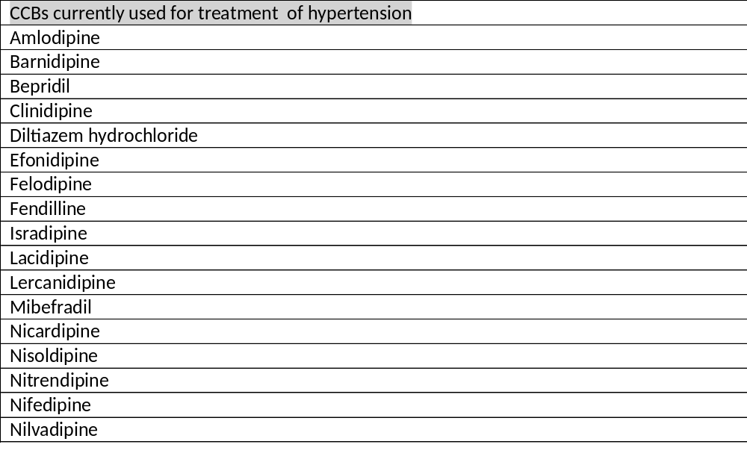
Calcium-channel blockers (calcium antagonists Cas)
Group of antihypertensive
medications introduced
into clinical medicine in the 1960s
Agents used for the treatment of a
host of cardiovascular disease
First-line treatment options for hypertension
Sica DA. Pharmacotherapy review: calcium channel blockers.
J Clin Hypertens 2006;8:

Slide 35
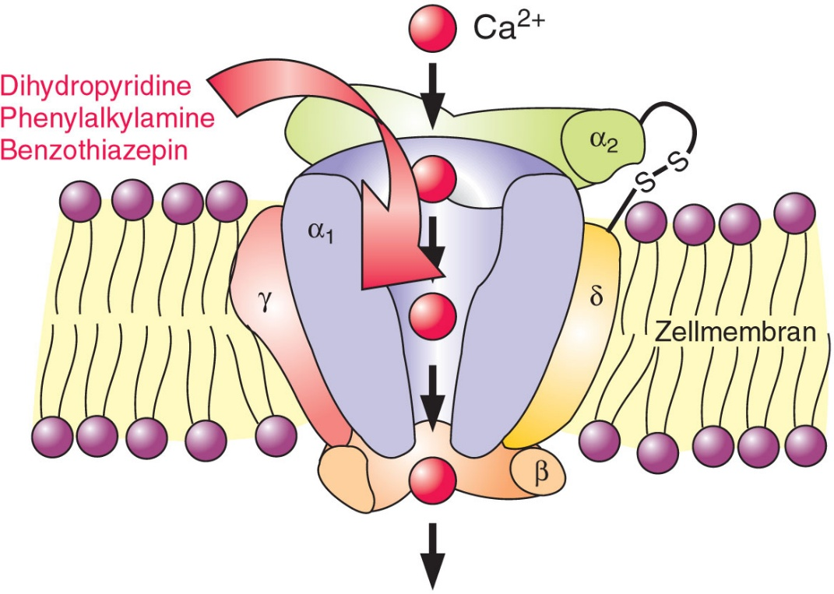
Calcium-channel blockers CCBs
(calcium antagonists Cas)
Property of blocking the transmembrane
flow of calcium ions (into the cell through
voltage-gated channels)
Binding to the L-type calcium channels in
the hearth and in smooth muscle of the
peripheral vasculature
Notes:
Ac actúan sobe canales de calcio dependientes de voltaje de larga duración. Estos canales delas células musculares lisas miocárdicas y vasculares son estructuras moleculares complejas compuestas or 4 subunidades.. Real de Asua y C Suarez Hipertens riesgo vasc 2013
CCBs dilate coronary arteries and peripheral arterioles but not veins. They aso decresase cardiac contractility (negative inotropic effect), automaticity at the SA node and conduction at the AV node; diatation of the coronary arteries increases myocardial oxigen supply…but there are differences in terms of tissue selectivity betwween DHP, diltiazem and verapamil

Slide 36
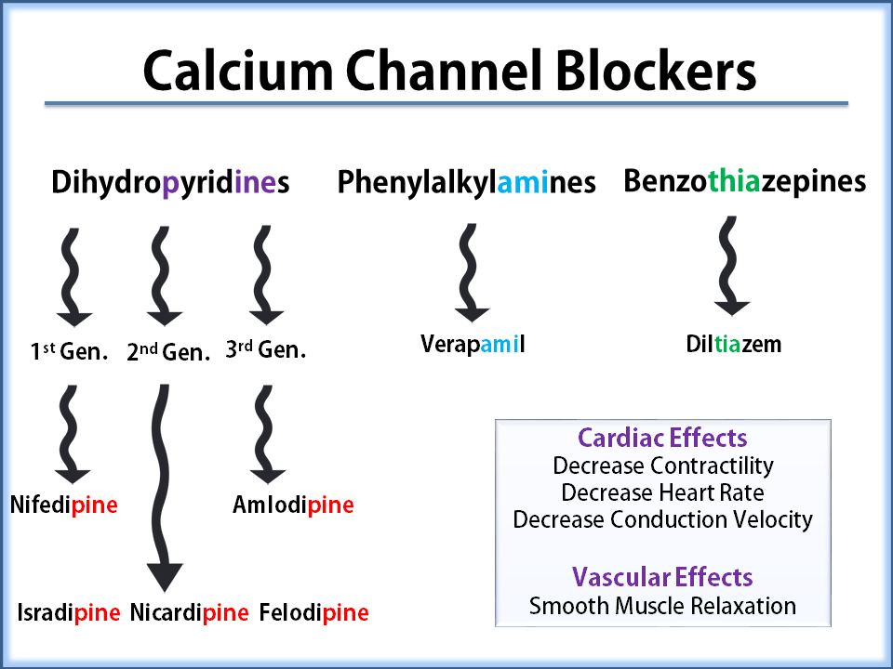
A group of compounds with distinctive structures and pharmacologic effects
Three subclases:
Phenylalkylamines
Benzothiazepines
Dihydropyridines DHP: have minimal effect on cardiac conduction or hearth rate while have potent action as arteriolar vasodilators….peripheral and coronary)
Espacio para el texto
Lecarnidipine
Notes:
Non DHP provide a series of advantages such as their potent coronary vasodiatator effect , an antiarrhytthmic effect based on their negative chronotropic and inotropic properties, and a lower incdence of peripheral edema
Combination with other firwt-line agents ,such as renin-angiotensin system blockers , make CCBs especally attractive

Slide 37
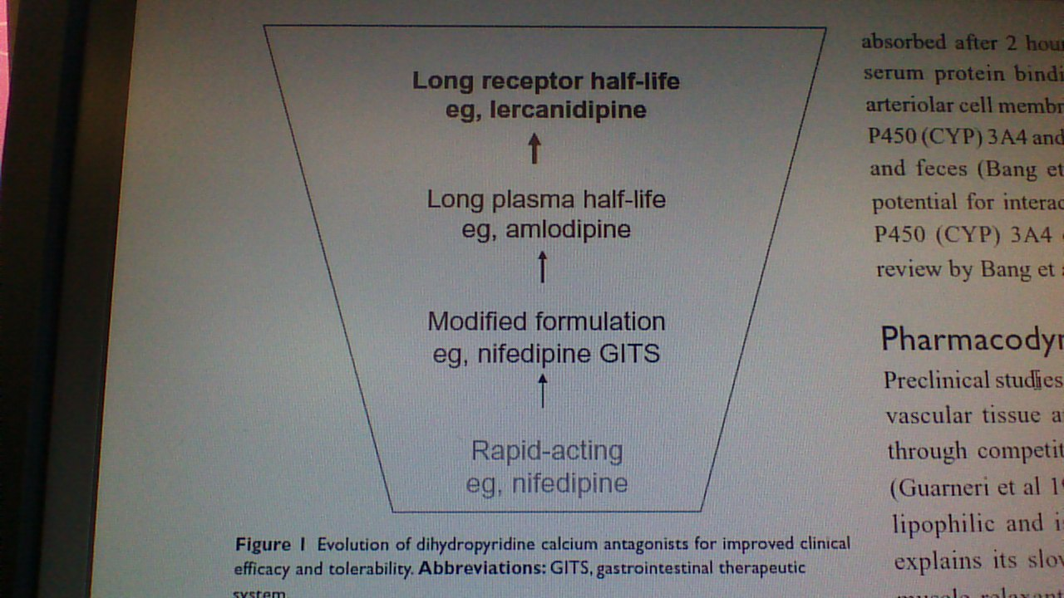
Lercanidipe is a vasoselective lipophilic dihydropyridine calcium antagonist which causes systemic vasodilatation by blocking the influx of calcium ions through L-type calcium channels in cell membranes.
Has a slower onset and longer duration of action than a number of other CCBs
Beckey Ch Lercanidipine in the treatment of hypertension. Ann Pharmacother 2007;41:465-74
Borgui C. Lercanidipine in hypertension. Vascular Health and Risk Management 2005;2005:173-182
Mc Clellan KJ. Lercanidipine: a rview of its use in hypertension. Drugs 2000;60:1123-40
Leonetti G et al . Tolerability of long-term treatment with lercanidipine versus amlodipine and lacidipine in elderly hypertensives. Am J Hypertens 2002;15:932-40

Slide 38
LERCANIDIPINE
Once daily administration of lercanidipine 10 or 20 mg effectively reduce blood presure
Antihypertensive effect comparable to that of amlodipine but a better tolerability profile
Edema –related symptoms (lower limb swelling and heaviness) ocurred significantly more often with amlodipine
Borgui C. Lercanidipine in hypertension. Vascular Health and Risk Management 2005;2005:173-182
Notes:
What distinguishes lercanidipine from other members of the DHP class is its lower incidence of adverse effects, particularly edema

Slide 39
Cutaneous Adverse Reactions associated with Calcium Channel Blockers
In spite of their widespread use, little data have been published about the spectrum of CAR by CCBs
It appears that the frequency is low but occasionally severe reactions are associated with the use of these drugs
Range from non serious reactions to serious and potentially fatal conditions , including erythema multiforme, Steven-Johnson syndrome, toxic epidermal necrolysis(TEN) or exfoliative dermatitis
Most serious reactions occur within two weeks of initiating drug therapy
Stern R, Khalsa JH. Cutaneous adverse reactions associated with calcium cannel blockers.
Arch Inter Med 1989;149.829-832
Notes:
Published reports of CCBs reactions are infrequent .information obtained fron spontaneous reposrts by phisician an other health pprofessionals to FDA, ADRRS….american academy of dermatology ´s adverse drug reactions reporting systemTHE GENERALLY LOW SUSPICTION THAT THESE DRUGS MIGHT BE RESPONSIBLE FOR CUTANEOUS REACTIONS MAY HAVE LED LO LESS REOORTING OF SEVERE ADVERSE CUTANEOUS REACTIONS BY THESE DRUGS

Slide 40
Cutaneous Adverse Reactions associated with Calcium Channel Blockers
Flushing, ankle or pedal edema and gingival hiperplasia are common side effects
Photosensistivity reactions
Photodistributed facial telangiectasia or on nonphotoexposed areas
Lichenoid eruptions
Psoriasiform eruptions (simultaneous intake of β blockers might have a synergist effect on the onset of psoriasis)
Ioulios P, Charalampos M, Efrossini T. The spectrum of cutaneous reactions associated with calcium antagonists: a review of the literature and the possible etiopathogenic mechanisms. Dermatol On line J 2003 ,9:6
Notes:
Published reports of CCBs reactions are infrequent . THE GENERALLY LOW SUSPICTION THAT THESE DRUGS MIGHT BE RESPONSIBLE FOR CUTANEOUS REACTIONS MAY HAVE LED LO LESS REOORTING OF SEVERE ADVERSE CUTANEOUS REACTIONS BY THESE DRUGS

Slide 41
Cutaneous Adverse Reactions associated with Calcium Channel Blockers
Acute generalized exanthematous pustulosis
Subacute cutaneous lupus erythematous
Pemphigus and pemphigoid
Hypersensitivity syndrome (presented as exfoliative dermatitis or TEN)
Ioulios P, Charalampos M, Efrossini T. The spectrum of cutaneous reactions associated with calcium antagonists: a review of the literature and the possible etiopathogenic mechanisms. Dermatol Online J 2003 ,9:6
Notes:
Published reports of CCBs reactions are infrequent . THE GENERALLY LOW SUSPICTION THAT THESE DRUGS MIGHT BE RESPONSIBLE FOR CUTANEOUS REACTIONS MAY HAVE LED LO LESS REOORTING OF SEVERE ADVERSE CUTANEOUS REACTIONS BY THESE DRUGS

Slide 42
LERCANIDIPINE-INDUCED CUTANEOUS REACTIONS
Drug reaction with eosinophilia and systemic symptoms (DRESS)
Macupapular rash
    Slim R et al. Drug reaction with eosinophilia and systemic symptoms due to lercanidipine. Indian J Dermatol Venereol Leprol 2016;82:324-326
    Tuchinda P. et al. Cutaneous adverse reactions to calcium channel blockers. Asian Pac J Allergy Immunol 2014;32:246-50
Notes:
Only a few previous cases of adverse drug reaction following lercanidipine have been reported

Slide 43
Cutaneous Adverse Reactions associated with CCBs
Photodistributed hyperpigmentation (reticulated or homogenous)..Induced by dialtiazem and amlodipine
No previous cases of hyperpigmentation have been reported following exposure to lercanidipine
.-Scherschun L et al. Diltiazem-associated photodistributed hyperpigmentation: review of 4 cases. Arch Dermatol 2001;137: 179-82
.-Chawla A, Goyal S. Diltiazem-induced hyperpigmentation in an African American woman. J m Acad Dermatol 2002; 46:468-9
.-Kubo Y. et al. Diltiazem-associated Photodistributed hyperpigmentation: report of two Japanese cases and published work review 2010;37.807-811
.-Erbagci Z. Amlodipine associated hyperpigmentation. Saudi Med J 2004; 25:103-105
Notes:
Published reports of CCBs reactions are infrequent . THE GENERALLY LOW SUSPICTION THAT THESE DRUGS MIGHT BE RESPONSIBLE FOR CUTANEOUS REACTIONS MAY HAVE LED LO LESS REPORTING OF SEVERE ADVERSE CUTANEOUS REACTIONS BY THESE DRUGS

Slide 44
Conclusions
Drugs-induced hyperpigmentation, in particular with antihyertensive medications must be considered in unexplained pigmented lesions in the elderly

Slide 45
Conclusions
Morphological appearance of the hyperpigmentation is most distinctive….
slate-gray to brown and reticulated
Notes:
These features are noticeably different tan those other drugs or chemical induced hyperpigmentation
Minocycline induces HP in áreas of cutaneous inflammation,typically in acné scars..AND PIGMENT DEPOSITION RELATED TO MINOCYCLINE HAS BEEN DEMONSTRATE TO BE IRON
Argyria induced slate-gray hp in sun exposed áreas, lunulae of nails, mucous membranes and sclera
Amuodarone, imipramine, cholpromacine induces slate.gray maculas or patches

Slide 46
Conclusions
Long –term administration of lercanidipine -as well as diltuazem or amlodipine- may be associated with reticulated hyperpigmentation on sun-exposed áreas
Telmisartan and ARBs can induce pigmentation disorders

Slide 47
Conclusions
A long interval between the initiation of antihipertensives therapy and the emergence of the hyperpigmentation (mean duration: 15months)
Notes:
Kubo et al the average age was 63 years and the average interval from the initiation of diltiazem therapy through the onset was 15 months in 14 cases, which was markedly longer tan the intervals for other types of drug reactions
The face was affected in all cases , followed by neck and forearms

Slide 48
Conclusions
Cessation of the suspicious drug results in a gradual fading of the rash, although in some cases it never resolves
Notes:
BLOCKING SUN SCREENS WITH A BLANCHIN AGENT AS HYDROQUINONE AND IF AVAILABLE LASER THERAPY

Slide 49
Conclusions
Prevention of photosensitivity involves adequate protection from the sun with clothing and sunscreens
Diet supplementation with antioxidants may be beneficial in increasing the minimun erytemal UV radiation dose
Moore DE. Drug-induced cutaneousphotosensitivity:incidence, mechanism, prevention and management. Drug Saf 2002, 25:345-372

Slide 50
Conclusions
Hypertension management aims to prevent cardiovascular morbidity and mortality and involves lifestyle modifications, antihypertensive drug therapy and treatment of comorbid conditions

Slide 51

Vitamin D has some health benefits , particularly related to skeletal health and some solid tumors
Vitamin D levels in the highest quartile have around half the relative risk of hypertension, obesity, cardiovascular disease or all-cause mortality as those in the lowest quartile…Oral vitamin D supplementation has not effect…..
Liu D, et al UVA irradiation of human skin vasodilates arterial vasculature and lowers blood pressure independently of nitric oxide synthase. J Invest Dermatol 2014;134:1839-46

Slide 52
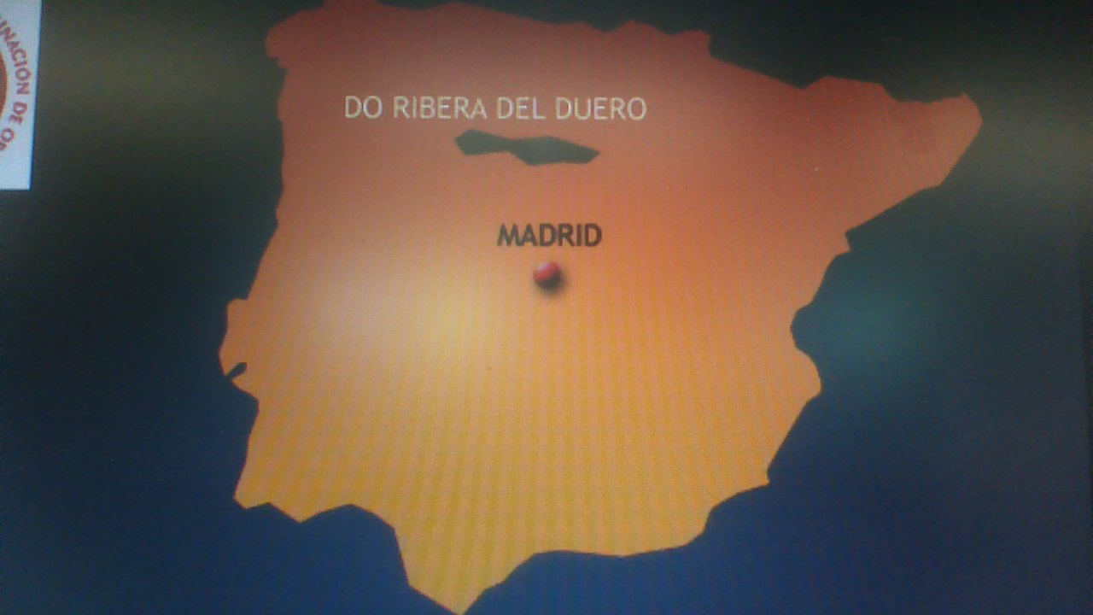


THANK YOU ¡¡¡¡¡¡

