Slide 1

Modulating the Antioxidant
Defences to Potentiate Oncolytic Virotherapy in Refractory Cancer Cells
5th European Immunology &
2nd Innate Immunity and Immune System Diseases
Berlin, Germany July 22, 2016 & Im diclege
September 9, 2015
Rongtuan Lin, Ph.D.
Lady Davis Institute/McGill University
Montreal, QC Canada

Slide 2
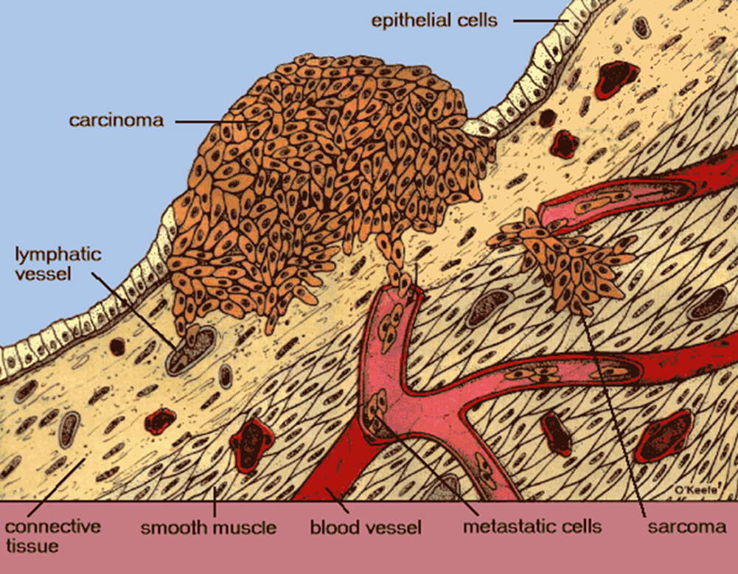
Cancer and therapies
Surgery
Chemotherapy
Radiation
Limited effectivity and side effects
Notes:
2

Slide 3
Biotherapeutic Approaches to Cancer Treatment
  Based on utilizing the patient’s immune system
  Monoclonal antibodies
  Biotherapeutics (cytokines, receptor agonists)
  Cancer Vaccines (tumor cell vaccine, DNA vaccine)
  Oncolytic viruses
An innovative therapeutic strategy to harness the replicative properties of viruses to specifically target and destroy tumor cells, while leaving normal tissues largely unaffected

Slide 4
Oncolytic Viruses in Cancer Treatment
Cancer cells have a dampened innate immune response
They are more susceptible to pathogens
Use viruses to infect and kill cancer cells

Slide 5
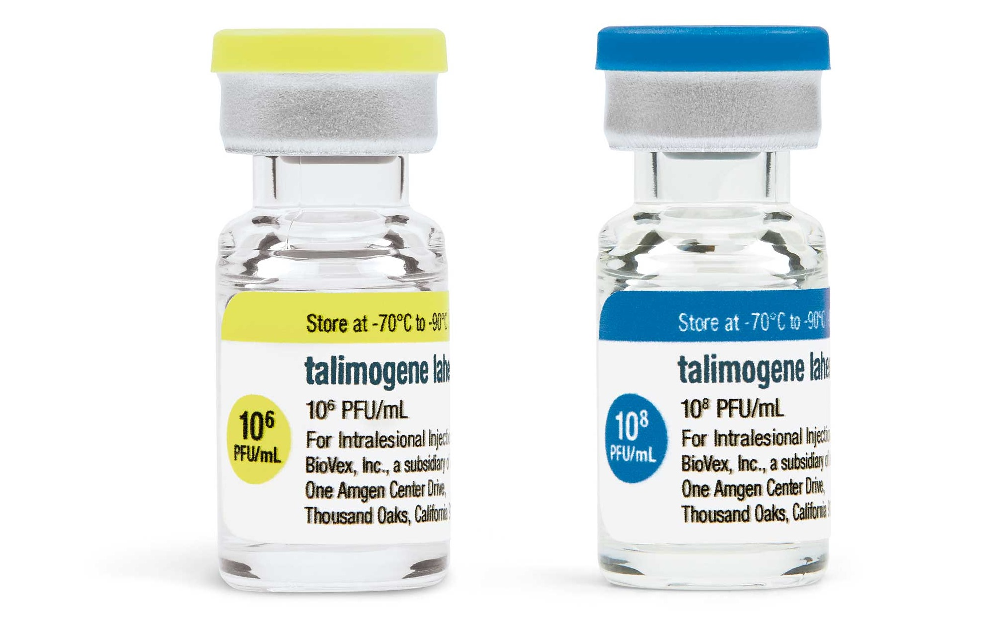
Oncolytic Viruses in Cancer Treatment
Cancer cells have a dampened innate immune response
They are more susceptible to pathogens
Use viruses to infect and kill cancer cells
FDA approved TVEC virus to treat malignant melanoma

Slide 6
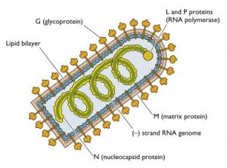
VSV as an onolytic virus
Vesicular stomatitis virus (VSV) is a negative sense RNA virus
Non-pathogenic in humans
Has been used to treat different types of cancer
In phase II clinical trials
Problem: A lot of cancer cells have a residual innate anti-viral response making them resistant to infection

Slide 7
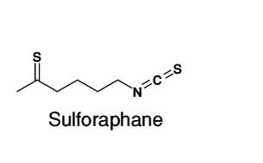
Overcoming the barrier
Tumor sensitivity to VSV can be increased by combining the virus with small molecules
Extracted from cruciferous vegetables: well tolerated, cheap.
In Phase II clinical trials as a chemotherapeutic drug

Slide 8
SFN activates autophagy and Nrf2
Nrf2:
  Anti-oxidant transcription factor
  Mediates reactive oxygen species scavenging
  during cell stress
Autophagy:
  Clears protein aggregates
  Removes damaged organelles
  Helps decrease cell stress
Dampen the innate antiviral response to enhance VSV-mediated oncolysis in resistant cancer cells
Notes:
Under normal conditions, Nrf2 is constantly ubiquitinated through Keap1 and degraded in the proteasome. Following exposure to electrophiles or oxidative stress, Keap1 is inactivated. Stabilized Nrf2 accumulates in the nucleus and activates many cytoprotective genes. Ub, ubiquitin.

Slide 9

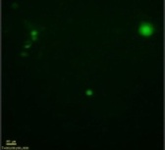
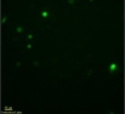
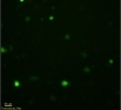
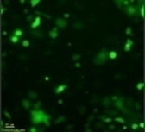
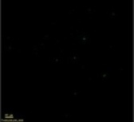
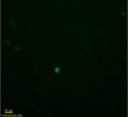
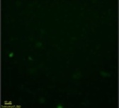
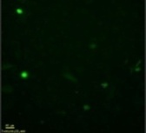
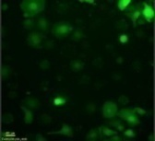
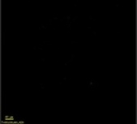
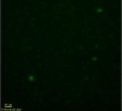
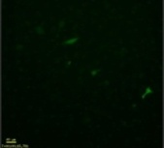
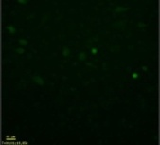
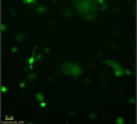
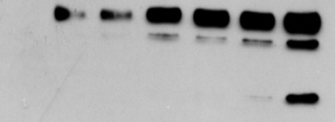

SFN Treatment Increases VSV Replication in Refractory Prostate Cancer PC-3 Cells
SFN (μM)
NT
VSVΔ51
5 10 20
24h
48h
72h
-
+
+
+
+
VSVΔ51
+
+
-
-
5
20
10
SFN
1
15
G
N
αVSV
Virus Titer ( 10⁷ PFU/mL)
M
Actin
1
5
2
3
4
6
-
-
+
+
7
+
+
+
+
VSVΔ51
+
+
+
+
VSVΔ51
+
+
-
-
-
-
1
5
10
SFN
15
1
20
20
5
10
SFN
15

Slide 10
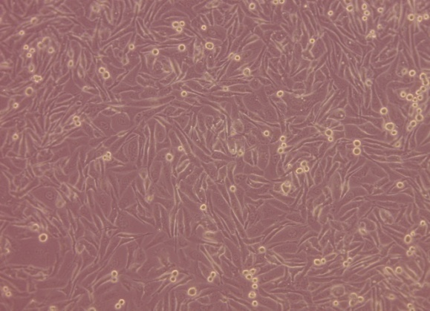
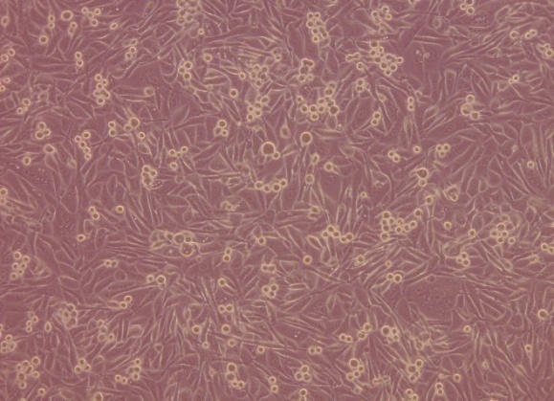
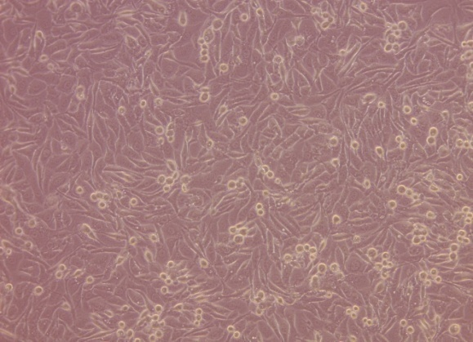
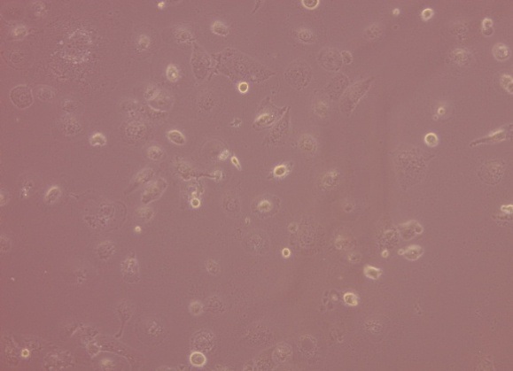
SFN Treatment Potentiates VSV-Induced
Oncolysis in PC-3 Cells
NT
SFN
Viability (%)
-
+
+
+
+
+
+
VSVΔ51
-
SFN
-
5
15
1
10
20
VSVΔ51
VSVΔ51+SFN
% of Annexin-V+ cells
72h
-
+
+
+
+
VSVΔ51
-
-
+
+
SFN
5
15
1
10
20

Slide 11
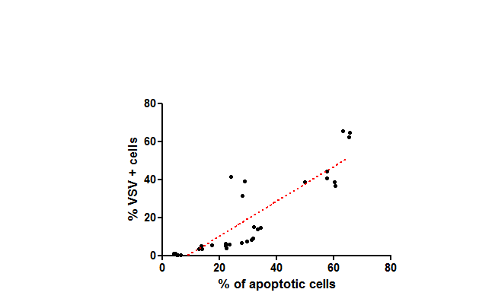
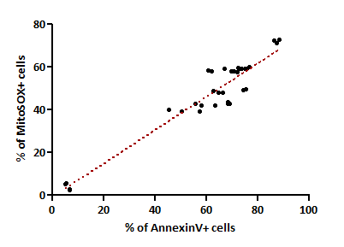

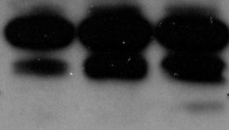



SFN Treatment Increases Mitochondrial Control
of Caspase-Dependent VSV-Based Oncolysis
V
S +V
NT
P<0.0001
r²=0.7774
n=33
P<0.0001
r²=0.924
n=36
CL-CASP3
CASP7
CL-CASP7
CL-CASP7
PARP
CL-PARP
% of MitoSOX+ cells
VSV-GFP
% of VSV + cells
ACTIN
% of Annexin V+ cells
% of Annexin V+ cells

Slide 12
SFN Treatment Increases VSV Infectivity in Various Human and Murine Cancer Cells
Prostate (h)
Breast (m)
Leukemia (h)
Lung (h)
DU145
TS-A
THP-1
A549
**
***
***
***
% of VSV-GFP+ cells (%)
VSV 1
SFN 10
VSV 0.01
SFN1
VSV 1
SFN10
VSV0.1
SFN5

Slide 13
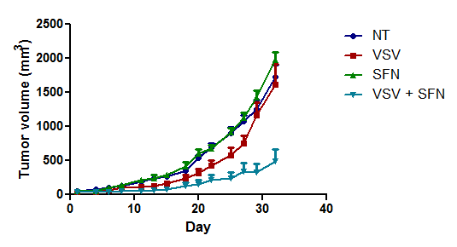
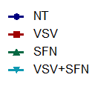
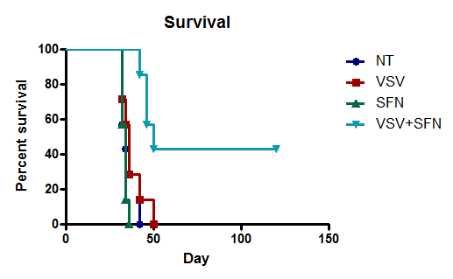
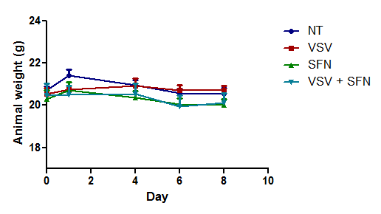
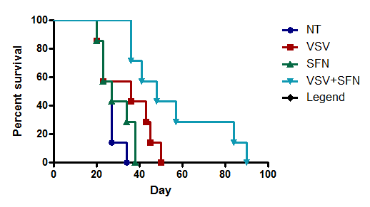
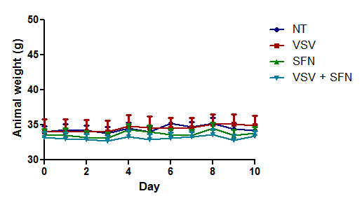
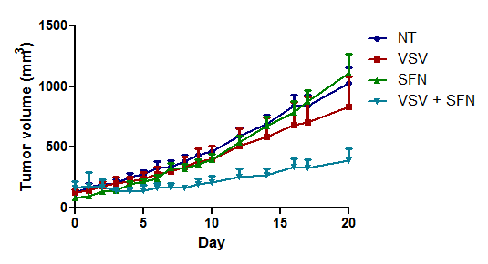
VSV and SFN Combinatorial Treatment Reduces Tumor progression and Prolongs Survival in Mouse Syngeneic and Xenograft Tumor Models
Murine breast TS-A cells in BALB/c mice
**p=0.0064
***p< 0.0001
Human prostate PC-3 cells in athymic nude mice

Slide 14
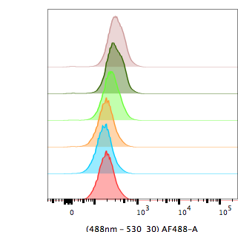
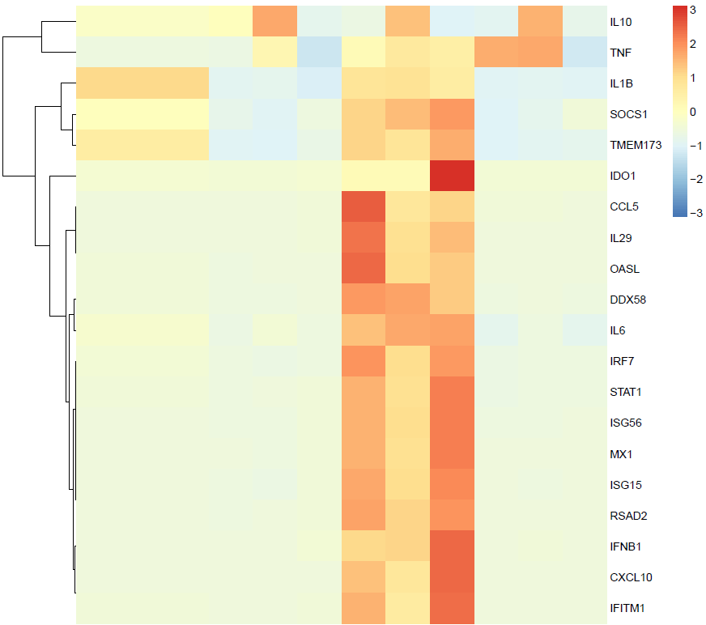
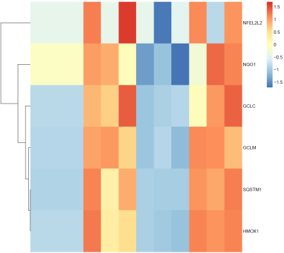
VSV and SFN-Induced VSV Replication
is Dependent on Nrf2
SFN 50
SFN 40
SFN 20
SFN 10
Count
SFN 1
NT
-
SFN
20
5
15
1
10
Nrf2 (Phospho S40)
MEF Cells
A549 Cells
S +V
V
S
NT
WT
siCTRL
Nrf2
Nrf2 ^{-/-}
siNrf2
NqO1
Keap1^{-/-}
Gclc
VSV-GFP+ cells (%)
VSV-GFP+ cells (%)
Gclm
Sqstm1
Hmox-1
-
-
-
SFN
+
+
+
VSVΔ51
+
+
+
+
+
+
+
VSVΔ51
+

Slide 15

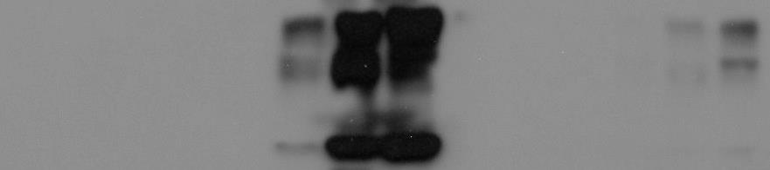



SFN-Mediated VSV-Increased Infectivity Relies
on Atg5-dependent Autophagy
-
-
-
+
+
VSVΔ51
-
+
SFN
20
-
20
15
15
LCIII-I
LCIII-II
NT
G
3-MeA
N
% of VSV-GFP+ cells (%)
αVSV
M
+
+
ATG5
VSVΔ51
+
+
-
-
SFN
+
+
ACTIN
WT
Atg5 ^{-/-}
1
5
8
2
3
4
6
7
LCIII-I
LCIII-II
10⁷
G
WT
WT
Atg5 ^{-/-}
10⁶
Atg5 ^{-/-}
N
αVSV
10⁵
M
% of VSV-GFP+ cells
Viral titers (PFU/mL)
10⁴
ATG5
10³
-
-
-
-
ACTIN
SFN
7.5
7.5
SFN
7.5
7.5
+
+
+
+
+
+
+
VSVΔ51
VSVΔ51
+
SFN
-
-
-
-
7.5
7.5
7.5
7.5
-
-
-
-
+
+
+
VSVΔ51
+

Slide 16


Nrf2 Triggers Autophagy and Dampens the Innate Antiviral Response
SFN
SFN+VSV
NT
VSV
-
-
-
+
+
Il10
+
VSVΔ51
-
-
SFN
20
20
Tnfα
15
15
Il1-β
P-STAT1
Socs1
STAT1
Tmem173
STING
Ido1
HO-1
Ccl5
G
Il29
N
Oasl
αVSV
Si CTRL
Si NRF2
Ddx58
M
SFN
- + - +
Il6
ACTIN
Stat1
LC III-I
Irf7
LC III-II
Isg56
NRF2
Mx1
Isg15
ACTIN
Rsad2
Ifnb1
Cxcl10
Ifitm1
SFN
-
1
5
10
15
20
Ifnβ1
Nrf2
Ifit1
uninfected
si control
SeV
Si Nrf2
ISRE Luciferase activity
mRNA levels
-
-
-
pNrf2
-
-
-
+
-
+
0.125
5’ppp
+
+
+
0.25
0.5
1.0
+

Slide 17
Conclusions
Stimulation of Nrf2 using SFN increases VSV-induced oncolysis in various cancer cells
Nrf2 transcription factor supports VSV replication
SFN potentiation of VSV-induced oncolysis relies on Nrf2-dependent autophagy
Activation of Nrf2 suppresses VSV-induced immune responses (through induction of autophagy ??)
SFN bolstered VSV oncolytic activity in different syngeneic and xenograft mouse models

Slide 18







Acknowledgements
McGill University-Montreal
David Olagnier
Rasin Lababidi
Samar Bel Hadj
Yiliu Liu
Alexandre Sze
Marie-Line Goulet
Fundings
Pasteur Institute - Rome
John Hiscott
Cindy Chiang
Vladimir Beljanski
University of Dundee-Dundee
Albena Dinkova-Kostova
Elena Knatko

