Slide 1

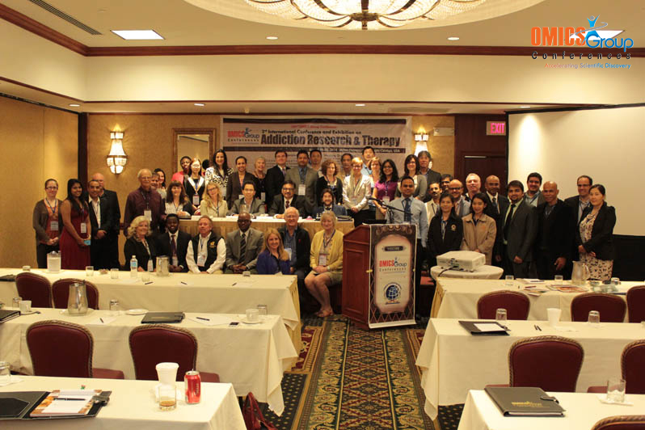
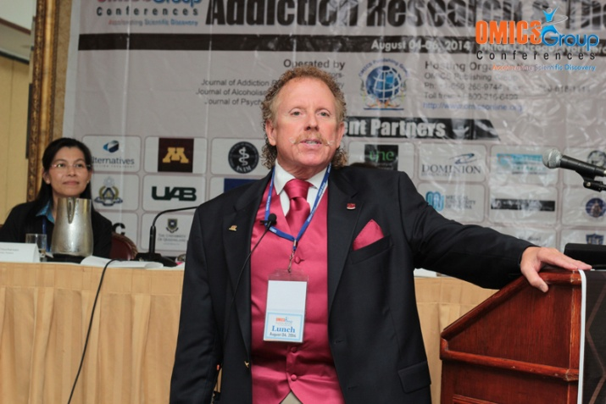
Addiction Therapy-2014
Chicago, USA
August 4 - 6, 2014
Ronald H. Bradley

Slide 2

Psychiatric SMI Medical Home Model: Integration of Medical Care within Community Mental Health:
Affordable Care Act cost savings in Real Dollars
Ronald H. Bradley, D.O., Ph.D.
Senior Associate Dean of Clinical Affairs
Central Michigan University,
College of Medicine
Integrity • Respect • Compassion • Inclusiveness • Social Responsibility • Excellence • Innovation

Slide 3
The Problem: Objective:
Medical Illness and
Premature Mortality in the Public Mental Health Sector
Know: What works in SMI Population
Know: Do I want to be involved

Slide 4
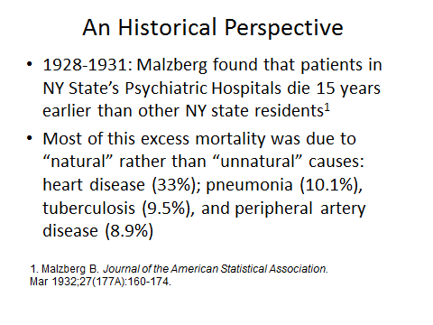

Slide 5
TOTAL PHARMACY SPENDING VS. BH SPENDING
Total Annual Pharmacy Spending (all drugs): $913,350,041
$389,475,908 or 43%
Behavioral Health Drugs
$523,874,133 or 57%
Non-Behavioral Health Drugs
5

Slide 6
Numerous barriers that are innate to the SMI who have substance abuse issues that also have chronic medical conditions (CHF, CAD, DM-II, HPTN, etc.)

Slide 7
Medicaid State Spending
Per Beneficiary Per Month*
Ping
Notes:
7

Slide 8
Boardman (2) reviewed the patient sampling of other researchers and he found that the SMI had an 88% occurrence of one chronic medical illness as well as 51% of two chronic medical illnesses

Slide 9
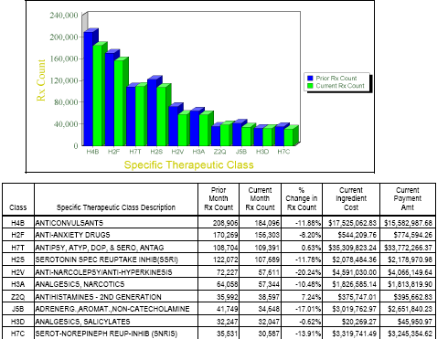
Top 10 Therapeutic Classes Ranked by Claim Volume

Slide 10
Health Home Navigation in a Recovery-Oriented System of Care, was obtained to address these issues. The “health home” was used to mean a combination of comprehensive health care management, care coordination and health promotion, comprehensive transition
care (including appropriate follow up from inpatient to next level of care), patient and family supports, referrals to community and social services, and use of health technology to linkservices as described in the Patient Protection and Affordable Care Act (PPACA), section 2703.

Slide 11
Prevention of psychiatric hospitalization, sub-acute detoxification and sobering facility admissions, and the effective management of chronic disease, with concomitant improvement in health status, are target goals of Patient Protection and Affordable Care Act (PPACA), Section 2703 and the pilot behavioral health home. The focus is on the integration of physical and mental health care.

Slide 12
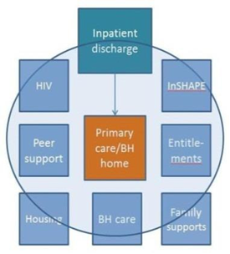

Slide 13
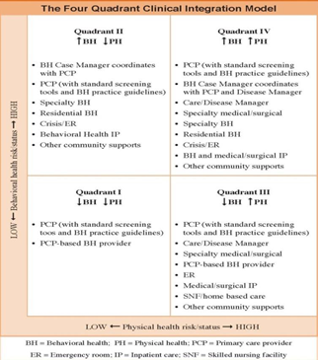

Slide 14
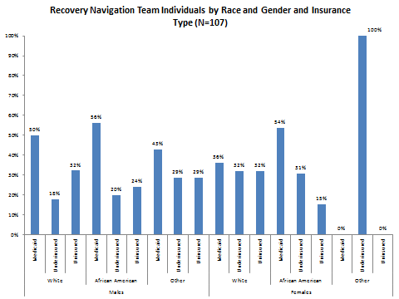

Slide 15
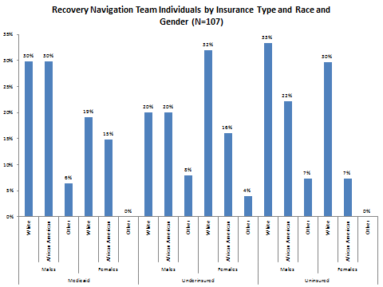

Slide 16
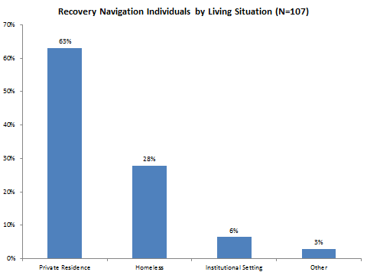

Slide 17
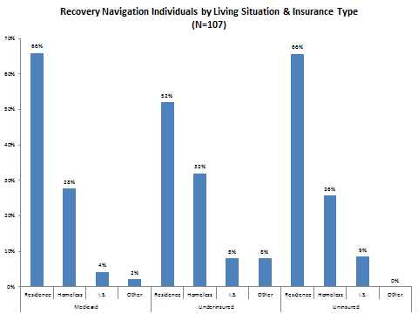

Slide 18
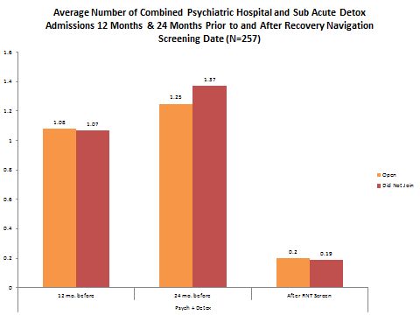

Slide 19
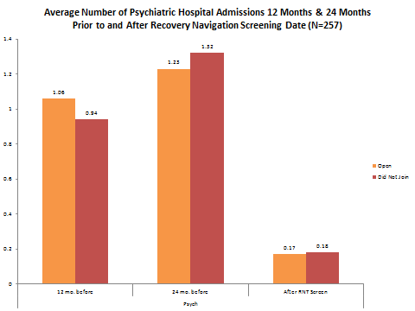

Slide 20
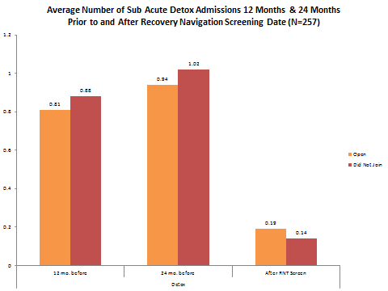

Slide 21
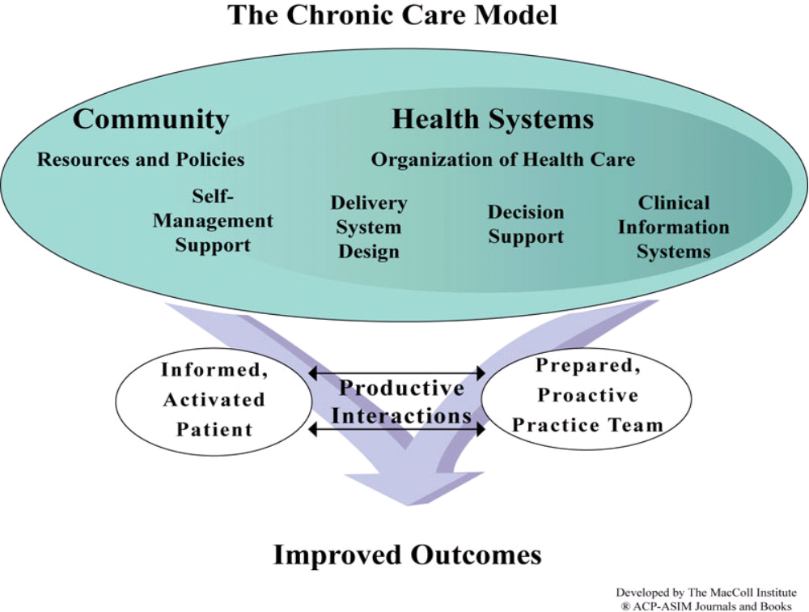
Tertiary Prevention: Effective Treatment of Chronic Illness-DOES NOT FUNCTION

Slide 22
THIS DOES NOT WORK:Care Delivery: Building a Medical Home for People with SMI
Collocated Models: Bring care onsite: No resources
Facilitated Referral: Link to community medical providers: Does Not work
Partnership: Develop a relationship between a CMHC and medical provider-Difficult to connect Silo’s

Slide 24
Summary: Integration In CMH Psychiatric HOME
By same day appointment for either medical or psychiatric cut total expenses by 80% medical/psych
Decrease inpatient for both medical and psychiatric care by 80%
Treatment of Substance Use disorders
Treatment of Prison population with Court System to keep mentally ill out of jail as long as the client engaged with treatment

Slide 25

Meet the eminent gathering once again at
Addiction Therapy-2015
Florida, USA
August 3 - 5, 2015
Addiction Therapy – 2015 Website:
addictiontherapy.conferenceseries.com

