Slide 1
Cardiovascular Risk Prediction Using WHO/ISH Chart in Urban and Rural Subjects Attending Diabetes Screening Clinic: A Pilot Study
Dr. Rohit A, Dr Balu P S
Public Health Specialist [ NCD]
India

Slide 2
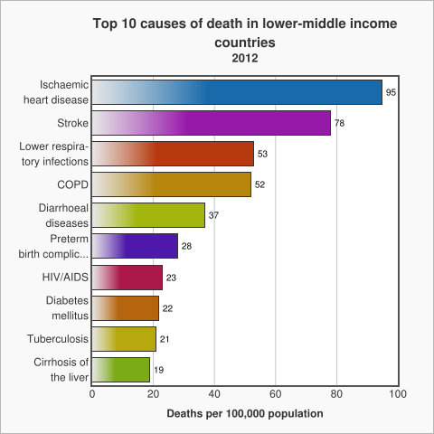
Introduction

Slide 3
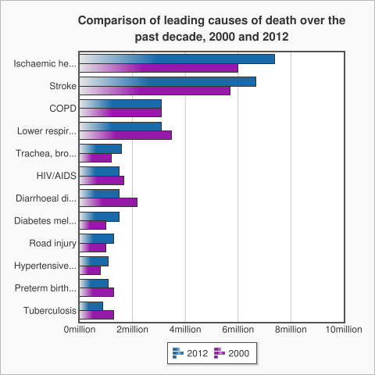
Introduction

Slide 4
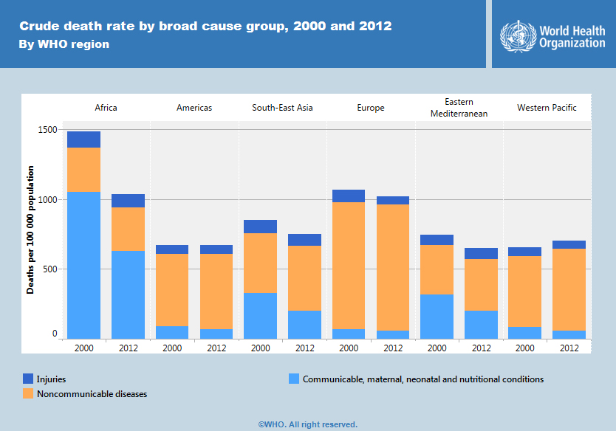
Introduction

Slide 5
Cardiovascular Risk and Diabetes
Cardiovascular disease is responsible for between 50% and 80% of deaths in people with diabetes.
Diabetes increases the risk of heart disease and stroke. In a multinational study, 50% of people with diabetes die of cardiovascular disease (primarily heart disease and stroke)
WHO projects that diabetes will be the 7th leading cause of death in 2030
Introduction

Slide 6
Community Based Approach
Over three quarters of CVD deaths take place in low- and middle-income countries.
People in low- and middle-income countries often do not have the benefit of integrated primary health care programmes for early detection and treatment of people with risk factors compared to people in high-income countries.
NCDs already disproportionately affect low- and middle-income countries where nearly three quarters of NCD deaths
Introduction

Slide 7
Objective
To assess 10 year risk of a fatal or non-fatal cardiovascular event in adults attending diabetes screening clinic using WHO/ISH risk prediction chart
Objective

Slide 8
Material and Methods
Study design: Cross sectional
Study setting: Non Communicable Disease[Diabetes] screening Clinic of Davanagere district.
Location:
  Urban: 1 [ District hospital]
  Rural : 2 [ Rural Primary health centres]
Material Methods

Slide 9
Material and Methods
Study population: Adults aged more than 40 years
Inclusion criteria: Age > 40 years
Exclusion criteria:
  Pre existing heart condition
  Other major cardiac abnormality
  Age more than 80 years
Material Methods

Slide 10
Material and Methods
Study instrument: WHO/ISH Risk predictions charts to predict 10 year risk of a fatal or non-fatal cardiovascular event among the adults. [SEAR D]
Study period: 27 July – 14 August 2015
Data entry: Epidata3.1
Data analysis: IBMSPSS20.0.
Material Methods

Slide 11
WHO/ISH Chart
Categorizes individual subjects into cardiovascular risk
  Age
  Sex
  Smoking
  Diabetes status
  Systolic blood pressure
  Cholesterol level
Material Methods

Slide 12
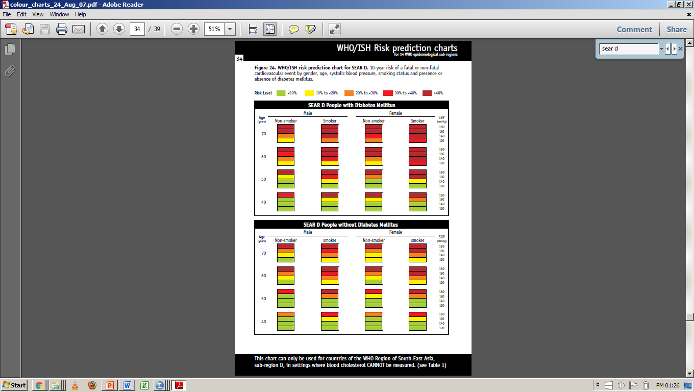

Slide 13
Results
General Observation
In relation to cardiovascular risk prediction
  Comparison Of Urban And Rural
  Comparison Of Male And Female
  Comparison Of Diabetics And Non Diabetics
  Comparison in relation to tobacco and other
Results

Slide 14
Graph 1: Distribution Of Study Subjects Based On Location
Results

Slide 15
Graph 2: Distribution Of Study Subjects Based On Gender
Results

Slide 16
Graph 3: Distribution Of Study Subjects Based On Tobacco Consumption
Results

Slide 17
Graph 4: Distribution Of Study Subjects Based On Diabetes Status
Results

Slide 18
Graph 5a: Distribution Of Study Subjects Based On Cardiovascular Risk
Results

Slide 19
Graph 5b: Distribution Of Study Subjects Based On Cardiovascular Risk
Results

Slide 20
Graph 5c: Distribution Of Study Subjects Based On Cardiovascular Risk
Results

Slide 21
Graph 6: Urban-Rural Comparison Of Cardiovascular Risk
Results

Slide 22
Table 1: Urban-Rural Comparison Of Cardiovascular Risk
 | Urban | Rural | Total | P value > 0.05 Chi Square= 2.234 dF 1
Less than 20 % | 114 | 44 | 158
More than 20 % | 13 | 10 | 23
 | 127 | 54 | 181
Results

Slide 23
Graph 7: Gender Wise Comparison Of Cardiovascular Risk
Results

Slide 24
Table 2: Gender Wise Comparison Of Cardiovascular Risk
 | Male | Female | Total | P value < 0.05 Chi Square= 4.024 dF 1
Less than 20 % | 49 | 109 | 158
More than 20 % | 12 | 11 | 23
 | 61 | 120 | 181
Results

Slide 25
Graph 8: Comparison Of Cardiovascular Risk Based on Diabetes Status
Results

Slide 26
Table 3: Comparison Of Cardiovascular Risk Based on Diabetes Status
 | Diabetics | Non diabetics | Total | P value < 0.05 Chi Square= 26.479 dF 1
Less than 20 % | 23 | 135 | 158
More than 20 % | 14 | 9 | 23
 | 37 | 144 | 181
Results

Slide 27
Graph 9: Comparison Of Cardiovascular Risk Based on Tobacco Consumption
Results

Slide 28
Table 4: Comparison Of Cardiovascular Risk Based on Tobacco Consumption
 | Consume tobacco | No Tobacco | Total | P value < 0.05 Chi Square= 17.957 dF 1
Less than 20 % | 13 | 145 | 158
More than 20 % | 9 | 14 | 23
 | 22 | 159 | 181
Results

Slide 29
Discussion
Risk of cardiovascular event increases
  Age
  Gender
  Diabetes
  Smoking
  Waist Hip Ratio
  Hypertension
  Location
Studies from India and Abroad
Discussion

Slide 30
Conclusion
Categorizing people as low (<10%)/moderate (10%-20%)/high (>20%) risk is one of the crucial steps to mitigate the magnitude of cardiovascular fatal/non-fatal outcome
Risk increase is compounded by modifiable and non modifiable factor.
Diabetes management- cardiovascular risk counselling.

Slide 31
Recommendations
WHO/ISH Risk Prediction Chart
  Evidence based
  Simple tool
  Used in community setting
  Training
  Counselling

Slide 32
References
Global status report on noncommunicable diseases 2014. Geneva, World Health Organization, 2012.
World Health Organization. Global Health Estimates: Deaths by Cause, Age, Sex and Country, 2000-2012. Geneva, WHO, 2014.
Mathers CD, Loncar D. Projections of global mortality and burden of disease from 2002 to 2030. PLoS Med, 2006, 3(11):e442.
Roglic G, Unwin N, Bennett PH, Mathers C, Tuomilehto J, Nag S et al. The burden of mortality attributable to diabetes: realistic estimates for the year 2000. Diabetes Care, 2005, 28(9):2130–2135.
References

Slide 33
References
Definition, diagnosis and classification of diabetes mellitus and its complications. Part 1: Diagnosis and classification of diabetes mellitus. Geneva, World Health Organization, 1999 (WHO/NCD/NCS/99.2).
Morrish NJ, Wang SL, Stevens LK, Fuller JH, Keen H. Mortality and causes of death in the WHO Multinational Study of Vascular Disease in Diabetes. Diabetologia 2001, 44 Suppl 2:S14–S21.
Global data on visual impairments 2010. Geneva, World Health Organization, 2012.
Global status report on noncommunicable diseases 2010. Geneva, World Health Organization, 2011.
References

Slide 34
Acknowledgement
Dr Alur Manjunath, Principal, JJM Medical College
Dr Balu P S, Professor, JJM Medical College
Dr Manu A S, JJM Medical College
KHSDRP, Karnataka
Department of Health and Family Welfare, Davanagere District

