Slide 1

Genotoxicity: Basic aspects and most commonly worldwide employed and validated in vivo assays
4th Global Summit on Toxicology
August 24-26, 2015
Philadelphia, USA
Rohan Kulkarni, PhD
Director, Genetic Toxicology-Study Management,
BioReliance, Inc.

Slide 2



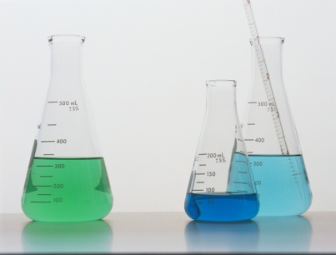
Historical Perspectives and Background- Genotoxicity assays
  “..many carcinogens are mutagens and that most mutagens are carcinogens”
James A. and Elizabeth C. Miller
In Vivo Genotoxicity
Assays
(1970s)
Rodent Bioassay
Epidemiology Studies
(1915)
5 years + $4-5 million
(16th century)
Ethical issues, long latency & high background make epidemiology studies impractical
Screening Tests (early 1990’s)
In Vitro Genotoxicity Assays
(1970s; Bruce Ames )
Structure activity relationship (SAR/QSAR)
(1990’s)
Pathways of Toxicity/Adverse Outcomes Pathway
Fast, inexpensive, very sensitive. Genotoxins are considered rodent carcinogens and potential human carcinogens

Slide 3
Topics for Discussion
Most commonly used assays:
In vivo Micronucleus Assay
In vivo Mammalian Alkaline Comet Assay
Less commonly used assay:
Transgenic Rodent Somatic and Germ Cell Gene Mutation Assays
In vivo Chromosome Aberration Assay
Pig-a In Vivo Gene Mutation Assay

Slide 4
Historical Perspectives and Background- in vivo MN Assay
Heddle 1973
Assess the potential for DNA damage that may:
  alter chromosome structure
  interfere with the mitotic apparatus causing changes in chromosome number
In Vivo Micronucleus Assay
  detects micronuclei (MN)
    Clastogenicity
    Aneugenicity
  serves as biomarkers of cytogenetic damage
  No exposure = No Test

Slide 5
In Vivo MN Assay
Polychromatic
Erythrocyte (PCE)
Normochromatic
Erythrocyte (NCE)
Final Mitosis
Maturation/expulsion of nucleus
Normal
NCE
Normal
Final Mitosis
Stem Cell
(erythroblast)
Chromosomal
Damage
Micronucleated
NCE

Slide 6
Exposure Methods
Test System
  rat, mouse or any suitable mammalian species
  weight variation within 20% of mean weight/sex
Dose Administration
  oral gavage
  intraperitoneal
  intravenous
  subcutaneous
  Dermal
Dose Formulation
  Solids, liquids:
  freshly prepared unless stability is demonstrated

Slide 7
Study Design:
Maximum Dose
Maximum Tolerated Dose (MTD)
  dose inducing some clinical signs of toxicity, but not mortality
  dose inducing a marked decrease in bone marrow PCEs (reduction in PCEs/ECs ratio; inhibition of erythropoiesis)
  dose that does not disturb animal physiology
  used as the highest dose in the definitive study, otherwise
Limit dose
  2000 mg/kg/day (≤4 days) or 1000 mg/kg/day (>14 days)
Maximum Feasible Dose (MFD)
  Highest able to be administered based upon solubility and dose volume limitations
Safety multiple NOT appropriate

Slide 8
Study Design: Definitive Assay
Dose formulation
Dose administration
TK sample collection, if necessary
Clinical observations
Bone marrow collection (24 and 48 hrs after single dose)
  if chromosome aberrations, treat with Colcemid prior to sacrifice
  hypotonic treatment, fix cells, apply to slides
Stain and prepare slides for microscopic evaluation
or
Prepare samples for flow analysis where applicable

Slide 9
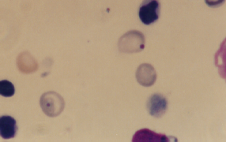
Scoring
Stained micronuclei

Slide 10
Summary:
Key Guideline Requirements
2000 mg/kg (limit dose) or Maximum Tolerated Dose or Maximum Feasible Dose
Bone marrow (systemic) exposure achieved in single or multiple treatments
Advantages
  possible to demonstrate bone marrow exposure by:
    bone marrow cytotoxicity (PCE/EC ratio)
    TK/BioA
  takes advantage of intact metabolic processes (ADME)
Disadvantages
  Without exposure, test is not valid

Slide 11
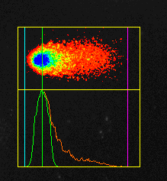
Comet Assay: Test System Theory
Single Cell Gel Electrophoresis (Comet) Assay
  Micro-electrophoretic technique which detects DNA damage and repair in individual cells
  In vitro and in vivo
Under alkaline conditions (pH>13) it can detect:
  DNA single and double strand breaks
  single strand breaks as a result of alkali-labile sites
  nucleotide excision repair
              Level of DNA damage is correlated to the length and amount of fragmented DNA that migrates outside the cell nucleus (comet tail)

Slide 12
History of In Vivo Validation
2006
2007
2008
2009
2010
2011
1st
At 5 lead labs
with ethyl methanesulfonate (EMS)
▲
Start in Aug.
Protocol Optimization
2nd
At 5 labs
with EMS
+3 coded chem.
Optimized-Protocol Confirmation
Within/Between-Lab reproducibility
3rd
At 4 labs with EMS+3 coded chem.
Lab Recruitment
(Transferability)
Within/Between-Lab reproducibility
4th (1st)
At 13 labs with EMS+4 coded chem.
Predictive Capability
4th (2nd)
At 14 labs
with EMS+40 coded chem.
Slide provided by - Dr. Hayashi /JaCVAM

Slide 13
When to Perform
In Vivo Comet Assay?
As a second in vivo test
In combination with the in vivo micronucleus assay (acute or integrated in 28-day toxicity studies)
To further evaluate in vitro positive findings (in vitro genotoxic compounds) or positive in vivo genotoxicity data.
Tissue-specific genotoxic activity: cell proliferation not required
To explore mechanism of carcinogenicity in long-term rodent studies.

Slide 14
How We Perform Acute “Combination” Study
Dose Range Finder assay - doses selected for the definitive assay.
Main assay - Animals are dosed, 3 doses, vehicle and positive control
Animals are bled – plasma (systemic exposure) and/or serum (to check for liver enzymes) collected.
Animals are euthanized, necropsied and organ(s) of interest is collected/extracted.
Organ - 3 samples – histopathology, comet slides and tissue exposure
Femoral bone marrow or peripheral blood for MN assay
Notes:
Blood may also be processed to serum and used in analysis for liver enzymes such as, Alanine transaminase (ALT), Aspartate transaminase (AST) and Alkaline phosphatase (ALP), to measure test article related toxicity. Plasma analyzed to confirm exposure.

Slide 15
Parameters of DNA Damage:
% Tail DNA (Intensity) Amount of DNA in the tail
No Damage
Head
Tail
Tail Moment
Product of the distance between the center of head mass and the center of tail mass (tail length) and the amount of DNA in the tail
Low Damage
Medium Damage
High Damage
Tail migration
Level of DNA damage is correlated to the length and amount of fragmented DNA that migrates outside the cell nucleus (comet tail)
Tail Migration
DNA migration length from the edge of the head to smallest detectable fragment in the tail

Slide 16
Summary
Comet assay is being used more and more to clarify the positive responses in the initial genetox battery.
It can also be used as the follow up assay along with the MN assay after doing the Ames assay (ICH S2 R1).
Can also be combined with 28-day tox studies in rodents.
It is possible to include comet in long term tox studies with other types of animals.

Slide 17
Topics for Discussion
Most commonly used assays:
In vivo Micronucleus Assay
In vivo Mammalian Alkaline Comet Assay
Less commonly used assay:
Transgenic Rodent Somatic and Germ Cell Gene Mutation Assays
In vivo Chromosome Aberration Assay
Pig-a In Vivo Gene Mutation Assay

Slide 18
In Vivo Chromosome Aberration
Assay
Dose selection
Dose administration
Treatment with Colchicine
Bone marrow collection:
First sampling time: 18 hours post-dose (at 1.5 X the cell cycle time)
Second sampling time: 42 hours post-dose

Slide 19
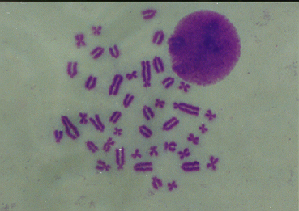
In Vivo Chromosome Aberration
Assay: Protocol
Hypotonic Treatment
Fixation
Giemsa staining
Analysis:
150 metaphases/animal for structural and numerical aberrations
Mitotic Index
Fisher exact ratio test,
p≤ 0.05

Slide 20
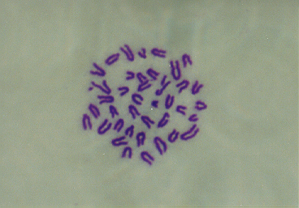
Bone Marrow Cell Metaphase
Rat (2n=42) and Mouse (2n=40)
quadriradial
breaks

Slide 21
In Vivo Mutation Assays
  Historically, in vivo mutation assays have been of limited use
  Follow-up assays after Ames positive results
In vivo Comet, UDS, and micronucleus do not measure mutation
  Transgenic Rodent Mutation Assays: Big Blue® Assay
Pig-A
Pig-a – the gene coding for the enzyme phosphatidylinositol N-acetylglucosaminyltransferase, subunit A
  one of 12 genes involved in glycosylphosphatidylinisotol (GPI) anchor biosynthesis (first step)
GPI anchors – direct and attach proteins to cell surface (e.g., CD59, CD24)

Slide 22
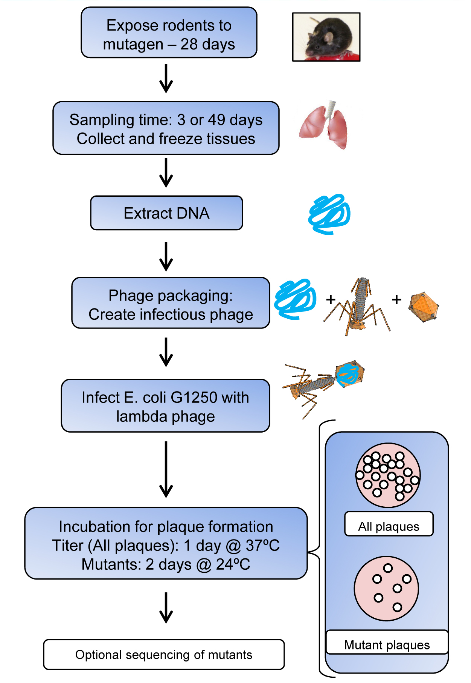
Big Blue® Assay: Overview
Dose animals
Necropsy - freeze tissues
Extract DNA
Cut out shuttle vector (Transpack)
Package into empty phage particles
Adsorb onto E. coli G1250
Plate onto 100 mm plates
Incubate at 37ºC and 24ºC
  37ºC – both cII wildtype and mutants give plaques
  24ºC – only cII mutants produce plaques
Count and evaluate
Mutant frequency: ratio of mutants to total phage (plaques) screened

Slide 23
Pig-A Assay: Overview
Wild-type Cell
Pig-a Mutant Cell
fluorescent labeled antibodies
against GPI-anchored proteins
GPI
Pig-a
FCM analysis
FCM analysis
Fluorescent
positive
Fluorescent
negative
CD59
Genotoxin

Slide 24
Big Blue vs Pig-a
Pig-a Assay
Big Blue Assay
In Vivo Gene Mutation Assay
No OECD Guideline (~2015)
Listed in the M7 Guideline
28-day format
Blood Only
Interim sampling possible
Less expensive
Quicker study start date
In Vivo Gene Mutation Assay
OECD Guideline 488 (2011)
Listed in the M7 Guideline
28-day format
Almost any tissue (2 std)
Sampling only at termination
More Expensive (animal $)
Dependent on animal avail.

Slide 25
Thank you
Toxicology 2015 Summit
  Marcelo Larramendy
  Ofelia Olivero
  Meeting Organizers

Slide 26


