Slide 1
About OMICS Group
OMICS Group International is an amalgamation of Open Access publications and worldwide international science conferences and events. Established in the year 2007 with the sole aim of making the information on Sciences and technology ‘Open Access’, OMICS Group publishes 400 online open access scholarly journals in all aspects of Science, Engineering, Management and Technology journals. OMICS Group has been instrumental in taking the knowledge on Science & technology to the doorsteps of ordinary men and women. Research Scholars, Students, Libraries, Educational Institutions, Research centers and the industry are main stakeholders that benefitted greatly from this knowledge dissemination. OMICS Group also organizes 300 International conferences annually across the globe, where knowledge transfer takes place through debates, round table discussions, poster presentations, workshops, symposia and exhibitions.

Slide 2
About OMICS Group Conferences
OMICS Group International is a pioneer and leading science event organizer, which publishes around 400 open access journals and conducts over 300 Medical, Clinical, Engineering, Life Sciences, Phrama scientific conferences all over the globe annually with the support of more than 1000 scientific associations and 30,000 editorial board members and 3.5 million followers to its credit.
OMICS Group has organized 500 conferences, workshops and national symposiums across the major cities including San Francisco, Las Vegas, San Antonio, Omaha, Orlando, Raleigh, Santa Clara, Chicago, Philadelphia, Baltimore, United Kingdom, Valencia, Dubai, Beijing, Hyderabad, Bengaluru and Mumbai.

Slide 3
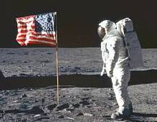
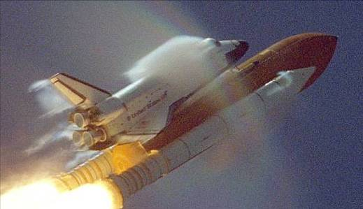

Precise Heat Control.
Essential Materials Characterization Techniques Everyone Needs to Solve Real Problems
Rodrigo Devivar, Ph.D.
Jacobs Technology / NASA-Johnson Space Center
ES4 Materials Analysis Laboratory
Houston, Texas

Slide 4
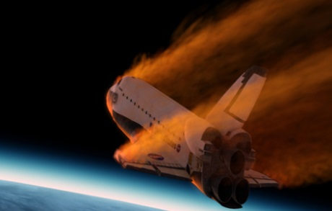


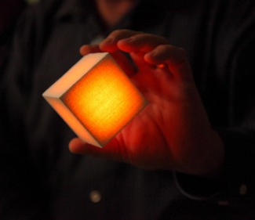
Controlling Heat in Aerospace
Picture of Space Shuttle During Atmospheric Re-entry taken from ISS

Slide 5
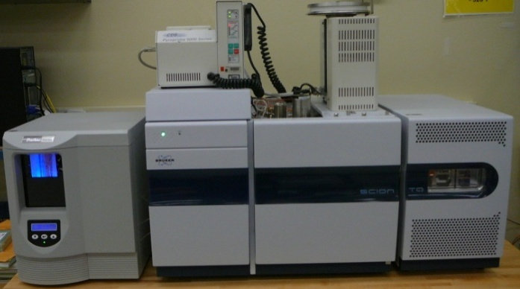
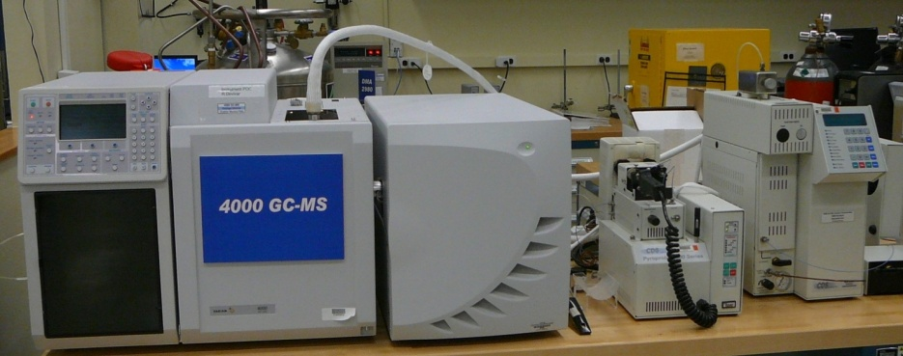
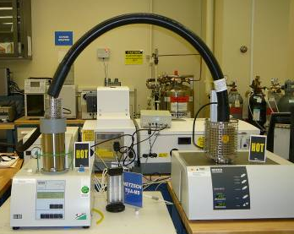
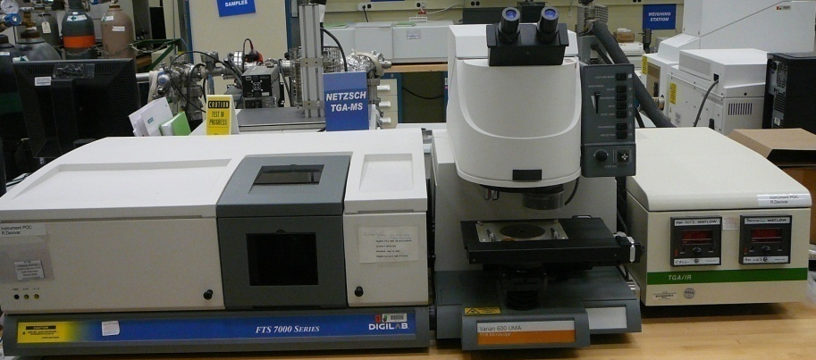
Analytical Chemistry Laboratory Equipment
  Key Laboratory Equipment
  Optical Instrumentation
    UV-Vis, Fluorimeter, Solar Reflectance, Infrared Emittance, Raman
  Thermal Analysis Instrumentation
    DSC, DMA, TGA, TMA, LFA, Rheometer
  Chemical Analysis Instrumentation
    FT-IR, Ion trap GC-MS, Py-GC-MS, TGA-MS, TGA-IR

Slide 6

Optical Vs. Thermal Techniques
Reflectance
Emittance
Absorbance/Transmission
Fluorescence
UV-Vis Absorbance
FT-IR Analysis
Raman Analysis
Light
Material Curing
Thermal Transition-Tg
Melting Point/ Boiling Point
Residual Solvent
Identification of additives
Material Decomposition
Elimination of labile functional groups
Identification of Material Components
Identification of Inorganic Components
Heat

Slide 7

Controlling Heat Exposure
Thermal Analysis
Slow: minutes to hours
TGA
Furnace
Sample at 25ºC
Sample at 1000ºC
Pyrolysis
Filament
Fast: microseconds to seconds
Thermochemical Analysis

Slide 8
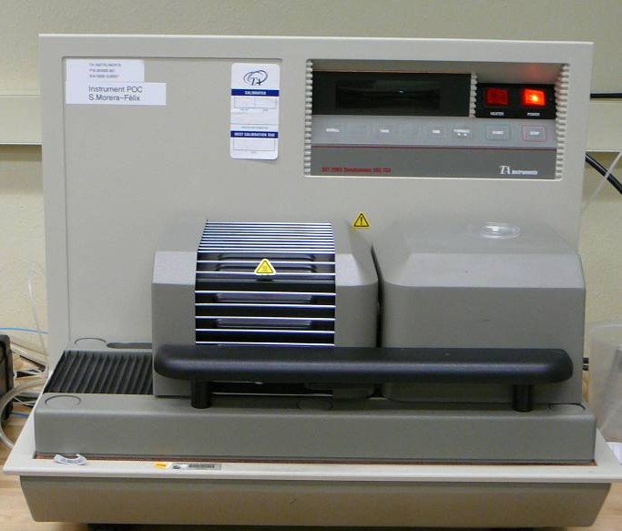
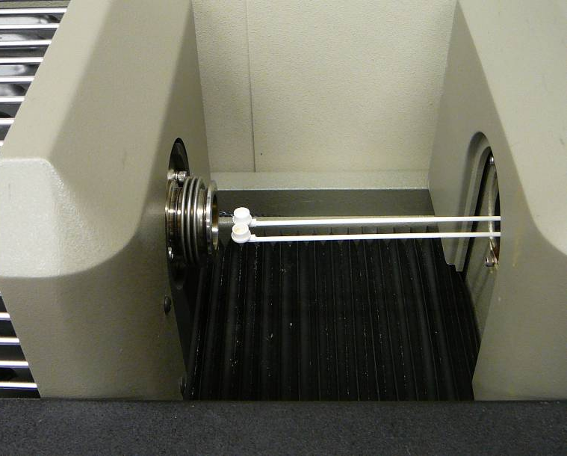
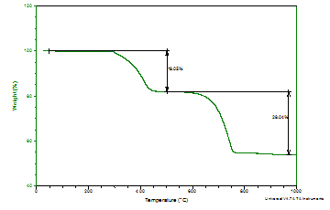
Thermogravimetric Analysis (TGA)
A TGA instrument consists of an analytical balance and a furnace.
A small sample of material is heated and its change in mass is measured as a function of temperature.
Experiments can be conducted under inert or oxidizing atmospheres.
Information gained from TGA includes:
  Thermal stability for conducting additional thermal analysis
  Identification of the number of components in the sample if the decomposition temperatures are different
  Residual mass for assessing the extent of inorganic additives

Slide 9
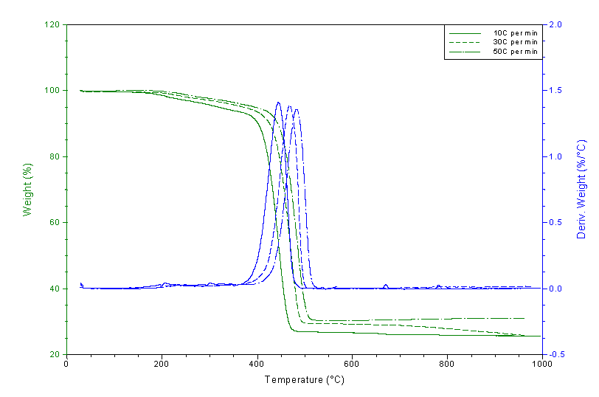
The Influence of Temperature Ramp Rates
Slower Ramp
Faster Ramp

Slide 10
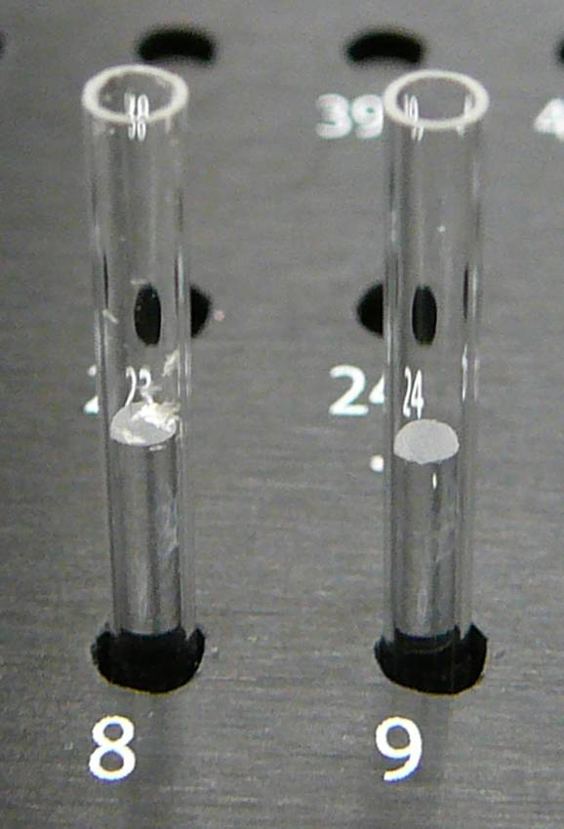
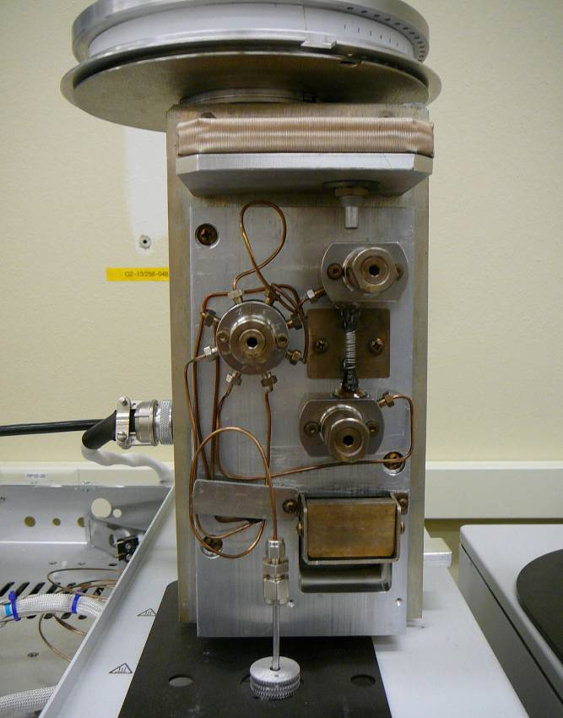
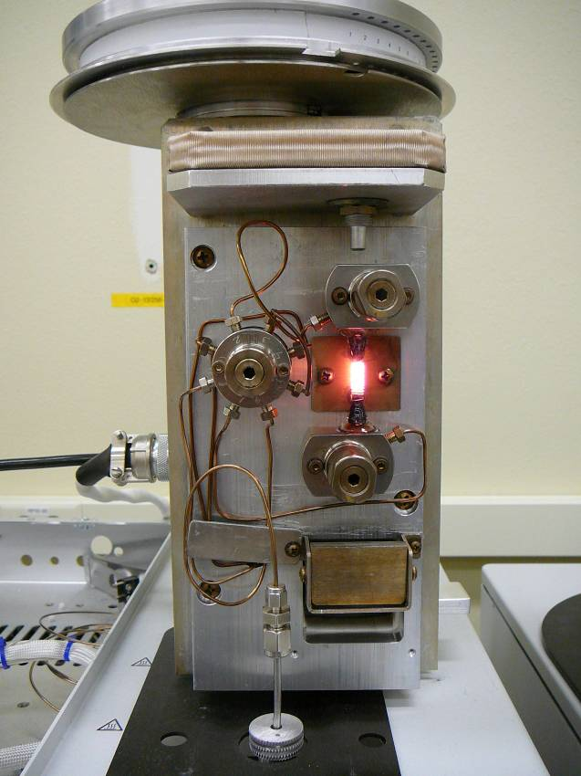
Pyrolysis for GC-MS of Solids
Sample size is relatively small:
50 to 200 μg is sufficient for solids
50 to 200 nL is sufficient for liquids
Sample preparation is easy: Place sample inside 1.5 inch quartz tube containing filler tube and plug with glass wool.
Samples can be solids, gels, viscous liquids, greases, crystalline, emulsions, foams, fabrics
Pyrolysis temperatures are almost instantaneous
Sample components can be quantified with the use of software
Pyrolysis is the thermal degradation of any substance through the fast application of heat.

Slide 11
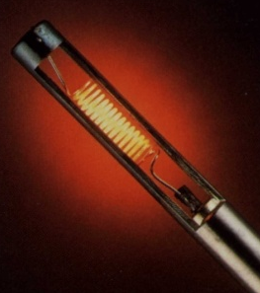
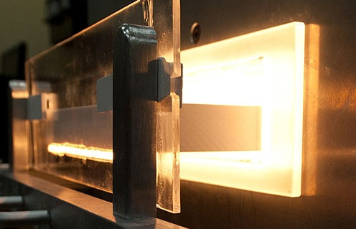
Pyrolyzers: Filament Versus Furnace
CDS Platinum Filament
Microfurnace
Heating Rate: ~20,000ºC per sec
Max Temperature: 1400ºC
Cooling Rate: > 1000ºC per sec
Fast Heating, Fast Cooling
Heating Rate: ~50ºC per min
Max Temperature: 800ºC
Cooling Rate: 25ºC per min
Slow to Heat, Slow to Cool

Slide 12
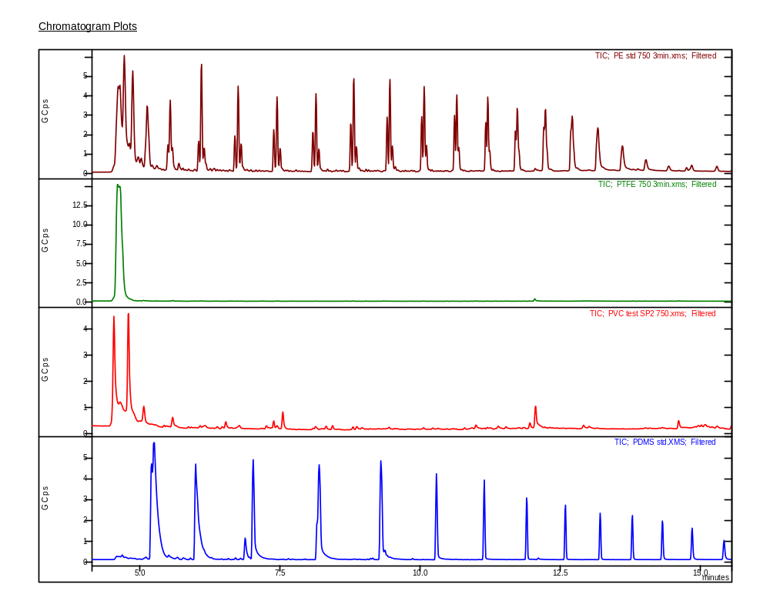
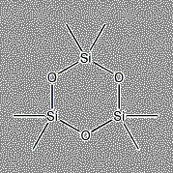
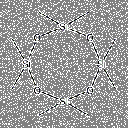
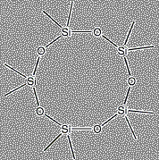
Flash Pyrolysis of Polymers
Mechanism of
Pyrolytic Degradation
Polyethylene: -CH₂-CH₂-CH₂-CH₂-CH₂-CH₂-CH₂-CH₂-CH₂-
Random Scission
PTFE : -CF₂-CF₂-CF₂-CF₂-CF₂-CF₂-CF₂-CF₂-CF₂-
Unzipping
PVC: -CH₂-CH-CH₂-CH-CH₂-CH-CH₂-CH-CH₂-CH-
Side Group Elimination
Cl
Cl
Cl
Cl
Cl
Silicone Scission
Silicones : -O-Si(CH₃)₂-O-Si(CH₃)₂-O-Si(CH₃)₂-O-Si(CH₃)₂-

Slide 13
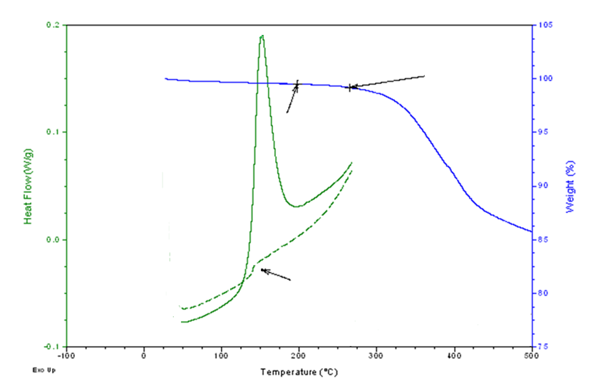
Thermal Analysis of Composite
Thermal Analysis
Thermal Desorption
Pyrolysis
Onset of Decomposition
Curing Temperature
Tg

Slide 14
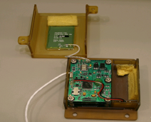
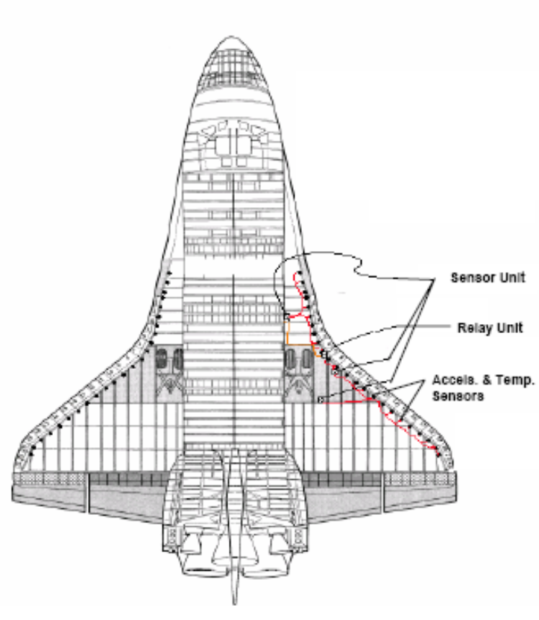
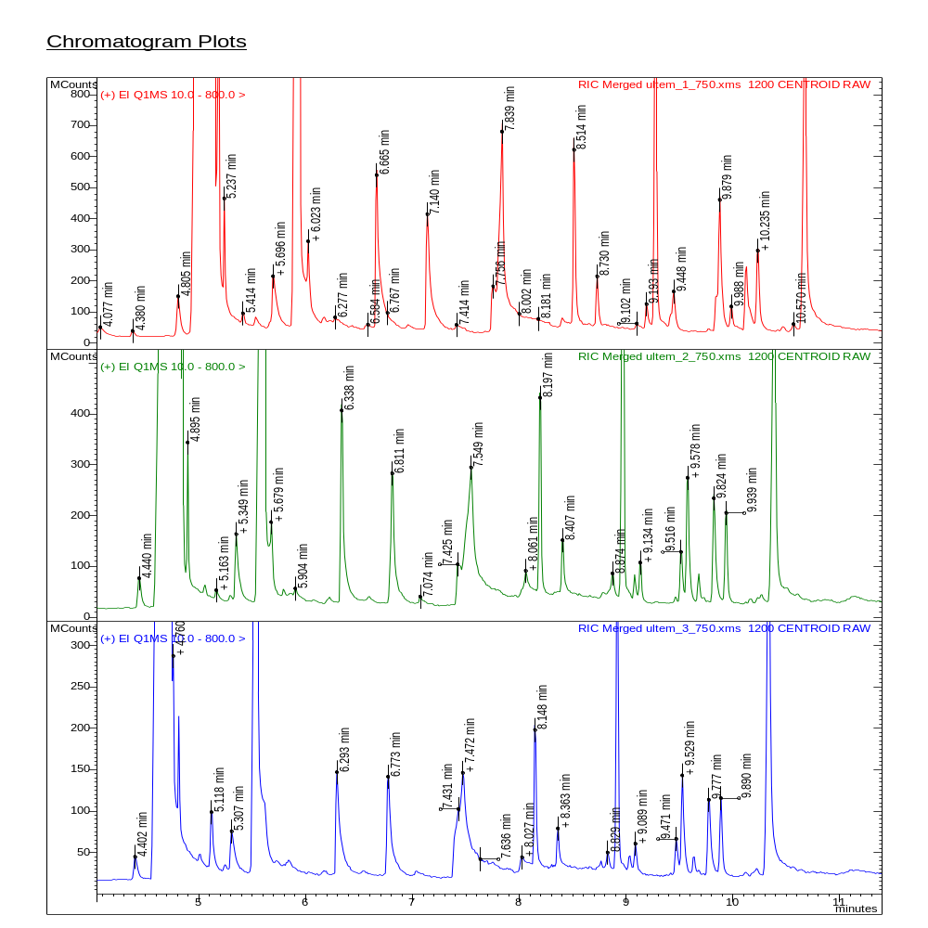
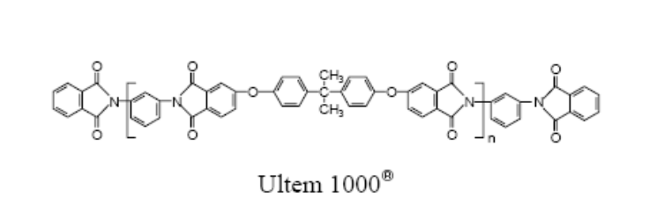
Flash Pyrolysis-GC-MS of Ultem 1000
Relay sensor boxes along the shuttle’s wing leading edge were composed of Ultem 1000.
One lot used to make these relay sensor boxes had failed
Various manufacture lots of sensor boxes were analyzed by Py-GC-MS and an extra peak was noted in one of those lots. The extra peak was due to dichlorobenzene, a solvent used during manufacture of Ultem 1000.

Slide 15
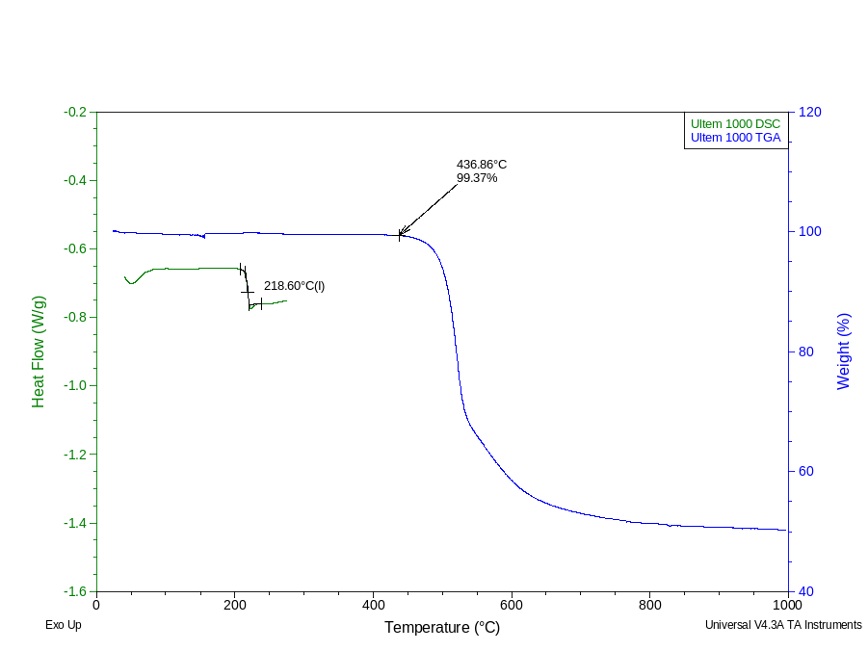
Thermal Analysis of Ultem 1000
Key thermal values can be measured or obtained from product specification information.
Ultem 1000 Tg: 218ºC
Onset of Decomposition: 437ºC

Slide 16
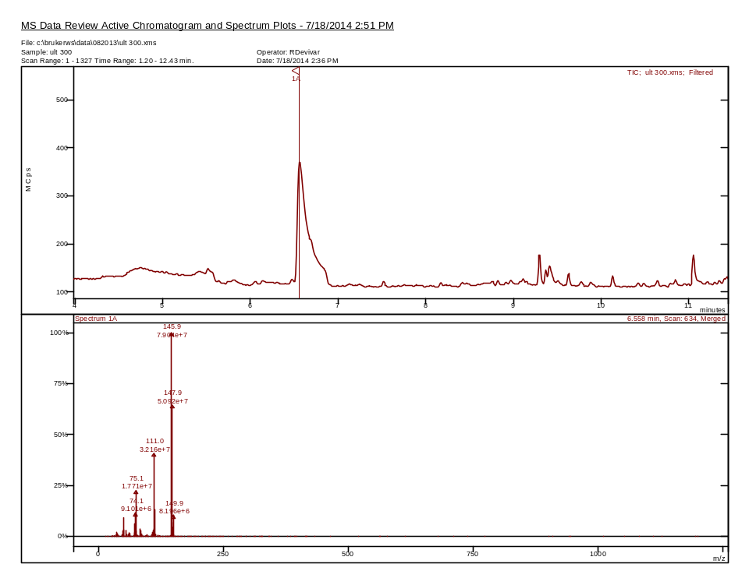
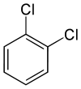
Thermal Extraction of Ultem 1000
Thermal extraction temperature: 400ºC

Slide 17
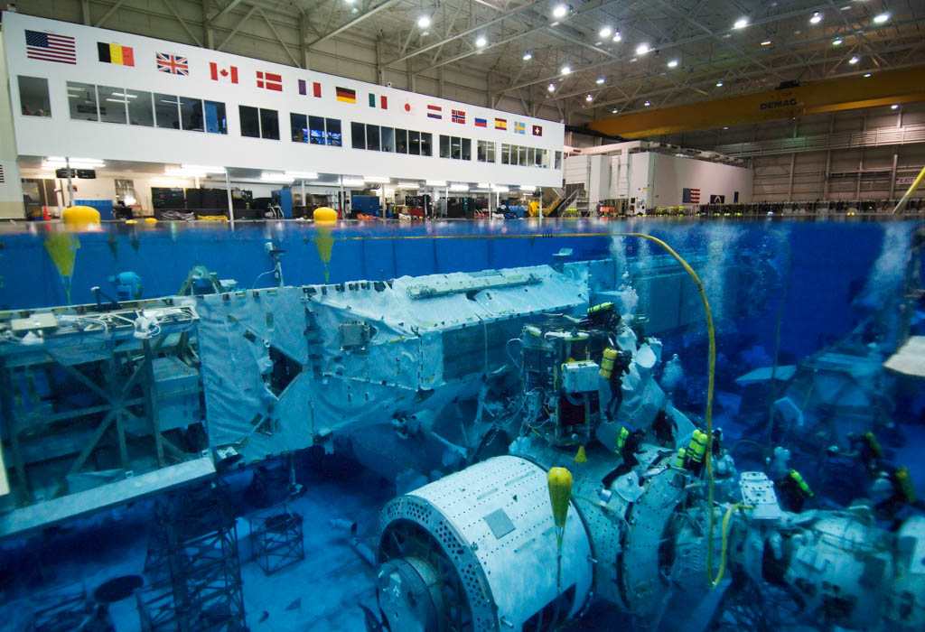
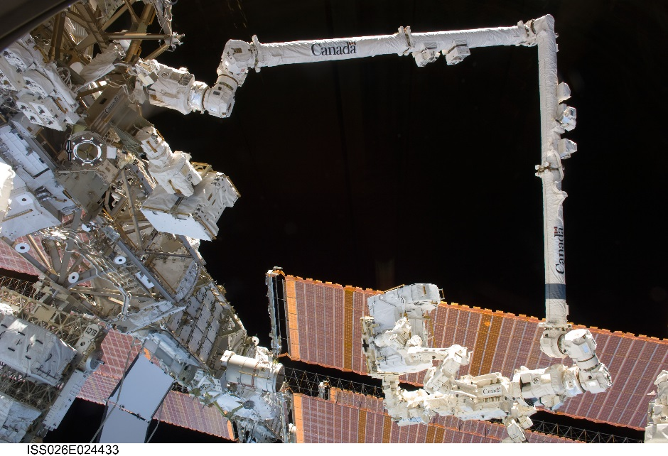
Neutral Buoyancy Training Facility
The NBL tank is 202 feet (62 m) long, 102 feet (31 m) wide, and 40 feet 6 inches (12.34 m) deep, and contains 6.2 million gallons (23.5 million litres) of water.
The facility is essential for astronaut EVA training prior to a mission.
On one occasion, a Viton gasket from the Canadarm hydraulics swelled and failed. We implemented a few thermal techniques to reveal the cause of the failure.

Slide 18
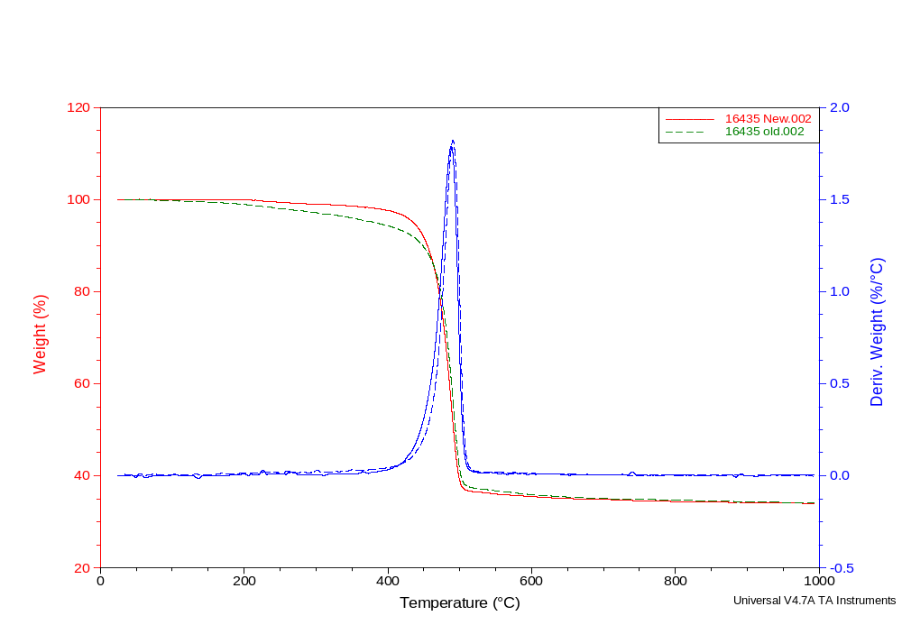
TGA Comparison of Gaskets
Area of difference
Under conditions of increasing temperature, the only difference between the two Viton Gaskets was found below 400ºC, where the old sample lost a larger percentage of its mass compared to the new sample.

Slide 19
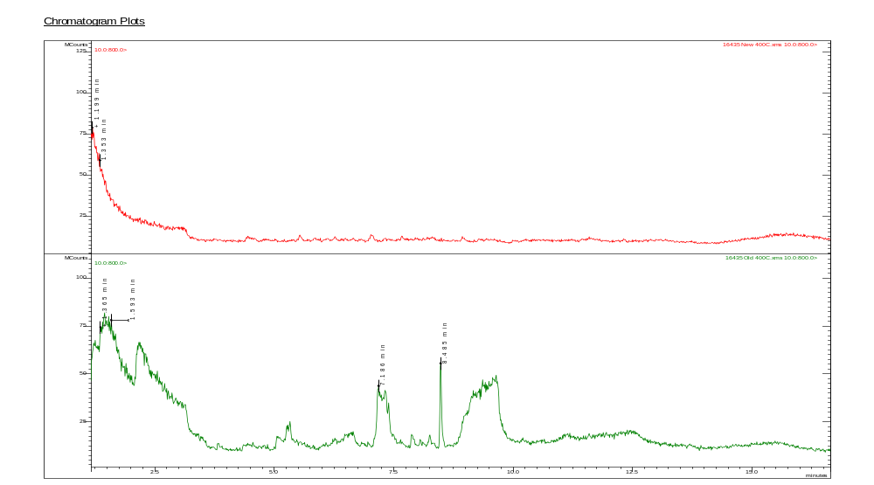
Thermal Extraction of Samples
New Sample
Carbon Dioxide
Carbon Dioxide
BHT
In Service Sample
1,4-Dioxane
Glycerin
Thermal extraction of the two samples was performed to account for the difference observed in the TGA experiments at temperatures below 400ºC. Such an experiment indicated the Old sample contained various fragments that are attributed to polyethylene oxide. Other substances found included Glycerin and Butylated hydroxy toluene (BHT).

Slide 20
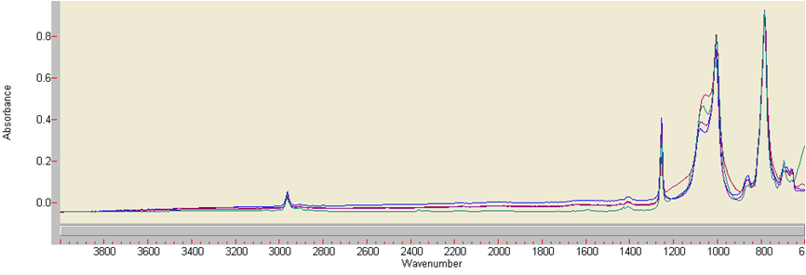
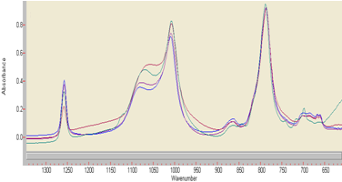
FT-IR Analysis of Silicone Materials
1. Silicone O-ring
2. RTV 560
3. Red, Tacky RTV
4. PDMS
FT-IR is a non-destructive technique that is very diagnostic. However, if infrared light cannot penetrate the sample, any signal obtained through reflectance is only valid for the external surface of a sample.

Slide 21
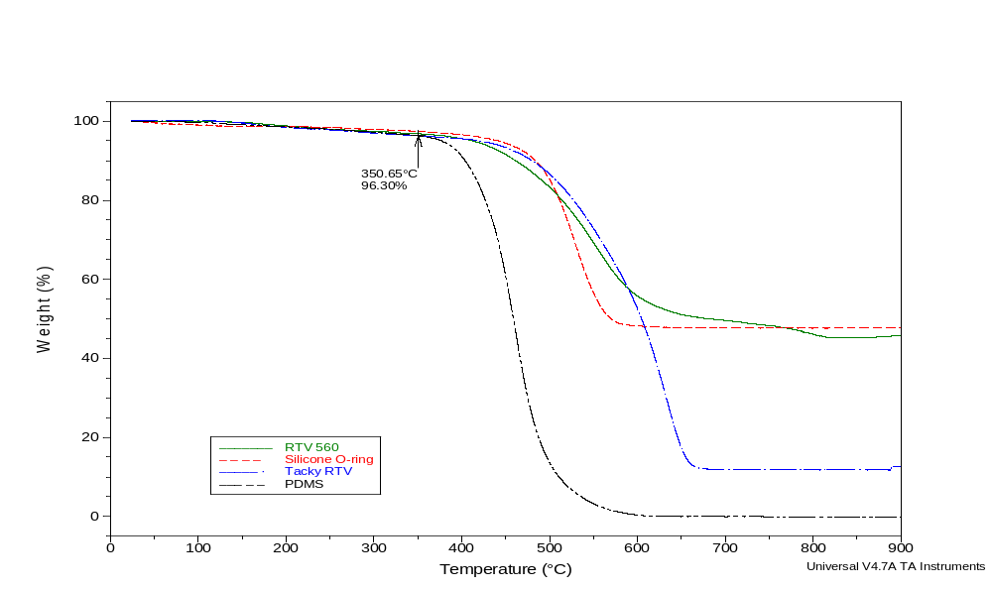
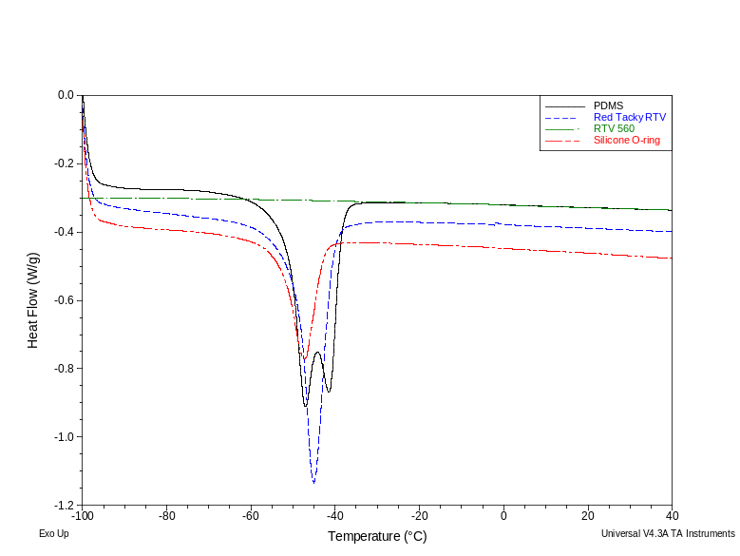
Thermal Analysis of Silicone Materials
The Silicone samples that were nearly identical by FT-IR displayed very different properties by thermal analysis.

Slide 22
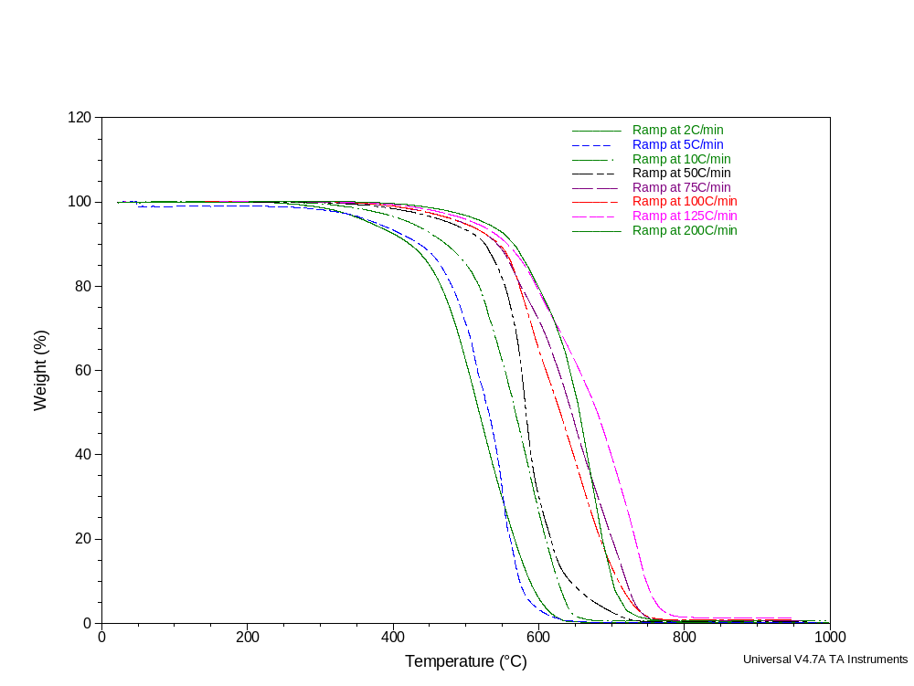
TGA Analysis of Silicone Oil
The thermal profile of silicone oil at different ramp rates indicates the complexity of thermal analysis

Slide 23
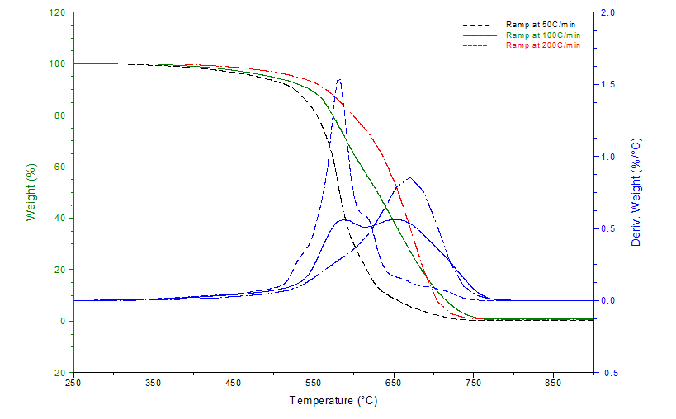
High Temperature Ramp Rates
Increase Molecular Fragmentation
At high temperature ramp rates, silicone oil undergoes two types of processes detected by TGA analysis, evaporation through boiling and molecular fragmentation.

Slide 24
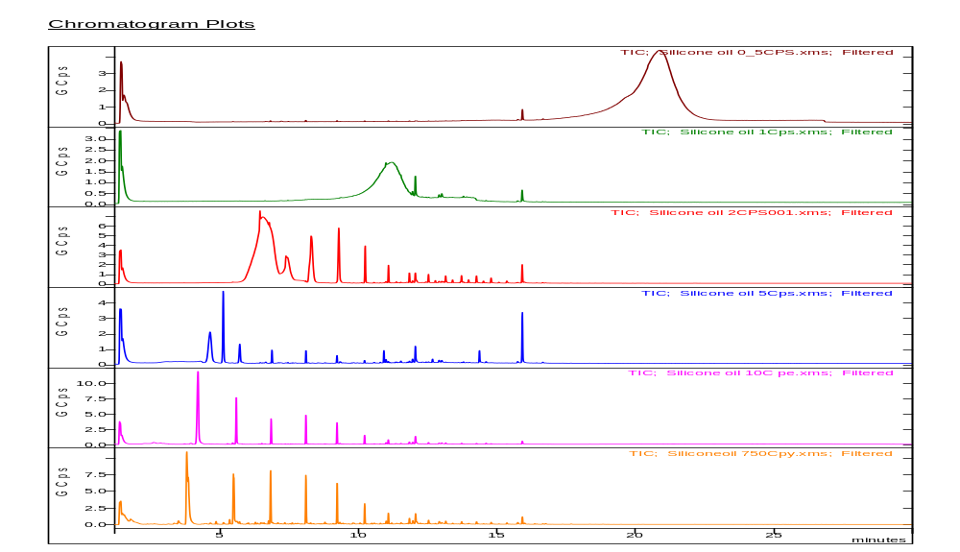
Pyrolytic Analysis of Silicone Oil at Different Heating Rates
Heating Rate: 30ºC per min
Heating Rate: 60ºC per min
Heating Rate: 120ºC per min
Heating Rate: 300ºC per min
Heating Rate: 600ºC per min
Flash Pyrolysis
Pyrolysis provides insight into the TGA data. Pyrolysis indicates that silicone oil stays intact and simply boils off at heating rates of 30ºC/min. The oil starts to display substantial fragmentation at 120ºC

Slide 25
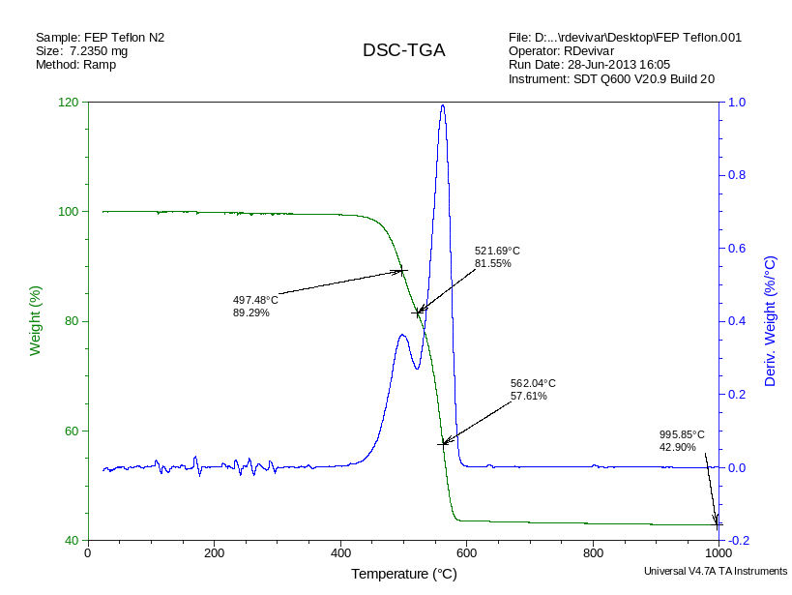
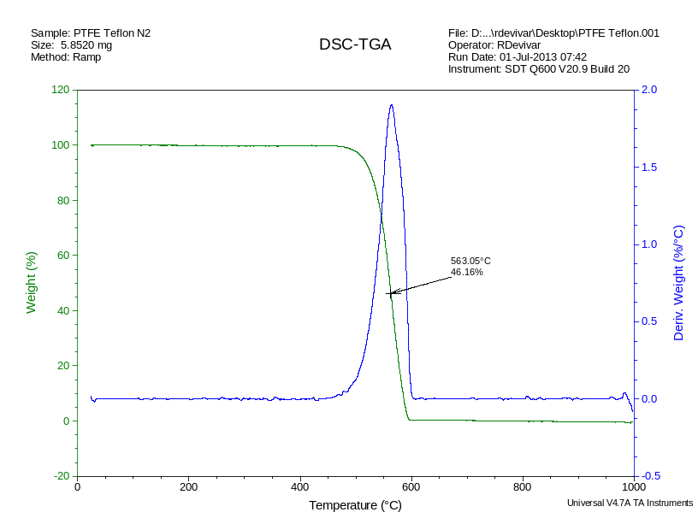
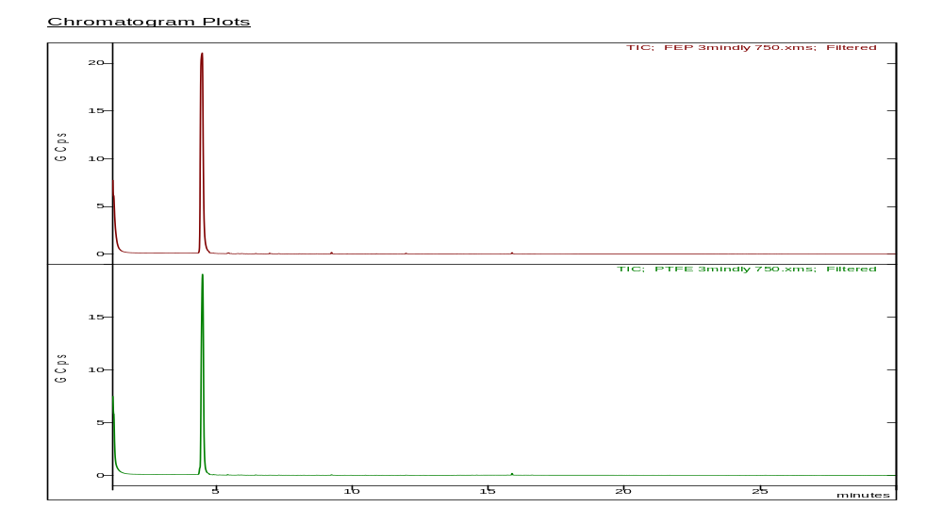
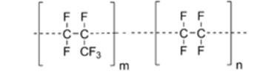
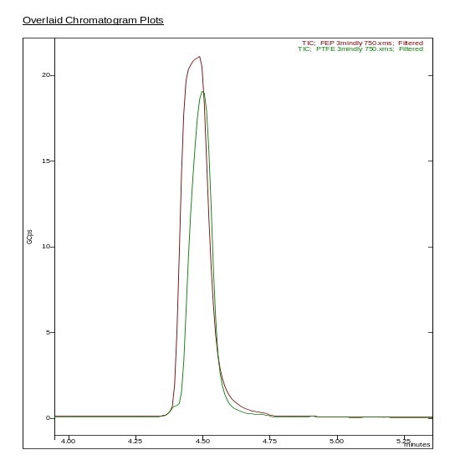
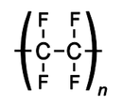
FEP Vs. PTFE Teflon
FEP Teflon
PTFE

Slide 26
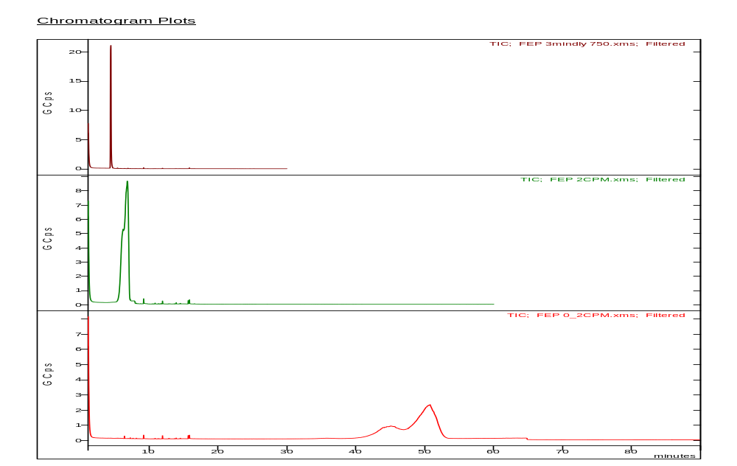
FEP Teflon Heated at Different Rates
Heating Rate: >1000ºC per sec
GC Method run time: 30 min
Heating Rate: 120ºC per min
GC Method run time: 60 min
TGA
Heating Rate: 12ºC per min
GC Method run time: 100 min
During pyrolysis, materials undergo thermal degradation via chemical pathways dictated by the thermal stability of the components. When pyrolysis is slowed to simulate TGA conditions, a thermal response pattern similar to what was observed with TGA first derivative plot is observed.

Slide 27
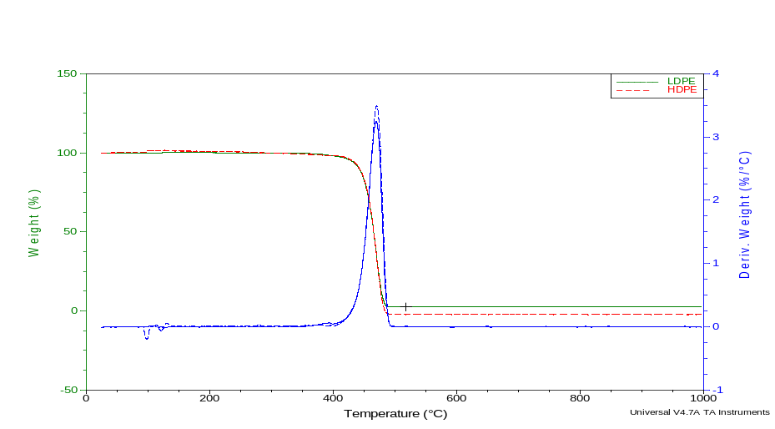
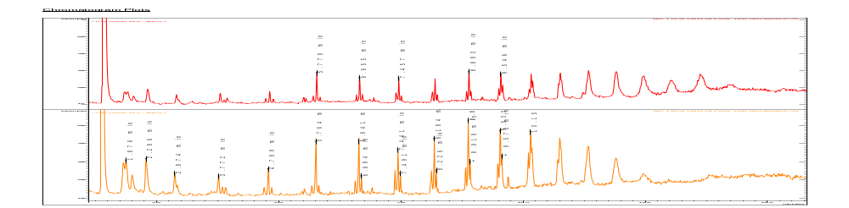
Thermal Analysis of HDPE and LDPE
Polyethylene: -CH₂-CH₂-CH₂-CH₂-CH₂-CH₂-CH₂-CH₂-CH₂-
TGA
Pyrolysis-GC-MS
C10
C11
C13
C14
C15
C6
C12
C7
C8
C9

Slide 28
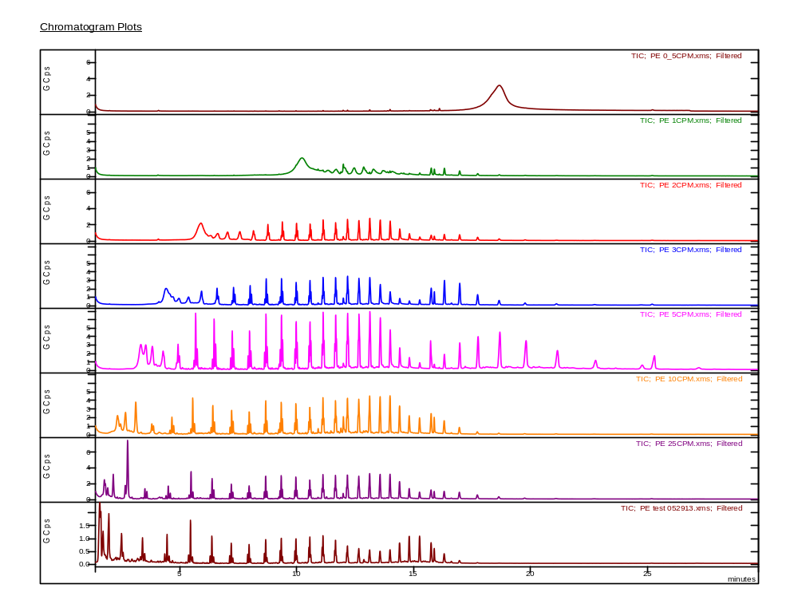
Temperature Ramp Pyrolysis
Heating PE in Pyrolysis chamber from 25ºC to 750ºC at different rates
Heating Rate: 30ºC per min
Heating Rate: 60ºC per min
TGA
Heating Rate: 5ºC per min
Heating Rate: 120ºC per min
Heating Rate: 180ºC per min
Heating Rate: 300ºC per min
Heating Rate: 600ºC per min
Heating Rate: 1200ºC per min
Heating Rate: >1000ºC per sec

Slide 29




Correlating TGA and Pyrolysis Techniques
Irganox 1076
Py 440ºC
Py 450ºC
Py 460ºC
Py 470ºC
Irganox 1010
Py 480ºC
440ºC
450ºC
Py 490ºC
460ºC
470ºC
Py 500ºC
480ºC
490ºC
Py 510ºC
Py 750ºC
Pyrolysis at specified temperatures for 20 seconds

Slide 30


Thermal Analysis of PE
Pyrolysis at 450ºC For Specified Duration
20 seconds
Irganox 1076
Irganox 1010
40 seconds
60 seconds
80 seconds
Silicone
Modification of the thermal parameters at the onset of TGA degradation for PE can provide valuable information about the additives or contaminants.

Slide 31




TGA Analysis of Fluorinated Materials
Krytox 143 AZ
Brayco 815Z
Krytox 143 AZ
Brayco 815Z

Slide 32

Thermal Response of Travertine in Different Atmospheres

Slide 33



CaCO₃ CaC₂ or Calcium Kaolinite
Travertine
Travertine TGA ashes (Helium or Nitrogen)
Travertine TGA ashes (Air)

Slide 34
The Role of Gaseous Atmosphere
During Thermal Decomposition of Travertine
Calcium Carbonate
TGA of Travertine in
Air
TGA of Travertine in Nitrogen
Calcium Kaolinite
Calcium Carbide

Slide 35

TGA Analysis of Geothite in Helium
At 120ºC, Mass losses include: m/z 14 (CH₂), 16 (O), 32 (O₂)
Goethite
α-FeO(OH)
At 308ºC, Mass losses include: m/z 18 (H₂O), 32 (O₂)
At 1290ºC, Mass losses include: m/z 16 (O), 18 (H₂O), 32 (O₂)

Slide 36



Goethite Analysis by Py-GC-MS at 1400ºC
Oxygen
Total Ion Count
Water
m/z = 18 amu
A sample of Goethite was first pyrolyzed at 750ºC to remove all but the pertinent high temperature species. The same sample was then pyrolyzed at 1400ºC to reveal two key molecules, Oxygen and Water. Since ample quantities of Goethite have been detected on the surface of Mars by Spirit, the NASA rover, we essentially have a source of water and oxygen waiting on Mars; we just have to heat the Goethite under the proper conditions to release these vital substances.

Slide 37
Applying Thermal Energy to Extract Chemical Information
Using Thermal Energy:
How much Thermal Energy do we
add
How fast do we add the Thermal
Energy
How long do we maintain the Thermal Energy
What atmosphere do we use
How much sample do we use
Chemical Information
Trapped solvent
Organic additives
Contaminants
Labile Functional Groups
Monomer identification
Off-gassing information
Inorganic additives
TGA DSC Pyrolysis-GC-MS TGA-MS-IR

Slide 38

Questions?

Slide 39
Let Us Meet Again
We welcome you all to our future conferences of OMICS Group International
Please Visit:
http://materialsscience.conferenceseries.com/
Contact us at
materialsscience.conference@omicsgroup.us
materialsscience@omicsgroup.com

