Slide 2
Biosimilars in emerging markets- regulatory and Commercial considerations
OMIC Group
Biosimilars 2104
Hyderabad
India
27-29 October 2014
Rodeina ChallandChallandRodeina@prahs.com

Slide 3
Biologic Molecules
Biologic molecules are complex macromolecules with some form of polymer structure. They can be purified from naturally derived substances, produced by recombinant DNA technology or chemically synthesized.
Biosimilars are defined as non-original biologic copies of innovative brands that have been approved by a dedicated regulatory pathway
Non-original biologics (NOBs) are copies that have not been approved through such a dedicated pathway and generally did not undertake stringent comparability and bioequivalence studies.

Slide 4
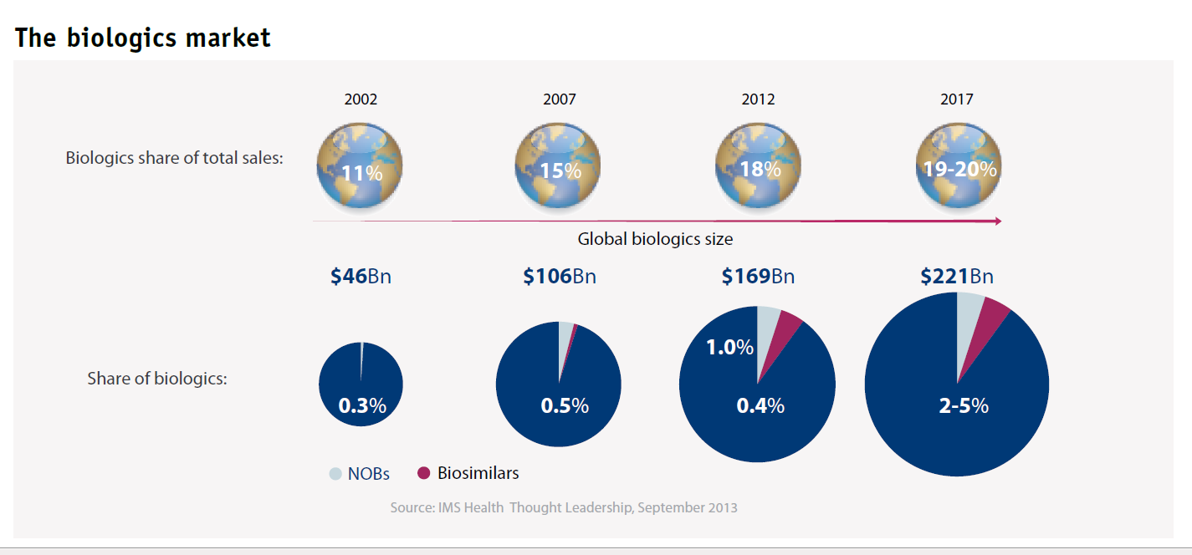
Biologic market

Slide 5
Biologic Growth
Biologics growth is driven by Monoclonal Antibodies (MABs) and human insulin, with four out of the top five biologics in 2012 being MABs
In many countries with less rigorous IP protection laws we have seen a recent surge of NOBs.
In pharmerging markets, both governments and patients struggle to pay for biologics and hence NOBs, encouraged by market demand and government policy, have grown very quickly.

Slide 6
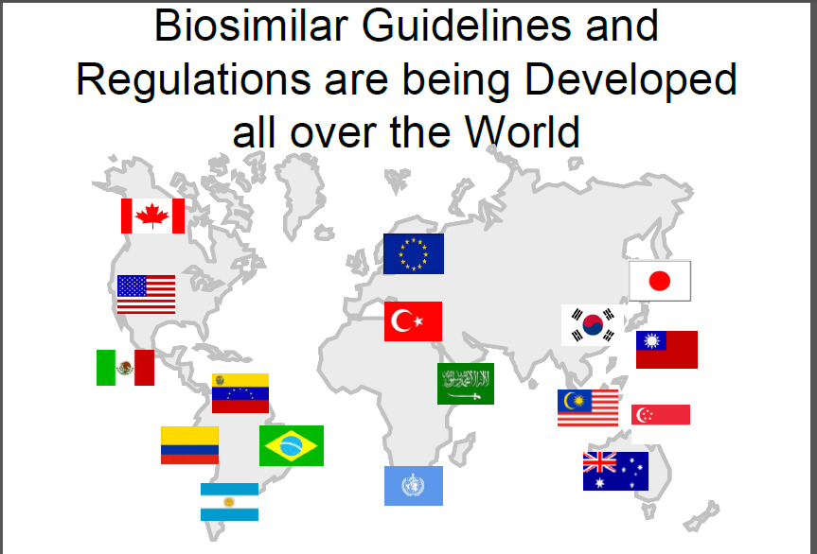

Slide 7
Emerging markets
Biosimilars will follow a SPECIFIC BIOSIMILAR approval pathway in:
Malaysia
Taiwan
Singapore
South Korea
Japan
Biosimilars will follow a SIMPLIFIED NEW PRODUCT approval pathway in:
China
Indonesia
Thailand
Biosimilars will follow a GENERIC DRUG approval pathway in:
Philippines
India
Vietnam

Slide 8
INDIA
Department of Biotechnology (DBT) and Central Drugs Standard Control (CDSCO)
Guideline June 2012
Stepwise approach
Similar to EU &US

Slide 9
INDIA
Extensive Quality Characterization
RP licensed in India and if not at least 4 years use in highly regulated market
Detailed requirement for animal
Potential reduced clinical
Can waiver Safety/Efficacy dependent on PD markers

Slide 10
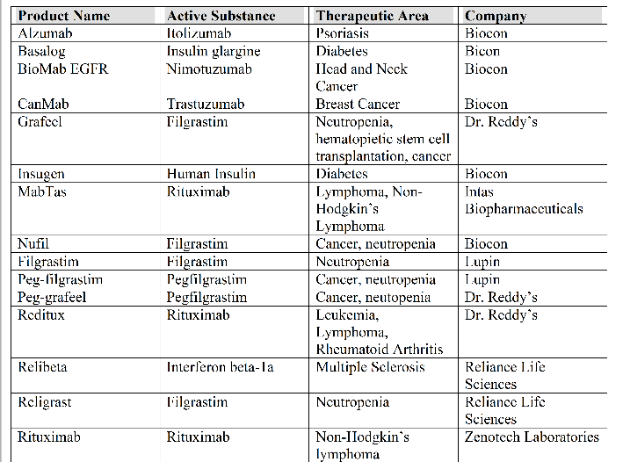
“Similar Biologics” approved in India

Slide 11
NOB or Biosimilars?
Majority approved prior to the “biosimilar guideline”
Are these then true “biosimilars”?
More recent approvals:
  Human growth Hormone-LG Life Science Dec 2013
  Infliximab- Epirus September 2014

Slide 12
Data submitted
Difficult to find
Lack of transparency
No publically available source e.g. EU EPARs and FDA SBAs
Clinicaltrial.gov India
Information only available when companies announce publically
Clinical data not specified in the label

Slide 13
INDIA- Summary
Semi-regulated
In-house development- substantial cost advantage
Less stringent regulatory framework
Low clinical development cost
Unhindered product launches –different patent landscape
Cheap workforce
Interchangeability immediate
Therapy primarily chosen by physician

Slide 14
CHINA
Growing number of middle-class consumers with increasing purchasing power
Increasing incidence of chronic diseases
No abbreviated pathway available
Any biopharmaceutical drug (biologic or biosimilars) must be filed as new drug application

Slide 15
Approval Path
New biologics with clinical trials requirements
Does not require “non-innovative” biologics to prove equivalence in efficacy, quality, and safety through systematic comparison with the originator
SFDA admits unavailability of technical requirements and quality control rules written specifically for biosimilars

Slide 16
Regulatory
No statuary definition or regulatory pathway for biosimilars in China.
Most biological products in China are “generics” but not like US/EU defined biosimilars.
Biosimilars can be registered as a new drug or a generic drug in China depending on whether its product standards are in the Chinese Pharmacopeia
CFDA is in the process of developing technical guidelines for biosimilars
Indication expansion is highly unlikely
PD/PK consistency to be established by comparing the biosimilar to the originator drug in a Phase I study
Combined Phase II/III study is possible but does not require any reference drug

Slide 17
Data Requirements
Clinical trial requirements for therapeutic biologics: CFDA Drug Registration Rules (2007)
Phase I: >=20 subjects
Phase II: >=100 subjects
Phase III: >=300 subjects
Phase IV (post marketing trial): >=2000 subjects

Slide 18
Biosimilar Guideline
China prepares new biosimilar guidelines
10 September 2014
The China Food and Drug Administration has worked up draft biosimilar guidelines that it plans to post for comment by Chinese New Year in 2015, according to Joe Zhang, executive deputy head of the Center of Medical and Translational Sciences at Shanghai CP Guojian Pharmaceutical Co.
The guidelines will be quite similar to existing biosimilar guidelines from the European Medicines Agency and World Health Organization

Slide 19
Expectations?
“Unlikely that China will follow Malaysia which has adopted EMA biosimilar guidelines”
"China would want its own trials and data for biosimilar approval”
"How far it would go in accepting other data is probably limited, though the language of the regulations could be very similar to EMA and others."

Slide 20
Approved “Biosimilars”
Interferon- several approved
Insulin- several approved
Erythropoietin- several approved
Interleukin- several approved
G-CSF- several approved
Etarnacept (8 applications at least 3 local)
Infliximab (2 applications pending)
Adalimumab (nine applications with one approved)
Bevacizumab- 6 applications 2 approved
Tratsuzumab- seven applications one approved
Rituximab- 8 pending applications
Cetuximab- 3 pending applications
Nimotuzumab one pending

Slide 21
Development considerations
Lack of transparency
Data not available in the public
Lack of experience in developing biosimilars
Lack of experience in the SFDA in assessing applications
Require local trials
Five to 10 years and cost from 1 to 10 million US $
Domestic manufacturing or up to 2 years for GMP certification

Slide 22
Russia
No accelerated marketing approval procedure currently exists in the Russian Federation for biosimilars
A full clinical development program must be completed
The submission of documents and timelines for biosimilars is the same as for the registration of a biological product (which is considered to be a “pharmaceutical product”.

Slide 23
Clinical Studies
The scope of the clinical studies depends upon:
Pharmaceutical product type, form and route of administration (original or generic)
Pharmacotherapeutic group and indications for use;
Scope of clinical trials conducted abroad- Clinical studies conducted abroad do not have to be repeated; nonetheless, a manufacturer is not exempt from conducting at least one clinical study in Russia. However, the clinical studies conducted abroad influence the scope (number of patients, indications) to be conducted in Russia
Whether an international, multi-center study was conducted and whether part of the study was conducted in Russia (If Russia was included then additional studies probably will not be needed).

Slide 24
Approved biosimilars- Russia
Epoetin Beta
Interferon beta-1b
Filgrastim
Rituximab
“True biosimilar”?

Slide 25
Brazil
2010: ANVISA issued new set of regulations: a public Consultations 49/2010 (CP 49/10); End 2010 New regulation RDC 55/2010 published
Two regulatory pathways
Individual Development Route
Comparative pathway
Approval time for both route the same

Slide 26
Individual Development Route
An applicant submitting a new biological product or biological product registration application under this route must submit sufficient information and data (through nonclinical and clinical studies) to demonstrate the quality, safety and efficacy of the new biological product or biological product:
A reduced dossier can be presented; phase I, II and III studies are required with phase III studies being absolutely mandatory
Clinical studies may be conducted in or outside Brazil
Complete quality data package- does not have to be comparative
Non-clinical and clinical studies can be reduced depending on the knowledge of the pharmacological properties, safety and efficacy
At least one comparative study phase III with originator-mandatory
Extrapolation of indications not accepted

Slide 27
Comparative Pathway
Similar to EU and WHO guidelines
Reference previously authorized in Brazil
All stages comparative: Quality, Safety and Efficacy
The pharmacodynamic and pharmacokinetic clinical studies can be Combined provided that the pharmacokinetic/pharmacodynamic relationship is characterized.
Any comparative clinical studies must demonstrate the comparability in terms of the safety and efficacy profiles between the biological product and the comparer biological product.
The design and comparability margins of any safety and efficacy studies must be statistically and clinically supported. Finally, data from a phase IV study must also be submitted if available
The analytical procedures used are sufficient to point out any relevant differences that could impact the safety and efficacy of the biological product and/or the relationship between specific quality attributes, safety and efficacy have been established.
Extrapolation is accepted

Slide 28
Approved Biosimilars- Brazil
Somatropin (a growth hormone) which is marketed by Sandoz Do Brasil Indústria Farmacêutica LTDA, Merck S/A, Laboratorios Pfizer LTDA, Laboratório Químico Farmacêutico Bergamo LTDA Bergamo LTDA, Biosintética Farmacêutica LTDA, Novo Nordisk Farmacêutica Do Brasil LTDA and Aspen Pharma Indústria Farmacêutica LTDA;
Filgrastim (a granulocyte colony-stimulatory factor) which is marketed by Produtos Roche Químicos e Farmacêuticos S.A, Laboratório Químico Farmacêutico Bergamo LTDA, Blausiegel Indústria e Comércio LTDA, Dr. Reddys Farmacêutica Do Brasil LTDA, Teva Farmacêutica LTDA, and Biosintética Farmacêutica LTDA;
Enoxaprin (a low molecular weight heparin) which is marketed by EUROFARMA Laboratórios S/A, Instituto Biochimico Indústrua Farmacêutica LTDA, Cristália Produtos Químicos Farmacêuticos LTDA, Sanofi-Aventis Farmacêutica LTDA, Blausiegel Indústria e Comércio LTDA and Aspen Pharma Indústria Farmacêutica LTDA;
Etanercept (a fusion protein) which is marketed by Wyeth Indústria Farmacêutica LTDA; and
Recombinant erythropoietin (a hormone) which is marketed by Biosintética Farmacêutica LTDA and Chron Epigen Indústria e Comércio LTDA.
Several biosimilars for the treatment of RA are under development by Productive Development Partnerships (PDPs): strategic partnerships comprising government-funded laboratories, local manufacturers, and multinational corporations.
Several biosimilars are expected to launch in the next three years: biosimilars of Amgen/Pfizer’s Enbrel [etanercept], Janssen/Merck’s Remicade [infliximab], Roche’s MabThera [rituximab], AbbVie’s Humira [adalimumab], and UCB/Astella’s Cimzia [certolizumab pegol].

Slide 29
Development Consideration BRIC
Large population with unmet medical needs
Benefit vs. risk
Head to head- timely, costly and delays to market
High cost of biologics limiting access
Hence
Abbreviated clinical packages
Need stringent post marketing safety follow up to identify any safety signals

Slide 30
Harmonization
In principle YES
Step wise approach
Quality aspects key
Non-clinical and clinical
Bioanalytical methodology key
Totality of the evidence
Post marketing safety

Slide 31
Divergence
The regulation frameworks are inconsistent with global norms and can expose patients to unknown risk.
Adapting generic-like pathways to approve biosimilars- “looser approach”
Lack of Robust Pharmacovigilance systems hinders signal detection
But
Does the benefit outweigh the risk?

Slide 32
Clinical study designs- divergence
Statistical considerations
  Effect size and equivalence margins
Sample size
Use of comparator head to head
Waiver phase I or phase III
Unblinded open label

Slide 33
Biosimilars in development- sample size
Rituximab
  Sandoz n=915
  Biocad n=442
  Pfizer n=551
  Dr Reddy n= 67 (open no-comparative)
Infliximab
  Celltrion n=856
  Epirus n= 273

Slide 34
Sustainability of Biosimilars
Biosimilars offer the chance to get treatment otherwise prohibited by cost of originators
Do we need extensive clinical comparability studies which are costly and timely?
Can we do less clinical and more quality?
Case by case?
Safety should not be compromised
One serious safety case due to “substandard quality” can risk the sustainability of biosimilars!
Prescribers and users must have confidence in the products!

Slide 35
Thank You

