Slide 1


The Vaxonella® Platform for Oral Recombinant Vaccine Delivery
Dr Rocky Cranenburgh
Chief Scientific Officer
Friday 26th September 2014
4th International Conference on Vaccines & Vaccination, Valencia

Slide 2

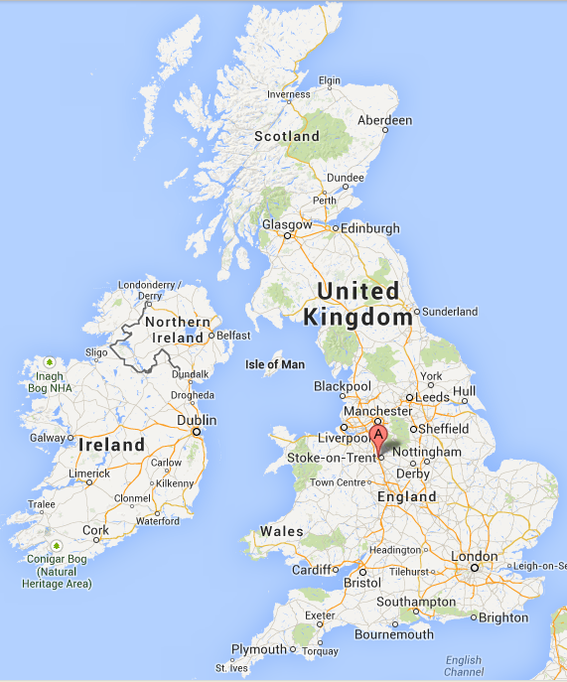

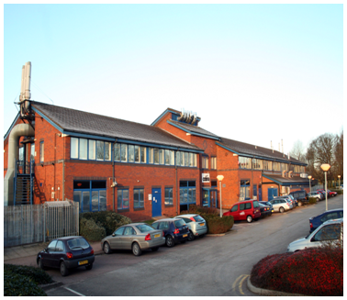

Prokarium Ltd
Spun out from Cobra Biologics Ltd in June 2012
Located in Keele (Staffordshire) and London, UK
Oral recombinant antigen delivery using Salmonella enterica
www.prokarium.com
Page 2

Slide 3
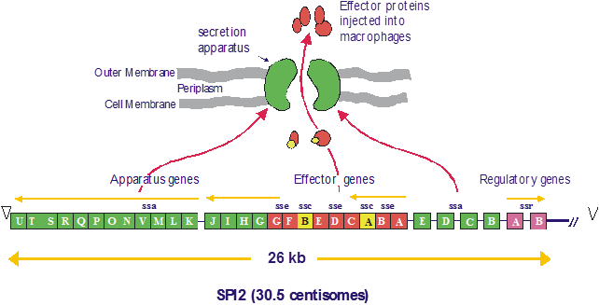
Re-engineering Salmonella
Salmonella enterica serovar Typhi is a serious pathogen (ACDP 3): we have used synthetic biology to modify it into a safe, precisely targeted oral vaccine delivery system
ΔssaV: attenuation by preventing replication in macrophages
X-mark: automatic selectable marker gene deletion
ΔaroC: prevents survival in the environment; attenuation
ssaG promoter: induced in macrophages
Multi-copy plasmids: high-level antigen production
ORT-VAC: selectable marker gene-free plasmid stabilisation
Page 3

Slide 4
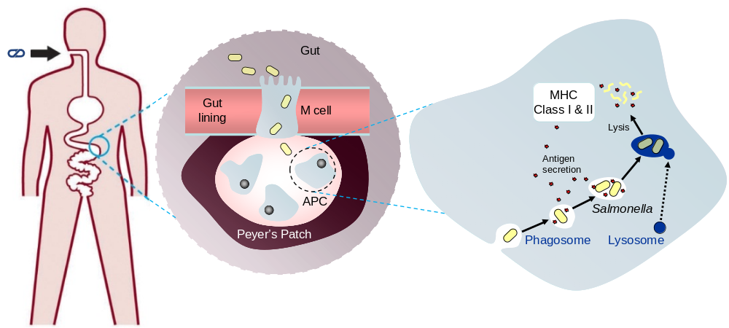
Vaccine targeting using Vaxonella®
Page 4

Slide 5
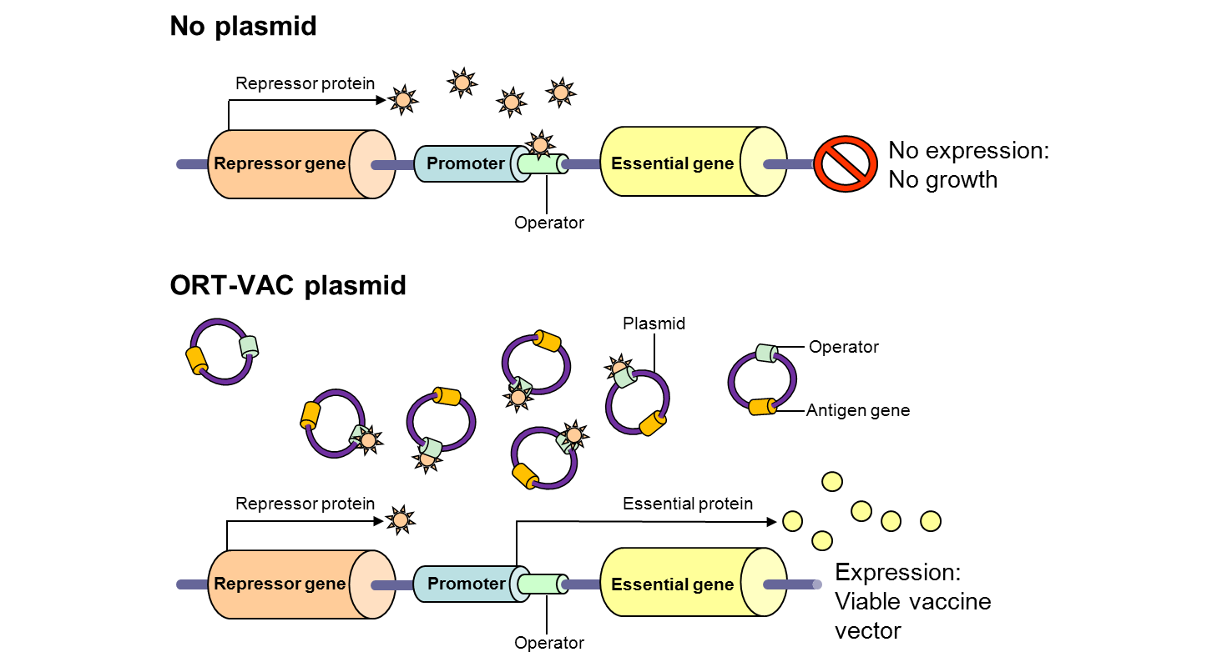
ORT-VAC™: Marker Gene-Free Plasmid Stabilisation
Wild-type strain
ORT-VAC strain (Vaxonella)
PtetA
Repressor
dapD
PdapD
PtetR
dapD
Rep
Antigen expressed
Page 5

Slide 6
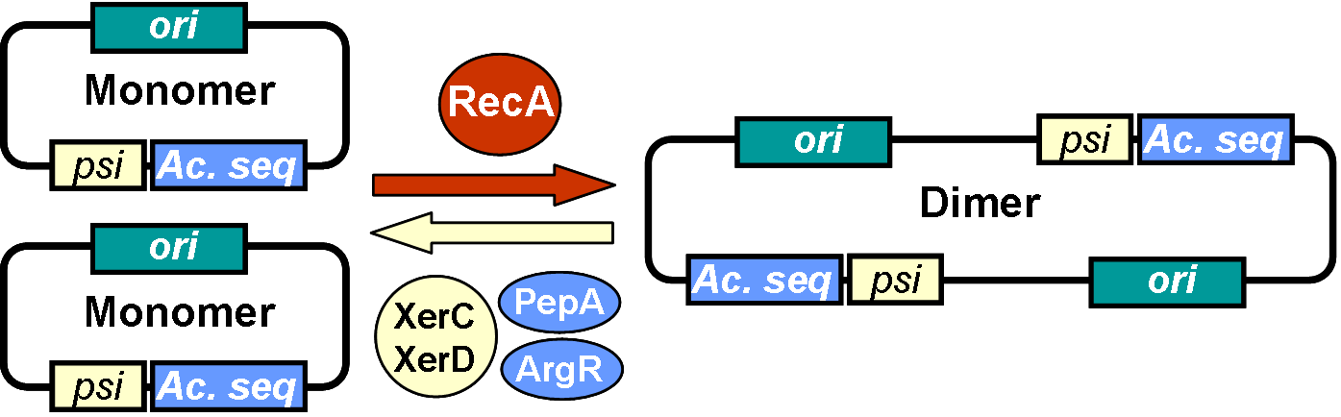
X-mark™ uses Natural Xer Recombination
Plasmid monomers in bacteria are recombined into dimers by RecA, which makes them unstable
XerCD and accessory proteins PepA and ArgR convert dimers back to monomers by Xer site-specific intramolecular recombination at their recognition site psi, requiring accessory sequences (Ac. seq)
Therefore DNA placed between Xer sites is effectively excised
Page 6

Slide 7
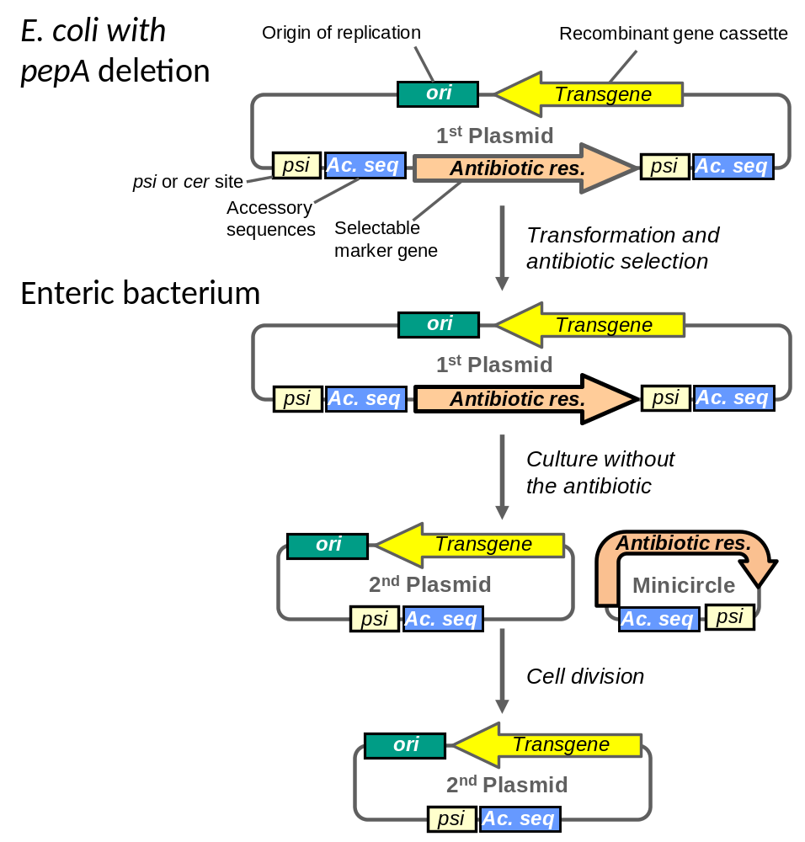
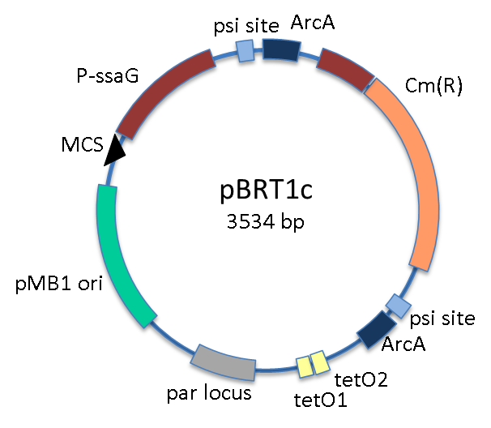
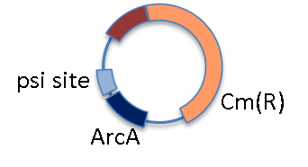
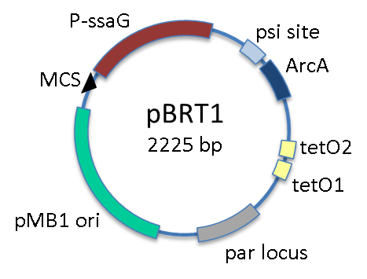
X-mark™: Auto-Deleting Plasmid Technology
The PepA accessory protein is needed for dimer resolution on plasmids but not on chromosomes – pepA mutants are viable
E. coli pepA mutant
Any enteric bacterium
Page 7

Slide 8
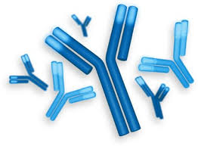
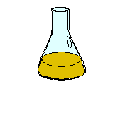

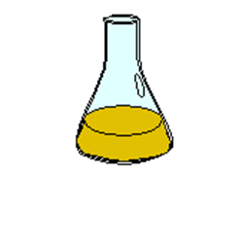

Vaxonella®: Simple Vaccine Development
  Antigen gene synthesis and cloning
  Antigen-specific assay development
  Evaluation of expression in vitro
  Murine immune responses
S. Typhimurium WT05 is used in mice…
…which is equivalent to S. Typhi ZH9 in humans
  GMP manufacture in shake flasks
  Phase 1 trial in humans
  Toxicology
Page 8

Slide 9
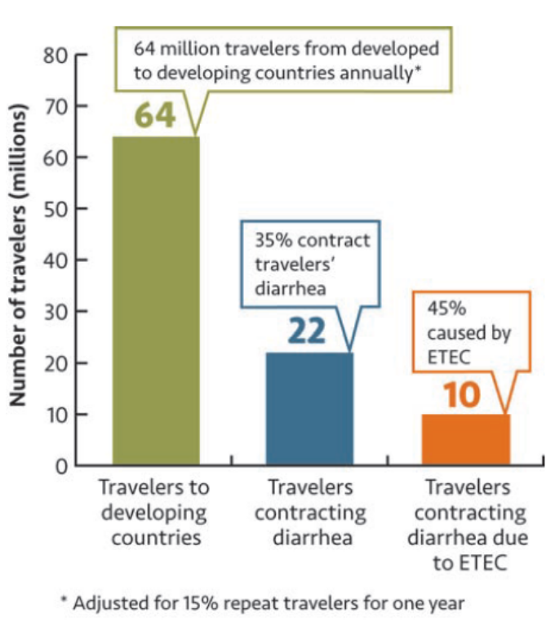
Dual ETEC Diarrhoea-Typhoid Vaccine
ETEC is a major cause of diarrhoea and of a most severe kind
  Causes 45% of all travellers’ diarrhoea (~10 million travellers infected annually)
  Kills 300-500,000 <5 year olds each year and infects >10 million travellers
  Unmet medical need – no dedicated vaccine
Typhoid infects 17-22 million people and causes ~200,000 deaths p.a.
  The combined ETEC and typhoid market is estimated at $890 million p.a.
Prokarium is developing an oral typhoid-ETEC vaccine: Typhetec®
Estimated cases of travellers’ diarrhoea due to ETEC
PATH/BVGH report 2011
Page 9

Slide 10
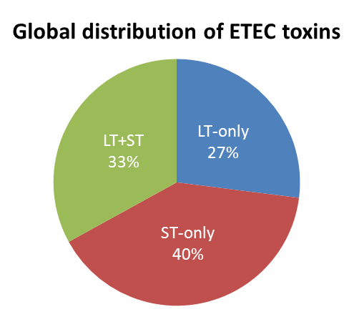
Typhetec® Vaccine Design
The typhoid component is the vector: S. Typhi ZH9, shown to be safe and immunogenic in eight clinical trials (Phase 1 & 2)
The ETEC component is a fusion protein with epitopes from:
  Labile toxin (LT)
  Stable toxin (ST)
  Colonisation factors (CFs)
ETEC is defined by expression of ST and/or LT; our vaccine will be 100% protective against the many strains of ETEC (45% of all travellers’ diarrhoea!)
Data from Isidean et al. 2011
Page 10

Slide 11
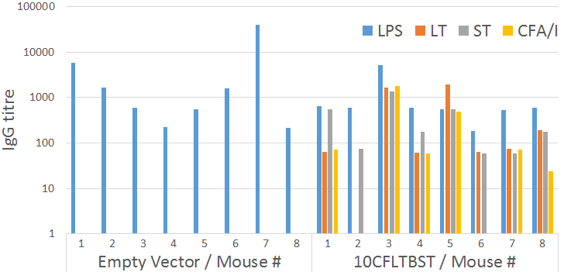
Antibody Responses to Vaccine
Antibody (IgG) titres against vaccine components:
LPS response: typhoid vaccine component on Salmonella surface
LT, ST and CFA/I responses: ETEC toxin-colonisation factor recombinant protein
Page 11

Slide 12
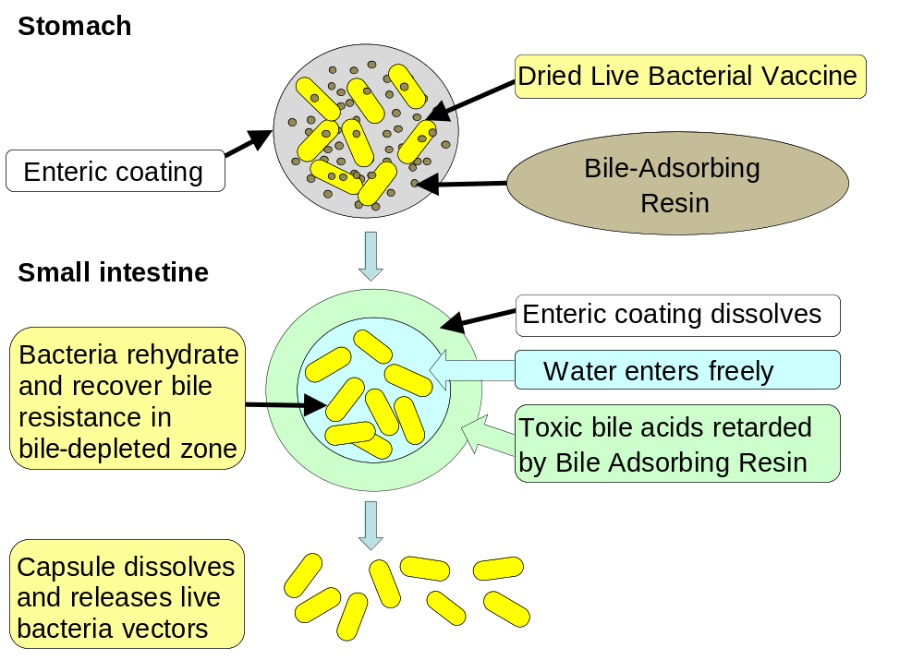
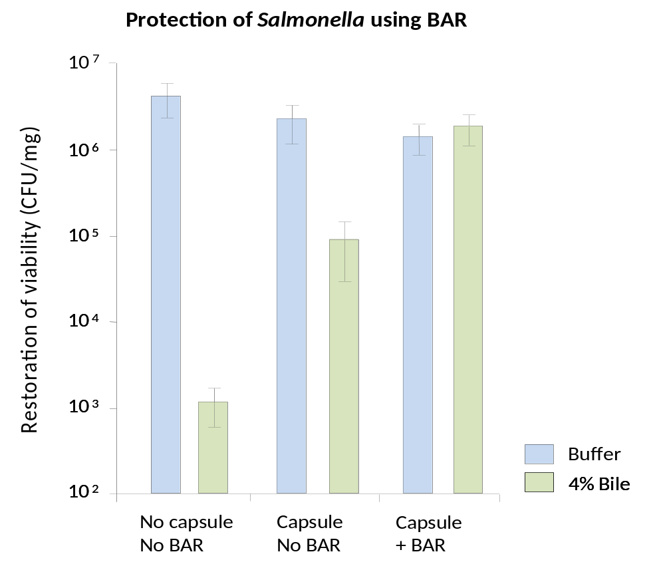
Bile-Adsorbing Resin (BAR)
Final formulation will be capsular with BAR for adults
Page 12

Slide 13
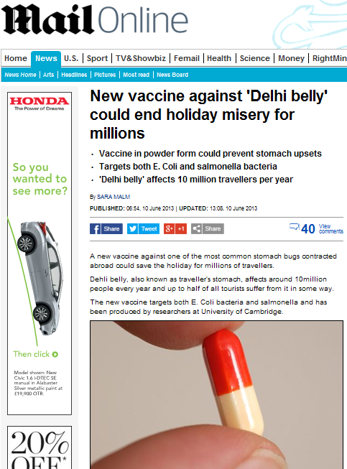
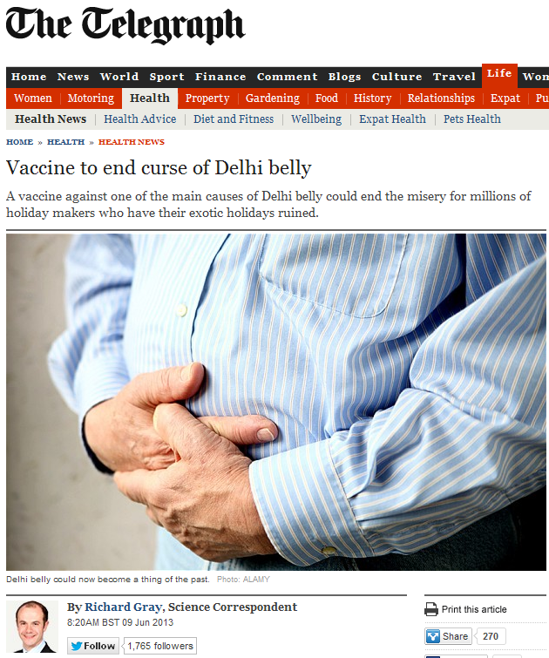
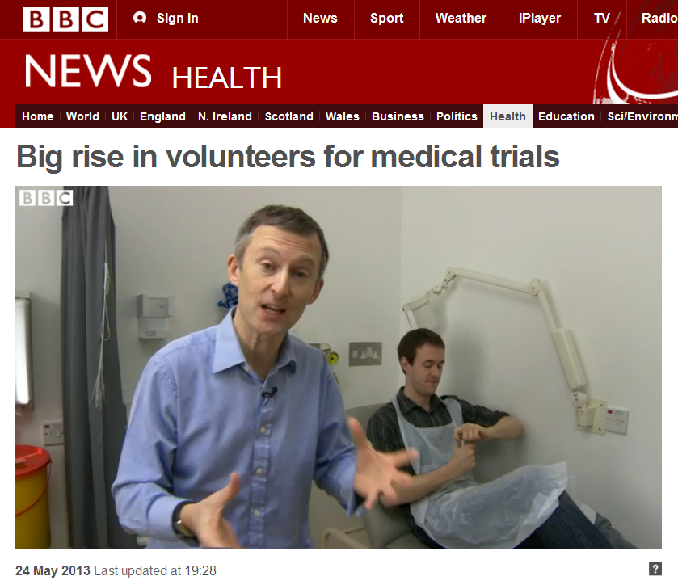
News
Page 13

Slide 14
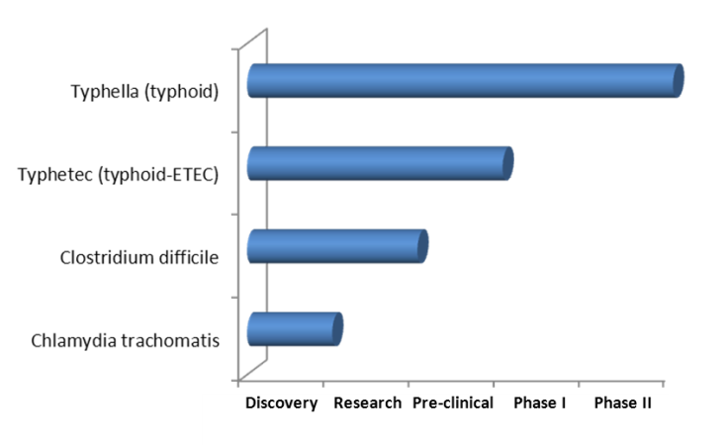

Prokarium’s Vaccine Pipeline
Enterotoxigenic E. coli + Typhoid
  Dual ETEC-typhoid vaccine Typhetec®
  Typhoid is responsible for 22 million cases and 200,000 deaths per year
  Diarrhoea caused by ETEC affects 10 million travellers every year
Clostridium difficile
  Major hospital-acquired infection
  Causes ~3 million cases of diarrhoea and colitis annually in the USA alone
Chlamydia trachomatis
  The most common STI, with >92 million new cases worldwide annually
Page 14

Slide 15
Vaxonella® Advantages
Oral delivery – a capsule containing a bile-adsorbing resin
No adjuvant required - the vector is strongly immunostimulatory
Broad immune response – systemic IgG, mucosal IgA, T-cell
Good mouse model – S. Typhimurium in mice ≈ S. Typhi in humans
Safe vector – ZH9 tested in 8 clinical trials, including in children
No downstream purification of proteins - eliminates the most expensive element of biopharmaceutical production
A single, simple manufacturing process – regardless of antigen
We are keen to collaborate on recombinant vaccine delivery!
Page 15

Slide 16




Acknowledgements
Prokarium
  Paola Salerno
  Annelise Soulier
  Ted Fjällman
Cobra Biologics
Matthew Leckenby
University of Oxford
  David Sherratt
University of Cambridge
  Nigel Slater
  Alexander Edwards
University of Birmingham
  Ian Henderson
  Timothy Wells
Co-funded by
Page 16

