Slide 1



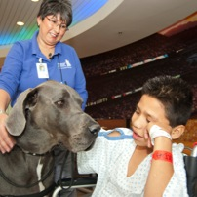
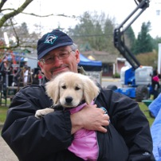
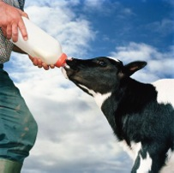
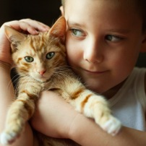
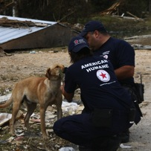

Slide 2

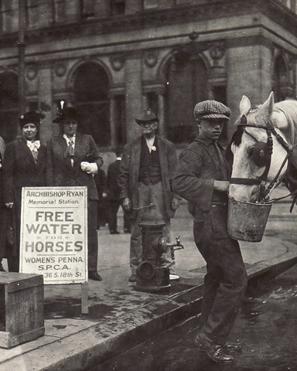
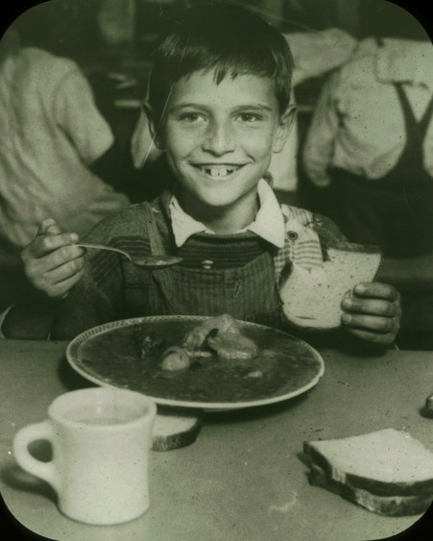
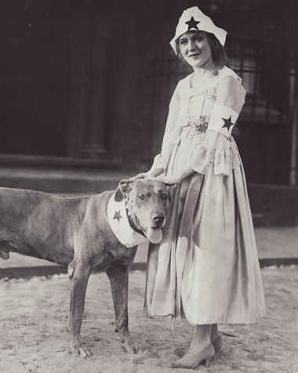
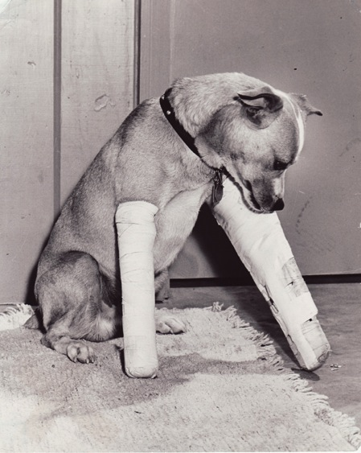
The Oldest National Humane Organization
Since 1877…
At the forefront of every major
advance in the protection of
children and animals
Empowering the human-animal
bond
Collaborating on evidence-based
solutions

Slide 3
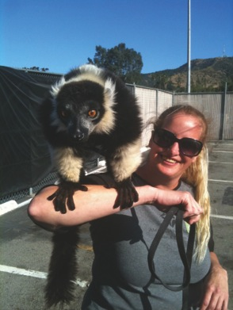
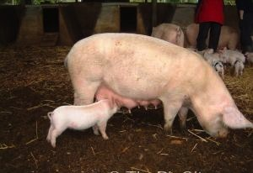
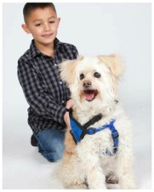
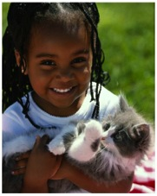
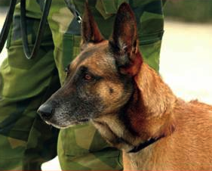
Responsibility of Care
However animals are in our lives, whether companions, working, entertainment, or agriculture
We are responsible for the quality of their lives.

Slide 4
The Five Freedoms
Freedom from hunger and thirst
Freedom from discomfort
Freedom from pain, injury or disease
Freedom from fear and distress
Freedom to express normal behaviors

Slide 5
Animal Rights/Liberation versus Animal Welfare
Animal Rights/Animal Liberation
Non-human animals should have the same rights as humans
Animals should not be regarded as property
Protectionists – focus on suffering and consequences
Abolitionists – adverse to use of animals for food, clothing, research, entertainment
Activists – property destruction and undercover exposés
Vegans/vegetarians
Animal Welfare
Animals are sentient beings
Concern for physical and psychological well-being for animals used by humans
Measured by behavior, physiology, longevity and reproduction
Focus in Western public policy: veterinary science, ethics and animal welfare organizations
Science-based measurements vs. anthropomorphic evaluations
Attitudes vary by different types of animal uses

Slide 6
What we are – What we are not
What we are:
Recognized Experts Open to Learning
Animal Health & Welfare Focus
Science & Evidence Based
Veterinary Oversight
Moderate with a Common Sense Approach
Passionate – care about Children as well as Animals
Good for Animals and People
What we are not:
We don’t demonize the various roles of animals in our lives
We don’t have an animal rights/activist agenda
We don’t vilify those who don’t meet our standards
We are not unreasonable
We do not have a vegan/vegetarian agenda

Slide 7
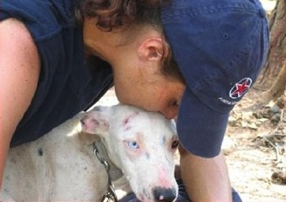
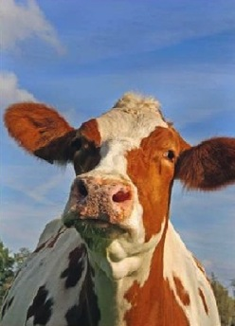
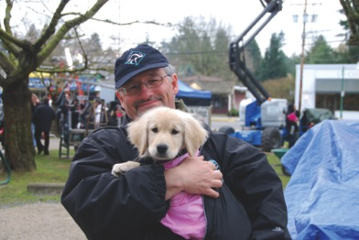
American Humane Association Animal Welfare
Positive Collaboration
Common Sense Solutions
Evidence & Science Based
Measurable Outcomes

Slide 8
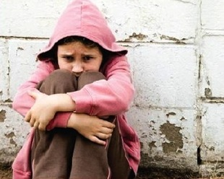
American Humane Association Agenda:
Programs with Measurable Outcomes
Humane InterventionTM
Humane Research and TherapyTM
Humane HollywoodTM
Humane HeartlandTM

Slide 9
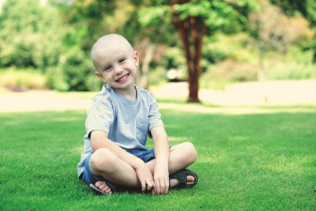
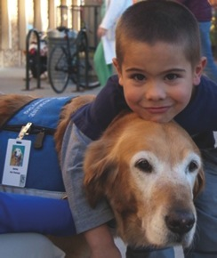
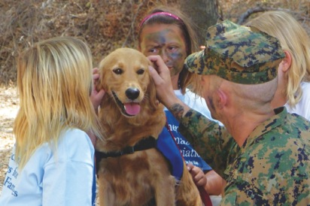
Humane Research and TherapyTM
Helping Military Families, Communities in Crisis, Kids with Cancer and Shelter Pets
Animal Welfare Research Institute
Children’s Innovation Institute
Red Star® Animal-Assisted Therapy
Humane research solutions
Wags4Patriots
K9 Battle Buddies

Slide 10
Humane Research and TherapyTM
Research Model: CCC Study
We launched innovative research – the Canines and Childhood Cancer (CCC) Study - to determine the relationship between the therapy dogs’ behavior and their physiological stress levels during therapy sessions with pediatric oncology patients and their families across multiple hospital settings. In addition to measuring human health outcomes, canine behavior is being quantitatively assessed from videotapes of each therapy session, and the dogs’ physiological response is being measured using cortisol.

Slide 11
Humane Research and TherapyTM
Video from Congressional Briefing

Slide 12
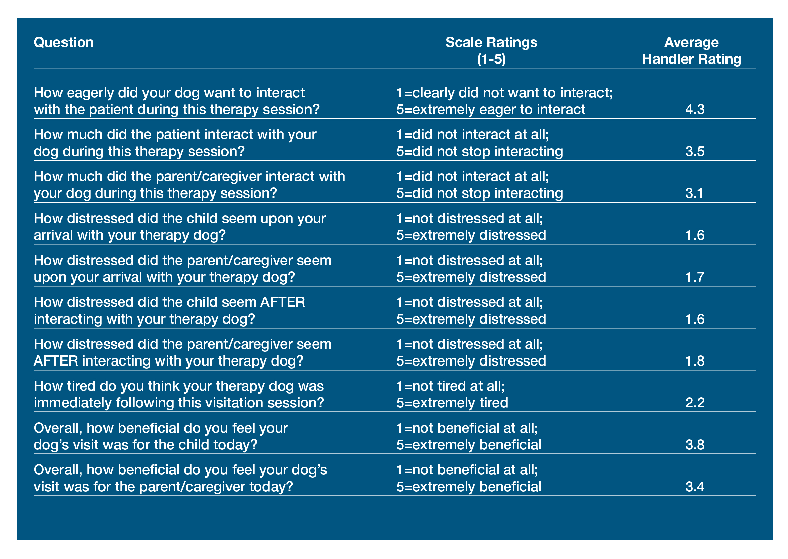

Slide 13
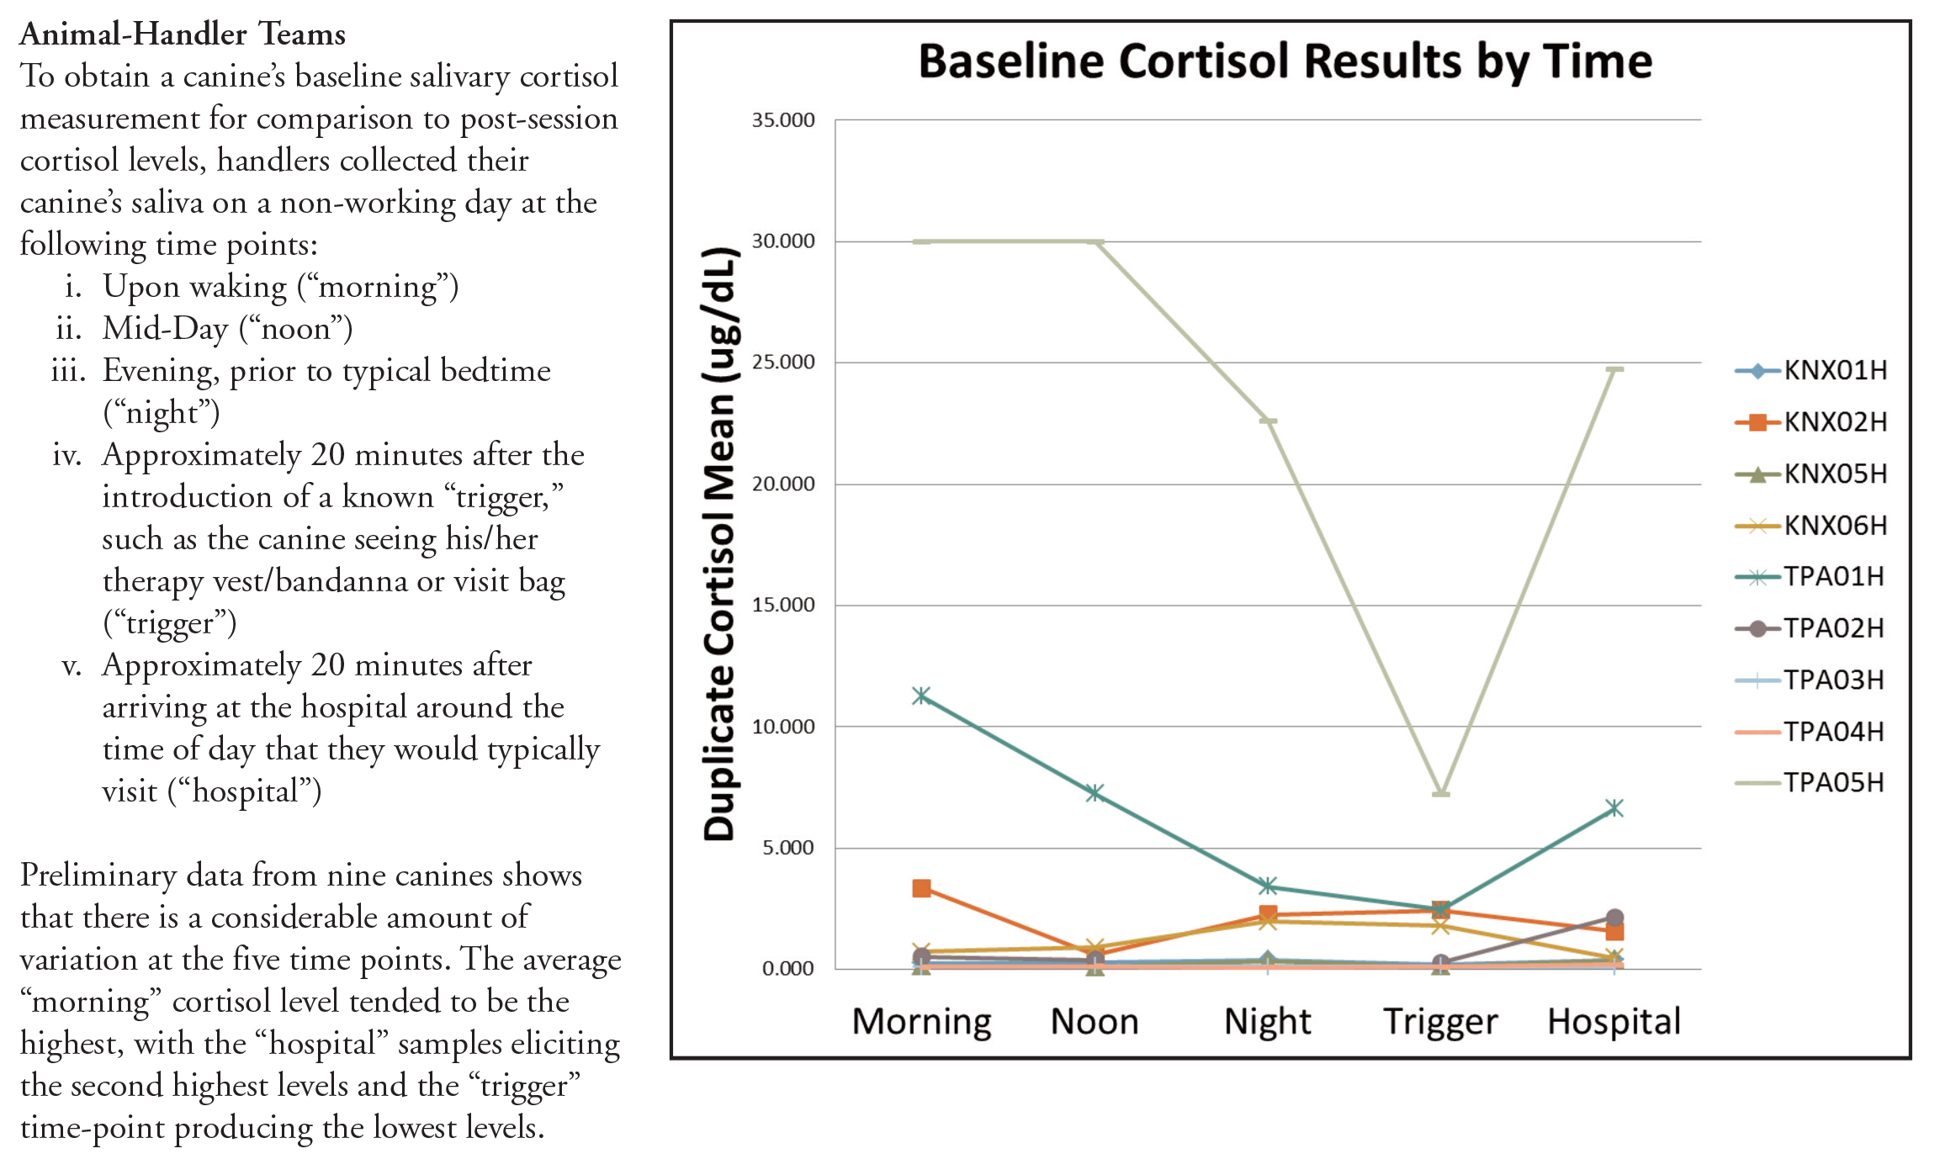

Slide 14
Humane Research and TherapyTM
New Research Model
“Dr. House, Meet Doctor Doolittle”
Redefining the Boundaries of Medicine
“Do Animals Get [Insert Big Disease]?”
Jaguars get breast cancer and may carry the BRCA1 genetic mutation
Rhinos in zoos get leukemia
Melanoma in penguins to buffaloes
Gorillas and rupture of aortas . . .

Slide 15
Humane Research and TherapyTM
Koalas in Australia are in middle of rampant epidemic of chlamydia.
Osteosarcoma hits human teenagers and large breed dogs with ferocity.
The neuroendocrine cancer that claimed Steve Jobs is a fairly common tumor in ferrets, German Shepherds, Cocker Spaniels and Irish Setters.
And melanoma in gray horses . . .

Slide 16
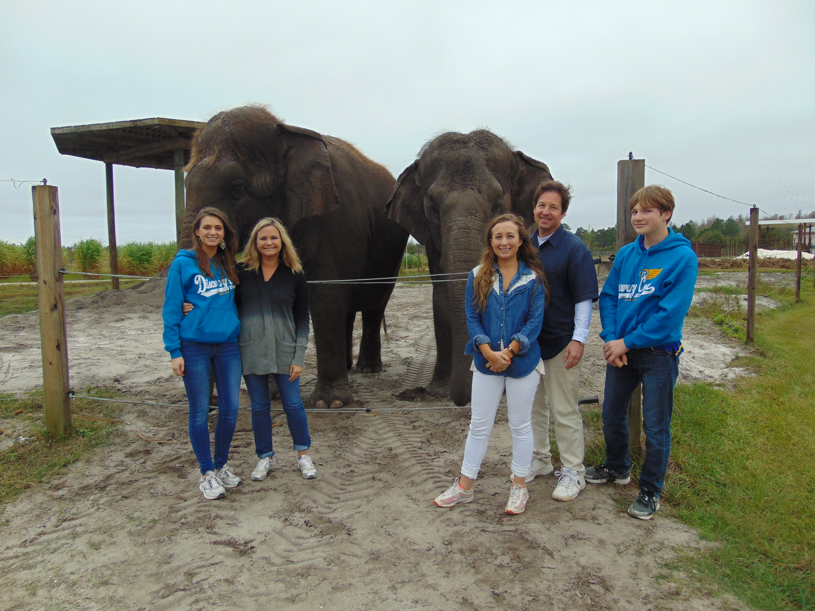

Slide 17
Medical, veterinary and wildlife scientists are incentivized to work largely in isolation. Thus, common disorders that affect both animals and people are often not studied with multidisciplinary partners to address novel strategies.
Tuberculosis affects children, elephants, dairy cows, birds and badgers – yet few coordinated and multidisciplinary activities have emerged to consider how this disease might be eradicated, how vaccines might be developed, or how current multiple-drug and extreme-drug resistant forms of the disease might be treated.

Slide 18
Animals used in research have contributed mightily to the advancement of human health. There have also been egregious uses of animals in pain, physiological, and psychological studies; cosmetic testing; and teaching programs. Some animal models have provided little information for treating disorders in humans, and research results from animals housed in facilities that fail to reflect natural environments (and variables) often yield results that cannot be translated to other species or environments.
A new model that provides opportunities for breakthrough discoveries with a higher probability of preventing disease and developing gentler therapies for both animals and people.
Let’s ask the age-old question of why? Let’s change the incentive model for better inquiry. And let’s remember to be humane.

Slide 19
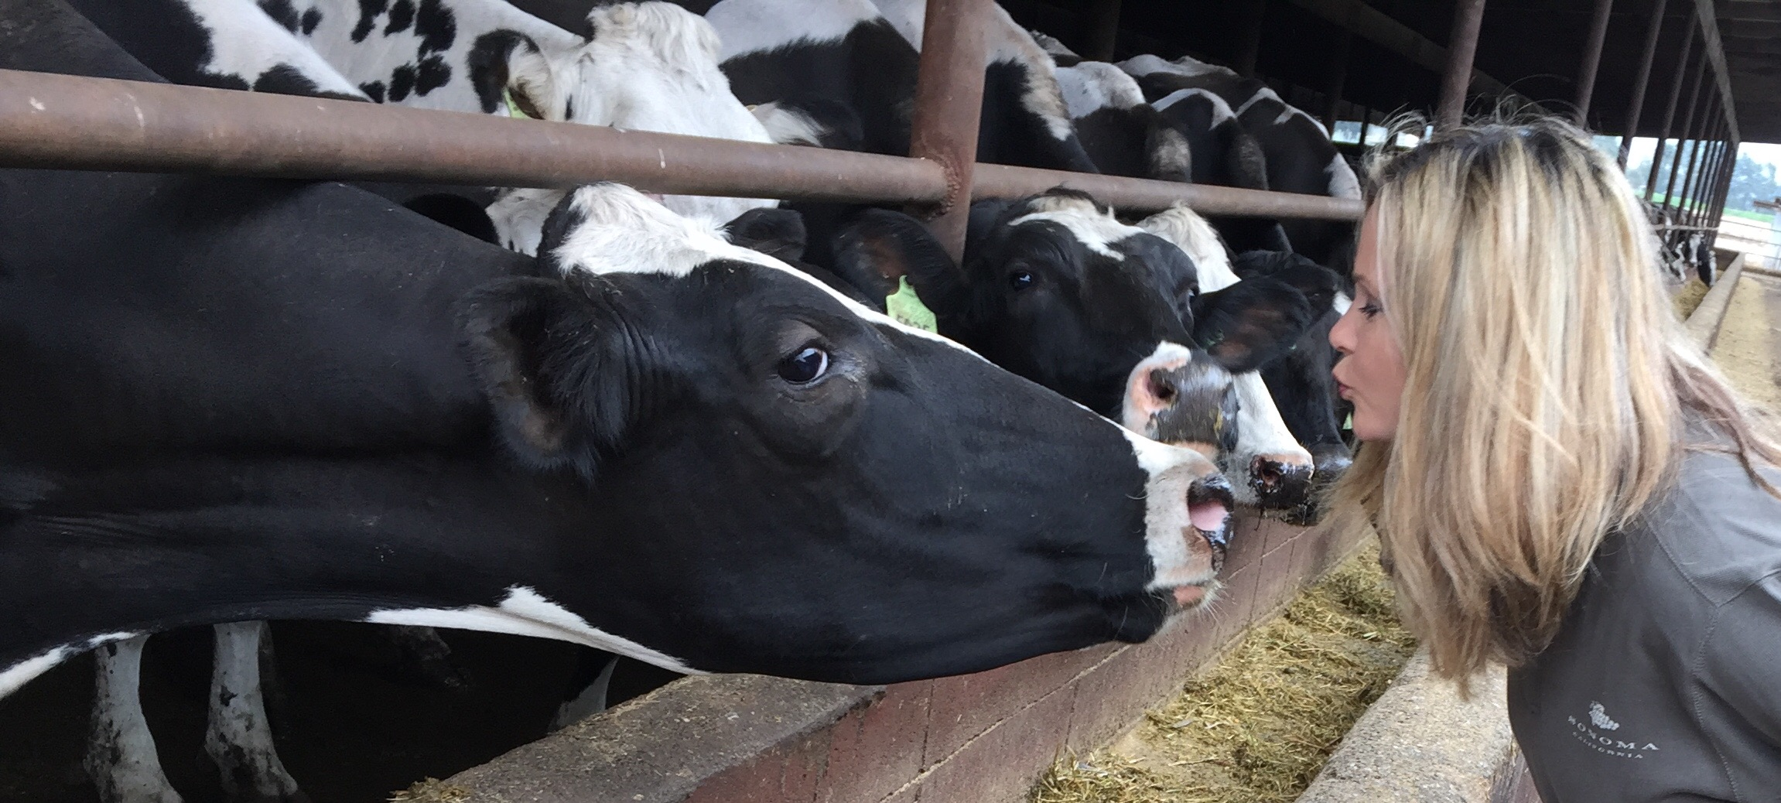
Respiratory syncytial virus (RSV) is a common illness in neonatal calves and children. While a nasal vaccine is available to prevent the disease in dairy calves, there is no similar vaccine for children (Zoetis).
Millions of children under the age of 4 acquire RSV each year with many requiring hospitalization. Why?

Slide 20
Naked mole rats might have provided better clues on cancer prevention since they appear to be cancer-resistance, having a lifespan exceeding 30 years. Why? The Tasmanian devil is now endangered due to a contagious facial cancer. Transmissible venereal tumors in dogs is also contagious without a known infectious etiology. What makes these cancers contagious? Why are pet cats at-risk for vaccine-associated sarcomas to level that veterinarians are instructed to vaccine cats in specific limbs so the later amputation might be feasible? Virally-induced cancers and chronic diseases that occur in domestic and wild cats (e.g., feline leukemia, feline infectious peritonitis, and feline immunodeficiency) do not occur in dogs. Why?
Might not all of these examples indicate that the animals in our world hold tremendous clues and promise to significant breakthrough – if only our research model allowed for it?

Slide 21
Look to animals, and the doctors who care for them for answers
To humankind’s most pressing concerns.
Animal and human commonality holds the linkages to discovery.
Dr. Barbara Natterson-Horowitz

Slide 22
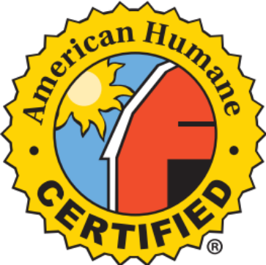
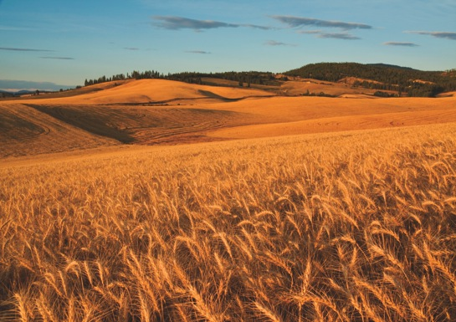
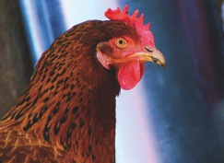
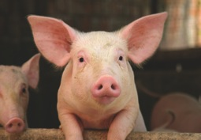
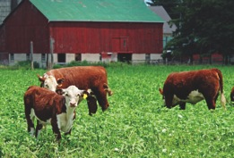
Humane HeartlandTM
Ensuring the Humane Treatment of More Than 1 Billion Farm Animals
American Humane CertifiedTM
– Third Party Farm Animal Welfare Audit Program
Humane Housing + Humane Equipment & Technology Approval
Humane Training
– Farm Workers & Managers
Humane Education
– Urban School Curriculum

Slide 23
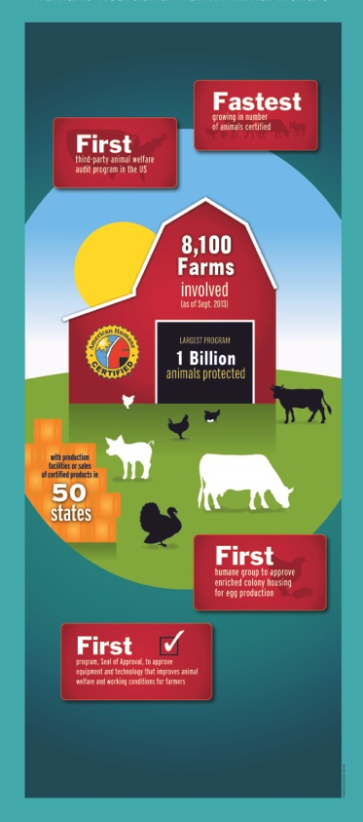
Humane HeartlandTM
First Third Party
Farm Animal Welfare Audit Program in U.S.
Fastest Growing Animal Welfare Label – More Than 1.4 Billion Farm Animals –10,000 Farms and Ranches – Certified Products in 50 States – Certify Over 90% of Cage Free Eggs
Innovative Humane Seal of Approval
Program for humane housing, equipment, and technology that improve animal welfare and worker environments

Slide 24
Robin R. Ganzert, Ph.D.
robing@americanhumane.org
@robinganzert
www.americanhumane.org

