Slide 1
Separation Science That’s Built for Biopharma
Taking mAb Characterization into UHPLC
Robert van Ling
Separation Techniques
Valencia, September 26, 2016

Slide 2
How to Improve a UHPLC Separation?
Customers told us they need:
More resolution
More sensitivity
Easier and less method development
More productivity
Easier interaction and operation
More robust and more reliable
More sample capacity
More access to experts
More and fast service
New, fresh & exciting instruments
Better results in shorter time
Mass Spectrometry
Perspective
Chromatography Power Perspective
Software Perspective

Slide 3


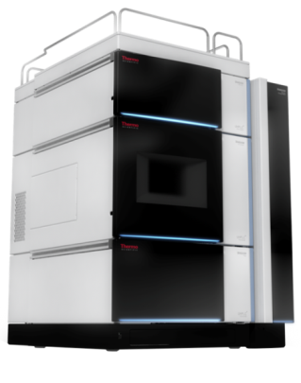


Vanquish Platform Brings You
Confidence
Performance
To ensure highest data quality
Unmatched retention time precision with SmartInject
Automation of workflows with
barcode reading
Predictive performance indicators
To improve separations
Binary and Quaternary pumping systems
Widest flow-pressure footprint
Optimized system fluidics
Sensitivity
Accuracy
To find the complete picture
UV detection optimized for lowest dispersion and minimal baseline noise
Highly sensitive and selective fluorescence detection
Near universal charged aerosol detection
To control experiments
Unsurpassed sample dosage
Active and passive pre-heating
Multiple thermostatting options

Slide 4
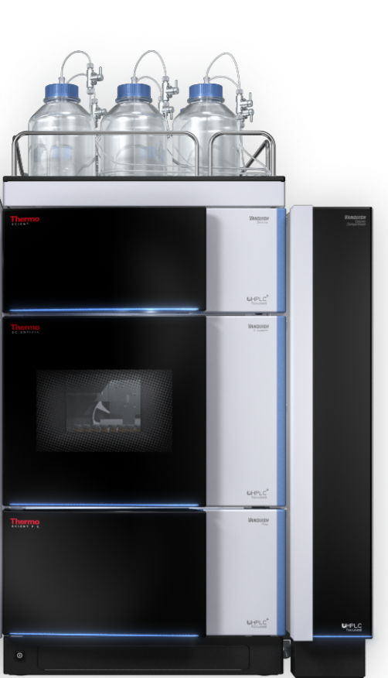
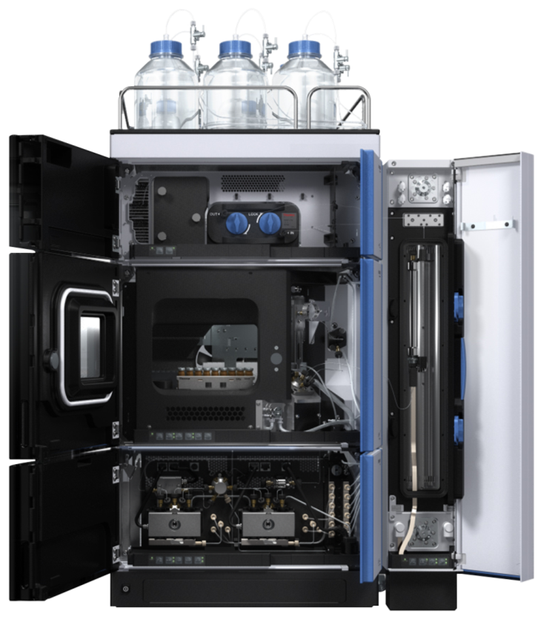
Vanquish Platform… Provides More!
Integrated modularity
Viper-based, tool-free fluidic connections
Biocompatible, iron-free flow path
Unique SmartInject technology
New column thermostatting technology with up to
3 column compartments in one system
Enhanced LC/MS support and integration
Reduced system height
Revolutionary module drawer system for maintenance
Removable doors for easy access

Slide 5






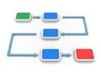
Chromeleon CDS
… Increase productivity
Industry-leading Operational Simplicity™ and throughput with eWorkflows™
Faster data processing, visualization, and reporting with dynamic updating and Intelligent Functionality built-in
… Control all your instrumentation
  Thermo Scientific LC/IC/GC/(quant)MS plus >300 third-party modules
  Customizable instrument ePanels for consistent look and feel
… Achieve regulatory compliance
  Flexible to support research and compliant laboratories
  Comprehensive user management and eSignatures
… Simplify administration
  Centralized or distributed data storage
  Scales from workstation to large global networks
… Connect your laboratory
  Easily interface with other laboratory software (e.g. LIMS)
  Download ready-to-run applications from AppsLab Library

Slide 6

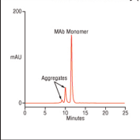

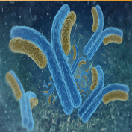
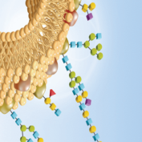
Vanquish Flex Quaternary System – Fulfilling the Needs of Biopharma
Peptide mapping
Confirm sequence
Analytical reproducibility
Aggregate analysis
Check monomer vs Aggregates
High salt condition, biocompatible, low dispersion
Charge variant
analysis
Check charge variation within antibody sample
High salt condition, biocompatible
Intact proteins
Check purity of the antibody
Biocompatible, gradient and thermostatting capabilities
Glycan analysis
Check glycan presence and structure
Gradient capabilities
UV and UV-MS UV (UV-MS) UV UV and UV-MS FLD and FLD-MS
Acclaim MAbPac SEC MAbPac IEX MAbPac RP GlycanPac AXH-1
SMART digest pH gradient buffers MAbPac HIC and AXR-1

Slide 7
Vanquish Flex Quaternary – Peptide Mapping
Very high precision of both retention time and peak area
Excellent separation in 30 minute gradient only
Active eluent pre-heating to avoid any thermal mismatch
High retention time precision with Acclaim Vanquish, 2.2 µm
2.1 x 250 mm column (n=5)
mAU
50
40
30
20
10
0
min
5
10
15
20
25
30

Slide 8
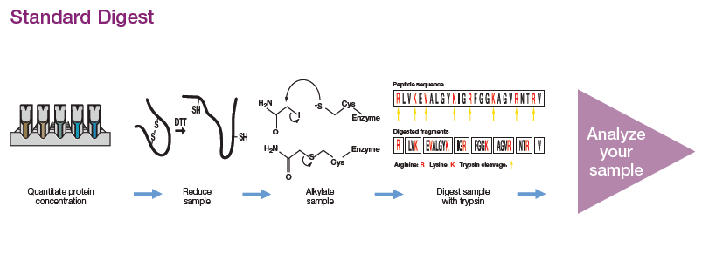
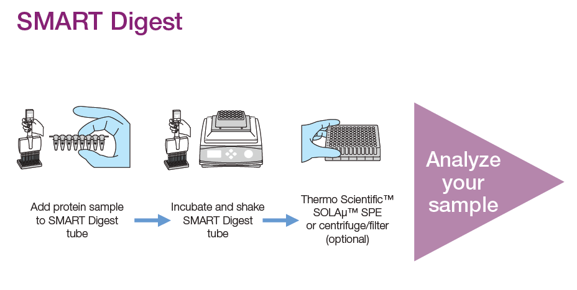
Comparing Standard Digestion with SMART Digest Protocol
Make up reagents: 8M Urea, DTT, Iodoacetamide, Trypsin
Perform protein quantification
Reduction of disulfide bridges: 30 – 60 min
Alkylation of Cysteines: 30 min
Quenching of excess Iodoacetamide: 15 min
Dilute to 1 M Urea
Add trypsin to vial and digest overnight: 12 – 24 hrs
Spin to remove particulates
Extract peptides with SPE
Heat stable trypsin
  70C for protein unfolding to provide trypsin access to arginine and lysine
  Immobilized trypsin reduces risk of autolysis
    Cleaving itself apart
Reduction and Alkalytion can be performed after digestion
1 2 3 steps

Slide 9
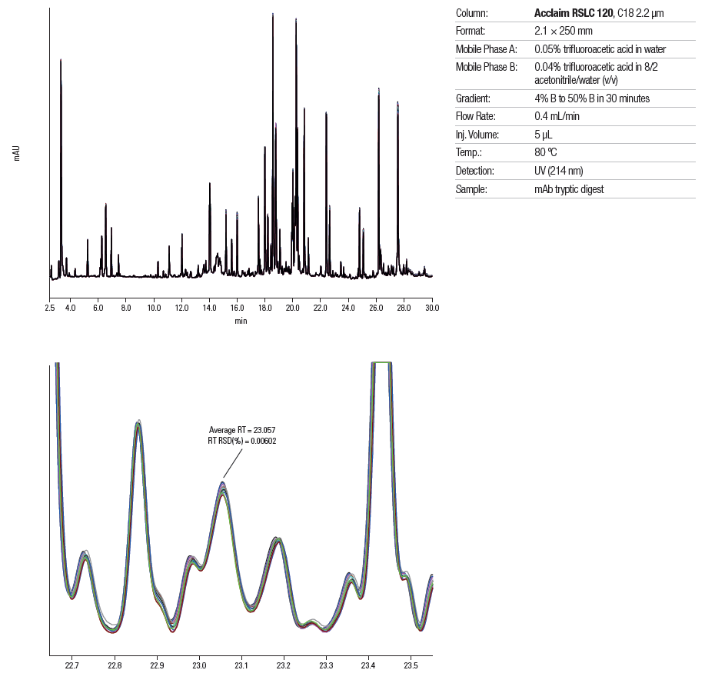
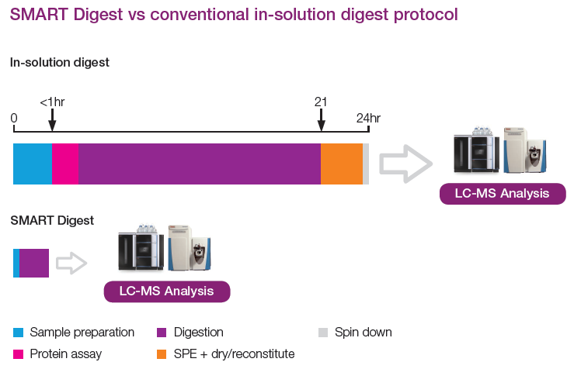
Simplified Digestion Protocol for Fast, High Resolution and Reproducibility

Slide 10
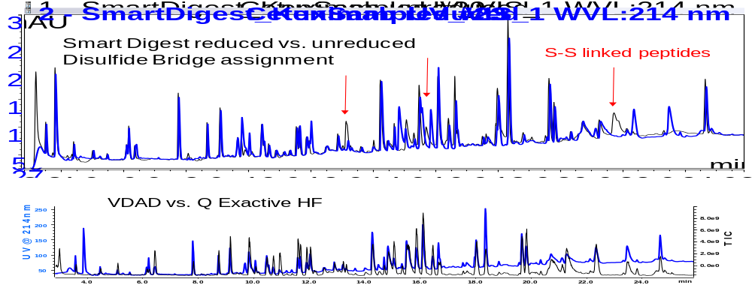
Disulfide Bonds – Determining Ternary Structure

Slide 11
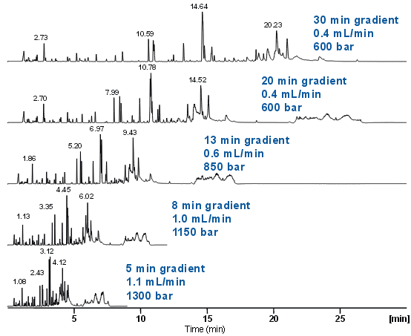
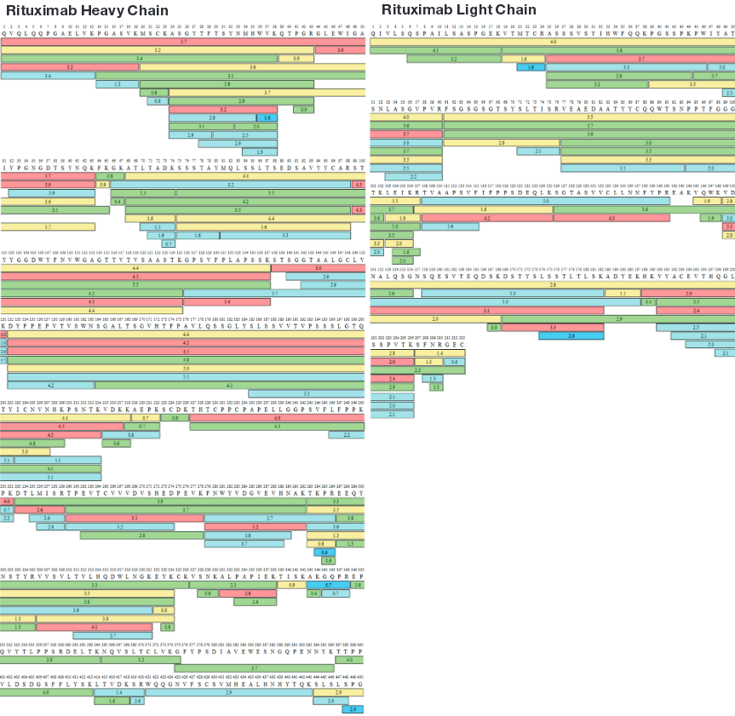
Increased Speed and Throughput - Retuximab
100% Sequence coverage obtained for Light and Heavy Chain of Rituximab using BioPharma Finder software

Slide 12
Vanquish Flex Quaternary – Aggregate Analysis
mAb size exclusion separation using MAbPac SEC-1, 4 x 300 mm
Size exclusion is the standard test for aggregate analysis with therapeutic proteins
Baseline separation achieved of dimer (2) and monomer (1)
Thermo Scientific™ LightPipe™ DAD linearity allows detection of aggregates even in very low amounts
500
mAU
1
400
2
1
300
200
100
2
0
min
0
5
10
15
20

Slide 13
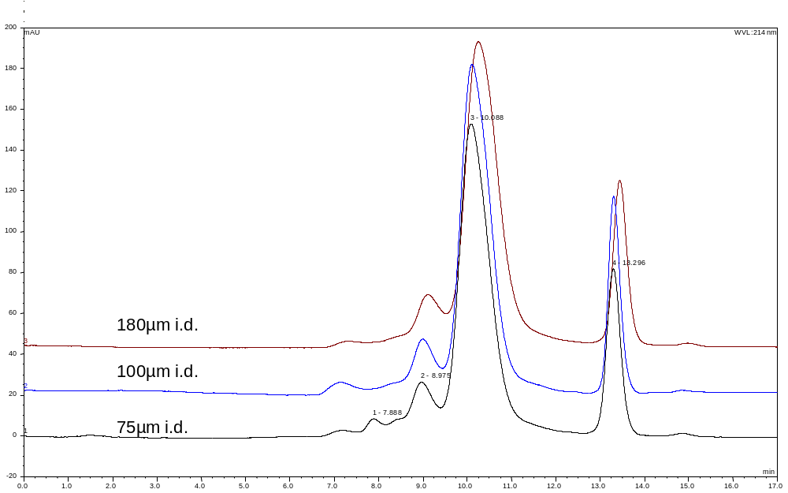
Optimize LC Set-up Prior to SEC Column

Slide 14
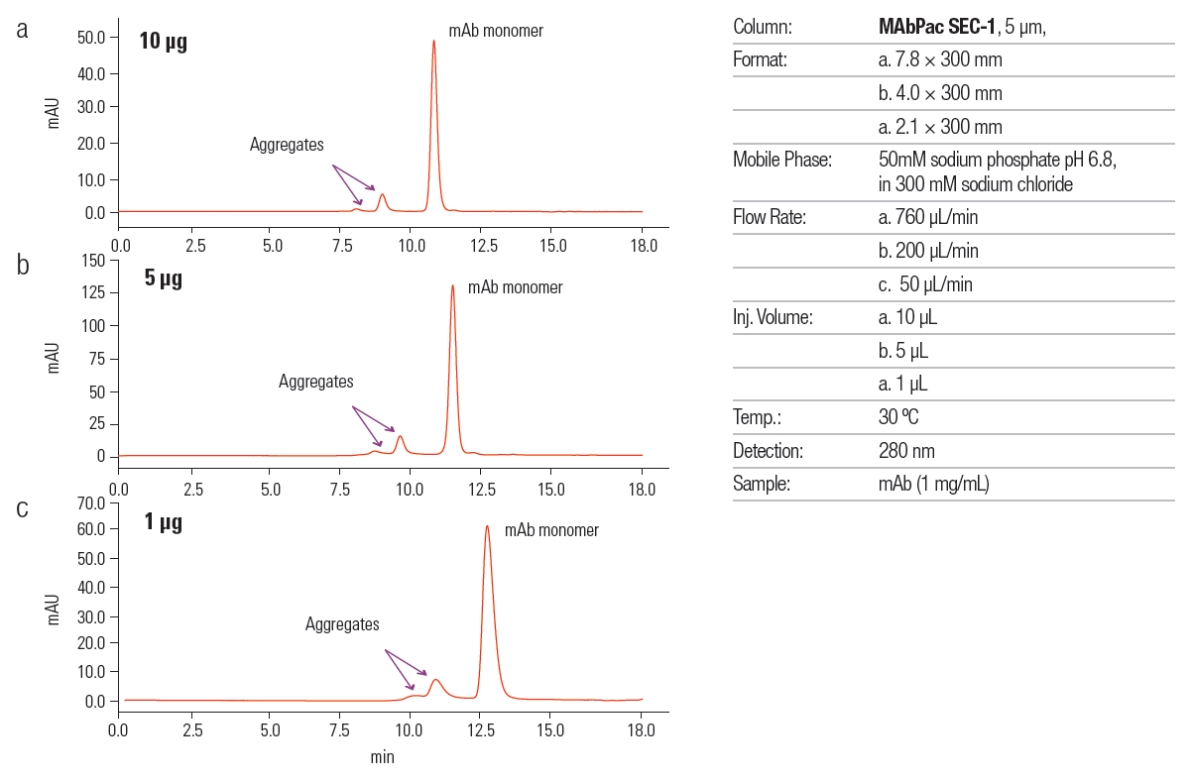
Size Exclusion Chromatography for Aggregation Monitoring

Slide 15
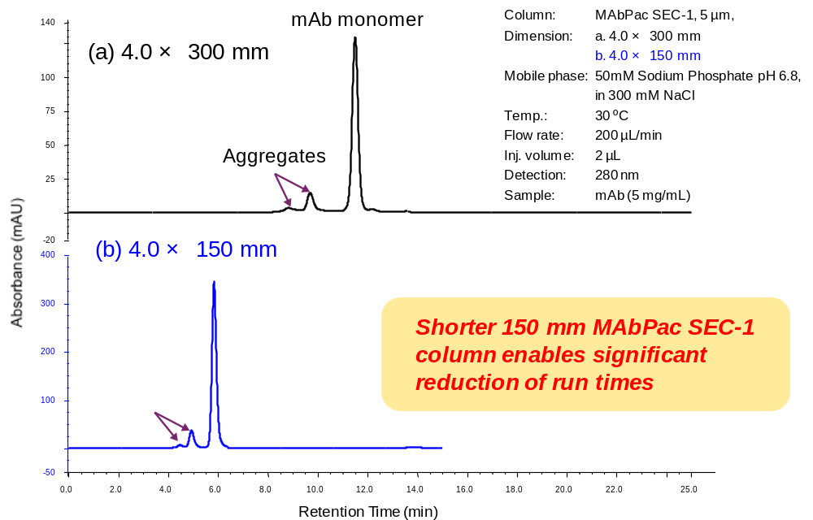
Shorter Runtimes in SEC

Slide 16
Vanquish Flex Quaternary – Charge Variant Analysis
pH gradient ion exchange of monoclonal antibody (overlay of six runs)
pH gradients allow generic gradients for the separation of mAbs with a range of isoelectric points
Dedicated buffer kit allows easy method set-up
Easy to optimize to increase sample throughput
180
mAU
160
140
120
100
80
60
40
20
0
min
0
1.0
2.0
3.0
4.0
5.0
6.0
7.0
8.0
9.0
10.0

Slide 17
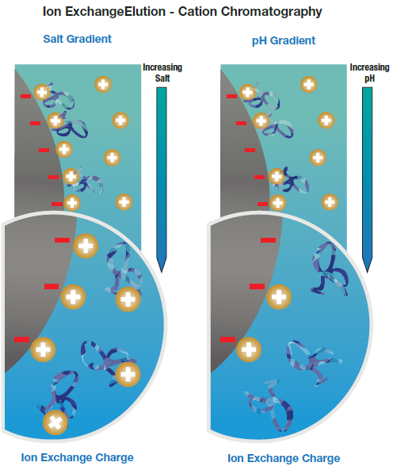
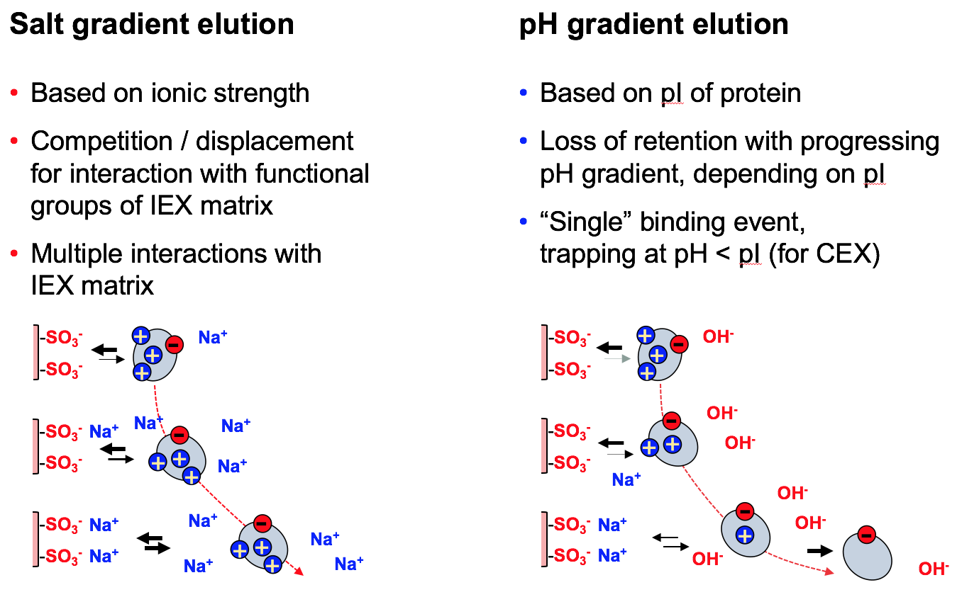
Difference Between Salt and pH Gradient IEX

Slide 18
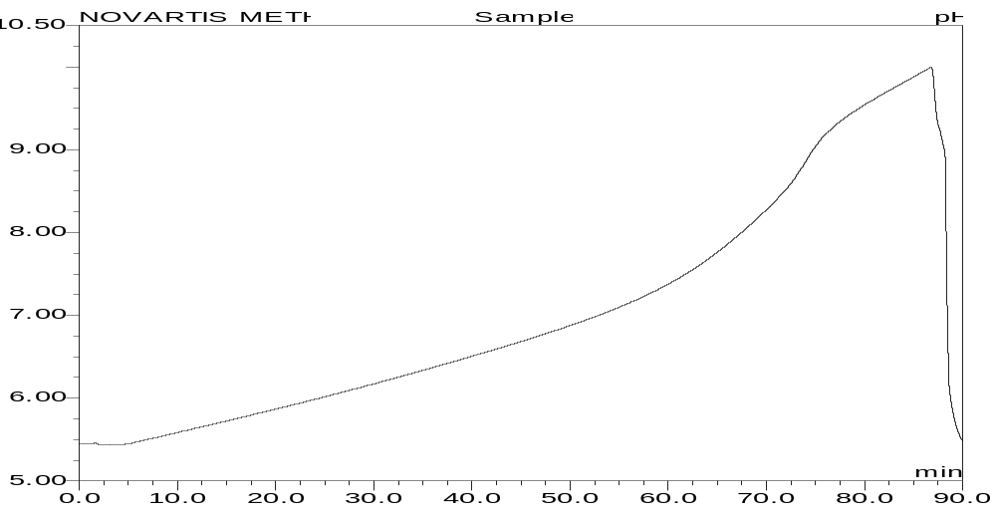
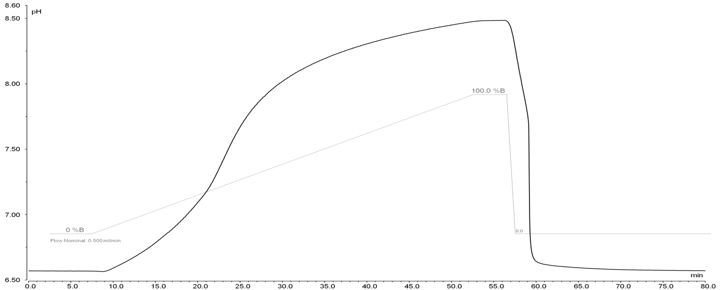
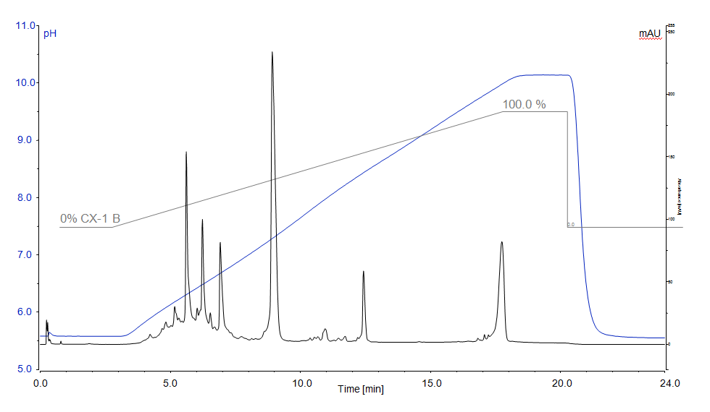
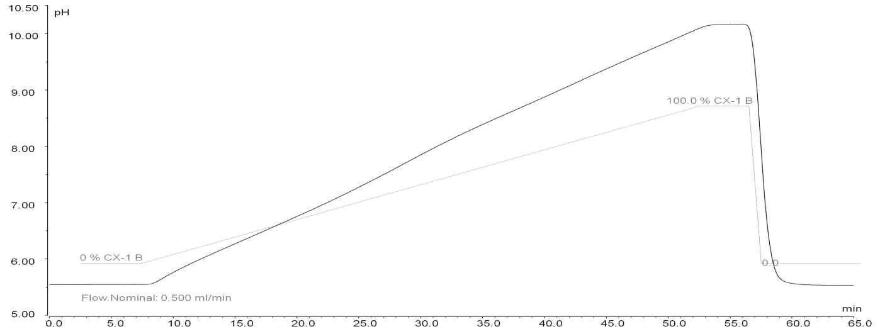
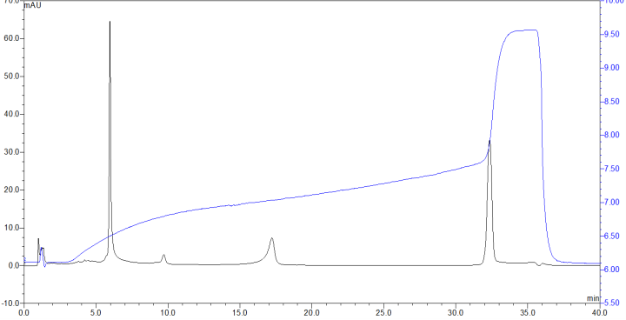
Comparison of pH gradient buffer systems
In house buffer system 1
In house
buffer system 2
ΔpH
ΔpH
Thermo Scientific
CX-1 buffer
Phosphate based
Thermo Scientific CX-1
pH 5.6 and 10.2
MAbPac SCX-10 (5 µm) 4x50 mm
Notes:
Although there are very good benefits to using pH gradients, it is not easy to produce an eluent buffer system that will produce a linear pH gradient.
Each of the traces above have had exactly the same linear gradient programed into the pump and it is only the Thermofisher CX-1 pH buffers that produce a linear pH profile. The pH in this case has been monitored on line using the PCM3000 pH and Conductivity detector.
The top left is a buffer cocktail produced by Genentech in the first publication advocating the use of pH gradients, here we see what is really happening during the gradient. The top left is another published pH buffer method using Goods buffers.
And the bottom right is from a few publications which claim a simple phosphate gradient can be used, it obviously cannot perform in this way. It can be seen how the phosphate buffer holds the pH within its natural buffering capacity around pH 7.

Slide 19
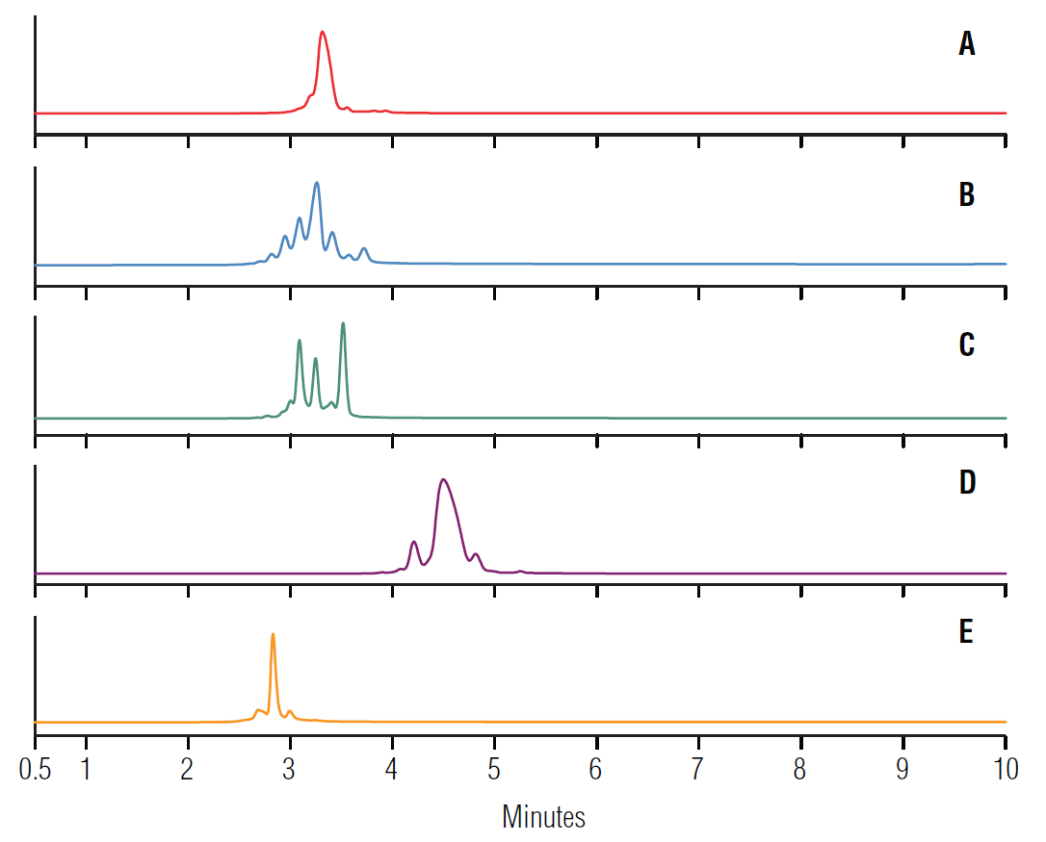
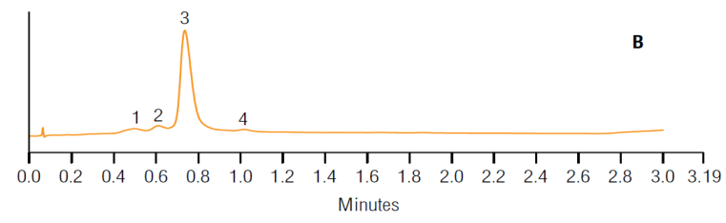
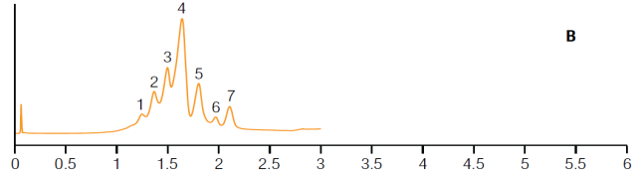
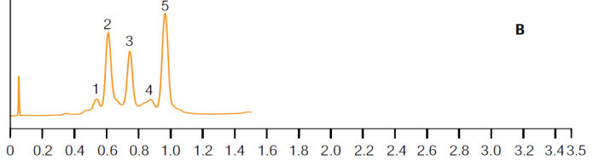
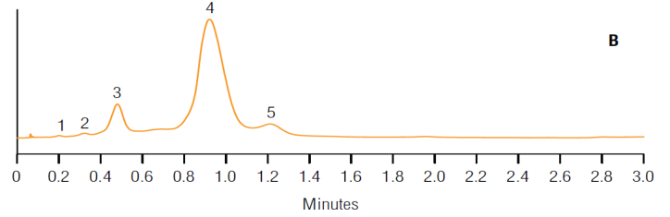
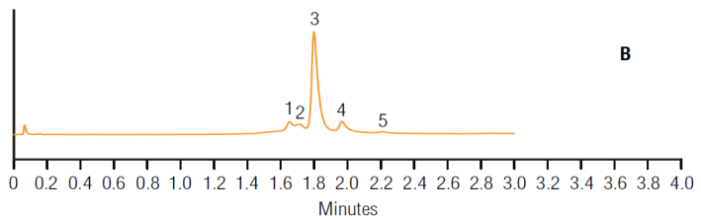
Fast, Generic and Linear pH Gradient – Vanquish UHPLC
Separation of 5 therapeutic mAbs
with a generic 0→100 %B in 10 min at 0.45 mL/min
pH gradient, optimized
for individual mAb
t_{grad} ≤ 2.5 min
23-35 %B, 2.5 min
pH 6.7-7.2, 1.0 mL/min
Bevacizumab, 25 μg (1 μL)
10-35 %B, 2.5 min
pH 6.1-7.2, 1.0 mL/min
Cetuximab, 20 μg (4 μL)
18-27 %B, 0.8 min (!)
pH 6.4-6.8, 1.2 mL/min
Inflixumab, 40 μg (4 μL)
33-45 %B, 2.5 min
pH 7.2-7.7, 1.0 mL/min
Trastuzumab, 42 μg (2 μL)
5-30 %B, 2.5 min
pH 5.8-7.0, 1.0 mL/min
“mAb A”, 42 μg (2 μL)
pH 5.6 to 10.2 in 10 minutes, MAbPac SCX-10 (5 µm), 2 x 50 mm
Notes:
This can be speeded up dramatically by using a shorter small particle size column, with run times for a global Mab charged variant analysis of 10 minutes.

Slide 20
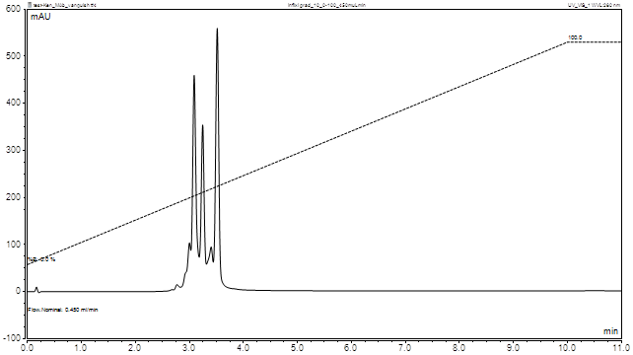
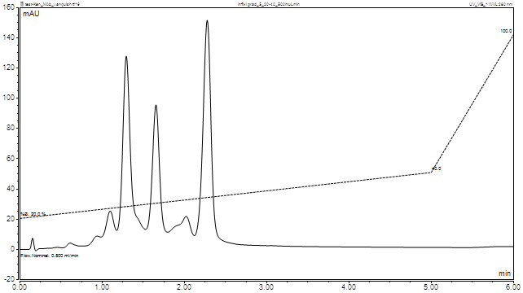
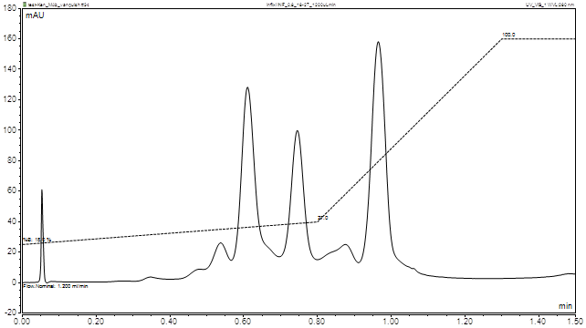
Infliximab – Vanquish System Ultra-fast Gradients
3 steps method development
1. Full gradient run
10 minutes 0→100% B
2. Adjusted pH window
20→40% B in 5 minutes
3. Flow and shape optimized
18→27% B in 0.8 minutes
5 min gradient
10 min gradient
0.8 min gradient
Resolution and number of charge variants maintained
in sub-minute gradients
Notes:
Due to the linearity of the buffer system these methods can be optimised and speeded up even further with a very short and simple method development protocol.

Slide 21
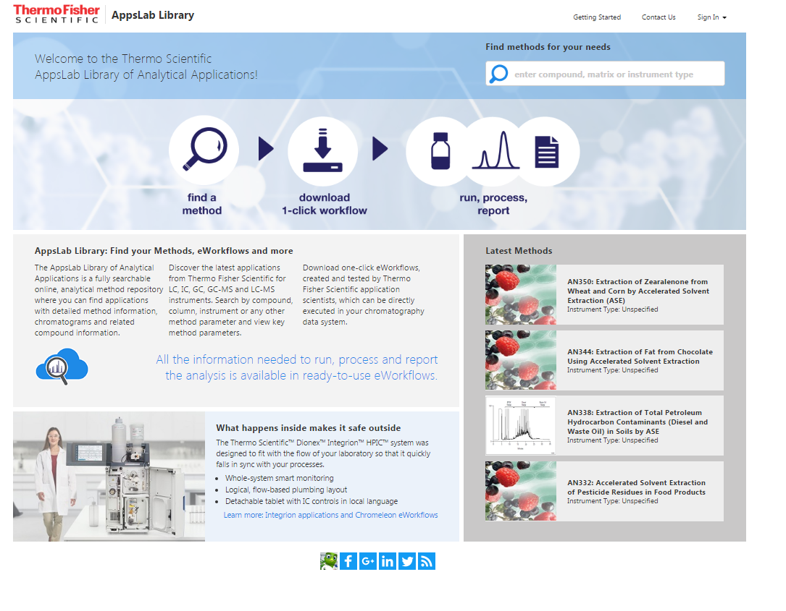
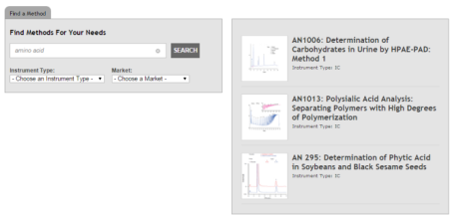
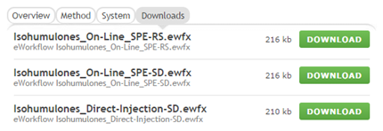
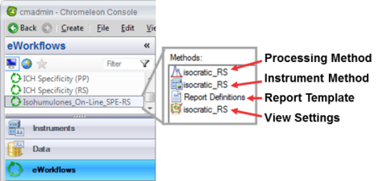
AppsLab - Search, Find and Implement Applications
Search applications
Filter based on instrument, analyte or technique
Search your method
Download eWorkflows
Run!
Review the applications
Download the Chromeleon eWorkflows
Run the eWorkflow in Chromeleon
thermofisher.com/appslab

Slide 22


For more information please visit
www.thermofisher.com/vanquish

