Slide 1
Atmospheric Mercury:
Are We Measuring It Correctly?
Robert Talbot
Professor of Atmospheric Chemistry
Director, Institute for Climate and Atmospheric Science
University of Houston
July 29-30, 2014

Slide 2
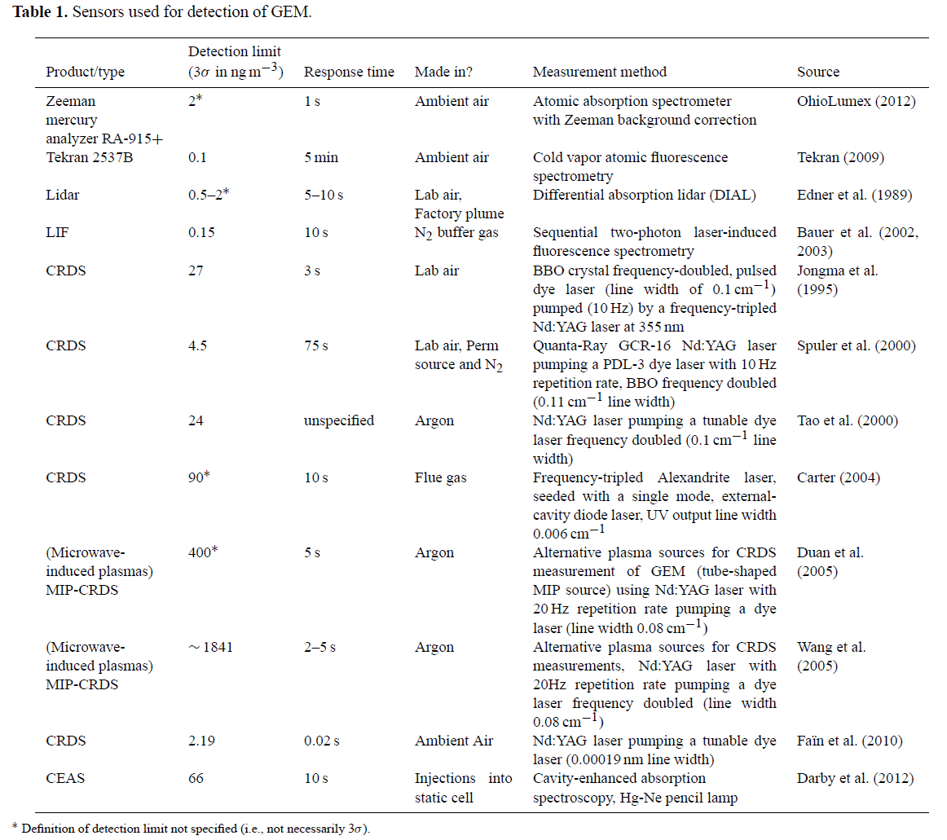
Pierce et al.
(2013)
Pierce et al. CRDS 25 Hz
5 min. 0.35 ng m⁻³

Slide 3
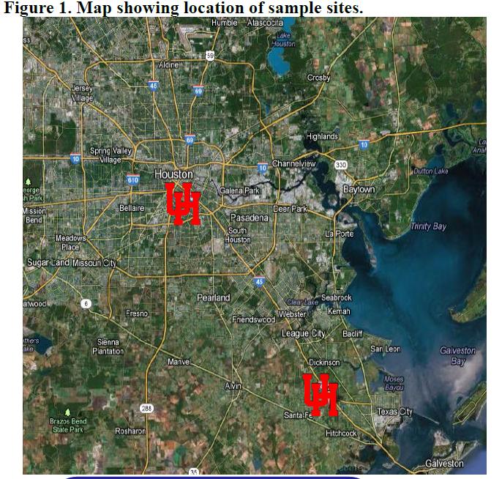

Slide 4
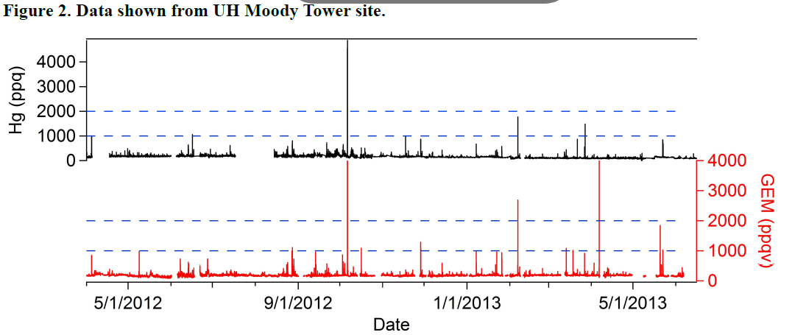
T
Urban Houston: Hgº measured with just a 2537 unit is much lower
than with a speciation system.

Slide 5
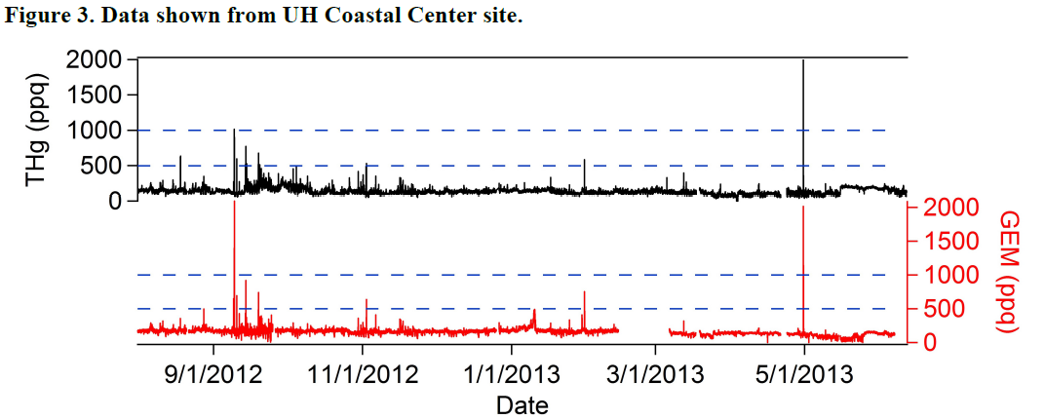
Coastal Center: ~equal with both systems.

Slide 6
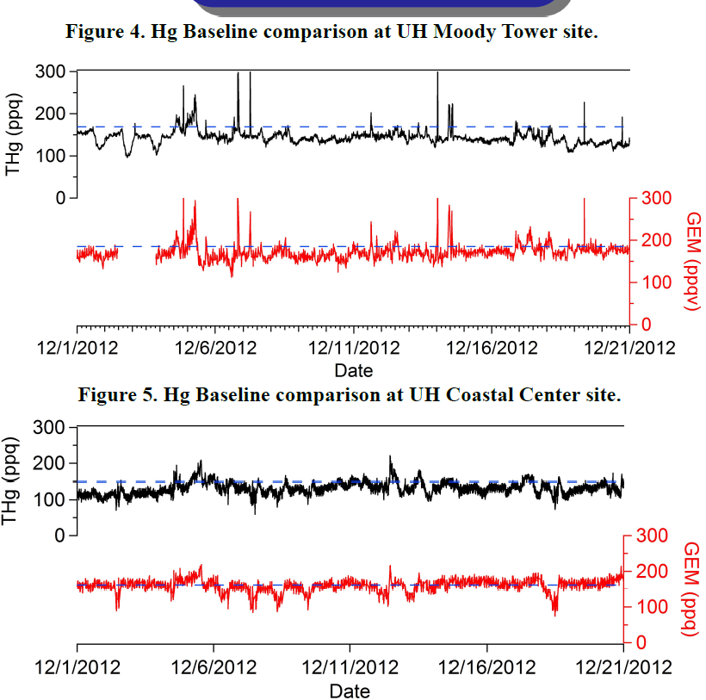
Same result.

Slide 7
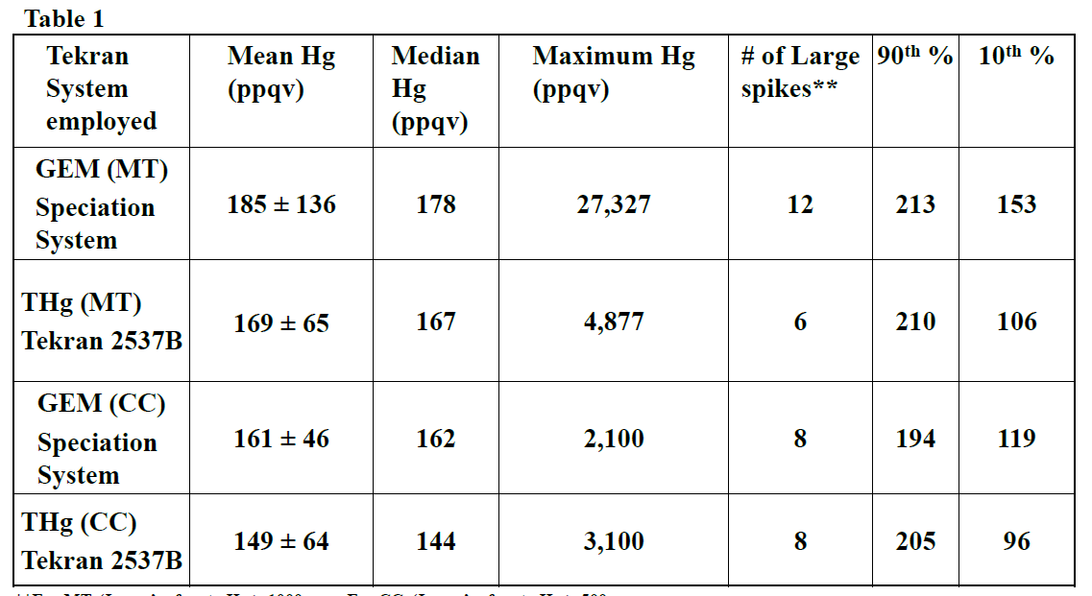

Slide 8
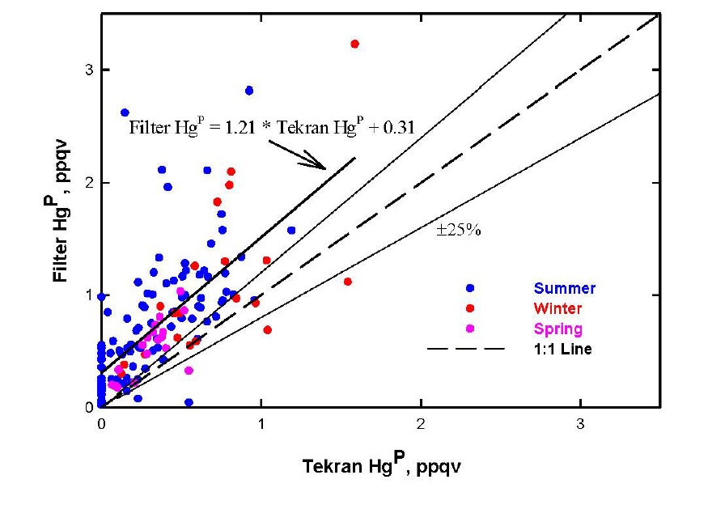
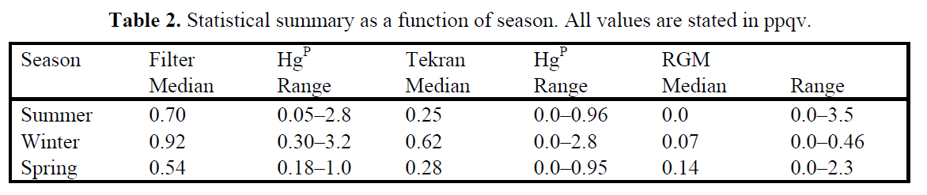

Slide 9
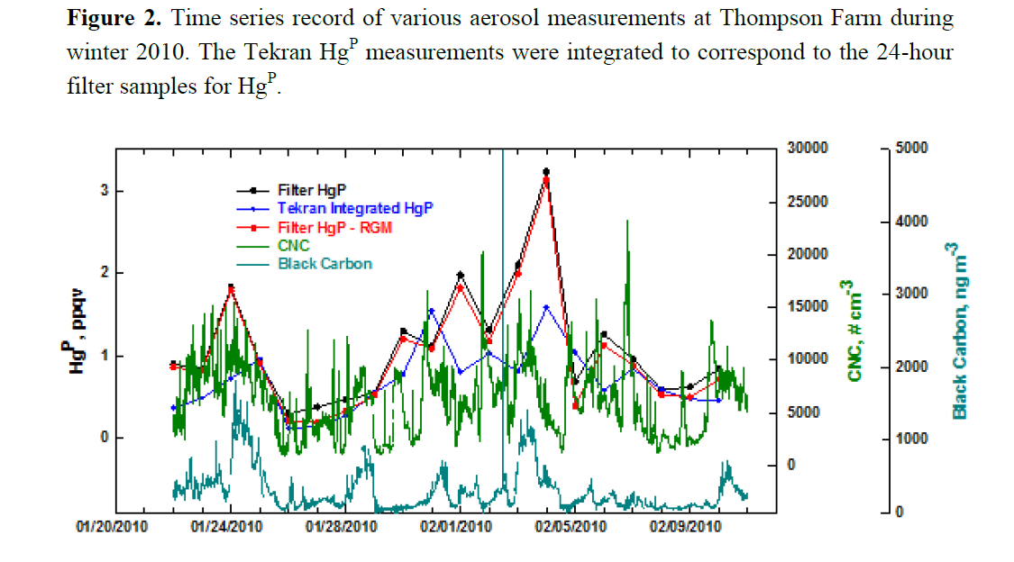
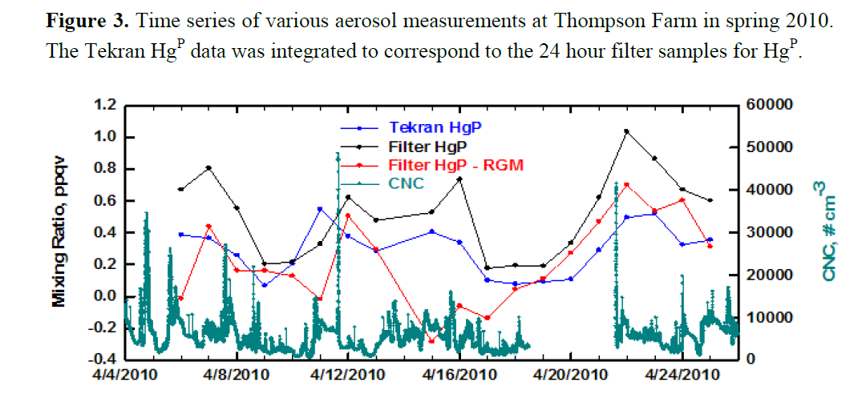
Winter: GOM uptake not
apparent on filter, but
speciation system saw
lower values at times.
Spring: Filter Hg^{P}
generally higher.
could be some GOM
uptake on filter.

Slide 10
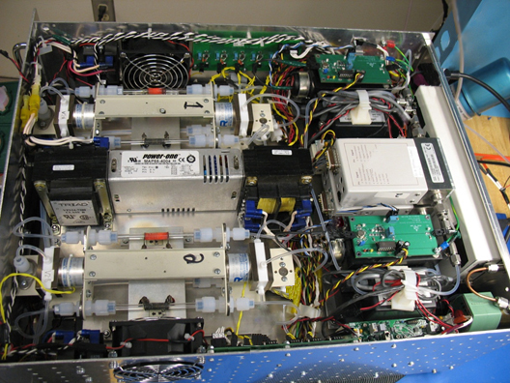
Designed and built a new instrument for Hgº.
Capable of one minute time resolution.
RGM removal allows us to get Hgº and TGM, and GOM by difference.

Slide 11
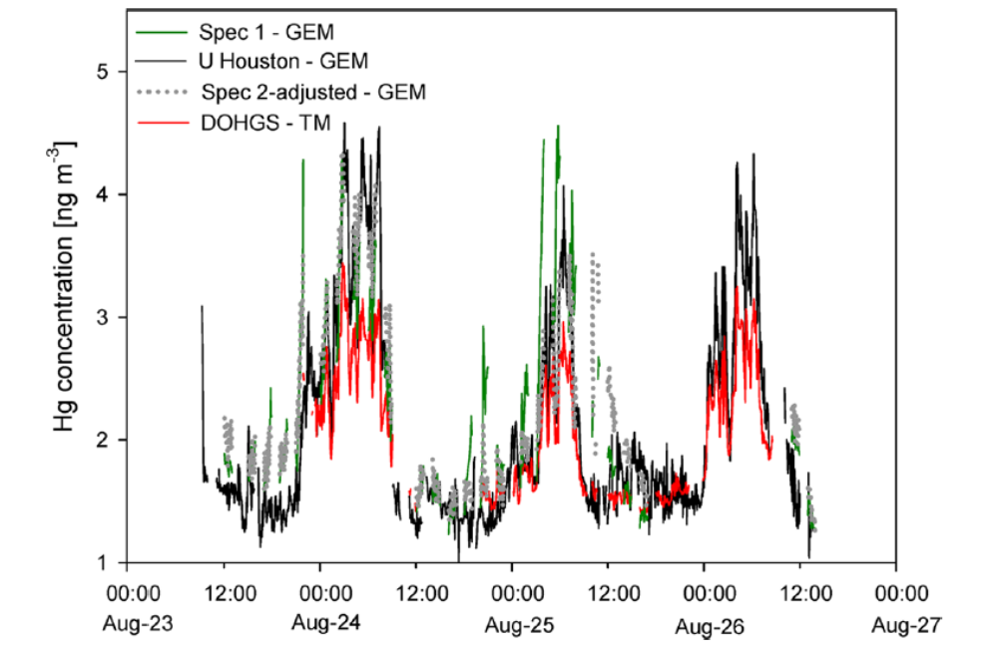
Gustin et al., 2013

Slide 12
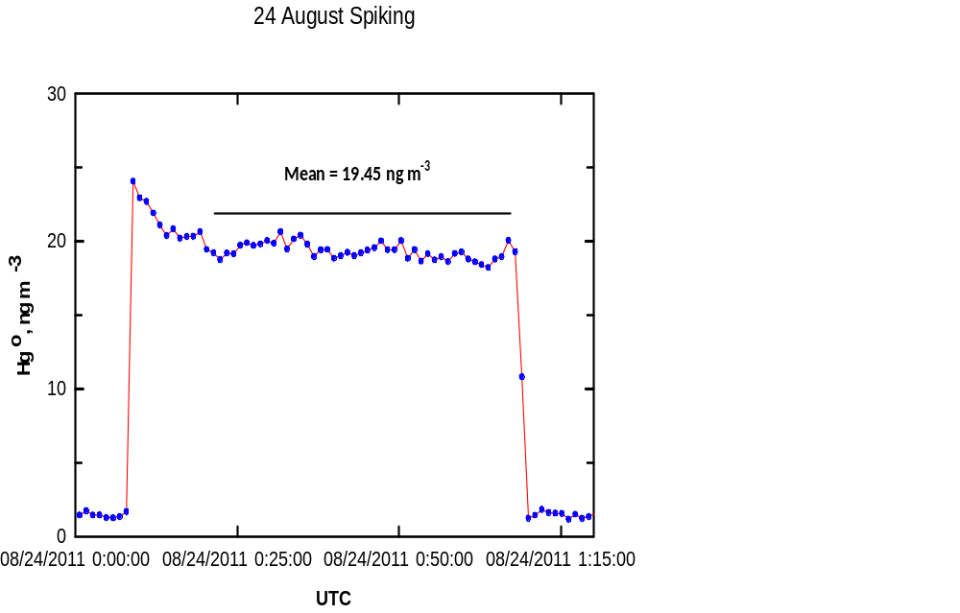

Slide 13
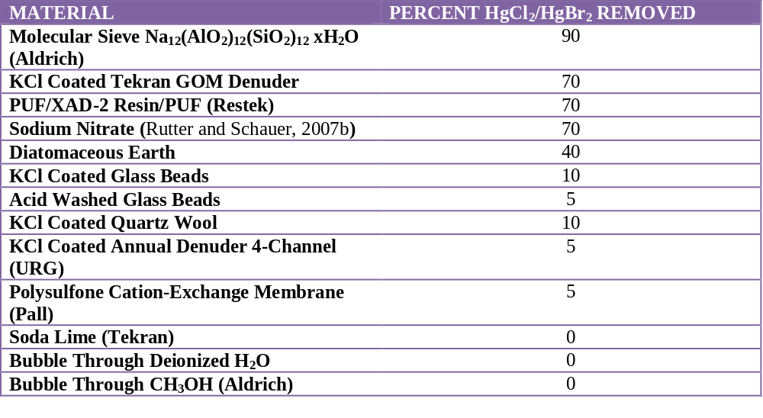
Results of Tests to Remove GOM from a Zero Air Stream.

Slide 14
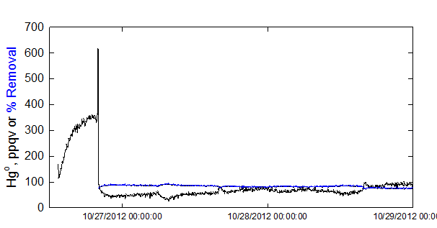
Removal of GOM by molecular sieve.

Slide 15
Now, lets get to work and figure this out!

