Slide 1
Intro to Space Insurance
First party
August 2015
Bob Whearty – 202 263 7840
Marsh Space Projects
Notes:
0

Slide 2
Marsh Space Projects
A History of Leadership and Innovation
Marsh Space Projects (MSP) operates within the Aviation and Aerospace Practice of Marsh Inc.
During the 1970’s the MSP founding team developed the market for satellite and launch vehicle insurance with niche underwriters
MSP senior colleagues have worked together for more than 30 years through changing market cycles and a myriad of risk management scenarios
MSP has maintained a reputation for achieving lowest rates, best coverage terms, and demonstrated creativity in problem solving through soft and hard markets
Marsh was first broker to break “Best Terms” and achieve the now standard “Vertical Marketing” forcing even lower rates than ever before.
We continue to be the market leader for insurance coverage innovations and rating that other brokers follow
7/13/2012
1

Slide 3
Marsh Space Projects
A Specialized Global Space Insurance Broker
We continually invest in the MSP team
  MSP brokerage teams based in our core 3 offices
  Recruit college graduates and hire within the industry, where appropriate
Specialists are employed in every discipline
  Insurance marketing and placing
  Contractual and legal analysis
  Policy wordings
  Engineering and technical evaluation
  Insurance Administration
    Policy review
    Non-Disclosure Agreements
    ITAR coordination DSP 83s and TAAs
2

Slide 4
Marsh Space Projects
Market INTRODUCTION
Aug 15, 2012
Robert P. Whearty
Sr. Vice President
Washington DC

Slide 5
Launch Insurance
Recent Market Events

Slide 6
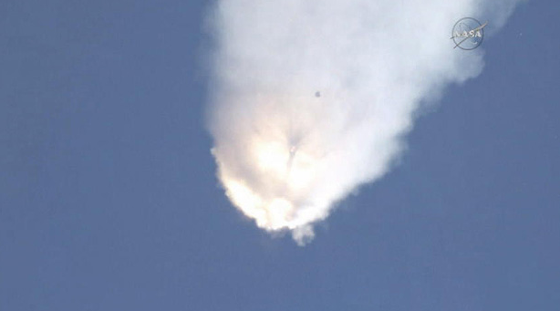
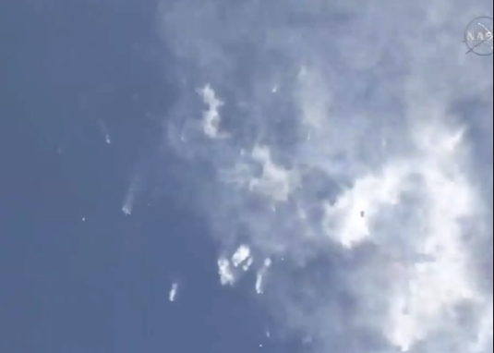
SpaceX
ISS Launch Failure
DOL: June 28, 2015 – Falcon 9 rocket failure
  No launch insurance placed (first party)
    Total Loss of Rocket and 4,000 pounds of NASA cargo
    NASA ISS adapter ring lost
    SpaceX did not insure NASA incentives ($30-50M est.)
  No reports of third party liability

Slide 7
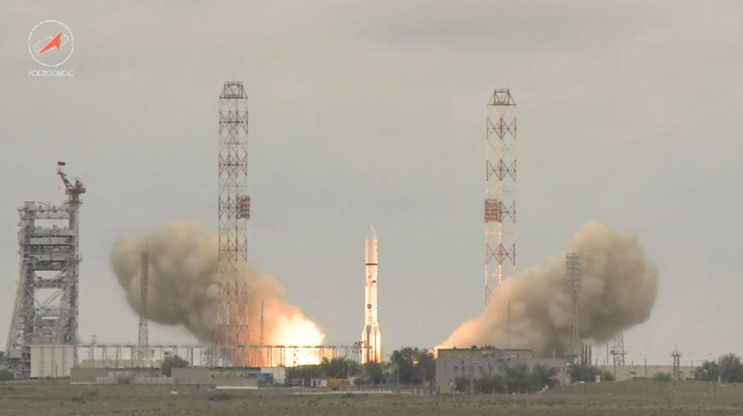
Proton Launch Failure
Mexsat 1 Launch
DOL: 16 May 2015 – Proton Launch Failure
Loss of approximately $390 million – includes Satellite, Launch Vehicle and Capitalized Expenses.
Total Loss of Satellite and Launch Vehicle.
One of the largest single event losses in the commercial space market

Slide 8
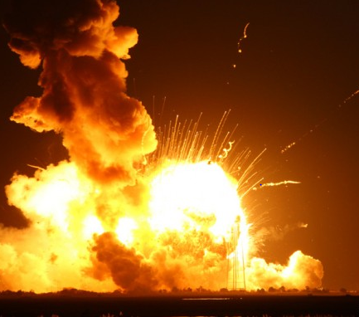
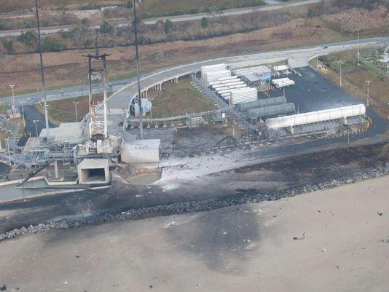
Antares Pad Damage
Wallops Island
DOL: October 28, 2014 - Antares rocket failure
  $48 million of Launch insurance placed
    Total Loss
  $52 million MPL requirement for damage to US. Government Property
    Minor damage reported
  No reports of third party BI
  Incident is expected to raise market concern over launch liability

Slide 9
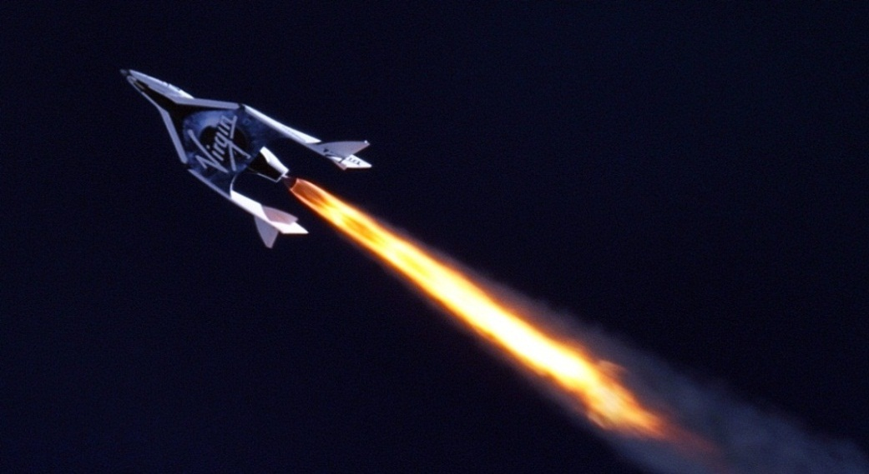
SpaceShip Two Accident
DOL: October 31, 2014 - SpaceShip Two destroyed during flight test
  Co-pilot killed, Pilot seriously injured
  Hull reportedly insured by Virgin Galactic/The Spaceship Company
    Hull Value of $40-50M (Total Loss)
  Flight operated under FAA Experimental Permit issued to Scaled Composites
    CSLA Cross waivers apply
    TPL MPL $9,000,000
    No indemnity above MPL

Slide 10

Space Insurance Overview
Notes:
9
9

Slide 11
Customer Satellite Insurance Types
Construction through End of Life (EOL)
Program Phase Type of Insurance | Construction | Shipment to Launch Facility | Launch Facility Activity | Launch/ Intentional Ignition | Post Sep through (up to) 1 year | In-Orbit (year 2 through EOL)
Manufacturers Property Policy
Transit and Pre-Ignition
Launch (+1)
Launch & In Orbit Liability (Third Party Liability, TPL)
Incentives
In-Orbit

Slide 12
Satellite Lifecycle Risk Coverage Overview
Commercial Programs
Policies often begin at either Intentional Ignition or Launch
Satellite Launch Insurance
Launch Risk Guarantee (LRG)
Transit & Pre Ignition
Post Sep & In Orbit Insurance
Incentives Insurance
Satellite Complete
Arrival at Launch Site
Intentional Ignition
Spacecraft Separation
In Orbit Testing Completion / Handoff
EDC
Launch
Manufacturing
Transit & Incidental Storage
Launch Site Processing
Launch
180 Days
Nominal Launch
Launch Abort
Intentional Ignition
Launch
Intentional Ignition
Engine Shutdown
Launch Pad is Safe
Seconds to Minutes depending on Launch Vehicle

Slide 13
Marsh Space Projects
A Specialized Global Space Insurance Broker
We continually invest in the MSP team
  MSP brokerage teams based in our core 3 offices
  Recruit college graduates and hire within the industry, where appropriate
Specialists are employed in every discipline
  Insurance marketing and placing
  Contractual and legal analysis
  Policy wordings
  Engineering and technical evaluation
  Insurance Administration
    Policy review
    Non-Disclosure Agreements
    ITAR coordination DSP 83s and TAAs
12

Slide 14
2015 International Market Capacity (Millions)
Launch – USD 694M
Launch Vehicle Flight Only capacity for a dual launch Ariane 5 ECA is more than USD 900M
13
13
13
Notes:
13
13
13

Slide 15
2015 International Market Capacity (Millions)
In-Orbit – USD 533M
14
14
14
Notes:
14
14
14

Slide 16
Historical International Market Capacity
15
15
15
Notes:
15
15
15

Slide 17
Transit Insurance & Pre-Ignition Insurance
Manufacturing
Transit, Incidental Storage
Arrival and Processing at Satellite Processing Facility at launch site
Intentional Ignition
Launch or Lift Off
Provides coverage for direct physical loss or damage to the launch vehicle or satellite, including its related launch equipment.
Incentives (both positive and negative) and consequential loss insurance can be included to provide cover for extra expenses, etc. arising out of the physical loss or damage to the satellite and launch vehicle.
Market offers delay start up and consequential loss cover for any launch delay

Slide 18
Launch Insurance
Intentional Ignition
Launch
S/C Separation
In-Orbit Testing 30-90 Days (Customer Acceptance)
Launch Plus 180 Days
Launch Plus 365 Days (aka Launch Plus One)
Requires in depth technical presentation
Provides coverage for the value of the satellite and launch vehicle for physical loss or damage from Intentional Ignition or Launch through In-Orbit testing to Commissioning and for some period of initial operation between 180 days to 365 days after launch.
Amount to be insured (sum insured) can include the cost of a replacement satellite, replacement cost of launch services, capitalized interest and the insurance premium.
Provides coverage for the loss of operational capability due to occurrences during the coverage period.
Future losses (fuel and power) are covered if the loss manifests itself during the coverage period.

Slide 19
Launch Risk Guarantees (LRG)
Provides refund or credit towards a re-launch
Intended to cover launch phase perils (Intentional Ignition/Lift-Off to Separation)
Covers only damage caused by the launch vehicle failure to perform within specification as measured by telemetry
Does not include the value of the spacecraft
Satellite owner’s insurance needs must be integrated with LRG, without gaps or overlaps in protection
  “Wrap around” to cover spacecraft induced launch failure
  Difference in conditions (DIC)

Slide 20
Launch Risk Guarantee (LRG) with a Wrap Around Launch Insurance Placement
$300M
C
D
$100M
A
B
$0
Launch
Spacecraft Separation
1 Year
Provided by Launch Services Provider
Provided by Insurers

Slide 21
In-Orbit Insurance
Expiration of Launch Policy
Up to 1 Year
Requires Health Status Review
Similar to Launch insurance
Amount of Insurance can include Replacement Cost/Re-launch Cost or Asset Value, Loss of Revenue, Extra Expenses or Contractual Obligations
Material anomalies generally dealt with via exclusions or deductibles or higher rates.

Slide 22
Incentives Insurance
Intentional Ignition, Launch, or Successful Separation
Up to 1 Year from Launch or Final Acceptance
Similar to Launch and In Orbit Insurance; covers loss of or repayment of incentives (in accordance with the contract with their customer) as a result of a launch vehicle or satellite anomaly during the Policy Period
Amount of Insurance is the amount of incentives/warranty paybacks per contract
Can commence at Intentional Ignition, Launch or Satellite Separation and continue until one year after Launch or Acceptance

Slide 23
Procurement/Risk Transfer Techniques
The procurement Process can result in risk transfer in a variety of ways
  Ground delivery
    More typical
    Title and risk of loss transfers at intentional ignition or liftoff/launch – i.e. “point of no return” (need to ensure Policy and Launch Service Providers definitions are consistent)
    Satellite Owner/Operator purchases Launch Service with or without a launch risk guarantee
  In-Orbit Delivery
    Title and risk of loss transfers after completion of in orbit testing, acceptance (as defined) or designated period
    Satellite manufacturer usually buys launch service
    Option for customer to purchase insurance

Slide 24
Space Risk Analysis
Notes:
23
23

Slide 25
How Premium is Determined
Rates are based on the following factors:
  Type of launch vehicle
  Type of satellite
  Amount of Insurance
  Loss formulas
  Type of coverage
  Insured’s premium/loss history
  Profitability of the Space and/or overall Insurance Market

Slide 26
Insurance Rates
Launch Vehicle Factors
Launch Vehicles: Ariane 5, Proton M/Breeze M, Delta IV, Falcon 9, Sea Launch, etc.
  Heritage
    Flight record
    Integration of new equipment or operations
    Testing program
  Technical presentations
    Launch vehicle development
    Previous flight failures or anomalies
    Multiple satellite dispenser experience
  Access to information
    Some insurers are very technical - they require a significant amount of information
    Crucial to maintaining market confidence and relationships
    Export control regulations - always a concern

Slide 27
Insurance Rates
Satellite Factors
Satellites:
  Heritage
    Satellite systems and subsystems
    Previous flight history
  Level of Redundancy - Bus and Payload
    Spare components
    Single point failures
  Customer Oversight
  Performance Margin
  Test Program
    Qualification
    Quality Control and workmanship screening
    Waivers
  Access to Information
    Technical presentation
    Disclosures prior to launch – i.e. Pre-ship review
    Post launch and in-orbit updates and claims information
    Export control regulations – May need to establish TAA or DSP licenses in order to export data to underwriters for insurance purposes. Marsh provides a monthly Export License List detailing all particulars of the space insurance community

Slide 28
Launch and In Orbit Insurance
Key Policy Terms & Conditions
  Premium (paid 30 days before launch for Launch Insurance)
  Export control
  Due diligence
  Definitions
Key Policy Terms
  Fuel life and power margins
  Insuring Agreement
  Intended “commercial communications purpose”
  Subrogation
  Material Change
  Salvage
  Named Insured’s duties - Sunset clause

Slide 29
ITAR: International Traffic in Arms Regulations
Impacts level of technical information dissemination without a license
State Department oversight via DTSA
  Alternatives for licensing
    DSP-5
    TAA
Master list of insurers, brokers and consultants
  Marsh sends on monthly basis (Export License List)
  Marsh to assure NDA’s are in place with all insurers, consultants, and brokers
Timing for licensing
  The earlier the better to start the licensing process
  Own Customer TAA or Manufacturer TAA?
  Can be customer driven because their concurrence is required for:
    Launch Presentations
    In-orbit health reports
    Claims

Slide 30

This document and any recommendations, analysis, or advice provided by Marsh (collectively, the “Marsh Analysis”) are intended solely for the entity identified as the recipient herein (“you”). This document contains proprietary, confidential information of Marsh and may not be shared with any third party, including other insurance producers, without Marsh’s prior written consent. Any statements concerning actuarial, tax, accounting, or legal matters are based solely on our experience as insurance brokers and risk consultants and are not to be relied upon as actuarial, accounting, tax, or legal advice, for which you should consult your own professional advisors. Any modeling, analytics, or projections are subject to inherent uncertainty, and the Marsh Analysis could be materially affected if any underlying assumptions, conditions, information, or factors are inaccurate or incomplete or should change. The information contained herein is based on sources we believe reliable, but we make no representation or warranty as to its accuracy. Except as may be set forth in an agreement between you and Marsh, Marsh shall have no obligation to update the Marsh Analysis and shall have no liability to you or any other party with regard to the Marsh Analysis or to any services provided by a third party to you or Marsh. Marsh makes no representation or warranty concerning the application of policy wordings or the financial condition or solvency of insurers or reinsurers. Marsh makes no assurances regarding the availability, cost, or terms of insurance coverage.
Notes:
29

