Slide 1


Dr Robert
Lambkin-Williams
BSc, PhD, MRPharmS
Executive Scientific Adviser
The Human Viral Challenge Model –
Accelerating Drug and Vaccine Development. Choice of Virus is Critical
International Conference on Flu
June 9, 2015
Notes:
Title Slide - should be in Arial Bold 36pt size

Slide 2


hVIVO at a Glance
hVIVO- pioneering our technology platform of human disease models to accelerate drug development and discovery in respiratory and infectious diseases
Founded 1989 at University of London, roots in virology research
Formerly Retroscreen Virology
Market-leading human challenge models (HCM) provider
15+ years designing HCM and working with regulatory authorities/safety boards
Clients- leading industry, governmental and academic organizations
Unique capabilities to support rational disease biomarker and drug target selection
Clinical quality human sample databank
Cutting-edge omics capabilities
40+
Clinical Studies
1970+
volunteers

Slide 3
Effective Vaccine
H3N2: High Prevalence Virus
Influenza viruses
circulating in
2014 – 2015
Only sentinel specimens are included
A unsubtyped
7%
“..H3N2-predominant seasons have been associated with more severe illness and higher mortality, especially in older people and young children, relative to H1N1- or B-predominant seasons…”
CDC 2015
Subtype A(H1)
14%
Subtype A(H3)
55%
Type B
24%
ECDC 2015
http://www.cdc.gov/flu/news/flu-activity-expands.htm
http://ecdc.europa.eu/en/healthtopics/seasonal_influenza/PublishingImages/influenza-europe-weekly-infographic.jpg
Notes:
The United States Advisory Committee on Immunization Practices recommends influenza vaccination for everyone over 6 months of age
The failure of the flu vaccine in 2014-2015 demonstrates the need for a model that allows the rapid development of novel antivirals, universal/intra-seasonal vaccines, immunomodulators, monoclonal antibodies and other novel treatments.
High prevalence- H3N2 also has particularly high mortality and morbidity and according to ECDC seasonal flu data, influenza A type H3 is the most prevalent subtype this year. It also has been growing in prevalence over the last few seasons, growing from 17% in 2012/2013 to 55% in 2014/2015 (ECDC reference is below), making it a growing danger and prime agent to use in challenge studies.
ECDC Season Summary Data (http://ecdc.europa.eu/en/healthtopics/seasonal_influenza/Pages/infographic.aspx)
Season summary data for previous seasons-
2013 to 2014 the data was
A(H3)- 45%
A (H1)pdm09- 52%
B- 3%
2012 to 2013
A(H3)- 17%
A (H1)- 30%
B- 53%

Slide 4
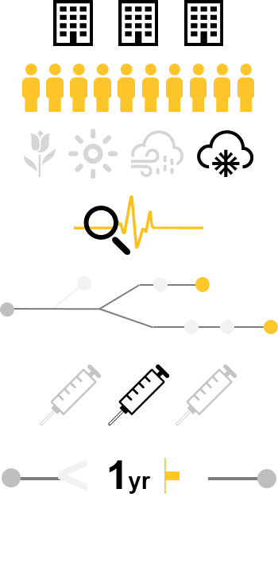



What We Do
Accelerate Drug Development
Challenge Studies = Streamline Processes, Reduce Costs, Move Forward Faster
Traditional
LAUNCH
1
2
3
TRIALS
LAUNCH
Drug Development Costly and Long
($216-$432 Billion, 9.5 to 15 years)
Notes:
Traditional drug development many constraints- Such as seasonality and time duration-
With traditional drug development process, its typically costly and long entailing
Many Sites
Many Subjects (300+)
Seasonality Constraints
Delayed Monitoring (48hrs)
Few End Points
Limited Dose Ranges
Long (1+ Yrs)

Slide 5
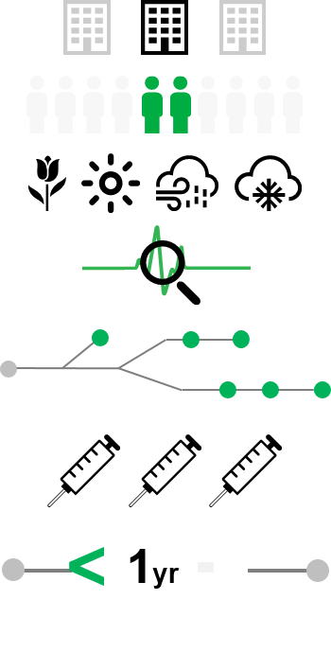



What We Do
Accelerate Drug Development
Challenge Studies = Streamline Processes, Reduce Costs, Move Forward Faster
Challenge
LAUNCH
1
2
3
TRIALS
LAUNCH
Provide an Effective and Efficient Option
Notes:
But What if you could run your trial regardless of season? What if you could run your study in one site and under 12 months? Challenge studies give you that flexibility.
With challenge trials, you have an effective and efficient option to field trials and the traditional process. hVIVO human challenge trials utilize
1 Site
Few Subjects (~20-140)
All Seasons
Real-Time Monitoring
Flexible End-Points
Multiple Dose Ranges
Short (<1 Yr)

Slide 6
What We Do
Accelerate Drug Development
Regulatory Support: WHO Vaccines 2004
Regulatory Support: FDA Guidance 2011
“.. Human challenge studies… can provide valuable information on the pathophysiology, clinical manifestations, diagnosis, immunology, treatment response and most importantly protective efficacy of vaccines…”
“..Challenge trials can provide useful exposure-response and safety information, as well as an opportunity to demonstrate pharmacological antiviral activity in humans under controlled conditions outside the influenza season.
Data from challenge trials can contribute to dose selection for phase 2B and phase 3 trials, and provide the opportunity to explore the effects of different times of drug initiation relative to virus exposure…..”
Regulatory Oversight: EC Legislation/Guidance
Clinical Trial Regulations (i.e., SI 2004/1031)
GCP (i.e., SI 2006/1928)
GCP for Laboratories
UK Human Tissue Act (HTA)
http://www.fda.gov/downloads/drugs/guidancecomplianceregulatoryinformation/guidances/ucm091219.pdf
Notes:
Take away- from these regulations and guidance- Regulatory authorities not only are aware but encourage challenge studies
Direct quotes from the FDA guidance, “ Guidance for Industry Influenza: Developing Drugs for Treatment and/or Prophylaxis” 2011
See source and details below
Challenge studies are an accepted, even encouraged, part of clinical trials by regulatory bodies. As such the studies and facilities also need comply with clinical trial guidelines and practices- inspections from authorities such as MHRA. We have been in active discussions with authorities such as FDA, and they have reviewed all of our models.
European Regulatory activities details
GCP Regulation in the UK
Clinical Trial Regulations SI 2004/1031
GCP Regulations SI 2006/1928
Inspected by the MHRA and included in regular five yearly inspection programme
Categorised Low Risk
Ethics committee has visited site and is considered ‘fit for purpose’
GCP For Laboratories Compliant
Inspected by the MHRA 2011
Human Tissues Licence
Issued by HTA June 2012
FDA Guidelines
http://www.fda.gov/downloads/drugs/guidancecomplianceregulatoryinformation/guidances/ucm091219.pdf
The quote was excerpted from a larger section on human challenge trials, which is below-
“.. After initial antiviral activity assessments and phase 1 human pharmacokinetic (PK) and tolerability trials, several sponsors have conducted challenge trials. In challenge trials, healthy volunteers are administered an investigational antiviral drug either before (prophylaxis trials) or after (treatment trials) inoculation with the established challenge strain of influenza virus. Challenge strains are influenza viruses that produce a milder set of symptoms compared to naturally occurring influenza. Pharmacodynamic (PD) endpoints in challenge trials include clinical respiratory symptoms, nasal discharge weight, and quantitative measurements of viral shedding in nasal washes. Sponsors are encouraged to include assessments of resistance in their challenge trials.
Challenge trials can provide useful exposure-response and safety information, as well as an opportunity to demonstrate pharmacological antiviral activity in humans under controlled conditions outside the influenza season. Data from challenge trials can contribute to dose selection for phase 2B and phase 3 trials, and provide the opportunity to explore the effects of different times of drug initiation relative to virus exposure. However, challenge trials should not be considered efficacy trials that can be used to support marketing approval, because challenge strains typically produce a milder set of symptoms compared to naturally occurring influenza, and inoculation in challenge trials may differ from acquisition in naturally occurring infections (e.g., amount of inoculum in challenge trials could be larger or smaller at various mucosal sites compared to naturally occurring infections). In addition, challenge trial results may not predict treatment outcomes for novel circulating influenza strains and pandemic strains because tissue distribution, viral replication, and host responses to novel strains can vary from those recognized in well-characterized challenge strains.
Whether challenge trials are feasible is dependent on the availability of adequately safety-tested challenge strains and ethics considerations. Proposals for challenge trials should include documentation of the safety testing and biologics investigational new drug application (IND) status (in CBER) of the influenza challenge strains. It is important for a sponsor wishing to use any new challenge strains to coordinate and consult with CBER staff reviewing the IND. The use of novel strains of high or unknown pathogenicity is not an option for reasons of ethics, safety, and containment.
Sponsors should provide dosing rationale for challenge trials on the basis of animal and human PK and tolerability data, cell culture EC50 values (adjusted for protein binding), animal model PK/PD data, and any other relevant information….”

Slide 7


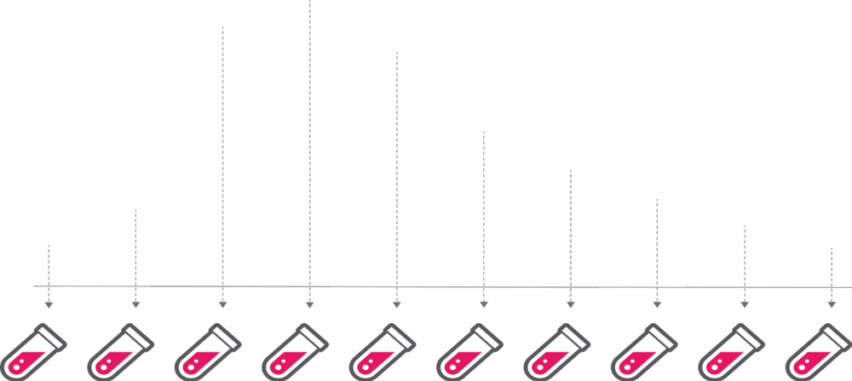
What We Do
Putting Humans at the Heart of Disease Modelling
Deliver Superior Clinical Results
Identify Promising Drugs, Faster
Enable Rational Biomarker and Drug Target Selection
Execute High Quality, Successful Studies
Disease in motion
Notes:
hVIVO puts humans at the heart of disease modelling. Our platform enables you to study subjects before, during and after they are sick- to study and understand disease in motion. These studies are performed using pharmaceutical grade agents, controlled settings and processes, and study designs based on over 15 years experience- so you can
Obtain Superior Clinical Results
Identify Promising Drugs, Faster
Enable Rational Biomarker and Drug Target Selection
Execute High Quality, Successful Studies

Slide 8


How We Do It
Disease Models: Viral Infection/Viral Exacerbation
Study design: Dependent upon client requirements, typically are randomised double-blind placebo controlled studies that evaluate IMP antiviral activity, safety and efficacy. Duration: 6 -12 months.
Study Population: Healthy aged 18 to 45 years, Over 45+ years old, Diseased (i.e. asthma)
Viral Challenge Agent: RSV, HRV, Flu
Route:
Intranasal Inoculation
Therapy: IMP
Dose schedule: Therapies-Start of Viral Shedding (PCR) or Day 6. Prophylaxis- Start Before Day 0
Sample Size*:
20 to 140+
Disease in motion
Duration of Quarantine: 12 - 15 days (10 - 12 days post-Challenge)
Primary Objective: IMP Antiviral effect vs placebo
Primary Endpoint: Reduction AUC viral load (qPCR)
*Sample size is customised on a per client basis
Notes:
This slide builds- our models are rigorously designed and tested- they have defined style design typically entailing double-blind placebo controlled studies that run 6-12 months.
We have multiple models in areas such as as RSV, flu and HRV with small sample size with short quarantine. Primary objective is activity compared to placebo with end-points that show reduction of viral load.

Slide 9
Using a Challenge Model
Improve Your Field-Based Studies Success
Challenge study enables you to refine your clinical development plan
Determine safety profile and identify potential safety biomarkers for field studies
Confirm efficacy and identify primary endpoints (i.e. ACQ/PEF)
Identify dose range in humans for field studies
Disease in motion
Move forward with confidence to field based studies
Notes:
Slide describes how to use the asthma model inclin drug dev plan slide and that would bring how to use in early phase asthma studies.
Make clear is that this is about refining confidence that field studies will work, not replacing field studies.
Use the peak flow data as an example, you can get good changes so this is transferable to field

Slide 10
How We Do It
Extensive Studies and Virus Library
Virus | # Clinical Studies | # Inoculated
Influenza | 25 | 1098
RSV | 12 | 6791
HRV | 4 | 181
TOTAL | 40 | 1970
Virus Library
  Influenza A:
  H1N1 (2)
  H3N2 (3)
  H5N1 (1)
  Influenza B
  RSV-A (Memphis 37b)
  HRV-39
  HRV-16
Notes:
We are the market leaders- done more than 40 studies in multiple diseases, inoculated more than 1950 volunteers, and have an extensive pharmaceutical grade virus challenge agent library, produced under cGMP standards.
Rigorous qualification and characterization
Immunogenicity and Phylogenicity
Clinical relevance
GMP Production- safety and pathogenicity testing
No Drug Resistance and Appropriate Therapy Susceptibility
Ferret Characterization Study
Human Characterization Study
Virus library- the exact details are below. Note that only the ones in bold are available for use in studies today.
Influenza A:
H1N1 (New Caledonia/20/9)
H1N1 (Brisbane/59/2007)
H3N2 (Wisconsin/67/2005)
H3N2 (Perth/16/2009)
H3N2 (Panama/2007/99)
H5N1 (Vietnam/1194/04) - NYC
Influenza B
RSV-A (Memphis 37b)
HRV-39
HRV-16

Slide 11
Disease Models
How We Do It
Notes:
Section header slide – blue variant
Title should be arial bold 40pt

Slide 12





How We Do It hVIVO Disease Models
Patient Populations
Healthy
Diseased (i.e., Asthma)
Over 45
Models
Operations
RSV
Flu
HRV
Asthma
Recruitment
Study Process
Facilities
Labs
Viruses
Notes:
We are market leader and bring years of data and experience designing human challenge studies from models, to patient populations to quality operational capabiltiies. This includes..
We have multiple models (RSV, Flu, HRV, asthma)
Healthy patient recruitment populations as well as diseased and older populations.
Our operations leverage
ongoing recruitment
standardized study process
en suite quarantine facilities and controlled setting
cutting edge labs located right near our quarantine facilities.
extensive virus library and cGMP produced viral challenge agents.
Unlike other organizations, we bring over 15 years of data and experience to compare viral characterization data. We also have placebo data to leverage for designing studies.

Slide 13
How We Do It
RSV: Path to Gold Standard
Two landmark studies (Alios, Gilead)
Reduced viral load
Completed in <10 months
RSV Becomes Gold Standard
Completed first siRNA RSV Study
2006
2014
Defined 1st RSV Model
Regulatory
Review (Gilead)
After studies completion,
J&J Acquired Alios

Slide 14


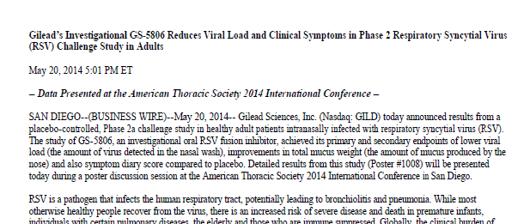

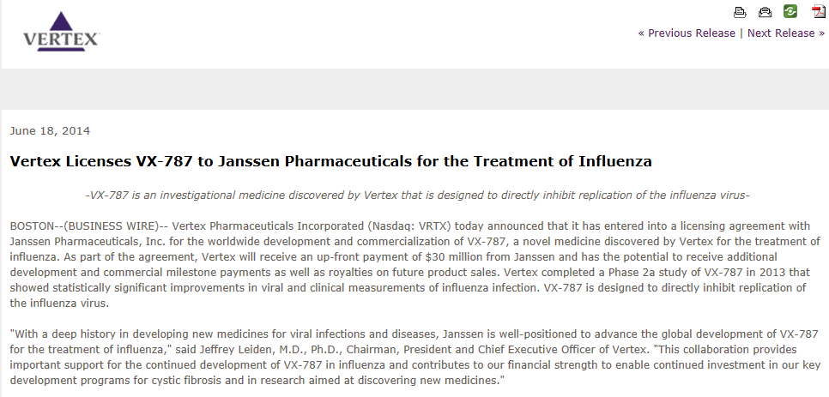
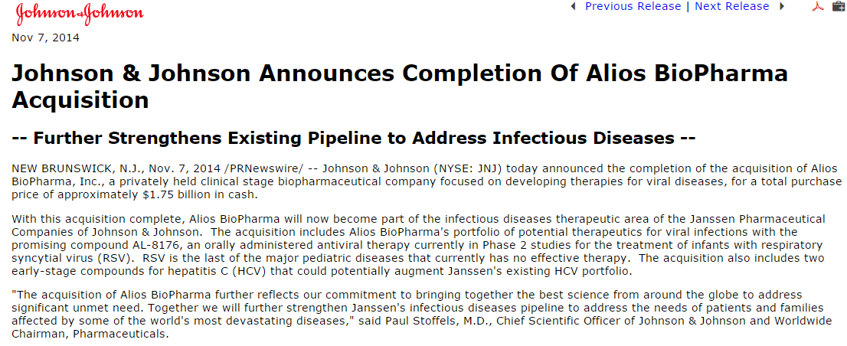
hVIVO: Case Studies
Landmark RSV and Flu Challenge Studies
“It is an evolving field. We benefitted hugely from this (Retroscreen challenge study) and I think our programme has moved at a faster pace than if we had gone out and tried to do a field-based study.”
John Fry
Assoc Director, Clinical Operations
Alios BioPharma
Notes:
Some examples of recent studies. In addition to the Gilead study already mentioned in our talk we also had two studies that were associated with drugs later acquired by big pharma.
Alios- proof of concept for a novel RSV antiviral therapeutic AL- 8176 . AL-8176 achieved a reduction in viral load and improvement in symptom scores, and the drug is now progressing through the regulatory framework. Following this study, Alios BioPharma was acquired by Johnson & Johnson for $1.7b including the RSV antiviral therapeutic, highlighting the value these types of studies can play in identifying safe, effective therapies.
Gilead- In one of its largest clinical studies, Retroscreen’s provided early proof of concept and dose selection for Gilead’s GS-5806 antiviral product for RSV infection in only 10 months. The study was included in the New England Journal of Medicine which concluded that: “Treatment with GS-5806 reduced the viral load and the severity of clinical disease in a challenge study of healthy adults”.
Summary of Alios and Gilead studies are below:
ALIOS-
Respiratory Syncytial Virus (RSV) is a lung infection responsible for as many as 125,000 hospitalizations annually of children under the age of one, according to the Centers for Disease Control and Prevention (USA). There are currently no specific drugs approved for RSV.
Retroscreen’s pioneering human challenge model the hVIVO platform provided positive results for a landmark human viral challenge study for Alios BioPharma Inc. Following this study, Alios BioPharma was acquired by Johnson & Johnson for $1.7b including the RSV antiviral therapeutic, highlighting the value these types of studies can play in identifying safe, effective therapies.
Alios BioPharma, a US clinical stage biopharmaceutical company is developing novel antiviral therapies for the treatment of respiratory diseases and turned to Retroscreen to provide and efficacy test and establish proof of concept and dose-ranging using the pioneering hVIVO platform designed for investigational new drugs early on in their development lifecycle.
This viral challenge model study was conducted at our clinical quarantine unit in London, with a total of 62 volunteers enrolled across three quarantine periods, providing the opportunity to use an adaptive design, with client-led dosage changes mid-study.
The study was a randomised, double-blind, placebo-controlled Phase 2 challenge study of AL- 8176 in healthy adult volunteers. AL-8176 achieved a reduction in viral load and improvement in symptom scores, and the drug is now progressing through the regulatory framework.
John Fry, Associate Director, Clinical Operations at Alios BioPharma, Inc., said: “It is an evolving field. We benefitted hugely from this (Retroscreen challenge study) and I think our programme has moved at a faster pace than if we had gone out and tried to do a field-based study.”
The study of Alios’ AL-8176 product for RSV infection highlighted hVIVO's ability to surpass field-based studies in producing clean compelling data in an accelerated timeframe, through targeted subject recruitment and defined timing of infection. This underpins our expansion into new human challenge models including for respiratory diseases such asthma and Chronic Obstructive Pulmonary Disease (COPD).
GILEAD
In one of its largest clinical studies, Retroscreen’s pioneering hVIVO platform of human models of disease, provided early proof of concept and dose selection for a new antiviral drug in Respiratory Syncytial Virus (RSV) infection for Gilead Sciences, Inc.
Gilead Sciences, Inc., an American research-base biopharmaceutical company, sought Retroscreen’s expertise and unique human viral challenge model to test its GS-5806, a small molecule antiviral in RSV infection, a common cause of infant hospitalisations with no existing antiviral treatment.
The study, which was the largest human viral challenge study at the time, was conducted at our purpose built, state-of-the-art clinical quarantine unit in Whitechapel, London over a 10-month period. Pre-study suitability tests identified 140 volunteers to receive the experimental active virus during seven separate quarantines over the course of the study.
Working closely with Gilead, our scientific staff supported an adapted design with double-blind placebo control, allowing for the alteration of doses mid-study, based on earlier positive test results. With the final anti-viral drug aimed at the pediatric population, the antiviral treatment was added to organic apple juice, imported especially from America, to mirror Gilead’s original drug stability testing programme.
In spite of its scale, this important study was completed quickly- demonstrating proof of concept for Gilead’s GS-5806 antiviral product for RSV infection in only 10 months. The study was included in the New England Journal of Medicine which concluded that: “Treatment with GS-5806 reduced the viral load and the severity of clinical disease in a challenge study of healthy adults”.

Slide 15

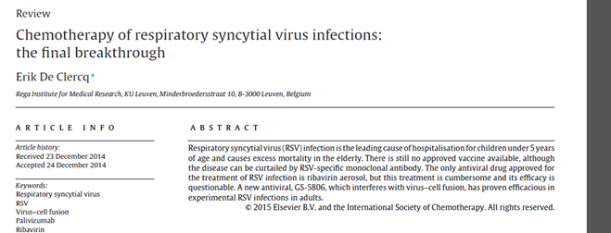
hVIVO: RSV as Gold Standard
Industry Adoption of the hVIVO Model
Evaluation of Therapeutics for RSV:
Breakthrough Results
“Since I reviewed the perspectives for the chemotherapy of respiratory syncytial virus (RSV) infections ….almost 2 decades ago, little progress has been made in the prophylaxis or therapy of RSV infection…The recent report of DeVincenzo et al. that GS-5806, which inhibits RSV fusion with the host cell, suppresses clinical disease in healthy adults experimentally infected with RSV[4] may have a significant impact on the prevention and treatment of RSV infection….”
Eric De Clercq
Rega Institute for Medical Research
2015
GS-5806= Gilead compound, study conducted by hVIVO
Source: http://dx.doi.org/10.1016/j.ijantimicag.2014.12.025
Notes:
Respected expert in RSV specifically cites results of the hVIVO human challenge study conducted for Gilead and described in the paper by Dr. John DiVincenzo (NEJM)
Full citation is here:
De Clercq E. Chemotherapy of respiratory syncytial virus infections: the final breakthrough. Int J Antimicrob Agents (2015), http://dx.doi.org/10.1016/j.ijantimicag.2014.12.025

Slide 16

How We Do It
Setting the Standard
Industry Adoption
Evaluation of Therapeutics for RSV:
An important step forward
“The advantages of a safe, reproducible human model are incalculable. This model permits the relatively quick and efficient study of new therapeutics in humans and assists in making critical decisions whether to advance a product into costly human trials in populations at highest risk for disease; children, elderly or immunocompromised patients. This constitutes a major and welcome advance in the field of RSV.”
Client X
“We saw the CLIENT Y challenge data and are pleased to see the RVL model can work so well. We are looking forward to beating the results that CLIENT Y got. Keep up the good work!”
Notes:
The value of human challenge models in accelerating drug and vaccine development is recognized by respected leaders in disease research and our clients, in paper within the highly respected ATS journal commonly refered to as the “blue book”.
___________________________________________________________
The reference can be found here: http://www.atsjournals.org/doi/pdf/10.1164/rccm.201008-1230ED
It is an editorial written by M. Boecki ( Fred Hutchison Cancer Research Center/University of Washington) and J. A. Englund (University of Washington/Seattle Children’s Hospital Research institute) in 2010.
It cites Dr. DeVincenzo’s studies on RSV with Retroscreen’s human challenge models as valuable tools for performing proof of concept studies for new therapies and vaccines for RSV.
“……The development of new therapeutics for the treatment of RSV has been a daunting task. Indeed, an absolute decrease in RSV research and development by both pharmaceutical and biotech companies since the mid-1990s has been well documented (13). If the burden of illness is so high and the medical need is clearly established (1, 13, 14), why don’t we have more RSV therapeutics or a vaccine? The reasons are multifactorial and complex, but one obstacle to speedy drug development is the difficulty to perform proof-of-concept studies for new therapeutics and vaccines. Proof-of-concept studies are needed to document evidence of efficacy in humans. Such studies are preferably not performed in highly vulnerable populations such as small infants or pregnant women, especially if other populations are available for study. Such populations exist (e.g., adult immunocompromised and immunocompetent elderly patients), but they are very difficult and expensive to study (15).
In this issue of the Journal, DeVincenzo and coworkers (pp. 1305–1314) describe their experience with a human experimental wild-type RSV infection model that appeared to be safe and produced highly reproducible rates of RSV infection and viral load dynamics (16). In this model, healthy adult volunteers are intranasally infected with an attenuated strain of RSV and followed daily for viral load, immune markers, and clinical symptoms. The researchers demonstrated that viral loads correlated significantly with intranasal proinflammatory cytokine concentrations (IL-6, IL-8) and increased viral load consistently correlated with increases in multiple different disease measurements such as clinical symptoms, physical exam findings, and the amount of nasal mucus (16). This result is good news for the development of RSV drugs and preventative strategies. It may now be possible to get a relatively quick ‘‘proof-of-concept’’ answer on novel drugs and immunotherapies, thereby significantly shortening the path to pivotal studies in pediatric target populations. Fortunately, promising therapeutic and vaccine targets exist (14), and both industry and academia now again have active RSV programs that are likely to benefit from such a model.
The advantages of a safe, reproducible human model are incalculable. This model permits the relatively quick and efficient study of new therapeutics in humans, and assists in making critical decisions whether to advance a product into costly human trials in populations at highest risk for disease: children, elderly, or immunocompromised patients. This constitutes a major and welcome advance in the field of RSV therapeutics. However, this new approach to the study of RSV also leaves important issues to be resolved. While the model may work well to study small molecules and vaccines aimed at adults, it is less certain whether the model adequately predicts vaccine response rates or even therapeutic benefit in young children who are immunologically naı¨ve to RSV. Pharmacokinetic properties of antiviral drugs and monoclonal antibodies in an adult model may not be reliably predictive. Nonetheless, the human challenge model is an important and necessary step forward to address the important and unmet need for the prevention and treatment of RSV.”

Slide 17
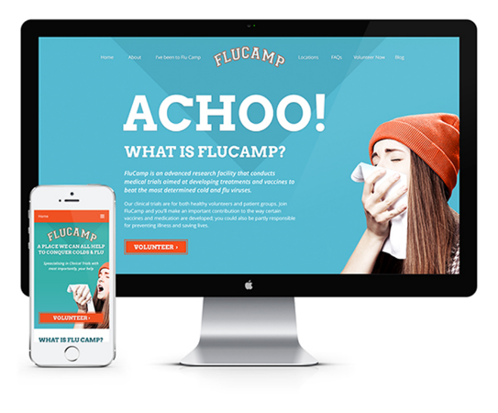

How We Do It
Ongoing Recruitment
97%
Volunteer enrollment
success rate
industry norm 15%
Notes:
Recruitment is an ongoing activity, helping to streamline study process.
Flexibility and track record of success- recruiting for over 15 years.
Viral visit model- can do subgroups, quicker start up and completion process
97% success rate for volunteer enrolment success rate
Our recruitment process
Customizable -Capabilities to target specific populations
Flexible - Adapt to study needs (i.e., Healthy, Over 45, Mild asthma), Fast start up (Viral visit model)
Successful- 15+ years and going strong, 30,000 hits/month on website
Community-Driven- 90% Volunteers hear about us through WOM, 190,000 volunteers and growing

Slide 18
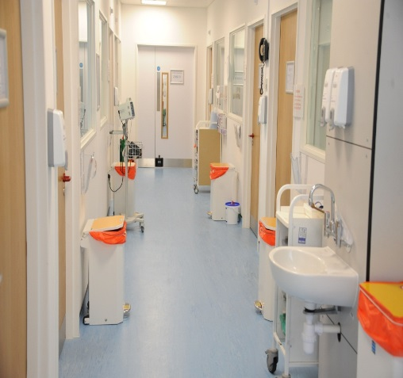

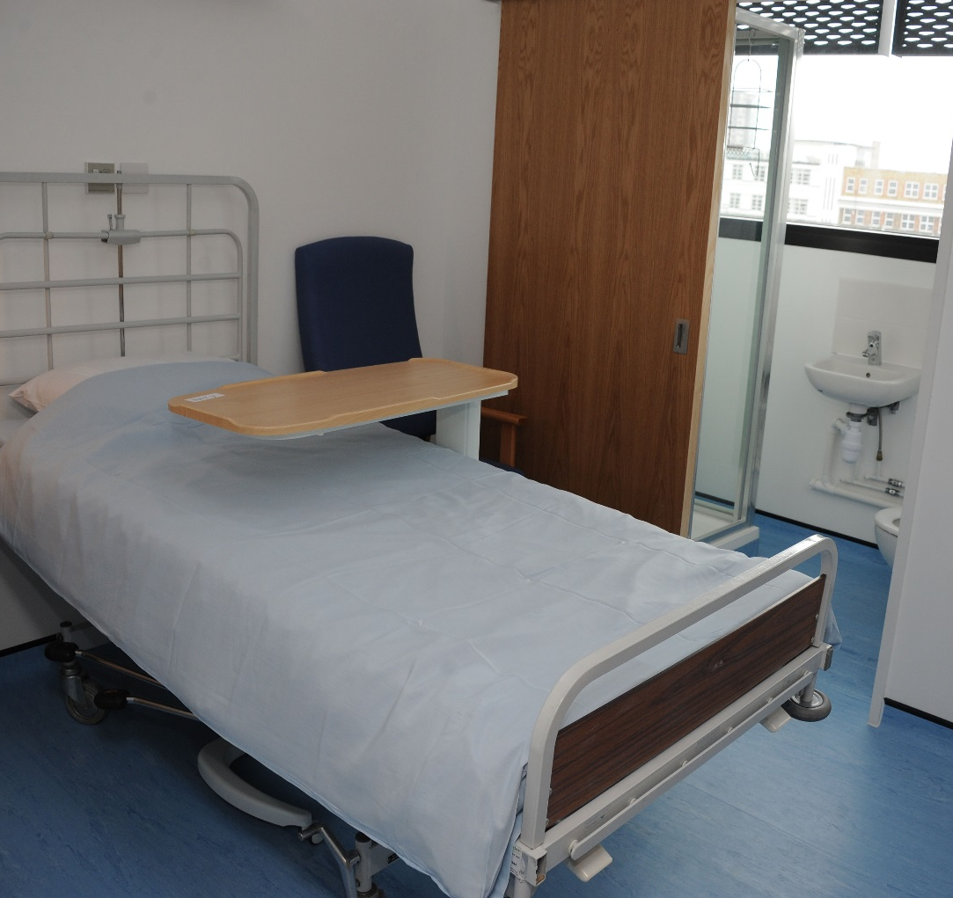
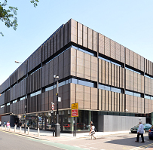
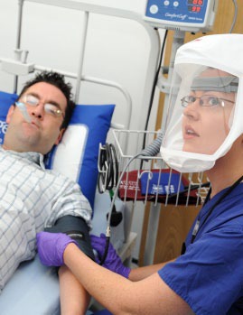
How We Do It
Controlled Settings and Processes
Notes:
Over 15 years designing infection control methods and managing quarantine units for challenge studies
Proven quarantine and inoculation processes (1900+ volunteers) with no serious adverse event
En Suite design keeps each volunteer isolated throughout study – be sure to emphasize how important this for delivering clean and unequivocal results ( theres no question of when the volunteer was inoculated with the virus and it enables much more consistent results) and that this design is unique to Retroscreen- no one else can say this, others have more open environment that include shared facilities.
Avoids risk of cross-contamination post-inoculation, promoting cleaner result

Slide 19

How We Do It
Clean Data: Virology Laboratory Operations
Fast processing- Highly
co-ordinated with Screening and Quarantine
Challenge Agent Development- virus production (cGMP)
BioLogistics- sample processing and managment
Project Support- consultancy and project management
Specialized Lab Teams
Operations and Quality Compliance
Diagnostic Development custom assays & new tech evaluation
Diagnostics Services- virological assays
Notes:
Virology expertise and local facilities
Operates as separate specialised functional teams including
Specialised sample processing and sample management team – BioLogistics
Extensive Range of Virological Assays - Diagnostic Services
Assay / Reagent Improvements and custom assay development, New Technology Evaluation - Diagnostic Development
Scientific consultancy and project management – Project Support
Virus production – Challenge Agent development
Management and Over sight of all Quality Control activities by dedicated Quality Compliance team
Operations are highly co-ordinated with Screening and quarantine to enable very fast sample collection to processing time and reporting
Maximises sample integrity, particularly for time sensitive or unstable samples
Provides services to both our own clinical trials as well external client trials
More specific Lab Services and Assays details- our lab can address a wide range of samples in high volumes tests include
Specialized virology and immunology assays
Cellular infectivity assays (plaque assay, )TCID50
Molecular assays: utilizing dedicated molecular labs and scientists
Automated RNA extraction
qPCR for viral load determination
qicPCR for virus positive triggered dosing decisions
Allelic PCR
Serology antibody screening analysis
HAI assay (Flu)
virus neutralization assays
ELISA
Virus resistance monitoring and analysis
Custom assay development and validation services

Slide 20
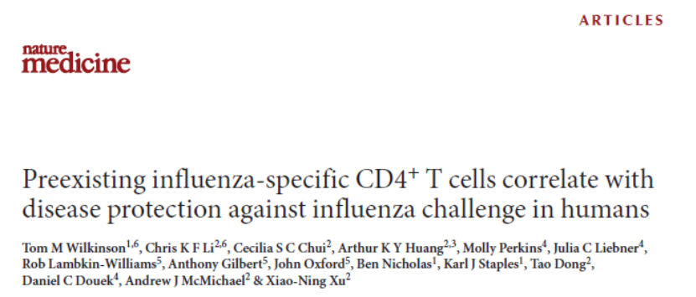
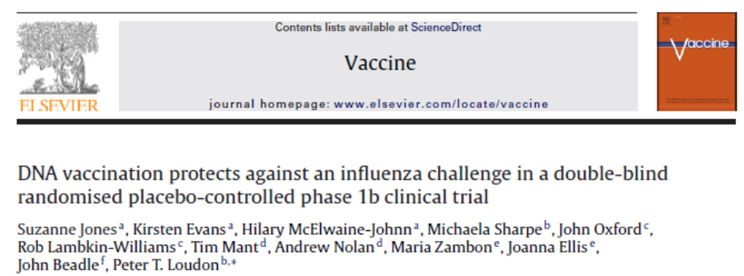
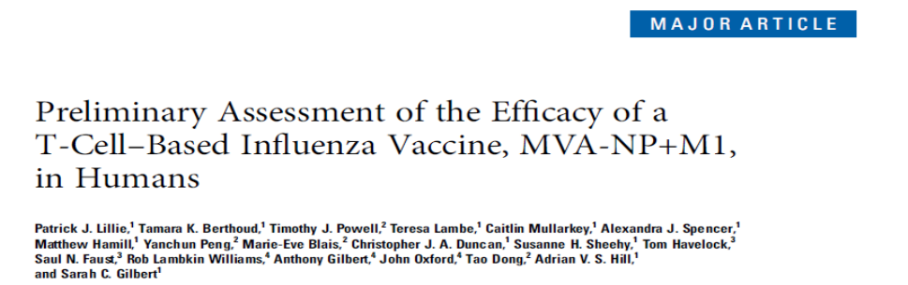
hVIVO: Case Studies
Vaccine Proof of Concepts
First proof of concept of a DNA vaccine against an infectious disease
First proof of concept of a T-cell influenza vaccine
Intranasal vaccine study provided insights on correlates of protection
  Found IgG and IgA played role in symptom severity
  Further studies showed importance T-cell immunity
  Efficacy data assisted in field study design
Notes:
We have done multiple proof of concepts for vaccines. The model allows rapid POC which can then move to field studies. It allows for rapid testing of novel influenza vaccines.
This is especially important going forward, bc novel influenza vaccines that are either “universal” or “intra-seasonal” are urgently required as the failure of this years H3 vaccine component demonstrates.
Examples of these include….
Intranasal vaccine- An intranasal vaccine given to over 100 volunteers in a multidose regime.
Efficacy was demonstrated against multiple endpoints. The Human Viral Challenge Study assisted in the design of a subsequent field study
Can help uncover correlates of protection- these are often misunderstood. This study provided useful information on the role of IgG and mucosal IgA in severity of symptoms. Subsequent studies have shown the importance of T-cell immunity.
DNA vaccine against an infectious disease
T-cell influenza vaccine

Slide 21






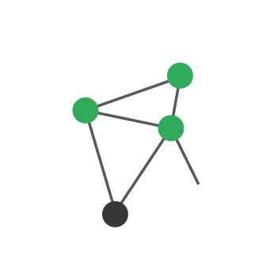


How We Do It
New Challenge Agent Production: H3N2
Stock Harvested into 225ml aliquots
Supernatant Removed from tubes and stock stored at -80 ºC
Infect SPF Eggs with A/Perth/16/2009
Centrifuge to remove debris
Stock Diluted to specified dose in GMP Diluent for Clinical Trials
Human Characterisation Study
GLP Ferret Study
Adventitious Testing
Notes:
WE used a scientific and systematic approach to producing and characterizing our virus- this is a process honed over 15 years studies and viral agent production to produce consistently high quality viruses.

Slide 22
How We Do It
New Challenge Agent: Study Design
Screening
Quarantine
Follow up
Panel Specific Screening
Study Specific Screening
Admission to Quarantine
Viral Challenge
(H3N2)
A/Perth/16/2009
Discharge from Quarantine
Assessments
Follow-up
  Serology sample
  GP letters
  Study Consent
  Medical History
  Assessments
  Admission D-2
  Inoculation Day 0
  Assessments
  Symptoms
  Start IMP Administration
  Assessments
  Symptoms
  Continue IMP administration (as needed)
  Leave Unit
  Assessments
Day (-80) to Day (-3)
Day (-56) to Day (-3)
Day (-2)
Day 0
Day 1 to Day 7
Day 8
Day 28 (+3 days)
Notes:
WE followed a controlled study process for testing our virus(symptomology, viral shedding, etc), follow same process we use for running our human challenge studies.

Slide 23
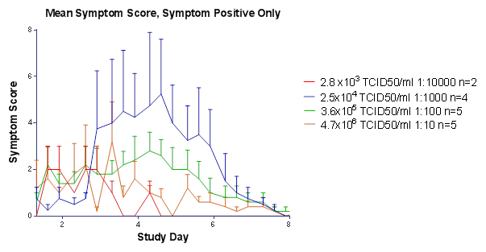
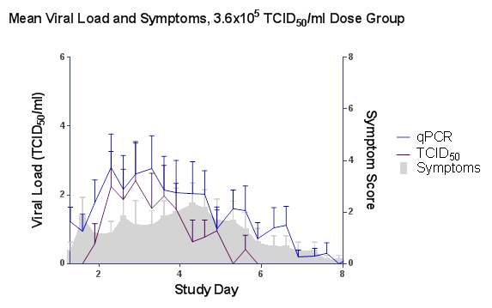
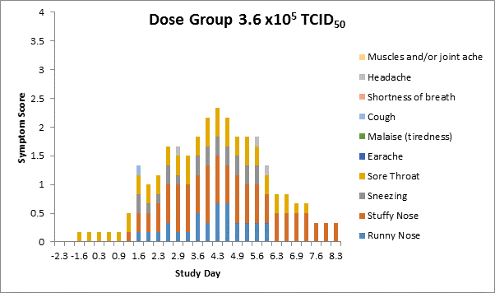
How We Do It
H3N2: Symptomology Characteristics
Symptomology is a vital consideration
Balance: Dose, Severity, Safety
Goal: Mimic natural disease
Notes:
These are results from the Dan and Rob’s H3N2 Perth characterization paper (2015)
Since this study was completed, the virus has since been in approx 100 vols with an infection rate confirmed as over 80% requiring 2 positive qPCRs and considerably higher if you use the NIH definition of one positive PCR (infection rate on CEL-CS-001, 81 vols, was 80%, plus for the 28 combined RVLvCS-003 it was 86%).

Slide 24
How We Do It
H3N2: High Infection Rate
Inoculum (TCID₅₀) | Culture Virus Positive (%) | qPCR Virus Positive (%) | Serocon’ (%) | Lab Confirmed Infection (%)
2.8 x10³ | 0 | 17 | 17 | 0 (0/6)
2.5x10⁴ | 68 | 68 | 50 | 77 (4/6)
3.6X10⁵ | 51 | 100 | 33 | 77 (4/6)
4.7X10⁶ | 68 | 100 | 77 | 83 (5/6)
Lowest inoculum level + Best infection rate + Symptoms Consistency =
Closest to natural infection and Minimizes artifacts
Notes:
Note- Selected 10⁵ for the best consistency- this is still 2 logs lower than typically used by other groups. Confirmed infection rate in more than 100 subjects already inoculated.
Select inoculum by balancing the different factors- infection rate, symptoms, etc.

Slide 25
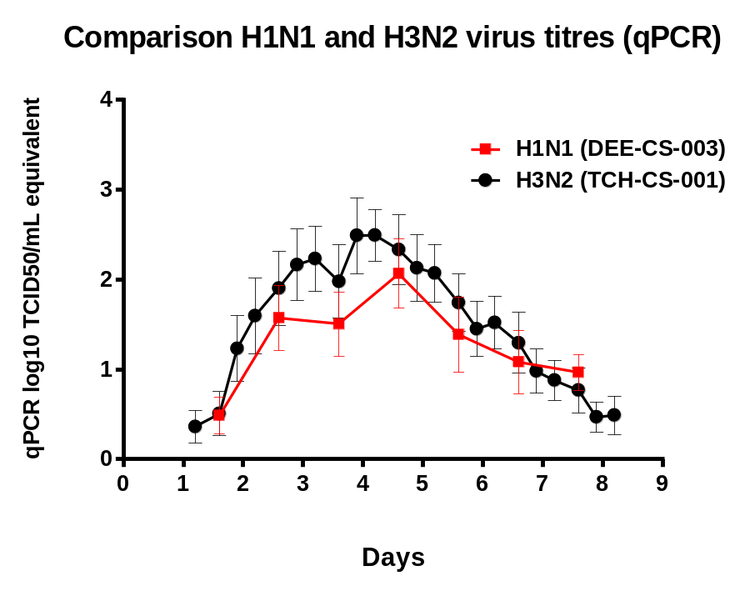
How We Do It
Virus Characterization: H3N2 vs H1N1 (hVIVO)
Notes:
New H3N2 virus comparable to H1N1
Sample charts and colour guide use

Slide 26
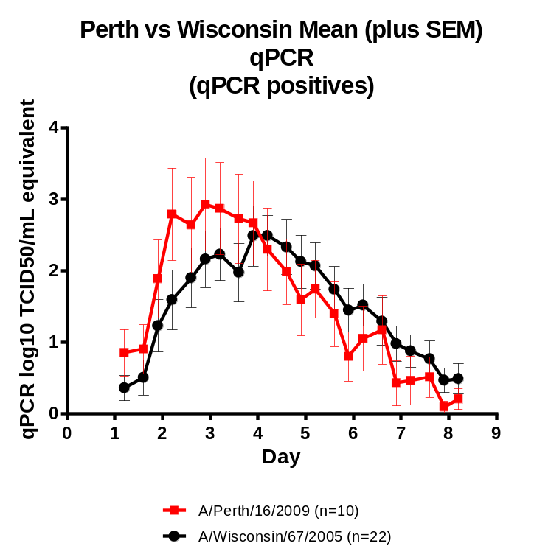
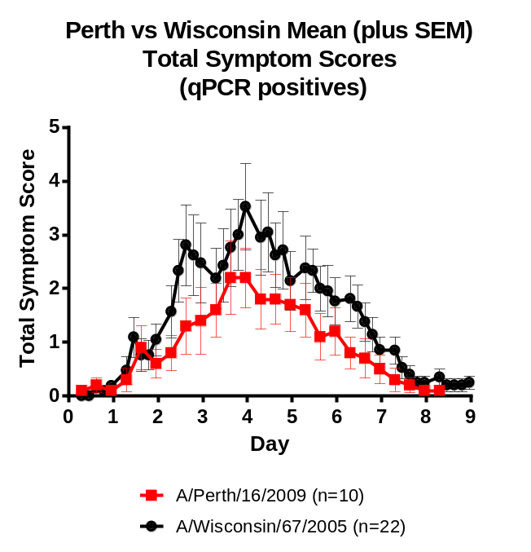
How We Do It
Virus Characterization: Comparability of Historical vs Current
Notes:
New 2015 produced H3N2 virus results show its comparableto virus we have been using for 15 years that we have shown safe and effective for human challenge studies. It also illustrates the consistent high quality viruses we provide due to our systematic approach, selection criteria, and efficacy/safety studies we apply.

Slide 27
hVIVO Summary
Human challenge models provide an effective option for testing drugs safety and efficacy
hVIVO is the market leader in challenge studies
Experienced: 40+ Studies, 1970+ Volunteers
Multiple models (RSV, Influenza, HRV, Asthma, Elderly)
Rigorously characterized cGMP viruses (H3N2 and H1N1)
The hVIVO platform enables organizations to accelerate their time to market
Product Validation
Rational Selection of Biomarkers and Drug Targets
Notes:
AS market leaders hVIVO provides human challenge models that are effective and valuable alternatives to field-based studies. hVIVO and the hVIVO platform brings…
Extensive experience developing the human viral challenge model over 14 years
Purpose-built quarantine facility to minimise cross-infection
Core team of highly experienced and trained staff.
Large database of placebo data for use in designing future studies
Capability to scale with your study needs
Range of GMP-grade Influenza/RSV/HRV virus strains. Recently produced a high quality, rigorously characterized GMP wild-type H3N2 virus
A higher infection rate than previously published influenza challenge studies, but using a lower inoculum titre
By using a strict definition of serosuitable (<10 HAI) subjects, in line with historical studies, we are able to ensure a consistent approach to the HVC Model improving reproducibility by limiting variance in clinical outcome due to varying pre-inoculation antibody titres.
Our Influenza A/Perth/16/2009 (H3N2) stock has been produced in sufficient quantity to enable the same batch to be used throughout the development of the different planned models, thus building up an important body of safety and pathogenicity data
hVIVO provides the ability to accelerate their time to market though product validation and rationally selecting biomarkers and drug targets driven by data and insights obtained through the study

Slide 28
Thank you
Contact Information
Rob Lambkin-Williams, BSc, PhD, MRPharmS
Executive Scientific Adviser
Email: rlw@hvivo.com
Phone: 011 44 (0) 7710577019
Rich Niemi
Senior Director Business Development
Email: r.niemi@hvivo.com
Phone: 1 609- 841-1504

Slide 29
