Slide 1
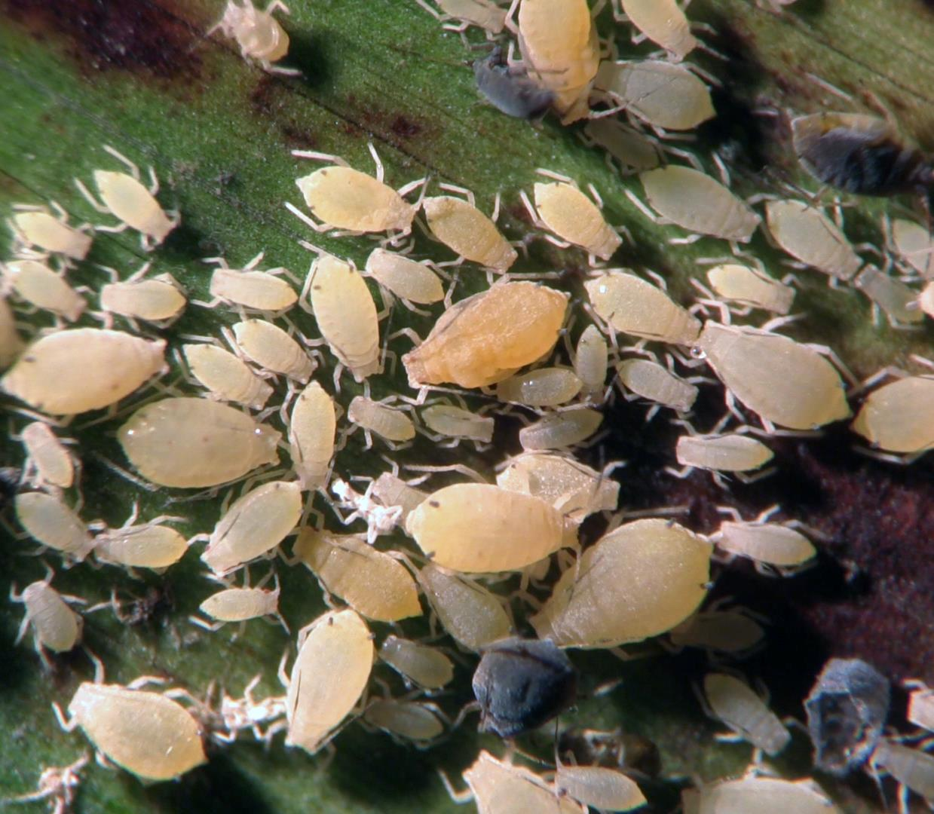
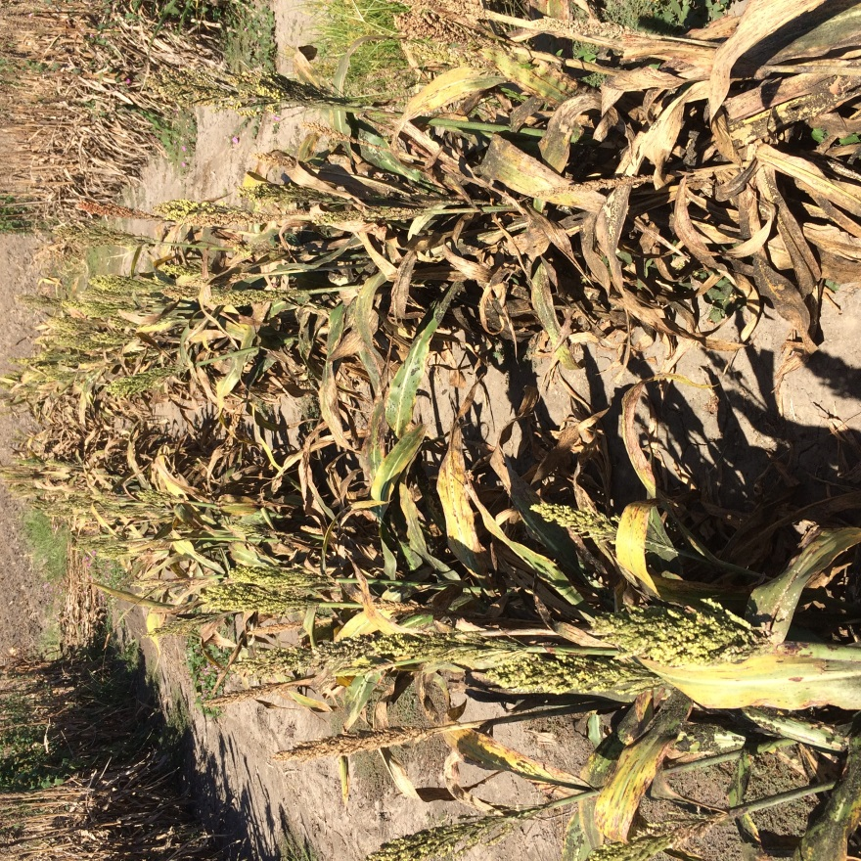
The Sugarcane Aphid (Hemiptera: Aphididae): An Invasive Pest of Sorghum in North America
International Conference on Agri-Biotech and Environmental Engineering
Robert Bowling
San Antonio, TX
September 11, 2017

Slide 2
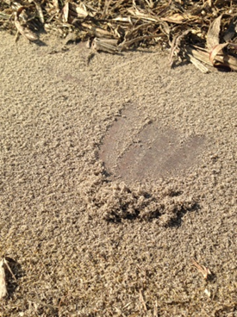
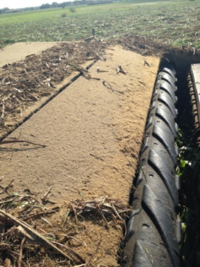
Agenda: Sugarcane Aphid (SCA):
Background
Management
  Threshold and Insecticides
    Insecticide Seed Treatments
    Foliar
    At Harvest
  Biological control
  Sudden Region Wide Collapse
  Host Plant Resistance
  Moving Forward

Slide 3
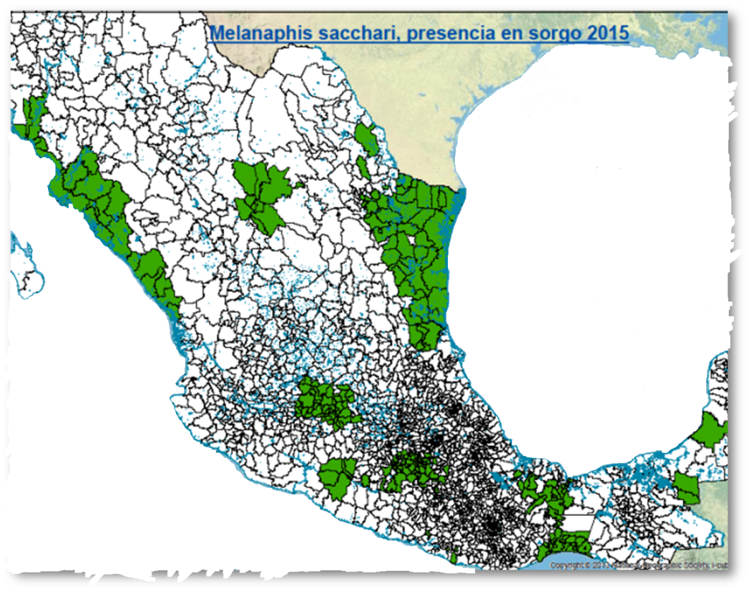
October 30, 2016
Occurrence:
19 States
Over 400 Counties
At Risk:
      All U.S. sorghum
2013

Slide 4
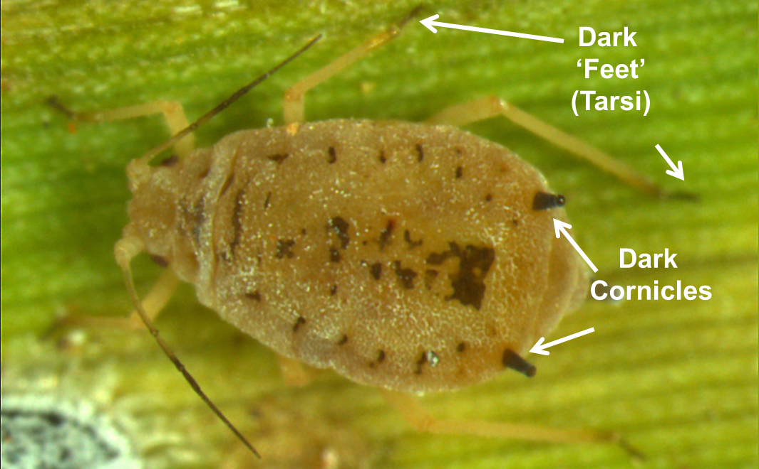
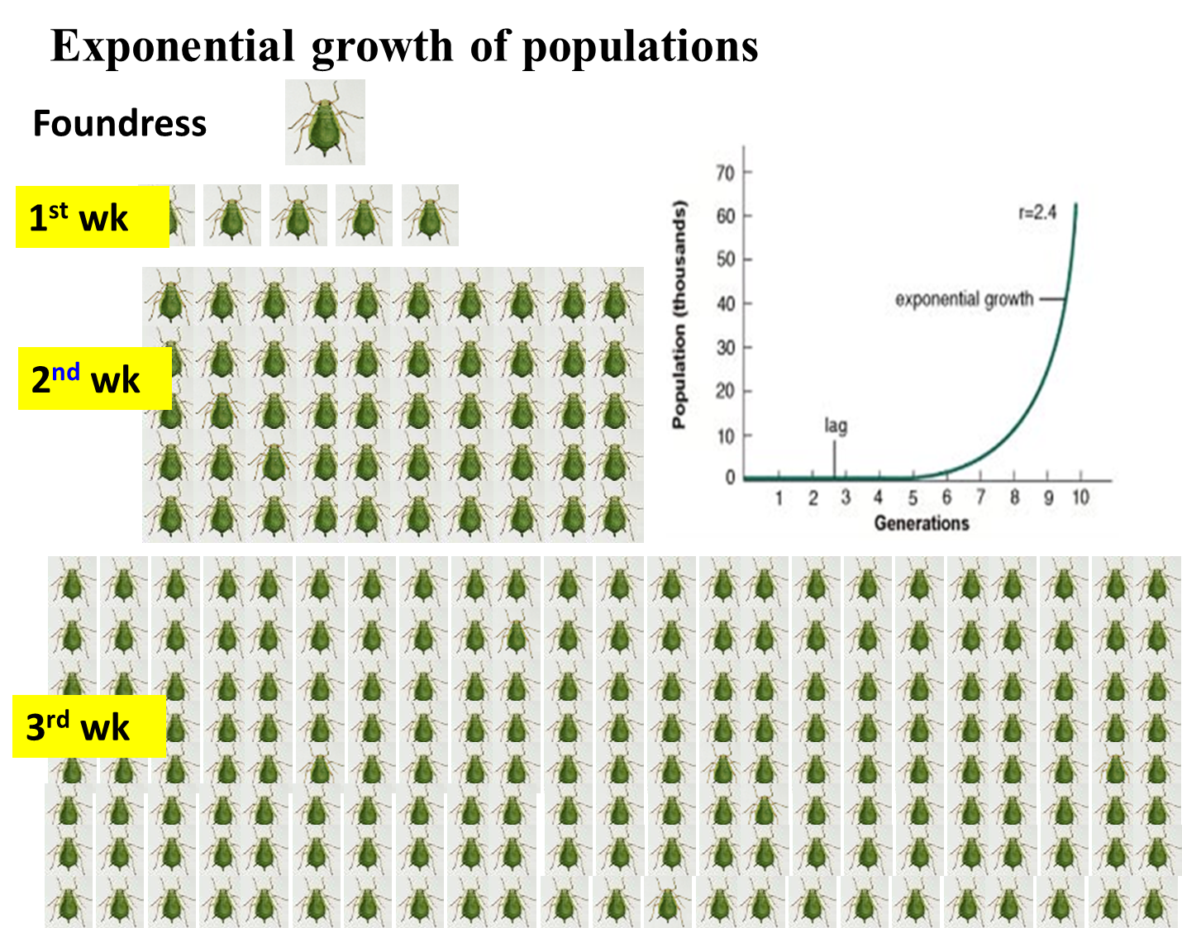
Background: Education for ALL!
Identification – Unique Characteristics
Biology – All female & exponential growth
Damage – sap feeders, general plant decline,
honeydew, sooty mold, move to heads
Insecticide – sorghum labeled insecticides not working
Biological Control – Not well understood
Host plant resistance – not available

Slide 5
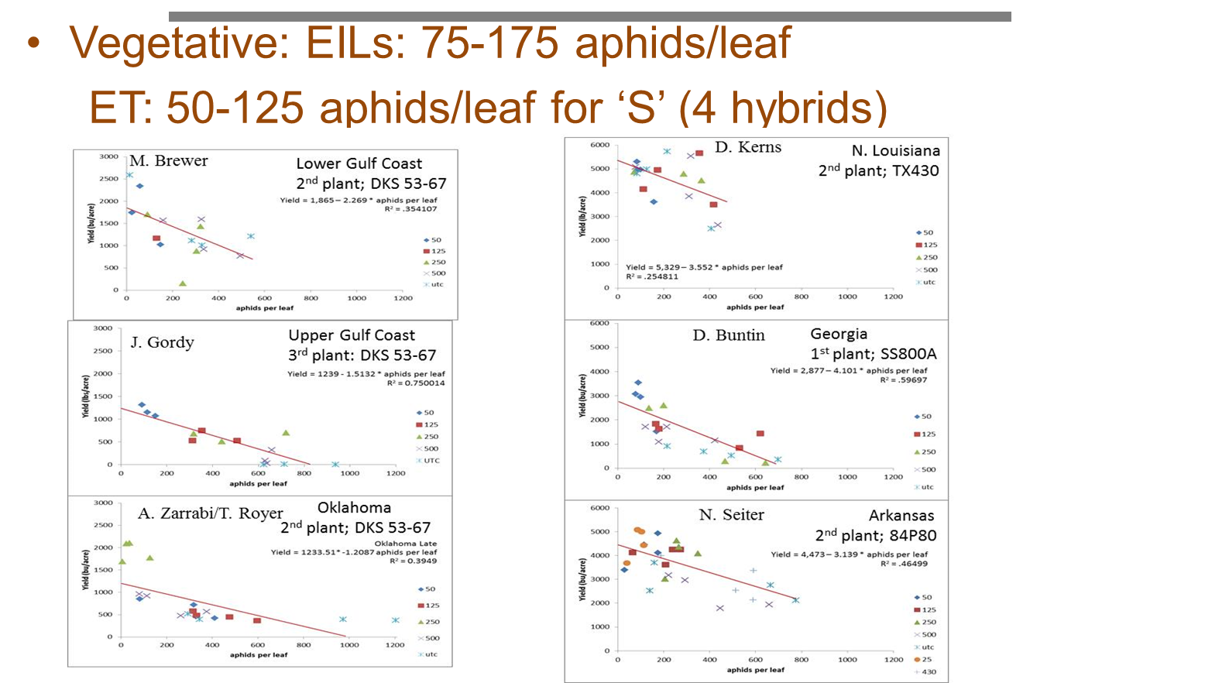
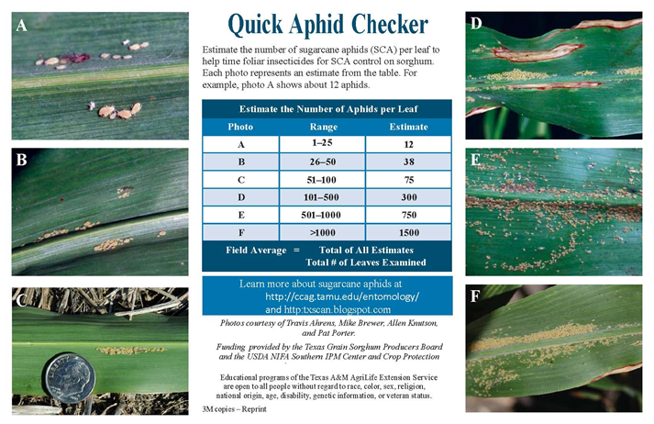
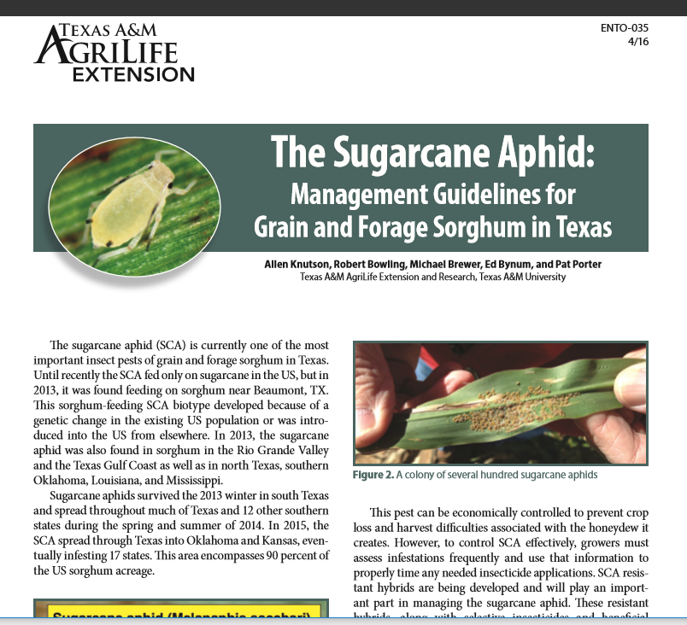
Management: Threshold and Outreach
Threshold
  Avg. of 50 – 125 Aphids/Leaf
    Regional variations
  Number to make treatment decisions
  Scouting Card
Educational Programming
  Field
  Classroom
  Publications

Slide 6
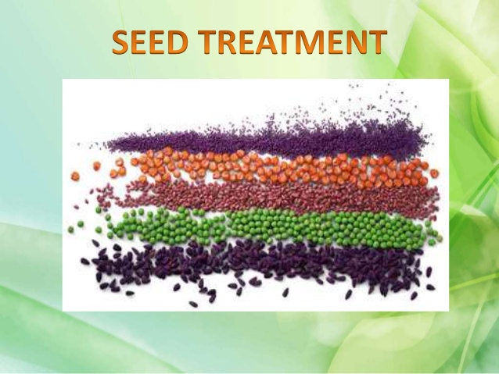
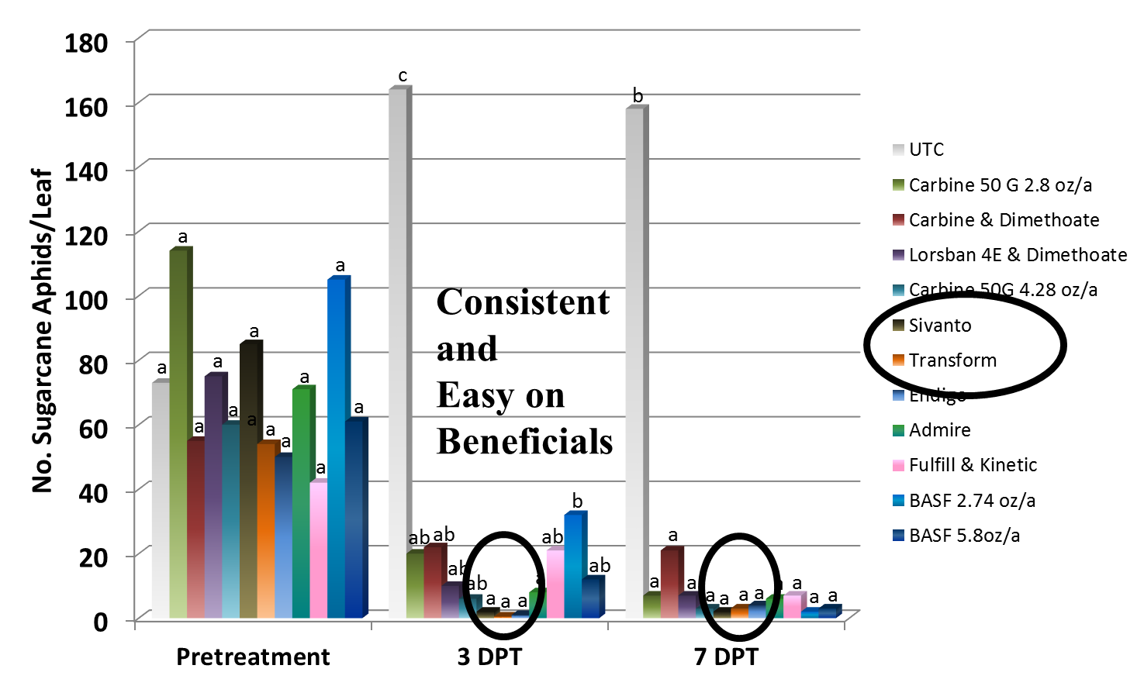
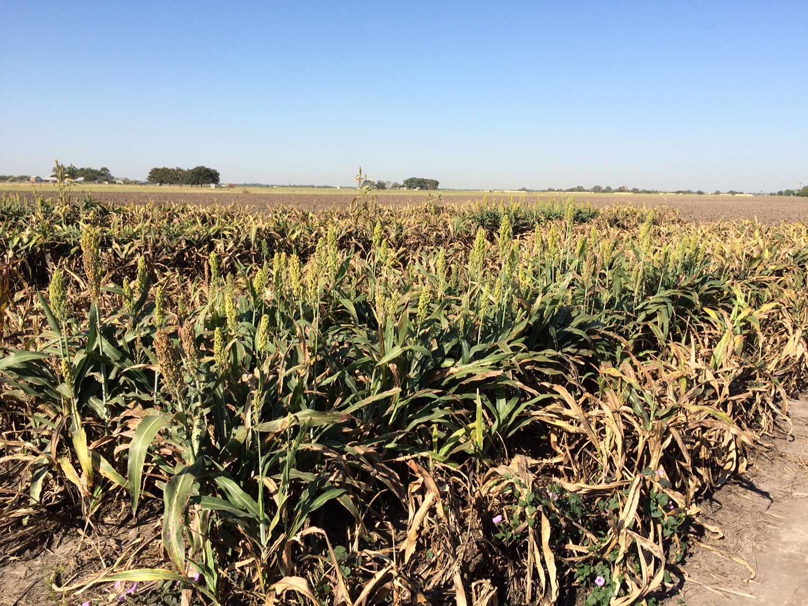
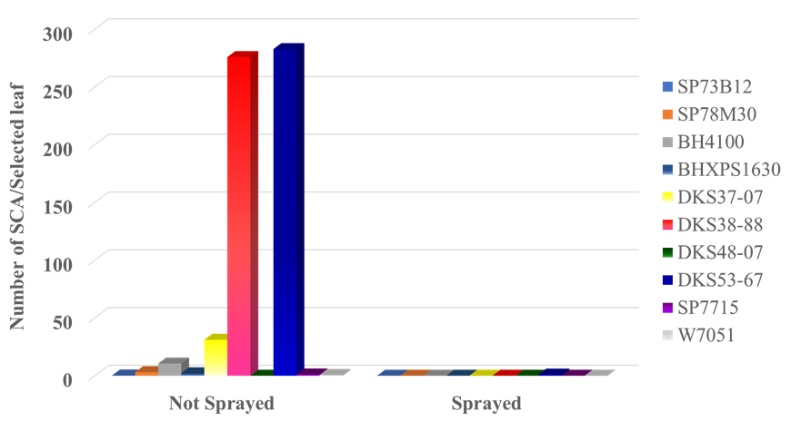
Management: Insecticides – Initial Defense
Insecticides labeled for aphids ineffective
Seed Treatments – Early Protection but not when needed
              Foliar Insecticides – Numerous Research Trials
                Transform & Sivanto –
  - Consistent
  - Safe to SCA biological control
  - w/harvest aids
              Continue looking

Slide 7
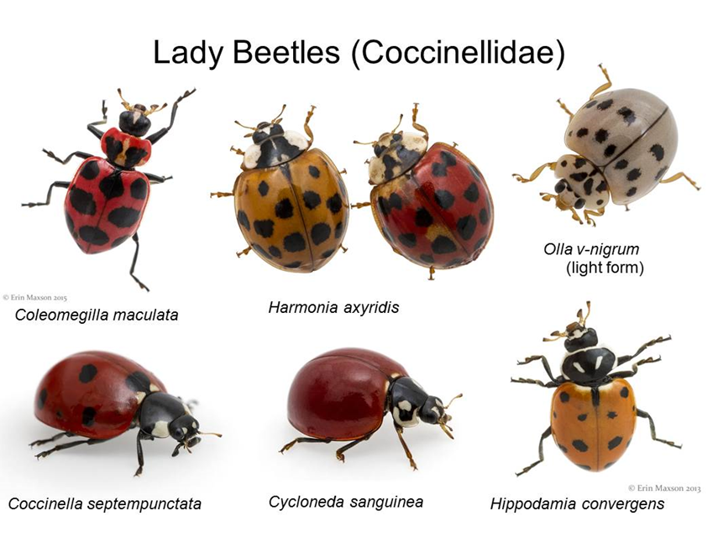
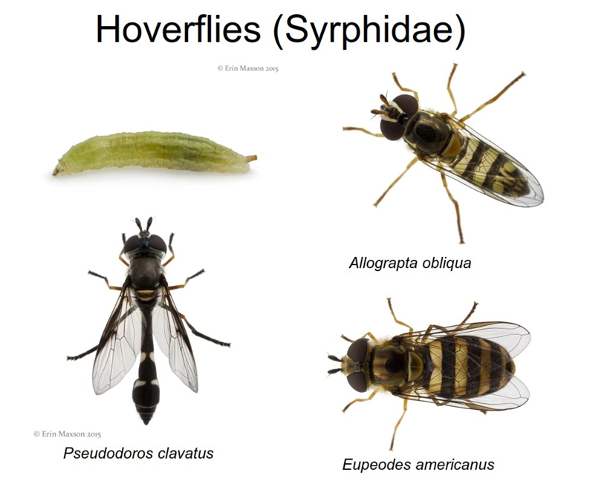
Biological Control
Numerous and well documented
Some help but generally ineffective
as control agents
Best fit may be in
conjunction with resistant
(tolerant) sorghum

Slide 8

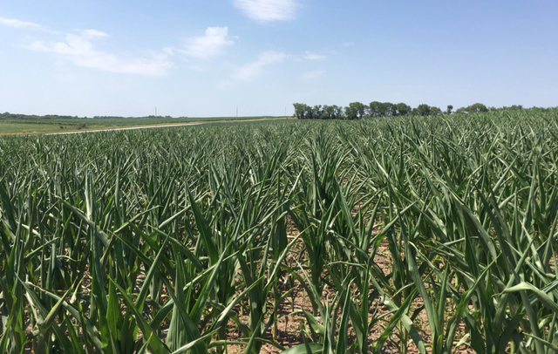
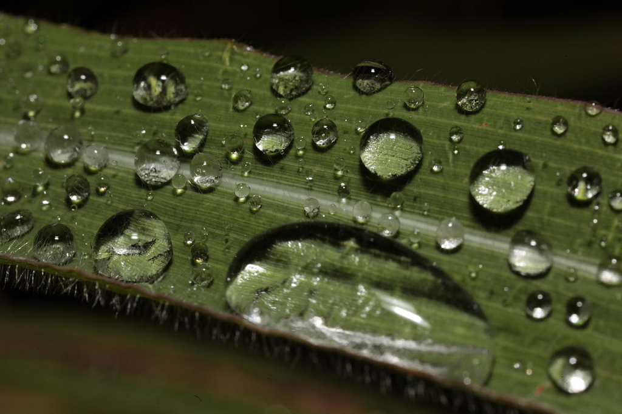
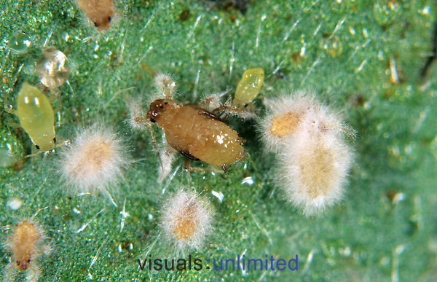
Sudden Collapse: Predictability
Some Predictability
May be weather related
Extreme heat may have
an effect
Heavy dew???
Cool and wet conditions
  Entomopathogens?

Slide 9
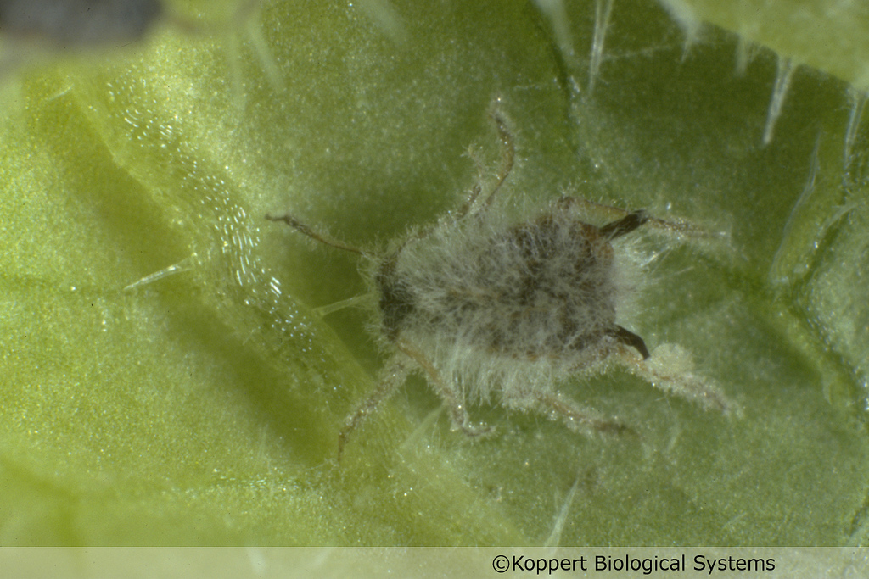
Fungal Entomopathogen:
Lecanicillium lecanii
Strain specific
High relative humidity
Temperature range
between 77 and 86 F
On possible cause for
widespread collapse
Hard to predict

Slide 10
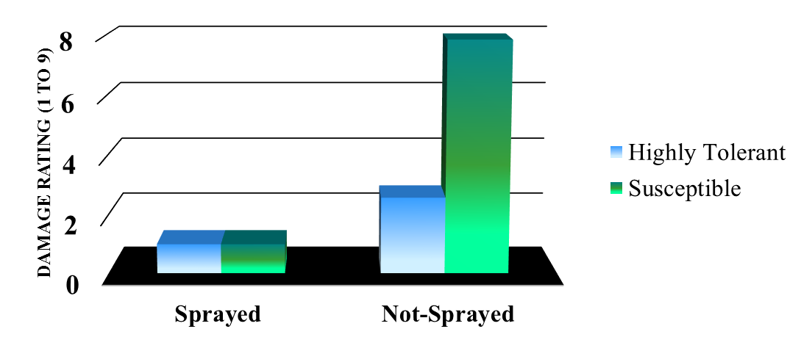
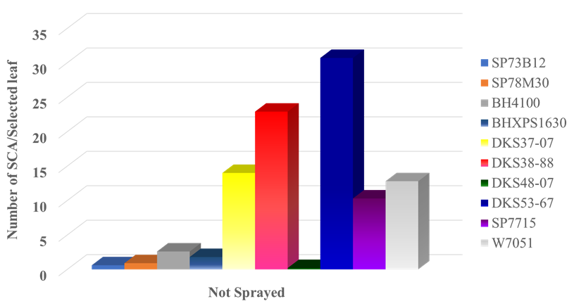
Sorghum Resistance to SCA
Highly desirable
  Cost effective
  Works well with other IPM practices
    Biological control
Not Perfect
  SCA will colonize
  Scouting important
Line-up continuing to grow
  Current research and list
Heavy dew?

Slide 11
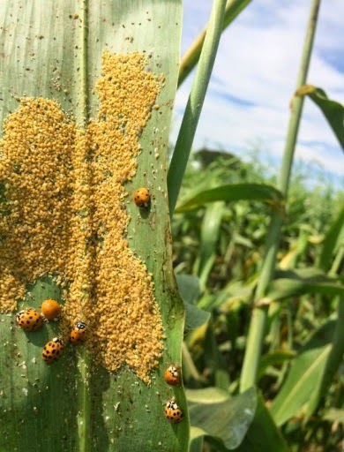
SCA Management – Moving Forward
Intensive sampling sorghum for SCA
  Refine economic thresholds
  Enhance sampling/scouting procedures
  ET for SCA tolerant sorghum
Sorghum Tolerance/Biological Control
  Compatibility of SCA tolerant sorghum and natural enemies
Areawide SCA Management
  Landscape of sorghum w/ and w/o SCA tolerance and biological control

Slide 12
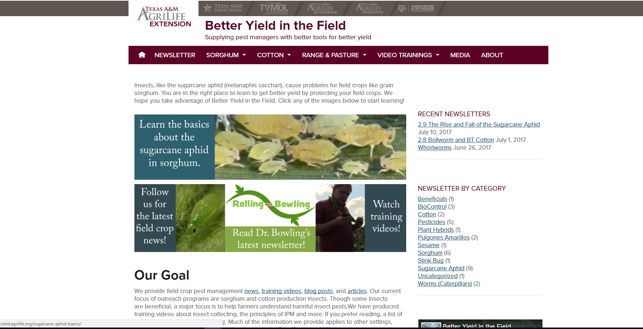

http://www.sorghumcheckoff.com/newsroom/2016/03/28/sugarcane-aphid/
http://betteryield.agrilife.org/

Slide 13

Thank You!
Questions!

