Slide 1


World Bioenergy Congress and Expo
Bioenergy: A Step Toward a Sustainable Future
“Back to the Future: a Perspective from the Central USA”
Rob Mitchell
WBCE Organizing Committee
June 13, 2016
Rome, Italy

Slide 2
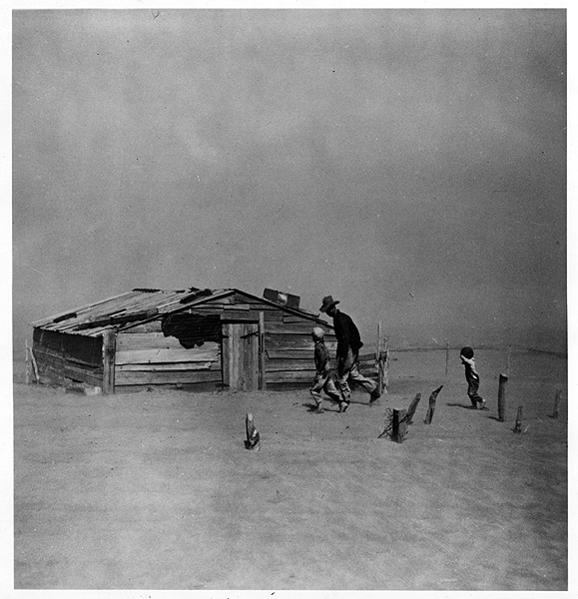
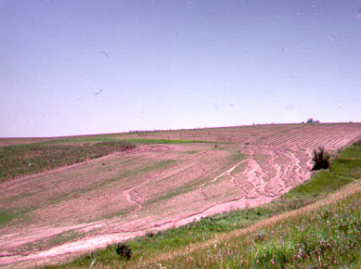
Land use change & concern for marginal land is not new
In the Central USA, European settlement & farming began in the 1860’s.
The Dust Bowl (a period of severe drought from 1928-1937) was the first large-scale indicator that farming practices were not sustainable.
Millions of acres of marginal cropland & overgrazed grassland had to be reseeded to correct this ecological & economic disaster.
From 1920 to 1954, the number of horses & mules in the US dropped from 27 to <5 million, releasing ~80 million acres of pasture & hay for other uses.
“Recent years have witnessed a growing interest in the possibilities of a more rational use of land in the US…. on those areas of such physical character or situation that the returns to production are either meager or precarious.” Peterson & Galbraith, 1932

Slide 3
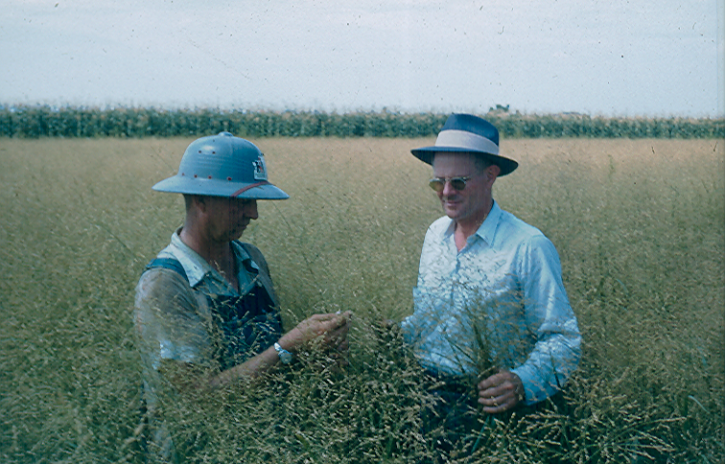
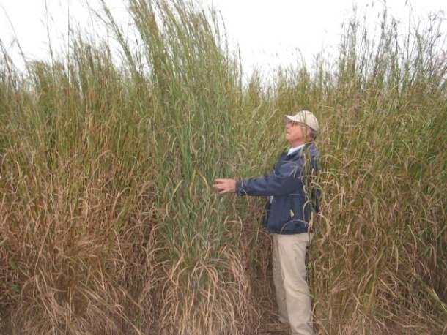
Perennial grasses aren’t new
Perennial grasses dominated the central US landscape for millenia.
Since 1935, USDA-ARS & universities have developed improved perennial grass cultivars & associated management practices for use on marginal cropland in the Central US for grazing, hay, conservation, & bioenergy.
L.C. Newell
1935-1975
Ken Vogel
1975-2014

Slide 4
Crop diversity declined dramatically after the 1960s
Settlement to 1970 - most farms in the central USA were characterized by diversified crop & livestock production (survive, sustain, succession)
  Most farms grew corn, sorghum (grain & forage), wheat, alfalfa, soybean, sugar beets, perennial pasture, cattle (beef & dairy), hogs, horses, sheep, & chickens
1970 to Present - Diversified systems have become abnormal in the central USA (increase, incorporate, intermission)
-Corn-soybean rotation dominates the farmscape
Bioenergy – 1st Gen biofuels from corn grain; 2nd Gen biofuels from corn stover; provides an opportunity to change the culture of agriculture to a modern diversified crop-livestock-bioenergy production system

Slide 5
Historic trends in crop production in Nebraska
 | 1969 | 1982 | 1997 | 2012 | Change, %
 | -------------------- Hectares --------------------
Corn (grain) | 1,778,529 | 2,640,296 | 3,353,197 | 3,680,580 | 107%
Corn (silage & forage) | 146,297 | 155,710 | 84,883 | 180,786 | 24%
Total Corn | 1,924,826 | 2,796,007 | 3,438,080 | 3,861,366 | 101%
Soybean | 265,258 | 852,855 | 1,355,414 | 2,018,217 | 661%
Sorghum (grain) | 591,821 | 671,181 | 2,91,712 | 24,304 | -96%
Sorghum (silage & forage) | 72,589 | 32,652 | 10,745 | 4,729 | -93%
Wheat | 994,309 | 1,046,970 | 717,688 | 530,254 | -47%
Total | 5,773,629 | 8,195,672 | 9,251,719 | 10,300,237 | 78%
NASS, 2016

Slide 6
World Bioenergy Congress and Expo
Demand for food, feed, fiber, & fuel will continue to escalate as the world population increases.
Research in the USA continues to cast doubt on the long-term sustainability of monoculture row crops like corn and soybeans on marginally productive cropland.
Rather than retire this cropland as has been done during the last 3 decades, growing herbaceous and woody perennials provides an excellent opportunity for biomass feedstock production to meet the fuel and livestock feed demand.
The science supports that strategically growing perennial biomass feedstocks on a small percentage of the marginally productive cropland can reap significant environmental benefits.

Slide 7
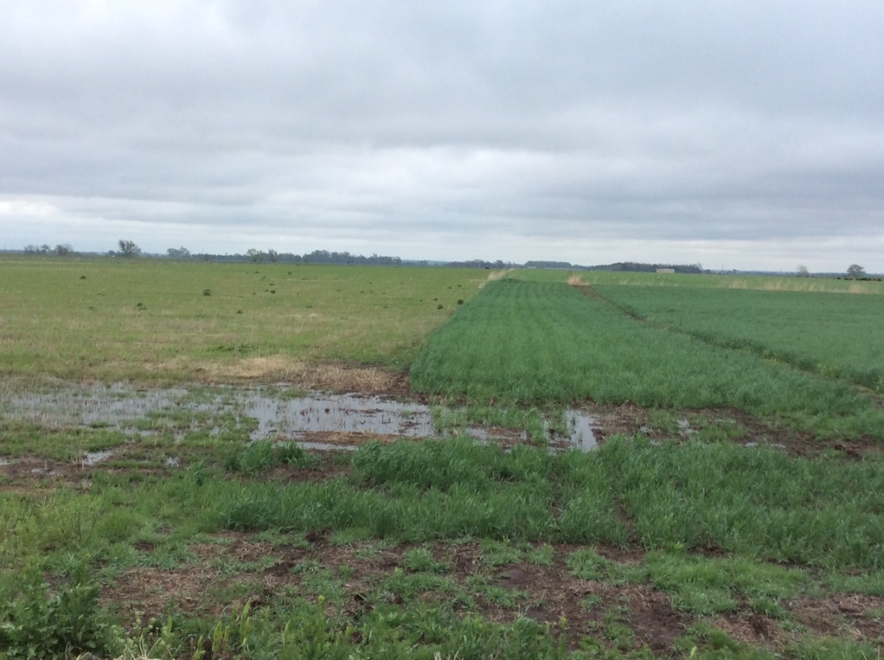
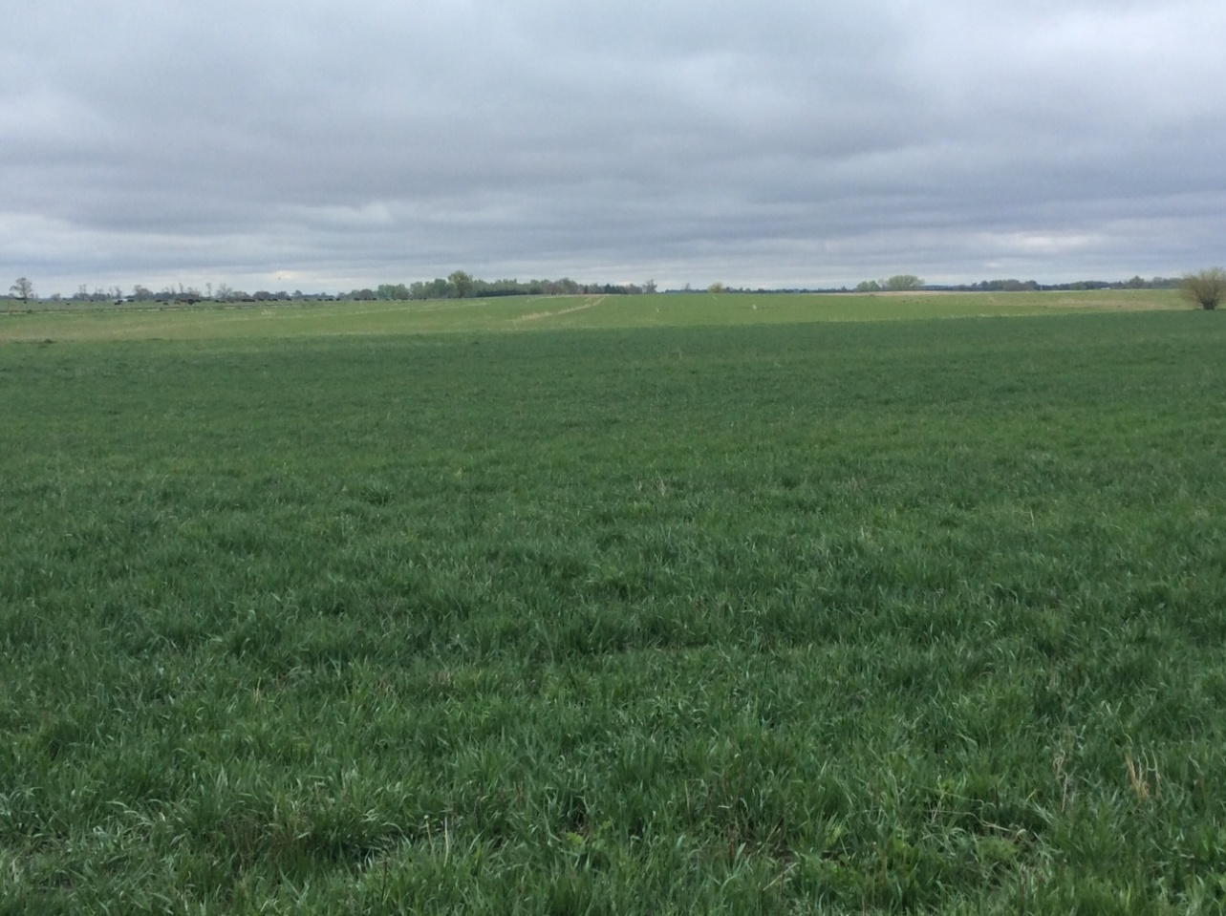
Crop-Livestock-Bioenergy Demonstration Site
UNL Agricultural Research & Development Center
This working lands approach to growing perennial bioenergy feedstocks on marginally productive cropland is in many ways a look ‘back to the future’, returning to a diverse crop system.
In my opinion, a biobased economy in the USA will be more similar to agricultural production of the 1950’s than what we see today, but coupled with recent technological advancements.

Slide 8
World Bioenergy Congress and Expo
During the next two days we will hear cutting edge research updates from about 20 countries.
Prepare to be challenged, excited, and inspired by the upcoming meeting.
Thank you to the organizing committee, all of the speakers, and invited guests.
I wish you every success in your discussions and a very pleasant stay in Rome!

