Slide 1


Inducing Dwarfing Bougainvillea for urban and peri-urban Landscaping
Indian Agricultural Research Institute, New Delhi
Ritu Jain
Division of Floriculture and Landscaping
Indian Agricultural Research Institute, New Delhi

Slide 2
Introduction
Bougainvillea is a very important plant as it is grown as shrub, climber, bush specimen , flowering hedge, ground cover , bonsai and pot plant.
Provides colour to the garden almost throughout the year.
It can be train on walls of a house or any building, arches, pergolas, etc.
Greatly demanded by soft landscape architects for the development of landscapes as it requires minimum maintenance, bloom heavily during hot summer months, requires very less water.
Breeding dwarf varieties or making bonsai or use of plant growth retardants could be alternatives to frequent pruning.
Due to less water requirement and low maintenance cost it is preferred plant of people living in urban and peri urban areas.
It goes upto 30 m. height, so requires regular pruning to keep them in shape and to maintain size.
Indian Agricultural Research Institute, New Delhi

Slide 3
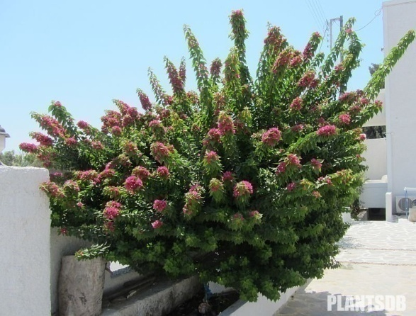
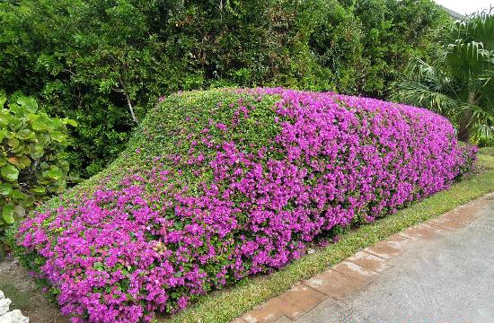
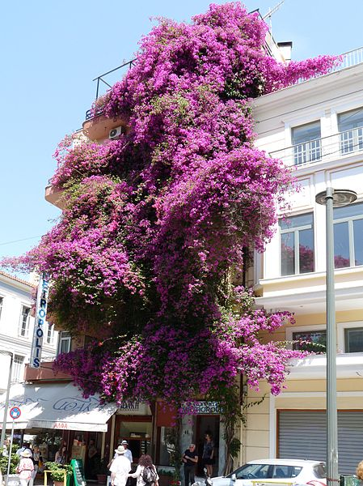
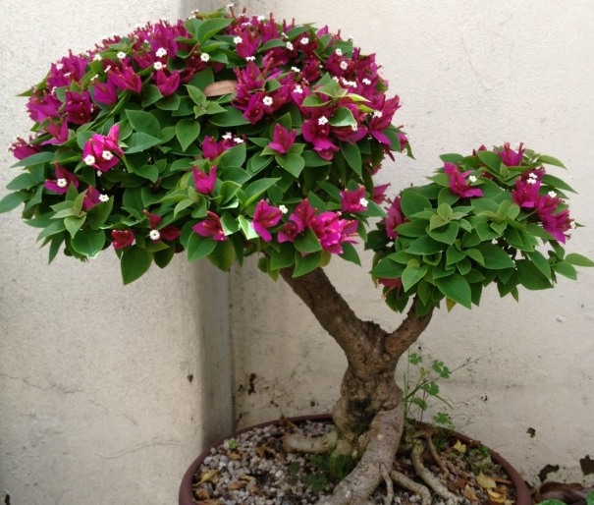

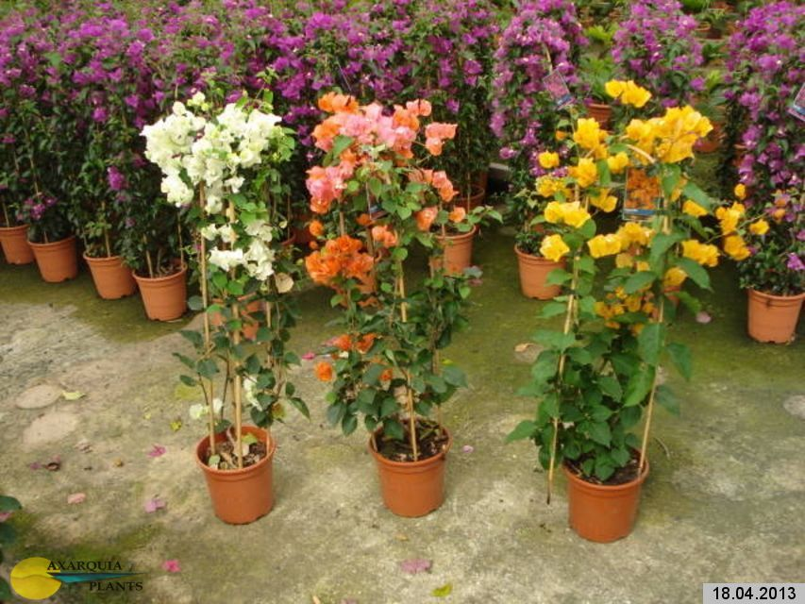
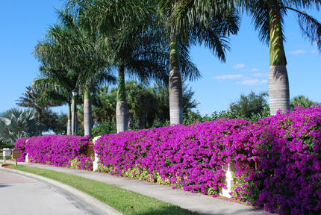
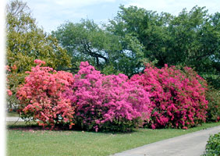

Uses
Shrub
Topiary
Climber
Bonsai
Pot
plant
Hedge
Group planting
Arches & Pergolas

Slide 4
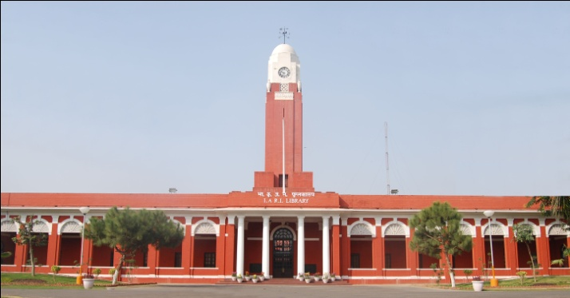
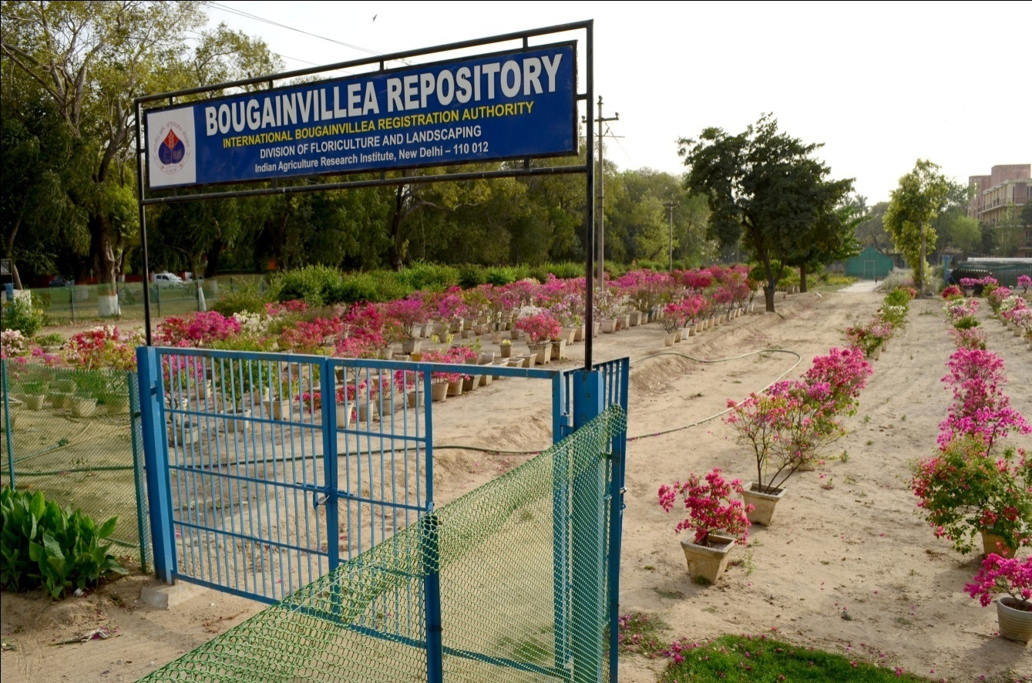
Seat of green revolution, INDIAN AGRICULTURAL RESEARCH INSTITUTE
International Crop Registration Authority for Bougainvillea appointed by the International Society for Horticultural Science, Belgium (1966)
Indian Agricultural Research Institute, New Delhi

Slide 5
Objective
To induce dwarfing in bougainvillea cv. Shubhra with the use of growth retardants.
Materials and Methods
Rooted cuttings of cv. Shubhra were planted on 7th July 2012 in earthen pot of 25 cm diameter and allowed to grow for two months
The plants were pruned to a uniform height of 25+5 cm, on 3rd September 2012.
After pruning the plants were treated with growth retardants

Slide 6
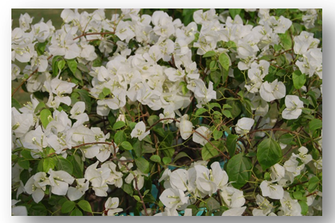
Experimental details
  Variety : Shubhra
  Treatments :11
  Replications : 4
  Growth Retardants :3
  (Paclobutrazol, maleic hydrazide, daminozide or B-9)
  Experimental Design : CRD
  Mode of application : Spray or Drench
  Data was recorded at 2, 6, 10 and 14 weeks for vegetative traits and after 10 weeks for flower traits
Indian Agricultural Research Institute, New Delhi

Slide 7
Observations recorded
Plant height (cm)
Plant spread (cm)
Internode distance (cm)
Shoot length (cm)
Shoot diameter (mm)
Number of branches
Growth index (Average plant height+ plant spread/2), flower index (1.00=none, 2.00 = slight, 3.00= some, 4.00=moderate, 5.00=heavy)
Form index (1.00=poor, 2.00= fair, 3.00= good, 4.00= excellent)
Number of structural branches per plant (> 15 cm in length)
Disease incidence (%)
Indian Agricultural Research Institute, New Delhi

Slide 8
Treatment Details
T₁ ⁻ 125ppm Paclobutrazol (Spray)
T₂⁻ 250ppm Paclobutrazol (Spray)
T₃⁻ 500ppm Paclobutrazol (Spray)
T₄⁻ 20 ppm Paclobutrazol (Drench)
T₅⁻ 30 ppm Paclobutrazol (Drench)
T₆⁻₋ 40 ppm Paclobutrazol (Drench)
T₇⁻ 1500 ppm Maleic Hydrazide (Spray)
T₈⁻ 2500 ppm Maleic Hydrazide (Spray)
T₉⁻ 5000ppm Daminozide (Spray)
T₁₀⁻ 7500ppm Daminozide (Spray)
T₁₁⁻ Control

Slide 9
Results
Indian Agricultural Research Institute, New Delhi

Slide 10
Effect of plant growth retardants on shoot diameter of bougainvillea cv. Shubhra
Treatments | Shoot Diameter (cm)
 | 0 wk (W₁) | 2 wk (W₂) | 6 wk (W₃) | 10wk (W₄) | 14 wk (W₅) | Mean
125ppm Paclobutrazol (T₁) | 9.66 | 9.74 | 10.57 | 9.83 | 10.10 | 9.98
250ppm Paclobutrazol (T₂) | 8.36 | 8.89 | 8.93 | 9.90 | 10.35 | 9.29
500ppm Paclobutrazol (T₃) | 7.48 | 6.05 | 8.22 | 7.95 | 8.21 | 7.58
20 ppm Paclobutrazol (T₄) | 7.56 | 11.50 | 11.90 | 11.60 | 11.91 | 11.06
30 ppm Paclobutrazol (T₅) | 7.68 | 7.62 | 8.44 | 8.97 | 9.22 | 8.39
40 ppm Paclobutrazol (T₆) | 7.16 | 7.80 | 7.62 | 8.02 | 8.26 | 7.77
1500 ppm Maleic Hydrazide (T₇) | 9.32 | 9.09 | 8.93 | 8.95 | 9.01 | 9.06
2500 ppm Maleic Hydrazide (T₈) | 11.99 | 8.07 | 8.20 | 7.81 | 7.82 | 8.78
5000ppm Daminozide (T₉) | 9.16 | 8.89 | 12.08 | 10.42 | 10.46 | 10.20
7500ppm Daminozide (T₁₀) | 8.87 | 10.35 | 10.59 | 10.32 | 10.37 | 10.10
Control (T₁₁) | 6.96 | 6.09 | 8.40 | 7.04 | 7.08 | 7.11
Mean | 8.92 | 8.67 | 9.44 | 9.17 | 9.34
CD _{0.05}
Treatments (T) | 2.46
Weeks (W) | NS
(TxW) | NS
Indian Agricultural Research Institute, New Delhi

Slide 11
Effect of plant growth retardants on internode distance of bougainvillea cv. Shubhra
Treatments | Internode distance (cm)
 | 0 wk (W₁) | 2 wk(W₂) | 6 wk (W₃) | 10wk (W₄) | 14 wk (W₅) | Mean
125ppm Paclobutrazol (T₁) | 1.55 | 2.51 | 2.79 | 3.48 | 3.45 | 2.75
250ppm Paclobutrazol (T₂) | 1.81 | 2.25 | 2.12 | 5.03 | 4.64 | 3.17
500ppm Paclobutrazol (T₃) | 1.72 | 1.83 | 2.44 | 2.17 | 2.21 | 2.07
20 ppm Paclobutrazol (T₄) | 2.33 | 1.93 | 1.62 | 1.56 | 1.67 | 1.82
30 ppm Paclobutrazol (T₅) | 1.78 | 1.77 | 1.77 | 1.80 | 1.78 | 1.78
40 ppm Paclobutrazol (T₆) | 1.77 | 1.59 | 1.48 | 1.55 | 1.55 | 1.59
1500 ppm Maleic Hydrazide (T₇) | 1.47 | 1.86 | 2.04 | 2.05 | 2.05 | 1.89
2500 ppm Maleic Hydrazide (T₈) | 1.39 | 1.49 | 1.65 | 1.71 | 1.71 | 1.59
5000ppm Daminozide (T₉) | 1.23 | 2.42 | 2.88 | 2.89 | 2.71 | 2.42
7500ppm Daminozide (T₁₀) | 1.82 | 2.04 | 2.24 | 2.27 | 2.23 | 2.12
Control (T₁₁) | 2.65 | 1.75 | 1.87 | 1.91 | 1.89 | 2.01
Mean | 1.77 | 1.95 | 2.08 | 2.40 | 2.35
CD _{0.05}
Treatments (T) | 0.52
Weeks (W) | 0.35
(TxW) | 1.15
Indian Agricultural Research Institute, New Delhi

Slide 12
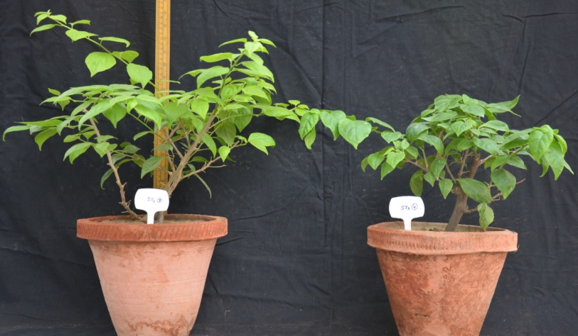
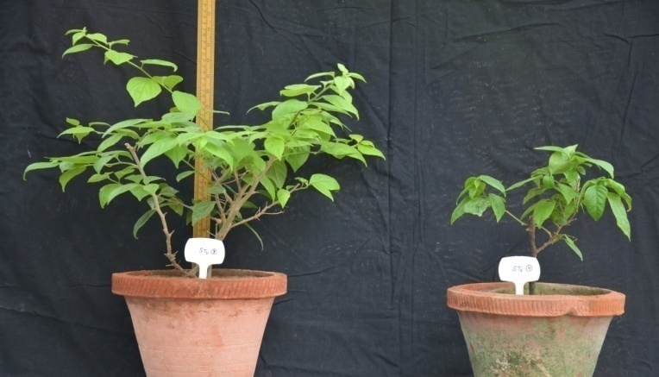
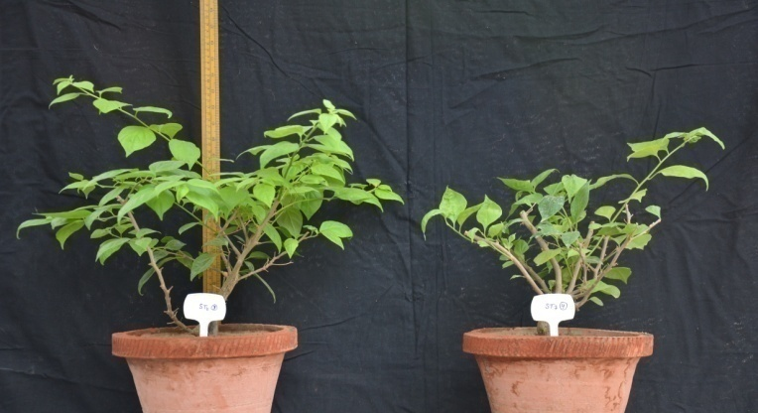
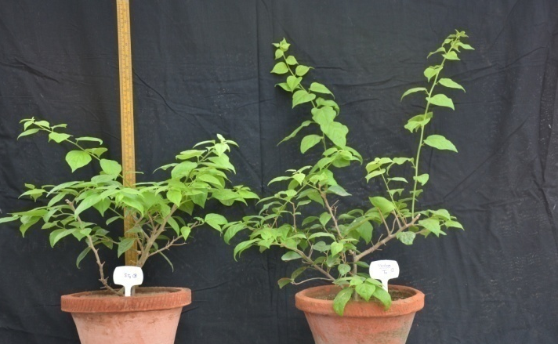
500 ppm Paclobutrazol spray
40 ppm Paclobutrazol drench
Indian Agricultural Research Institute, New Delhi
2500 ppm MH Spray
5000 ppm Daminozide spray
Effect of different growth retardants on plant height of Bougainvillea Cv. Shubhra

Slide 13
Effect of growth retardants on qualitative traits of bougainvillea cv. Shubhra
Treatments | No. of structural branches | Growth index | Flower index | Form index | Disease Incidence %
125ppm Paclobutrazol (T₁) | 9.50(3.23) | 60.94 | 2.84 | 2.25 | 0.00(1.00)
250ppm Paclobutrazol (T₂) | 6.50(2.72) | 50.06 | 3.00 | 1.75 | 0.00(1.00)
500ppm Paclobutrazol (T₃) | 5.00(2.45) | 42.38 | 4.50 | 1.50 | 6.25(2.03)
20 ppm Paclobutrazol (T₄) | 2.50(1.87) | 39.75 | 2.74 | 2.25 | 6.25(2.03)
30 ppm Paclobutrazol (T₅) | 5.00(2.38) | 42.31 | 3.24 | 1.75 | 0.00(1.00)
40 ppm Paclobutrazol (T₆) | 3.00(1.91) | 35.00 | 2.90 | 1.25 | 6.25(2.03)
1500 ppm Maleic Hydrazide (T₇) | 0.00(1.00) | 30.13 | 1.00 | 2.00 | 0.00(1.00)
2500 ppm Maleic Hydrazide (T₈) | 0.00(1.00) | 23.56 | 1.00 | 2.00 | 6.25(2.03)
5000ppm Daminozide (T₉) | 7.25(2.86) | 60.31 | 2.48 | 2.25 | 0.00(1.00)
7500ppm Daminozide (T₁₀) | 7.00(2.82) | 56.94 | 1.93 | 2.50 | 6.25(2.03)
Control (T₁₁) | 8.25(3.01) | 70.94 | 2.68 | 3.00 | 6.25(2.03)
CD (0.05%) | 0.55 | 14.77 | 1.48 | 0.64 | NS
Indian Agricultural Research Institute, New Delhi

Slide 14
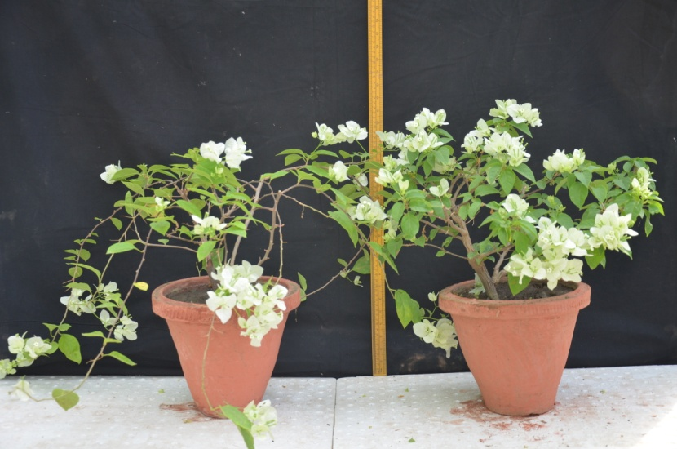
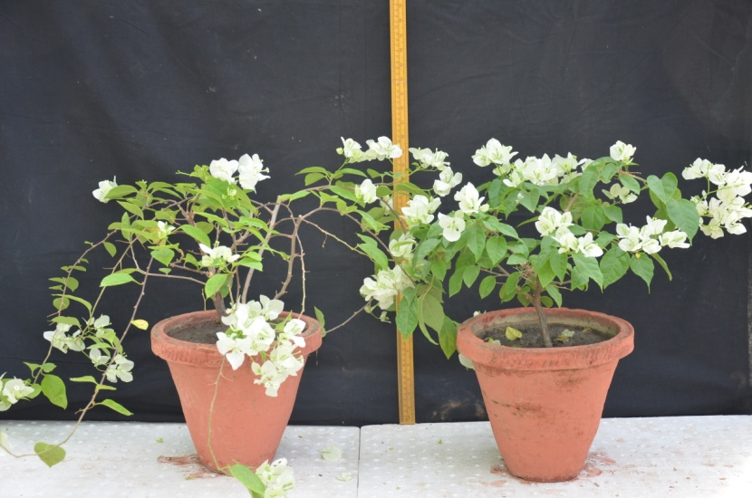
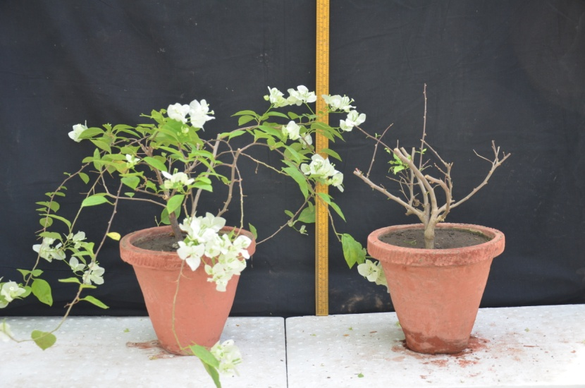
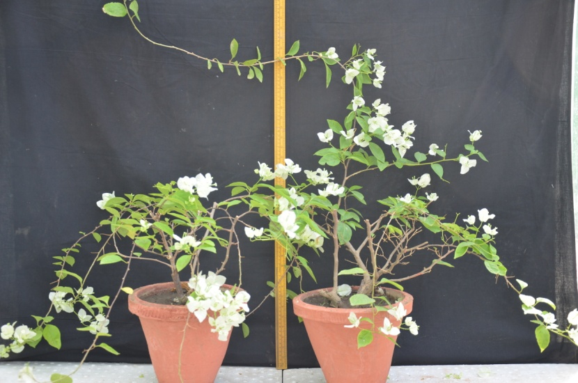
500 ppm Paclobutrazol Spray
30 ppm Paclobutrazol Drench
Indian Agricultural Research Institute, New Delhi
2500 ppm MH Spray
7500 ppm B-9 Spray
Effect of growth retardants on flowering of Shubhra

Slide 15
Conclusions
Land, labour and time is a major constraint in urban and peri urban areas, therefore, using growth retardants to keep plants dwarf and enjoying the beauty in apartments is a very viable option.
Application of 40 ppm paclobutrazol significantly reduced the plant height, internode distance, shoot length, growth and flowering index.
Application of 500 ppm paclobutrazol resulted in compact plants with better flowering, however, drench application of 30 ppm could achieve the similar results.
It is a very good alternative to pruning as the growth and flowering are not affected and the effect of retardants stay back for almost one year.
Indian Agricultural Research Institute, New Delhi

Slide 16


Thank you

