Slide 1
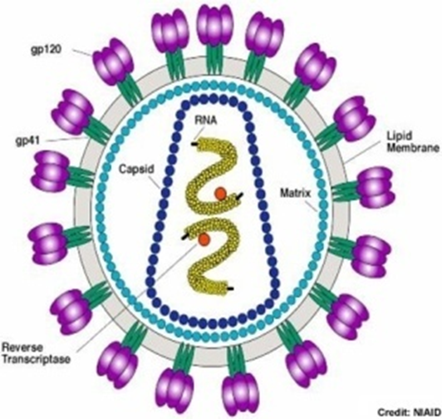

HIV Replication and Maturation
Ritu Gaur
Associate Professor
Faculty of Life Sciences and Biotechnology
South Asian University
New Delhi

Slide 2
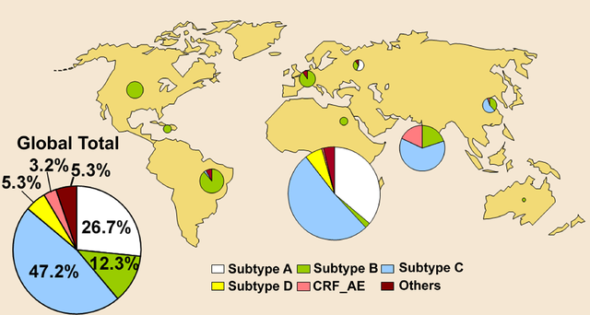
Global Distribution of HIV subtypes

Slide 3
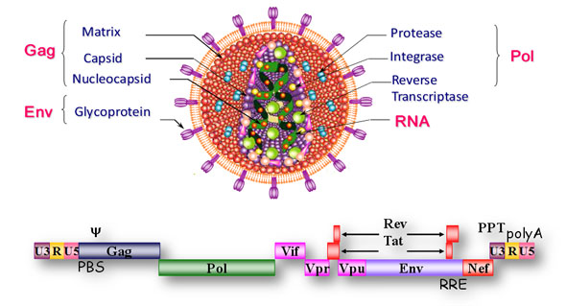
The HIV Structure and Genome

Slide 4
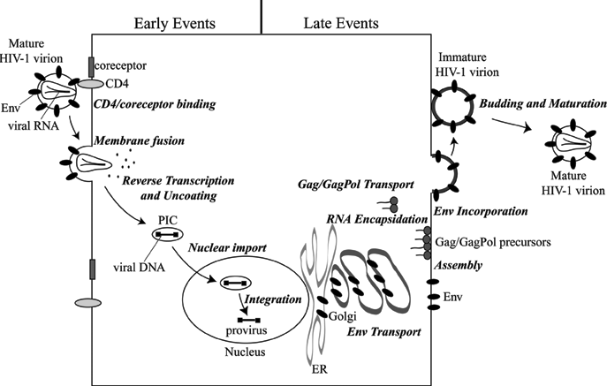
HIV-1 Replication Cycle
Bevirimat
APOBEC
Notes:
4

Slide 5
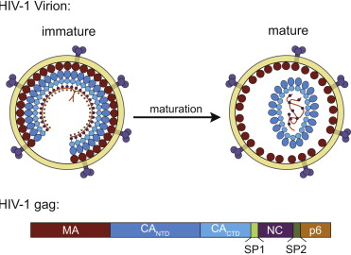
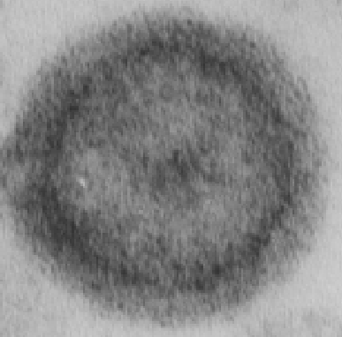
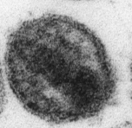
HIV Maturation

Slide 6
Gag is Processed in a Highly Ordered Cascade
Matrix
Capsid
Nucleo
capsid
p6
Pr55Gag
SP1
SP2
MA
CA
NC
p6
SP1
SP2
MA
CA
NC
p6
SP1
SP2
MA
CA
NC
p6
SP1
SP2

Slide 7
HIV-1 replication:
Targets for intervention
CCR5 antagonists
Protease inhibitors
Fusion inhibitors
NRTIs & NNRTIs
Maturation inhibitors
Integrase Inhibitors

Slide 8
Viral Resistance to ARTs
Mutations in viral genome make the virus resistant to ARTs.
HIV treatment is done using combination drugs- HAART

Slide 9
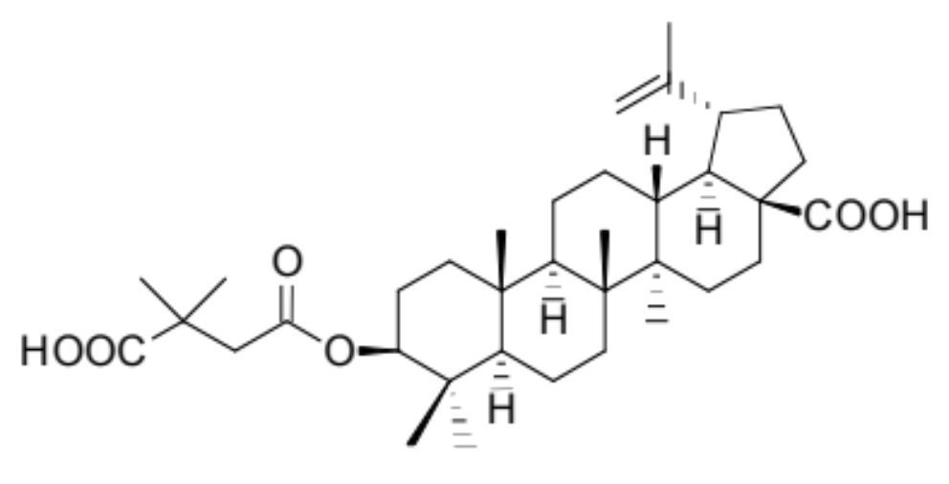
PA-457 − Dimethylsuccinyl Betulinic Acid
(Bevirimat-BVM)
Potently inhibits diverse HIV-1 isolates; no effect against
HIV-2 or SIV
Retains activity against strains of HIV-1 resistant to approved
RT, PR, and fusion inhibitors
Orally bioavailable, with low toxicity in vitro and in vivo
Collaboration with Panacos Pharmaceuticals

Slide 10
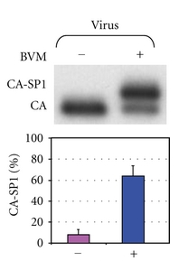
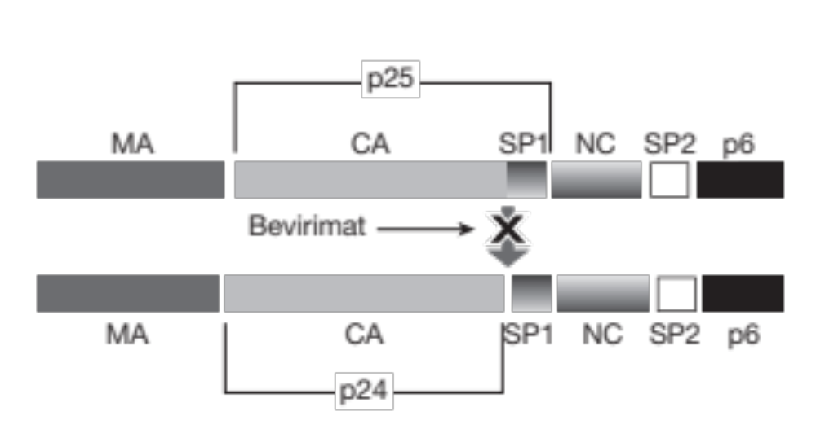
Inhibition of Gag Processing by Bevirimat
p25
p24
Li, Goila- Gaur et al., PNAS 2003

Slide 11
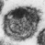
Blocking CA-SP1 Cleavage Inhibits Virion
Maturation and Infectivity
Immature
Non-Infectious
Mature
Infectious
BVM-
Treated
Non-Infectious
Li, Goila- Gaur et al., PNAS 2003

Slide 12
Replication Kinetics of HIV-1 in the
Presence of BVM
20000
pNL4-3+ DMSO
18000
pNL4-3+DMSO
16000
14000
pNL4-3 + BVM (100 ng/ml)
RT activity (cpm/μl)
pNL4-3 + BVM (1.0 μg/ml)
12000
10000
8000
6000
4000
2000
0
2
6
10
14
18
22
26
30
34
84
86
90
Days posttransfection
Notes:
12

Slide 13
Phase IIb BVM Clinical Trial
(Panacos)
Design:
- 14-day “functional monotherapy”
- BVM added to failing HAART regimen
- Patients received one oral dose/day
Outcome:
- ~50% of patients responded with a drop in viral
load of ~ 1 log

Slide 14

Non-responding patients had Gag polymorphisms
near the CA-SP1 cleavage site
CA
SP1
226
231
1
3
6
7
8
  …G H K A R V L A E A M S Q V T N S A T I M
Location of key SP1 polymorphisms

Slide 15
BVM Summary
BVM potently inhibits HIV-1 maturation by blocking the
cleavage of the CA-SP1 Gag processing intermediate to CA.
BVM showed encouraging results in phase II
clinical trials, demonstrating that targeting individual
Gag cleavage sites can be an effective antiviral
strategy.
However, not all patients responded. Polymorphisms in
SP1 induce varying levels of resistance to BVM.

Slide 16
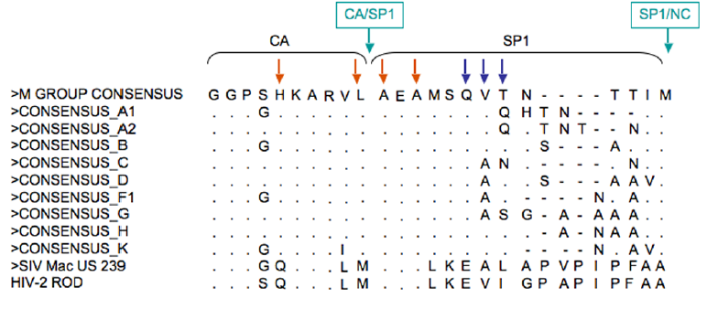
Polymorphisms within the vicinity of CA-SP1 cleavage site render resistance to BVM

Slide 17
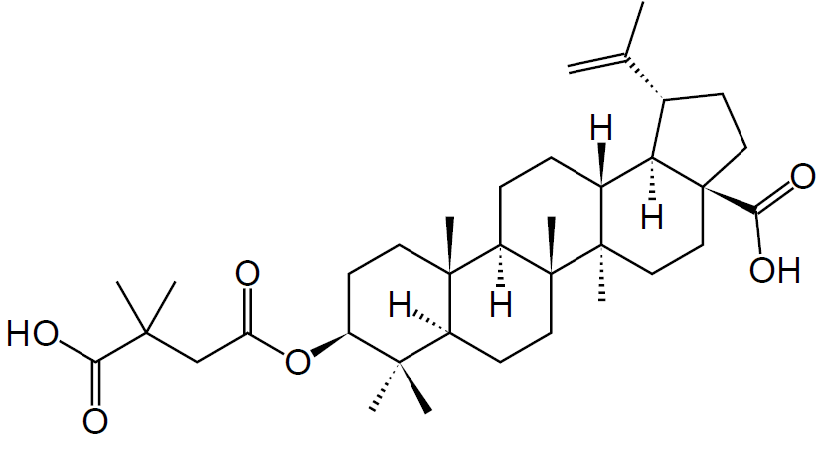
Bevirimat analogs
Modifications at C-28 of BVM - acids, alcohols, esters, amines, amides

Slide 18
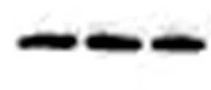
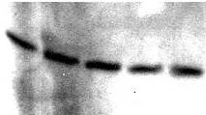

HIV-1 subtype C is resistant to wild type Bevirimat
BVM
-
0.5
1.0
(µM)
Transfection of HEK293T cells with HIV-1 subtype C molecular clone(s)
Incubation with/without BVM for 24 , then again for 2 hours
Ultracentrifugation of supernatant
SDS PAGE of viral pellet
Western blot using anti-HIV-1 IgG antibody
K3016
CA
BVM
-
0.1
0.5
1.0
5.0
(µM)
pIndieC1
CA
BVM
-
0.1
0.5
1.0
5.0
(µM)
ZM247F_flG11
CA
SP1
HIV B: A E A M S Q V T N P A T I M
HIV C: A E A M S Q A N N– G N I M

Slide 19
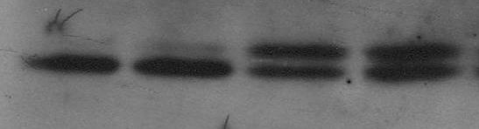
Bevirimat analogs are more potent
in HIV subtype C
HIV-1 subtype C
BVM
GT068
GT070
-
(1.0µM)
CA-SP1
CA
SP1
HIV B: A E A M S Q V T N P A T I M
HIV C: A E A M S Q A N N– G N I M
Uddhav Timilsina

Slide 20
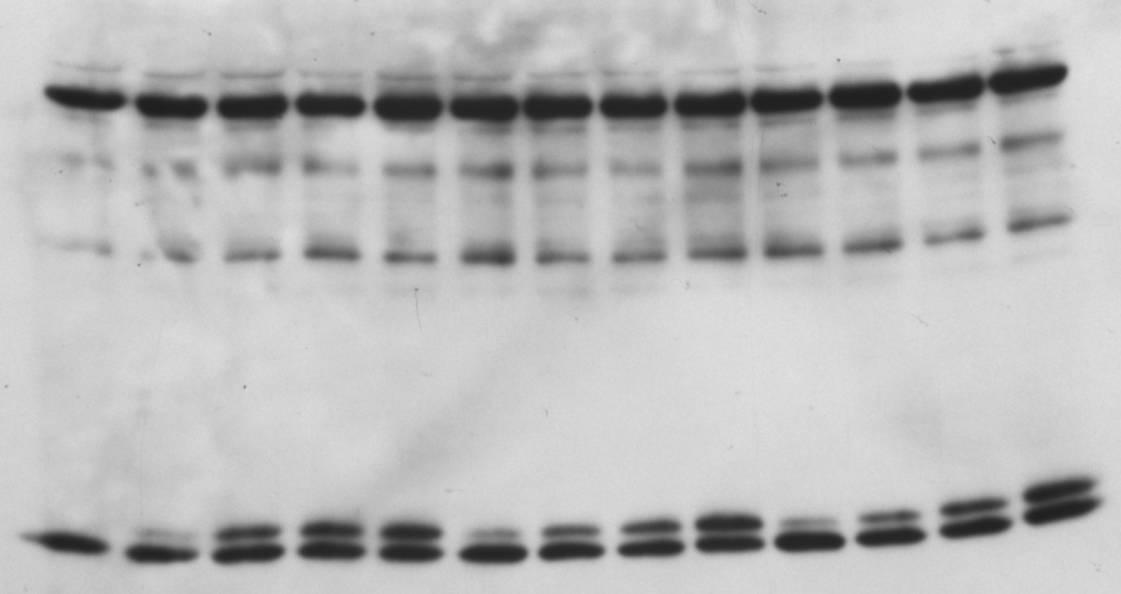
Inhibition by Bevirimat analogs is dose dependent
HIV subtype C
GTP03-16
GTP03-21
GTP03-22
2
10
20
50
2
10
20
50
2
-
10
20
50 nM
CA-SP1
CA
Uddhav Timilsina

Slide 21
Second-Generation BVM Analogs Potently
Inhibit HIV-1 Replication

Slide 22
Maturation Inhibitors: Conclusions
Progress is being made in understanding BVM binding at
the structural level and in defining the drug binding site.
Maturation inhibitors that block specific steps in Gag
processing remain attractive antiretroviral drug candidates.

Slide 23
HIV/SIV Vif APOBEC Interactions

Slide 24
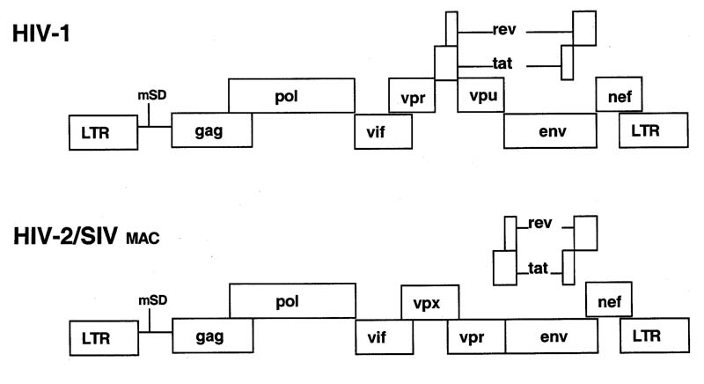
HIV-1, HIV-2, SIV Genome structure
Notes:
HIV is composed of two copies of positive single-stranded RNA that codes for the virus's nine genes enclosed by a conical capsid composed of 2,000 copies of the viral protein p24.
Three of these genes, gag, pol, and env, contain information needed to make the structural proteins for new virus particles.
The six remaining genes, tat, rev, nef, vif, vpr, and vpu (or vpx in the case of HIV-2), are regulatory genes for proteins that control the ability of HIV to infect cells, produce new copies of virus (replicate), or cause disease.
The two Tat proteins (p16 and p14) are transcriptional transactivators for the LTR promoter acting by binding the TAR RNA element.
The Rev protein (p19) is involved in shuttling RNAs from the nucleus and the cytoplasm by binding to the RRE RNA element.
The Vif protein (p23) prevents the action of APOBEC3G (a cell protein that deaminates DNA:RNA hybrids and/or interferes with the Pol protein).
The Vpr protein (p14) arrests cell division at G2/M.
The Nef protein (p27) down-regulates CD4 (the major viral receptor), as well as the MHC class I and class II molecules.
The Vpu protein (p16) influences the release of new virus particles from infected cells.[81]
The ends of each strand of HIV RNA contain an RNA sequence called the long terminal repeat (LTR). Regions in the LTR act as switches to control production of new viruses and can be triggered by proteins from either HIV or the host cell.
The Psi element is involved in viral genome packaging and recognized by Gag and Rev proteins.
The single-stranded RNA is tightly bound to nucleocapsid proteins, p7, and enzymes needed for the development of the virion such as reverse transcriptase, proteases, ribonuclease and integrase. A matrix composed of the viral protein p17 surrounds the capsid ensuring the integrity of the virion particle.
Like all known retroviruses, the HIV provirus contains two LTR elements at each end, along with 3 structural genes that are essential for virus replication.

Slide 25
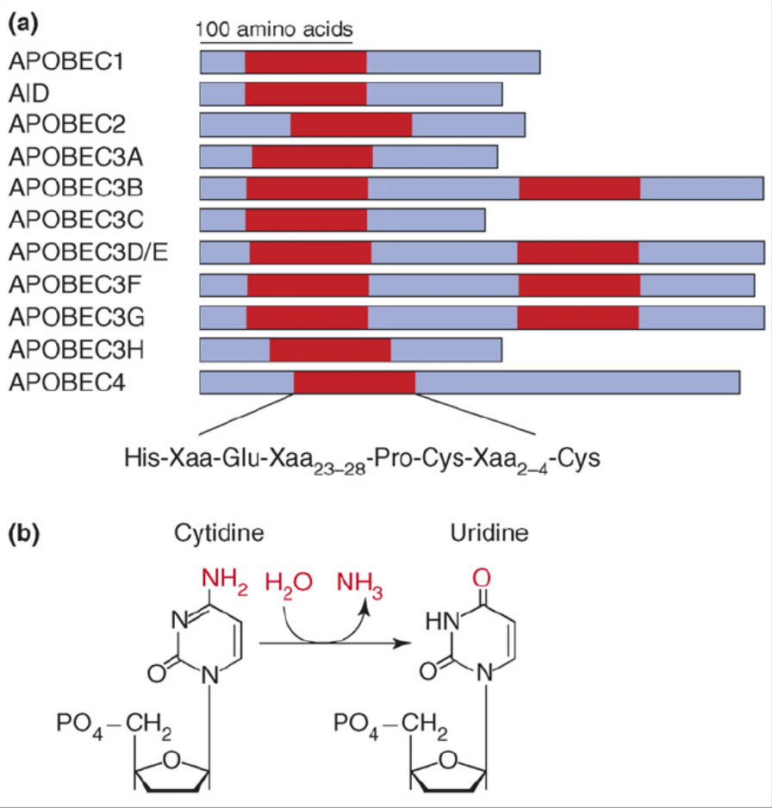
APOBEC family
(Apolipoprotein B mRNA-editing enzyme, catalytic polypeptide)
Function of APOBEC-1:
deamination of apoB mRNA (C6666-> U);
=> creates premature stop-codon in apoB mRNA
Function of APOBEC3G:
Physiological function is unknown.
displays potent anti-HIV activity
catalyses deamination of cytidine to uridine

Slide 26
HIV-1 Accessory Proteins: Vif
23 kD protein.
regulation of viral infectivity
Localized in the cytoplasm.
N-terminal domain important for association with APOBEC3G
conserved domain near C-terminus functions as SOCS box and
is responsible for binding Cul5, elonginB/C complex (E3 Ub-ligase)

Slide 27
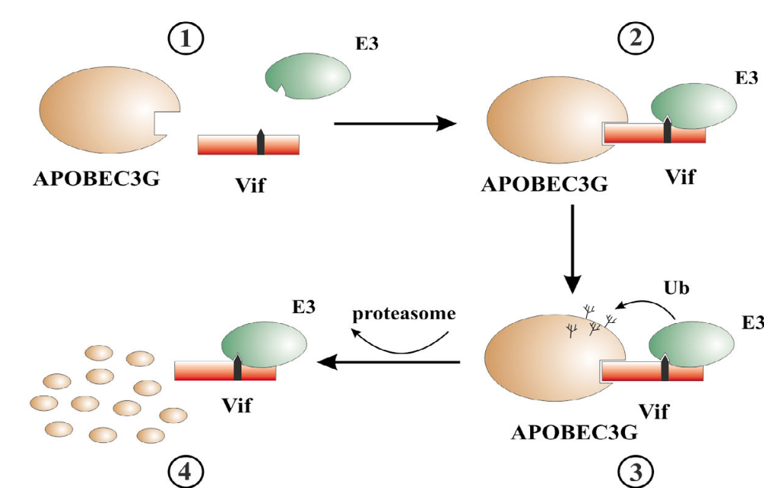
Mechanism of action of HIV Vif

Slide 28
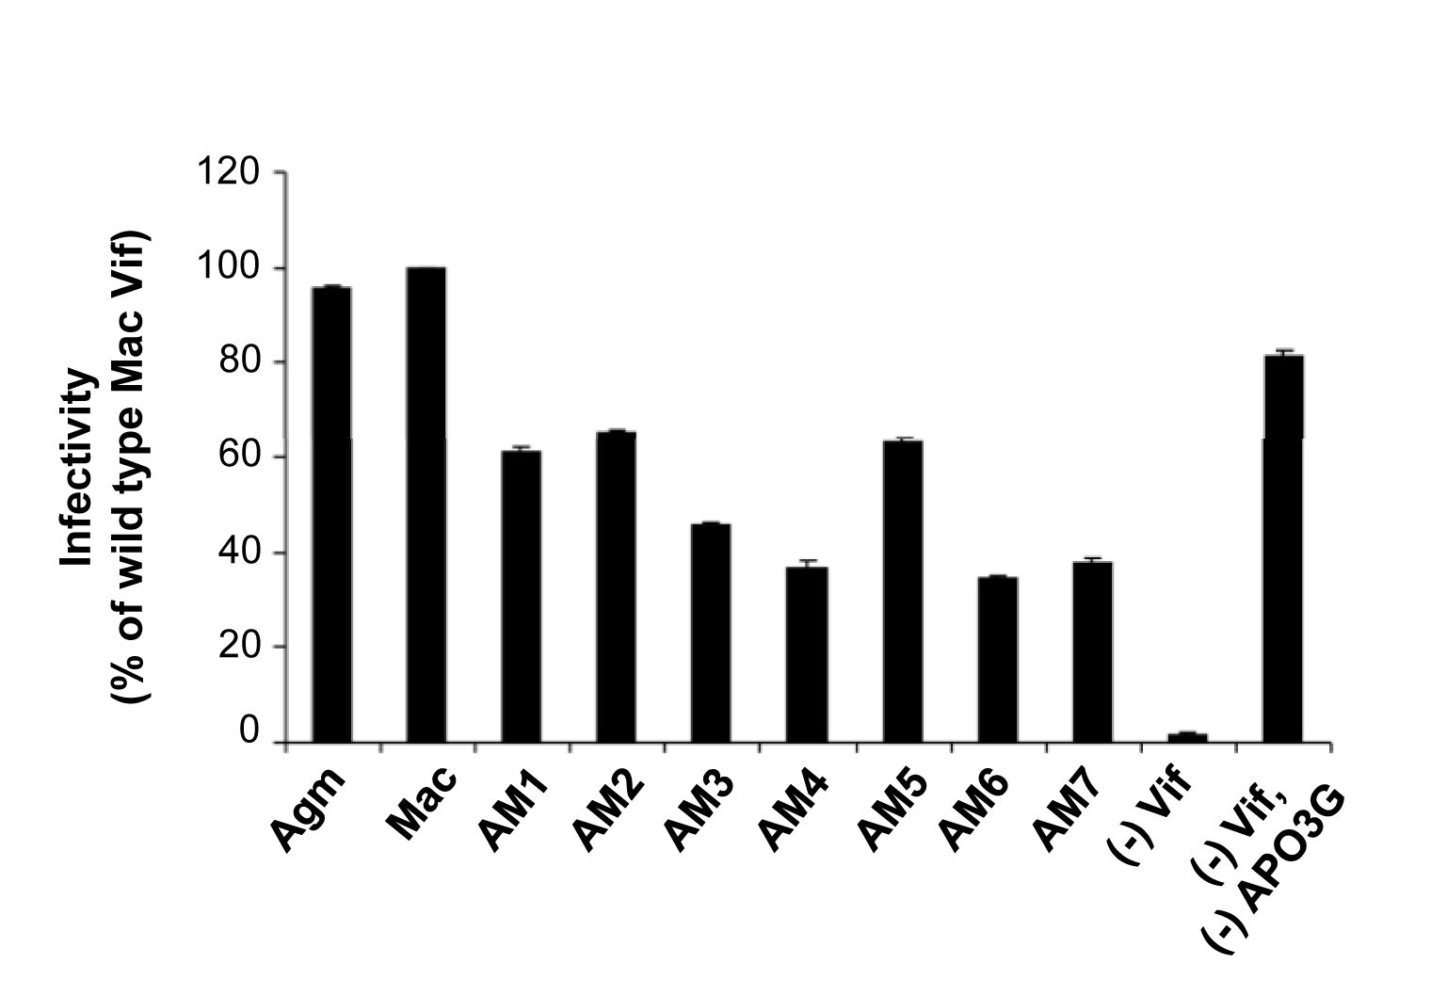
SIVmac-agm Vif chimeras retained activity
against Agm-APO3G

Slide 29
Broad Lines of Research
1. Differential Sensitivity of “Old” versus New” APOBEC3G to Human Immunodeficiency
Virus Type 1 Vif.
(Journal of Virology, 2009)
2. Targeting APOBEC3A to the viral nucleoprotein complex confers antiviral activity
(Retrovirology, 2008)
3. Production of infectious virus and degradation of APOBEC3G are separable functional
properties of human immunodeficiency virus type 1 Vif.
(Virology, 2007)
4. APOBEC3G Characterization (Journal of Virology, 2005, 2006)
Defects in human immunodeficiency virus budding and endosomal sorting induced by
overexpression of TSG101 (Journal of Virology, 2003).
6. A new class of potent HIV inhibitors disrupts core condensation by targeting a late step
in Gag processing.
(Proc. Natl. Acad. Sci. USA, 2003)

Slide 30
What controls species specificity in Vif ?
HIV-1 and SIVagm Vif ( African green monkey) are mono-specific.
can only inactivate APO3G of the species from which they are derived.
HIV-2 Vif and SIVmac Vif ( from Macaques) can inhibit both human and African green monkey APO3G ( Agm- APO3G).

Slide 31
Why SIVmac Vif and HIV-2 Vif has dual specificity ?
The mechanism remains unknown

Slide 32
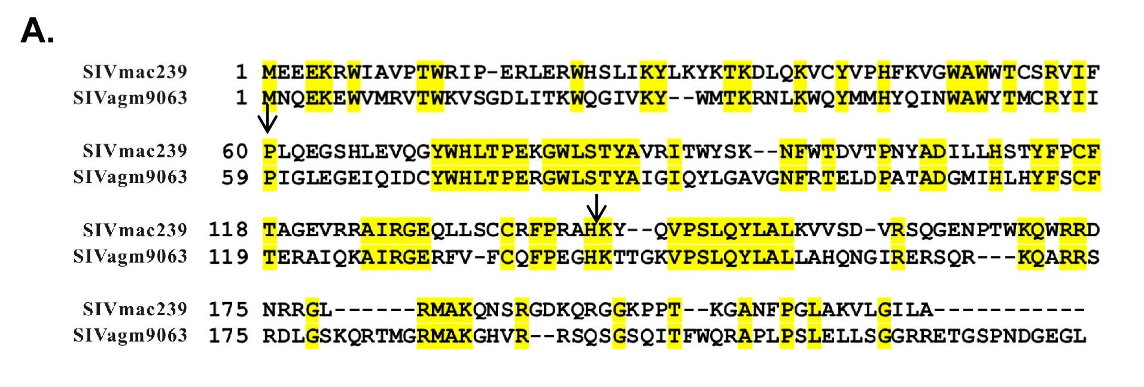

Slide 33
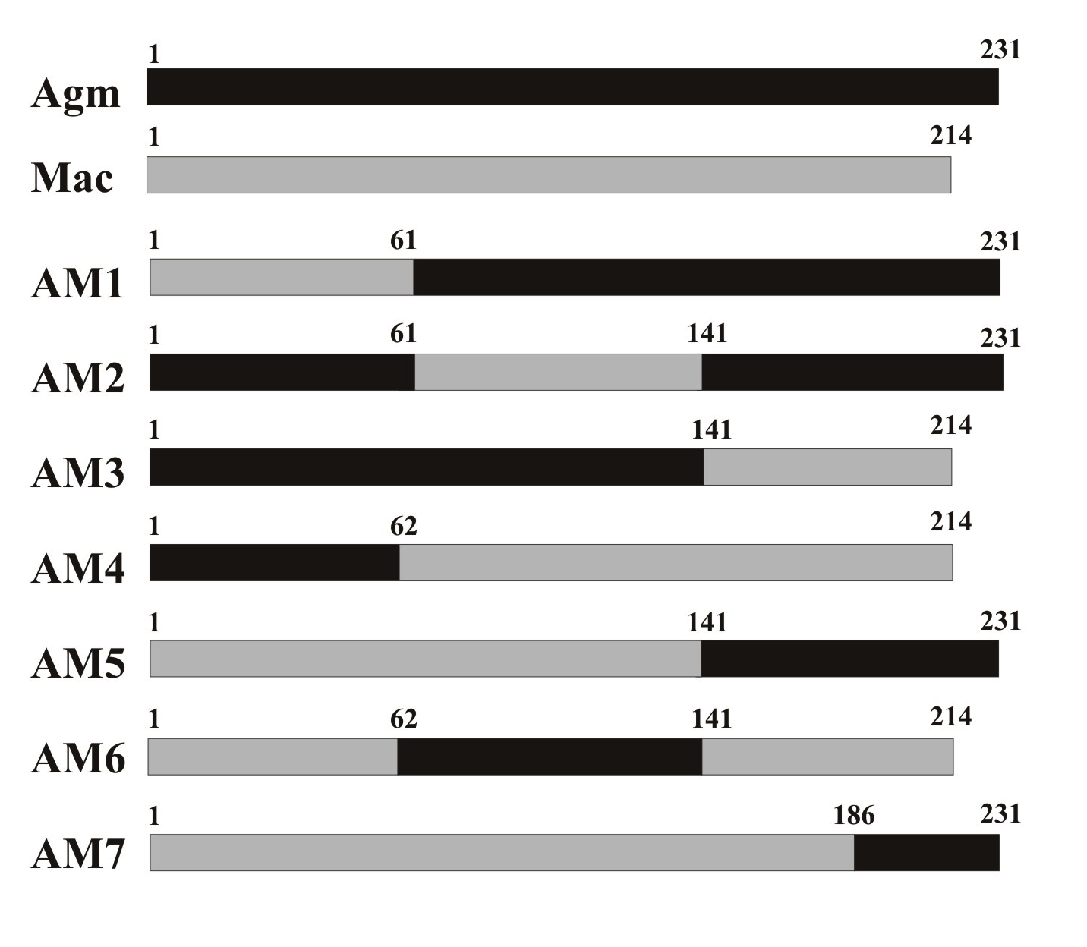
Schematic representation of the
SIVmac-agm chimeras
The borders between individual segments (residues 61/62 and 141) will be chosen
to reside in regions of local homology between SIVagm and SIVmac Vif.
Also, care will be taken not to interrupt known functional motifs in Vif such as the proteolytic processing site or the Cul5 binding motif.

Slide 34
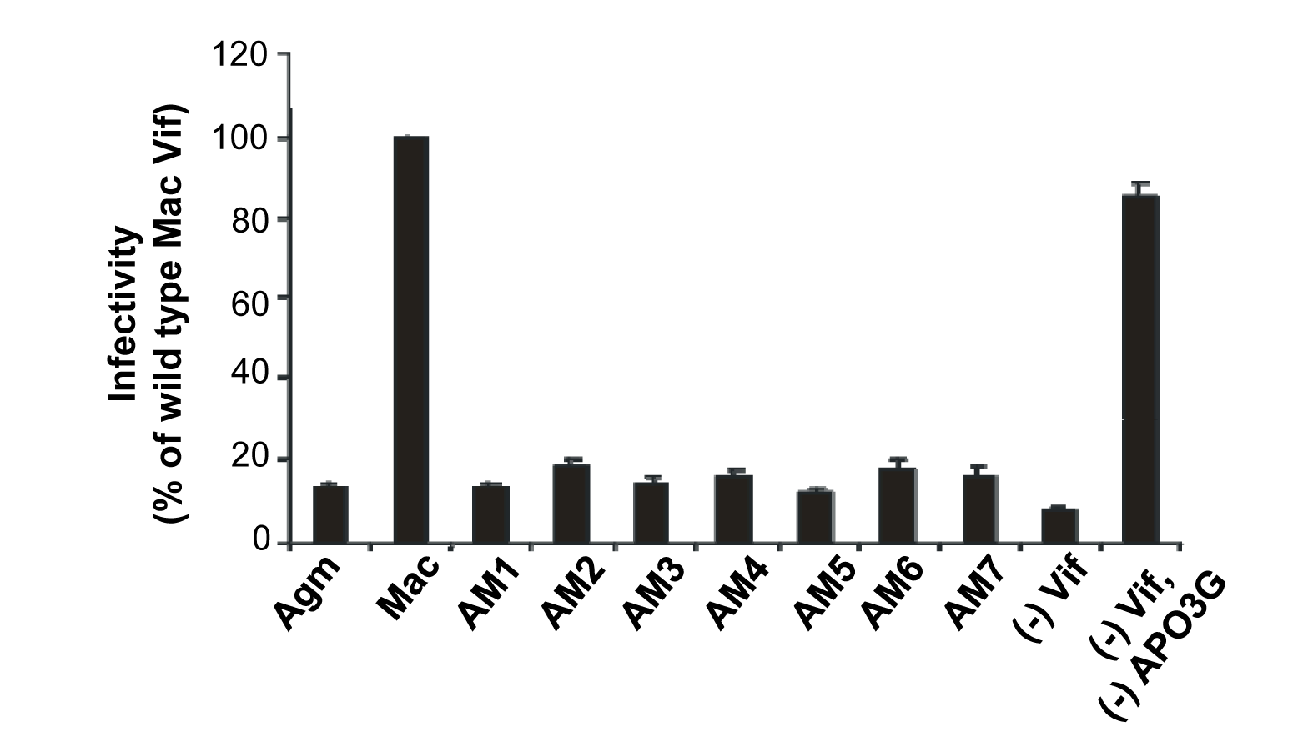
SIVmac-agm Vif chimeras were not active
against human APO3G
PLOS ONE 2012

Slide 35
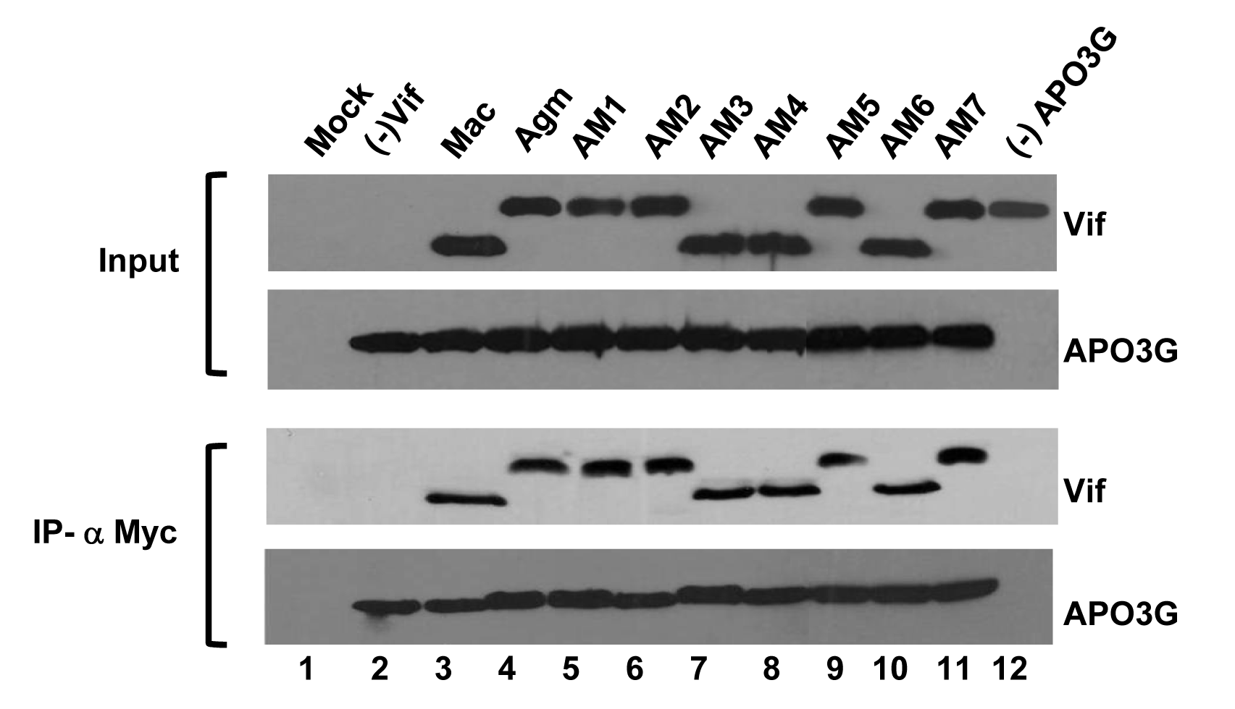
Co-Immunoprecipitation of APO3G and
SIVmac- agm Vif chimeras
PLOS ONE 2012

Slide 36
Summary
All SIV Mac-agm chimeras retained activity against Agm APO3G.
2. The chimeras did not gain activity against human APO3G.
3. Domains in SIVmac Vif required for targeting human and Agm
APO3G are distinct
4. Cannot be defined as linear amino acid motifs but rather
appear to depend on the overall structure of full-length
SIVmac Vif.

Slide 37
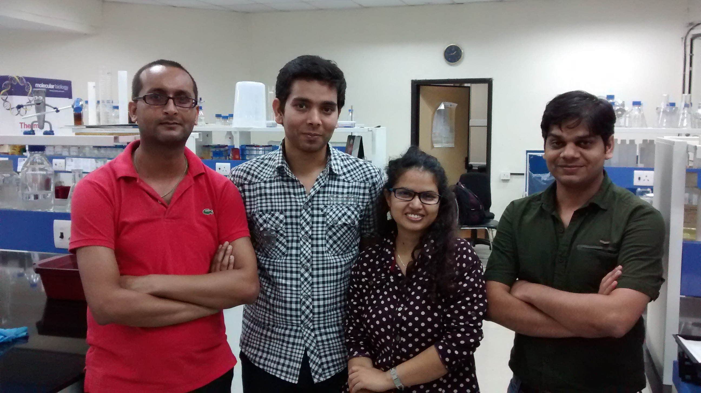
Acknowledgements
From L to R:, Uddhav, Nawneet, Dibya and Ravi

Slide 38
ACKNOWLEDGEMENTS
South Asian University
Prof. Rajiv Saxena
FLSB
NIH Intramural to India Grant
(NIH, ICMR, DBT)
Dr Eric Freed, NIH, USA

