Slide 1

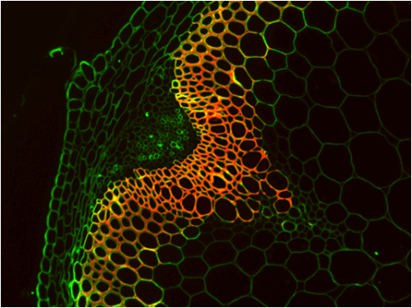
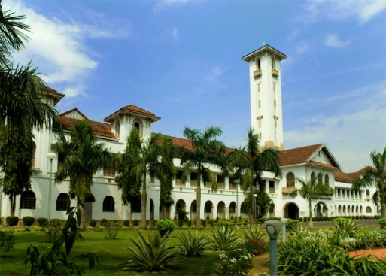
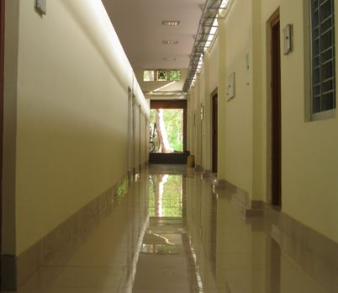
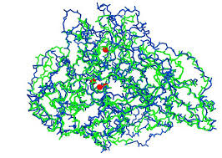

YELLOW LACCASE MEDIATED DELIGNIFICATION
- An attempt towards eco-friendly pretreatment of lignocellulosics
Prof. Rintu Banerjee, FNAAS, FBRS, FBRIAT
Professor, Agricultural & Food Engineering Department
Indian Institute of Technology, Kharagpur
India

Slide 2

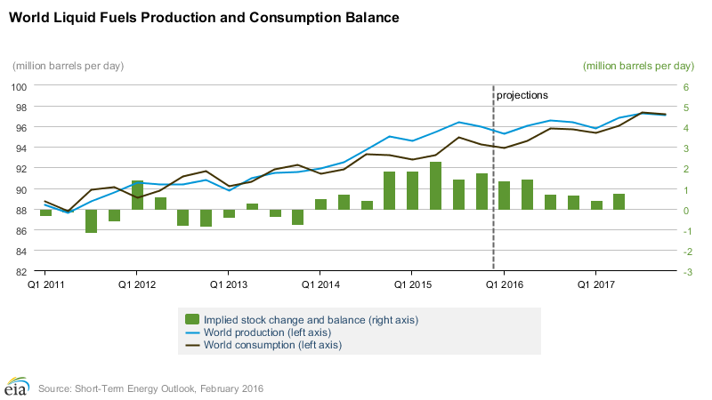
World Scenario for Liquid Fuels
Source: Energy Information Administration (EIA), USA
EIA estimates that global consumption of petroleum and other liquid fuels grew by 1.4 million barrels/day which is expected to grow by 1.5 million barrels/day in 2017

Slide 3
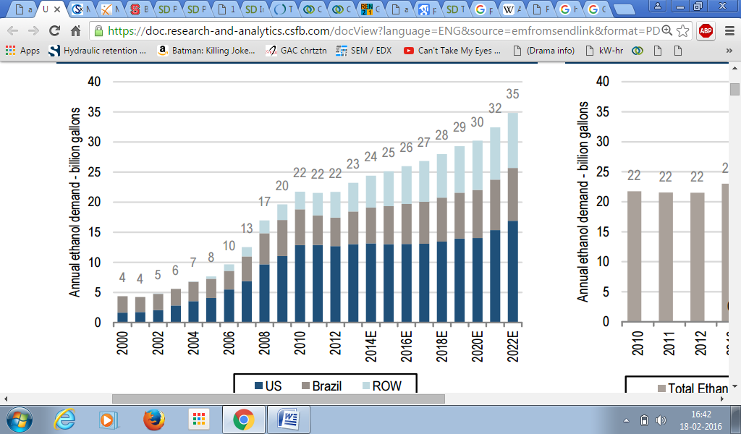
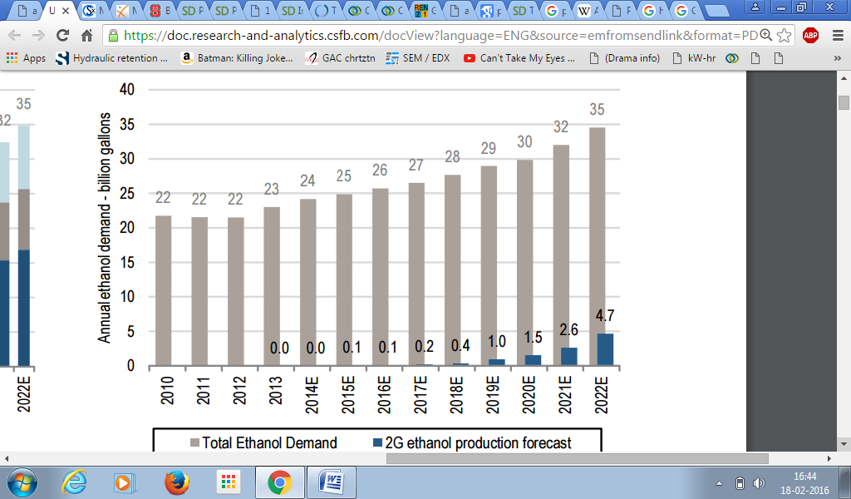
Projection Status On Global Ethanol Demand
Global ethanol demand forecast
Overall and 2G ethanol production forecast
Review of ethanol policies across major countries projected that global ethanol demand is expected to grow from 23 billion gallons in 2013 to 35 billion gallons in 2022
It is expected that global 2G ethanol to increase to ~0.15 million gallons by 2017 & 5 billion gallons by 2022

Slide 4
Classification of Biofuels
Biofuels
Liquid Biofuels
Bioethanol
Biobutanol
Gaseous Biofuels
Biohydrogen
Biodiesel
Syngas
Biomethane
Biohythane

Slide 5
Ethanol Demand With Blending Targets (%) In India - (in billion litres).
Parameter | 2015-2016 | 2020-21 | 2025-26 | 2030-31
Gasoline demand | 23.8 | 33.5 | 39.5 | 45.6
Ethanol demand (for 20% blending target) | 4.77 | 6.7 | 7.91 | 9.11
10% Blending target | 4.5 | 5.9 | 6.9 | 7.9
5% Blending target | 3.3 | 4.2 | 4.9 | 5.7
Source: United Nations Environment Programme (UNEP)

Slide 6
Biorefinery Concept
Fuel such as ethanol likely to be the major product
Production of co-products to improve the economy of the biorefinery
Large scale operation of the plant
Multi product facilities for processing biomass to various products

Slide 7
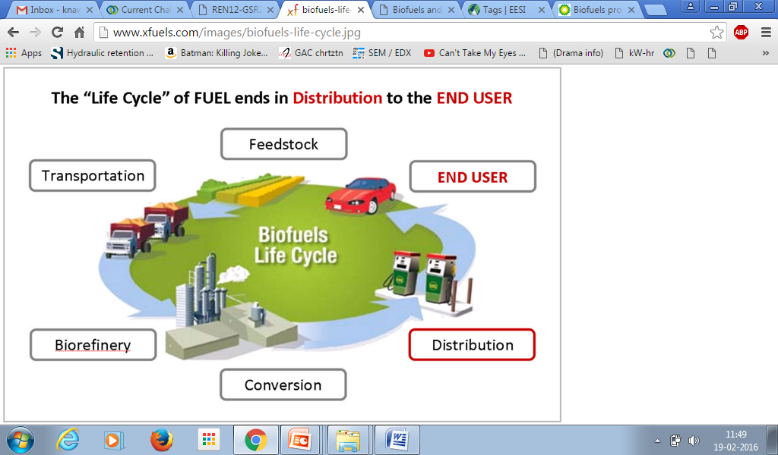
Rationale for Biofuels from Biomass
High prices of oil
Petroleum supply dependability
Environmental concerns (carbon emissions)
Present renewable fuel sources (grains and oilseeds) insufficient to meet future demands
Biofuels can support economic development by creating new sources of income in rural areas.
There are major incentives to develop a broader resource base and processing technologies to support a broader role for bioenergy

Slide 8
Agricultural residues (wheat straw, corn stover)
Energy crops (switchgrass, poplar)
Wood and wood waste
Municipal solid waste
Potential source of Biomass
Agricultural residues are the low cost agricultural source of biomass

Slide 9
Biomass Selection
Lignocellulosics
Grazing
Non-grazing
Rice straw
Maize straw
Wheat straw
Rice husk
Jute waste
Oil seed waste
Ricinus communis
Jatropha curcas
Pineapple leaf wastes
Bambusa bambos
Datura stramonium
Lantana camara

Slide 10

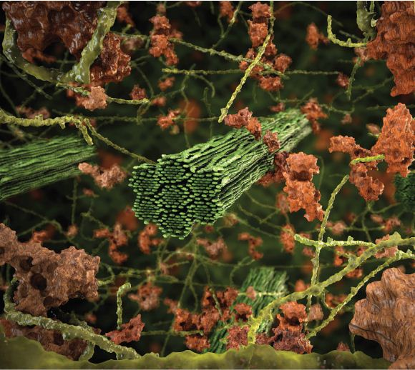
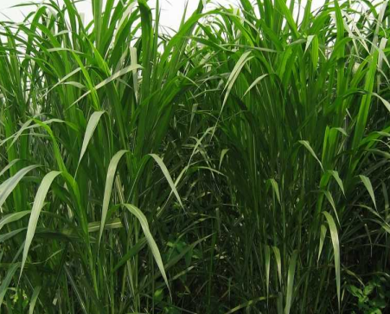
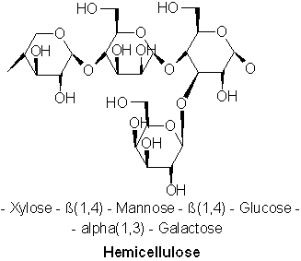
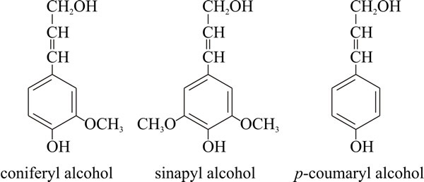
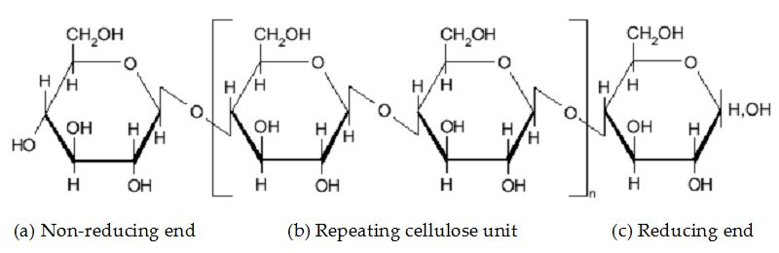
Biochemistry of Lignocellulosic Biomass
Plant cell
Plant cell wall
Hemicellulose
Lignocellulosic biomass
Macrofibril
Lignin
Microfibril
Cellulose

Slide 11
Application of Lignin
Enhances the tensile strength of paper by 40%
Antioxidant (free radical scavengers, used in cosmetic and topical formulation)
Acts as raw material for several chemicals like vanillin, humic acid
Catalytic conversion of lignin to green gasoline/ diesel
Used for carbon fiber and nanotubes
Dispersant in cement application, water formulation and textile dyes
Foams-Plastics/ polymers
Dust suppression for roads

Slide 12
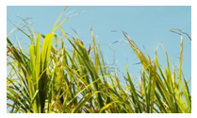
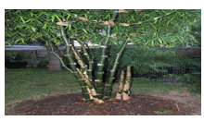
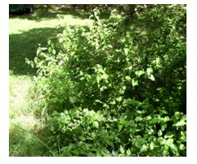
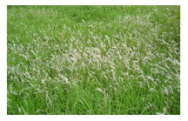
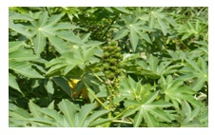
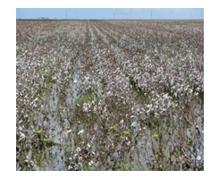
Second Generation Substrates: Lignocellulosic Biomass
WHY ONLY LIGNOCELLULOSICS?
Can be grown on barren uncultivable land
Need less amount of water to grow
Does not interfere with food chain
Available in ample amount
Mixture of lignocellulosic biomass circumvent the problem of round the year biomass availability
Higher yields per hectare, either by using fast-growing lignocellulosic plants

Slide 13
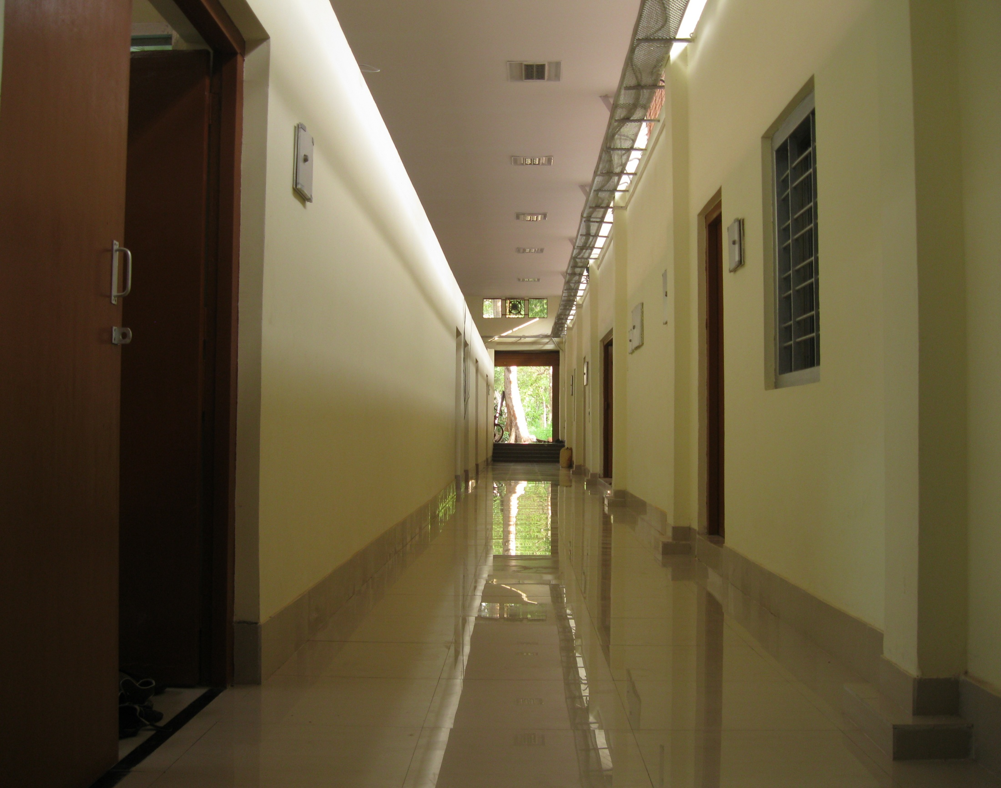
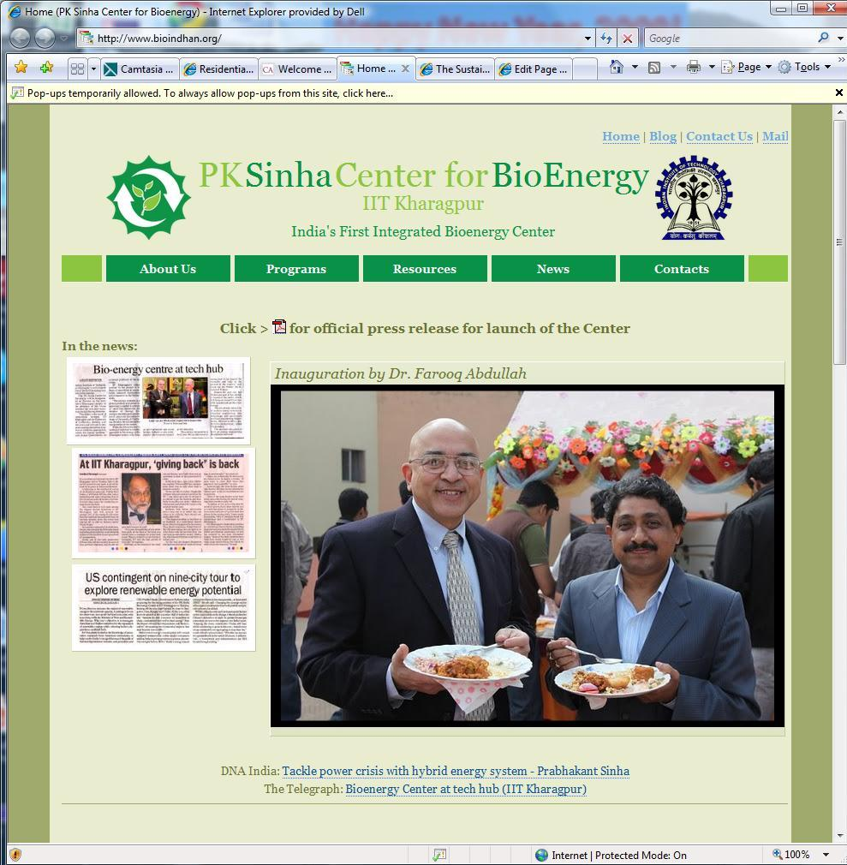

Slide 14
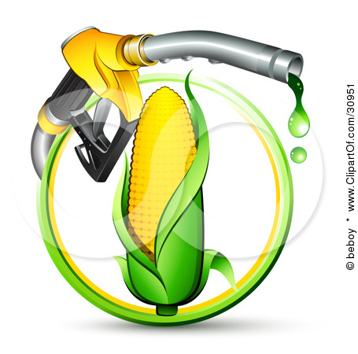
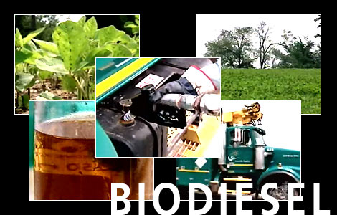
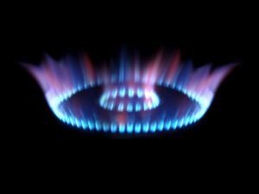

Bio-ethanol
Bio-diesel
Bio energy Activities
Bio-methane
Bio butanol

Slide 15
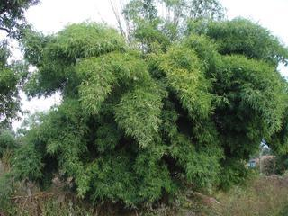
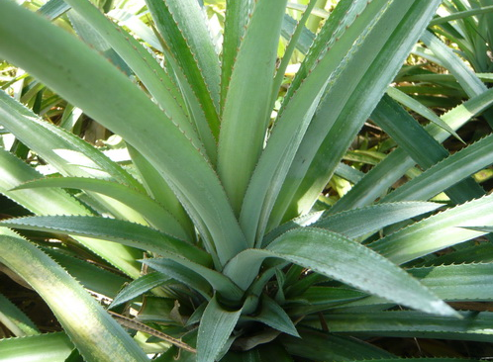
Lignocellulosics Selected for Study at IIT Kharagpur for Bioethanol Production
Ricinus communis
Lantana camara
Kans Grass
Bambusa bambos
Sugarcane Tops
Pineapple leaf waste
These species are mostly non-edible due to high toxin content (eg. Lantadene A , B, ricin and triterpene acid) and have been found to be toxic to animals
Such species would not compete for land use with food crops and could be grown at relatively dry zones

Slide 16
Biochemical Characterization
Biochemical composition | Cellulose (%) | Hemicellulose (%) | Lignin (%)
Lantana camara | 47.25 | 16.4 | 17.26
Ricinus communis | 42.00 | 18.02 | 19.88
Bambusa bambos | 45.00 | 17.00 | 19.20
Sugarcane Tops | 33.00 | 22.76 | 13.45
Kans Grass | 38.70 | 29.00 | 17.46
Pineapple leaf waste | 42.00 | 25.00 | 13.00
Mixture | 43.02 | 24 | 14.57

Slide 17
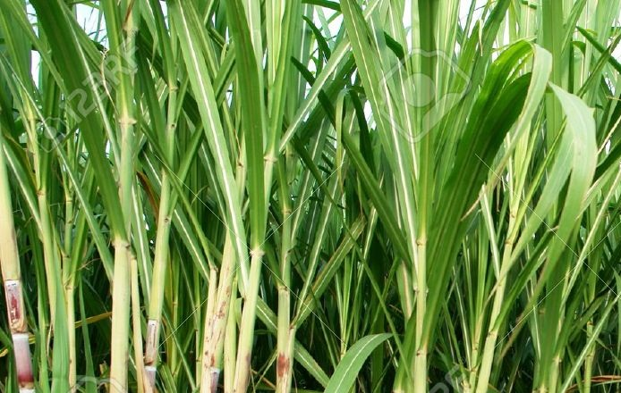
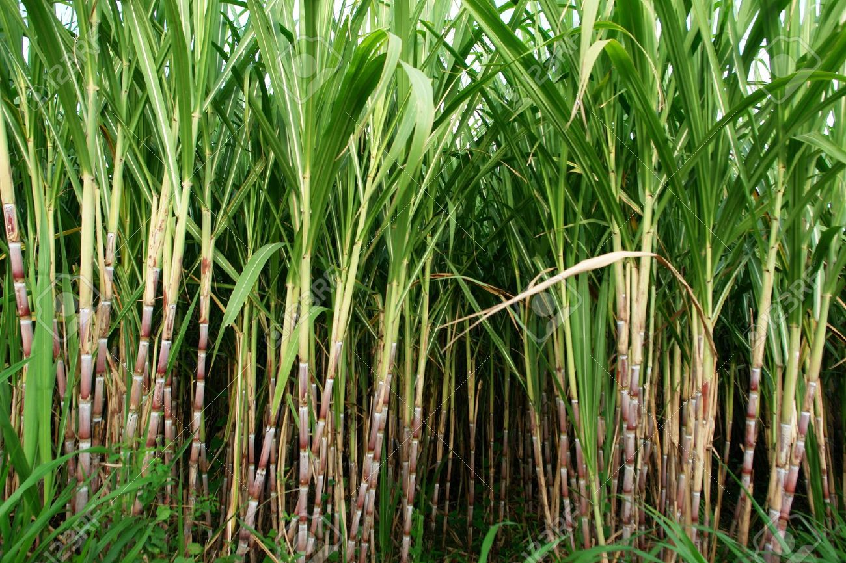
Sugarcane Tops (SCT)
Sugarcane is a tropical perennial grass belonging to Poaceae family
Sugarcane is an important cash crop. Cultivated over a large area with a production of more than 199.1 MMT in India ( Sukumaran et al., 2010)
Sugarcane gives two main residue i.e, the top portion of the plant (sugarcane tops) removed during harvesting and bagasse
SCT, a post harvest residue which does not find any suitable application. It is usually stored in open fields and burnt. It can also be used as animal fodder before the leaves start rotting
Sugarcane Tops (SCT)
Sugarcane

Slide 18
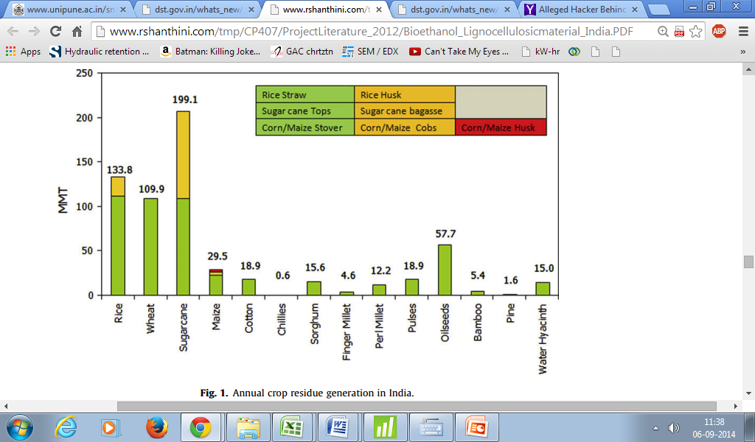
Cont…
Sugarcane top is the most surplus residue (79.4 MMT) available in India. 1 MT of sugarcane produced gives 0.25-0.3 MT of SCT
Annual crop residue generation in India (Sukumaran et al., 2010)

Slide 19

Major Bottlenecks in Lignocellulosic Bioethanol Production
Maximum lignin degradation with minimum loss of cellulose and hemicellulose
Simultaneous utilization of Pentose and Hexose sugars
Less tolerance of yeast towards higher concentration of ethanol
Efficient depolymerization of lignin without the production of furfurals and hydroxymethyl furfurals

Slide 20
Biological Processing Strategies
Enzymatic Biodepolymerization of lignin
Microbial Pretreatment
Done either by using microorganisms directly or by using the enzymes produced by various microorganisms
Key Microorganisms: Botrytis cinerea, Phanerochaete chrysosporium, Stropharia coronilla, Pleurotus ostreatus and Trametes versicolor
Key Enzymes: Manganese peroxidases, Lignin peroxidases, Laccases

Slide 21
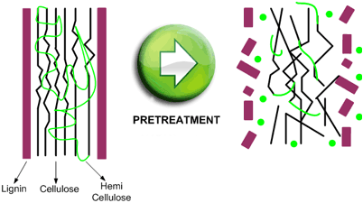
Enzymatic Delignification
Enzymatic Delignification: Enzyme mediated degradation of lignin without much altering the native structure of cellulose and hemicellulose
Increases accessibility of cellulose
Enhances rate of hydrolysis
Increased
Yield

Slide 22
Classification of laccase
LACCASE
Blue laccase
Pleurotus sp.
White laccase
Myrothecium verrucaria
Yellow laccase
Lentinus squarrosulus
yellow laccases catalyze reactions using non-phenolic substrates without mediators
Contains one copper, two zinc, and one iron atom instead of 4 and 3 copper atoms in blue and yellow laccase
Catalyze phenolics, and lignin with the presence of mediator in reaction mixture

Slide 23
Laccase mediated enzymatic delignification
Pretreatment gives enzyme accessible substrate
Cellulose
Lignin
Laccase
Amorphous Region
Pretreatment
Crystalline Region
Hemicellulose
Notes:
Pretreatment changes the physical structure of the cellulose portion (black lines) as well as disrupting the lignin (a glue like material) that protects the cellulose from hydrolysis (pink line). The structure – once disrupted by pretreatment is opened up and is amenable to hydrolysis since the catalysts that cause hydrolysis to occur can get into the cellulose structure.

Slide 24
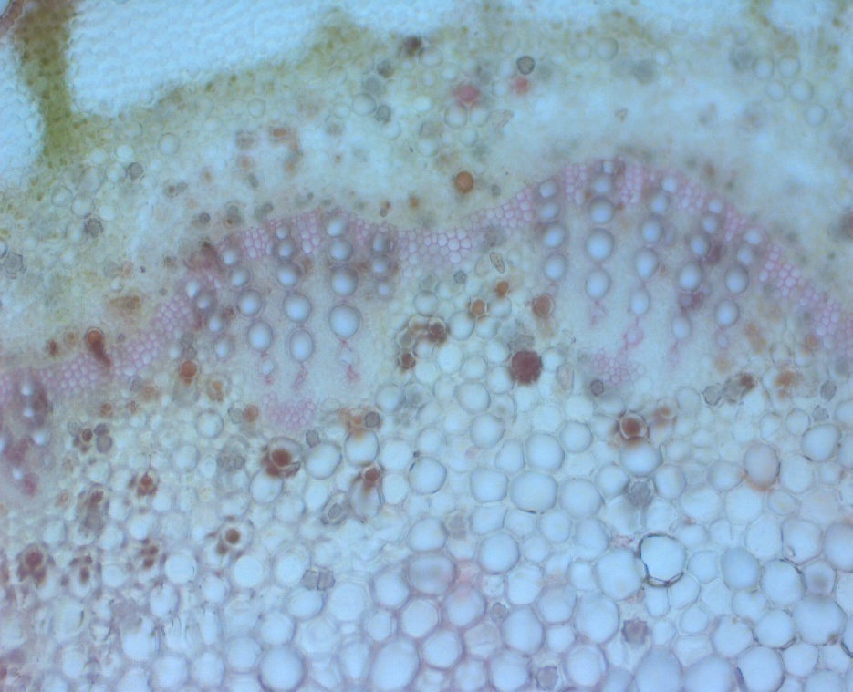
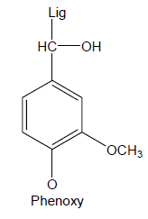
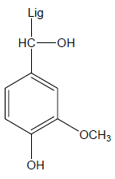
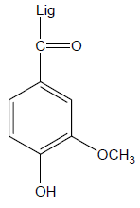
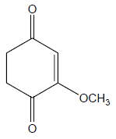

Mechanism of Laccase action
Laccase
O₂
2H₂O
Lignin
Cα-Carbonyl
P-Quinone

Slide 25

Enzymatic Delignification of Lignocellulosics
Microbial Biotechnology and DSP Laboratory, Department of AgFE, IIT Kharagpur
Blue laccase from a hyperactive strain of Pleurotus djamor
Yellow laccase from Lentinus squarrosulus

Slide 26
Production of Yellow Laccase from Lentinus squarrosulus

Slide 27
Optimum conditions for laccase production
Parameter | Range | Optimum condition
Lignocellulosic feedstocks | Rice straw | 33%
pH | 3-10 | 7
Temperature | 20-50 ˚C | 30 ˚C
Incubation | 4-15 days | 9
Inoculum % | 10% | 7%
Particle size | 0.25-7 cm | 1cm

Slide 28
Application of Yellow Laccase for Delignification
of Sugarcane Tops

Slide 29
OPTIMUM CONDITIONS FOR LACCASE MEDIATED DELIGNIFICATION
Parameter | Range | Optimum condition
Lignocellulosic feedstocks | L.camara, R. communis, B. bamboos, Cotton stalk, Sugarcane top, Kansgrass | SCT
pH | 5-9 | 7
Temperature | 20-50 ˚C | 40 ˚C
Incubation | 2-12h | 6-8 h
Particle size | 0.1-3 mm | 0.2 mm
Enzyme concentration | 200-900 IU/mL | 700 IU/mL

Slide 30

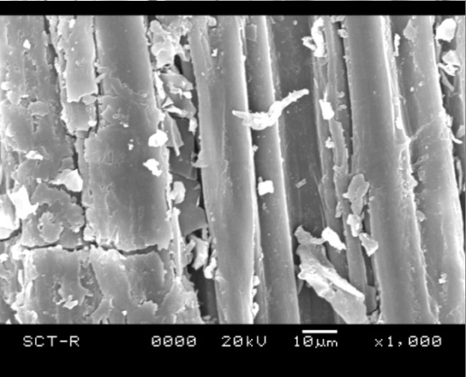
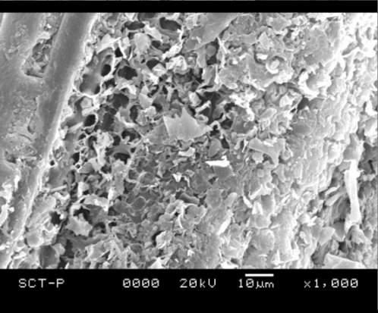
Scanning electron microscopy analyses
Control
Sugarcane top
Pretreated
Sugarcane top

Slide 31
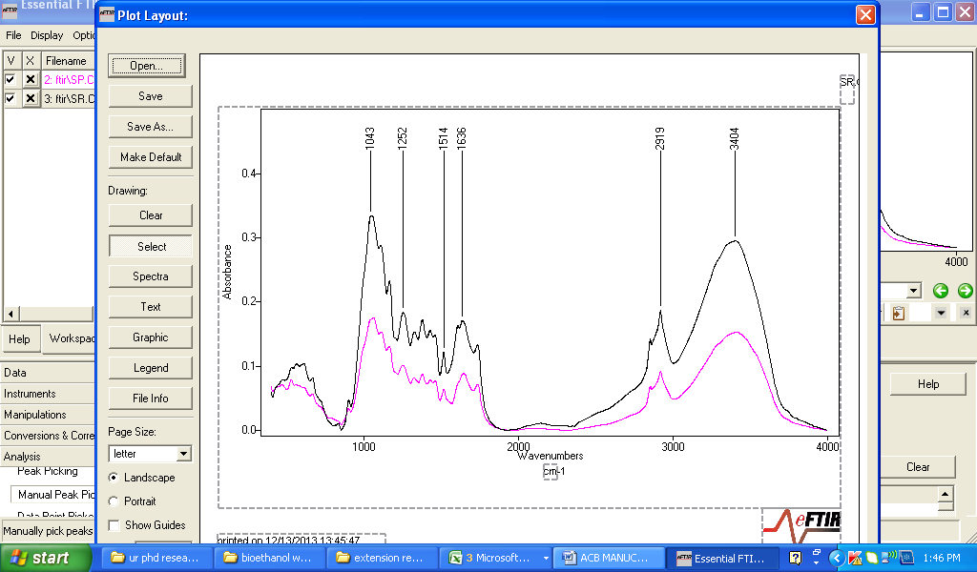
FTIR spectra of control and enzyme pretreated sugarcane tops
Peak (cm-1) | Functional group
3404 | OH vibration
2930 | C-H methyl and methylene group
1651 | C=C stretching
1514 | C=C (related to lignin removal) guaiacyl ring of lignin of the aromatic ring of lignin
1249 | C-O stretchingin lignin and hemicellulose
1043 | the vibrational modes of –CH₂OH groups and the C–O stretching vibration coupled with C–O bending of the C–OH groups of carbohydrates
Sugarcane top

Slide 32
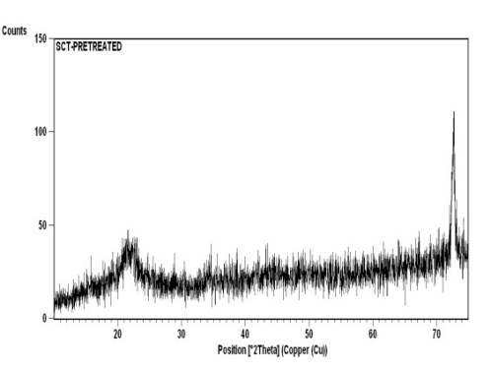
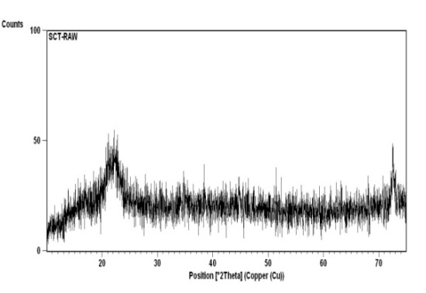
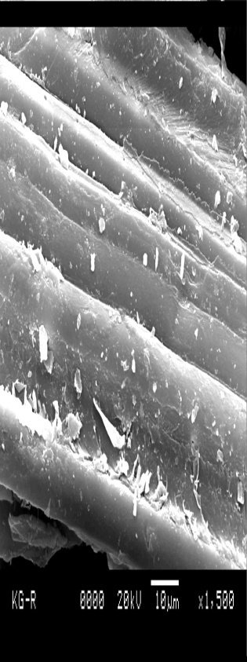
XRD Analysis
Control
Sugarcane top
Pretreated
Sugarcane top
Biomass | Increase in crystallinity (%)
Sugarcane top | 4.30

Slide 33

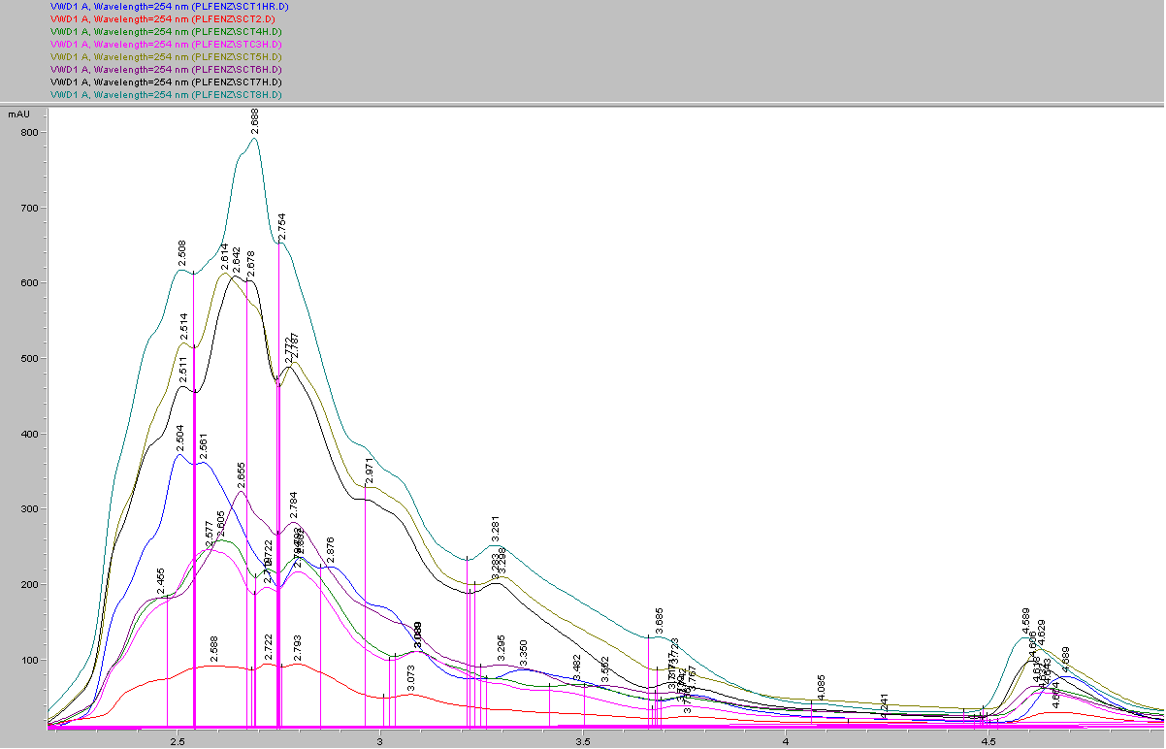
HPLC Analysis
HPLC chromatograms of lignin degradation products released over time : Sugar cane Top
HPLC results showed that with time, peak area of the individual peaks (having same retention time) increased in magnitude which infers that the concentration of intermediates produced during lignin degradation have been increased with time
(H)

Slide 34
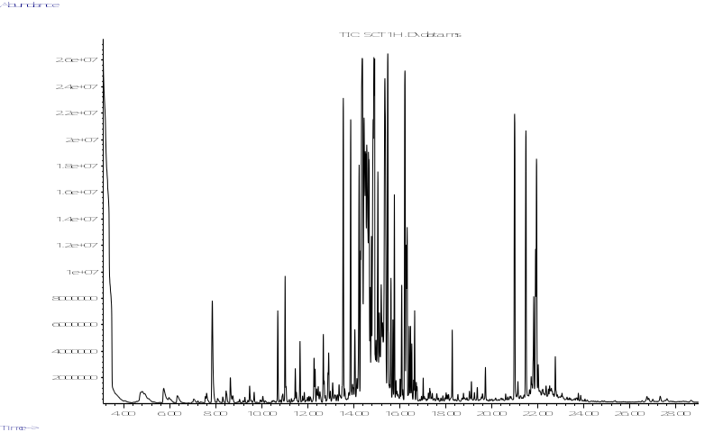
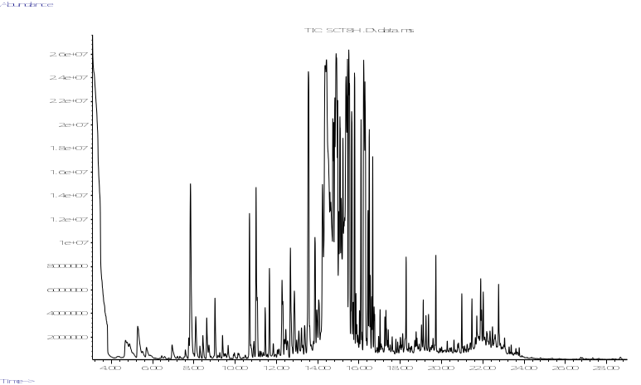
GC-MS Analysis
1 Hour
8 Hour
Sugarcane Top

Slide 35
GC-MS Analysis of lignin degraded compounds
Identified compounds | 0 h | 1st h | 2nd h | 3rd h | 4th h | 5th h | 6th h | 7th h | Retention time
Propanoic acid | - | + | + | + | + | + | + | + | 4.748
Butanoic acid | - | + | + | + | + | + | + | + | 5.731
Acetic acid | - | + | + | + | + | + | + | + | 5.974
Chromone | - | + | + | + | - | - | - | - | 7.167
Methanone | - | - | - | - | - | + | + | + | 7.544
Pentacene | - | + | + | + | - | - | - | - | 8.007
Butanedioic acid | - | + | + | + | + | + | + | + | 8.194
2-Butenedioic acid | - | + | + | + | + | + | + | + | 8.747
2(3H)-Furanone | - | + | + | + | + | + | + | + | 9.186
3,4-Methylenedioxyphenylacetic acid | - | - | - | + | + | + | + | - | 10.876
3,5-di-tert-Butyl-4-hydroxyphenyl propionic acid | - | + | + | + | - | - | + | + | 11.282
3-Bromo-5-ethoxy-4-hydroxybenzaldehyde | - | - | - | - | + | + | + | + | 12.269
2',6'-Dihydroxyacetophenone | - | + | + | + | - | - | - | - | 15.882
11H-Dibenzo[b,e][1,4]diazepin-11-one | - | - | - | - | - | + | + | + | 15.863
5(2-Dimethylamino-1-phenyl)-vinyl-thiadiazol | - | + | + | + | - | - | - | - | 16.264
Trimethylsilyl-3-methoxy-4-(trimethylsilyloxy)cinnamate | - | - | - | + | + | + | + | + | 17.023
Ferulic acid | - | - | - | + | + | + | + | + | 17.013
Trimethylsilyl-3,4-bis(trimethylsiloxy)cinnamate | - | - | + | + | + | + | + | + | 17.452
Ethyl-2-ethoxyquinoline-4-carboxylate | - | - | + | + | - | + | - | - | 21.628
Salbutamol | - | + | + | + | + | - | - | - | 23.876
2-(p(Dimethylamino)phenyl) benzimidazole | - | - | - | + | + | + | + | + | 25.070
3,4-Dimethylbenzamide | - | - | - | - | + | + | + | + | 25.375
Benzoic acid | - | + | + | + | + | + | + | - | 26.664
1,2-Benzenedicarboxylic acid | - | + | + | + | - | - | - | - | 26.425

Slide 36
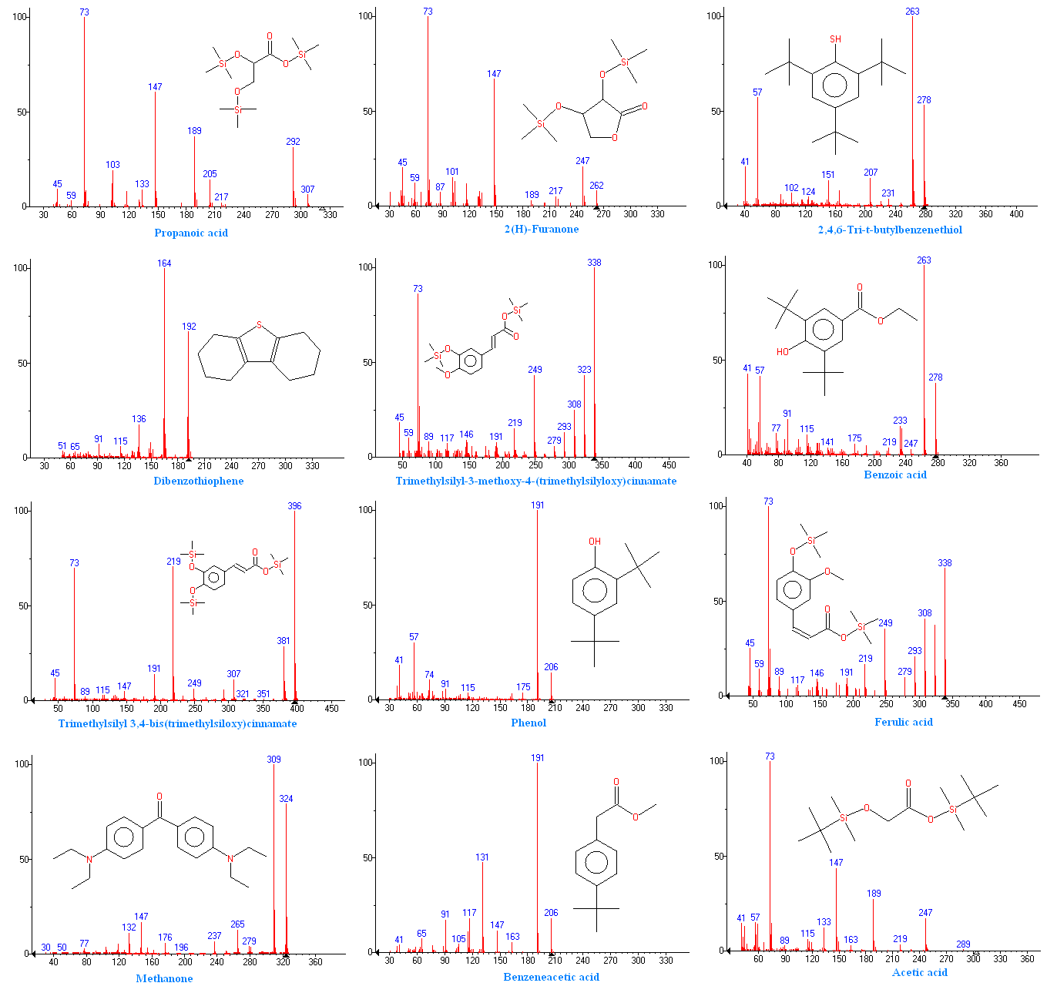
Some of the detected compounds

Slide 37
Compounds detected during laccase mediated delignification
Low molecular weight compounds like
2(3H)-Furanone (RT 9.186),
3,4-Methylenedioxyphenylacetic acid (RT 10.876),
Ethyl-2-ethoxyquinoline-4-carboxylate (RT 21.628)
Aeromatic compounds
Trimethylsilyl-3-methoxy-4-(trimethylsilyloxy) cinnamate (RT 17.023),
3-Bromo-5-ethoxy-4-hydroxybenzaldehyde (RT 12.269) and
Ferulic acid (RT-17.013)
Low molecular organic acids
Propanoic acid (RT 4.748),
Butanoic acid (RT 5.731),
Acetic acid (RT 5.974),
Butanedioic acid (RT 8.194)

Slide 38
% Delignification, Reducing sugar (mg/g) and Ethanol (%, v/v) of sugarcane top
Substrate | Delignification (%) | Reducing sugar (mg/g) | Ethanol (%, v/v) | Conversion efficiency (%)
Sugarcane top | 80.14 | 522 | 7.4 | 88

Slide 39
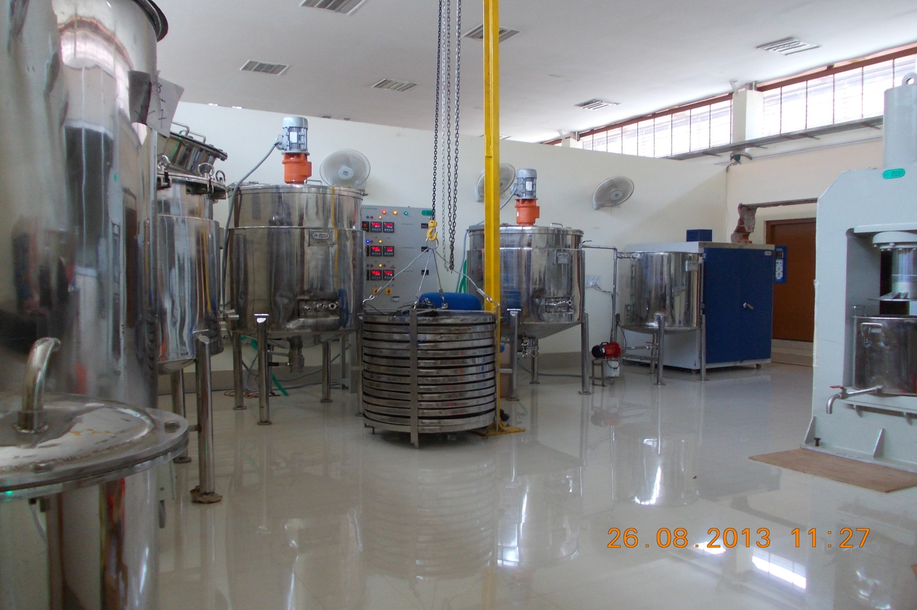
Pilot Plant facility for Ethanol Production
(Capacity: 500 kg biomass processing per batch)

Slide 40
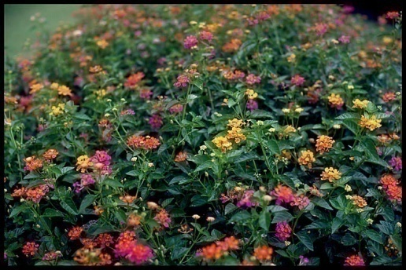
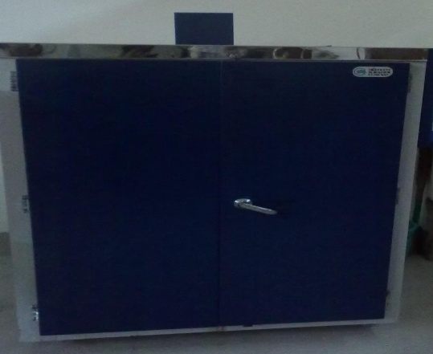
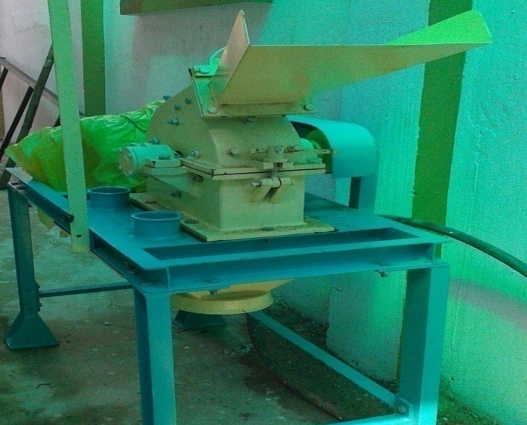
Lignocellulosic
Biomass
Hot Air Oven
Pulverizing unit

Slide 41
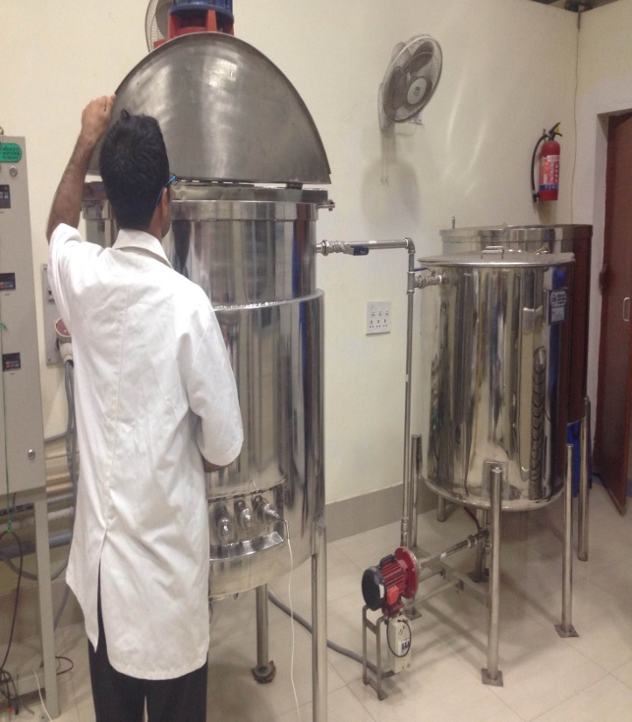





Pre-treatment tank
Saccharification tank
Fermentation tank
Control panel
Tincture press
Gantry system

Slide 42


Biomass collection tank
Gantry system for lifting the immobilization tray

Slide 43

Pilot Run
Substrate: 50 kg Ricinus communis
It had 19.5 % (weight/ dry weight) lignin
Bulk density of 0.253 Kg/L.
Process details
Castor-oil plant
Delignification (%) | Reducing sugar (mg/g) | Ethanol content (% v/v) | Distilled ethanol (% v/v)
80.34 | 602 | 5.8 | 96.16

Slide 44

Pilot Run Contd…
Substrate: 50 kg Lantana camara
It had 17.56 % (weight/ dry weight) lignin
Bulk density of 0.413 Kg/L.
Process details
Lantana camara
Delignification (%) | Reducing sugar (mg/g) | Ethanol content (% v/v) | Distilled ethanol (% v/v)
75 | 420 | 4 | 49.97

Slide 45
Pilot Run Contd…
Substrate: 50 kg Lantana camara: Ricinus communis (1:1 by dry weight) biomass
It had 18.5 % (weight/ dry weight) lignin
Bulk density of 0.328 Kg/L.
Process details
Delignification (%) | Reducing sugar (mg/g) | Ethanol content (% v/v) | Distilled ethanol (% v/v)
80 | 570 | 7.00 | 70.62
Based on the lab scale results, pilot plant trials have been planned for scaling up studies

Slide 46
Patents
R, Banerjee, A, Kuila, M. Mukhopadhyaya, “Enzymatic saccharification and fermentation of pretreated lignocellulosic raw material” (17/KOL/2012)
R, Banerjee, M. Mukhopadhyaya, A, Kuila, “A method for enzymatic delignification of lignocellulosic raw materials” (126/KOL/2012)
R, Banerjee, M.M. Ghangrekar et al., “Yellow laccase mediated delignification of lignocellulosic biomass” (201631005954 dt: 20.02.2016)

Slide 47


_{THANK YOU}

