Slide 1


Metal-Based Enzyme promiscuity of Human Senescence Marker Protein 30
Rinkoo D. Gupta, Ph.D.
Faculty of Life Sciences and Biotechnology
South Asian University
New Delhi

Slide 2
What is Enzyme Promiscuity?
One Enzyme
One Substrate
One Reaction
“The term ‘promiscuous’ is used to describe enzymes that catalyze more than one reaction”
“Enzyme promiscuity is an ability to catalyze secondary reactions that are physiologically irrelevant”
Substrate Promiscuity
Catalytic Promiscuity
Alternative Cofactors
Copley S.D. (2015), Trends in Biochemical Sciences
Notes:
either because they are too inefficient to affect fitness or because the enzyme never encounters the substrate

Slide 3
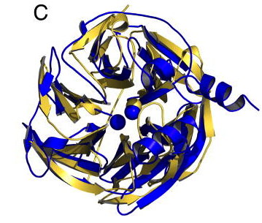
PON1
SMP30
Metal binding proteins
Only ~38% sequence similarity
Physiological function:
Lactonase: Hydrolysis of oxidized lipids
Secondary Function: OP hydrolase
Physiological function:
Lactonase: Vitamin C biosynthesis
Secondary Function: OP hydrolase
Designed for nerve agent hydrolysis, ~86000 fold higher catalytic activity
Gupta RD et.al. (2011) Nature Chem Biol.

Slide 4
SMP30
SMP30 was reported as a marker protein for ageing where concentration decreases with the age.
It is positioned on the X-chromosome, consists of seven exons and six introns and has an open reading frame of 897 bp which encodes for 299 amino acids long protein.
70-90% of amino acid sequence identity was observed among vertebrates, which is evocative of an essential biological function.
It is also reported as Ca²⁺-binding protein involved in the regulation of free cellular Ca²⁺ , hence also named as “Regucalcin”.

Slide 5
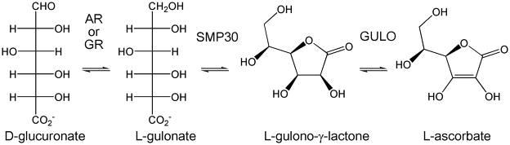
Vitamin C biosynthesis by Lactonase activity
Lactones are cyclic esters, a condensation product of an –OH group and –COOH group in the same molecule
What is a physiological function of SMP30 in primates?
The final 3 steps of the biosynthesis of L-ascorbate from D-glucuronate. In mammals lacking the ability to synthesize ascorbate, gulonolactone oxidase (GULO) is non-functional and highly mutated.
Scott and Bahnson, 2011, Biomol concepts

Slide 6
Role of SMP30 in Ca²⁺ binding
Metalloenzyme, known to bind with Ca²⁺ and play an important role in Ca²⁺ homeostasis.
Cellular Ca²⁺ level goes high during stress-
Stress
0.1-1 uM
1000 uM
During stress condition, SMP30 appears to regulate Ca²⁺-pumping activity via interactions with calmodulin and thus protects the cells from apoptosis.
What is the role of SMP30 during resting conditions?
Does it bind to other divalent cations and perform different functions?
Chakraborti and Bahnson, 2010, Biochemistry

Slide 7

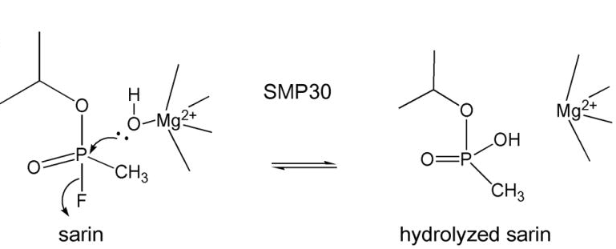
Organophosphate Hydrolysis
OPs are esters of phosphoric acid.
R1 and R2 = generally alkyl and/or alkoxy groups
X = leaving group for e.g. -F and -CN
Scott and Bahnson, 2011, Biomol concepts

Slide 8
Metal dependent activities of SMP30
What is the role of different divalent cations in lactonase and OP hydrolase activities of SMP30?
In resting condition---
Lactonase/OP hydrolase
During stress—
Ca²⁺ homeostasis ?

Slide 9
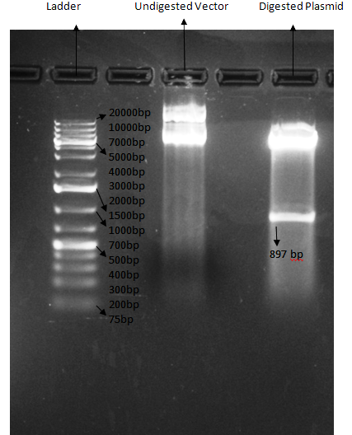
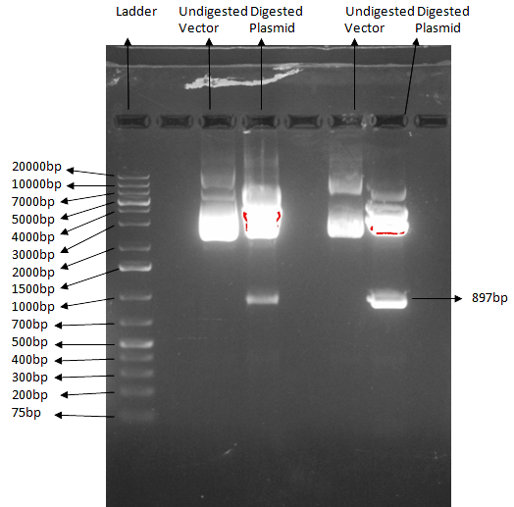
Cloning of huSMP30 and MoSMP30
Cloning of mouse SMP30 ORF in pJET1.2/blunt cloning vector.
Cloning of mouse SMP30 ORF in Bacterial expression pET28(a) vector.

Slide 10
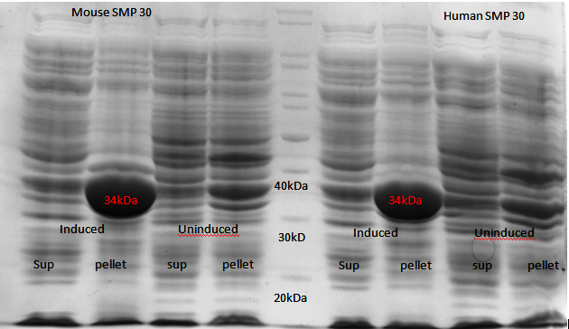
Bacterial expression of SMP30

Slide 11
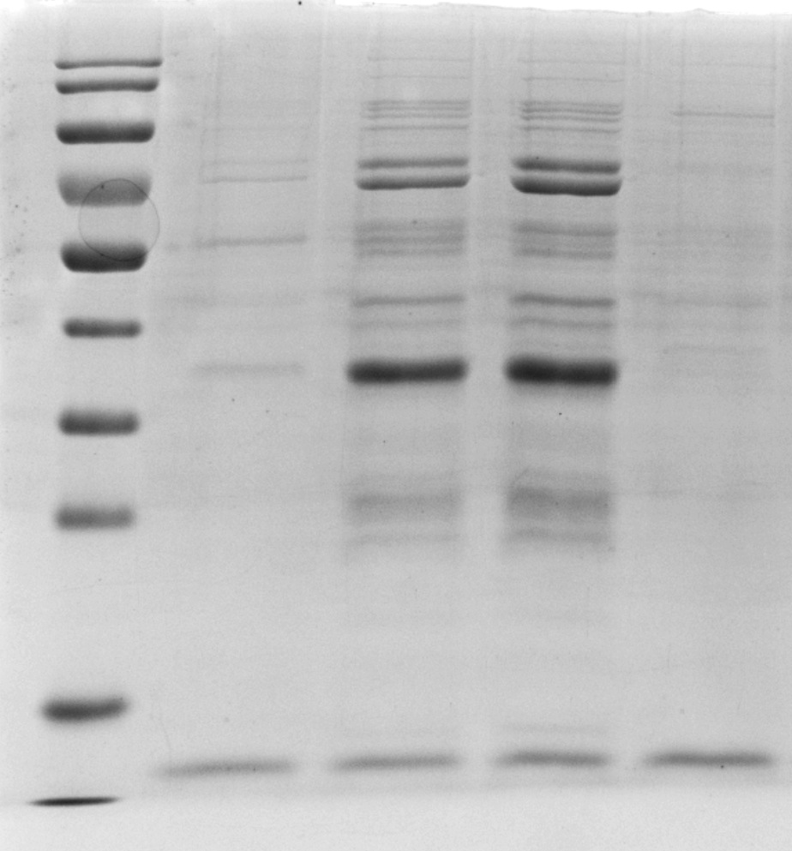
Purification of SMP30 by affinity chromatography

Slide 12
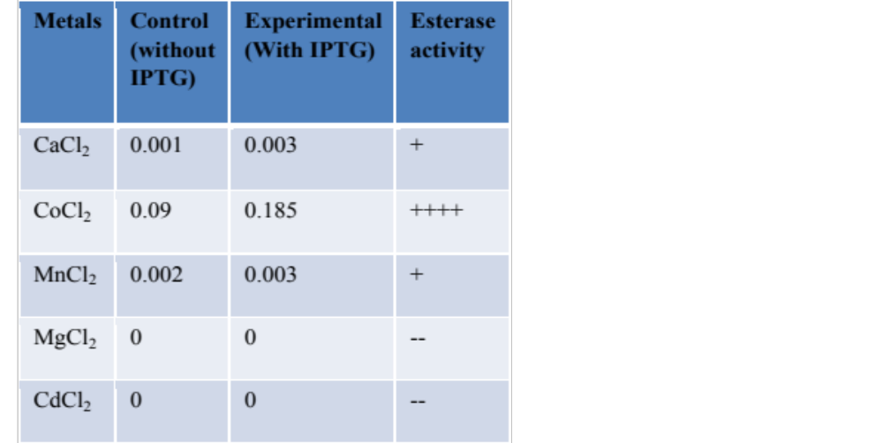
Esterase activity of huSMP30

Slide 13
Activity performed in the presence of different divalent cations
Ca Co Mn Ni Mg
Thiobutyrolacton
Phenyl Acetate
Napthyl Butyrate
Demeton S

Slide 14
Acknowledgments
My students:
Abhishek Singh Rathore
Roshan K. Dutta
Drishti Agarwal
Rohan Arora
Pallavi Prasad
Geetika Sharma
Alka Singh
Bhanuja Tripathi
Ghulam Reza Hazare
Parmanand Pandey
Shishir
Prof. Rajiv K. Saxena, Dean, FLSB
South Asian University
Financial Supports:
South Asian University, New Delhi
DST, India
Life Supports:
Shobhna & Shubham

Slide 15
Thank you

