Slide 1

Time is Limb
A case of Acute Limb Ischemia of the Upper Extremity
Author: Richultz C. Montevirgen, MD

Slide 2

Notes:
A medical emergency is defined as, “sudden onset of a medical condition manifesting itself by acute symptoms of sufficient severity (including severe pain) such that the absence of immediate medical attention could reasonably be expected to result in: placing the patient’s health in serious threat, serious impairment to bodily functions, or serious dysfunction of any bodily organ or part.”

Slide 3
65 year old
Male
Quezon City, Philippines
Admitted for the 1st time last March 28, 2015
Notes:
Good morning, I am here to present a case of 65 year old male, from Quezon city, admitted last March 2015, with a chief complaint of: click

Slide 4

Admit
Cleaning the table with a rug
Pain in the Right hand
Consult in a Private Hospital
Persistence
Right
Hand
Pain
Notes:
Right hand pain CLICK
History started morning PTA, after cleaning the table using a cloth rug, the patient suddenly developed Right hand pain, this prompted consult in a nearby Private Hospital where he was treated as a case of Osteoarthtritis, pain medications were given and was sent home. But due to persistence of the pain, this prompted consult in our institution was hence admitted.

Slide 5
Hypertensive
Hyperuricemic
15 pack year smoker
Occ. alcoholic beverage drinker
Notes:
Patient is a known Hypertensive for 15 years, and was maintained on Diltiazem 60mg tab OD, he is also diagnosed with hyperuricemia since March of 2015 and maintained on Allopurinol 100mg tab OD. He claims to have a 15 pack year smoking and a previous alcoholic beverage drinker.
NO history of: Diabetes mellitus, Pulmonary Tuberculosis, Previous operations, Bronchial asthma, Trauma. CLICK

Slide 6
Extremities
No gross deformities
No edema
No cyanosis
No limitation of movement
Gr.2 full and equal pulses all four extremities
Notes:
During the patient’s admission in the emergency room, he presented with unremarkable Physical examination. The extremities during that time was unremarkable including a Gr.2 full equal pulses in all extremities. CLICK

Slide 7
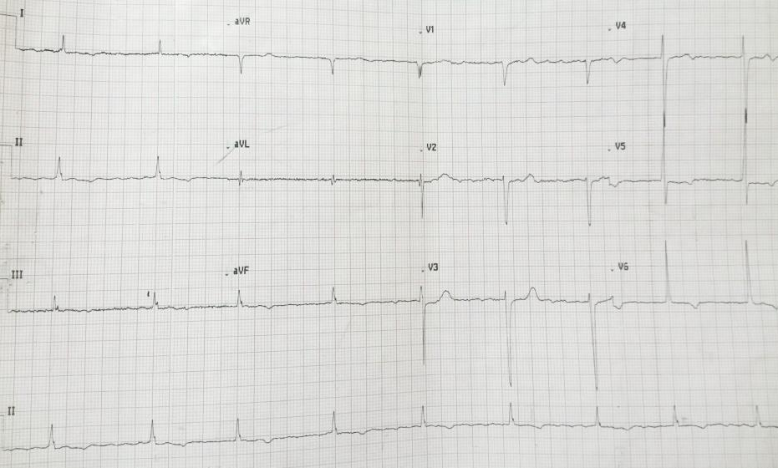
ECG: Sinus bradycardia, NSSTTWC
Notes:
ECG was done, revealing Sinus Bradycardia and NSSTTWC

Slide 8
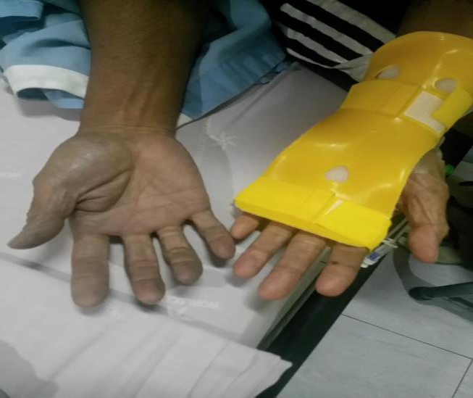
Ward Physical examination
RIGHT
LEFT
Notes:
Few minutes into ward admission, the patient suddenly developed cyanosis of the right hand, during this time, the patient verbalized a decrease in the previously noted pain, The cyanotic limb was also noted to be pulseless, cold to touch, CLICK

Slide 9
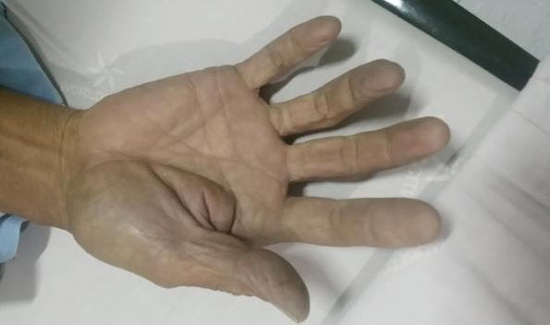
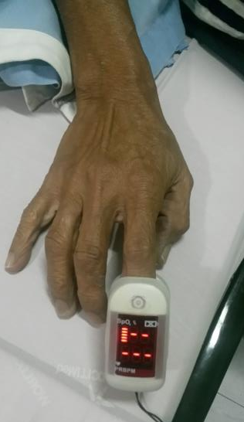
Ward Physical examination
Notes:
Absent capillary refill with no discernable pulse per portable pulse oximeter. Intact motor function was also noted with intact Grade 2 Brachial pulses CLICK

Slide 10
    Acute Limb Ischemia, Right hand
Notes:
Given the physical examination, initial diagnosis during that time was Acute Limb Ischemia of the Right hand.

Slide 11
Course in the ward
    Loading dose of Heparin
    Heparin Drip
    For Emergency Embolectomy
Notes:
Heparin loading dose of 5000 units via IV push was given, followed by Heparin drip at 900cc/hr was initiated. Referral to a TCVS specialist was done for emergency embolectomy.

Slide 12
Emergency Embolectomy
Notes:
Patient was then scheduled for emergency embolectomy

Slide 13
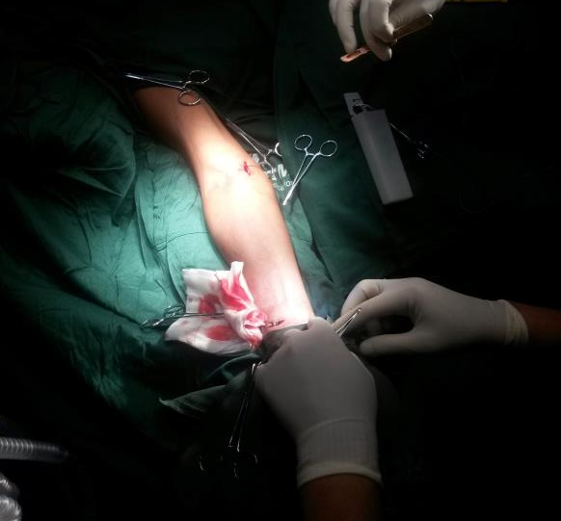
“E” Embolectomy
Notes:
As a simple overview of the embolectomy procedure, the surgeon dissects and exposes the brachial, ulnar and radial arteries.

Slide 14
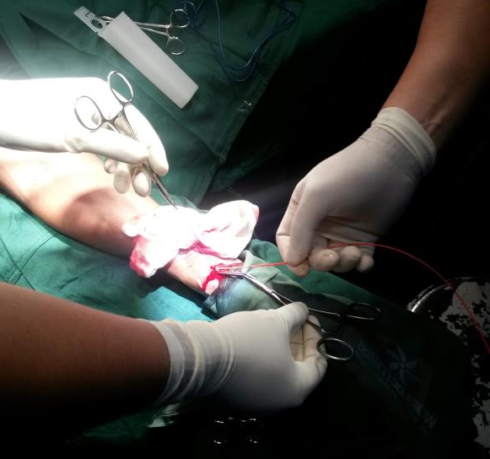
Embolectomy
Notes:
A Fogarty catheter is inserted at a retrograde fashion from distal to proximal reaching the brachial artery

Slide 15
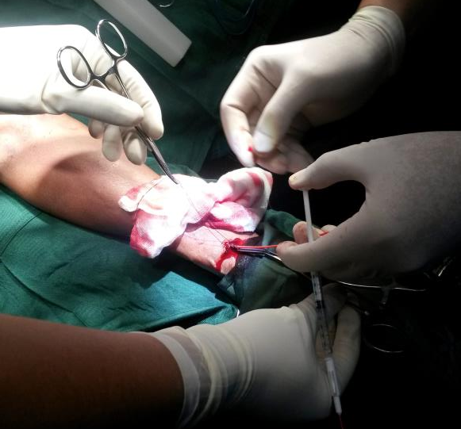
Embolectomy
Notes:
The balloon in the Fogarty catheter is inflated intermittently while slowly withdrawing the catheter “dragging” or “sweeping” with it the thrombus and or occluding embolus. This is done in both the radial and ulnar arteries.

Slide 16
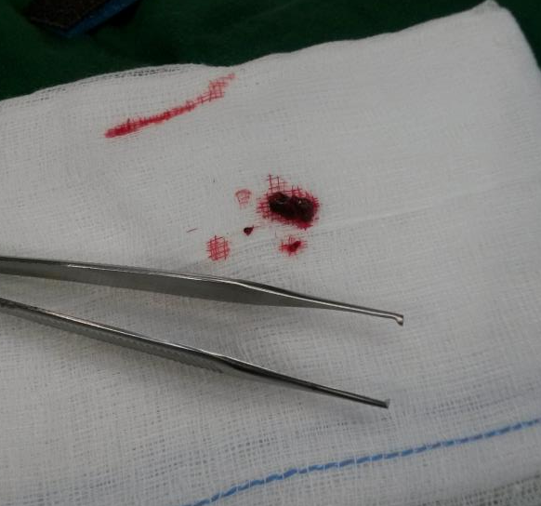
Embolectomy
Notes:
This embolus was drawn from the radial artery, relief of the occlusion is validated by a sudden gush of pulsating blood from each declogged artery.

Slide 17
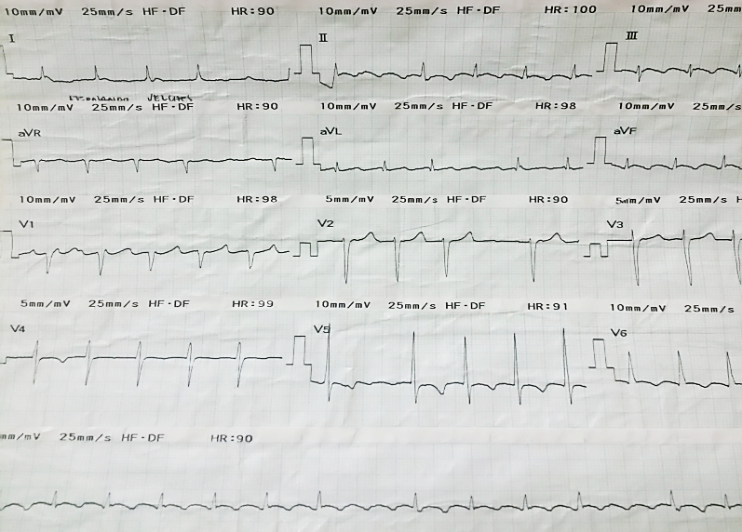
ECG: Atrial fibrillation with RVR
Notes:
Post operatively the patient was transferred to the ICU for observation, during this time the patient was noted to have irregular rhythm. ECG revealed Atrial fibrillation with Rapid ventricular response. Lanoxin 0.25mg IV was given.

Slide 18
Started on:
  Warfarin 5mg tab OD
  Continue Heparin drip
Notes:
Warfarin was started in overlap with continuous Heparin drip.

Slide 19
Vascular Studies
1. Peripheral Arterial Study Upper Extremities:
No evidence of hemodynamically significant peripheral arterial occlusive disease.
2. Arterial/Venous Study Lower Extremities:
No evidence of hemodynamically significant peripheral arterial occlusive disease.
Notes:
Vascular duplex studies done post operatively revealed unremarkable results.

Slide 20
Discussion
Notes:
Given our patients’ condition.

Slide 21
Question:
What are the common causes of peripheral cyanosis?
Notes:
I asked the question of: What are the common causes of peripheral cyanosis?

Slide 22
Cyanosis
Refers to a bluish color of the skin and mucus membranes resulting from increased quantity of reduced hemoglobin (Deoxygenated blood)
Central or Peripheral
Notes:
First let us define cyanosis, CLICK

Slide 23
Cyanosis
Refers to a bluish color of the skin and mucus membranes resulting from increased quantity of reduced hemoglobin (Deoxygenated blood)
Central or Peripheral
Notes:
Cyanosis pertains to a bluish discoloration of the skin or mucus membrane, resulting from increased quantity of deoxygenated blood.. CLICK

Slide 24
Cyanosis
Refers to a bluish color of the skin and mucus membranes resulting from increased quantity of reduced hemoglobin (Deoxygenated blood)
Central or Peripheral
Notes:
We have central CLICK

Slide 25
Cyanosis
Refers to a bluish color of the skin and mucus membranes resulting from increased quantity of reduced hemoglobin (Deoxygenated blood)
Central or Peripheral
Notes:
and peripheral cyanosis. CLICK

Slide 26
Common Causes of Peripheral Cyanosis
Peripheral cyanosis
CHF
Cold exposure
Peripheral arterial disease
Notes:
These three differentials may present as peripheral cyanosis; CLICK

Slide 27
Common Causes of Peripheral Cyanosis
Peripheral cyanosis
CHF
Cold exposure
Peripheral arterial disease
Notes:
Since our patient presented with pulsesness, we may now narrow our differentials to Peripheral arterial disease. CLICK

Slide 28
Peripheral Cyanosis
Peripheral cyanosis
Arterial obstruction
Decrease blood flow
Pallor, coldness, decrease pulses
Notes:
Arterial obstruction, causes decreased blood flow distal from the site of obstruction, which may present as Pallor or cyanosis, with coldness to touch and absent pulses, in which can be all found in our patient.

Slide 29
PERIPHERAL ARTERIAL DISEASE
Acute arterial occlusion
Loss of distal pulses, cyanosis or pallor, decreased skin temperature
Sudden cessation of blood flow to an extremity
Severe pain, paresthesia, numbness, coldness
Notes:
Acute arterial occlusion is defined as Sudden cessation of blood flow to an extremity, presenting as Severe pain, paresthesia, numbness, coldness and cyanosis of the affected limb. All of which are presented by our patient.

Slide 30
ACUTE LIMB ISCHEMIA equals
ACUTE ARTERIAL OCCLUSION
  Defined as:
  Sudden limb-threatening decrease in arterial perfusion of less than 14 days duration
  Non-traumatic acute occlusion of the arterial supply to a limb or organ
Can result either from an embolic occlusion or in situ arterial thrombosis
Vascular Medicine chapter on Acute Limb Ischemia by Creager et al 2013
Notes:
Acute limb ischemia is synonymous with acute arterial occlusion. Less than 14 days is considered Acute and can either be from an embolic or from an arterial thrombus source. CLICK

Slide 31
Epidemiology
Upper limb ischemia is very uncommon compared to lower limb ischemia
Estimated at 1.13 per 100,000 cases/year, but the true incidence can only be estimated
Affects Men and Women equally
Usually of older age, with mean age of 74 yo
Vascular Medicine chapter on Acute Limb Ischemia by Creager et al 2013
Notes:
Upper limb ischemia is very uncommon compared to the lower limb ischemia. It is estimated at 1.3 per 100,000 cases/year but the true incidence can only be estimated, it affects Men and Women equally, with a mean age of 74 years old.

Slide 32
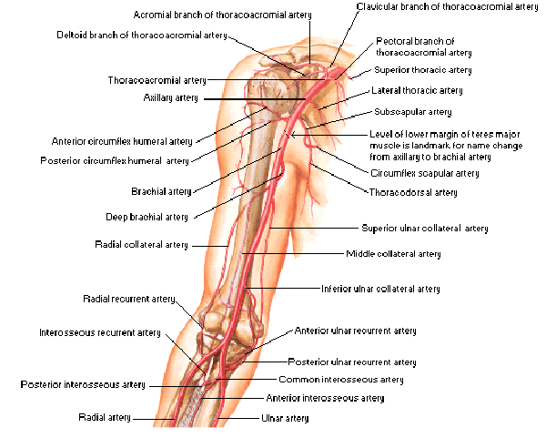
Etiology
Brachial and Axillary arteries:
  Most common site for Embolic events
Notes:
Axillary and brachial arteries are the most common sites for embolic events.

Slide 33
Etiology con’t
Embolism
  Most common cause
  Accounting to 74% to 100% in several reported series, of these cases 72% is cardioembolic in origin while 12% from proximal vessels and the remainder unknown.
  Atrial fibrillation and LV dysfunction is the most frequent causes of cardiac emboli
Vascular Medicine chapter on Acute Limb Ischemia by Creager et al 2013
Notes:
According to Craeger et al, Embolism is the most common cause of Acute limb iscemia, accounting for 74-100% in several reported series, of these embolism cases, 72% are cardioembolic in origin while the remainder remain unknown. CLICK

Slide 34
Etiology con’t
Embolism
  Most common cause
  Accounting to 74% to 100% in several reported series, of these cases 72% is cardioembolic in origin while 12% from proximal vessels and the remainder unknown.
  Atrial fibrillation and LV dysfunction is the most frequent causes of cardiac emboli
Vascular Medicine chapter on Acute Limb Ischemia by Creager et al 2013
Notes:
AF and LV dysfunction are the most frequent causes of cardiac emboli. Our patient presented with unremarkable physical examination and a NSSTTWC on ECG upon admission. CLICK

Slide 35
  Atrial fibrillation and LV dysfunction are the most frequent causes of cardiac emboli
Vascular Medicine chapter on Acute Limb Ischemia by Creager et al 2013
Notes:
As previously stated AF and LV dysfunction are the most common causes of cardiac emboli, post operatively during close monitoring in the ICU, our patient developed Atrial fibrillation with rapid ventricular response, in which Lanoxin 0.25mg IV was given providing relief.

Slide 36
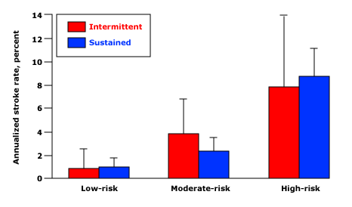
Annual Stroke Risk:
Comparing PAF vs. Sustained Atrial Fibrillation
Data from Hart RG, Pearce LA, Rothbart RM, et al. J Am Coll Cardiol 2000; 35:183.
Notes:
In one study according to Pearce and Rothbart et al, The risk of embolization appears to be similar irrespective of type, in the SPAF study (or Stroke prevention in Atrial Fibrillation), the yearly stroke rate was the same in PAF vs. sustained.
1. High risk: any of the following - age >75 and hypertension, age >75 and female, systolic BP >160 mm Hg, prior stroke or transient ischemic attack
2. Moderate risk: either of - hypertension and age ≤75 or diabetes and no high risk features
3. Low risk: no moderate or high risk features.

Slide 37
ASSERT Study
ASymptomatic AF and Stroke Evaluation in Pacemaker Patients and the AF Reduction Atrial Pacing Trial
Atrial Fibrillation lasting more than 6 minutes, increases the risk of developing Thromboembolic events such as Ischemic Strokes
Healey JS, Connolly SJ, Gold MR, et al. Subclinical atrial fibrillation and the risk of stroke. N Engl J Med 2012; 366:120-129.
Notes:
Another Study on Atrial Fibrillation, the ASSERT study showed that CLICK
an Atrial fibrillation episode lasting more than 6 minutes increases the risk of Thromboembolic events such as strokes.
By 3 months, subclinical atrial tachyarrhythmias detected by implanted devices had occurred in 261 patients (10.1%). Subclinical atrial tachyarrhythmias were associated with an increased risk of clinical atrial fibrillation (hazard ratio, 5.56; 95% confidence interval [CI], 3.78 to 8.17; P<0.001) and of ischemic stroke or systemic embolism (hazard ratio, 2.49; 95% CI, 1.28 to 4.85; P=0.007). Of 51 patients who had a primary outcome event, 11 had had subclinical atrial tachyarrhythmias detected by 3 months, and none had had clinical atrial fibrillation by 3 months.

Slide 38
Smoking
Some studies have found a stronger association between tobacco abuse and PAD than between tobacco abuse and ischemic heart disease. Moreover, the heavier smokers not only have a greater risk for PAD, they also have the more severe forms that cause critical ischemia. The cessation of smoking is accompanied by a reduction in the risk for PAD and, although the risk for PAD in ex-smokers are 7 times greater than in non-smokers, the risk in active smokers is 16 times greater. Additionally, the permeability of both venous coronary bypass and prosthetic grafts is reduced in patients who smoke. The rates of amputations and mortality are also greater in smokers.
1.Criqui MH, Fronek A, Barrett-Connor E, Klauber MR, Gabriel S, Goodman D. The prevalence of peripheral arterial disease in a defined population. Circulation. 1985;71:510-51
Notes:
Our patient has a 15 pack year smoking history, and as stated CLICK

Slide 39
Smoking
Some studies have found a stronger association between tobacco abuse and PAD than between tobacco abuse and ischemic heart disease. Moreover, the heavier smokers not only have a greater risk for PAD, they also have the more severe forms that cause critical ischemia. The cessation of smoking is accompanied by a reduction in the risk for PAD and, although the risk for PAD in ex-smokers are 7 times greater than in non-smokers, the risk in active smokers is 16 times greater. Additionally, the permeability of both venous coronary bypass and prosthetic grafts is reduced in patients who smoke. The rates of amputations and mortality are also greater in smokers.
1.Criqui MH, Fronek A, Barrett-Connor E, Klauber MR, Gabriel S, Goodman D. The prevalence of peripheral arterial disease in a defined population. Circulation. 1985;71:510-51
Notes:
The heavier the smoker, the greater the risk for developing PAD, their PAD tends to be more severe compared to non-smokers. While Ex-smokers have 7 times greater risk of developing PAD, active smokers have 16 times greater risk compared to non-smokers.

Slide 40
Diagnosis
Physical Examination:
  Basis for diagnosis
  A good physical examination avoids the need for additional imaging that can delay or shorten immediate therapeutic interventions
Bedside doppler evaluation:
  Makes for fast sufficient basis for the diagnosis
CT Angiogram or MRA:
  Confirmatory imaging
Vascular Medicine chapter on Acute Limb Ischemia by Creager et al 2013
Notes:
As with our patient, the diagnosis was made with physical examination with an aid of a portable doppler that confirmed the absence of peripheral pulses, specifically to the radio-ulnar arteries. Advanced imaging techniques can be used for confirmation, but is not a requirement for diagnosis, due to different factors that causes their use to delay immediate treatment.

Slide 41
Physical examination findings:
6 P’s of Arterial occlusive disease
  Pain- Most common sypmtoms
  Pallor/cyanosis- Early sign of ischemia
  Pulselessnes
  Poikilothermia
  Paresthesia- Replaces pain if not resolved
  Paralysis- Final stage of ischemic injury
Notes:
The 6P’s of Arterial Occlusive disease will help guide us in the diagnosis. CLICK

Slide 42
Physical examination findings:
6 P’s of Arterial occlusive disease
  Pain- Most common sypmtoms
  Pallor/cyanosis- Early sign of ischemia
  Pulselessnes
  Poikilothermia
  Paresthesia- Replaces pain if not resolved
  Paralysis- Final stage of ischemic injury
Notes:
As with our patient, he presented with 5 out 6 of the P’s. We need to determine the 6P’s to Clinically categories our patient, based on Rutherford Classification.
CLICK

Slide 43
Rutherford Classification of Limb Ischemia
Rutherford Class | Prognosis | Sensory exam | Motor exam | Arterial doppler | Venous doppler | Skin exam
Class I | Threatened | Normal | Normal | Audible | Audible | Normal capillary return
Class IIa | Salvageable with promt therapy | Minimal sensory loss | Normal | Often audible | Audible | Dec capillary return
Class IIb | Salvageable if treated immediately | Mild sensory loss and rest pain | Mildly to moderate abnormal | Usually inaudible | Audible | Pallor/ cyanosis
Class III | Irreversible tissue and nerve damage | Profound sensory loss | Paralysis and rigor | Inaudible | Inaudible | No capillary return, skin marbling
Notes:
Rutherford classification of Limb Ischemia is used to Triage patients and provide guidance in management. CLICK

Slide 44
Rutherford Classification of Limb Ischemia
Rutherford Class | Prognosis | Sensory exam | Motor exam | Arterial doppler | Venous doppler | Skin exam
Class I | Threatened | Normal | Normal | Audible | Audible | Normal capillary return
Class IIa | Salvageable with promt therapy | Minimal sensory loss | Normal | Often audible | Audible | Dec capillary return
Class IIb | Salvageable if treated immediately | Mild sensory loss and rest pain | Mildly to moderate abnormal | Usually inaudible | Audible | Pallor/ cyanosis
Class III | Irreversible tissue and nerve damage | Profound sensory loss | Paralysis and rigor | Inaudible | Inaudible | No capillary return, skin marbling
Notes:
Our patient falls under Class IIB.

Slide 45
Golden Period of 3-6 hours
Notes:
The golden period is 3-6 hours, and failure to recognize this condition may result in permanent disability and catastrophic untimely loss of limb and/ or function.

Slide 46
    Loading dose of Heparin 5,000 units IV
    Heparin Drip: D5W 98cc + 10,000 units Heparin to run for 900 units per hour
    Referred to TCVS service for evaluation and possible emergency Embolectomy
    Referred to Nephrology service for co-management
Once the diagnosis is made, the patient should be anticoagulated with intravenous heparin to prevent propagation of clot
Harrison’s 18th edition; Chapter on Vascular Diseases by Creager and Loscalzo
Notes:
According to Craeger and Loscalzo et al, Once the diagnosis is made, the patient should be anticoagulated with intravenous heparin to prevent propagation of clot. CLICK

Slide 47
    Loading dose of Heparin 5,000 units IV
    Heparin Drip: D5W 98cc + 10,000 units Heparin to run for 900 units per hour
    Referred to TCVS service for evaluation and possible emergency Embolectomy
    Referred to Nephrology service for co-management
Unfractionated heparin, bolus and continuous infusion, to achieve aPTT
2 to 3 times the upper limit of the laboratory normal
Loading dose: 80 units/kg
Infusion dose: 18 unit/kg/hr
Harrison’s 18th edition; Chapter on Vascular Diseases by Creager and Loscalzo
Notes:
Loading dose of Heparin may start at 80 units/kg, but can go as high as 100-150 units/kg loading dose, to rapidly increase PTT to 2 to 3 times the normal value, with an infusion rate dose at 18 units/kg/hr, all of which were done to our patient.

Slide 48
  Warfarin anticoagulation:
  Continue parenteral anticoagulation for a minimum of 5 days, with sequential INR values at 1 day apart, achieve the target INR range.
  Titrate to INR target of 2-3
Harrison’s 18th edition; Chapter on Vascular Diseases by Creager and Loscalzo
Notes:
Warfarin anticoagulation should be started in overlap with Heparin and continued for a minimum of 5 days, with a target INR of 2-3.

Slide 49
ACCF/AHA Guideline 2011
Catheter-based thrombolysis is an effective and beneficial therapy and is indicated for patients with acute limb ischemia.
(Level of Evidence: A)
Notes:
According to AHA Guideline 2011, Catheter-based thrombolysis is an effective and beneficial therapy and is indicated for patients with acute limb ischemia. With Level A of Evidence.

Slide 50
Conclusion
Proper History and Physical Examination is paramanount
Portable doppler ultrasound provides quick assessment of the level and some degree of occlusion in patient;s with ALI
Anticoagulation with Heparin is our first line therapy
Embolectomy is still the recommended mode of intervention for definitive cure
Notes:
In conclusion, Unlike other medical conditions, Physical examination alone may provide a diagnosis and in essence may result in prompt decision for treatment plans for Acute limb ischemia. Proper History and Physical Examination is paramanount, Portable doppler ultrasound provides quick assessment of the level and some degree of occlusion in patients with Acute limb ischemia, Anticoagulation with Heparin is our first line therapy, Embolectomy is still the recommended mode of intervention for definitive cure

Slide 51
“Life over limb principle”
Notes:
Having acute limb ischemia in itself means that the patient is at risk of developing life threatening conditions like MI, cardiogenic shock, strokes, and others, and in such cases, the PRINCIPLE OF LIFE OVER LIMB should always be kept in mind to guide the best therapeutic strategy.

Slide 52
Thank you

Slide 53
Prothrombin Time Monitoring
INR
1.60
1.91
1.74
2.11
2.42
3.68
13.5 secs
Warfarin

Slide 54
Partial Thromboplastin Time
31.3
61.0
56.0
46.9
66.0
53.2
40.6
28.0 secs
Heparin

