Slide 1

A computer model of glucose absorption and metabolism in healthy human adults and with metabolic disease.
Richard Naftalin
King’s College London School of Medicine.
Physiology Department and Vascular Biology Group
BHF centre of research excellence.

Slide 2
Menu
Some key points related to the physiological control of glucose absorption and metabolism.
A computer model and simulation of some aspects of global glucose absorption and metabolism.
Some problems of metabolic disease, e.g. NAFLD and NASH, relating to glucose metabolism.
Simulation of metabolic disease.

Slide 3
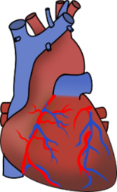

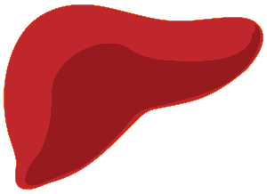

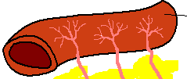
Simulation of integrated glucose absorption and metabolism
Simplified diagram of showing parallel splanchnic and systemic circulations
insulin insensitive
Systemic blood flow
The heart pumps blood via the aorta to the tissues via a network of arteries and capillaries.
Blood supply to muscle and fat is variable, dependent on exercise, temperature and insulin.
Blood flow to brain, 20% of total flow at rest, is insulin independent.
(6)
Pul V
Pul A
Rt Heart
lung
Lt Heart
jugular V
insulin sensitive
HV
HA
Vena cava
PV
intestine
SMA
insulin sensitive
Liver
(5)
pancreas
Hepatic V
insulin sensitive
insulin sensitive
(2)
Inf Vena
Cava
(3)
kidney
(4)
Splenic V
insulin insensitive
insulin insensitive tissue
(brain, bone skin)
Portal V
(7)
Renal
A
(1)
Sup
Mesenteric
Art
insulin insensitive
Pancreas
(6)
Insulin sensitive tissue
(muscle, fat)
Key elements in the circulation
Splanchnic blood is isolated from systemic blood as the portal vein blood passes through the liver prior to re-entry into the systemic circulation.

Slide 4
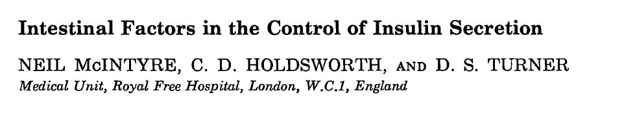
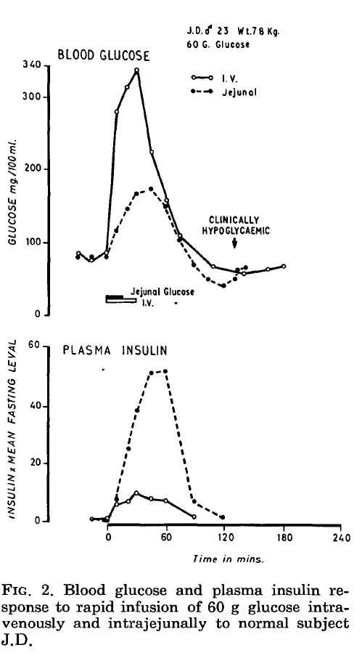
“The most likely explanation for our
findings is the release of a humoral sub- stance from the jejunal wall during glucose absorption which acts, along with a rise in blood glucose, by stimulating the release of insulin by the pancreatic islets. ”
Jejunal glucose gavage

Slide 5
Simplified diagram of showing parallel splanchnic and systemic circulations
Control of splanchnic blood flow
L cell GLP-1 secretion
activated by glucose
Glucose
SM capillaries
SMA flow activated by GLP-1
Pul V
Pul A
epithelium
Rt Heart
lung
Lt Heart
Intestinal lumen
HV
HA
PV
Vena cava
intestine
SMA
pancreas
Liver
Pancreatic islet
pancreas
Glucagon secretion activated by reduced systemic glucose
Insulin secretion activated by raised systemic glucose and GLP-1
kidney
Aorta
insulin insensitive tissue
(brain, bone skin)
Splanchnic blood flow
Superior mesenteric artery (SMA) supplies blood to intestine and pancreas.
The intestinal capillary blood flow drains glucose absorbed by small intestine into the portal vein PV
The PV takes blood to the liver.
Blood leaves the liver via to hepatic vein HV to re-enter the systemic circulation.
Insulin sensitive tissue
(muscle, fat)

Slide 6

Intestinal luminal glucose 50 mM
Paracellular diffusion transport
Apical Na dependent
glucose cotransport
J _{SGLT1}
J_{pc}
J _{GLUT2}
Apical facilitated
glucose transport
Na⁺ 140 mM
Na⁺ 10 mM
Intracellular
Glucose 55 mM
Intracellular
Glucose 55 mM
Intracellular
Glucose 25 mM
Baso-lateral facilitated
glucose transport
J _{BL}
Submucosal
glucose
40 mM
Intestinal capillary convective
glucose transport
Submucosal
glucose
20 mM
Submucosal Diffusive glucose flow
Superior mesenteric arterial
Glucose 5.0 mM
Superior mesenteric capillary
glucose 18 mM
J _{SMCap}
Fasting SMA flow rate = 800 ml min⁻¹
SMA flow = (aortic B.P - SM cap P) / R _{SMA}
Feeding SMA flow rate = 1800 ml min⁻¹
R_{SMA} =$\frac{ R SMA∗ Km GLP}{\left(Km GLP + [GLP SMA]\right)}$.
Intestinal Glucose absorption rate = (Glpump1*$\frac{intest luminal glc}{(intestglc + Glut2KM))} +\text{P} \text{gl}\text{ucose}∗( luminal glucose−sumucosal glucose))$

Slide 7
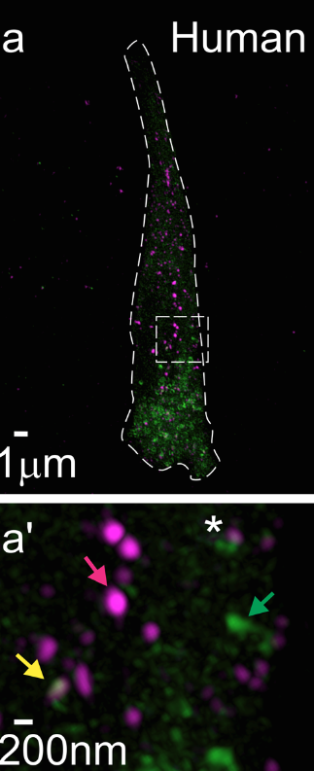
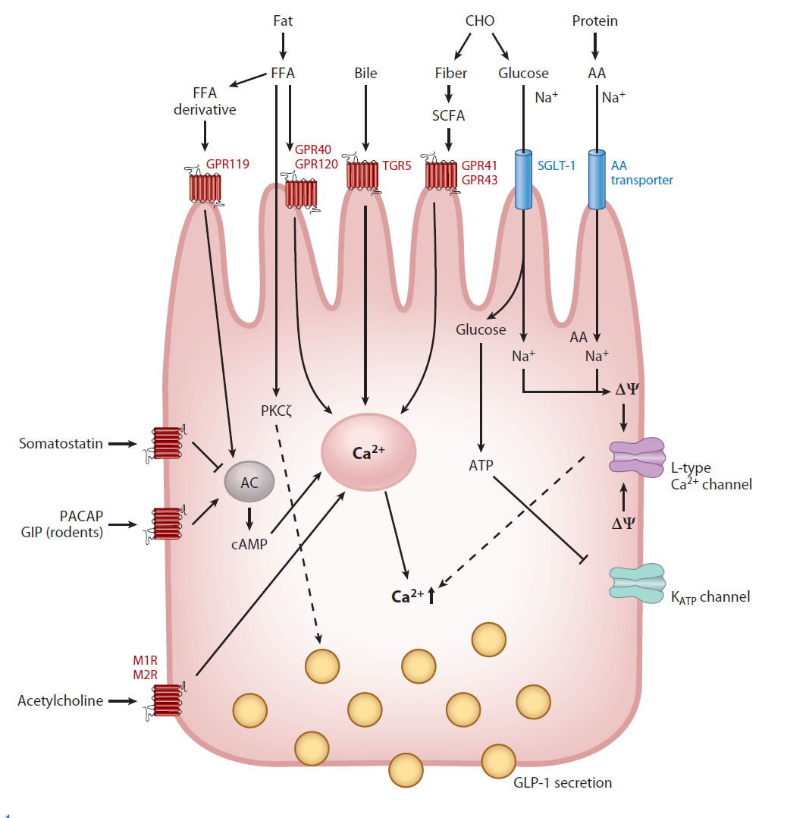
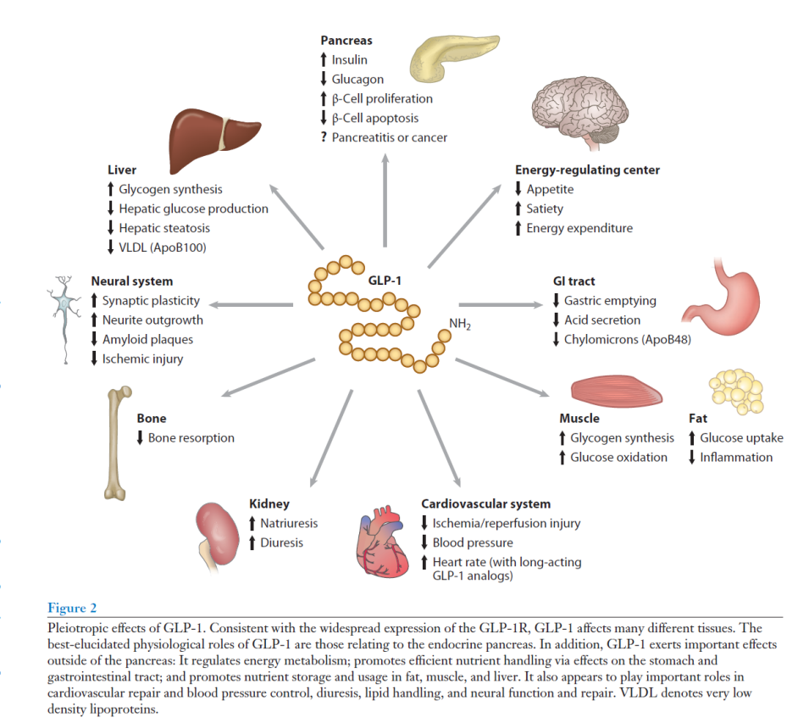
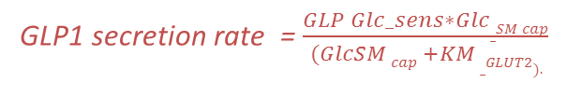
Intestinal L cell incretin secretion (GLP-1)
↑ glucose sensitive insulin secretion
↑ net hepatic glucose uptake
↑ Basolateral GLUT2
↑ insulin sensitive glucose uptake
Human jejunal villus
Green GLP-1 granules, mauve PYY.
↑ Increase SMA flow
GLP1 secretion rate = $\frac{GLP Glc_sens∗Glc_SM cap}{ (GlcSM cap +KM _GLUT2). }$
Hepatic GLP-1 inactivation rate = [Hep GLP-1]*hepatic GLP-1 inactivation rate
Sys GLP-1 inactivation rate = [Sys GLP1]*systemic GLP-1 inactivation rate

Slide 8
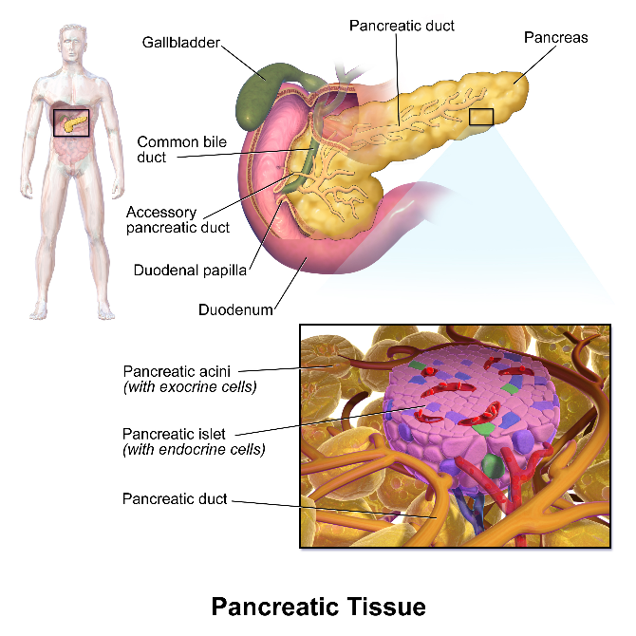
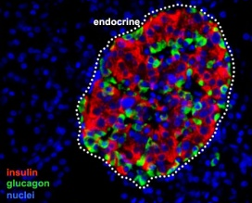

Pancreatic islets showing insulin and glucagon secreting cells.
These hormones are released in response to systemic arterial glucose concentrations into the splanchnic capillaries. Note that GLP-1 is released in response to splanchnic glucose concentration.
Insulin equations
$Insulin secretion rate$=$insulin glucose sensitivity coef ∗\frac{Glc_sys A}{(Glc sys A + Km_GLUT2)} ∗\frac{GLP_SysA }{(GLP SysA+ KmGLP)}$
Hepatic insulin inactivation rate = Hep[Ins]* Hep insulin inactivation rate.
Insulin inactivation rate = [sys Ins]*sys insulin inactivation rate.
Glucagon equations.
Glucagon secretion rate = $GLN glc_{sensitivity}coef ∗ (1− \frac{{Glc_sys A}^{ n}}{{Glc_sys A}^{ n}+{Km_GLUT1}^{n}}$).
Hepatic Glucagon inactivation rate = Hep [GLN]. Hepatic Gln inactivation rate.
Glucagon systemic inactivation rate = sys [GLN]* Gln inactivation rate.

Slide 9
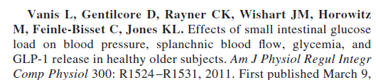
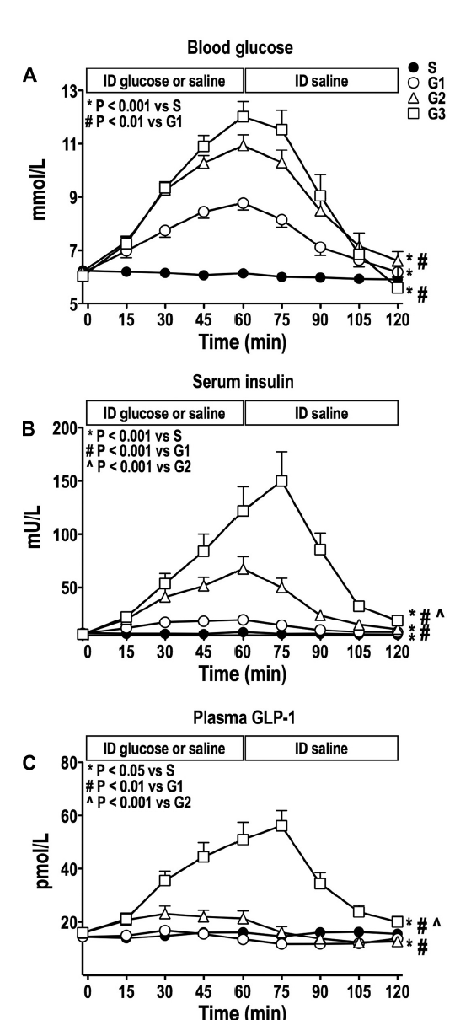
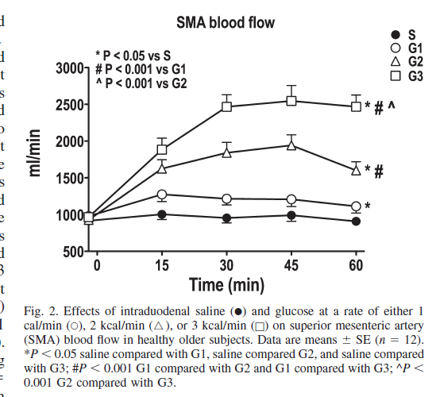
SMA blood flow increases and also insulin and GLP-1 release as the rate of glucose infusion into the duodenum increases.
Note: glucose = 4kcal/G 1 kcal/min= 1.4 mmoles/min, 2kcal/min = 2.8 mmole/min, 3 kcal/min= 4.2 mmole/min.

Slide 10
Summary
Hepatic glucose absorption occurs in sinusoids
Sinusoidal perfusion is essential for hepatic glucose uptake.
Insulin and GLP-1 stimulate hepatic glucose absorption.

Slide 11
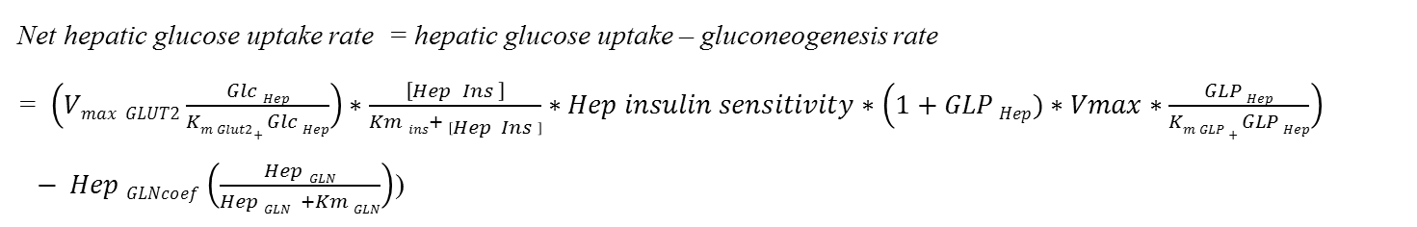
Hep V
Control of net hepatic glucose uptake and metabolism
Hep A
Liver parenchymal cells
lining sinusoids
Port V
Insulin and GLP-1 increase net hepatic glucose uptake by increasing hepatic GLUT2 and glucokinase activity.
Glucagon increases net hepatic glucose output by stimulating glycogenolysis and gluconeogenesis from hepatic protein and lipid sources.
Insulin
GLP-1
sinusoid
Portal vein glucose
glucose
Glucagon
Glycogen
.
GLUT2
Glucokinase
Net hepatic glucose uptake rate = hepatic glucose uptake – gluconeogenesis rate
= $\left(Vmax GLUT2\frac{Glc Hep}{Km Glut2+ Glc Hep}\right)∗\frac{\left[Hep Ins \right]}{Km ins+ \left[Hep Ins \right]}∗Hep insulin sensitivity∗\left(1+GLP Hep)∗Vmax∗\frac{GLP Hep}{Km GLP + GLP Hep}\right)$
$− Hep GLNcoef\left(\frac{Hep GLN}{Hep GLN +Km GLN}\right)$)
Glucagon secretion rate = $GLN glucose_sensitivity coef∗ (1− \frac{{Glc_sys A}^{ n}}{{Glc_sys A}^{ n}+{Km_GLUT1}^{n}}$).
Hepatic Glucagon inactivation rate = Hep [GLN]. Hepatic Gln inactivation rate.
Glucagon systemic inactivation rate = sys [GLN]* Gln inactivation rate.

Slide 12
Insulin insensitive
insulin sensitive
glucose
glucose
glucose
Insulin
GLP-1
$peripheral insulin independent metabolic rate∗ \frac{Glc_{sys A} }{Glc_{Sys A} + Km Glut1}$
glucose
Insulin
glucose
GLP-1
Insulin
GLP-1
$$Sys glc met rate = Sys glc met rate∗\frac{sys Glc}{Sys Glc+Km \left(GLUT4\right)} ∗ \frac{sys Ins}{Sys Ins+Km \left(Ins\right)}∗(1+sys insulin sensitivity∗sys [GLP1]$$
Insulin and GLP-1 also synergise glucose uptake into muscle and fat by upregulating GLUT4.
Glucose uptake into brain and kidney and other insulin insensitive tissues is mainly via non-inducible GLUT1.

Slide 13
The need for a computer model of glucose absorption and metabolism.
In order to fully comprehend the complex interactivity of the effects of glucose dependent changes on:-
Incretin and hormone secretion rates
Splanchnic circulation on intestinal glucose absorption
Net hepatic glucose uptake,
Peripheral insulin-dependent glucose metabolism,
Insulin-independent glucose metabolism,
Glucagon-dependent gluconeogenesis,
To comprehend the global effects of the above they have to be integrated into a global system.
Until now this has not been done.

Slide 14

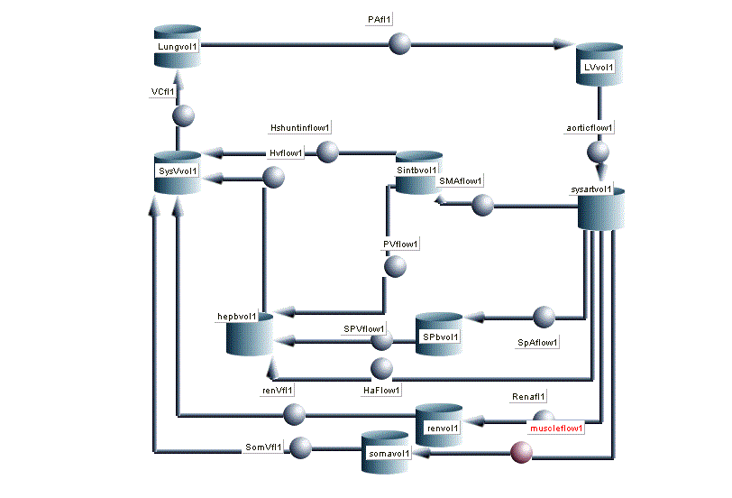
Berkeley Madonna™ was developed by Robert Macey and George Oster of the University of California at Berkeley.
Programmed by Tim Zahnley. Email: madonna@kagi.com
Computer block flow diagram of blood flow network which is the kernel of model

Slide 15
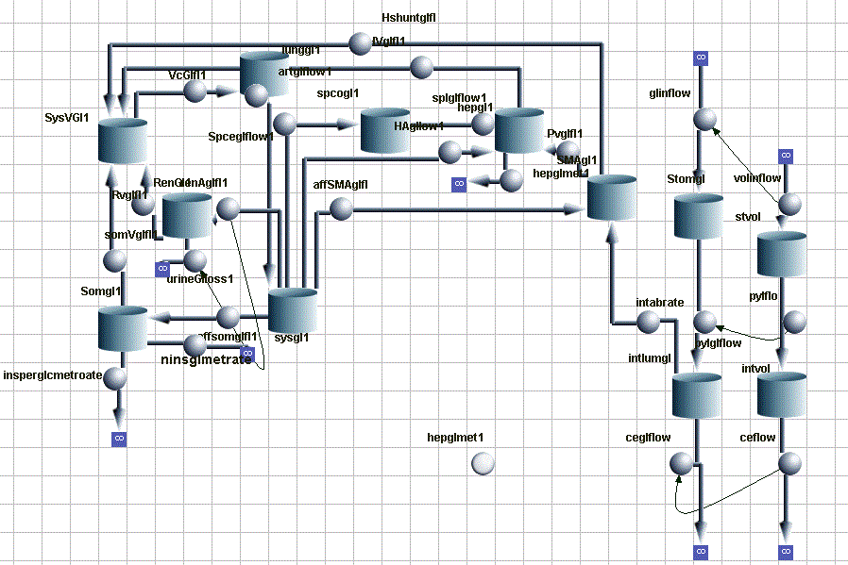
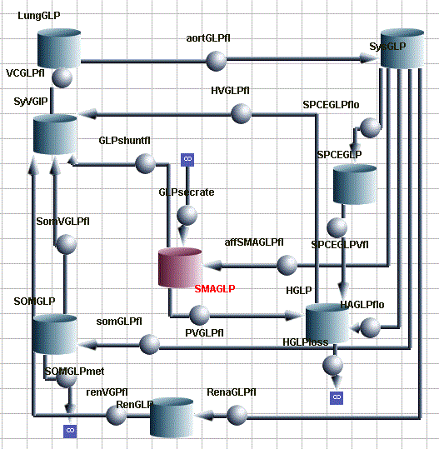
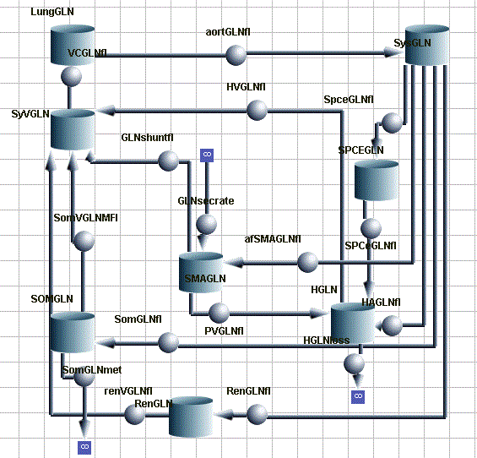
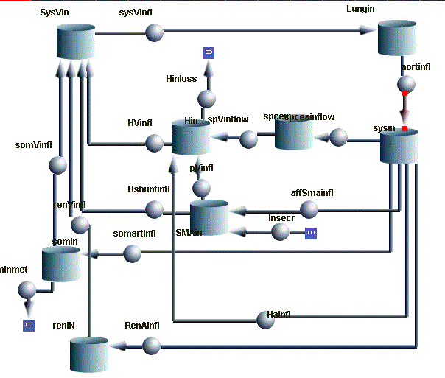
Glucose flow diagram
GLP-1 flow diagram
Glucagon flow diagram
Insulin flow diagram

Slide 16
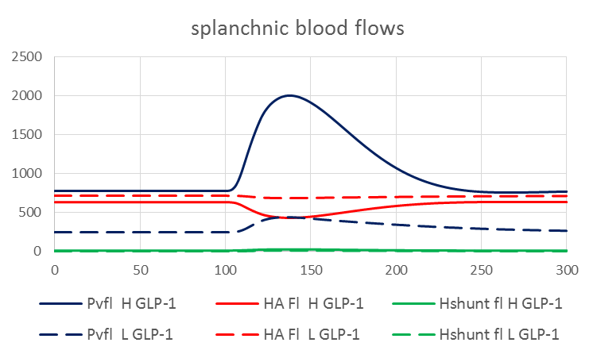
Splanchnic and systemic blood flows H/L GLP-1
min
High sensitivity to GLP-1 causes an increase in SMA flow during glucose feeding.
HA flow fall reciprocally
Portal pressures H/L GLP-1
Low GLP-1 sensitivity reduces PV pressure during glucose feeding
mm Hg
min
Notes:
Post prandial increases in SMA flow panel B lead to increased SM cap volume and decreased systemic blood volume panel A and raised PV pressure panel C. With low GLP-1 secretion these changes are greatly reduced.

Slide 17
Figure 2
Effects if varying GLP-1 secretion on splanchnic blood flows volumes and pressure following 50 G glucose delivery by duodenal gavage at 100 min.
Min
GLP-1 glucose
sensitivity
Min
GLP-1 glucose
sensitivity
Min
GLP-1 glucose
sensitivity
Min
GLP-1 glucose
sensitivity

Slide 18
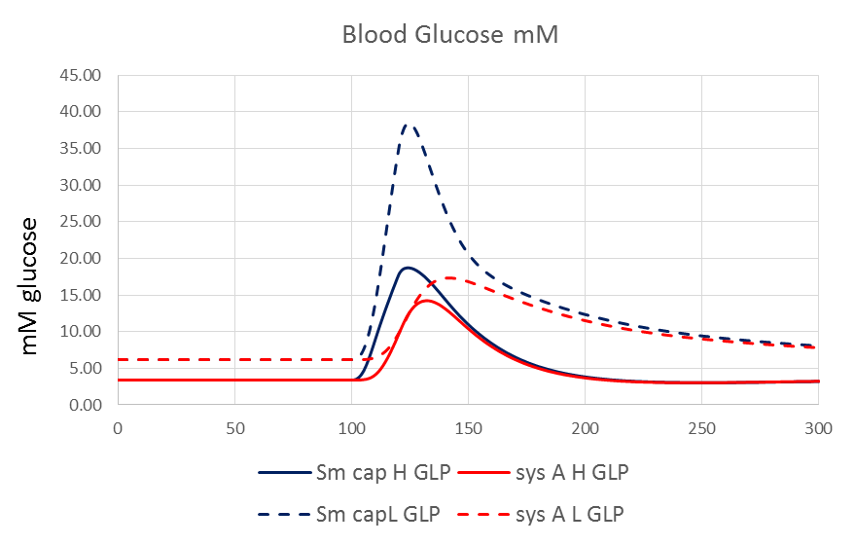
blood glucose concentrations H/L GLP-1
mM glucose
min
Notes:
The results in Figure 2 cause very large increases in SM cap glucose concentrations Panel A with L GLP-1 although the glucose flows are reduced Panel B. Note that increased glucose flow via the HA compensates for lower PV glucose flow with L GLP-1 Panel B. During fasting phase 0 -90 min net hepatic glucose output is reduced with low GLP-1 and hepatic uptake reduced during the absorption phase 100- 145 min in the hepatic metabolic phase of net uptake 160-250min is prolonged with L GLP-1. Panel C. LGLP1 also reduces peripheral insulin sensitive glucose uptake and slightly raised peripheral insulin insensitive glucose uptake and also produces glycosuria.

Slide 19
Splanchnic and systemic blood glucose concentrations H/L GLP-1
mM glucose
min
Low GLP-1 sensitivity raises post prandial splanchnic and systemic glucose concentrations
Low GLP-1 sensitivity prolongs post prandial hyperglycaemia.
Low GLP-1 increases the ratio of splanchnic: systemic glucose to ≈ 2.0
Notes:
The results in Figure 2 cause very large increases in SM cap glucose concentrations Panel A with L GLP-1 although the glucose flows are reduced Panel B. Note that increased glucose flow via the HA compensates for lower PV glucose flow with L GLP-1 Panel B. During fasting phase 0 -90 min net hepatic glucose output is reduced with low GLP-1 and hepatic uptake reduced during the absorption phase 100- 145 min in the hepatic metabolic phase of net uptake 160-250min is prolonged with L GLP-1. Panel C. LGLP1 also reduces peripheral insulin sensitive glucose uptake and slightly raised peripheral insulin insensitive glucose uptake and also produces glycosuria.

Slide 20
Splanchnic and systemic glucose metabolic rates high and low GLP-1 sensitivity
mmoles min⁻¹
min
High GLP-1 sensitivity increases net hepatic glucose uptake.
Low GLP-1 sensitivity prolongs duration of net hepatic glucose uptake.
High GLP-1 sensitivity greatly increases peripheral insulin sensitive glucose uptake.

Slide 21
Effects of varying GLP-1 secretion on glucose flows and metabolism after 50G glucose duodenal gavage.
Min
GLP-1 glucose
sensitivity
GLP-1 glucose
sensitivity
GLP-1 glucose
sensitivity
Min
Min
GLP-1 glucose
sensitivity
Min
Min
GLP-1 glucose
sensitivity
GLP-1 glucose
sensitivity

Slide 22
Systemic and splanchnic glucose, hormone and GLP-1 concentrations after gavage with varying glucose sensitivity of GLP-1 secretion.
Figure 4
GLP-1 glucose
sensitivity
Min
Min
Min
GLP-1 glucose
sensitivity
Min
GLP-1 glucose
sensitivity
GLP-1 glucose
sensitivity
GLP-1 glucose
sensitivity
Min
GLP-1 glucose
sensitivity
GLP-1 glucose
sensitivity
Min
GLP-1 glucose
sensitivity
Min
Min

Slide 23
Effects of GLP-1 dependent increases in SMA on apparent intestinal glucose permeability and on PV glucose flow
µm s⁻¹
mmole min⁻¹
Small increase in apparent glucose intestinal permeability with increased GLP-1 dependent SMA flow.
Larger relative changes in PV glucose flow with increased GLP-1 dependent SMA flow.

Slide 24
Summary of computer model findings in normal humans .
The computer model demonstrates that during intestinal glucose absorption, synchronously glucagon-like peptide-1, (GLP-1) release into the splanchnic blood.
Stimulates superior mesenteric arterial (SMA) blood flow.
Harmonizes absorption with its distribution and metabolism by increasing passive intestinal glucose absorption.
GLP-1 also synergises insulin-dependent net hepatic glucose uptake (NHGU).
GLP-1 synergises insulin-dependent glucose uptake into muscle and fat tissue.
When GLP-1 secretion is deficient post-prandial SMA blood flow is not increased and as NHGU is also reduced, hyperglycaemia follows.
Portal venous glucose concentration is also raised, thereby retarding the passive component of intestinal glucose absorption.

Slide 25
Normally 99% of portal blood venous blood flows through the liver sinuses.
With hepatic cirrhosis (fibrosis), or fatty liver (hepatosteatosis) portal venous pressure rises opening collateral hepatic vessels.
This leads to shunting of portosystemic blood.
Pul V
Pul A
Rt Heart
lung
Lt Heart
HA
HV
PV
SMA
Vena cava
intestine
Consequences of PS shunting
↓ Portal venous pressure.
Splanchnic blood bypasses liver sinusoids enters systemic blood.
During feeding ↑ glucose, ↑ insulin and ↑ GLP-1 enter systemic circulation.
↑ Peripheral glucose metabolism rates.
↓ Hepatic metabolism.
↑ peripheral metabolism leads to ↓ glucose.
This ↑ glucagon, and ↓ GLP-1.
Both characteristics of type 2 diabetes mellitus.
Liver
pancreas
Aorta
Portosystemic shunt
kidney
insulin insensitive tissue
(brain, bone skin)
Insulin sensitive tissue
(muscle, fat)

Slide 26
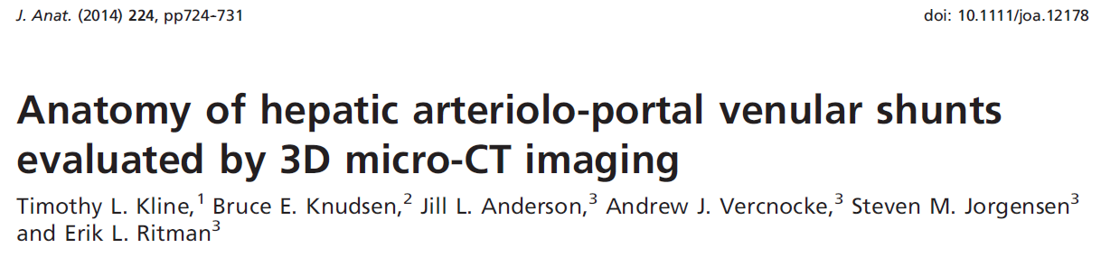
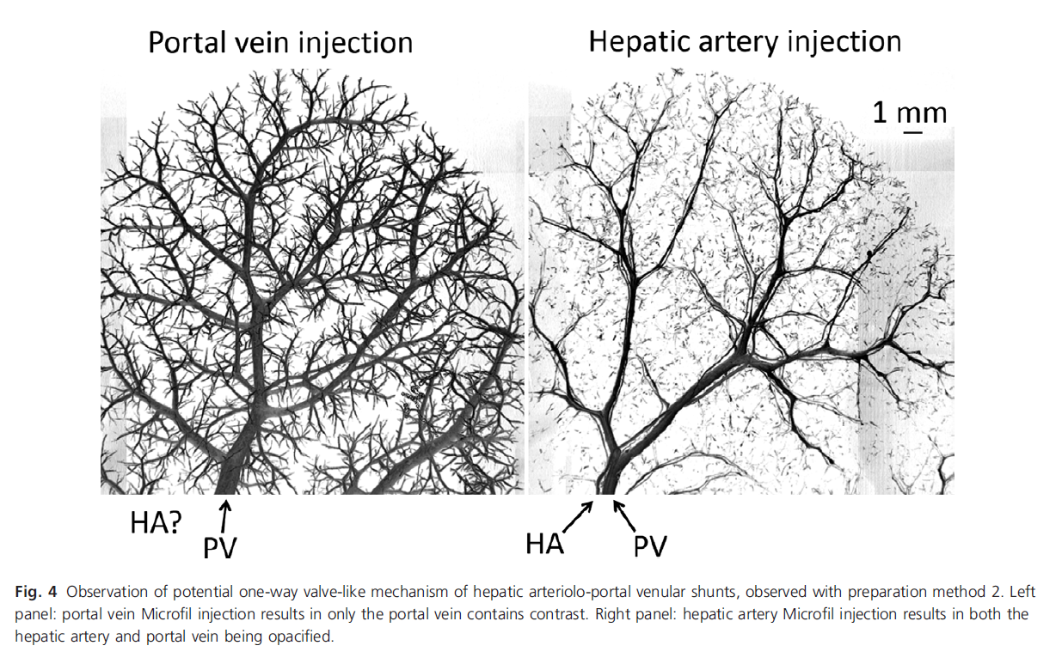

Slide 27
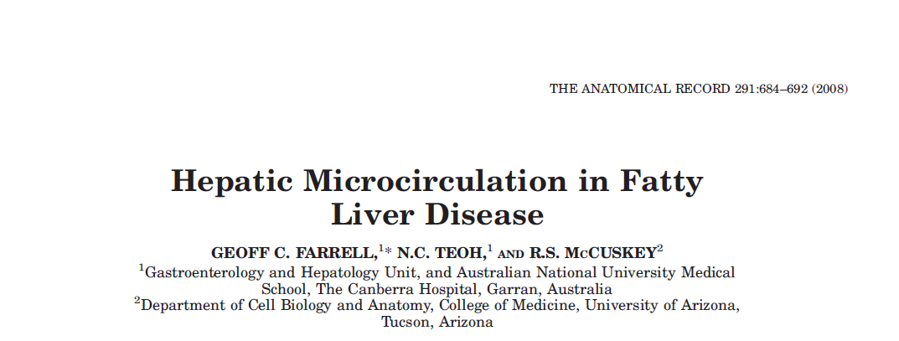
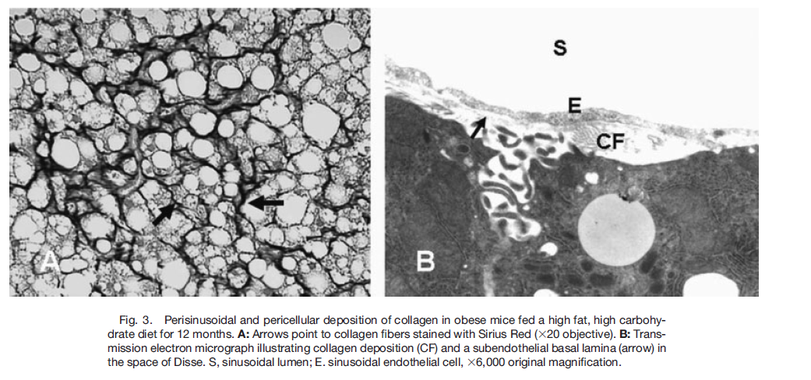
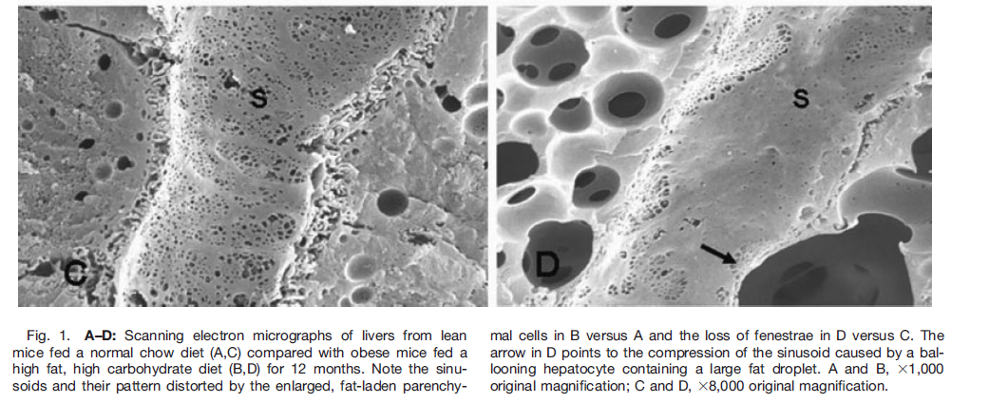
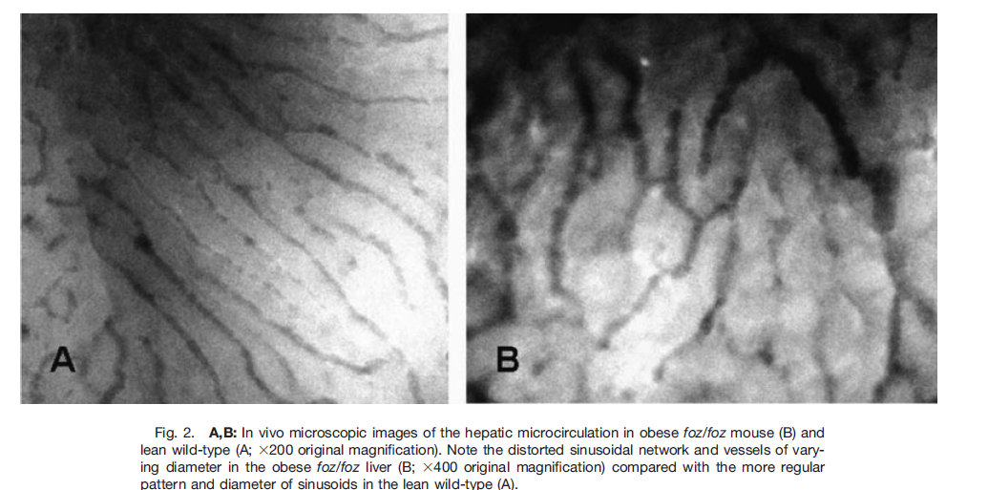
Fat laden hepatocytes are swollen and distort the sinusoids in NAFLD.
Involvement Kupffer cells leads to inflammation NASH with dysregulation of blood flow.

Slide 28
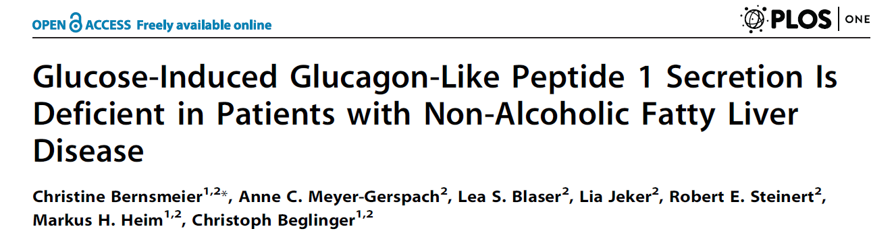
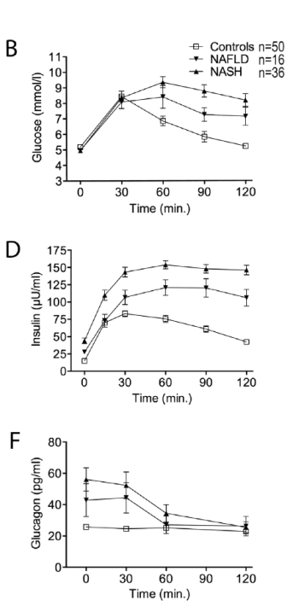
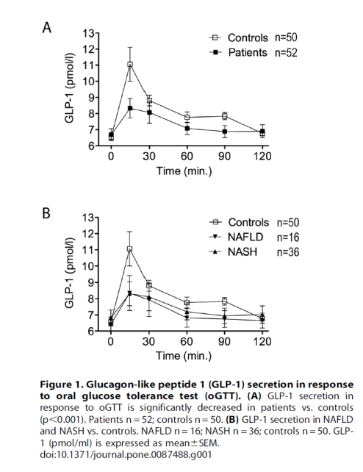
Patients with NAFLD and NASH have reduced GLP-1 secretion:
Raised and prolonged post prandial hyperglycaemia;
Raised and prolonged hyperinsulinaemia;
Fasting hyperglucagonaemia.

Slide 29
Hepatic steatosis leads to
portosystemic shunting of blood flow
Pul V
Pul A
Rt Heart
lung
Lt Heart
HV
HA
Vena cava
PV
intestine
SMA
Liver
pancreas
Aorta
kidney
Non alcoholic fatty live disease NAFLD
Leads to raised sinusoidal resistance
Increased portal venous pressure
Development of intra and extrahepatic collateral blood vessels
Shunting of blood flow from portal to hepatic vein
Relieves portal hypertension
During feeding shunts glucose, insulin and GLP-1 from splanchnic to systemic circulation raising systemic concentrations.
During fasting raised peripheral insulin dependent metabolism leads to early hypoglycaemia.
The premature hypoglycaemia leads to hyperglucagonaemia.
insulin insensitive tissue
(brain, bone skin)
Insulin sensitive tissue
(muscle, fat)

Slide 30
Effects of varying portosystemic shunt resistance on hormone and GLP-1 flows, metabolism and intestinal permeability
min
min

Slide 31
Effects of varying portosystemic shunt resistance on blood glucose, hormone and GLP-1 concentrations
min
PSS R

Slide 32
min
min
min
PSS R
PSS R
PSS R
PSS R

Slide 33
↑ ↑ Glucagon
↑ Insulin
↑ hepatic gluconeogenesis
PS shunting with raised PV resistance ↑ ↑ glucose and ↑ ↑ GLP-1 shunt flow after feeding
↑ ↑ peripheral insulin-dependent glucose metabolism
↓↓ net hepatic glucose uptake

Slide 34
Ratios of insulin/glucose; GLP-1/glucose; glucagon/glucose disease/control (primary data from Junker et al 2016)
min
min
The notable findings are the high ratios of insulin /glucose and high glucagon/glucose ratios in the glucose absorptive phase in NAFLD insulin /glucose that is suppressed in T2DM. The ratios of GLP-1/glucose in NAFLD are similar to control but suppressed in T2DM.

Slide 35
Summary
Portosystemic shunting as a consequence of metabolic disease opens the systemic circulation to the splanchnic circulation.
This leads to inappropriate increases in systemic insulin during glucose feeding with subsequent increased peripheral insulin-dependent glucose metabolism.
Early onset of splanchnic hypoglycaemia leads to fasting hyperglucagonaemia.

Slide 36
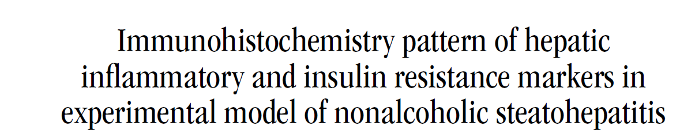

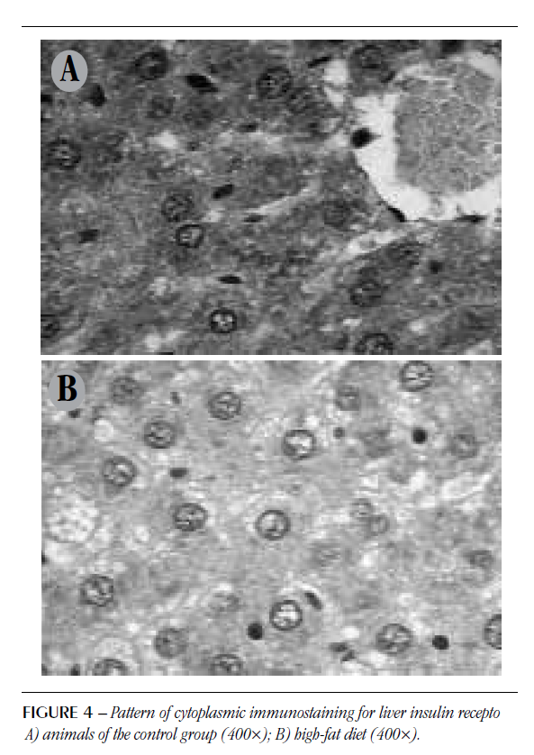
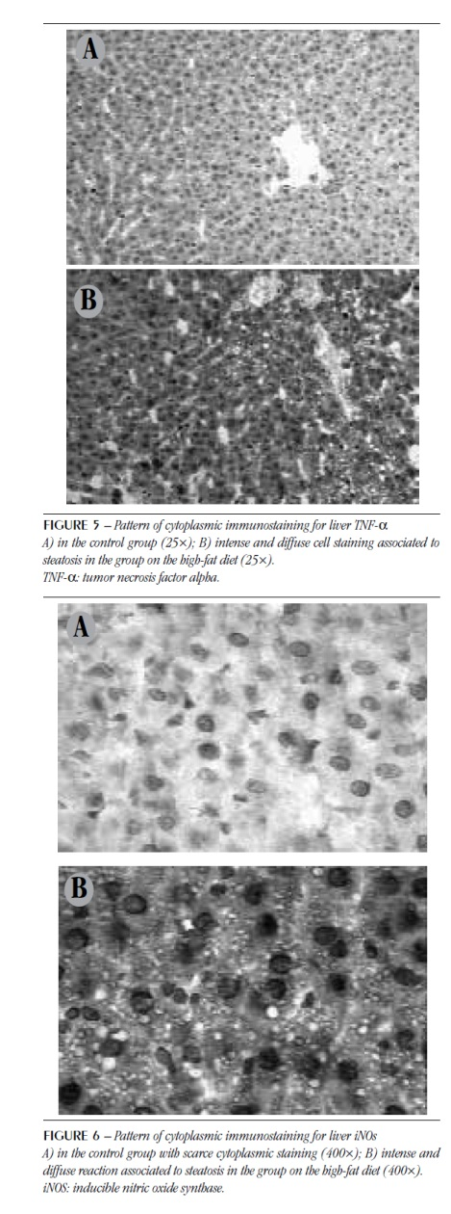

Slide 37
Effects if varying GLP-1 secretion on splanchnic blood flows volumes and pressure following 50 G glucose delivery by duodenal gavage at 100 min.
Min
Min
Min
GLP-1 glucose
sensitivity
GLP-1 glucose
sensitivity
GLP-1 glucose
sensitivity
Min
GLP-1 glucose
sensitivity

