Slide 1
Defects in ZnO nanowires
Heating, ion bombardment and contacts
Richard J. Cobley*, Chris J. Barnett, Olga Kryvchenkova, Nathan A. Smith, Karol Kalna, Thierry G. G. Maffeis
4th Int. Conf. on Nanotek & Expo
Mon 1st December 2014
* richard.j.cobley@swansea.ac.uk
www.swansea.ac.uk/staff/academic/Engineering/cobleyr/
M
Multidisciplinary
Nanotechnology
Centre
N
C

Slide 2
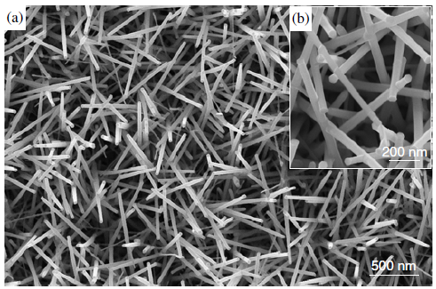
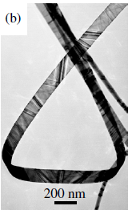
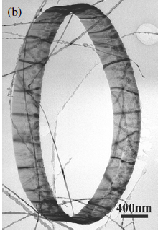
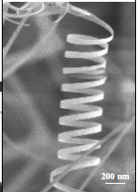
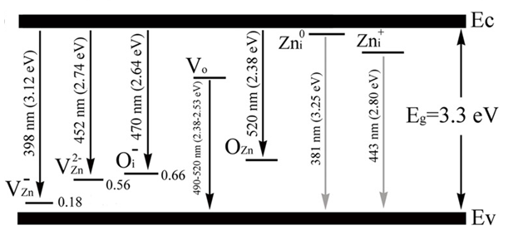
ZnO nanostructures and defects
Z.L. Wang, J. Phys.: Condens. Matter
16 (2004) R829-R858
Properties
Structures and devices
Defects
Liu, J., et al, J. Phys. D: Appl. Phys., 2009. 42(9): p. 095401.
Notes:
[sentence on devices / uses]
Zinc oxide is a wide band gap semiconductor with a direct 3.37 eV band gap and a large exciton binding energy of 60 meV [37]. It’s a naturally n-type material with a Wurtzite crystal structure and has received attention due to its wide range of properties including: piezoelectricity, high transparency, room-temperature ferromagnetism, and chemical-sensing effects [38].
Zinc oxide can form a number of different nanostructures including wires, rods and belts which are shown here. Studies have been carried out using ZnO nanowires as micro lasers, field emitters, piezo generators [41-43], there are also interests in energy harvesting and sensing.
As with most nanostructures, inherent defects incorporated during growth or processing can both create and alter the properties which make this material interesting.
Typical native point defects are cation or anion vacancies, antisite defects (in which anions or cations are in the wrong position) and interstitials in the lattice [7]. These defects have been reported to affect the electrical [5, 8], optical [1, 6, 8] and magnetic [9, 10] and RT ferromagnetic properties of ZnO. The most commonly observed native point defects in ZnO are O vacancies (VO), Zn interstitials (Zni) or antisite zinc atoms (ZnO) [1–10]. These defects (VO, Zni , ZnO), which have lower enthalpy of formation, are known as the ‘Zn-rich’ defects [8] and form shallow n-type energy levels close to the conduction band maximum. As a result, ZnO is typically found to be an n-type semiconductor [8]. ‘Oxygenrich’ defects, including interstitial O atoms (Oi), Zn vacancies (VZn) or antisite oxygen atoms (OZn), are predicted to create shallow acceptor electronic levels and thus make the material p-type [7, 8, 10, 11]. However, the formation of p-type defects requires higher enthalpy and these theoretical predictions have not previously been verified experimentally.
The fact that ZnO is naturally n-type is also thought this property could be down to hydrogen.
ZnO has a wide range of other defects, which are usually identified energetically using photoluminesnce. This review paper by Liu et al. depicts some of the defects in mass produced ZnO nanowires [59], although if we compile all observed or reported defects then there are more than twenty, and often dispute about their location energetically.

Slide 3
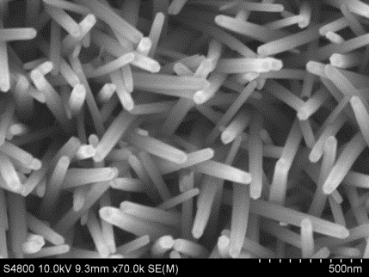
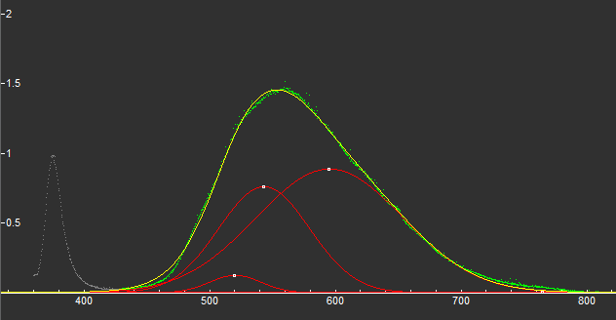
Growth, control of defects and motivation
Control and evolution of defects with argon bombardment and annealing
Role of defects on conductivity, transport, contacts and sensing
520 nm O_{zn}
O occupying zinc site
543 nm O_{i}
O interstitial no charge
595 nm V_{O}⁺/V_{O}⁺⁺
O vacancy + or ++ charge
Notes:
[Add a small discussion of defect band and near band edge, goodness of wires is defect band is lower than the ratio near band edge, always compared at same power]
There are two main ways to grow ZnO NWs: hydrothermal (also known as aqueous solution growth) and CVD. Primarily hydrothermal discussed, although at end talk about some wires grown by CVD.
Although hydrothermal or aqueous solution growth typically produces slightly lower quality wires, its low T process, almost any substrate, large area, must lower cost, with the obvious advantages for devices.
Hydrothermal = PVD (physical vapour deposition) of ZnO seed layer on to silicon or glass, float upside down with HMTA (hexa methylene tetramine) | zinc nitrate in water bath. Can control length, diameter and surface coverage by controlling ratio of zinc nitrate to HMTA.
Here is a typical PL spectrum of our hydrothermal ZnO NWs. For ZnO we have the near band edge here (the exciton recombination energy) and the defect band here – a combination of all the radiative transitions. PL of defect band at 75 C can be decomposed in to three peaks. [325nm laser He:Cd, calibrated against black light?]
Curve fitting to de-convolve components. Arrows indicate 520 nm (Oxygen Occupying a Zinc Site), 543 (Oxygen Interstitial with no charge ) nm and 595 nm (Oxygen Vacancy with single or double positive charge). A rule of thumb for ZnO NWs is when the defect band is lower than the near band edge emission you have ‘good’ wires, although the ratio is dependent on laser power.
Varying the growth parameters alters the relative intensity of the defect bands. For example, there’s an increase in the defect density as the temperature increases up 75 C, but below 70 C don’t get sufficient growth, so we trade off around 70 C
Later talk about CVD: growth is gold catalysed via vapour liquid solid (VLS) (Si substrate or mica, coat gold, tube furnace heat to about 950 C with a bath of ZnO powder and flow argon and oxygen. ZnO sublimates and join the gas flow. Gold contact is intimate and grows up.
So these as-grown defects can offer advantages when it comes to doping the nanowire and acting as a sensor, but also will affect contacts made to the wires and transport through them. The motivation of my talk today is to look as some work we’ve done to understand the effect that annealing and argon bombardment have on these defects, and how studying them can reveal more about where physically the defects are in the wires, and then look at how they affect contacts to the nanowires and transport through them.
[PL: fit until Chi squared is less than one → principle components without spurious ones]
[SEM images of ZnO nanowires grown hydrothermally for 6 hours in a 500ml solution containing 1.752g of HMTA and zinc nitrate 0.57:1 ]

Slide 4
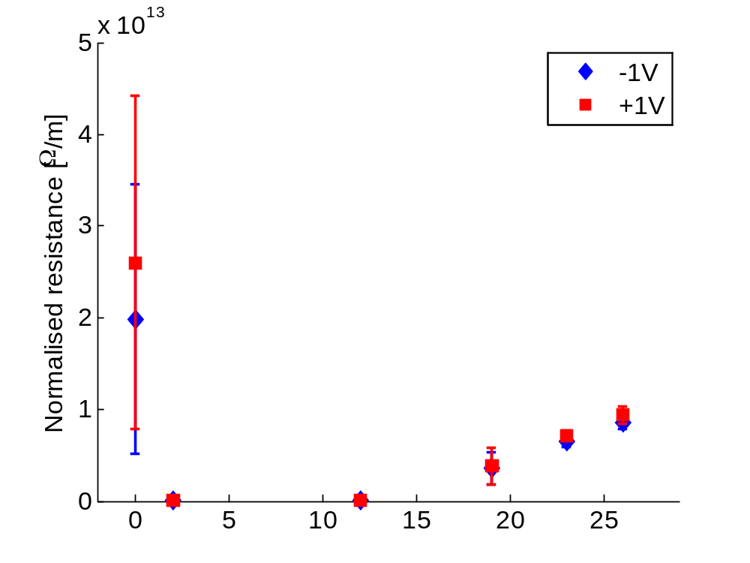
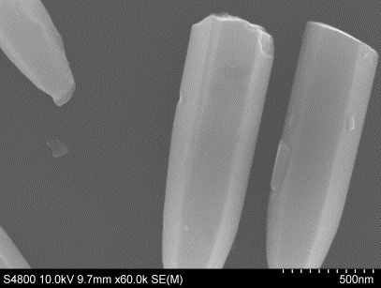
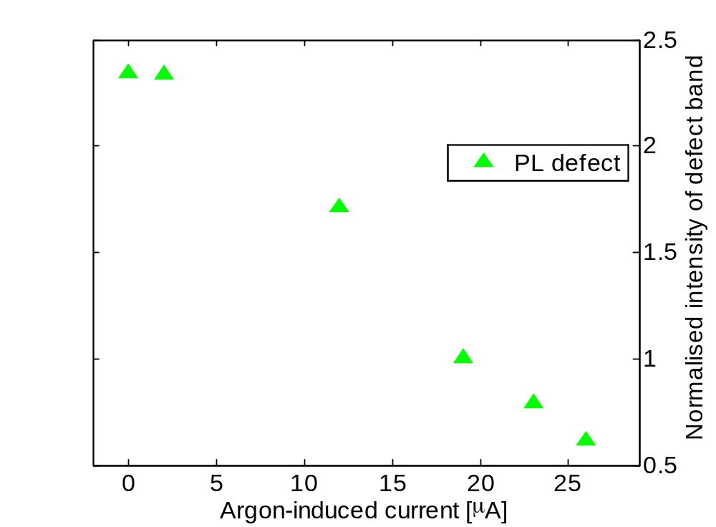
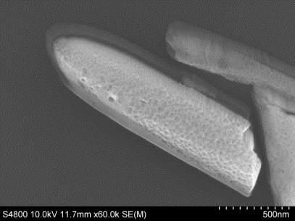
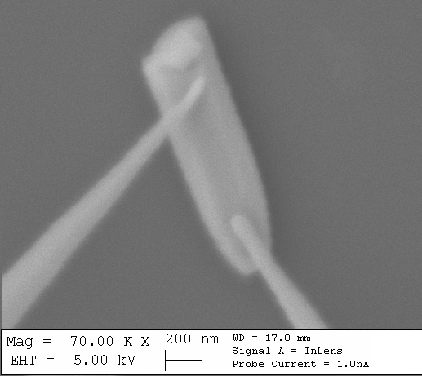
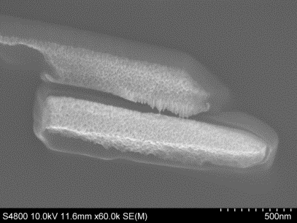
Effect of argon bombardment
2 μA
23 μA
Damage (PL)
Ar implantation (EDS)
26 μA
3. Chemistry (XPS)
4. Etching?
Notes:
One way we can process the NWs is to bombard them with argon from an ion gun at energies ranging from ~0.3 to 2 kV. For this, the as-grown vertical array of wires are brushed off the growth substrate on to Si, which snaps them leaving them a little short.
We then expose them to increasing Ar doses measuring the defect density changes between exposures using PL. [images are after 2uA, 23uA and 26uA, after 15 mins] Curve fitting the PL shows that the components don’t drop equally; oxygen vacancy defects appear to drop 595 +O vacancy (end at 25%) 520 O vacancy (16%) others (50%)
Initially there’s only a small change, but as the dose increases the overall defect density measured with PL reduces. The role of the Ar bombardment on the morphology of the NWs is important. This first image , for the lowest dose, finds no visible change but as we increase the dose there are morphological changes, and the NWs reduce in diameter, leaving behind a shadow of the former diameter.
To understand the change in contact behaviour of the wires during this change, we’ve performed nanoscale two point probe measurements using an Omicron UHV nanoprobe, shown here. For the as-grown wires the range of contact resistances measured at forward and reverse bias vary a lot. But after the initial low energy Ar bombardment the resistance drops by two to three orders of magnitude; this is before any morphology changes are seen in the NWs. Then as the dose is increased and the NWs reduce in diameter the resistance increases.
This initial dose is almost certainly cleaning the nanowire. Other work with Argon plasma treatment and SIMS has found a similar effect. Ra found Ar increased defects as well as cleaning; here we seem to be cleaning and reducing defect density.
Beyond this, there are a couple of things the Ar could be doing: 1. It could be damaging the lattice, but this would probably result in an increase in observed radiative defects with PL which the opposite of what’s observed. [other people have seen this and it was detectable with PL] 2. The Ar could be implanting in to the wires and healing the defects; however if we perform EDS on the wires during processing we find no increase in Argon – when exposed to a higher energy ion bombardment, some papers have reported that the inclusion can be detected by EDS, but we don’t see that. 3. The argon could be chemically altering the material, which we’re checking with XPS. 4. The Ar may not be damaging or healing the wire, (after all what would the mechanism be to reduce oxygen vacancy defects when we’re in vacuum) and we could be stripping the NW and look at a change in the properties as we etch back the nanowire diameter [this is also similar to work by Ra with Argon plasma, but it was done for one set of exposure parameters]
[Values of R for +1V are 2.6E13; 2.68E10; 8.48E10; 3.84E12; 7.13E12; 9.37E12]

Slide 5
Argon bombardment -> model of NW defects
Clean (no +defect)
PL not surface
3. Pitted -> sensor
4. Band model?
Notes:
[I/V data is I/unit length to normalise to different lengths]
We’ll come back to pick out the important results from this set in a second, but first we wanted to explore if we are stripping the nanowire, and as the PL indicates we’re not introducing additional defects [which others have reported when you strip with Ar plasma], what could give rise to the transport measurements results seen? Initially the contact resistance and contact type varies a lot, as shown by the wide error bars. We know from our own XPS that the surface is in depletion, and its accepted that additional surface defects give rise to this upward band bending at the surface. However, after a light argon treatment we find that the contact measurements are strongly Ohmic – indicating that the surface defects are highly localised on the surface and have been removed. Given that the PL doesn’t change much, but the light argon treatment is enough to drastically alter the electrical connections, it seems likely that the PL is sampling not just the surface but further in to the wire – this is important itself in the debate about where PL measurements the defects in NWs. We also seem to be able to make stable repeatable Ohmic contacts to ZnO NWs after a light argon treatment – normally such ohmic contacts are difficult with ZnO.
So, visibly the nanowires are not damaged, and the electrical measurements are consistent. But as we strip the nanowire further, the response becomes Schottky. If the visible pot-holing on the surface of the nanowire were responsible for the increased contact resistance [grain boundary effects are know to change the resistance of bulk ZnO], it doesn’t explain why the contact type would change to Schottky. This behaviour could however be explained by a reduction in the effective doping concentration of the nanowire as we etch towards the core. Using a full 3D coupled electrostatic, thermionic and tunnelling model we simulated the transport of the two point probe measurements, accounting in 3D for the actual tip shape used and the dimensions of the nanowire (I’ll say more about why this is important in a minute). We find that if the core of the nanowire were undoped – that is intrinsic ZnO and either the oxygen vacancy defects or hydrogen isn’t present towards the core so the effective doping is removed – then we would get the Schottky behaviour observed, and as we move out towards the edge we would get Ohmic when the doping concentration is higher than 10^13 (and we know it’s higher). This work is still under investigation, but it’s one effect we’re considering: the NW could be depleted only very close to the surface and then in accumulation just inside, with the wire moving towards intrinsic in the core. **Link this to the co-axial paper?** Part of this explanation comes from the width of these nanowires which are very wide – 200 nm or so – deliberately because we were performing two point probe and wanted a larger target. It may be for thinner NWs the accepted model of depletion at the edge going back to normally n-type in the centre is true, but for these larger wires there seems to be a region in the very centre where the defect density drops.
But if I bring together what we have found: We know that the surface defects give unstable contacts, but a light argon treatment doesn’t visibly change the wires, but it does lead to much more consistent Ohmic contacts to the wires. Further we know that as we increase the argon dose the wires appear to become pitted. There is a trade off in the middle of the first graph where the wires begin to become pitted, but we’re still able to make low-resistance Ohmic contacts to them – this could be an ideal regime for sensing, with the surface area of the NW increased by the pitting. We know that something else is happing as we continue to bombard beyond this point, and we’re still figuring out what.
Also larger wires, transport and sensing still in outside of wire.
[Not healing o vacnacy, erasing wire with defects]
Ra or Ha says that hydrogen or oxygen vacancy makes n-type.
[R tranport << R contact]
Need an XPS study which does the argon bombardment and XPS throughout.

Slide 6
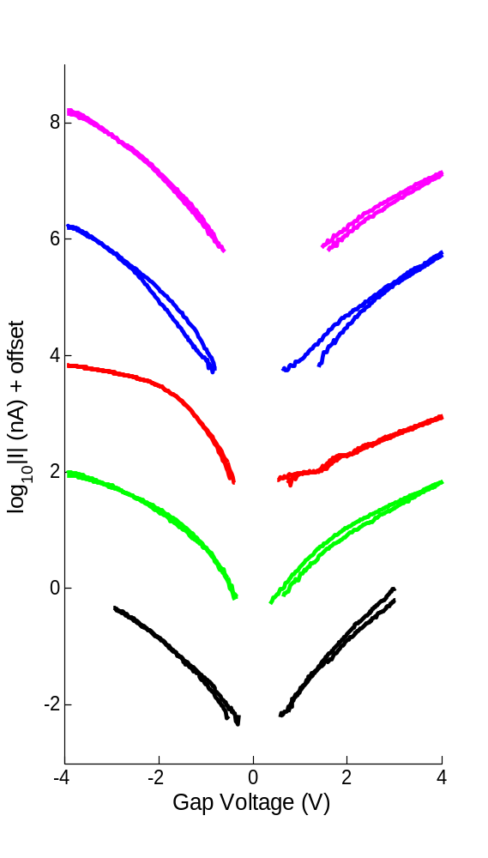
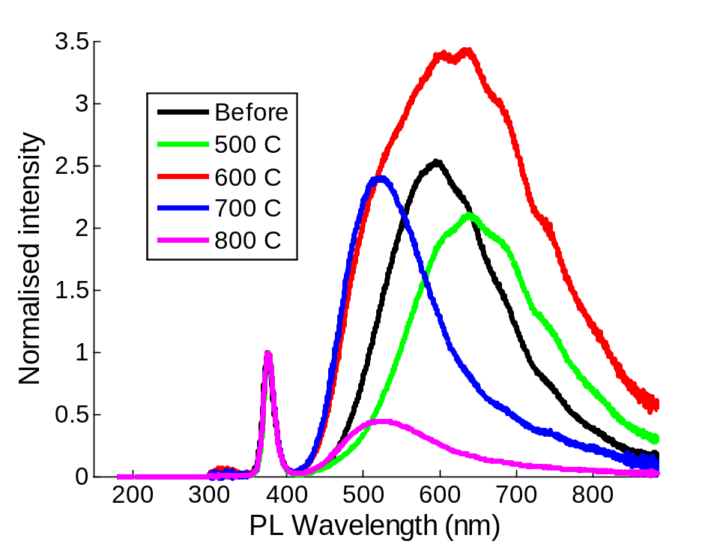
Effect of heating on hydrothermal ZnO NWs
640 nm O_{zn}
V_{O}++ -> V_{O}
500 C Cleaning
600 C Donors + acceptor states present
>=700C Donors reduced, acceptors
Notes:
Heating in vacuum, before, 500, 600, 700, 800. PL to look at defects, STS to look at local conductivity measurements (to match with work on ZnO nanoribbons)
1. Cleaning. First 500 C anneal seems to clean in much the same way as the first argon treatment did. Overall defect density reduces. [Tunnelling spectroscopy explanation: single point probe measurements on individual nanowires, each an average of about 60 curves, and a few measurements from different nanowires overlaid to indicate the consistency. An offset has been added to each set for clarity and colour match the PL Plot.
In most nanostructures the band edges follow the Fermi level of the probe in tunnelling spectroscopy, so as the voltage is swept rather than getting a strong onset at the band edges, these are essentially smoothed out. ] Appears to be narrower, the conduction and valence band edges sharpen up which suggests more conductive sample. There is another change though the contribution at 640 which has been attributed in the literature to a transition between the doubly ionised oxygen vacancy VO++ and the neutral oxygen vacancy defect VO increases. Still oxygen vacancy related, but for some reason we promote a different transition, don’t know why.
2. Next, at 600, curve fitting the PL shows the O vacancies defects (shallow n-type donors) still present, overall band increases because p-type defects have now been created. Overall defects larger. The is the most exoctic PL and the same is true for the tunnelling spectroscopy, where the CB has flattened out. Odd that VB hasn’t. With p and n, charge carriers could combine to reduce effective doping.
3. Then at 700 and above the o vacancy (n-type donors) reduce [because we’re sublimating the Zn out – see structural change in SEM, also suggests defects are higher towards centre] and we’re left with more p-type components in the defect band, the conductivity reduces in STS and the CB onset appear to move away from the Fermi level.
We’ve used XPS to check composition change, which is broadly in agreement, but we still need to iron out what’s happen in the middle cases.
[implications for devices: processing needs heating, also operation: we’ve done gas sensor and need to heat to ~400 C (will clean)

Slide 7
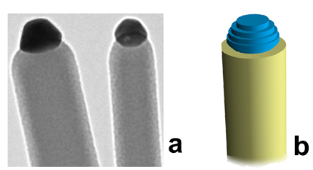
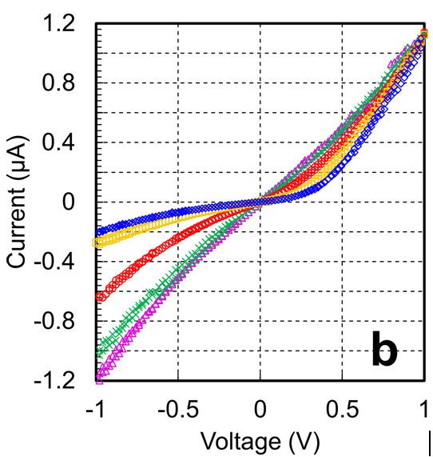
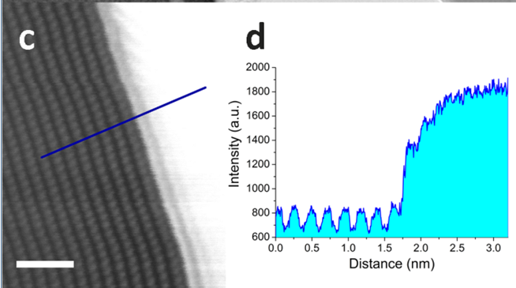
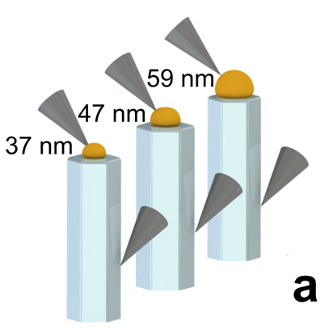
ZnO NW – role of contacts
59 nm
50 nm
47 nm
40 nm
36 nm
“Controlling the electrical transport properties of nanocontacts to nanowires”, In preparation,
AM Lord, TG Maffeis, O Kryvchenkova, RJ Cobley, K Kalna, DM Kepaptsoglou, QM Ramasse, AS Walton, MB Ward, J Köble, SP Wilks
Notes:
So I said that when modelling transport through NWs the contact shape was important to include. These transport measurements were performed by a colleague on CVD grown ZnO NWs. go on to key points: barrier height is fixed in the contact measurement, but the barrier width changes. Interestingly the contact behaviour near the edge, leading to current crowding, ratio of contact to NW width.
In this we used passivated wires to remove the effect of the surface depletion, which essentially does, we now believe, something similar to the first treatment, then for this we assumed bulk was constant. Actually now believe in more recent results that the inherent doping concentration may reduce towards the centre of the wire. For this case most of the interesting transport happens outside of the contact edge and this may be why, again, the edges of the NW are more important for transport.
““A full 3D model of the tip on the nanowire surface is used to consider carrier transport of electrons and holes including thermionic emission and tunnelling current with a field dependent barrier lowering due to image force.”

Slide 8
Conclusion – ZnO NWs
Ohmic contacts possible with light Ar treatment, without additional defects
Surface pitting with intermediate Ar, more surface but still with Ohmic contact -> better sensing?
Heating alters the ratio of donors and acceptors?
Growth surface defects very localised to surface – can be removed by a light argon treatment
PL not dominated by surface -- probing bulk of wire?
In wide NWs the defect density drops towards centre -> current in a ring? Larger wires still surface sensitive?
Notes:
Growth defects (depletion region) very localised to surface, can be removed by a light argon treatment or anneal (PL dominated by these, suggesting surface sensitive)
Ohmic contacts possible after light Ar treatment
Surface pitting after intermediate Ar treatment allows more surface area (sensing), with Ohmic contact
Heating alters the ratio of donors and acceptors
In wide NWs defect density drops off towards center – current in ring? → lager wires still surface sensitive but dissipate heat

