Slide 1
Regulatory Landscape for Novel Polymers
International Conference and Exhibition on Biopolymers and Bioplastics
August 12, 2015

Slide 2
Overview
This is a brief overview of U.S. regulations of new chemicals
It is impossible to capture all the details and nuances in a twenty minute presentation
Companies should seek expert advice on the specifics of their technologies to understand which statute is operative and what reporting is required
Plan ahead, especially with novel technologies

Slide 3
Federal Statutes Regulating New Substances
In the United States, the vast majority of new chemical substances are regulated by two federal agencies and three statutes:
  U.S. Food and Drug Administration (FDA)
    Federal Food, Drug, and Cosmetics Act (FFDCA)
  U.S. Environmental Protection Agency (EPA)
    Federal Insecticide, Fungicide, and Rodenticide Act (FIFRA)
    Toxic Substances Control Act (TSCA)

Slide 4
Use Determines Controlling Statute
Food, feed, food additives, drugs, medical devices, cosmetics
  FFDCA
Pesticide active ingredients and pesticide formulations
  FIFRA
Industrial, commercial, consumer uses
  TSCA
The same substance may be regulated by all three statutes

Slide 5
Drugs & Medical Devices
Pre-notice communication strongly recommended
Substance- and use-specific approval
Facility must be compliant with Good Manufacturing Practices (GMP)
Drugs
  Any healthcare product that achieves its principal intended purposes by chemical action or by being metabolized
  Extensive clinical trials and pre-market approval required
Medical devices
  Any healthcare product that does not achieve its principal intended purposes by chemical action or by being metabolized
  Most require premarket notification
  Increasing testing burden depending on risk of use (from bandages to implants)

Slide 6
Food Additives
Substance- and use-specific approval
Direct food additives:
  Pre-notice communication strongly recommended
  Facility must be compliant with GMP
  Extensive testing and pre-market approval required
  May submit substances for Generally Regarded as Safe (GRAS) status
  Process typically takes two to five years
  Once approved, anyone can utilize
Indirect food additives -- food contact materials:
  Includes packaging and substances used to wash or treat food, but not intended to stay in contact with the food
  Testing burden depends on migration potential
  FDA has discretion to decide if food additive petition is necessary
  Minimum 120 day review
  Proprietary to submitter and their customers

Slide 7
Cosmetics
Pre-market approval not required by FDA; formulator is responsible for ensuring no deleterious effects
Must be able to demonstrate safety as well as “cosmetic” purpose
Testing likely required by formulator

Slide 8
Pesticides
Substances that claim to kill or control microbes, fungi, rodents, insects and similar pests, but not for a therapeutic purpose
  Extensive testing and pre-market approval required for active ingredients
  Pre-market approval required for final formulations, including inert ingredients
  Substance- and use-specific approval
4-24 month review depending on use

Slide 9
Uses TSCA Regulates
TSCA is the “catch all” chemical statute; it regulates uses not regulated by other federal statutes
TSCA does not regulate:
  Food, food additives, food contact materials, animal feed, drugs, drug intermediates, medical devices, cosmetics, or personal care products
  Tobacco and tobacco products
  Pesticides
  Nuclear source materials and radioactive byproducts
  Munitions
  Plant pests

Slide 10
TSCA Inventory
TSCA Inventory -- A list of all chemical substances that may be manufactured or imported into the U.S. for TSCA purposes
  May not reflect chemicals currently in commerce
TSCA Inventory status determines whether a substance is “new” or “existing”
  Existing Chemical Substance -- Any chemical substance listed on the TSCA Inventory
  New Chemical Substance -- Any chemical substance not listed on the TSCA Inventory

Slide 11
TSCA Inventory (cont’d)
All chemicals in commerce MUST be on the TSCA Inventory, or be eligible for an exemption
  Exemptions without reporting requirement:
    No commercial purpose (e.g., impurities)
    Research and development
    Non-isolated intermediates
    Most articles
  Exemptions with reporting requirements:
    Low volume, test market, low-release/low-exposure (all require notification)
    Some polymers

Slide 12
Naturally Occurring Substances
Automatically included on Inventory
Defined as: unprocessed or processed only by manual, mechanical, or gravitational means; by dissolution in water; by flotation; or by heating solely to remove water; or extracted from the atmosphere by any means
Examples are raw agricultural commodities, crude oil, rocks, ores, minerals
Chemical modifications (e.g., acid/base or redox reactions, distillation) nullify naturally occurring designation

Slide 13
TSCA Nomenclature
Based on Chemical Abstracts Service (CAS) identities
Not all CAS identities are appropriate for TSCA
There are two classes of TSCA identities
  Class I substances:
    Single, defined substances
    E.g., ethanol; 1,4-butanediol; anthracene
  Class II substances:
    Single formula, multiple structures
      Xylenes (mixed isomers)
    Definite molecular formula, unknown structural diagram
      Aluminum cerium nickel sulfide, AlCe₃NiS₇
    No definite molecular formula and either partial or no structural diagrams (“unknown or variable composition, complex reaction products, or biological materials,” UVCBs)

Slide 14
TSCA Nomenclature of UVCBs (cont’d)
Corn oil
  Extractives and their physically modified derivatives. It consists primarily of the glycerides of the fatty acids linoleic, oleic, palmitic, and stearic (Zea mays)
Soybean oil
  Extractives and their physically modified derivatives. It consists primarily of the glycerides of the fatty acids linoleic, oleic, palmitic, and stearic (Soja hispida)

Slide 15
Source-based Identities and the Supply Chain
Soybean oil
Fatty acids, soya
Fatty acids, soya, polymers with glycerol and phthalic anhydride
Corn oil
Fatty acids, corn-oil
Fatty acids, corn-oil, polymers with glycerol and phthalic anhydride
Not interchangeable identities

Slide 16
Polymer Exemption
Polymer exemption restrictions
  Molecular weight (MW) range
  Oligomeric content
  Constituent monomers
  Constituent elements
  Reactive function groups
  No perfluoro groups
  Must not degrade, decompose, or depolymerize
  High MW, must not absorb water or swell
If eligible: recordkeeping, limited notification required

Slide 17

Always Check the TSCA Status
Is it excluded from TSCA?
Is it exempted from TSCA?
If not, verify identity and check Inventory status
If not on the Inventory, pre-manufacture notice (PMN) required
Download TSCA Inventory
Search EPA’s online Substance Registry Service

Slide 18
TSCA New Chemicals Notification
Substances not listed on the TSCA Inventory require a PMN at least 90 days prior to manufacturing
PMN must include:
  Identity, structure, anticipated uses, anticipated production volume, any test data that submitter already has, expected releases, and exposures from processing and use
If manufactured (not just imported), must also include:
  Starting materials, manufacturing process, expected releases and exposures
May include optional Pollution Prevention (P2) Statement

Slide 19
P2 Statement
A P2 Statement is the submitter’s opportunity to tell EPA reviewers about the P2 benefits of the substance
All green chemistry-related PMNs should have one
P2 benefits may be for feedstocks, process, or substance itself
EPA may use P2 information to make a relative risk determination and allow the substance to proceed without regulation (or with reduced regulatory burden)
Submitter may receive Pollution Prevention Recognition, which is public recognition of the P2 benefits of the technology

Slide 20
THANK YOU
Richard E. Engler, Ph.D.
Bergeson & Campbell, P.C.
2200 Pennsylvania Avenue, N.W.
Suite 100W
Washington, D.C. 20037
rengler@lawbc.com
202-557-3808

Slide 21
Feedstock Flexibility
“Soap and Detergent Association (SDA) Nomenclature”
  System to provide some flexibility on feedstocks
  Categorizes surfactant supply chain substances into alkyl ranges and functional classes
  Draws equivalence between natural sources and synthetic equivalents

Slide 22
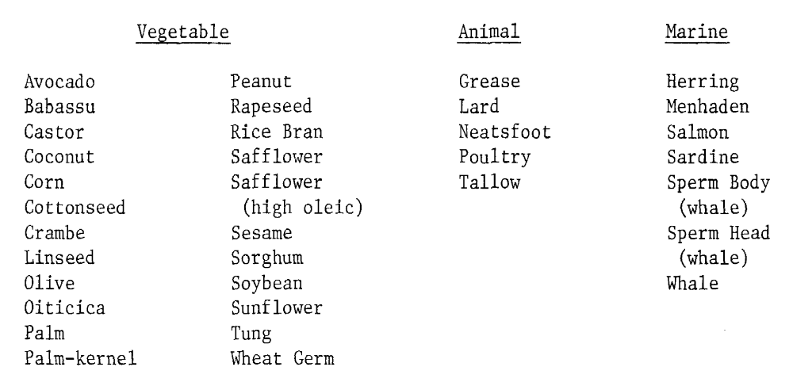
SDA Nomenclature Sources
Oils with fatty acids that may be called “C₁₆-C₁₈ and C₁₈ unsatd.”
“Alkyl groups derived from other natural sources are not covered by this procedure”

Slide 23
SDA Identities and the Supply Chain
Glycerides, C₁₆-C₁₈ and C₁₈-unsatd.
Fatty acids, C₁₆-C₁₈ and C₁₈-unsatd.
Fatty acids, C₁₆-C₁₈ and C₁₈-unsatd., ethoxylated

Slide 24
TSCA Obligations: New vs. Existing
New chemicals must be notified to EPA prior to manufacture or import
  Section 5 -- PMN
Existing chemicals subject to reporting, recordkeeping, and applicable restriction requirements
  Section 4 -- Testing
  Section 5 -- Use restrictions
  Section 6 -- Risk management
  Section 7 -- Imminent hazard
  Section 8 -- Inventory, information collection
    Chemical Data Reporting (CDR)
  Section 12 -- Export notification
  Section 13 -- Import certification

