Slide 1

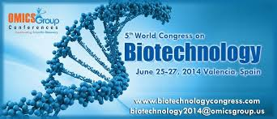
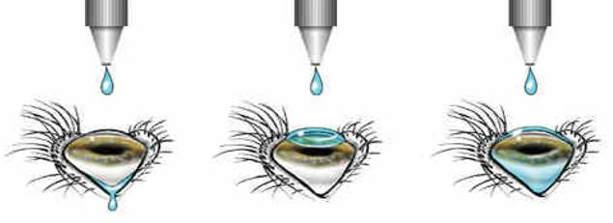
Ocular Delivery of peptides and proteins
Richard Addo, R.ph., ph.D
ASSOCIATE PROFESSOR
UNION UNIVERSITY SCHOOL OF PHARMACY
JACKSON TENNESSEE USA

Slide 2
outline
Structure of eye and different pathways of ocular administration
Challenges for ocular delivery of proteins/peptides
Formulation considerations
Peptide transport systems in the eye
Ocular administration for topical delivery of proteins/peptides
Ocular administration for systemic delivery of proteins/peptides
Strategies for ocular delivery of proteins/peptides

Slide 3
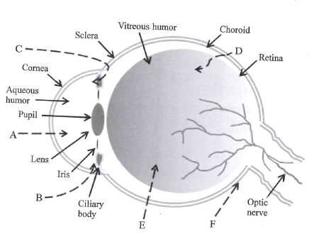
Structure of the Eye
Outermost coat: Clear, transparent cornea and white, opaque sclera
Middle layer: iris anteriorly, choroid posteriorly and intermediate ciliary body
Inner layer: retina
Topical administration with trans-corneal permeation
Topical administration with non-corneal permeation across the conjunctiva and sclera
Drug distribution from the blood through the blood-aqueous barrier into the anterior chamber
Drug distribution from the blood-retina barrier into the posterior chamber
Intra-vitreal drug administration route
Sub-tenon injection

Slide 4
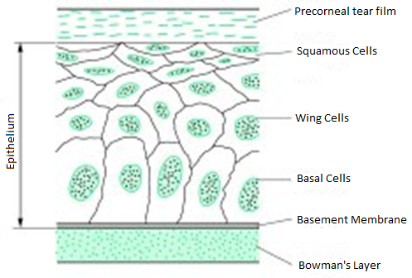
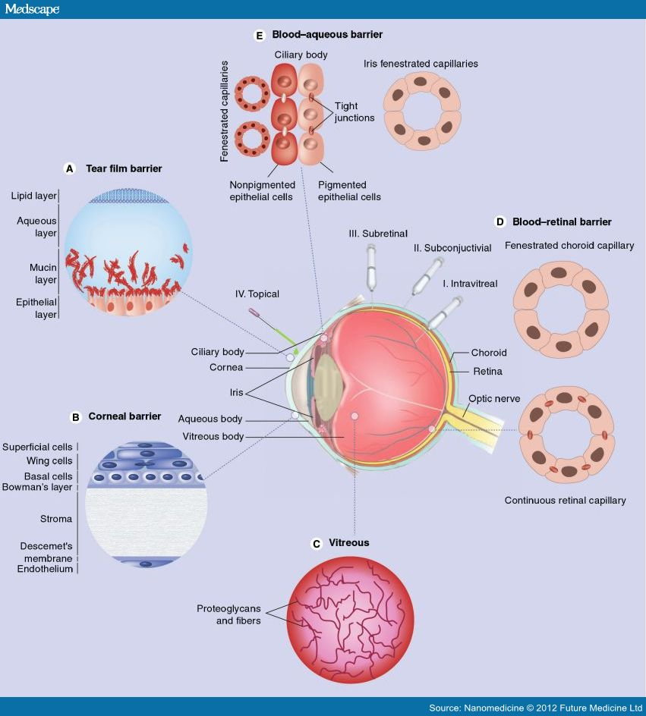
Barriers to Absorption
Basal layer, 2-3 layers of wing cells and 1-2 outermost layers of squamous cells
Outermost layers
  Intercellular tight junctions surround the most superficial layers and restrict passage of peptides and proteins
  Absorption relies on transcellular passage or strategies that can modulate the tight junctions
Wing cells and basal cells
  Intercellular spaces are wider and permit paracellular diffusion
Negatively charged corneal epithelium offers greater resistance to negatively charged compounds as compared to positively charged ones

Slide 5
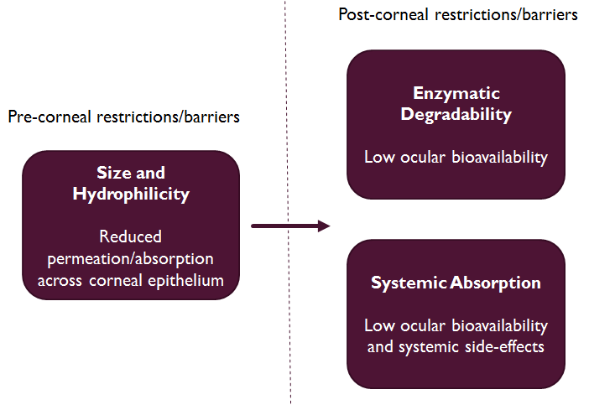
Challenges to ocular delivery of proteins/peptides
Barriers for locally delivered drugs
  Loss of drug from ocular surface
  Lacrimal-fluid barrier
  Blood-ocular barrier
Low drug contact time
Tear production and turnover
Consequent dilution
Schematic presentation of the different barriers for ocular delivery of proteins and peptides
Notes:
Size and hydrophilicity: Intercellular junctions are very tight…. Passage depends on transcellular passage
Charge: negative charge is repelled
Enzymes: endopeptidases, exopeptidase, aminopeptidase
Example: 90% of leucine enkephalin and 100% of methionine enkephalin were found hydrolyzed in the rabbit corneal epithelium 5 minutes after instillation…. Therefore, aminopeptidase activity must be inhibited

Slide 6
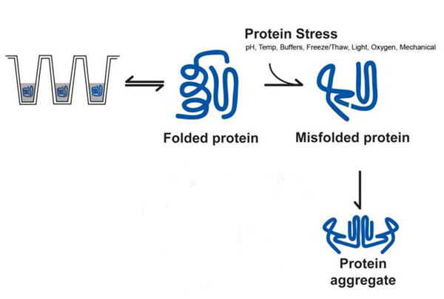
Formulation Considerations
Aggregation
Is induced by shaking, prolonged storage, heating, freezing, lyophilization
Can lead to
  Reduced bioactivity
  Immunogenic reactions
  Blockage of tubing, membranes or pumps in an infusion set
  Unacceptable physical appearance such as opalescence
Example:
  Insulin can undergo self-association/aggregation due to the hydrophobic regions of the molecule
  Human epidermal growth factor (hEGF) undergoes pH and concentration dependent aggregation
Can be prevented by
  Use of appropriate formulation excipients; example: mannitol, trehalose
  Proper care in processing of formulation
  Synthesizing a resistant derivative

Slide 7
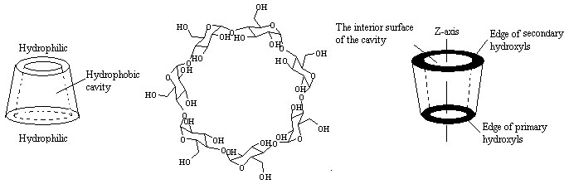
Formulation Considerations
Formulation Additives
  Protease Inhibitors:
    Used if the protein/peptide is likely to degrade upon ocular administration
    Aminopeptidase inhibitors: bestatin, amastatin, puromycin, p-chloromercuribenzoate
  Sugars: Exert a protective effect on proteins by changing the solvent structure around the protein
  Cyclodextrins: Act by molecular encapsulation of amino acid chains thereby preventing hydrophobic interactions

Slide 8
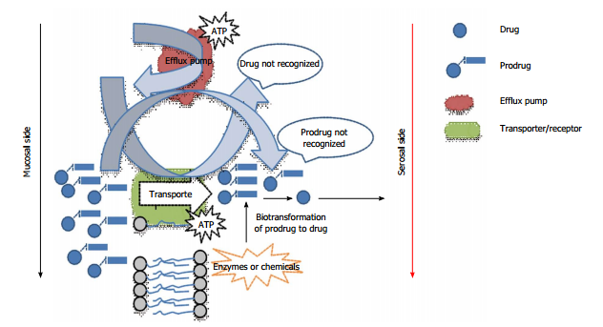
Peptide transport systems in eye
Epithelial cells express nutrient transporters and receptors on their surface which help the movement of vitamins and amino acids across cell membranes
Proton coupled receptors help translocation of di- and tripeptides across the epithelium
Transporters are classified as PepT1, PepT2 and peptide/histidine transporters (PHT1 and PHT2)
Expression of PHT1 in bovine and human retinal pigment epithelial cells (BRPE and HRPE), ARPE-19 cells (human RPE cell type), bovine and human neural retina cells has been reported
PepT2 and PHT 2 expression reported in bovine and human retina
Drugs with poor ocular bioavailability can be suitably modified by design to facilitate recognition and uptake by peptide transporters

Slide 9
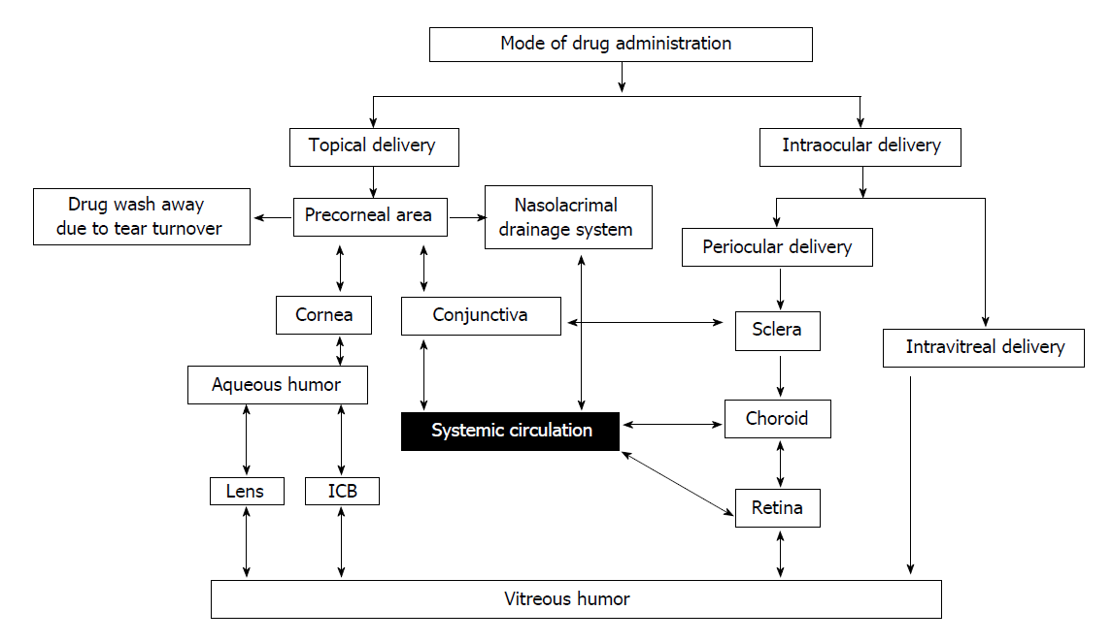
Modes of Ocular drug administration

Slide 10
Ocular administration for topical delivery
Topical delivery is considered to be the best option for treatment of most ocular disorders
Several peptides have been identified for treatment of ocular disorders like dry eye disease, age related macular degeneration, proliferative diabetic retinopathy, etc.
Loss to systemic circulation must be minimized
  Phenylephrine used as a vasoconstrictor to minimize systemic absorption
  Use of mucoadhesive polymer to improve ocular absorption
Adverse physicochemical properties or enzymatic degradation of peptides might render them less effective
  Loading them in a carrier system like liposome or nanoparticle may limit some of these problems

Slide 11
Ocular administration for topical delivery
Growth Factors
  Human Epidermal Growth Factor (hEGF) stimulates cell proliferation in the corneal epithelium thus causing epithelialization during wound healing
  EGF can be produced biotechnologically in a commercially feasible manner
  It can thus be a suitable therapeutic agent for corneal trauma and during intraocular surgery
Tissue Plasminogen Activator
  tPA can be used to achieve clot lysis after surgery for cataract and/or glaucoma
  Since tPA is present in aqueous humor and other ocular tissues, its use is like a supplementation of body function
Cyclosporin A
  It has immunosuppressive, anti-fungal and anti-inflammatory activity
  Primary use is inhibition of kidney graft rejection
  Instillation in eye can inhibit rejection of corneal grafts

Slide 12
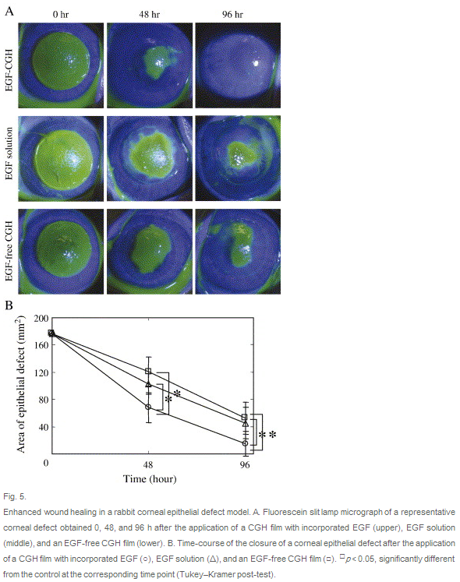
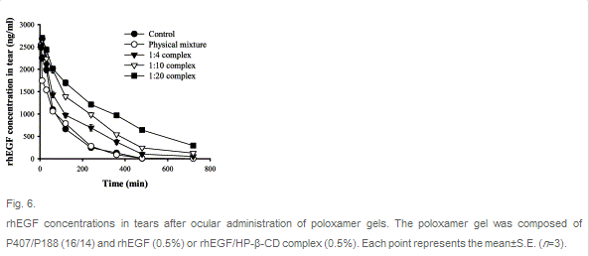
Studies showing ocular delivery of EGF
EGF Incorporated in Cationized Gelatin Hydrogel
EGF Incorporated in Beta Cyclodextrin Complex
Controlled-release of epidermal growth factor from cationized gelatin hydrogel enhances corneal epithelial wound healing, Hori K, Sotozono C, Hamuro J, Yamasaki K, Kimura Y, Ozeki M, Tabata Y, Kinoshita S, J Control Release. 2007 Apr 2;118(2):169-76.
rhEGF/HP-beta-CD complex in poloxamer gel for ophthalmic delivery, Kim EY, Gao ZG, Park JS, Li H, Han K, Int J Pharm. 2002 Feb 21;233(1-2):159-67.

Slide 13
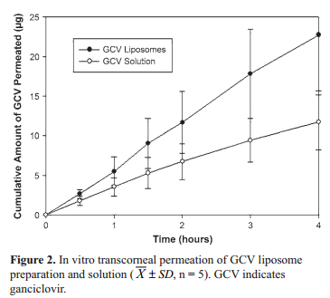
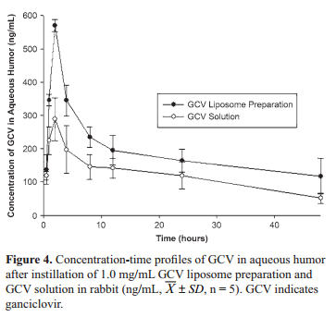
Ocular Delivery of Ganciclovir
Concentration in aqueous humor after instillation in rabbit eye
In vitro transcorneal permeation
Preparation and ocular pharmacokinetics of ganciclovir liposomes, Yan Shen, Jiasheng Tu, AAPS J. Sep 2007; 9(3): E371–E377.

Slide 14
Ocular administration for systemic delivery
Occurs because of contact of instilled solution with conjunctival and nasal mucosae
Advantages:
  Relative ease and low cost of formulating and administering eye drops (compared to injections)
  Relative insensitivity of eye towards immunological reactions (compared to lung and gut)
  Absence of first pass metabolism
Challenges:
  Reproducible delivery
  Low bioavailability

Slide 15
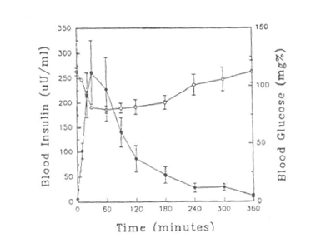
Ocular administration for systemic delivery
Insulin:
  When administered to the eye, a sustained lowering of blood glucose was observed
  Use of absorption enhancers may often be required to enhance absorption of peptides through the eye
  Absorption enhancers must be safe and non-irritating to the eye
  Order of efficacy: Saponin>Fusidic Acid>BL-9 = EDTA>Glycocholate>Decamethonium=Tween 20
  Aminopeptidase inhibitors or peptide analogs that are resistant to enzymes also help to improve bioavailability
Systemic absorption of insulin (± SEM; n=5) following the ocular instillation of a 0.25% insulin solution containing Brij-78 as an enhancer. Data generated following a b.i.d. administration of eyedrops over a three-month period (• - blood insulin concentration; o – blood glucose levels)

Slide 16
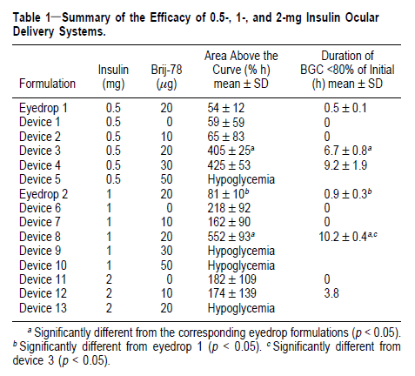
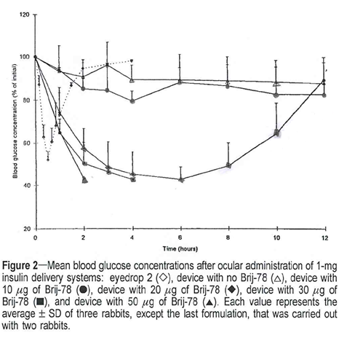
Effect of absorption enhancer (brij 78) on systemic delivery of insulin from an ocular insert device
Effect of Brij-78 on systemic delivery of insulin from an ocular device, Lee YC, Simamora P, Yalkowsky SH, J Pharm Sci. 1997 Apr;86(4):430-3.
Notes:
Gelfoam DevicessA Gelfoam disc of ∼6 mm diameter and 2 mm height was punched from a slab of Gelfoam sponge with a hole punch and accurately weighed with a Mettler (model AE163) analytical balance. Devices containing different amounts of sodium insulin and Brij-78 were prepared according to the procedure described earlier.9 A known amount of sodium insulin together with Brij-78 were dissolved in a 30 µL of a solution of 30% (v/v) ethanol in water. The mixture was placed on the Gelfoam disc by Pipetteman pipettor and sorbed into the Gelfoam disc. The wet matrices were dried under reduced pressure for at least 72 h. The dried matrices were weighed to verify their content. There is a 0.02 mg standard deviation of insulin in the devices, and insulin remains intact up to 30 days.20

Slide 17
Ocular administration for systemic delivery
Glucagon
  Used in treatment of hypoglycemia
  Can be delivered by the ocular route and has been reported to increase blood glucose
  Mol wt. is lower than insulin; may not need absorption enhancers
Calcitonin
  Long term administration required for treatment of hypercalcemia
  Besides the ocular route, other alternative routes like nasal, rectal, transdermal have also been explored

Slide 18
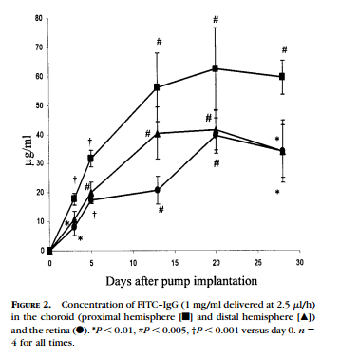
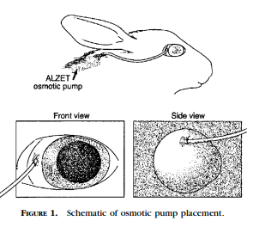
Trans-scleral delivery of Igg to the retina
Transscleral Delivery of Bioactive Protein to the Choroid and Retina, Ambati J, Gragoudas ES, Miller JW, You TT, Miyamoto K, Delori FC, Adamis AP, Invest Ophthalmol Vis Sci. 2000 Apr;41(5):1186-91.

Slide 19
Strategies for the ocular delivery of proteins/peptides
Prodrugs
Change physicochemical properties of a drug to improve permeation across cornea and enhance bioavailability
First prodrug for ocular delivery: Dipivefrin, prodrug of epinephrine used to treat glaucoma
Desirable properties
  Good stability
  High enzyme lability
Most common barriers that can be overcome are
  A low aqueous solubility, which prevents the development of aqueous eyedrops
  A low lipid solubility, which results in low corneal permeation and low ophthalmic bioavailability
  A short duration of action due to rapid drug elimination from site of action
  Systemic side-effects, due to low corneal and high systemic absorption

Slide 20
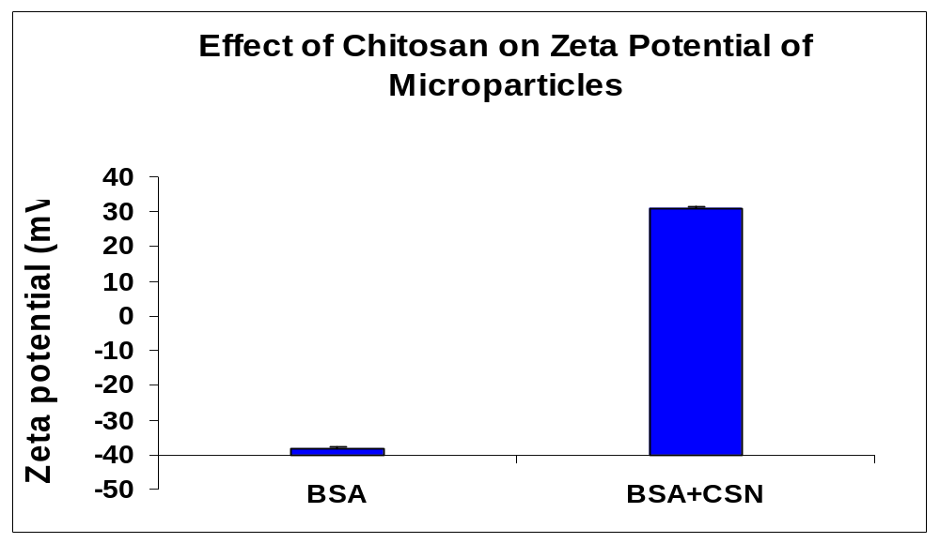
Strategies for the ocular delivery of proteins/peptides
Mucoadhesive Particulate Carriers
  Cornea and conjunctiva have a net negative charge
  Cationic polymers help to increase the concentration and residence time of polymer-associated drug
  Chitosan – biocompatible, biodegradable, enhances the paracellular transport of drugs
Conventional
eye drops
Anionic or poly-anionic
Cationic or poly-cationic
washout
Electrostatic
Repulsion
Electrostatic
Attraction

Slide 21
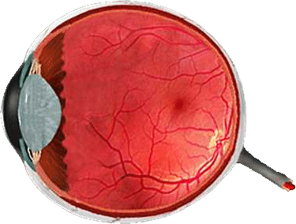
Delivery mechanism of cationic nanoparticles
Electrostatic interaction leading to
  Retention at the surface
  Reservoir effect in :
    Cornea
    Conjunctiva
  Transcorneal Route
  Diffusion via the scleral route
      Sustained release to the retina

Slide 22
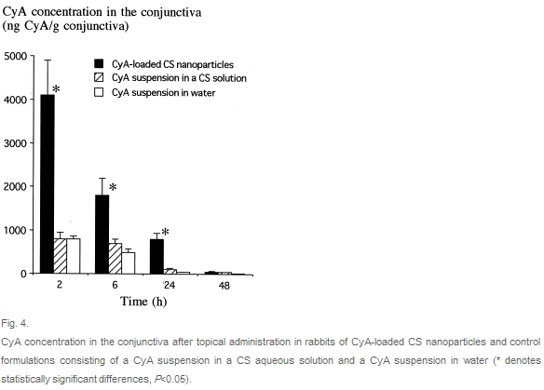
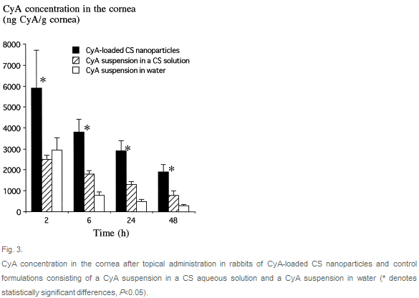
Chitosan nanoparticles for cyclosporin a delivery
Chitosan nanoparticles: a new vehicle for the improvement of the delivery of drugs to the ocular surface. Application to cyclosporin A, De Campos AM, Sánchez A, Alonso MJ. Int J Pharm. 2001 Aug 14;224(1-2):159-68

Slide 23
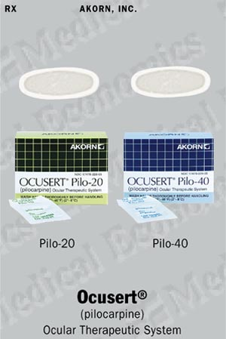
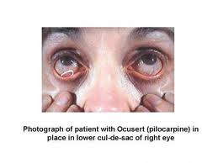
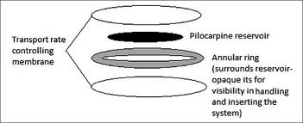
Strategies for the ocular delivery of proteins/peptides
Hydrogel Delivery Systems
  Allows slow release of drug from a hydrogel inserted beneath the eyelid
  Ocusert: First such device
    Non-erodible ocular insert
    Pilocarpine alginate core sandwiched between two transparent, rate controlling membranes

Slide 24
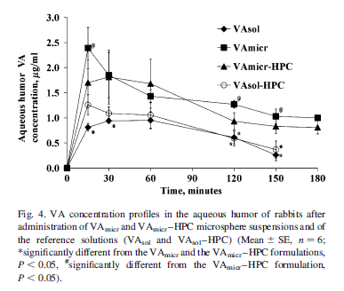
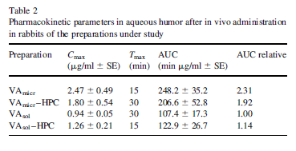
PLGA microspheres for delivery of vancomycin
PLGA microspheres for the ocular delivery of a peptide drug, vancomycin using emulsification/spray-drying as the preparation method: in vitro/in vivo studies, Gavini E, Chetoni P, Cossu M, Alvarez MG, Saettone MF, Giunchedi P, Eur J Pharm Biopharm. 2004 Mar;57(2):207-12

Slide 25
Strategies for the ocular delivery of proteins/peptides
Absorption Enhancers
  Promote penetration of drugs through corneal barrier by changing integrity of epithelial cell layer
  Examples: EDTA, sodium glycocholate and related cholates, tween-20, saponin
Miscellaneous Approaches
  Cell penetrating peptides: TAT (Trans-activating transcription factor from human immunodeficiency virus) exhibit efficient penetration to the retina after topical delivery
  Intravitreal injections
    Can cause several complications like hemorrhage and retinal displacement
    Bevacizumab (Avastin): Used for the treatment of ocular vascularization

Slide 26
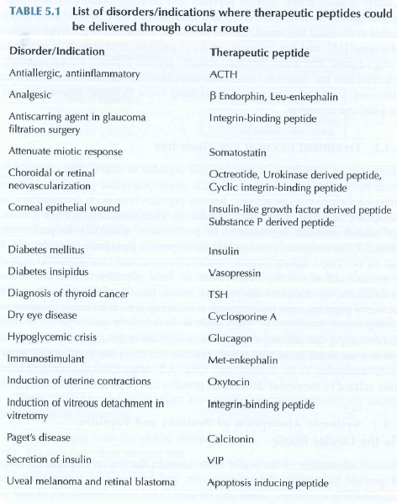
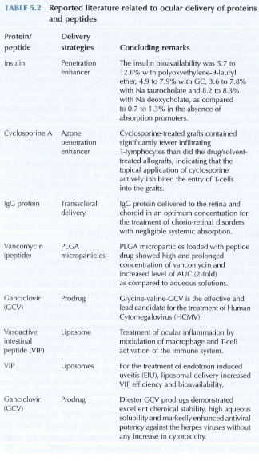
Adapted from Peptide and Protein Delivery by Chris Van Der Walle

Slide 27




