Slide 1
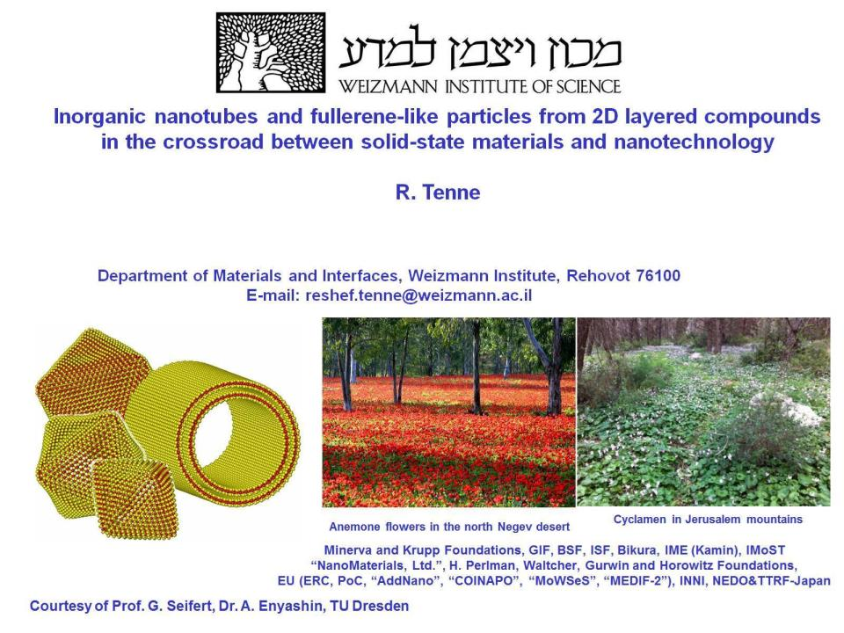
Department of Materials and Interfaces, Weizmann Institute, Rehovot 76100
E-mail: reshef.tenne@weizmann.ac.il

Slide 2
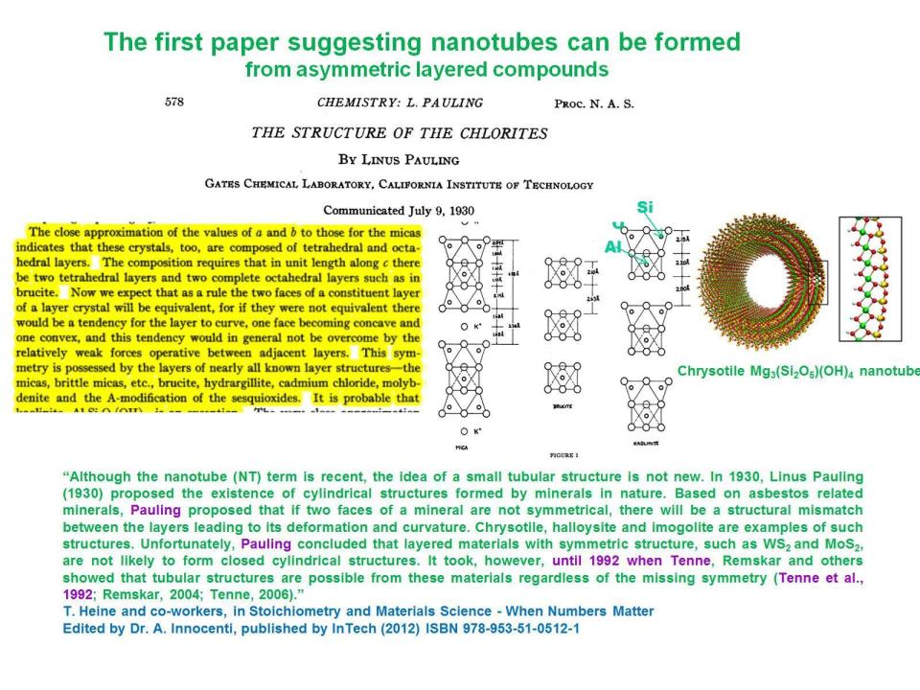

Slide 3
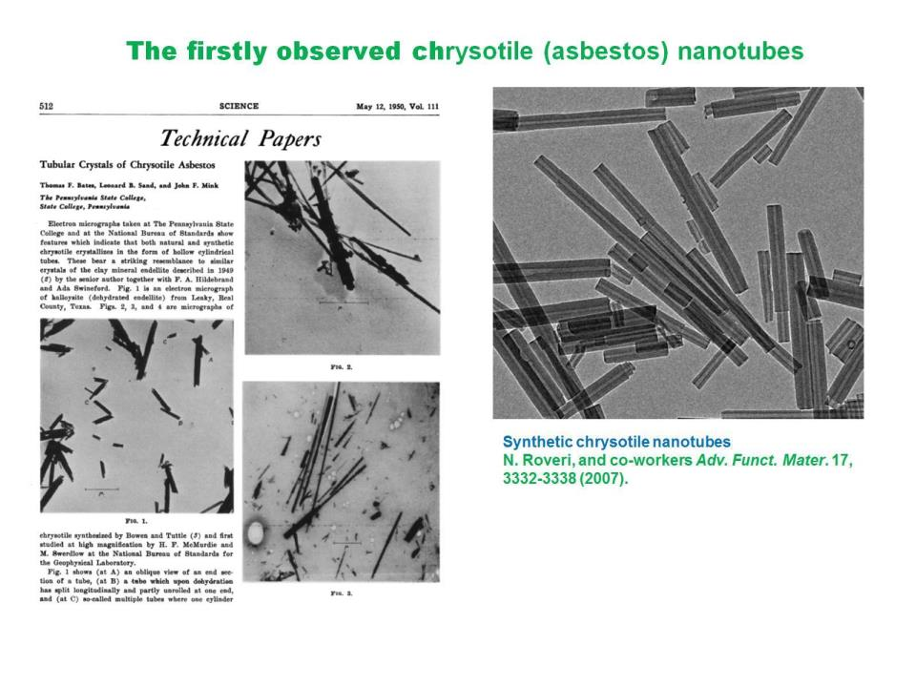
The firstly observed chrysotile (asbestos) nanotubes

Slide 4
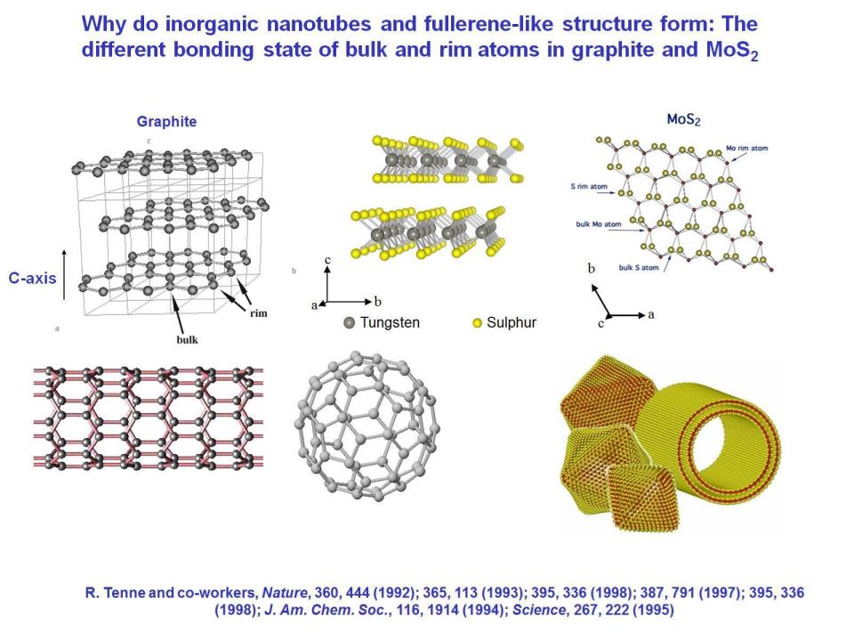
Why do inorganic nanotubes and fullerene-like structure form: The different bonding state of bulk and rim atoms in graphite and MoS₂

Slide 5
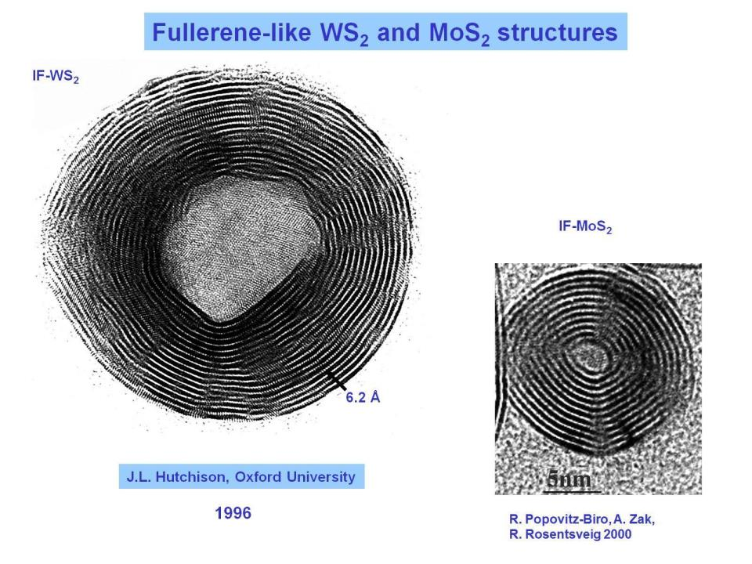

Slide 6
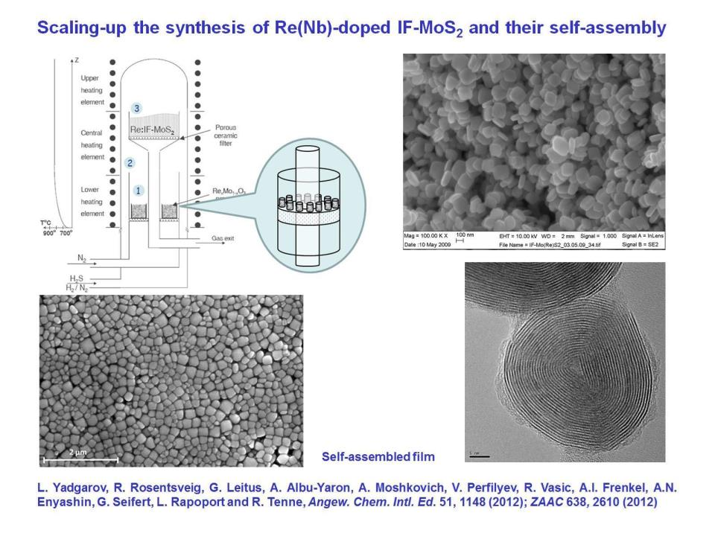

Slide 7
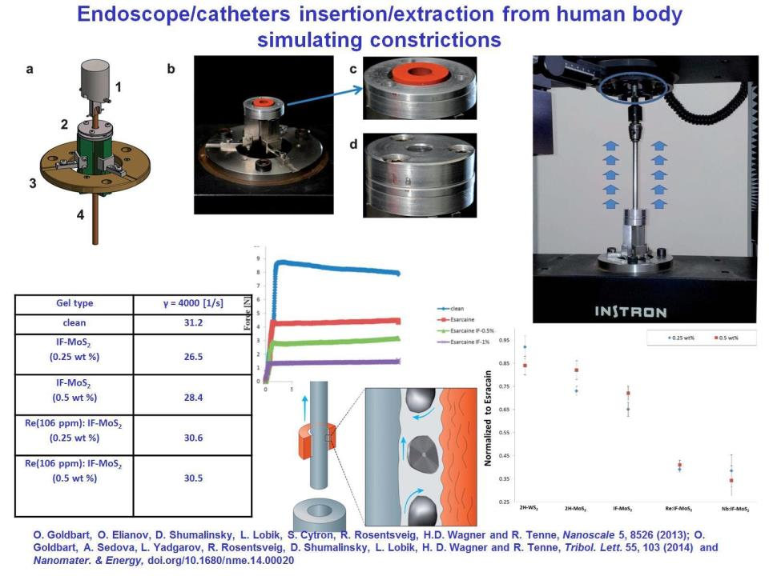
Endoscope/catheters insertion/extraction from human body simulating constrictions

Slide 8
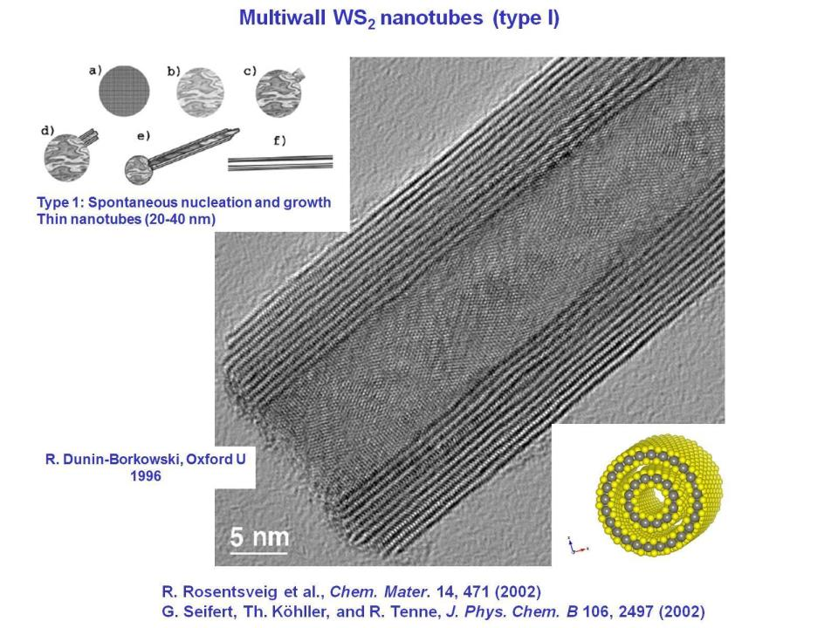

Slide 9
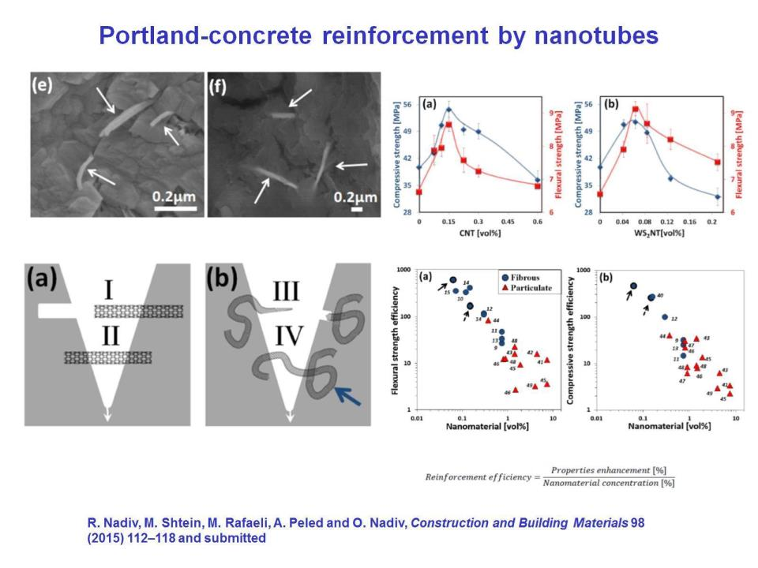
Portland-concrete reinforcement by nanotubes

Slide 10
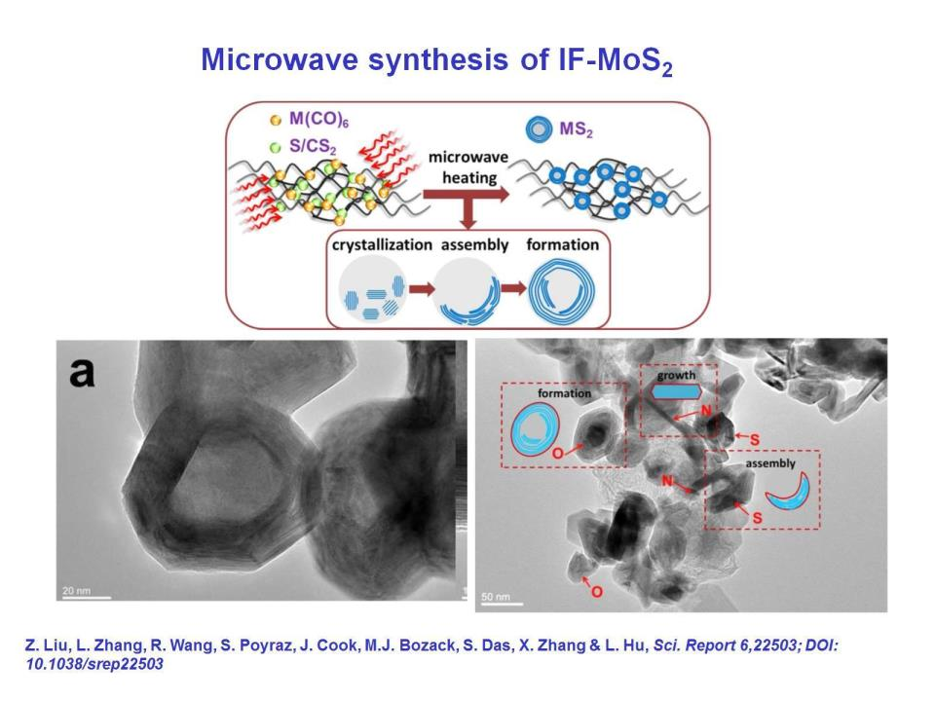
Microwave synthesis of IF-MoS₂

Slide 11
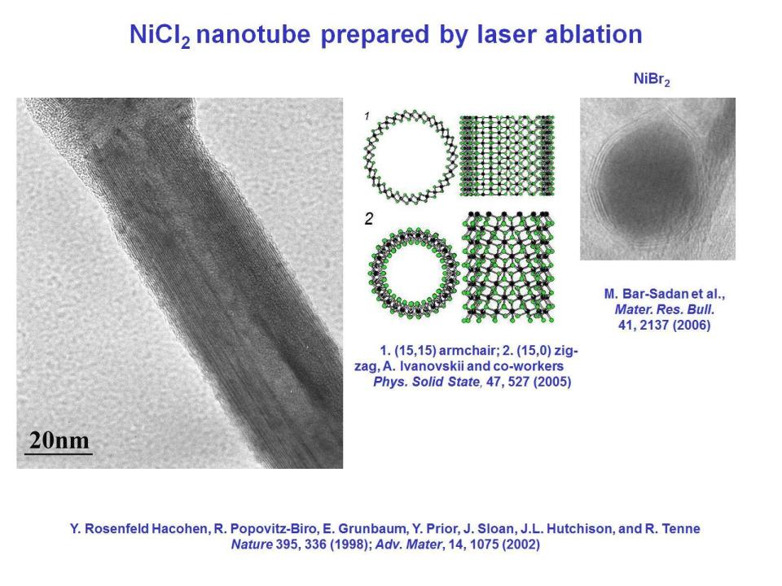

Slide 12
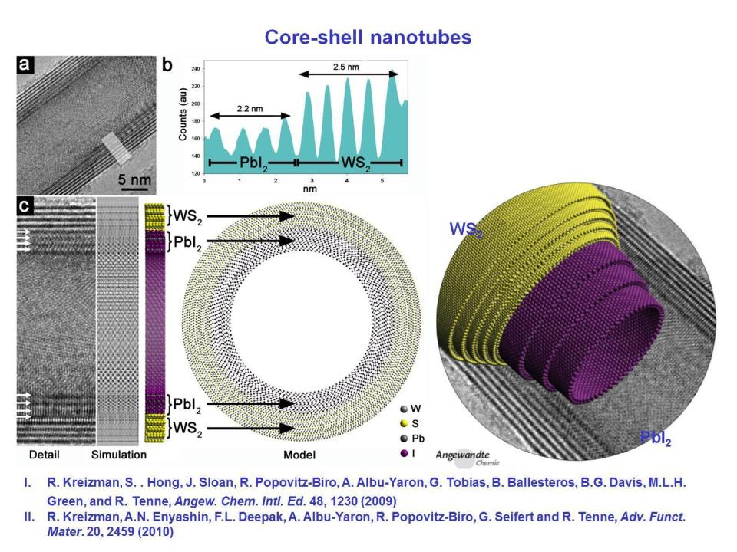
Core-shell nanotubes

Slide 13
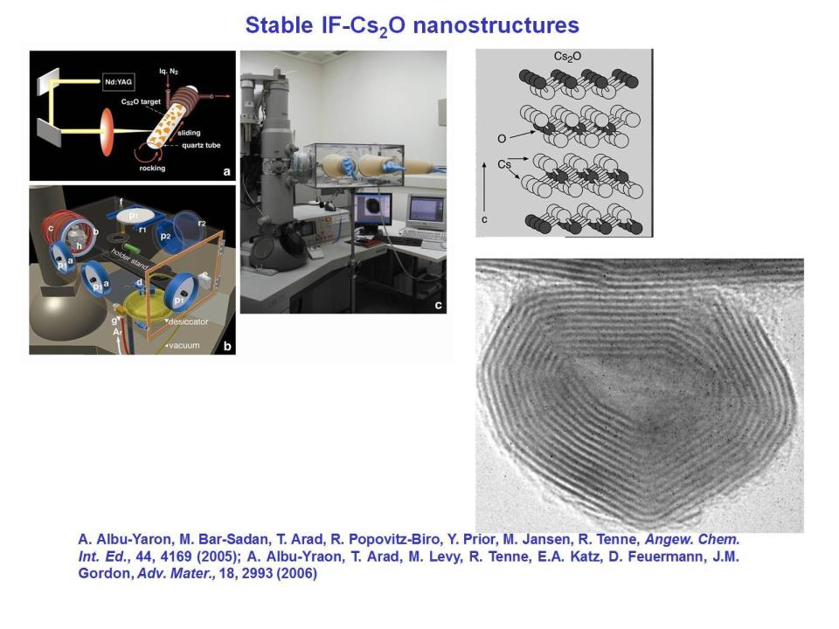
Stable IF-Cs₂O nanostructures

Slide 14
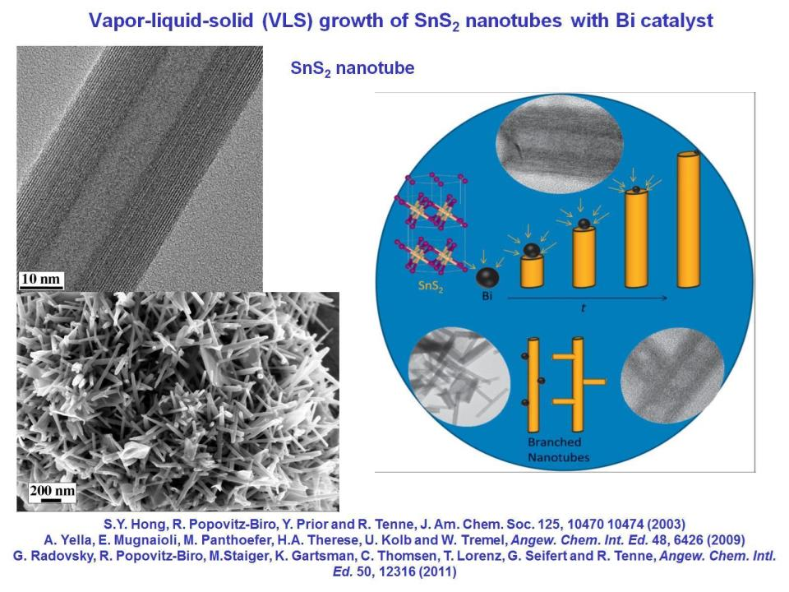
Vapor-liquid-solid (VLS) growth of SnS₂ nanotubes with Bi catalyst

Slide 15
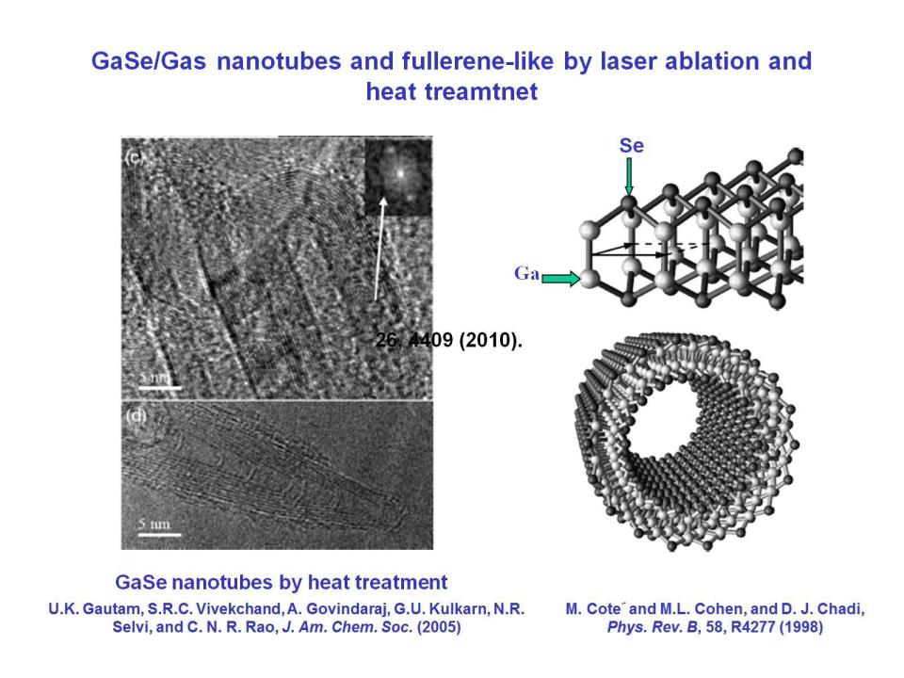
GaSe/Gas nanotubes and fullerene-like by laser ablation and heat treamtnet

Slide 16
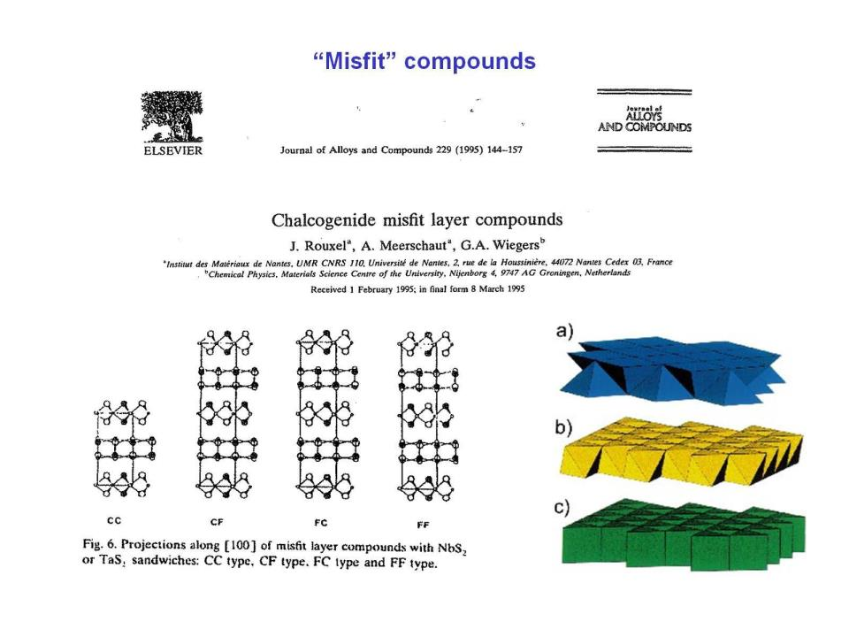
“Misfit” compounds

Slide 17
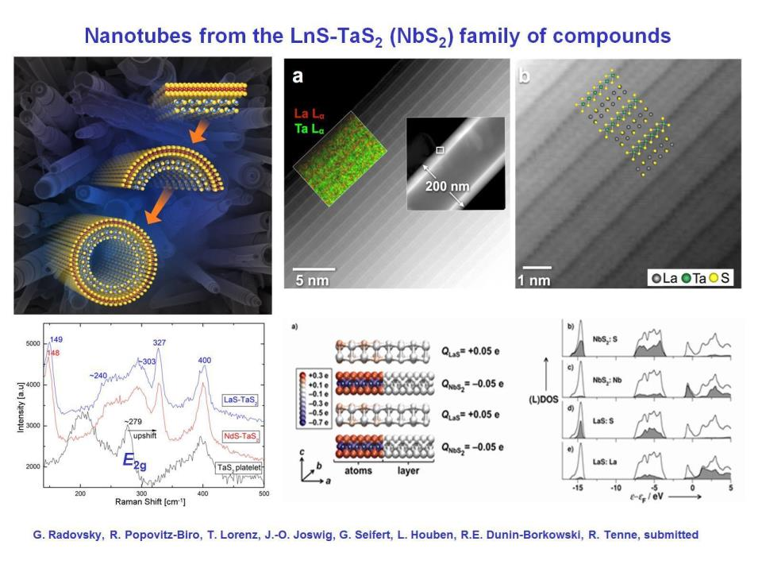
Nanotubes from the LnS-TaS₂ (NbS₂) family of compounds

Slide 18
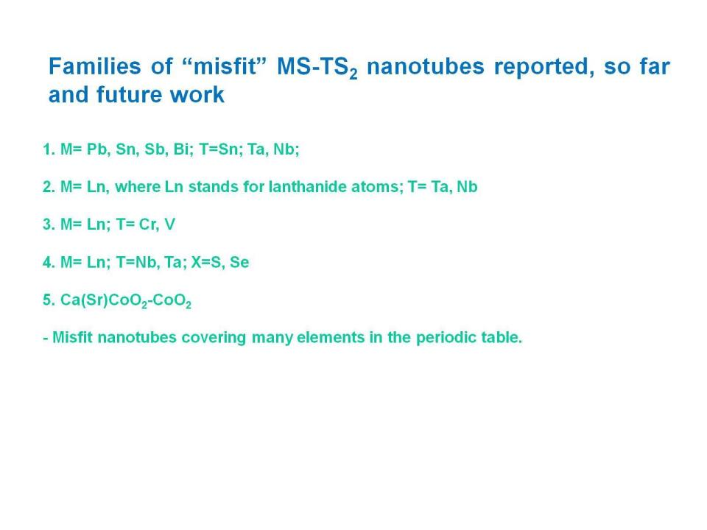
Families of “misfit” MS-TS₂ nanotubes reported, so far and future work

Slide 19
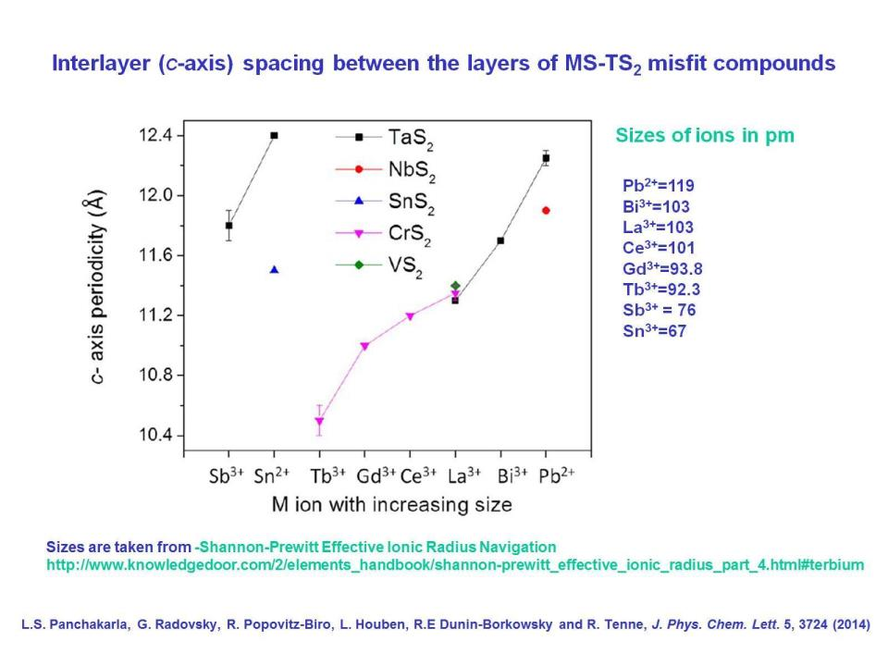

Slide 20
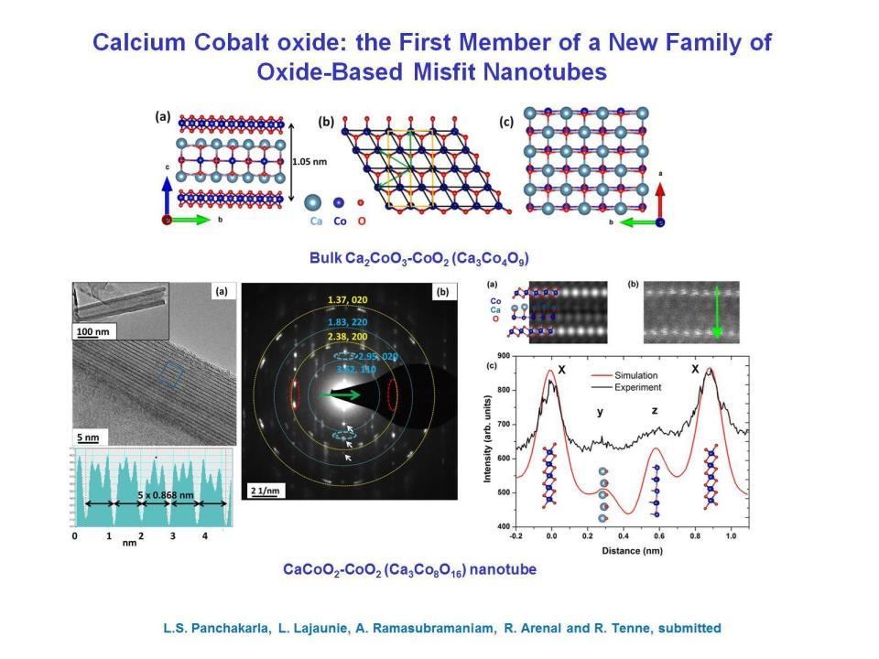
Calcium Cobalt oxide: the First Member of a New Family of Oxide-Based Misfit Nanotubes

Slide 21
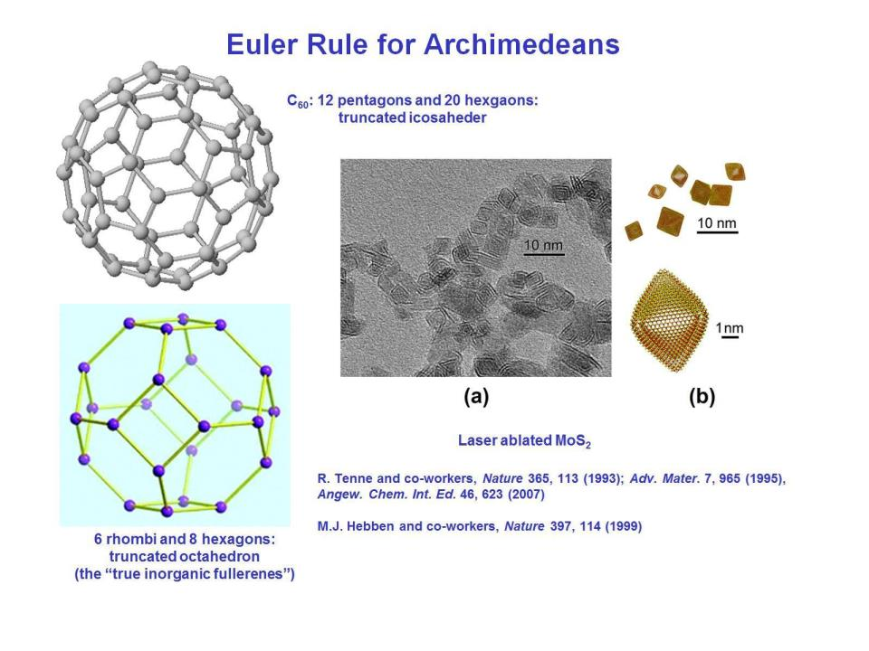
Euler Rule for Archimedeans

Slide 22
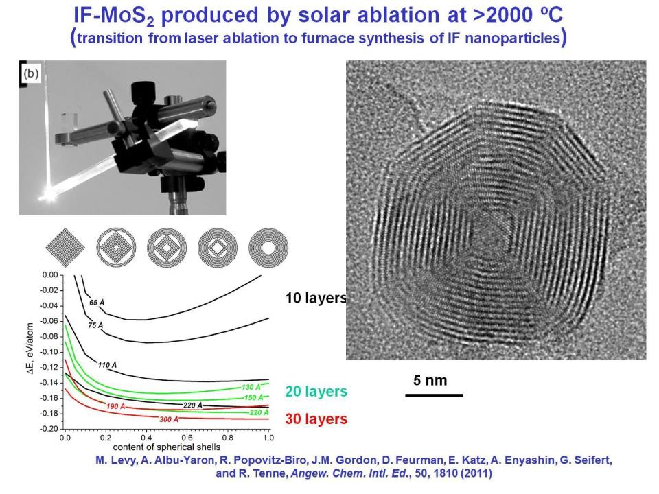
IF-MoS₂ produced by solar ablation at >2000 ºC
(transition from laser ablation to furnace synthesis of IF nanoparticles)

Slide 23


Slide 25
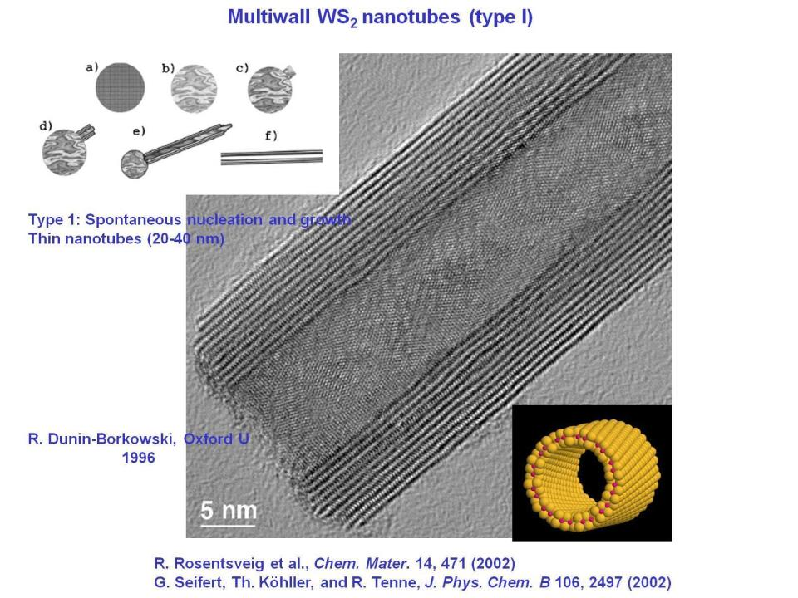

Slide 26
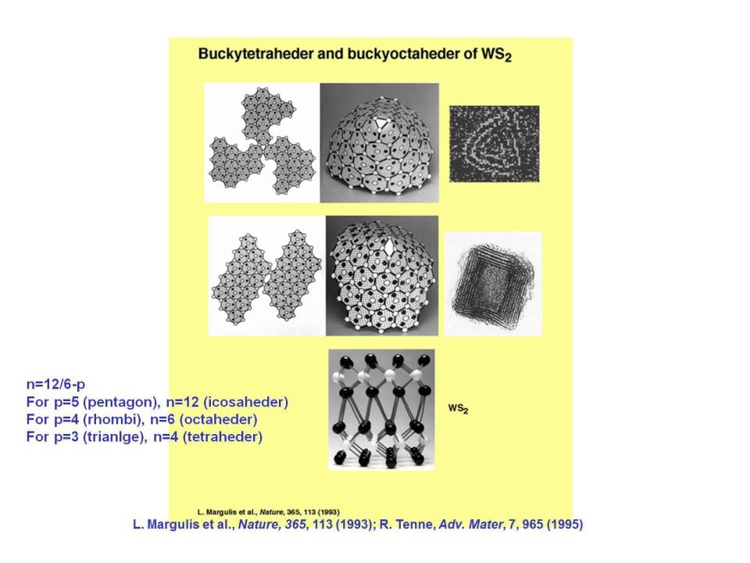

Slide 27
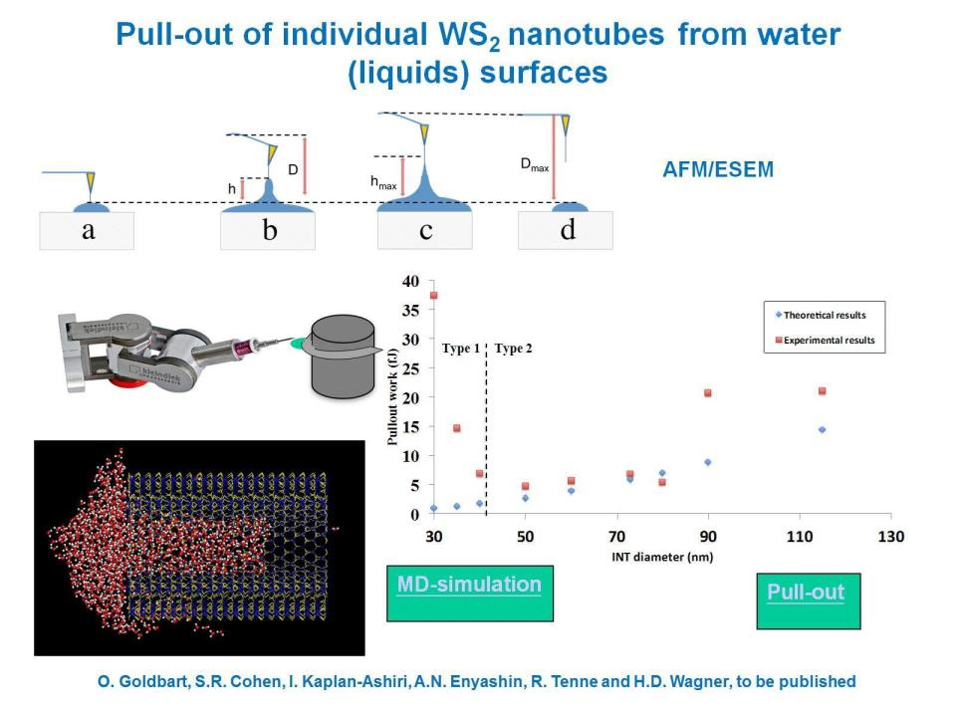
Pull-out of individual WS₂ nanotubes from water (liquids) surfaces

Slide 28
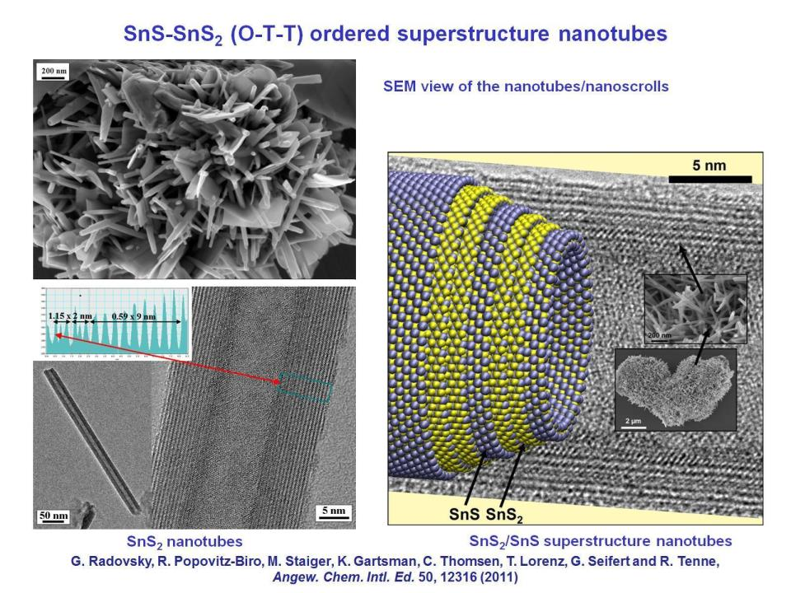
SnS-SnS₂ (O-T-T) ordered superstructure nanotubes

Slide 29
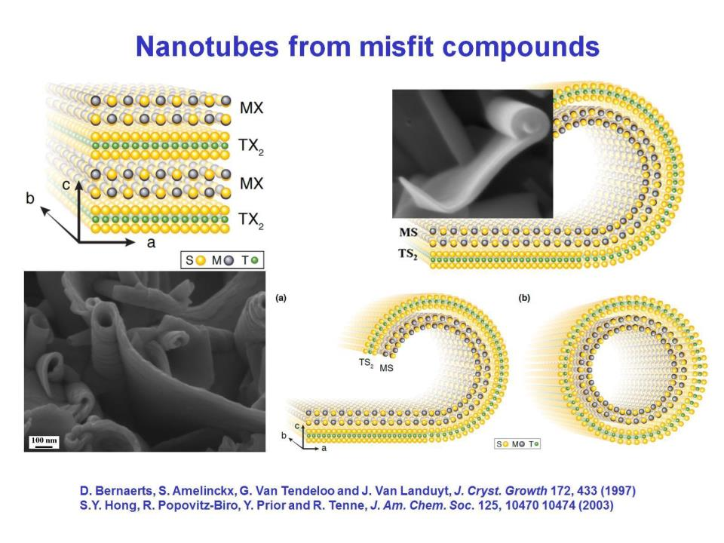
Nanotubes from misfit compounds

Slide 30
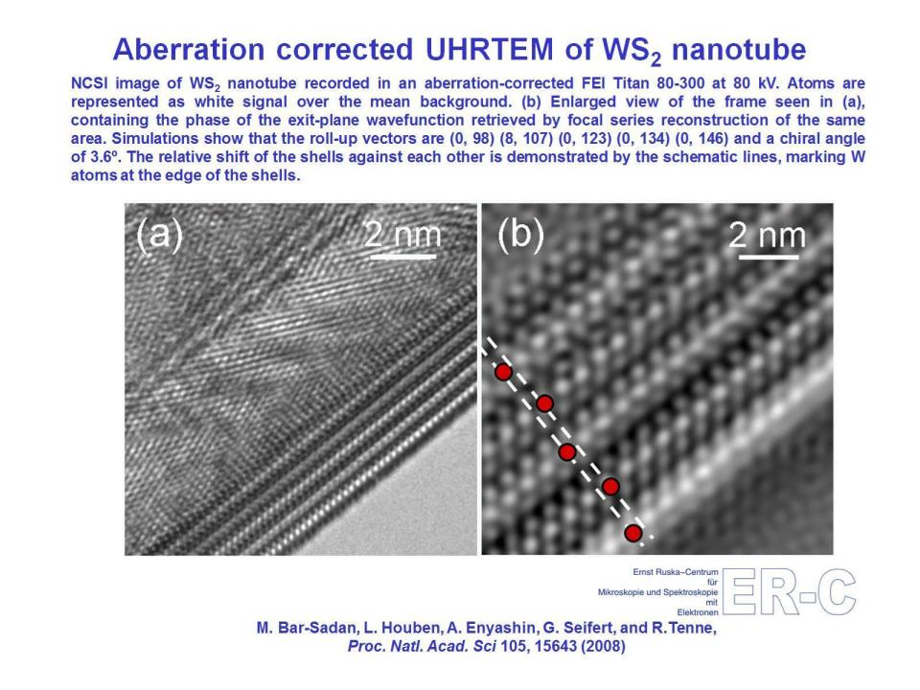

Slide 31
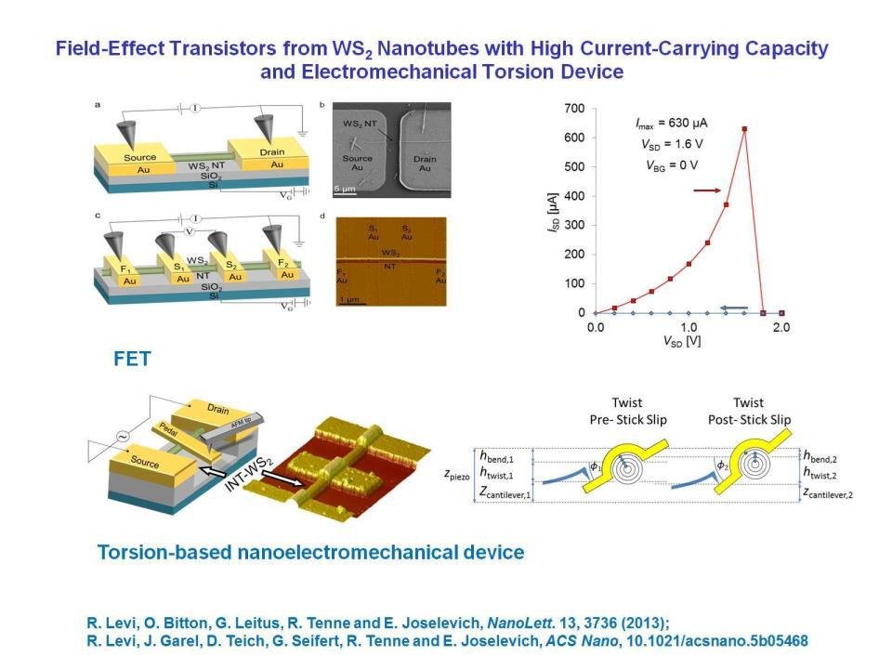
Field-Effect Transistors from WS₂ Nanotubes with High Current-Carrying Capacity and Electromechanical Torsion Device

Slide 32
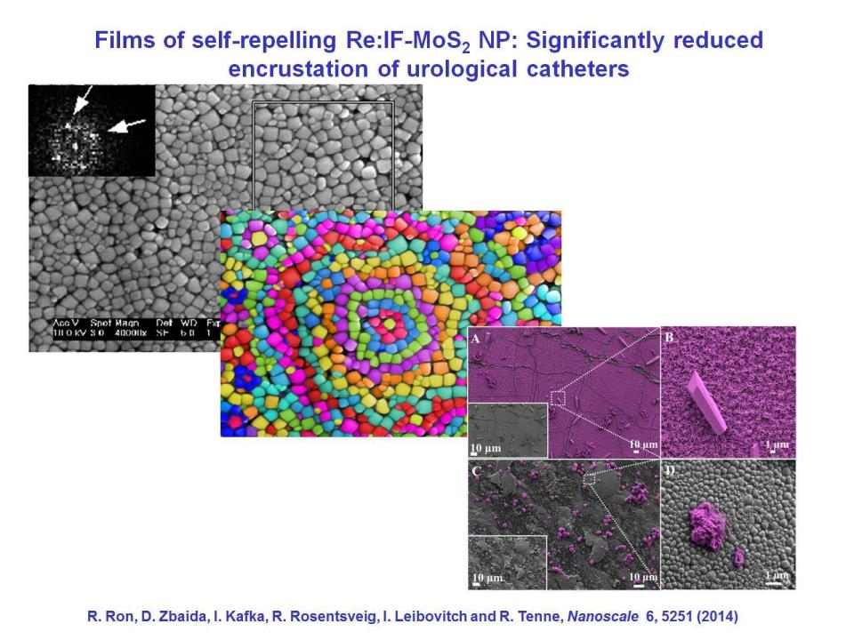
Films of self-repelling Re:IF-MoS₂ NP: Significantly reduced encrustation of urological catheters

Slide 33
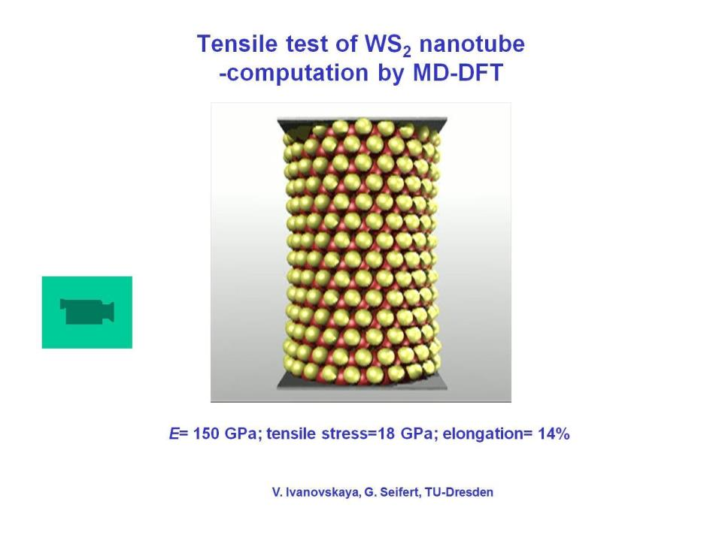
Tensile test of WS₂ nanotube
-computation by MD-DFT

Slide 34
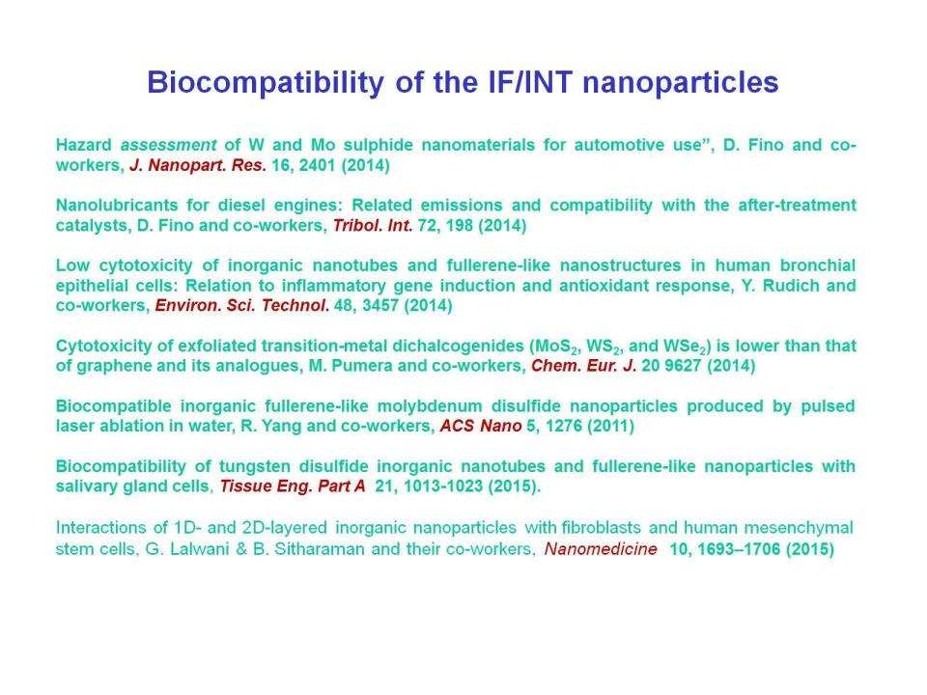
Biocompatibility of the IF/INT nanoparticles

Slide 35
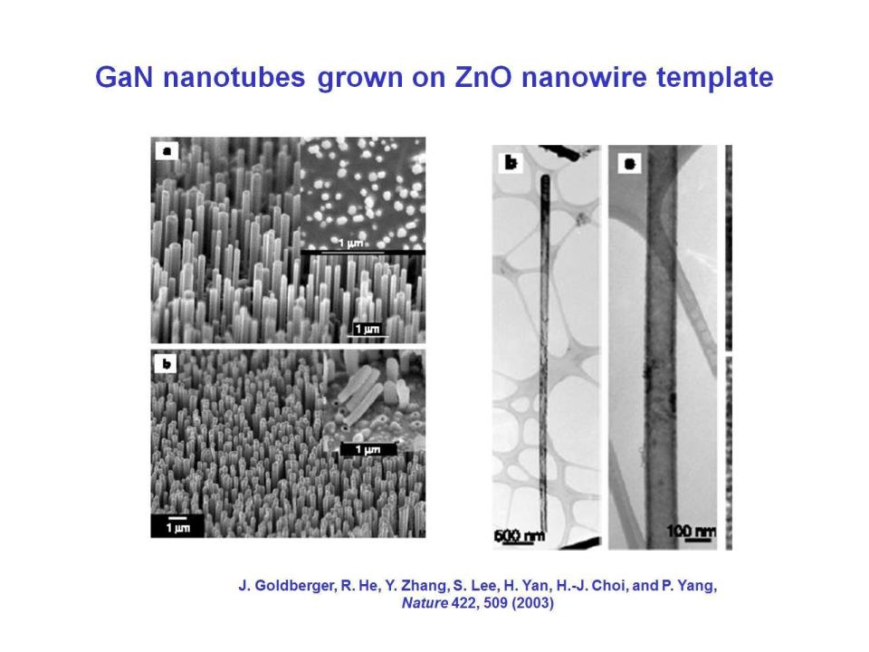
GaN nanotubes grown on ZnO nanowire template

Slide 36
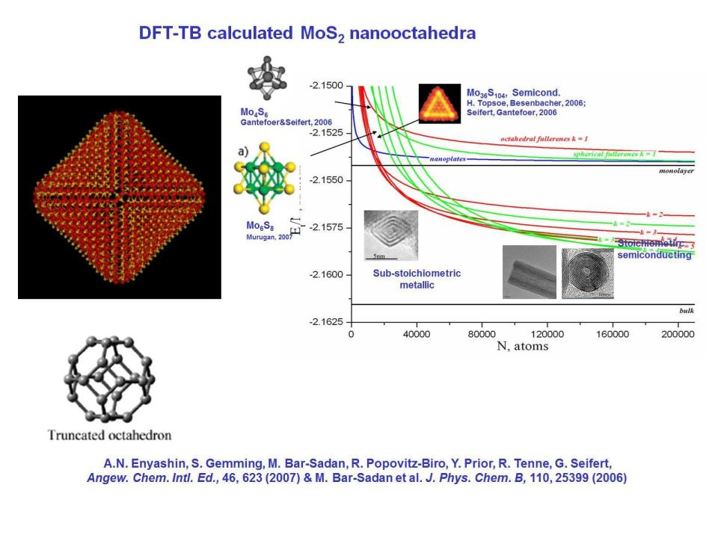

Slide 37
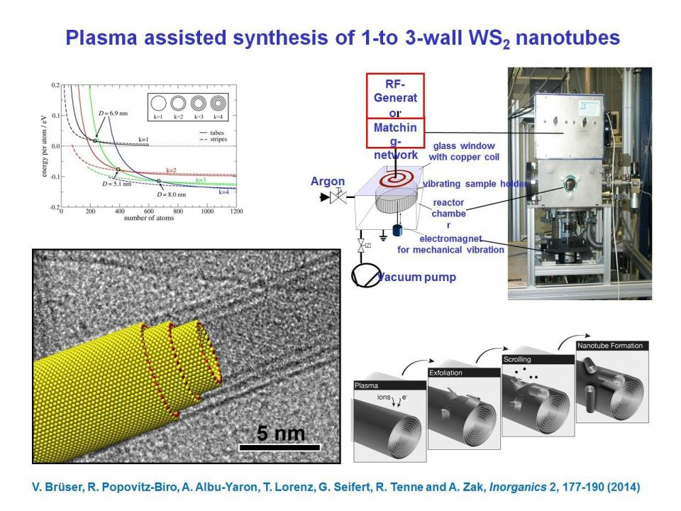
Plasma assisted synthesis of 1-to 3-wall WS₂ nanotubes

Slide 38
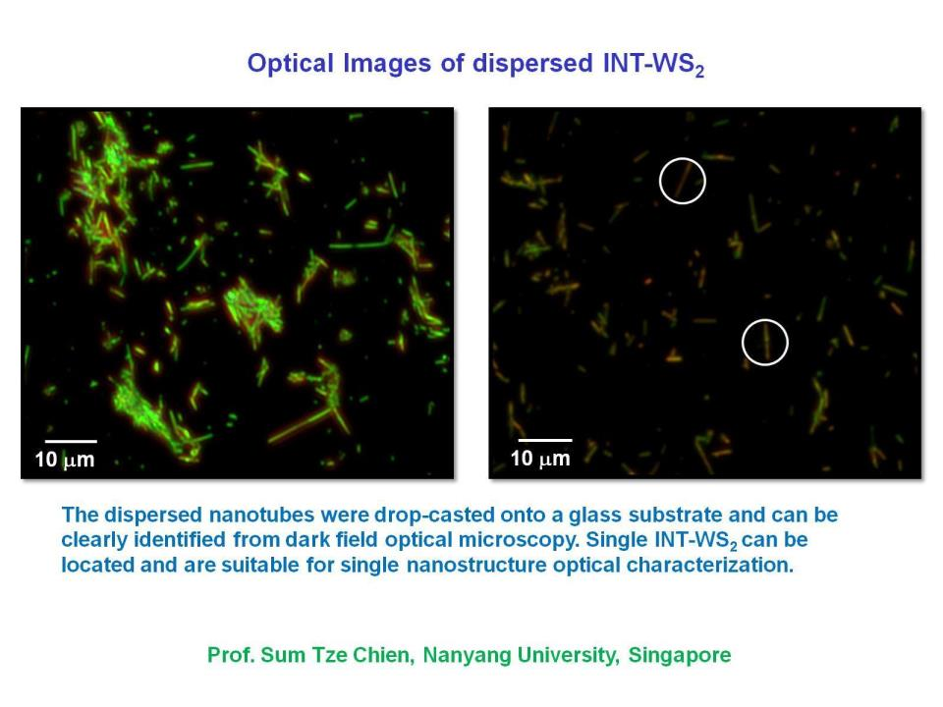

Slide 39
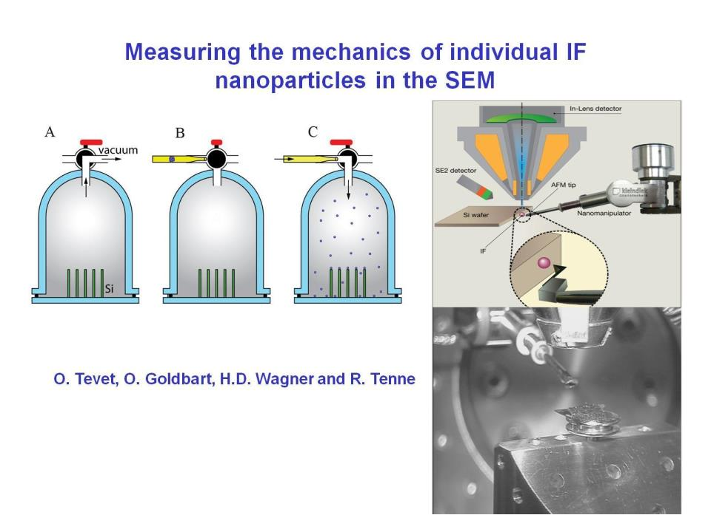
Measuring the mechanics of individual IF nanoparticles in the SEM

Slide 40
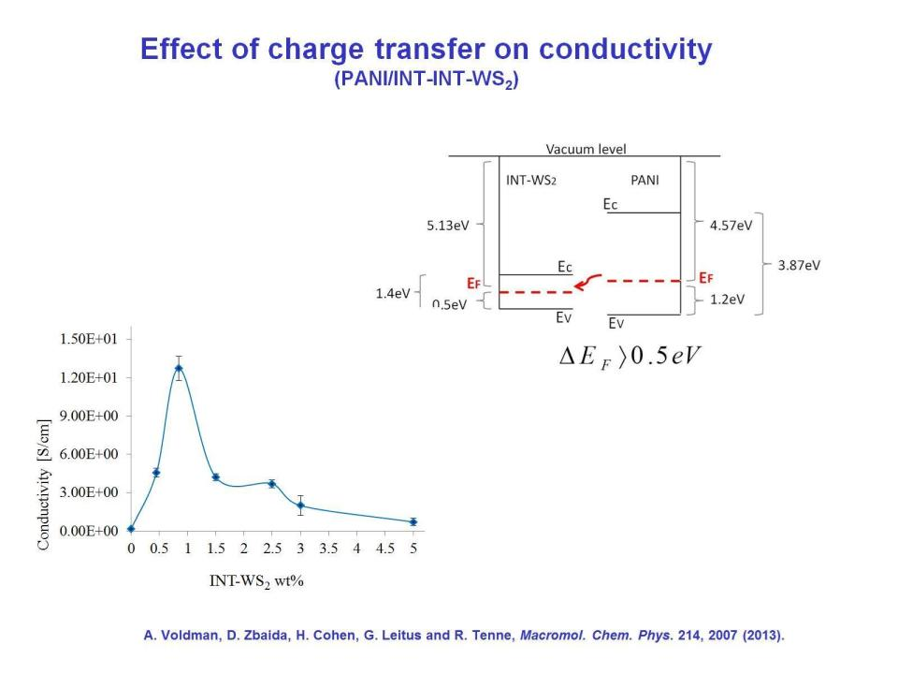
Effect of charge transfer on conductivity
(PANI/INT-INT-WS₂)

Slide 41
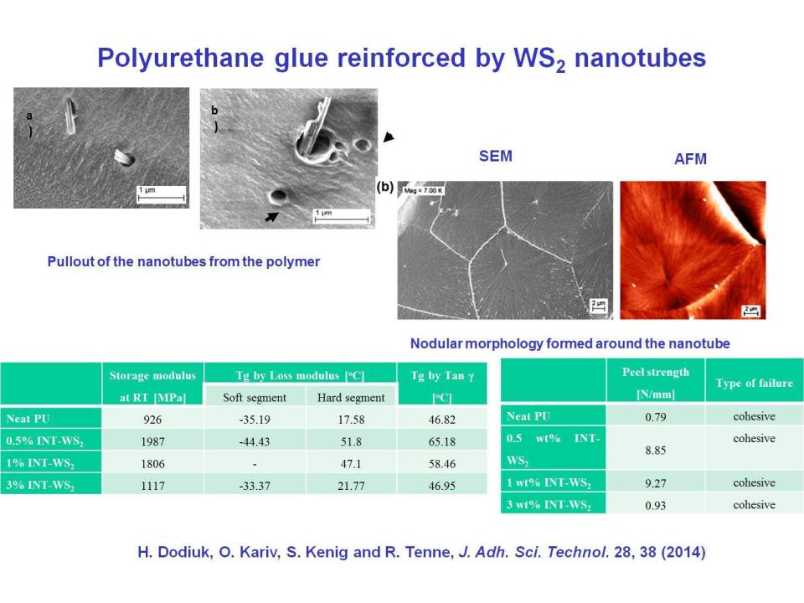
Polyurethane glue reinforced by WS₂ nanotubes

Slide 42
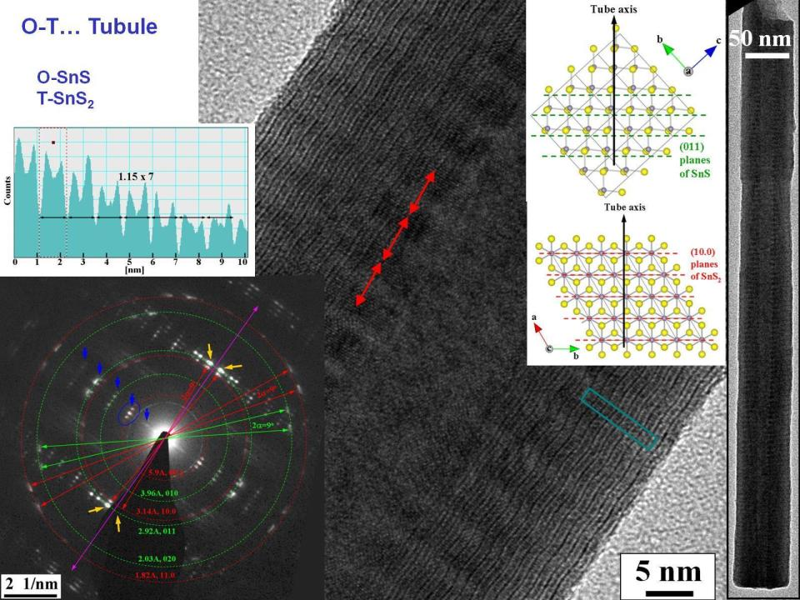

Slide 43
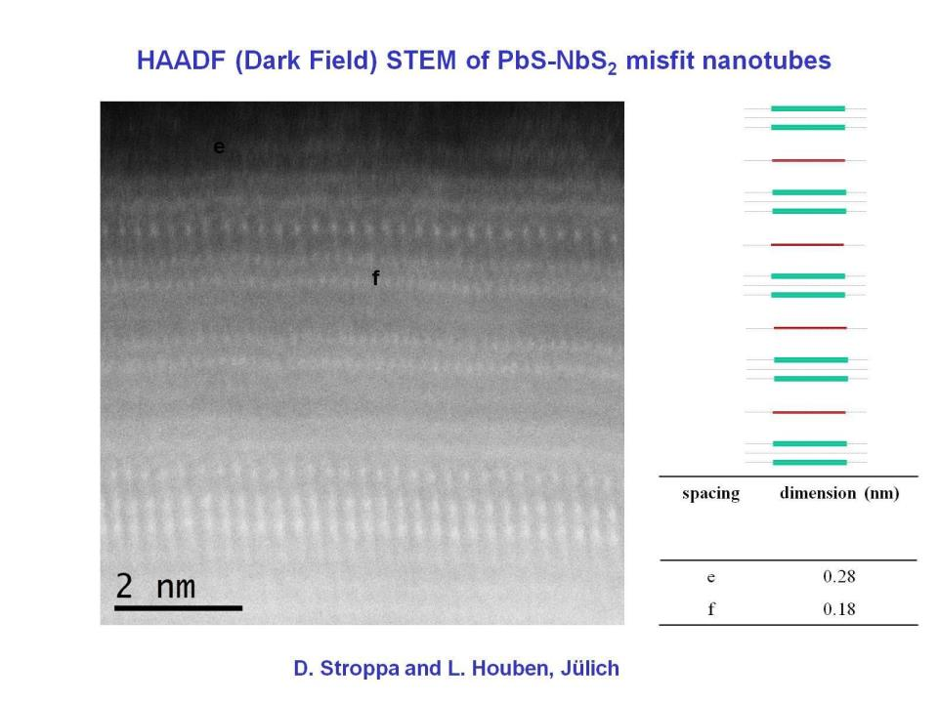

Slide 44
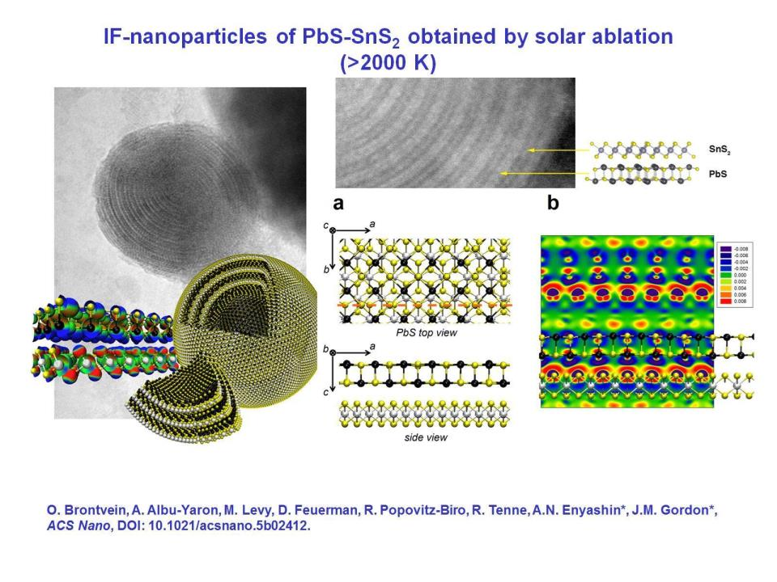
IF-nanoparticles of PbS-SnS₂ obtained by solar ablation (>2000 K)

Slide 45
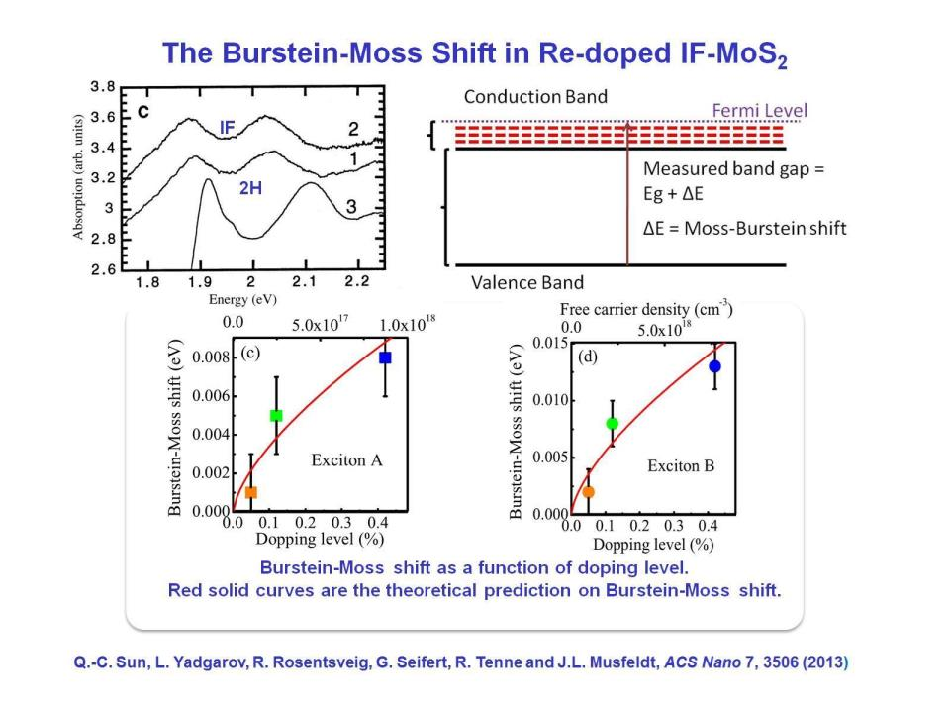
The Burstein-Moss Shift in Re-doped IF-MoS₂

Slide 46
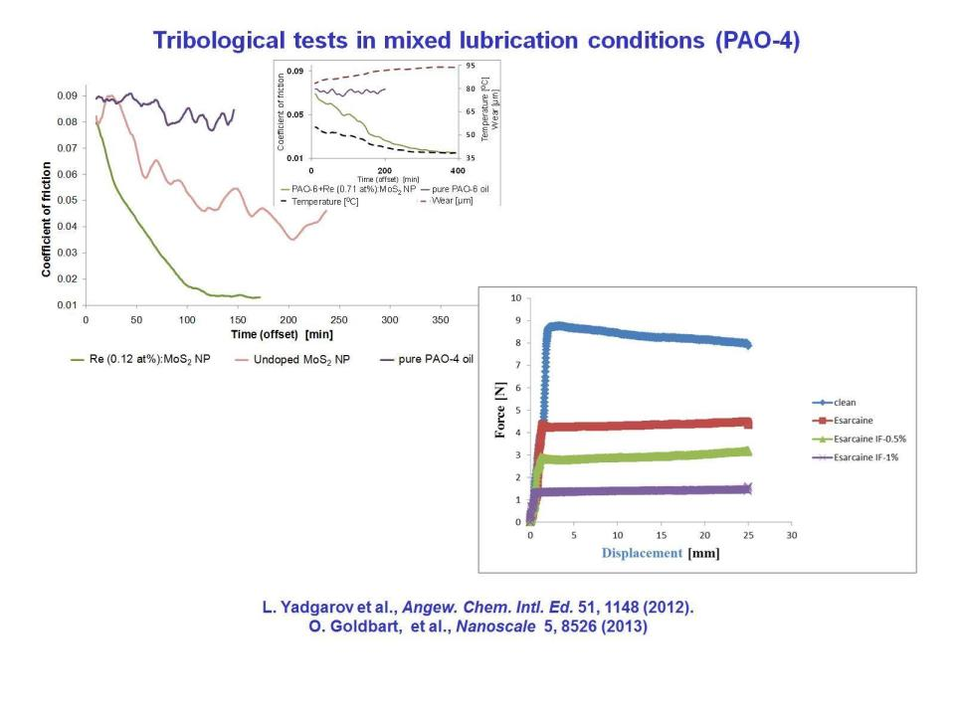

Slide 47
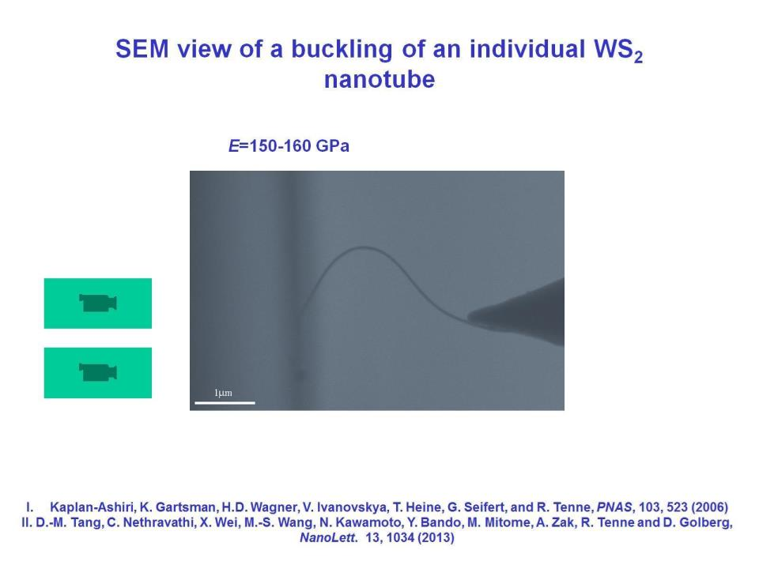
SEM view of a buckling of an individual WS₂ nanotube

Slide 48
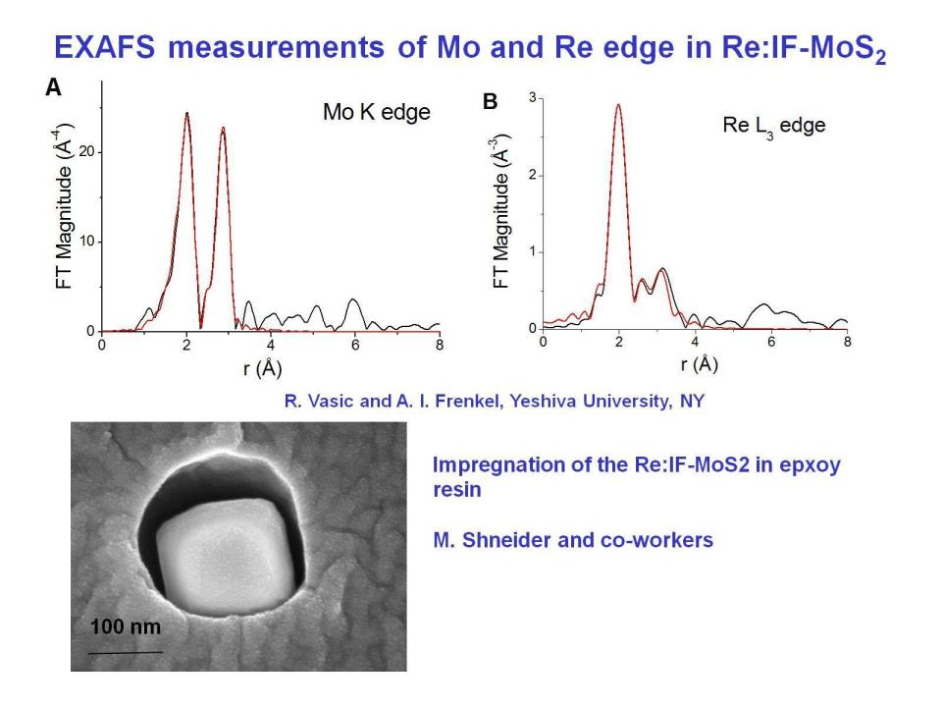

Slide 49
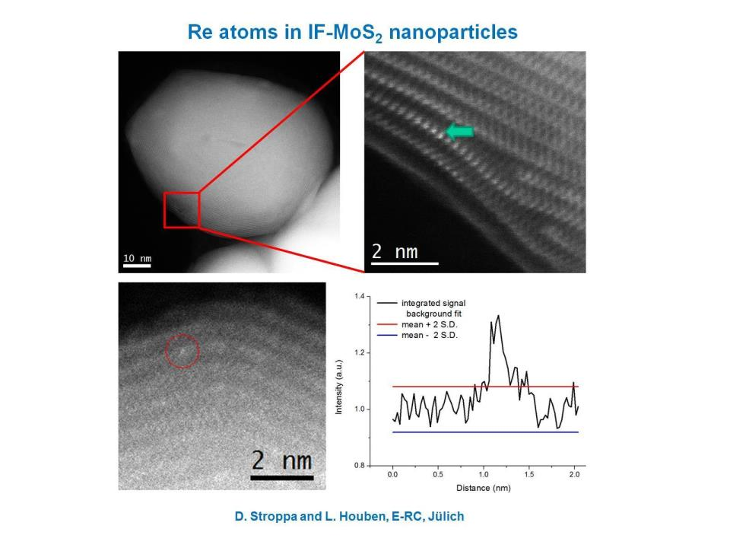
Re atoms in IF-MoS₂ nanoparticles

Slide 50
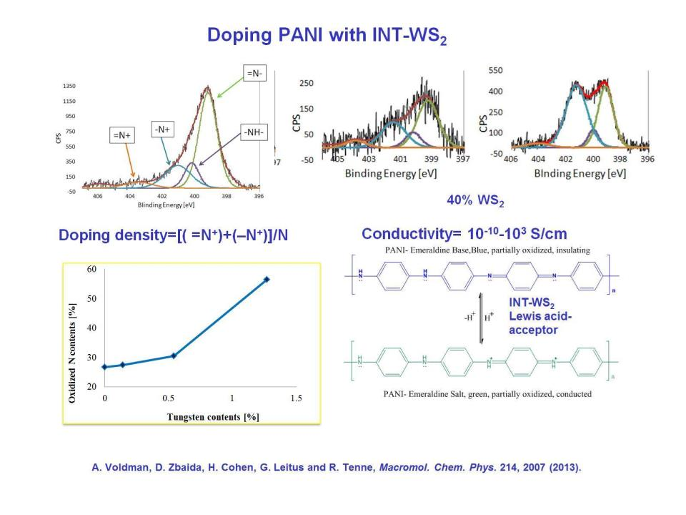
Doping PANI with INT-WS₂

Slide 51
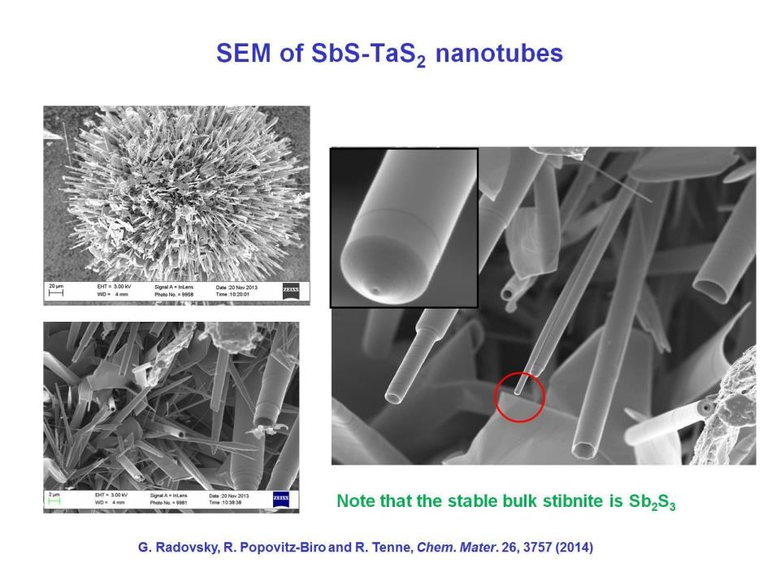
SEM of SbS-TaS₂ nanotubes

Slide 52
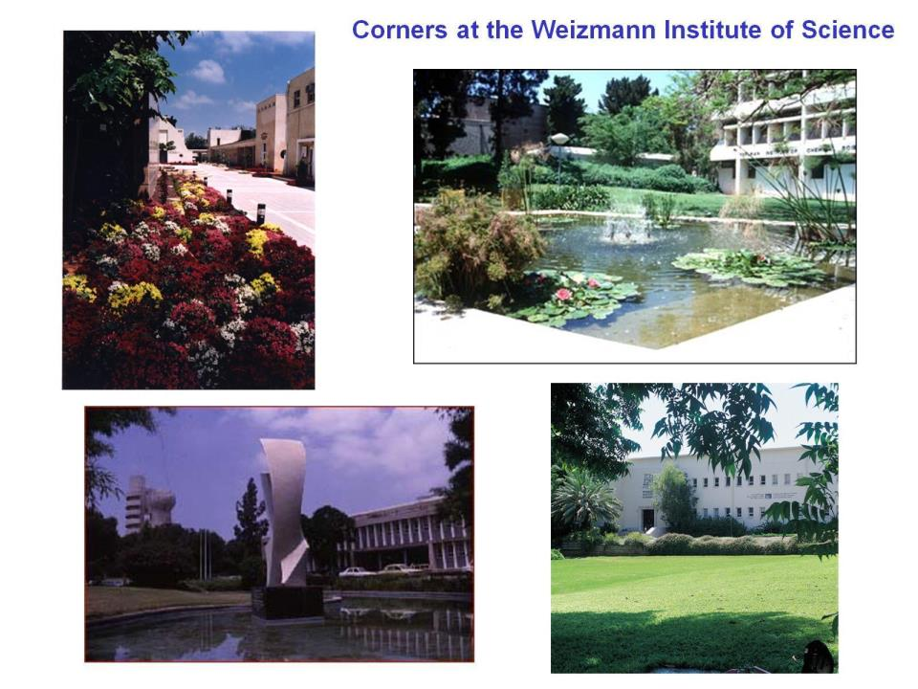

Slide 53

Mie surface plasmon scattering of WS₂ nanotubes in solution

Slide 54

Advanced Mg alloy nanocomposites reinforced by WS₂ nanotubes

Slide 55

Reinforcing Cement by MWCNT or INT-WS₂

Slide 56

HRTEM analysis of CeS-CrS₂ nanotube

Slide 57

On the mechanism of lubrication of IF nanoparticles

Slide 58

Lanthanide-sulfide (misfit) nanotubes with CrS₂ and VS₂

Slide 59

Electrospun PMMA fibers

Slide 60

Summary of the mechanical properties of IF NP

Slide 61

V₂O₅ IF-like nanoparticles produced by pusled laser ablation

Slide 62


Slide 63

Cobalt coated self-lubricating films

Slide 64


Slide 65

The role of rolling friction? in nanomaterials

Slide 66

Isotactic polypropylene/IF-WS₂ nanocomposites

Slide 67


Slide 68


Slide 69


Slide 70

Torsion of a gold pedal suspended on WS₂ nanotube

Slide 71


Slide 72


Slide 73


Slide 74


Slide 75

IF nanocomposites with polyetheretherketone (PEEK)
IF-WS₂/PEEK nanocomposite coatings have been produced using aerosol-assisted deposition process
With 1 wt%IF nanoparticles, the thermal stability of the nanocomposite coatings increases by 20–30 °C

Slide 76

IF nanocomposites with polyphenylenesulfide

Slide 77

Pressing individual IF-WS₂ nanoparticle

Slide 78


Slide 79

Tribological measurements of IF-MoS₂ nanoparticles

Slide 80


Slide 81

Mass production of multiwall WS₂ nanotube (type 2)

Slide 82

Stress-strain curve of a WS₂ nanotube from SEM tensile stress experiment

Slide 83


Slide 84

Synthesis of IF-MoS₂ by the gas phase reaction between MoO₃ vapor and H₂S

Slide 85

Comparison between the calculated and STM determined bandgaps of WS₂ nanotubes

Slide 86

Shock wave synthesis of inorganic nanotubes

Slide 87

Resonance Raman excitation spectroscopy of WS₂ nanotubes

Slide 88

Band structure of MoS₂ nanotubes

Slide 89

Nanomechanics of WS₂ nanotubes (type I and II)

Slide 90

Reinforcement of epoxy resin by WS₂ nanotubes

Slide 91


Slide 92

Re (Nb) doped IF-MoS₂

Slide 93


Slide 94


Slide 95

Stability range for the PbI₂@MoS₂ core-shell nanotubes

Slide 96


Slide 97

Raman spectra of SnS₂ and SnS/SnS₂ ordered superstructure nanotubes

Slide 98

SKF Launched New “NanoLub inside” Line of Products based on UTA Graphite Cage Technology
(and the IF-WS₂ nanoparticles)

Slide 99


Slide 100


Slide 101


Slide 102


Slide 103


Slide 104

Synthesis of MX₂ nanotubes by solar ablation

Slide 105

Orthodontic and medical devices

Slide 106

Possible new medical applications of IF/INT

Slide 107

The scaling-up of IF and INT-WS₂ at “NanoMaterials”

Slide 108

Tribology of Epoxy/WS₂ Composites

