Slide 1
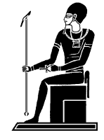

Alteration of B and T cell Markers in Chronic Granulomatous Disease (CGD) Patients
Faculty of Medicine

Slide 2
By
Reem J. Farid*; Safa S. Meshaal*; Rabab El Hawary*;
Engy M. Fekry*; Diana N. Masoud*; Aisha M. El Marsafy**
Departments of Clinical and Chemical Pathology*; Pediatrics**
Faculty of Medicine - Cairo University.

Slide 3
INTRODUCTION
Chronic granulomatous disease (CGD) is a primary immunodeficiency disorder caused by inherited defects in the NADPH oxidase complex.
This enzyme complex is used by phagocytic cells to generate microbicidal superoxide and its metabolites hydrogen peroxide, hydroxyl anion, and hypochloric acid .

Slide 4
Decreased superoxide production represents the major pathophysiologic mechanism during CGD, not only because NADPH oxidase is a critical host defense mechanism, but also because it may be associated with important pathways that connect innate and adaptive immunity.
Autoimmune diseases resembling systemic lupus erythematosus and inflammatory bowel disease are also experienced by CGD patients and their relatives.

Slide 5
T lymphocytes
Classified into
  Naïve
  Antigen experienced populations (memory)
Classification is based on markers as CD45
CD45; a protein tyrosine phosphatase regulating src-family kinases expressed on all hematopoietic cells.
CD45 can have many isoforms (CD45RA, CD45RB, CD45RC and CD45RO) Based on alternative splicing of exons that comprise the extracellular domain.

Slide 6
Isoforms can be identified specifically by the binding of monoclonal antibodies and are differentially expressed depending on the cell’s activation status.
CD45RA is expressed on naïve T cells.
After antigen experience, central and effector memory T cells gain expression of CD45RO and lose expression of CD45RA.
CD27 is considered an immunophenotypic marker identifying peripheral blood memory B cells.

Slide 7
There is an established O generating NADPH oxidase in B cells however differing from that in professional phagocytes;
B cells produce only a small amount of superoxide even when fully stimulated by various stimuli.
B lymphocytes use their slowly generated O₂- and H₂O₂ for other purposes like acting as second messenger in signal transduction pathways .

Slide 8
This study was done to characterize the naive and memory compartments of B and T lymphocytes in patients with CGD and establish correlation with their clinical phenotype.

Slide 9
SUBJECTS
The study included twenty patients with CGD (CGD group) and twenty healthy age and sex matched group (control group). The patients were recruited from the Primary Immunodeficiency clinic at Cairo University Specialized Pediatric Hospital, from 2012 through 2014. The study was approved by the Clinical Pathology department‘s ethical committee.

Slide 10
All patients were diagnosed as CGD according to the European Society of Immunodeficiency Diseases (ESID’s) diagnostic criteria mainly presenting with:
Deep seated infection (liver, peri-rectal or lung abscess; adenitis; or osteomyelitis)
Staphylococcus, Serratia Marcescens, Candida or Aspergillus
Diffuse granulomata in respiratory, gastrointestinal or urogenital tracts.

Slide 11
All the patients and controls were subjected to full history taking and complete clinical examination with reference to:
Age, sex, family history (consanguinity).
Onset, course & duration of the disease.
Full general examination with emphasis on site of abscesses and the presence of lymphadenopathy

Slide 12
All patients and controls were subjected to:
1. Routine laboratory investigations:
  Complete blood picture including HB%, Red cell indices (MCV, MCH) , differential WBCs count and platelets count.
  CRP & ESR.
  Chemistry.
  Culture.
2. Radiological investigations:
  Chest: x-ray and CT.
  Abdomen: ultrasound and CT.
  Bone: x-ray.3.Special investigations:

Slide 13
Group I:
Twenty patients suffering from chronic granulomatous disease diagnosed by DHR test (dihydrorhodamine). This group included 22 males (73.3%) and 8 females (26.7%), their ages ranged from 40 days to 16 years.
Group II:
Twenty healthy children of matched age & sex as control group with normal DHR test.

Slide 14
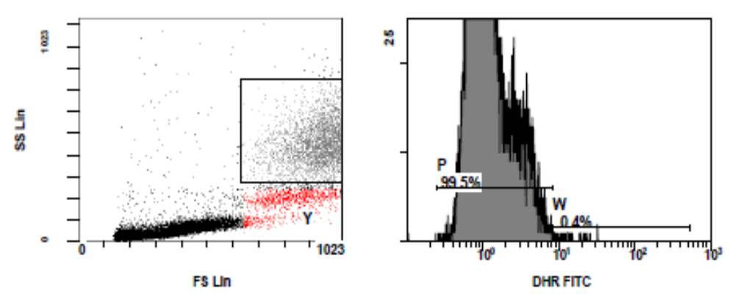
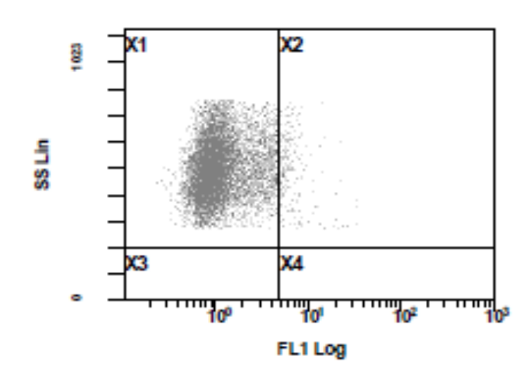
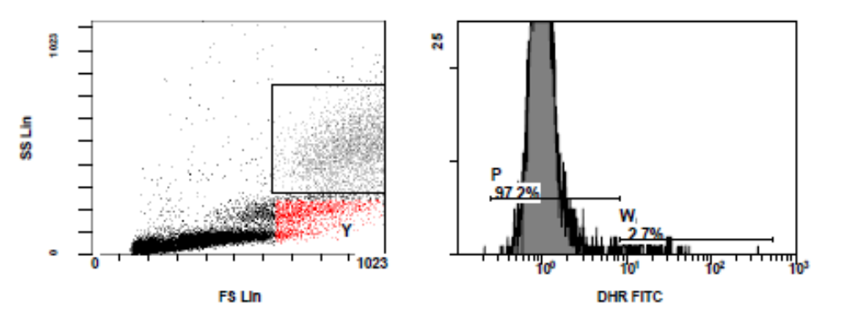
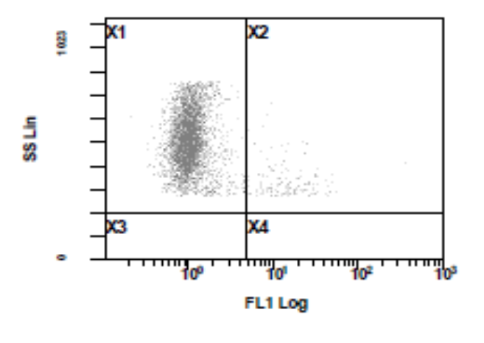
DHR
Before stimulation with PMA
After stimulation with PMA
Notes:
A stimulation index (SI) was calculated for gated neutrophils by dividing the mean fluorescent intensity (MFI) of stimulated cells by the MFI of unstimulated cells. SI of 70 was considered the cutoff for our lab.
phorbolmyristate acetate

Slide 15
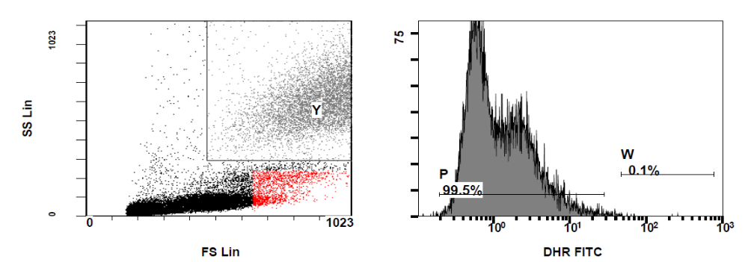
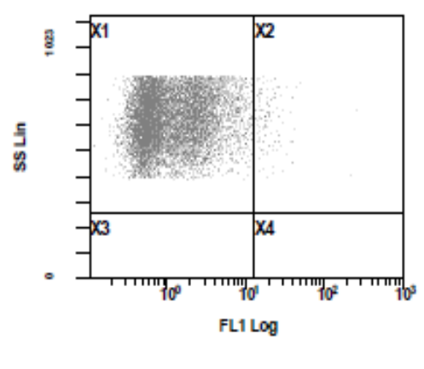
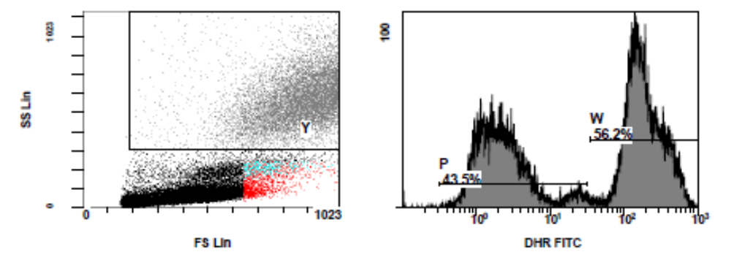
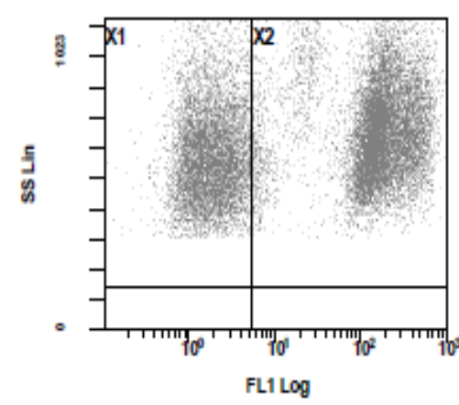
Before stimulation with PMA
After stimulation with PMA

Slide 16
Flow cytometric analysis:
Sample collection:
Samples were collected by venipuncture under complete sterile conditions from cases and controls after oral and written consent were taken from the parents.
Three ml of venous blood was obtained from each of the cases and controls and preserved in K₂EDTA (ethylene diamine tetra-acetic acid) and was processed within few hours from sampling.
All samples were collected at room temperature.

Slide 17
Reagents:
The following monoclonal antibodies were used:
Anti-CD3 with ECD (energy coupled dye) as pan T-lymphocyte marker.
Anti-CD19 with PC5 (phycoerythrin cyanin 5) as pan B-lymphocyte marker.
Anti-CD27 with PC7 (phycoerythrin cyanin 7) .
Anti-CD45RA with FITC (fluorescein isothiocyanate) .
Anti-CD45RO with PE (phycoerythrin).

Slide 18
Procedure:
50 µl from the cells are added to 1.5 µl from each of the five monoclonal antibodies and incubated for 20 minutes in dark room then added 1cm from lysing reagent and incubated for another 20 minutes in dark room.
The staining samples were finally mixed and ready for analysis by flow cytometry.

Slide 19
Analysis of samples:
Samples are analyzed immediately. Analysis of lymphocytes were done using EPICS ELITE Coulter flow cytometer. The wavelengths were adjusted according to the fluorochrome.
The region of lymphocytes was identified by their size and granularity and thus they were gated upon.

Slide 20
Interpretation of results:
The number of lymphocytes expressing the CD3, CD19, CD27, CD45RA or CD45RO emit fluorescence signals which were multiplied by PMT (photomultiplier tube) then the computer analyzed the data and expressed them as percentage of cells.

Slide 21
RESULTS
Faculty of Medicine

Slide 23
Comparison between CGD patients and Control group

Slide 24
There was a statistically significant decrease in the percentage of total lymphocytes in CGD patients in comparison to the control group.

Slide 25
On gating on CD3⁺ lymphocytes, CGD patients had a statistically significant decrease in the absolute count of CD45RA⁺cells compared to the control group.

Slide 26
There was an almost significant increase in the percentage of CD45RO⁺ cells on gating on CD3⁺ cells in CGD patients in comparison to the control group.

Slide 27
On gating on CD19⁺ cells, there was a decrease in the absolute count of CD27⁺cells in CGD patients in comparison to control group with no statistical significance.

Slide 28
Comparison between Autosomal Recessive and X-linked CGD Patients

Slide 29
On gating on CD3⁺Lymphocytes, there was a statistically significant decrease in the percentage and the absolute count of CD45RA ⁺ cells in X-linked CGD patients in comparison to autosomal recessive CGD patients.

Slide 30
On gating on CD3⁺Lymphocytes, there was a statistically significant increase in the percentage of CD45RO⁺cells in X-linked CGD patients in comparison to autosomal recessive CGD patients.

Slide 31
On Gating on CD19⁺lymphocytes, There was a statistically significant decrease in the percentage of CD27in X-linked CGD patients in comparison to autosomal recessive CGD patients.

Slide 32
Faculty of Medicine
Case Presentation

Slide 33
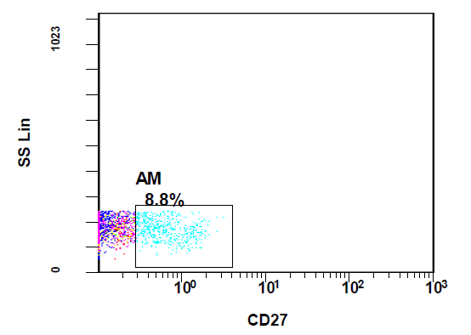
Case (1)
Notes:
Flow cytometry shows reduction of CD27 on total lymphocytes.

Slide 34
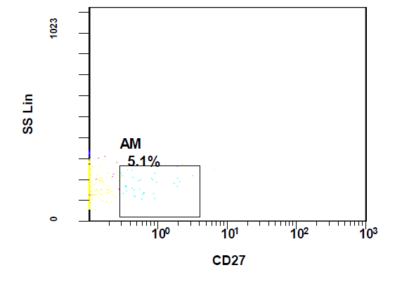

Notes:
Flow cytometry shows reduction of CD27 on B lymphocytes.

Slide 35
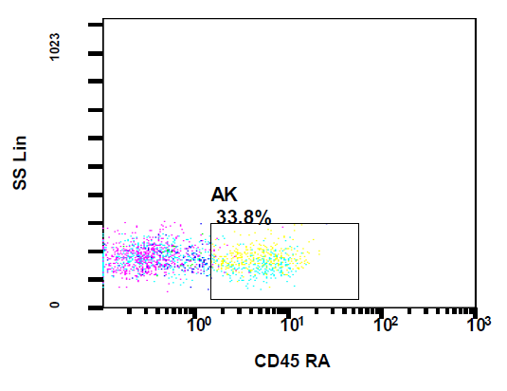
Notes:
Flow cytometry shows reduction of CD45RA on T lymphocytes.

Slide 36
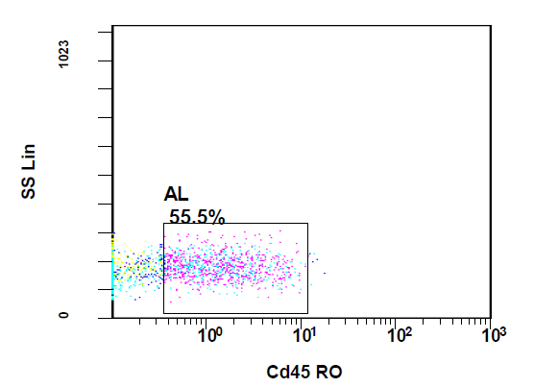
Notes:
Flow cytometry shows increase in CD45RO on T lymphocytes.

Slide 37
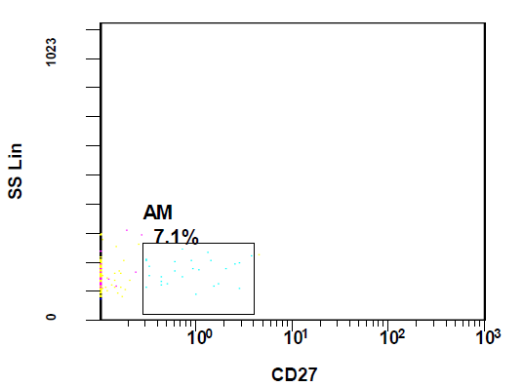
Case (2)
Notes:
Flow cytometry shows reduction of CD27 on B lymphocytes

Slide 38
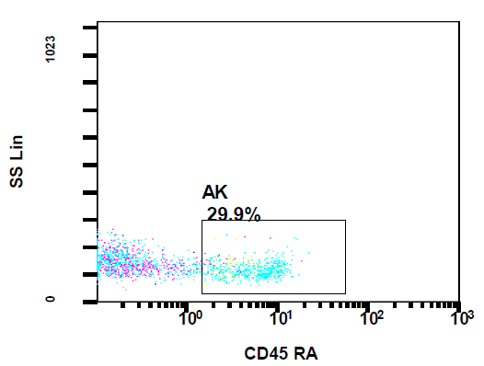
Notes:
Flow cytometry shows reduction of CD45RA on T lymphocytes.

Slide 39
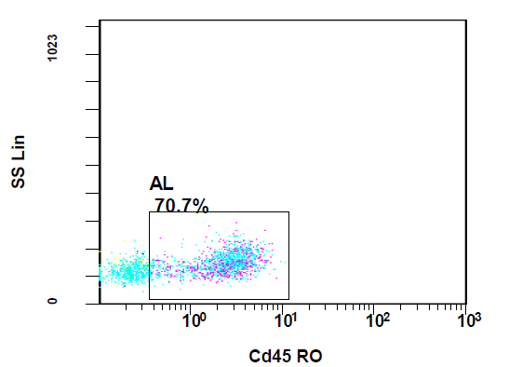
Notes:
Flow cytometry shows increase in CD45RO on T lymphocytes.

Slide 40
Faculty of Medicine
DISCUSSION

Slide 41
The memory B cells (CD27+) among our patients were lower than the normal controls with no statistical significance.
X-linked CGD patients revealed a statistical significant decrease in CD27+B cells in comparison to autosomal recessive CGD patients.
This may explain why the difference did not mount a statistical significant between the control group and the CGD patients as most of our patients are autosomal recessive while most of recorded CGD patients worldwide are mainly X-linked.

Slide 42
These results suggest a role for NADPH in the process of memory B cell formation. This in turn is in agreement with Bleesing et al., 2006, Moir et al., 2012 and Mohsenzadegan et al., 2014 who investigated memory B cells in the blood of CGD patients and evaluated their functional capabilities and demonstrated that the overall number of peripheral blood memory B cells is reduced in CGD patients compared with healthy controls.

Slide 43
This study also revealed a statistical significant decrease in expression of CD45RA⁺ T-lymphocytes and an almost significant increase in the percentage of CD45RO⁺ T-lymphocytes in CGD patients compared to the healthy control group.
This is in agreement with Whitmire et al., 2007 , Kraaij et al., 2010 and Shatynski et al., 2011 that revealed that a defective NADPH oxidase in CGD patients leads to a diminished T-cell suppression and increased IFN-γ, consequently increased conversion of naïve T-cells (CD45RA⁺) to memory T-cells (CD45RO⁺).

Slide 44
Faculty of Medicine
Conclusion

Slide 45
Although CGD is caused by defect in the phagocytic cell function, it plays a role in adaptive immune response reflected in both the T and B cells. The key finding of this study revealed that patients with CGD show reduction in the percentage of total lymphocytes with a decreased population of CD27-positive B cells and CD45RA naïve T cells on one hand and an increased population of CD45 RO memory T cells on the other hand.

Slide 46

Faculty of Medicine

