Slide 1
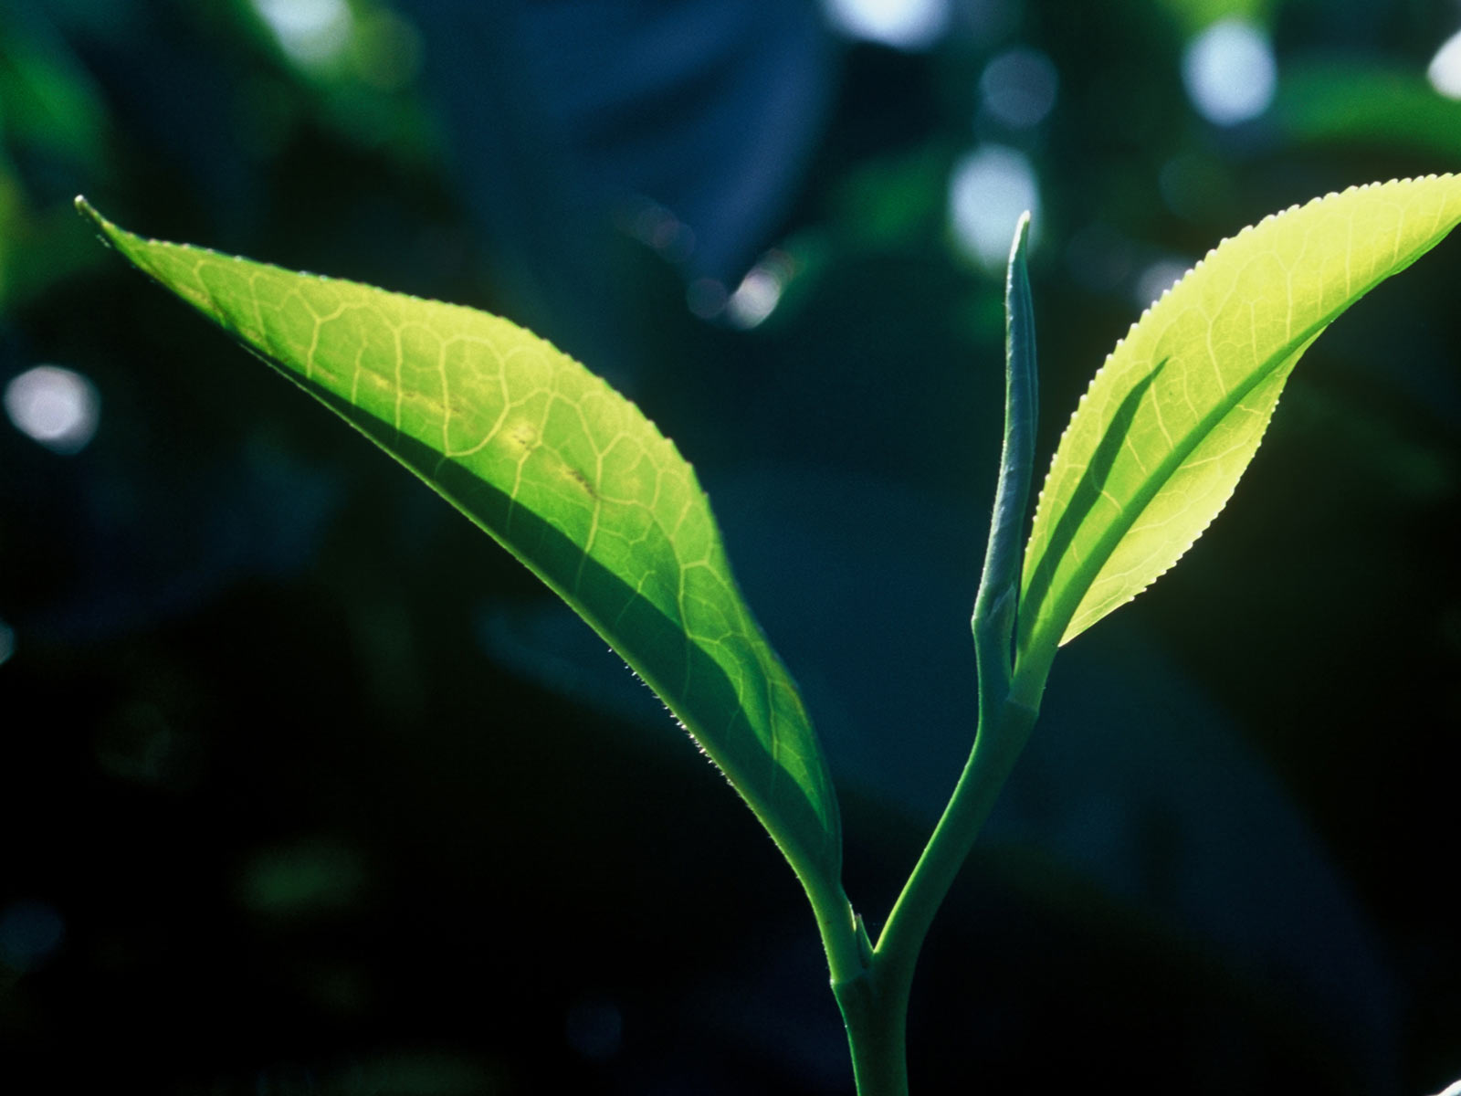

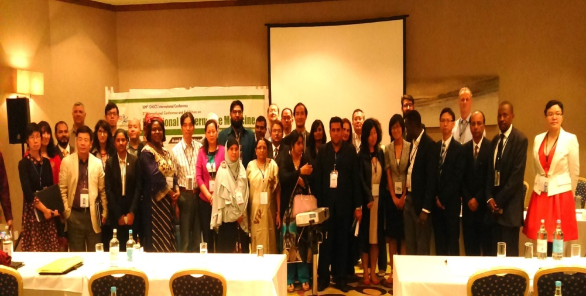
3rd International Conference and Exhibition on
Traditional & Alternative Medicine
August 03-05, 2015 Birmingham, UK
In Association with
Presented By
Name: Dr. Reem Issa
Country: Applied Science University, Amman , Jordan

Slide 2


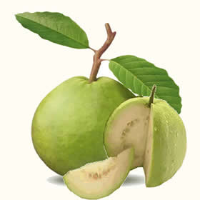
Screening different pharmacological activities of aqueous extract of Jordanian Psidium guajava unripe fruit peel using Microwave and Conventional Soxhlet Extraction Methods

Slide 3
Protocol
Two different methods for extraction were used; microwave and the conventional soxhlet extraction.
HPLC-MS\MS analysis for their phenolic content.
Followed by linking the phenolic content of each extract with the method of extraction used.
Evaluation of the hypoglycemic, hypolipidaemic, antioxidant and antimicrobial effects of the extracts.
Correlation between the pharmacological effects of each extract with their phenol compounds profile.

Slide 4
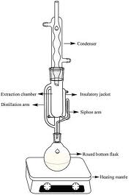
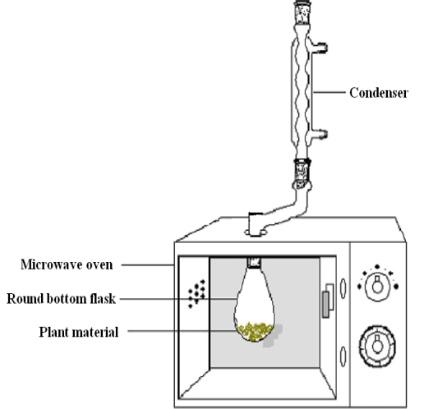
The effect of extraction method (CS and MIS) on the physical characterizations of PGFP extracts
Extract characters | CS method | MIS method
Wight of fresh plant material/ cycle | 30 g | 60 g
Extraction time | 8 hrs | 1 hr
Averaged percentage of yield | 4.8% | 2.5%
Extraction temperature | 90-100˚c | 78-88˚c
Lyophilized extract color | Caramel brown powder | Whit to ivory powder

Slide 5
A Comparative Evaluation Of Microwave and Conventional Soxhlet Extraction Methods for the Hypoglycemic and Hypolipidaemic Potential of Jordanian Psidium guajava Raw Fruit Peel Extracts
Reem Issa, Samar Khater, Maha Habash, Ghadah Al-Obeidi
Normal and streptozotocin induced, mild and severely diabetic rats were fed with variable doses of each extract (200 & 400 mg/kg) for 3 weeks in aim to evaluate each extract potential for hypoglycemic and hypolipidaemic effects

Slide 6
Treatment | % change in FBG | % change in Total cholesterol | % change in TG | % change in HDL | % change in Body Wt (g)
Control | 61.72 | 34.13 | 228.97 | 2.69 | -12.18
Glibenclamide (3 mg/kg) | -23.13 | 17.96 | -21.19 | 19.22 | -20.00
Microwave extract (200 mg/ kg ) | 2.43 | 4.72 | 27.77 | 18.40 | -25.62
Microwave extract (400 mg/ kg ) | -12.72 | -6.56 | -11.42 | 67.81 | -26.05
Soxhlet extract (200 mg/ kg ) | 51.03 | -21.10 | 89.41 | 39.25 | -15.67
Soxhlet extract (400 mg/ kg) | 31.30 | -20.39 | -9.99 | 8.21 | -16.18

Slide 7
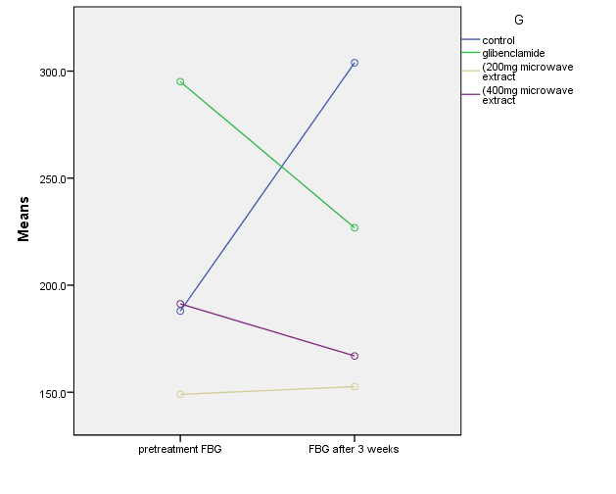
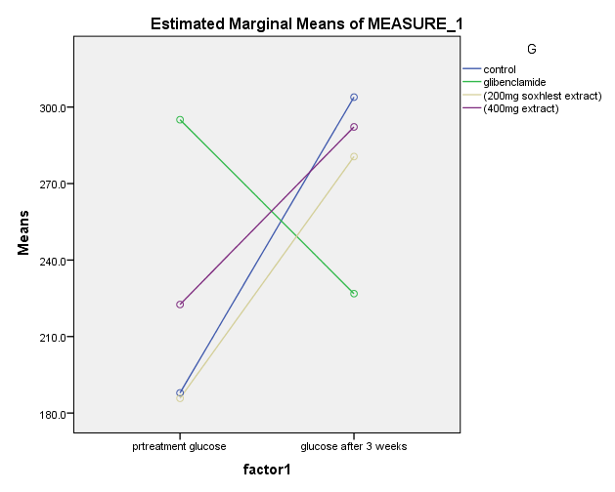
MIS extract
Chronic hypoglycemic effect
CS extract
Chronic hypoglycemic effect

Slide 8
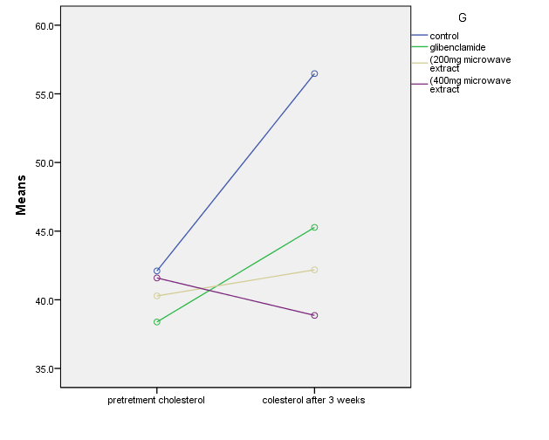
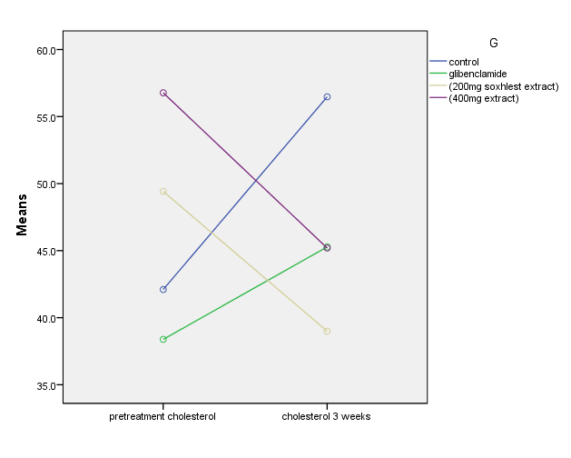
MIS extract
Total cholesterol effect
CS extract
Total cholesterol effect

Slide 9
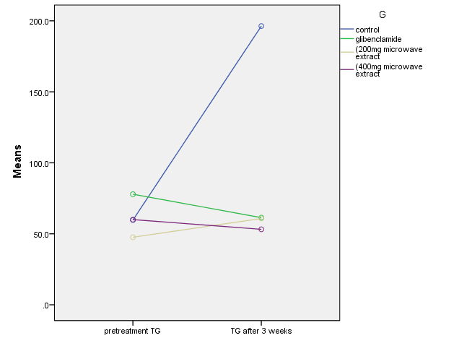
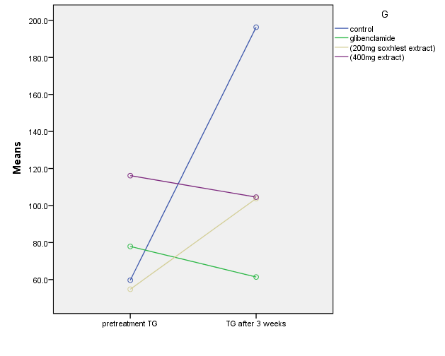
MIS extract
TG effect
CS extract
TG effect

Slide 10
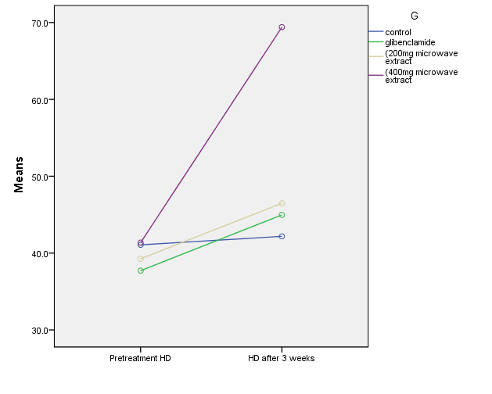
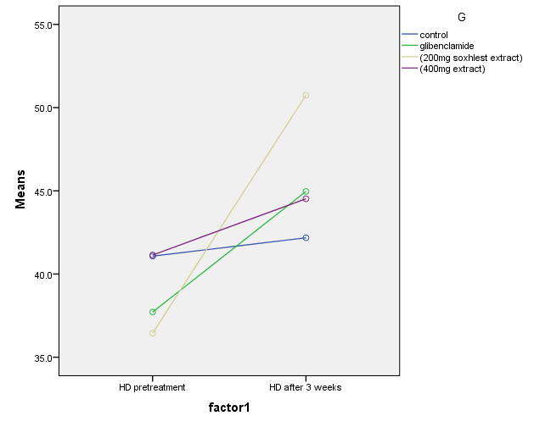
MIS extract
HD effect
CS extract
HD effect

Slide 11
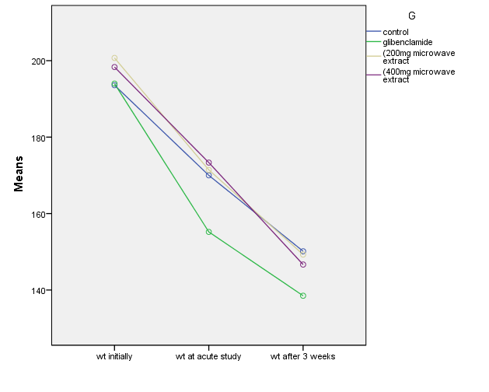
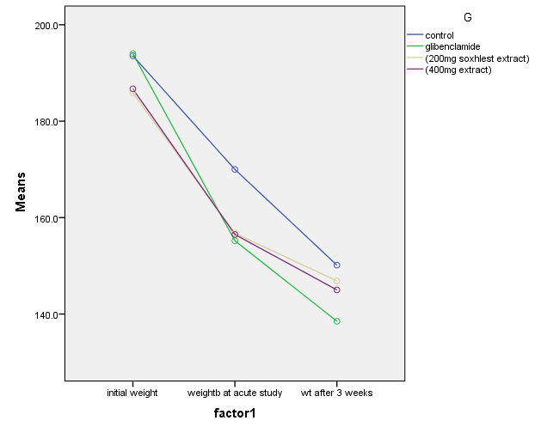
MIS extract
% Weight change
CS extract
% Weight change

Slide 12
Phytochemical investigation and antimicrobial activities of Psidium guajava extract using soxhlet and microwave extraction methods
Reem Issa, Wamidh H. Talib, Afaf Al Nadaf, Sajdah A. Salah
The minimum inhibitory concentration (MIC) of each extract against Escherichia coli, Staphylococcus aureus, Propioni bacterium acnes and Bacillus cereus, was determined using microtiter plate dilution method in comparison of the two types of extracts with the commercially available antibiotics

Slide 13
Microbial strains (MIC) |  |  |  | Test solution
B. cereus | P. acnes | S. aureus | E. coli
5 | 10 | 10 | 10 | MIS extract
10 | 20 | 10 | 20 | CS extract
0.07 | 0.20 | 0.35 | 0.25 | Penicillin G
0.07 | 0.15 | 0.15 | 0.15 | Tetracycline

Slide 14
Phytochemical investigation and antioxidant activities of Psidium guajava extract using soxhlet and microwave extraction methods
Reem Issa, Maha Habash, Dima Khater
Plant material | Method of extraction | IC 50 Antioxidant activity (mg dry extract /ml)
Premature guava peel | Soxhlet | 0.2970
 | Microwave | 0.3248

Slide 15
Comparison for the yield of each individual phenolic compound detected in the PGFP extracts using CS and MIS methods determined as (mg/ kg )of fresh weight of plant material.
Metabolites | CS (mg/ kg) | % mg/ total phenolic* | MIS (mg/ kg) | % mg/ total phenolic*
Ellagic acid | 12.1 | 30.86 | ND | ------
Gallic acid | 8 | 20.40 | 26.4 | 13.26
Quercetin | 2 | 5.10 | 0.7 | 0.35
P-Coumaric acid | 8.3 | 21.17 | 3 | 1.50
Ferulic acid | 7.2 | 18.36 | ND | -------
Ascorbic Acid | 1.6 | 4.08 | 169 | 84.88
Total phenolic | 39.2 | ------- | 199.1 | -----
*The % of each phenolic compound to the total sum of phenols in the extract

Slide 16
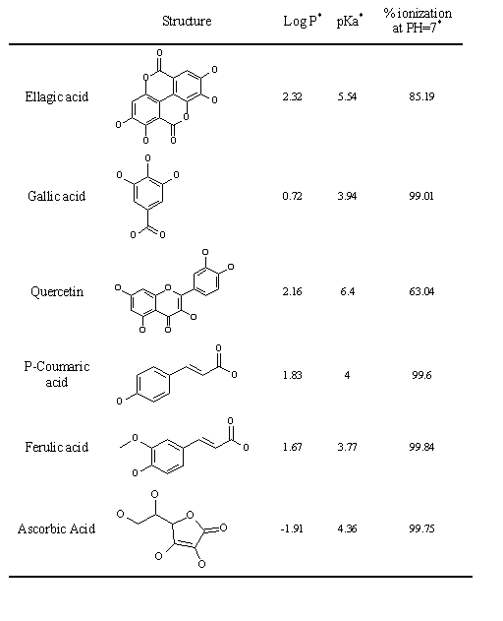
Correlation of the observed pharmacological effects of PGFP extracts with their phenolic content

Slide 17
Summery
As can be observed from the present data, Significant differences were observed between the two extracts.
The hypoglycemic, hypolipidaemic, antioxidant and antimicrobial activity does not necessarily correlate with high amounts of phenolics.
Therefore, it is why both the total phenolic content and the individual compounds activity information must be discussed when evaluating the pharmacological potential of extracts.
Optimization of the extraction method used is a critical parameter for evaluation of medicinal plants activities.

Slide 18
Acknowledgments
Applied Science University-Amman-Jordan for the fund
Dr. Wamid Taleb, Samar Khater, Dr. Maha Habash, Sajdah Salah, Ghada Al-Abidi, Dima khater at Faculty of pharmacy, Applied science university, Amman, Jordan

Slide 19


Slide 20


Meet the eminent gathering once again at
Traditional Medicine-2016
London, UK
October 03-05, 2016
Traditional Medicine-2016
Website: http://traditionalmedicine.conferenceseries.com/

