Slide 1
Short-Term Outcome of Balloon Angioplasty of Discrete Coarctation of Aorta
Reda Biomy
MD Cardiology

Slide 2
Introduction
Coarctation is a term derived from Latin which mean a drawing or pressing together; more precisely it refers to a narrowing of the lumen of a vessel producing an obstruction to flow. Considering the aortic artery; a localized segment of narrowing at the junction between the isthmus and the descending aorta is called coarctation, whereas a diffuse segment of narrowing is known as tubular hypoplasia. (Mueller et al.,2015)

Slide 3
Meckel originally noted coarctation on autopsy in 1750, Forty-four years after Paris provided the first accurate description of coarctation of the aorta in 1791, Legrand made the first diagnosis in a living patient in 1835. (Mueller et al.,2015)
It’s one of few anomalies that continue to generate more controversy regarding optimal management: whether to balloon dilate, stent the native coarctation or operate upon; which surgical technique to employ; optimal age at intervention and the role of balloons, conventional stents, covered stents and more recently bio-absorbable stents for native and recurrent coarctation

Slide 4
Aim of the work
The aim of this study is to assess the immediate and intermediate-term effectiveness and safety of balloon angioplasty in infants and children with native discrete coarctation of the aorta who are 10 years of age or less.

Slide 5
SUBJECTS AND METHODS
Study population:
Our study included 40 consecutive patients (8 infants and 32 children) with native discrete coarctation of the aorta referred for balloon angioplasty during a 2-years period from March 2013 to July 2015 at the National Heart Institute.

Slide 6
Inclusion criteria:
Patients studied were pooled in one group, all of them have:
native discrete aortic coarctation segment.
Age of 10 years or less.
Weight less than 35 Kg.
Exclusion criteria:
patients with the following criteria were excluded:
Previous aortic coarctation angioplasty or surgery.
Long aortic coarctation segment.
Severe aortic arch hypoplasia.
Associated abdominal aortic coarctation segment.
Associated complex cardiac anatomy.
Associated pathological extra cardiac syndromes.

Slide 7
All patients were subjected to the following:
Through history taking & Physical examination including:
Examination of the radial and femoral pulses.
Measurement of arterial blood pressure.
Cardiac examination
Conventional 12 leads ECG
Chest x-ray
Doppler echocardiography
Cardiac catheterization:

Slide 8
Follow-up:
All patients underwent periodic clinical evaluation immediately after and at 9 to 12 months and 18 to 24 months.
Follow-up data were collected consisting mainly of history taking, cardiovascular examination with special emphasis to measurement of upper and lower limb blood pressure; blood pressure was measured in the right arm and in the leg contralateral to the side used for angioplasty.
It’s one of few anomalies that continue to generate more controversy regarding optimal management: whether to balloon dilate, stent the native coarctation or operate upon; which surgical technique to employ; optimal age at intervention and the role of balloons, conventional stents, covered stents and more recently bio-absorbable stents for native and recurrent coarctation

Slide 9
Balloon angioplasty was considered successful when the coarctation diameter was significantly increased and the post dilatation pressure gradient was ≤20 mmHg measured by cuff sphygmomanometer, echocardiographic Doppler-derived peak pressure gradient or at repeat cardiac catheterization if needed, without formation of a significant aneurysm.

Slide 10
RESULTS
Our study was conducted on 40 patients having native discrete coarctation of the aorta. All patients were treated by balloon angioplasty in the pediatric cardiology department; National Heart Institute. Giza, Egypt, during the period from March 2013 to June 2015, all patients were pooled in one group.

Slide 11
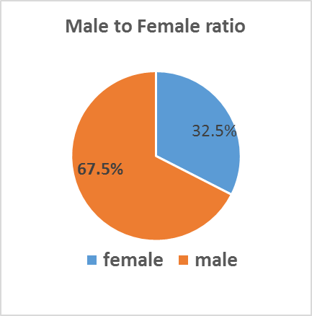
Patients characteristics
The study population were 13 females (32.5%) and 27 males (67.5%) children, their age ranges from 2 months to 10 years (3.6± 2.8),

Slide 12
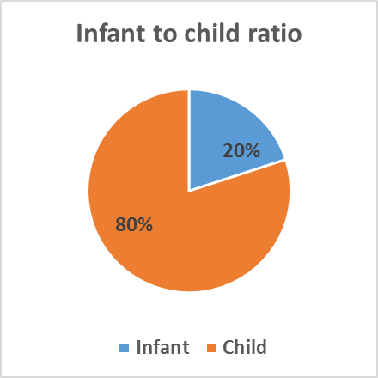
Only 8 patients (20%) in our study were infants -one year or less- their mean age in months was (7.8 ±4.3),

Slide 13
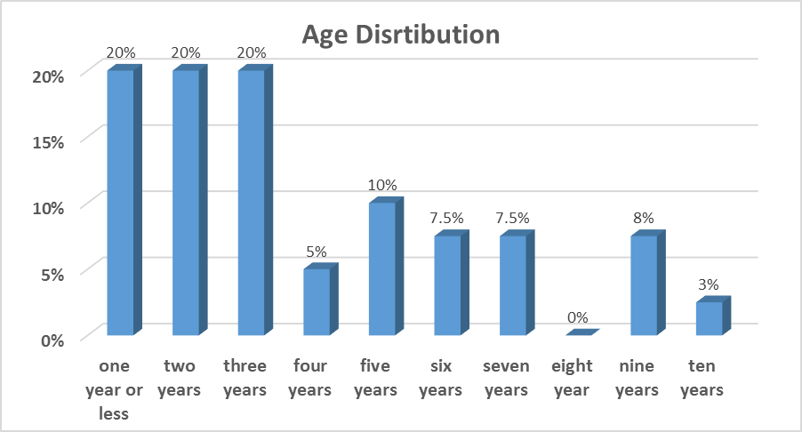

Slide 14
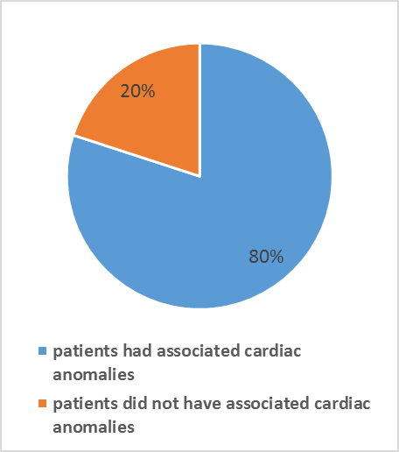
Associated anomalies
Of the 40 patients studied only 32 patients had associated cardiac anomalies (80%) while 8 patients did not have any associated cardiac anomalies (20%),

Slide 15
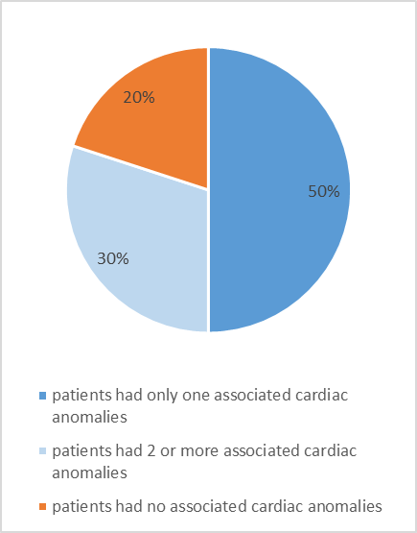
20 patients had only one associated cardiac anomalies (50%) while 12 patients had 2 or more associated cardiac anomalies (30%),

Slide 16
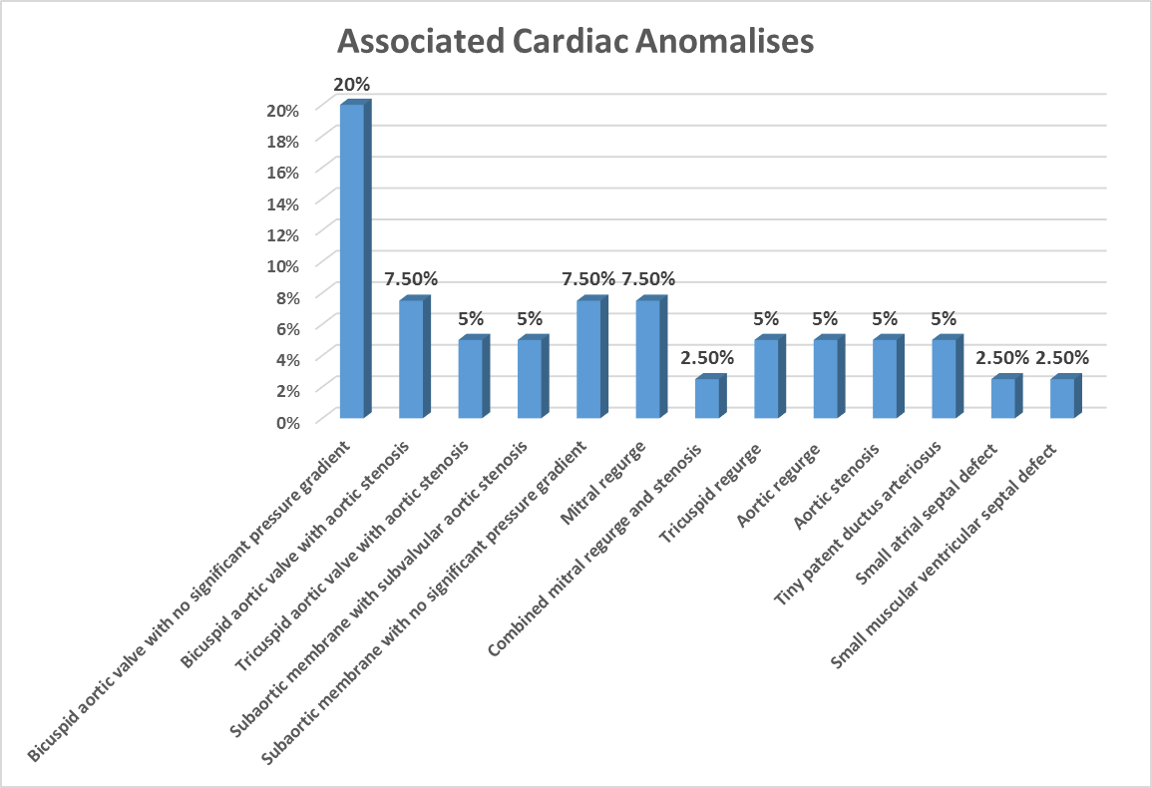

Slide 17
Procedure:
All the forty patients in our study (13 female and 27 male children) were submitted to balloon angioplasty for aortic coarctation. The balloon size used equal to or 1 mm smaller than the diameter of the aorta immediately distal to the origin of the subclavian artery, and not exceeding the diameter of the descending aorta at the level of the diaphragm
The balloon angioplasty of the coarcted segment was done in all patients. 8 patients (20%) needed another inflation with a larger balloon; inflation time didn’t exceed 10 seconds each. The balloon size ranged from 6 to 14 mm in diameter, inflation pressure never exceeded 5 atmospheric pressures

Slide 18
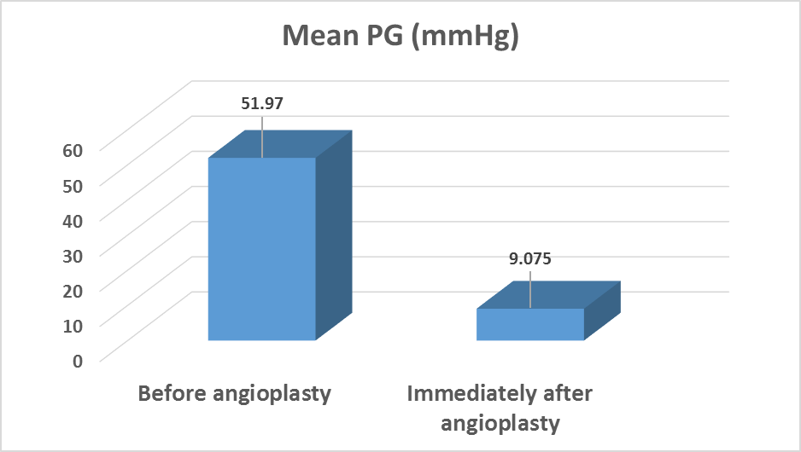
Immediate hemodynamic results

Slide 19
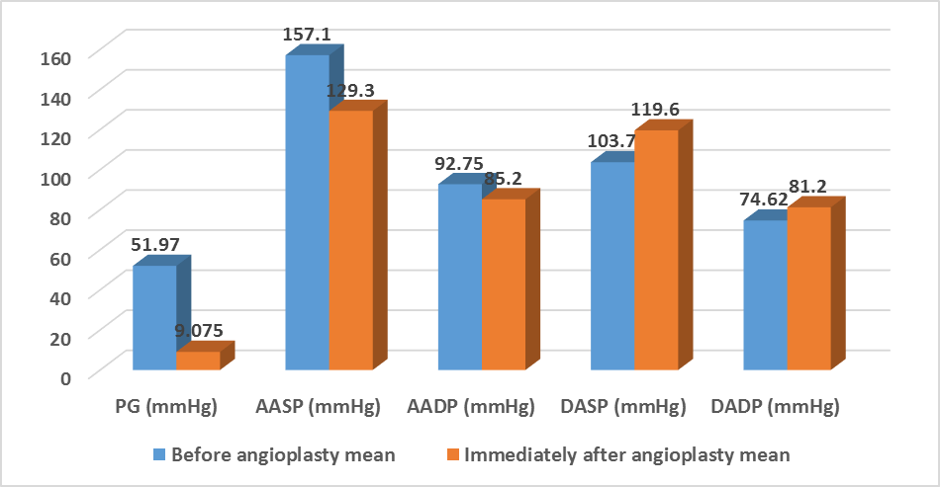

Slide 20
Thirty-seven angioplasty procedures were considered to be immediately successful in 92.5%
of patients. 3 patients (7.5%) had suboptimal immediate results with their recorded pressure gradient 25, 30,40 mmHg

Slide 21
Immediate angiographic results
The mean diameter of the coarcted segment doubled significantly from 0.439±0.16 to 0.87±0.16 cm; and the isthmic diameter also significantly increased from 0.91±0.18 to 0.96±0.18 cm
Immediately after balloon angioplasty small aneurysm appear in 2 patients ,the diameter of each didn’t exceed double diameter of the descending aorta

Slide 22
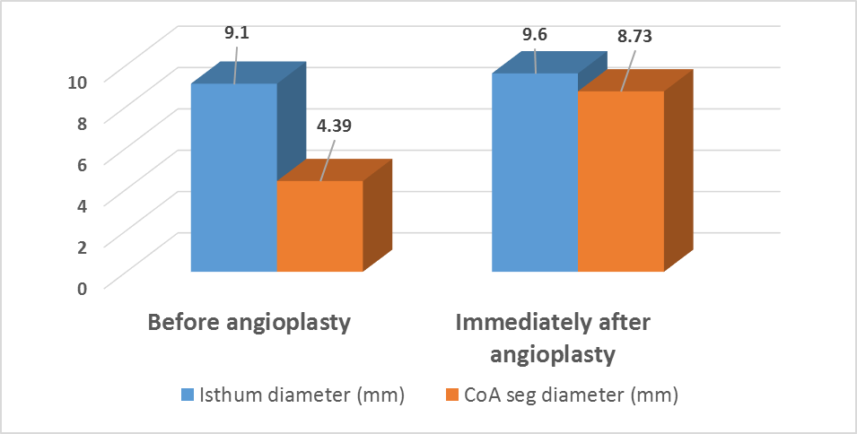

Slide 23
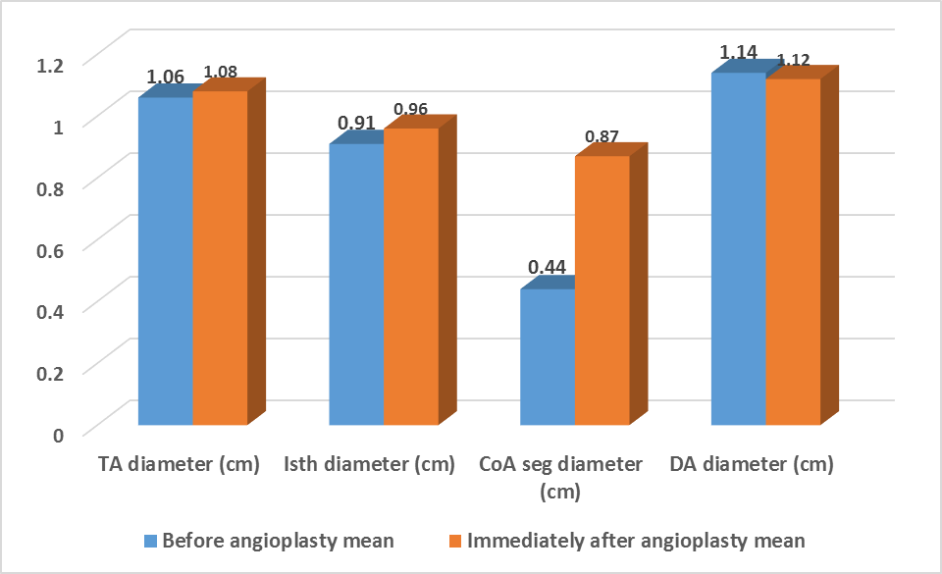

Slide 24
Follow up
Clinical follow-up could be done in all patients at 9 to12 months and 18 to 24 months’ periods following balloon angioplasty, no patients were lost during follow-up.
follow-up was done clinically and by echocardiography

Slide 25
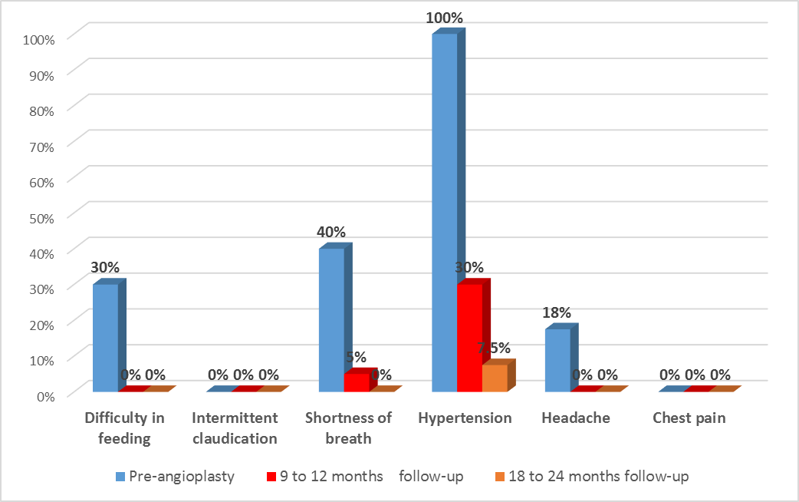
Progression of symptoms before angioplasty and during follow up periods.

Slide 26
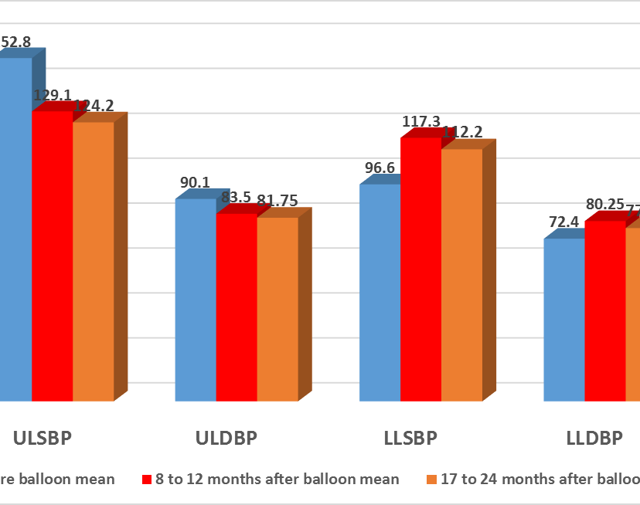
comparison between blood pressure measurement before angioplasty,9 to 12 and 18 to 24 months after the procedure

Slide 27
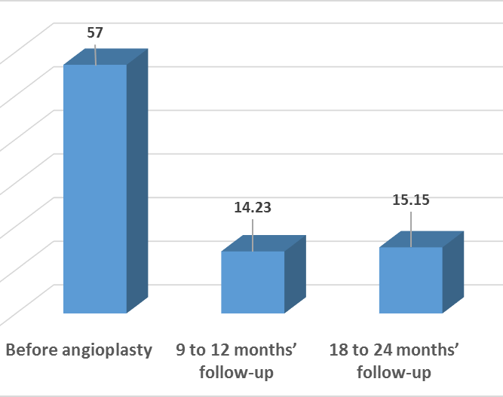
comparison between pressure gradient across the coarcted segment diameters before angioplasty, 9 to 12 months and 18 to 24 months follow up periods.

Slide 28
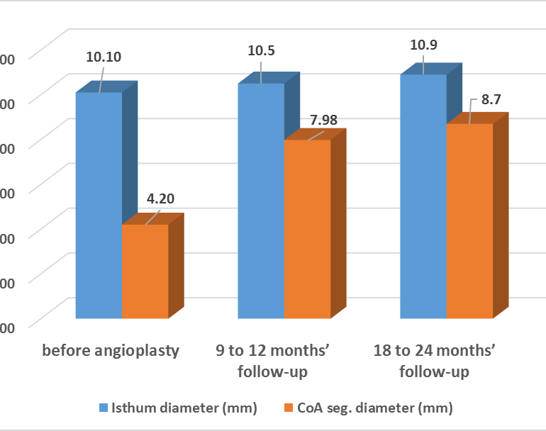
comparison between isthmus and coarcted segment diameters before angioplasty, 9 to 12 months and 18 to 24 months follow up periods.

Slide 29
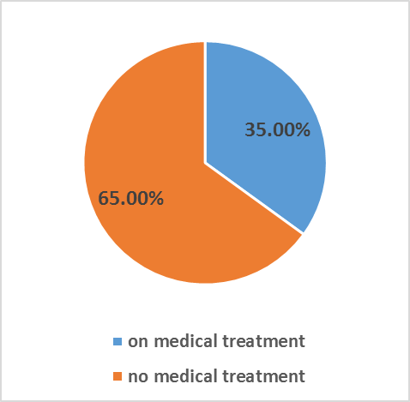
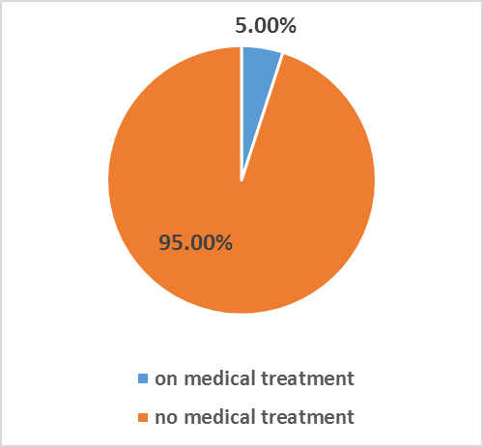
Medical treatment
Although all patients in our study were hypertensive for age; only 14 patients were on antihypertensive and/or antifailure medication
By the end of the study 95% (38/40) of patients were free of any medical treatment

Slide 30
Complications
There was no patient mortality related to the procedure within about 24 months following balloon angioplasty.
three patients (7.5%) (no.14, 20, 38) had reduced pulses in the catheterized leg, venous and arterial duplex was done confirming no significant arterial or venous occlusion and treated with low molecular weight heparin intravenously.
Blood loss requiring blood transfusion occurred in another three patients.

Slide 31
Early Failure
Three patients showed suboptimal initial procedure with a maximum systolic pressure gradient of more than 20 mmHg.
Re-catheterization and dilation was done for all the three patients; which was successful in both patients (no 16 & 27) and show some improvement in the pressure gradient in patient no. 31 but the resultant PG still above 20 mmHg so still considered suboptimal.
At 9 to 12 months’ follow-up period; the same patient was re-catheterized and dilated for the third time at 18 months’ follow-up and still the same pressure gradient is preserved with no improvement.

Slide 32
Aneurysm formation
Two patients (5%) (patients no. 4 and 12) had small aneurysms at the site of coarctation diagnosed by angiography immediately after balloon angioplasty. diameter of both didn’t exceed double the diameter of the descending aorta.
The first one remained stable during the follow-up period while the second patient was referred to surgery due to enlarging aneurysm and concomitant recoarctation.

Slide 33
Recoarctation
recoarctation incidence reached 17.5% in the whole studied population (7/40 patients) (no.3,6,12,24,32,34,39) about the end of the 1st year follow-up, but it was up to 25% among infants aged one year or less (2/8 patients) (no.32,39)., while all the patients who had recoarctation were less than 6 years of age.
All the 7 children (6 of them were male children) had successfully repeated angioplasty with post dilatation gradient ranging from 0 to 10 mmHg and 3 of them maintained no clinical evidence of restenosis during their second follow-up period.
during their second follow-up period(no.6,24,39).
While 4 patients (10%) (no.3,12,32) developed evidence of restenosis during their second follow-up period including one infant 12.5%(1/8 infants at time of 1st intervention)

Slide 34
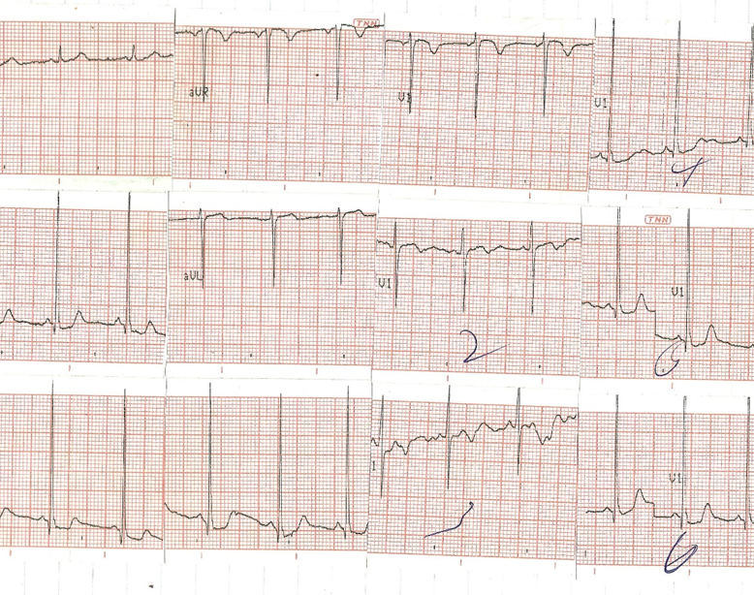
12 lead ECG showing left ventricular hypertrophy with strain pattern (9 years old female patient; no.35).

Slide 35
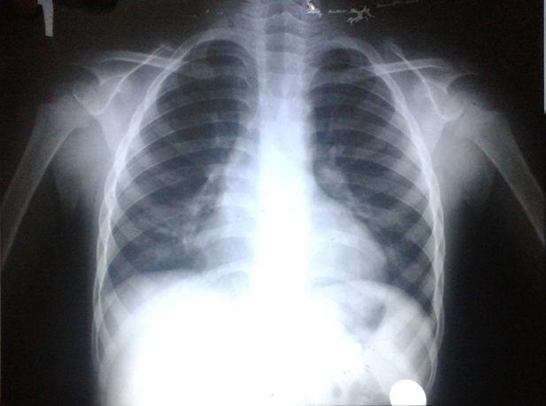
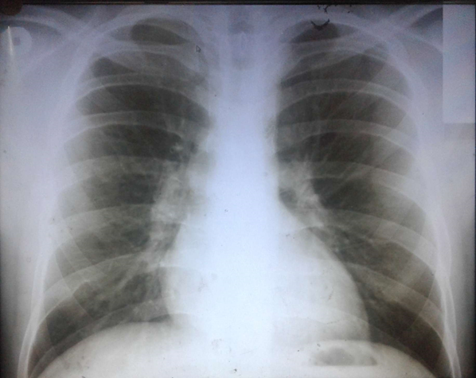
chest X-ray, PA view in patient no.27(6 years old male) with no specific signs Compared with chest X-ray of 25 years’ patient with aortic coarctation (not included in our study) showing bilateral rib erosion.

Slide 36
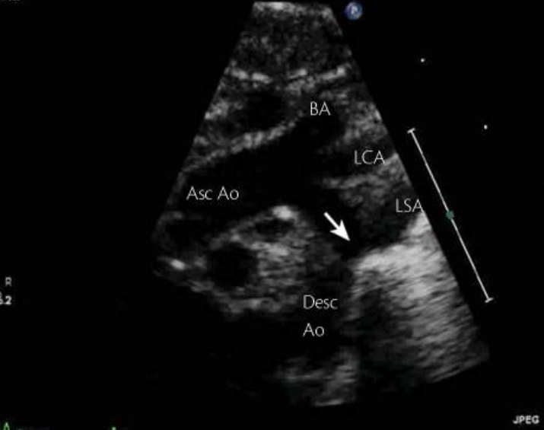
2D suprasternal image showing coarctation of aorta.
(9 years old female patient; no.35)

Slide 37
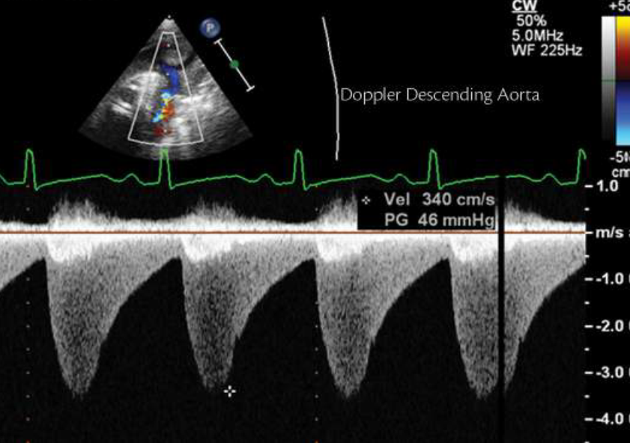
Continuous wave Doppler through the coarctation segment. The typical ‘saw-tooth’ pattern is identified with the typical diastolic run-off. (9 years old female patient; no.35)

Slide 38
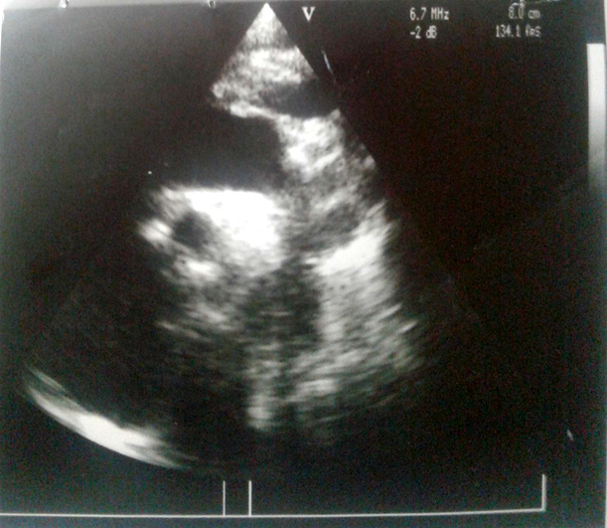
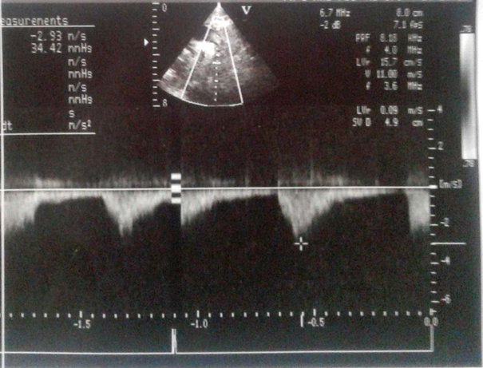
echocardiography 9 months after balloon angioplasty in 18 months old male patient (no.36) Up: 2D suprasternal image showing coarctation of aorta; Down: continuous wave Doppler through the coarctation segment with no significant Pg recorded.

Slide 39
Study Limitations
The limited number of subjects and the limited percentage of infant subgroup were the main limitations of this work.

Slide 40
CONCLUSION
From our present study; it’s to be concluded that percutaneous balloon angioplasty is valuable in treatment of infants above the age of 2 months and children10 years of age or younger diagnosed as having native discrete aortic coarctation.

Slide 41
RECOMMENDATIONS
our study recommends balloon angioplasty as an effective and safe alternative to surgery for treatment of aortic coarctation in infants older than 2 months and children10 years of age or younger; taking into consideration the clinical presentation and the patient age.

Slide 42


