Slide 1

Biosimilars: Accelerating Early Clinical Development
Raymond A. Huml, MS, DVM, RAC
Vice President
QuintilesIMS Biosimilars Center of Excellence
10 August 2017
Asian Biosimilars 2017
Radisson Blu Hotel
August 10, 2017 (Day 1)
Keynote Presentation at 11:50AM

Slide 2
Disclaimer
The views and opinions expressed in the following PowerPoint slides are those of the individual presenter(s) and should not be attributed to QuintilesIMS, its directors, officers, employees, volunteers, members, chapters, councils, Special Interest Area Communities or affiliates, or any organization with which the presenter is employed or affiliated.
These PowerPoint slides are the intellectual property of the individual presenter and are protected under the copyright laws of the United States of America and other countries. Used by permission. All rights reserved. QuintilesIMS, QuintilesIMS logo are registered trademarks or trademarks of QuintilesIMS. All other trademarks are the property of their respective owners.

Slide 3
Agenda
This presentation will discuss how early clinical development with biosimilars is key to later development and registration success. The presenter will describe a model for accelerated development that has been successfully used by a global leader in healthcare intelligence.
Ideal Phase I Site Characteristics
Biosimilars Experience and Next Generation Clinical Development
Why a Phase I Multi-site Approach May Be Needed
Regional Advantages
Accelerated Phase I/III Approach and Case Study
Key Aspects of the Overall Phase III Country Selection Strategy

Slide 4
Characteristics of Phase I Biosimilar Studies
These are the first clinical trials, testing the biosimilar in humans.
For U.S. products, these take place after the Investigational New Drug application (IND) is submitted.
Large numbers of healthy volunteers (HVs) are required due to high inter- and intra-subject variability.
Primary objective is to determine whether the biosimilar has a similar pharmacokinetic profile and, if applicable, a similar pharmacodynamic response, to the reference product.
Small sentinel cohorts are dosed first to mitigate the risk of potential untoward immunogenic safety events.
Due to the large number of subjects, a multi-site approach can be useful.

Slide 5
Drivers for a Successful Phase I Biosimilar Study
Large population center
  Sites need to enroll ~200 HVs
Cost location
  Low reimbursement for HVs
  Low investigator fees
Commercial considerations
  A history of conducting Phase I trials
  Current, competitive Phase I trials
Bed capacity
  Large sample size and tight timelines
  Ability to dose large groups
Good medical infrastructure
  Most Phase I trials are “first-in-human”
Strong transportation network
  Long clinical duration requiring multiple ambulatory visits with time sensitive PK draws
Regulatory environment
  Speed of Ethical Review Boards
  Timeline for regulatory approval – parallel and not sequential
Experience in conducting Phase I FIH and regulatory trials
  Demonstrating commitment to subject safety, clinical quality and data integrity
Identify and Choose the Right Site/s

Slide 6
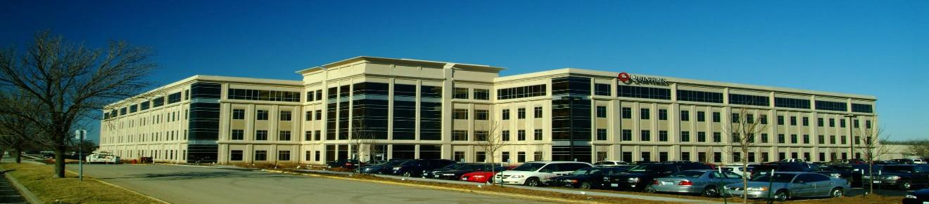
Overland Park, Kansas
Flagship Clinical Pharmacology Unit
Committed to early clinical stage biosimilar drug development
Remodelled to accommodate large throughput at screening and large cohort sizes
On-site laboratory
Local medical specialists and consultants

Slide 7
Drivers for a Successful Phase I Biosimilar Study
Short start-up timelines
  The market for biosimilars is very competitive
Sound recruitment strategy
  Invest proactively in recruitment strategy
  Need to fill large group sizes quickly
  No time to make up for a shortfall of volunteers
Sound retention strategy
  Need to keep the volunteers engaged and committed for 2+ months
Trained CRAs
  Vast amount of data generated quickly by sites
  The data will form part of the submission – must be of high quality
Ability to identify and minimize variability
  Small differences in sample draw techniques and dosing techniques among site staff and between sites raises risk of not achieving the primary objective
  Natural variability amongst biologics makes it important to minimize other sources of variability
Operational Excellence is Required for Superior Delivery

Slide 8
Considerations with a Multi-Site Approach
Timely recruitment of HVs is critical.
The entire biosimilar development program must be kept in mind when determining the Phase I strategy – especially with accelerated approaches.
Partnerships with companies that have access to global delivery models is recommended, taking into account patient demographics, speed of regulatory approval, and the quality and cost associated with each site.
Western sites are typically high quality, but also high cost.
Options that employ high quality with lower cost should be considered (e.g., Central Europe or SE Asia).

Slide 9
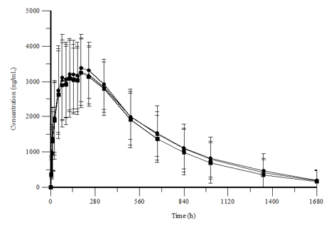
Ways to Minimize Between-Site Variability
Carry out a review of Standardized Operating Procedures (SOPs) across sites to identify and harmonize key procedures.
  Use standardized cross-training programs for investigators to ensure uniform practices in drug administration and study conduct.
Employ focused training for the site’s operational teams.
  Utilize sites that can use the same SOPs.
  The graph below demonstrates the quality of data we have been able to achieve.
PK curve for Test Product, US reference, EU reference for a 2-site biosimilar study successfully completed

Slide 10
Notes:
Jochen

Slide 11
Accelerated Phase I/III Trial Solution:
The Paradigm
Goal: Reducing time to Phase III initiation
CTA/IMP
or IND
Regulatory Submission
Phase I
Interim Safety Data to initiate Phase III earlier
Phase III
Phase I Accelerators
Multi-site delivery solution
Pre-planning for the interim safety data analysis
Upfront planning for Phase III patient recruitment

Slide 12
An Accelerated Approach to Phase III
It is possible to initiate the Phase III (confirmatory safety and efficacy trial) prior to completion of the Phase I comparability trial.
  This approach is based on interim safety data.
  This may not be acceptable in all countries.
A feasibility study is needed to ensure that key countries will accept interim safety data to initiate the Phase III study.
The biggest risk is that if the CMC package is not robust, the Phase III trial may be initiated without adequate PK (or PD) data.
  A thorough review and gap analysis of CMC data is recommended prior to conducting accelerated biosimilar clinical trials.

Slide 13
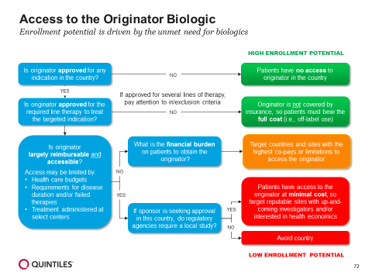
Overall Country Selection for Biosimilar Trials
Data points supporting country selection for biosimilar trials
Traditional Considerations
Regulatory Considerations
Competition
and Access
Start-up timelines
Incidence/prevalence
Randomization rate
Indication experience
Competition from novel drug trials
Acceptance of interim Phase I data to begin Phase III trial
Inclusion of patient population if seeking registration in a country
IP sourcing
Requirement for sponsors to provide combination drug
Access to safer or more effective therapies than the originator biologic (approved or investigational)
Competition from other biosimilar trials
Access to the originator biologic
>20
biosimilar feasibility studies
7 biologics
11 indications
(2011-2015)
Developed an optimized process to evaluate each country’s enrollment potential based on patients’ access to the originator biologic

Slide 14
Case Study − Phase I Timeline Acceleration
Transition from Phase I to Phase III in psoriasis patient population
Challenges | Solutions | Outcomes
Complete three-arm Phase I study with large numbers of healthy volunteers (HV) and start Phase III comparison as soon as possible
Confirmed similarity of CMC/nonclinical comparability data
Proposed starting Phase III based on interim safety data from Phase I
Built in strategy for interim safety report preparation and submission
Obtained agreement from regulatory authorities
9
months
earlier
Phase III comparison started 9 months earlier than would have been possible if all volunteers had been required to complete the Phase I study prior to initiation of the Phase III study

Slide 15
Delivering Biosimilar Trials with Confidence
March 2017
18 biosimilar compounds
abatacept, adalimumab, bevacizumab, cetuximab, darbepoetin, erythropoetin, etanercept, GCSF, infliximab, interferon beta, peg-GCSF, ranibizumab, short- and long-acting recombinant insulins, rituximab, teriparatide, tocilizumab, trastuzumab
CMC gap analyses
and planning
11 biosimilar compounds
52 phase I/III trials
18 Rheumatology
12 Oncology
9 Hematology
4 Dermatology
3 Endocrinology
2 Nephrology
4 Other
FDA/EMA regulatory meetings
13 biosimilar compounds
Clinical development planning
11 biosimilar compounds

Slide 16
Next Generation Clinical Development
QuintilesIMS
CONFIDENTIAL

Slide 17
Essential Secondary Data Sources to Support Biosimilar Trials
For country selection and protocol validation:
Electronic Medical Records (EMR) data which can produce:
  Patient counts with a specific diagnosis
  Filtered by age, gender
  With or without prior specific treatment
    e.g. patients diagnosed with RA with prior treatment with cDMARDs, but no biologic
For site selection:
Several data sources can be leveraged to produce heat maps and a list of sites with a high number of patients of interest
  Medical claims data
  Longitudinal prescription data
  Hospital encounter data
In the U.S., one can further identify potential investigators with many patients of interest who have a large out-of-pocket expense, and who might be eager to participate in a biosimilar trial

Slide 18
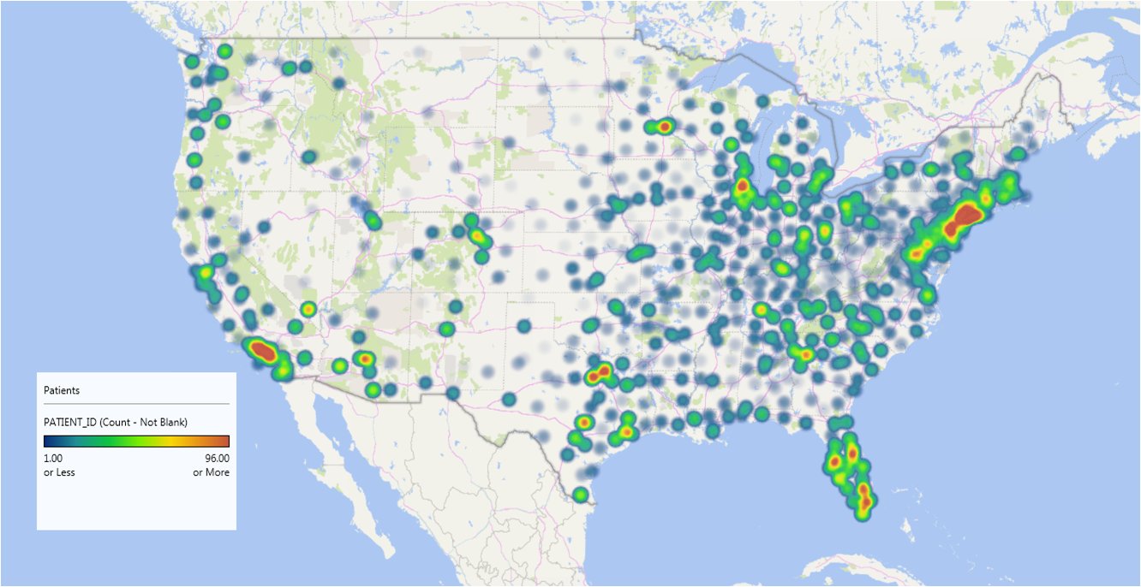
Example: Heat Map of Patients with Psoriasis Not Yet Treated with Biologics - with High Out of Pocket Copays
Illustrative

Slide 19
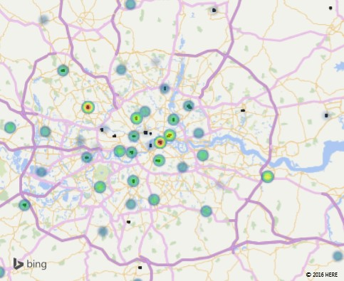
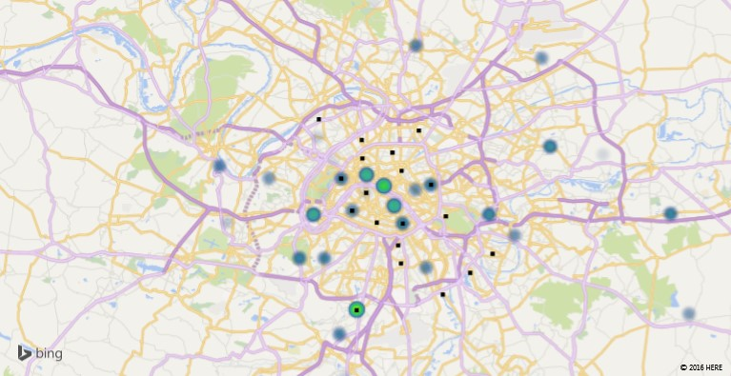
Investigator Heat Maps – Ex-U.S.
Ulcerative Colitis Patient Concentrations in London and Paris
London Heat Map
HPA GI Wards and OneKEY
GI Clinicians Affiliated with Hospitals
Paris Heat Map
PMSI Patient Attrition at hospital Discharge
Overlaid with QuintilesIMS GI Investigators
Data leveraged: Ward-level hospital consumption data
Data leveraged: Hospital discharge data

Slide 20
Summary
A properly set up Phase I biosimilar program is critical to the success of the Phase III biosimilars program - as well as for registration success.
Experience is important for success when conducting early biosimilar drug development programs.
  Phase I trials for biosimilars are typically large (100-300+ HVs), so it is best to work with an extensive network of partner sites.
Feasibility is different between Phase I and Phase III biosimilar programs. With the exception of rituximab biosimilars, all Phase I biosimilar programs for Western registration are conducted in HVs.
A Phase I/Phase III accelerated approach may be appropriate for certain biosimilars. If successfully implemented, this can save both time and money.
Secondary data sources can be helpful identifying patients for Phase III biosimilar trials.

Slide 21
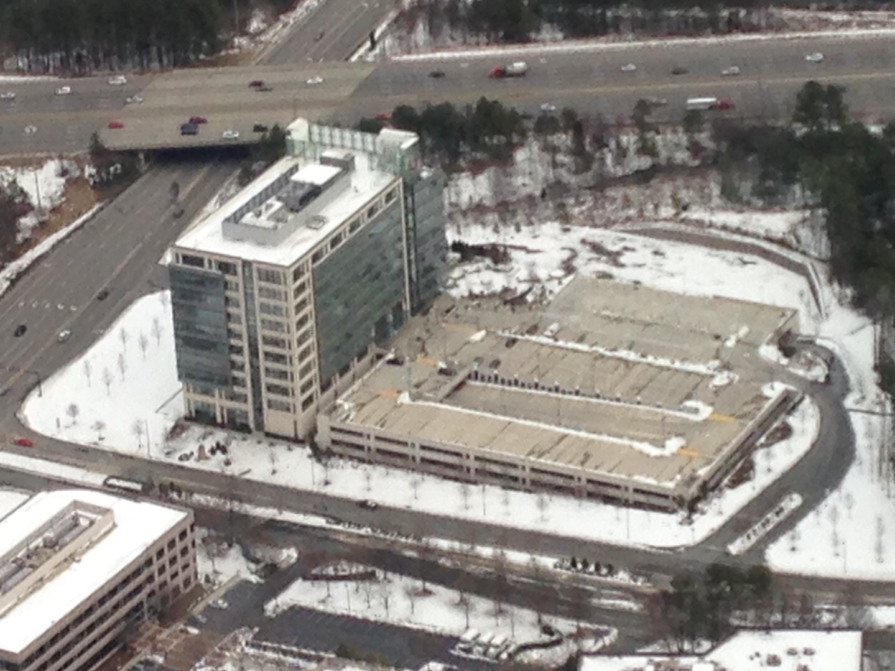

Questions?

Slide 22
QuintilesIMS Biosimilars Resources

Slide 23
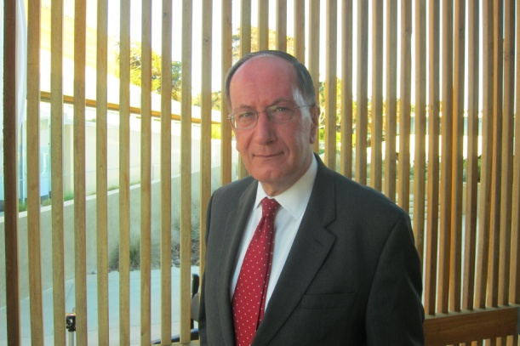
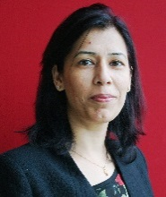
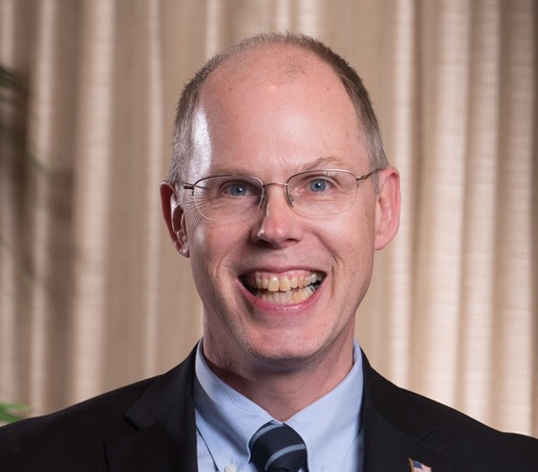
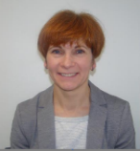
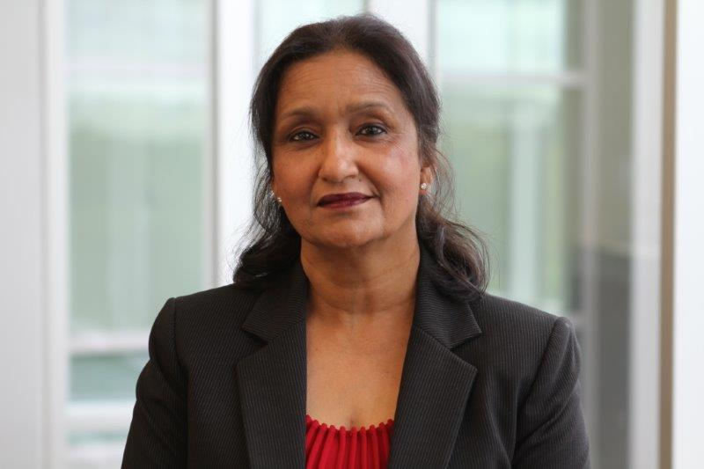
QuintilesIMS Biosimilars Center of Excellence
Nigel Rulewski, MD
Vice President
Head of Biosimilars COE
Clinical Development Planning
Charu Manaktala, MD
Senior Director
Head, Asia Pacific Biosimilars COE
Raymond Huml, MS, DVM, RAC
Vice President
Head, Biosimilars Strategic Planning
Oxana Iliach, PhD
Senior Director
Global Biosimilars Regulatory Strategy and CMC
Kamali Chance, MPH, PhD, RAC
Vice President
Head, Global Biosimilars Regulatory Strategy
Members of the Biosimilars Center of Excellence are dedicated to supporting clinical trial delivery.

Slide 24
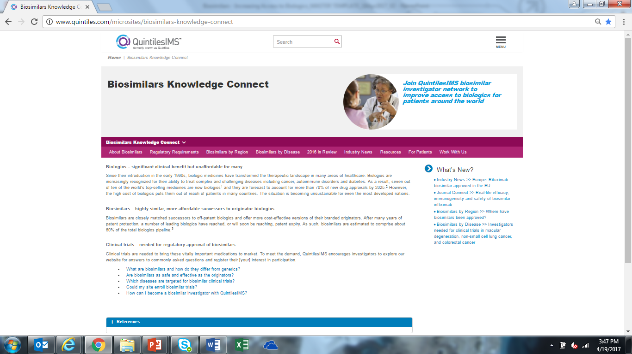
Learn more…
Bookmark our website
BiosimilarsKnowledgeConnect.com
A special thanks to Laura Wilbraham, from QuintilesIMS Early Clinical Development group, and Michel Denarié,
from QuintilesIMS Analytics Center of Excellence, who assisted with some of the slides.

