Slide 1

Fordyce Spots of the lips Treated with Isotretinoin: Case Report
Rawan K AlMesned
Medical Intern
King Saud University
Collage of Medicine

Slide 2
Introduction
Definition: Fordyce spots are enlarged sebaceous glands commonly found on the vermilion boarder of the lips and oral mucosa, they may occur on other body surfaces, including penis, labia, and esophagus
Clinical Presentation: They present as asymptomatic multiple whitish or yellowish papules of 0.1mm to 1mm in diameter
Epidemiology: Their frequency increases with age, especially after hormonal stimulation during puberty
Despite Fordyce spots benign nature patients seek treatment for cosmetic reasons

Slide 3
Case 1
Personal History: 50 years old Saudi lady
Chief Complaint: Presented to the clinic complaining of whitish spots over the upper lip that progress slowly over years
She was bothered because of alternation of her natural lip color
She denies using any topical nor systematic treatment
Examination: Whitish to yellowish papules at the upper lips

Slide 4
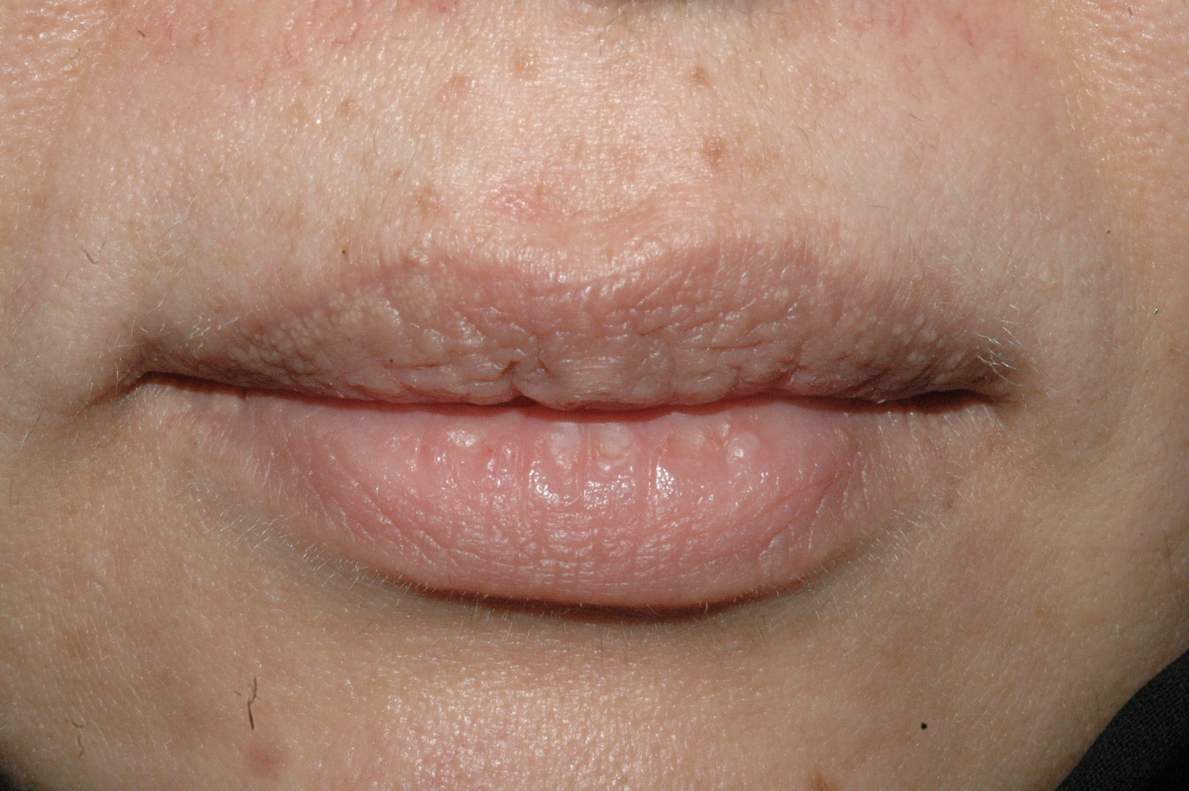
Case 1

Slide 5
Case 1
Treatment: We started her on low dose of isotretinoin 20 mg/daily for three months with approximately 50% fading of the spot in term of color and size
Because of her high cholesterol level even before starting isotretinoin, the dose decrease to every other day over 6 months with almost 90% fading of lesions
Follow up: We followed her at the clinic for 2 years without any recurrence of the lesion

Slide 6
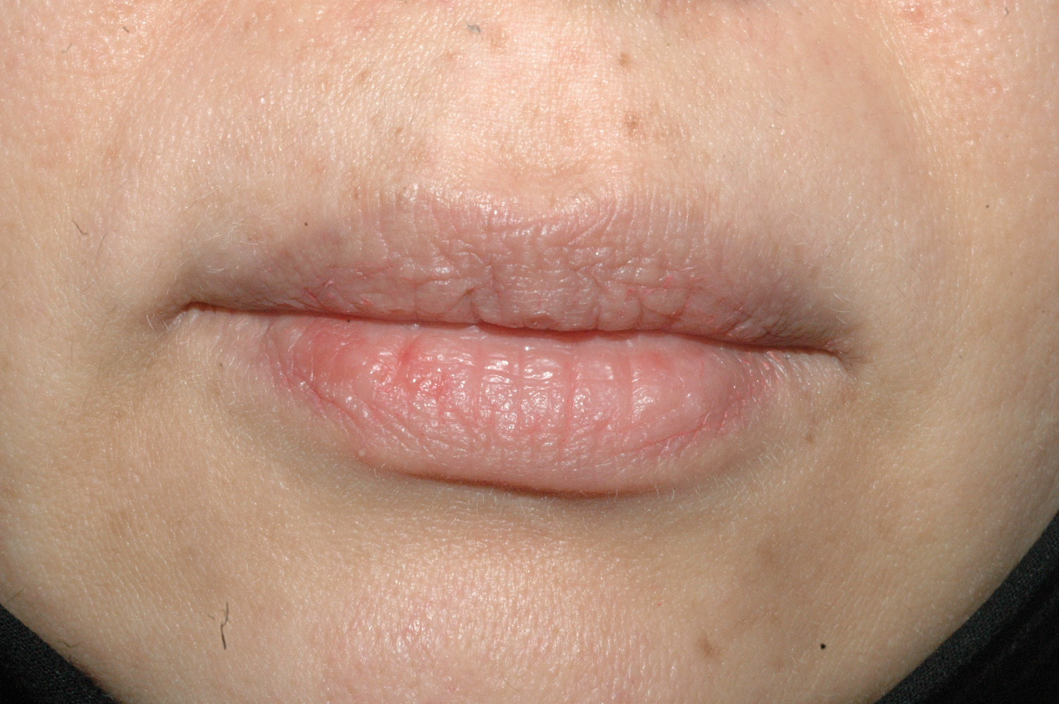
Case 1

Slide 7
Case 2
Personal History: 47 years old Saudi lady
Chief Complaint: Presented to clinic complaining of whitish discoloration of her lips mainly the upper one. It was progressive in nature over years
She was treated by general practitioner as a case of vitiligo with topical cream that did not show any difference
Examination: Both upper and lower lips showed adherence whitish tiny papules classical of Fordyce spots that may mimic vitiligo for none dermatologist

Slide 8
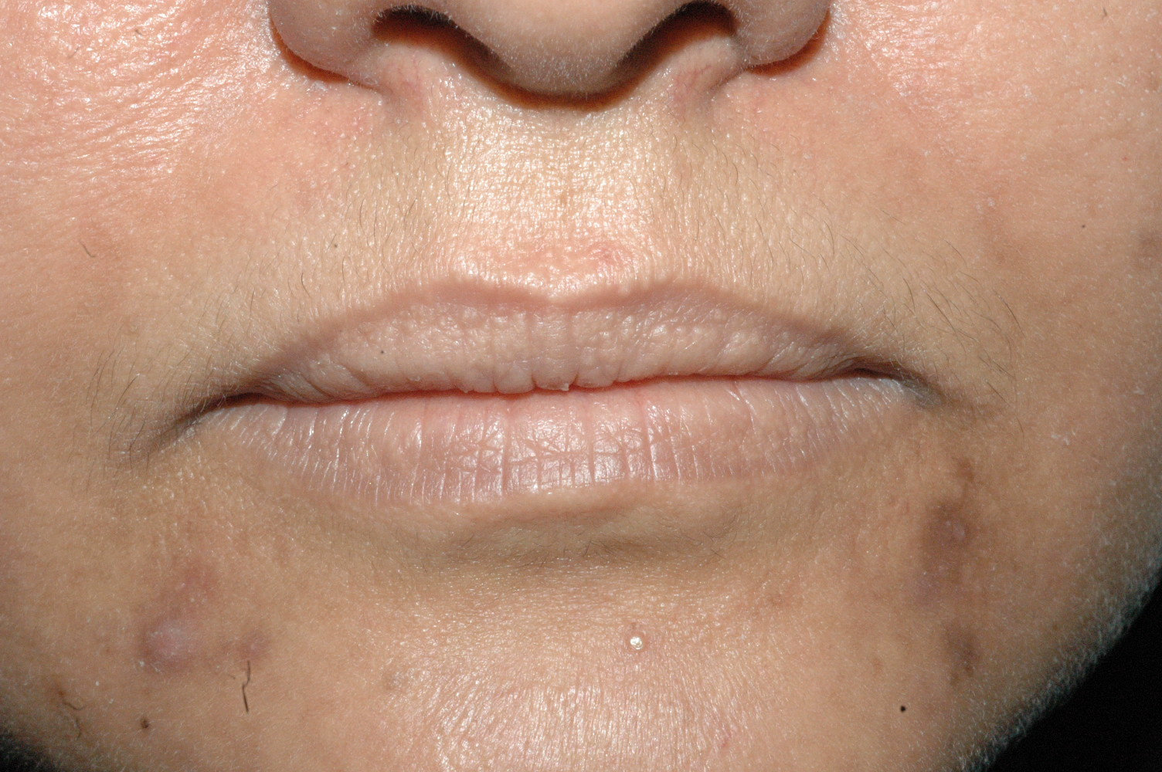
Case 2

Slide 9
Case 2
Treatment: We started her on low dose of isotretinoin 20 mg/daily for three months, which improvement in term of the size of the spots but not much in color
Then Isotretinoin was tapered every other day for another 6 months with same does
Follow up: We followed her at the clinic for 3 years without any progression

Slide 10
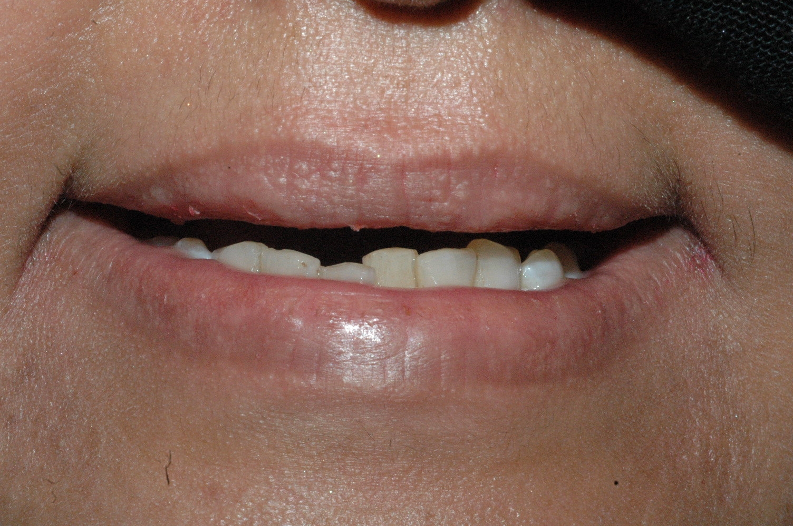
Case 2

Slide 11
Discussion
We observed that our patients were able to stop isotretinoin without recurrence of the lesion, Since isotretinoin causes an atrophy of the sebaceous glands
Reported cases in literature:
The first case report prescribed oral isotretinoin for Fordyce spots, the patient started with 0.5mg/kg per day. On 4 weeks the lesion cleared and Isotretinoin stopped after 10 weeks but lesion repapered 9 weeks after stopping the treatment
Fordyce spots disappeared within 2 weeks of starting isotretinoin at 0.48 mg/kg daily. After 1 month of discontinuing isotretinoin the lesion repapered
The last reported case, the lesion cleared within the first 6 months and the patient remind free of Fordyce spot after completing 12 months course of isotretinoin. The patient described in this report was treated with 0.75 mg/kg daily

Slide 12
Conclusion
Low dose of Isotretinoin shows significant respond in treating Fordyce Spots without recurrence in the absence of other treatment modalities

Slide 13
References
. Elston DM,Meffert J. Photo quiz. What is your diagnosis? Fordyce spots. Cutis 2001;68:24, 49
Plotner AN, Brodell RT. Treatment of Fordyce spots with bichloracetic acid. Dermatol Surg 2008;34:397–399; discussion 399
Monk BE. Fordyce spots responding to isotretinoin therapy. Br J Dermatol.1993;129(3):355
Mutizwa MM, Berk DR. Dichotomous long-term response to isotretinoin In two patients with fordyce spots. Pediatr Dermatol 2014;31(1):73-5
DalzielK, Barton S,Marks R. The effects of isotretinoin on follicular and sebaceous gland differentiation. Br Jdermatol 1987;117:317–323

Slide 14
Thank You..

