Slide 1


Effect of harvest and post-harvest processing methods on quality of bêche-de-mer in Fiji Islands
Ravinesh Ram¹, Roveena Vandana Chand² and Paul C. Southgate¹
School of Marine and Tropical Biology, Faculty of Science and Engineering, James Cook University, Townsville, Australia
School of Biological and Chemical Sciences, Faculty of Science Technology and Environment, University of the South Pacific, Suva, Fiji Islands

Slide 2
Introduction
Sea cucumber a delicacy for Asians
Harvested in Fiji for over 2 centuries
Sea cucumbers are nutritionally rich in protein (43%), minerals (21%), fatty acids (5-61%).
Has a number of health benefits and serve as a tonic and traditional remedy for hypertension, asthma, rheumatism, cuts and burns, impotence and constipations.
Sea cucumber in perishable state processed to a dry form known as bêche-de-mer.
Simple processing – boiling and drying stages

Slide 3

Location of study site
Source: http://www.taveunidive.com/sg_userfiles/world_according_to_Fiji_Map.png

Slide 4
Materials and Methods
Data collected through formal and informal interviews with the fishers (n=86), middleperson (n=8), and the bêche-de-mer exporters (n=5) (Chinese nationals).
Data analysed using SPSS statistical software by the method of Logistic regression and Hosmer and Lemeshow test.

Slide 5
Results and Discussion
Sea cucumber processing technique used in Fiji Islands

Slide 6
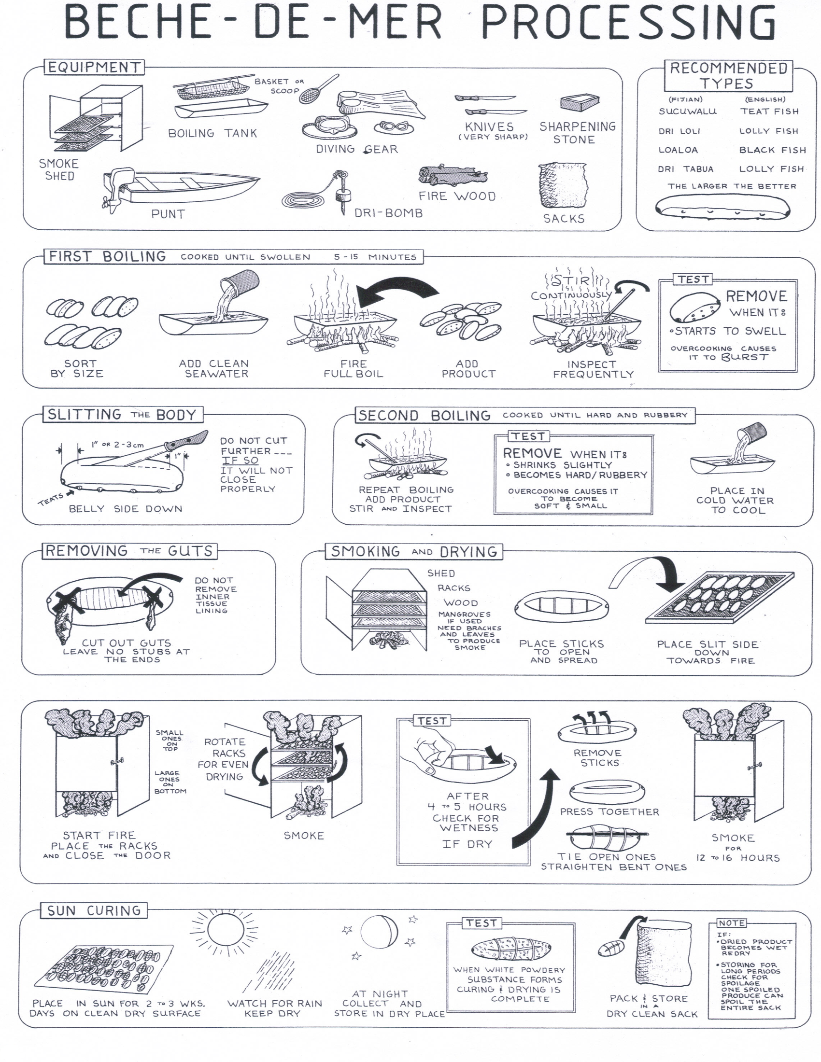

Slide 7
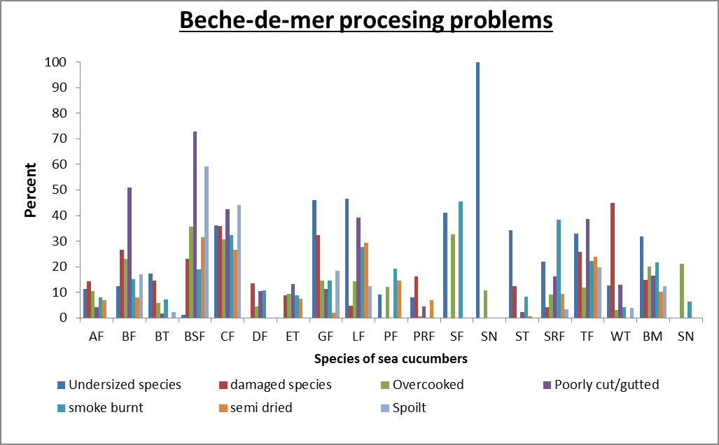
first cook, cutting and gutting, smoke drying (P < 0.04; P < 0.05)

Slide 8
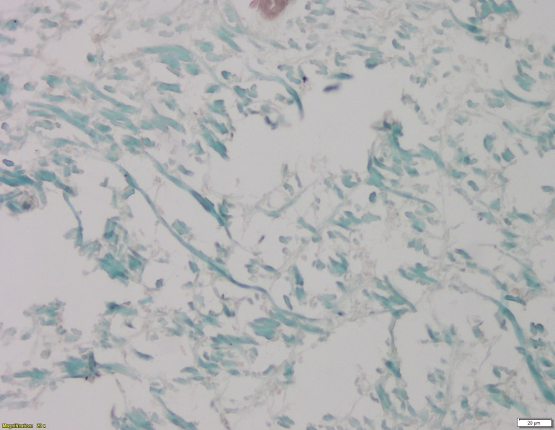
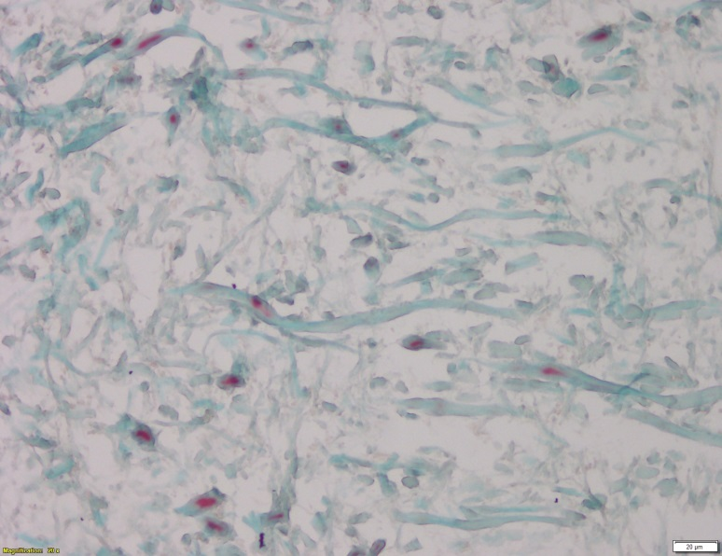
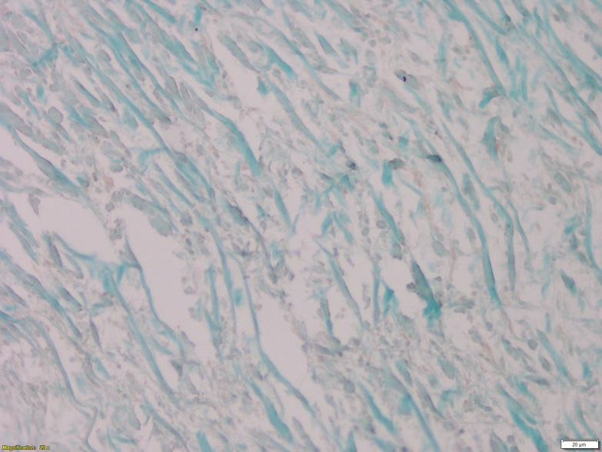
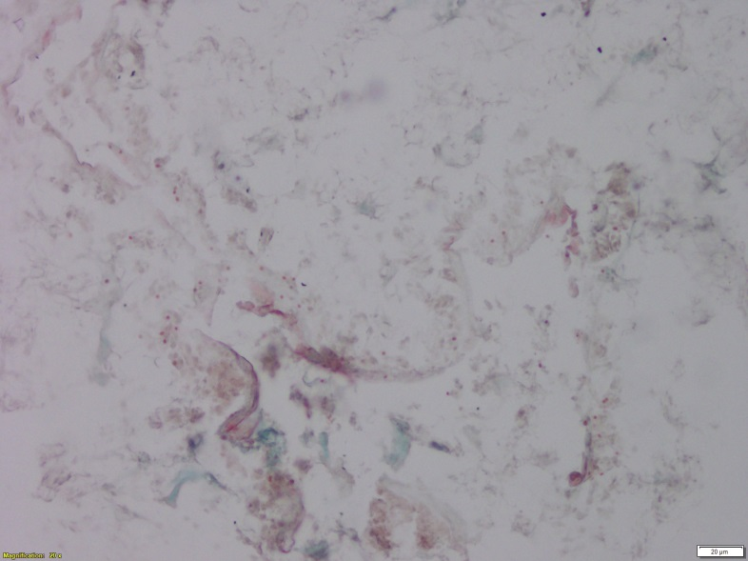
Collagen stain – dry salting process
36 hours
24 hours
72 hours
48 hours
Picrogomori stain

Slide 9
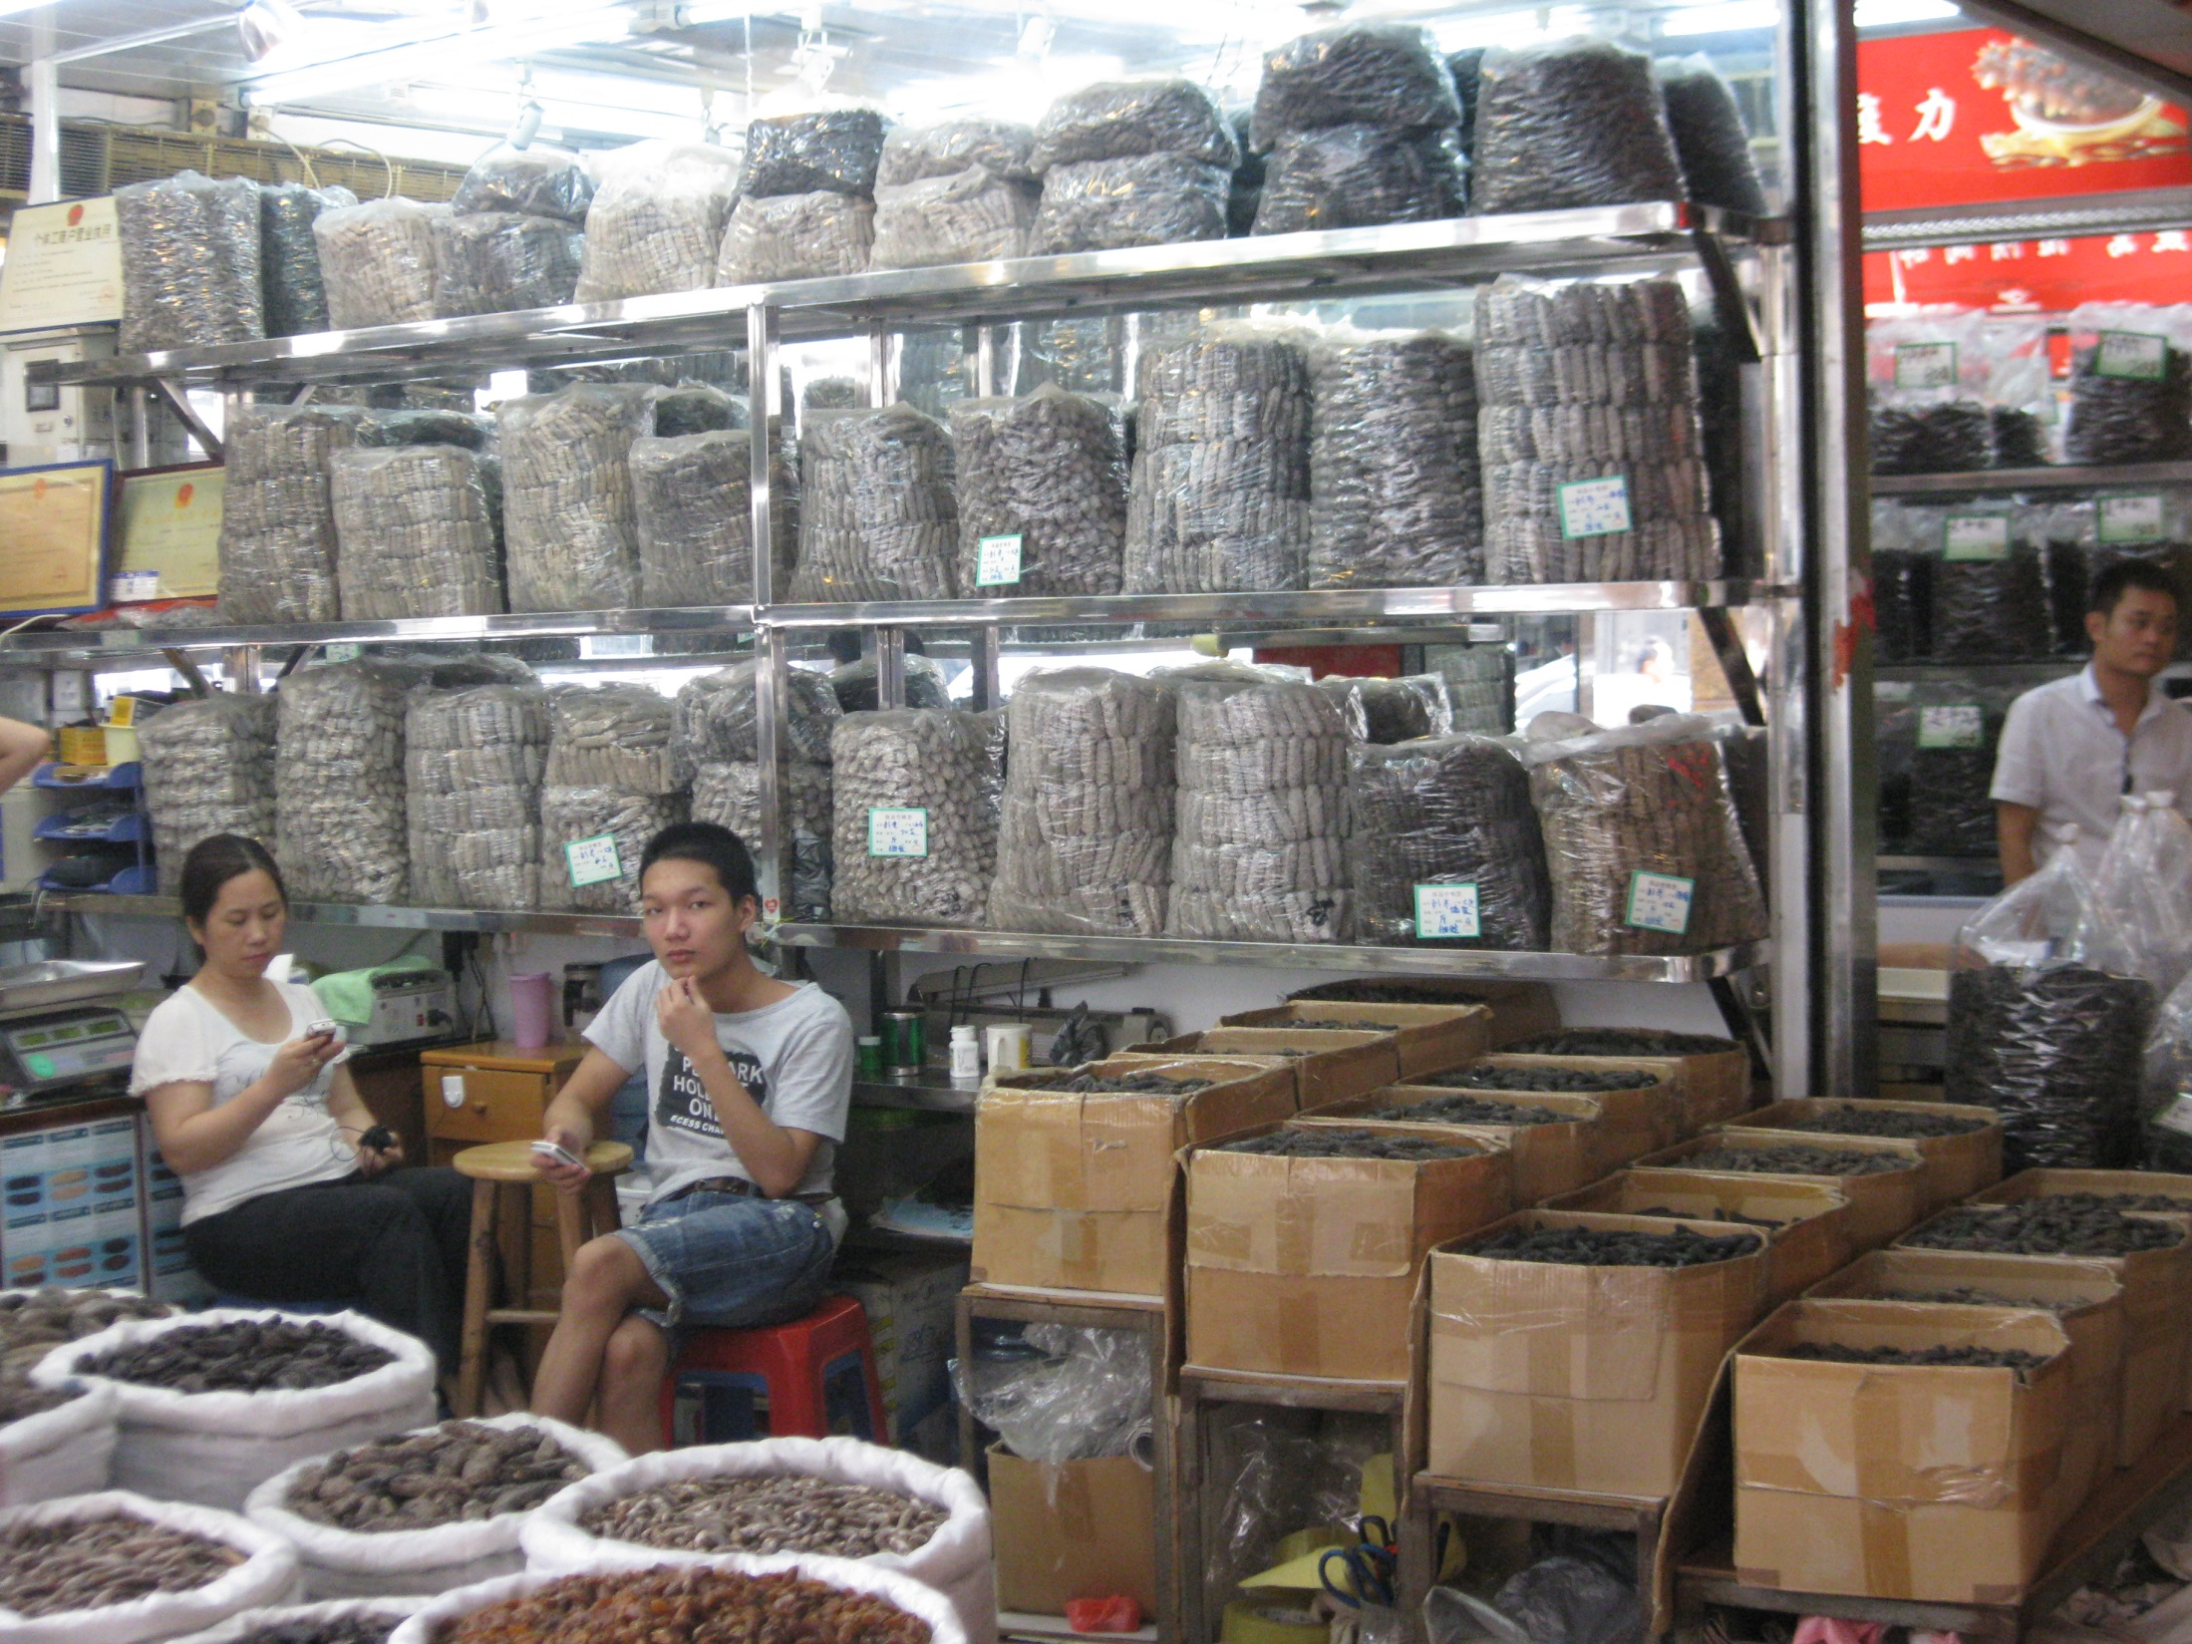

Slide 10
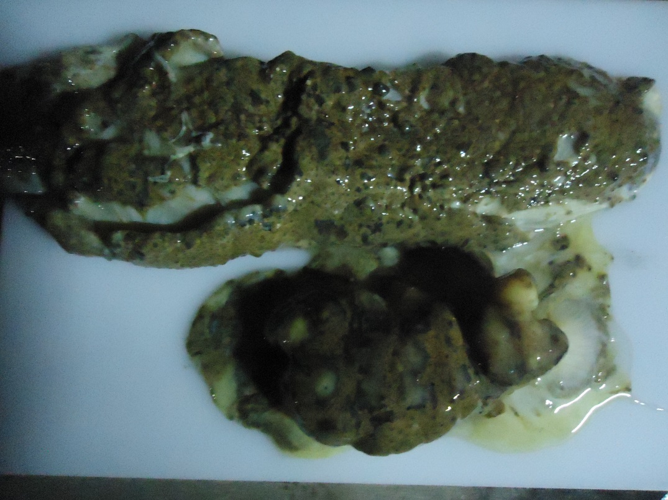
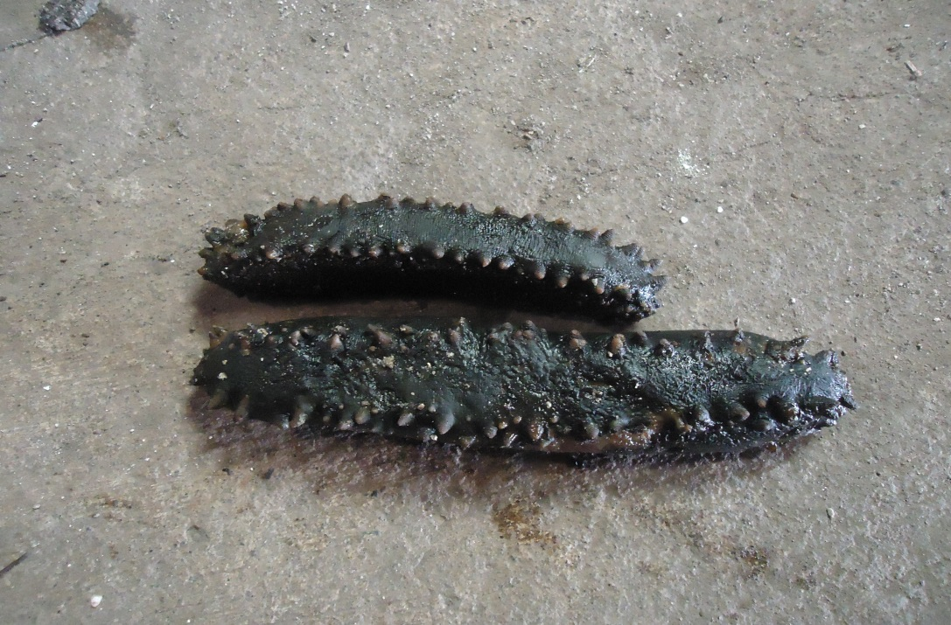
Species difficult to handle
Holothuria hermanni
(Curry fish)
Stichopus Chloloronotos
(Green fish)

Slide 11
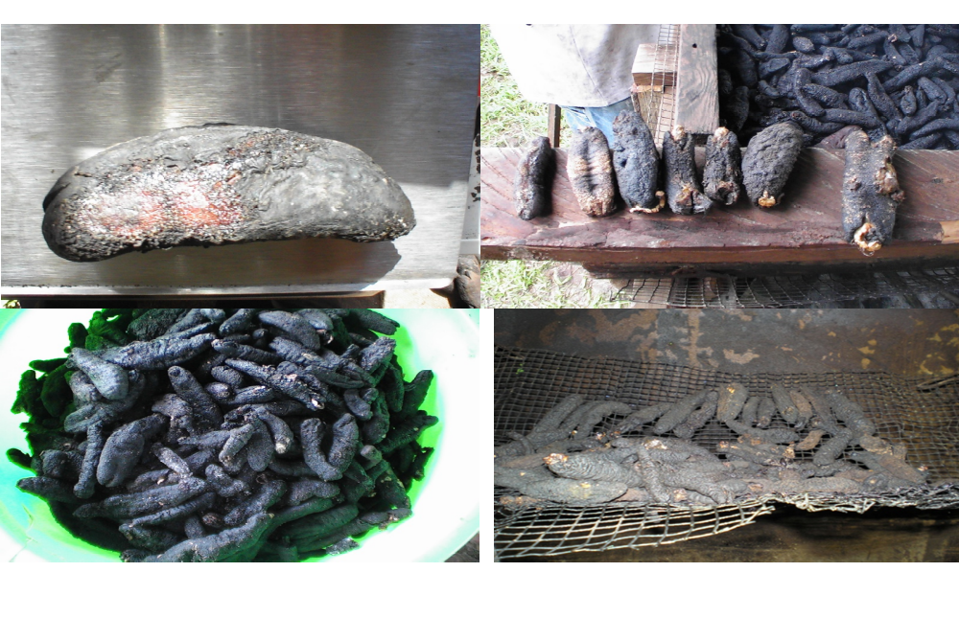
Poorly smoked products

Slide 12
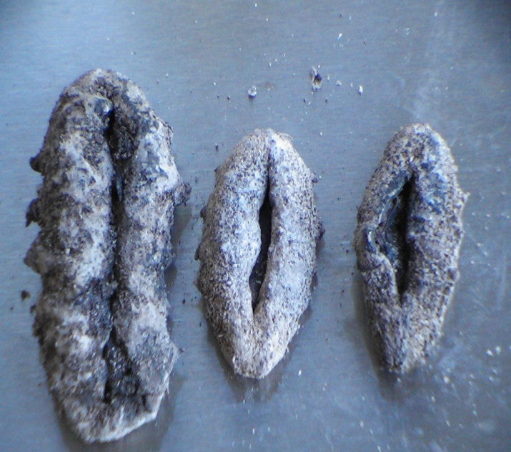
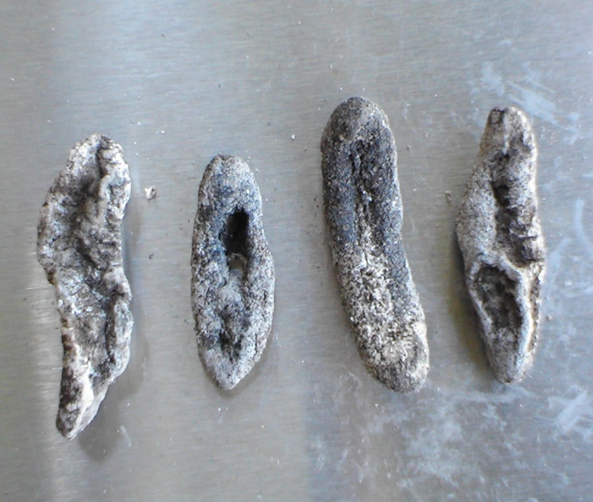
Poor quality products

Slide 13
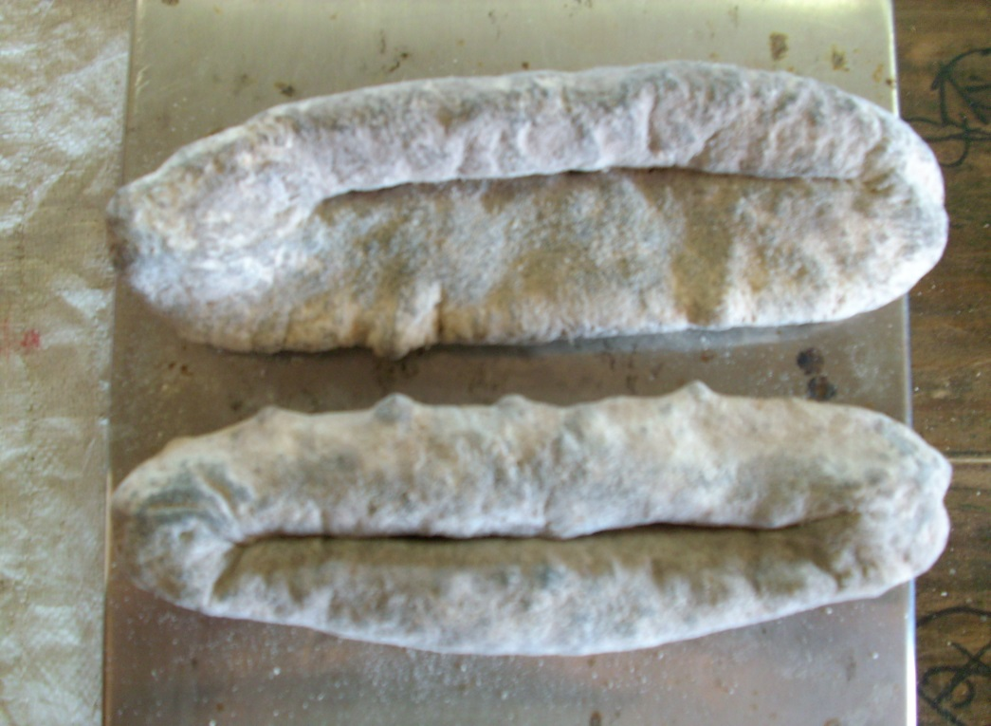
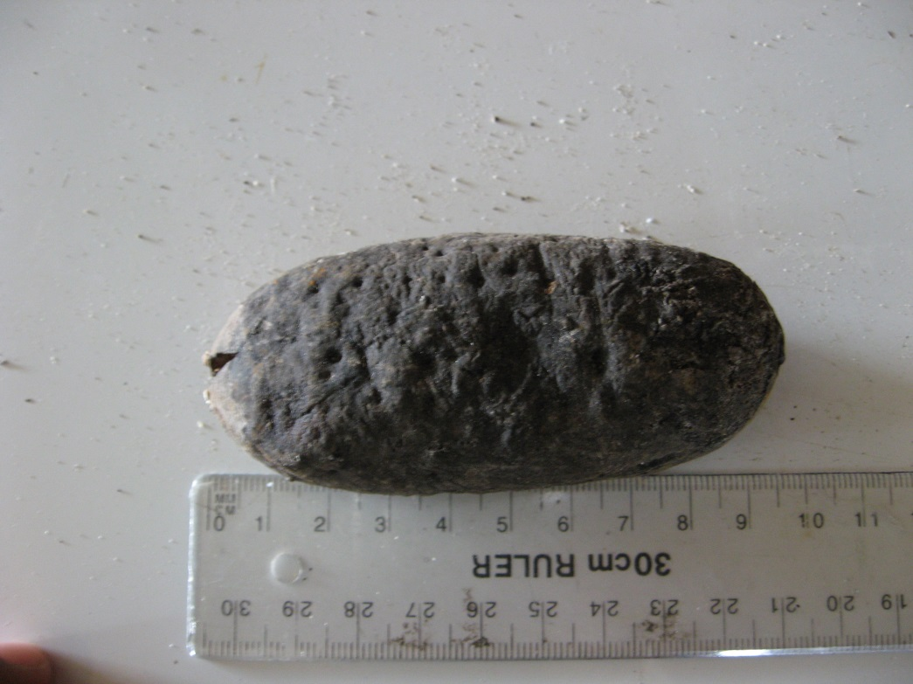
Good quality products

Slide 14
Implications
Improving the processing techniques will help the fishers of the Pacific to process better yield.
Processing manuals be designed for individual species and distributed to fishers and processors conversed in vernacular languages (currently underway)
Workshops/training and awareness be raised on sea cucumber harvesting and processing

Slide 15
Conclusion
Sea cucumber processing technique in Fiji is used from the 1800’s
Processed by series of boiling and drying process
First boil, cut and gut and smoke drying were difficult steps in processing technique identified by the processors
Follow up study in progress (“Impacts of processing techniques on quality and nutritional composition of tropical sea cucumbers”- JCU)

Slide 16
References
SPC, Sea cucumbers and beche-de-mer of the tropical pacific. Handbook No. 18. 1994, Noumea: SPC. 51.
Seeto, J., Bêche-de-mer processing – a little more effort to get much more money while saving precious resources. SPC Bêche-de-mer information bulletin, 1999. 11: p. 2-3.
Sachithananthan, K., et al., Report on the national workshop on fish handling in Zanzibar, in United Republic of Tanzania and report on the Tanzania/ SWIOP national workshop on Bêche-de-mer processing. 1985, National workshop on fish handling. p. 45-83.

Slide 17

Source: https://i.chzbgr.com/maxW500/5895416832/h88F92155/
Thank you

