Slide 1



Yield and water productivity of cumin as influenced by irrigation techniques and land configuration
3rd International Conference
October 27-29, 2014
Hyderabad International Convention Centre, Hyderabad, India
Dr. Ravindra Singh
ICAR-National Research Centre on Seed Spices, Ajmer, Rajasthan, India- 305206

Slide 2
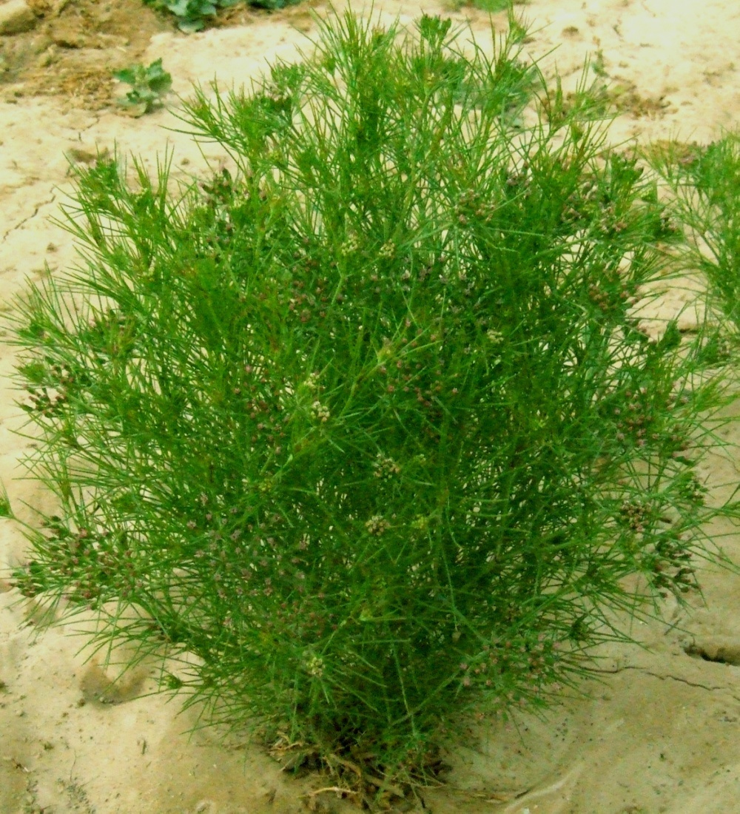
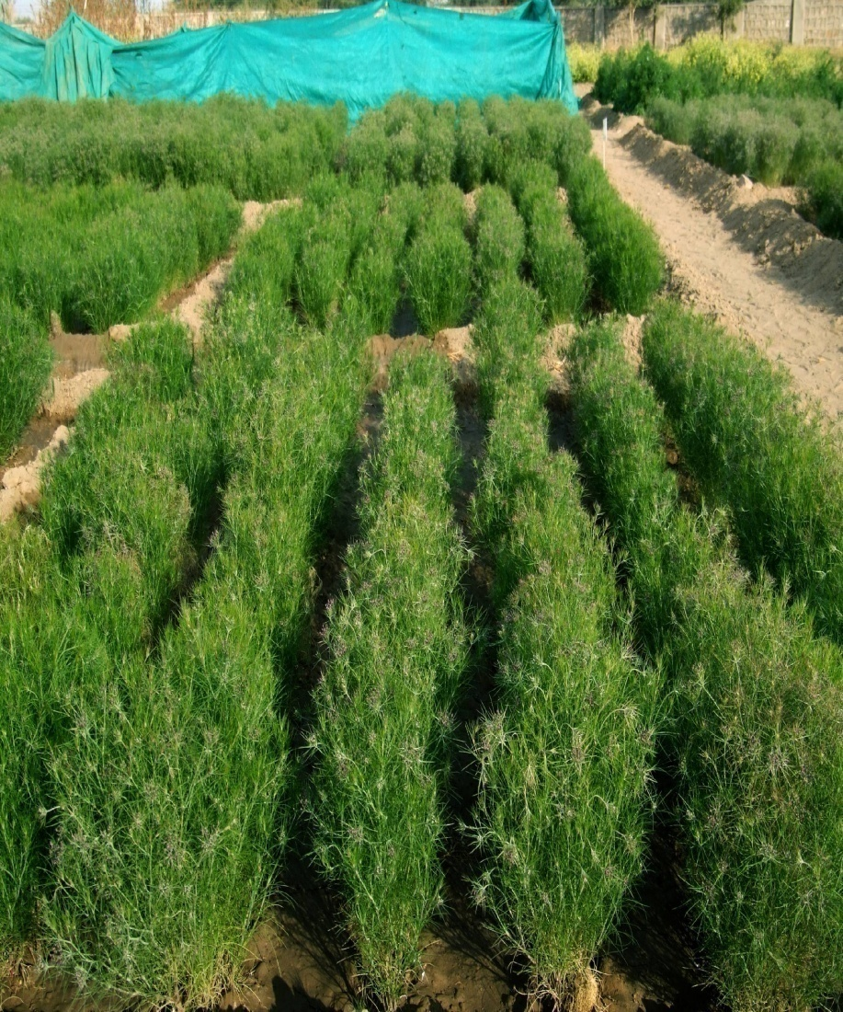
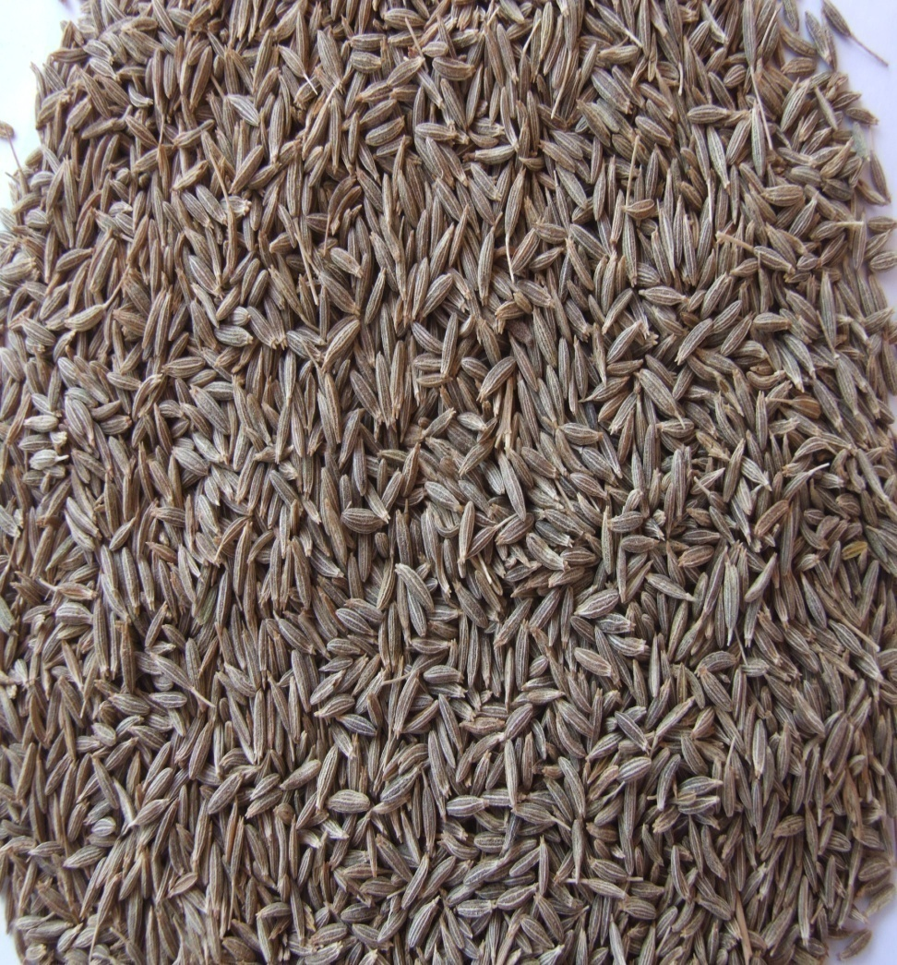
CUMIN
Cumin Plant Cumin Seed

Slide 3
Climatic Requirement
Moderately cool and dry climate.
It does not prefer humidity in atmosphere during flowering
Susceptible to frost injury during flowering and early fruit setting stage.
Rain during flowering or early fruit setting and at the time of maturity period is highly undesirable.
Cumin crop requires cool (15-25⁰ C temperature) and dry climate for good growth and production.
High humidity, cloudy weather, more dew and unseasonal rain after flowering of the crop are detrimental to cumin crop.

Slide 4
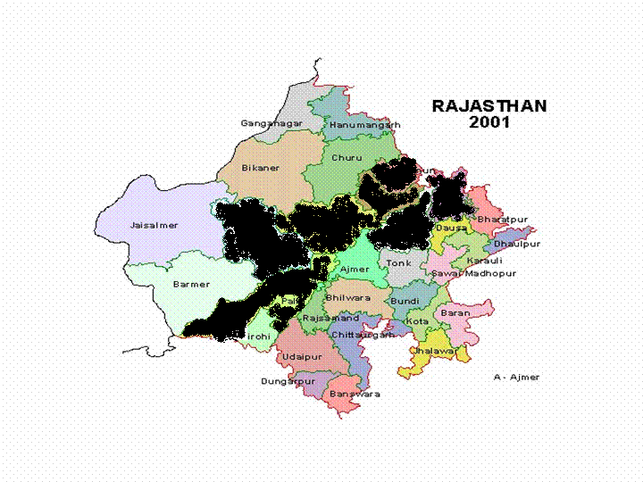
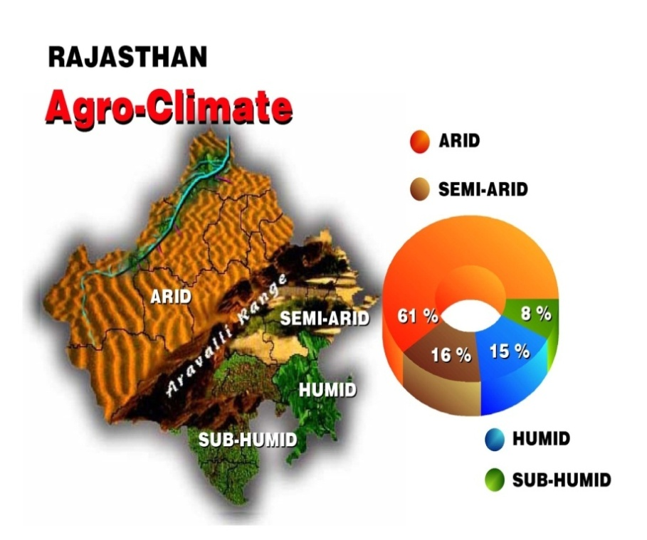
Jhunjhunu
Sikar
Alwar
Jodhpur
Nagaur
Jaipur
Pali
Jalore
Most of the Seed Spices can’t tolerate frost and therefore, Rajasthan offers an ideal climate for the cultivation of these crops

Slide 5
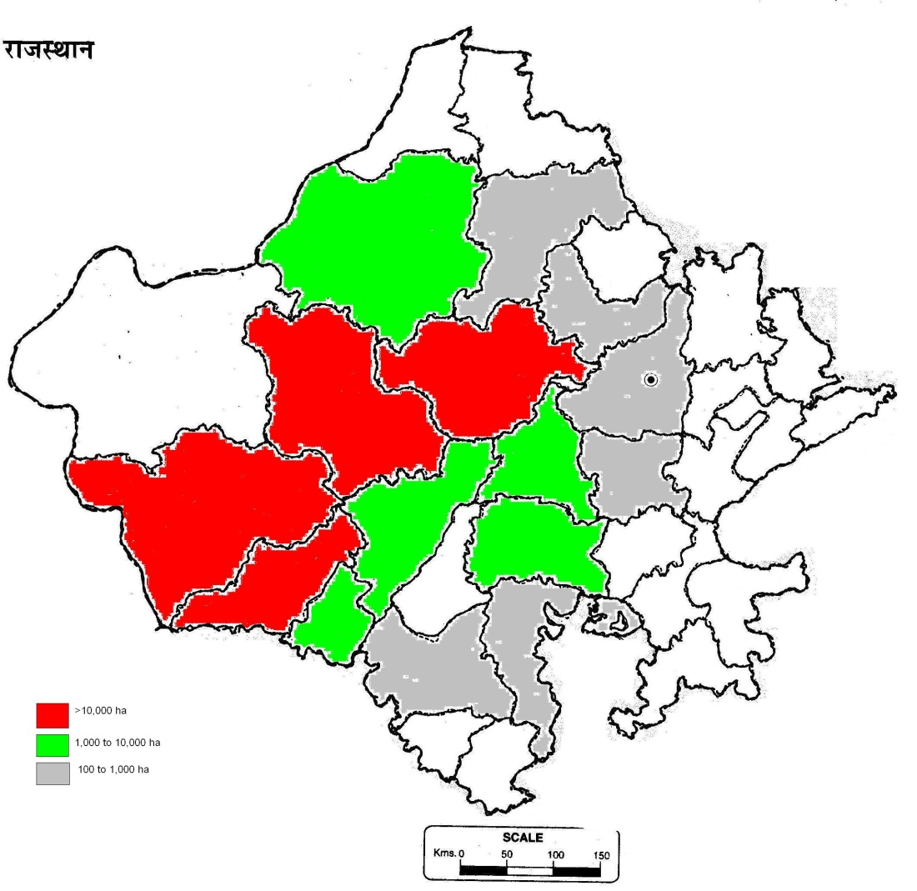
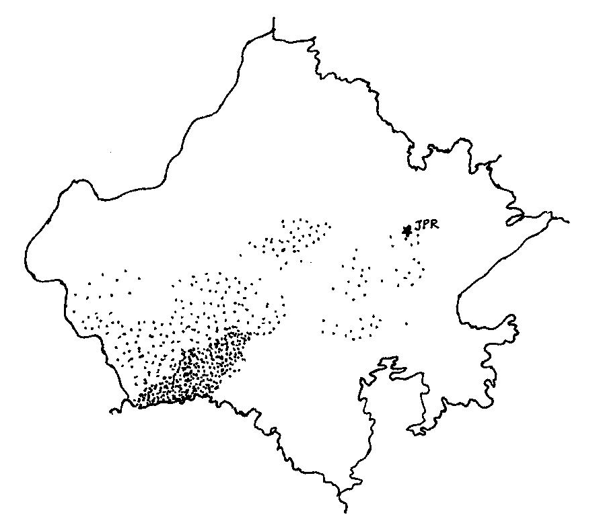
Cumin
Cumin is concentrated in the districts of Jodhpur, Jalore and Barmer contributing to 70% of the total area of the state

Slide 6
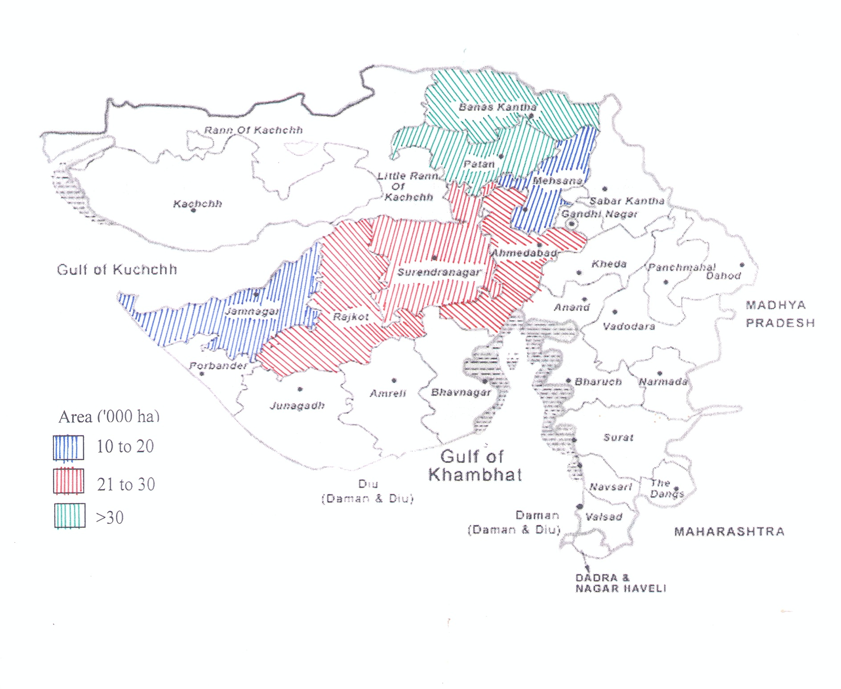
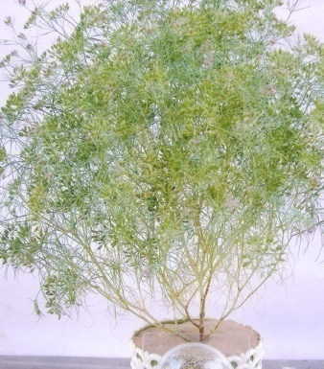
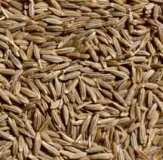
Major cumin growing districts of Gujarat

Slide 7
Objective:
To find out the suitable planting and Irrigation methods for seed spices
To work out the economics of seed spices production under different land configuration and irrigation systems under maize based cropping system
To quantify the water productivity of seed spices

Slide 8
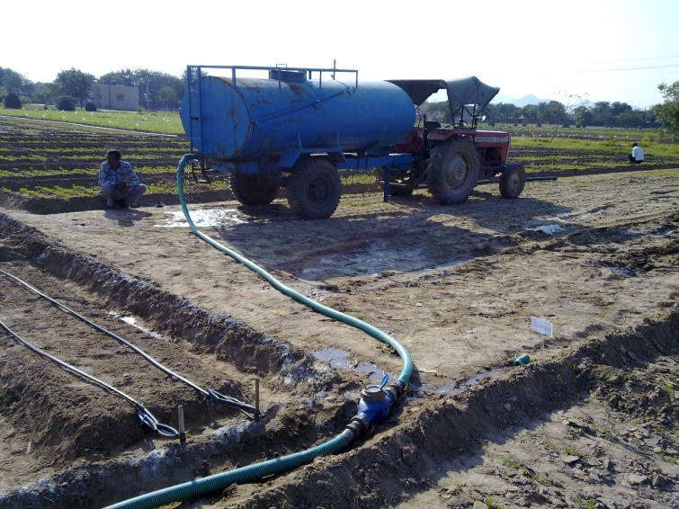
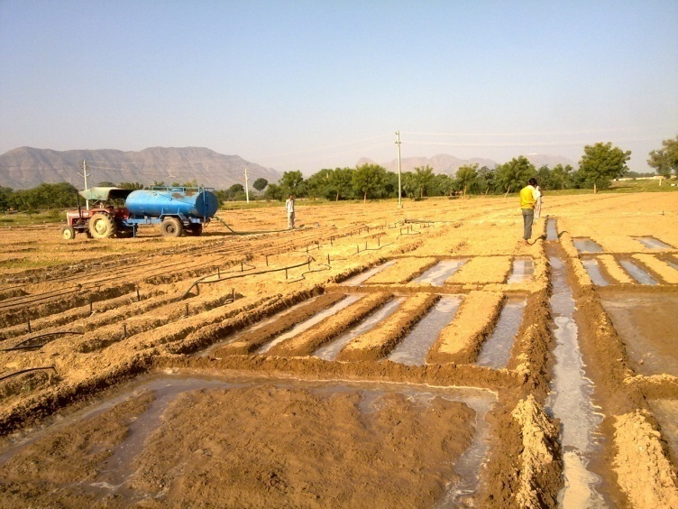
Treatments
Main Plot: Irrigation Methods (3)
Drip Irrigation
Flood Irrigation
Micro Sprinkler Irrigation
Sub Plot: Land Configuration (3)
Flat bed
FIRB (75 cm, Normal bed)
FIRB (150 cm, Wider bed)
Number of Treatments: 09; Replication: 4 ;
Total Plots: 36; Design: Split Plot,
Plot size: 13.5 m²
Varieties: GC-4 (Cumin),

Slide 9
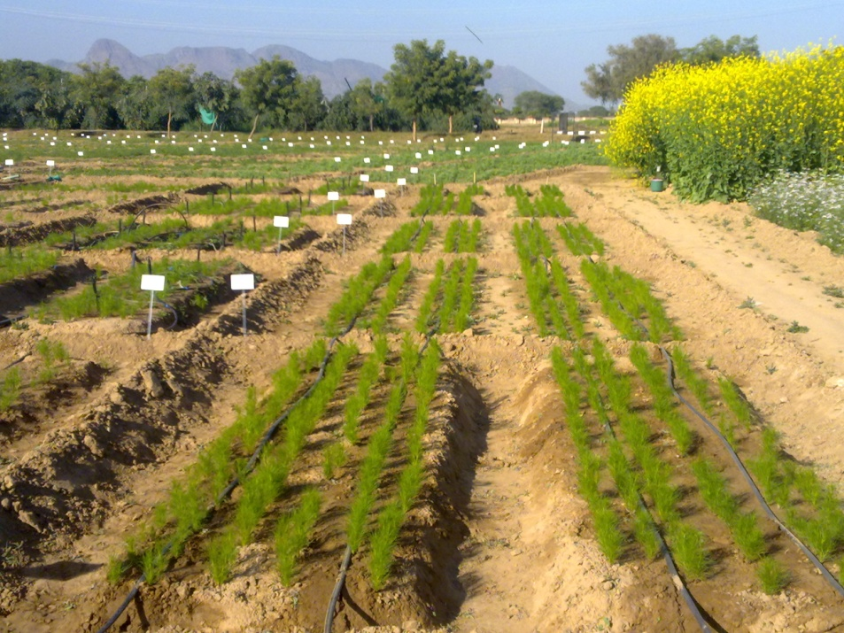
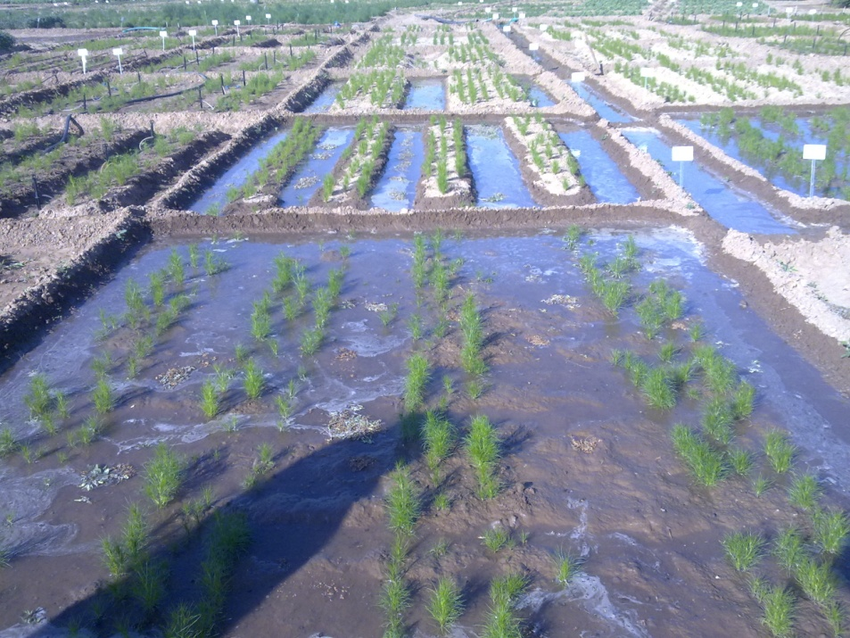
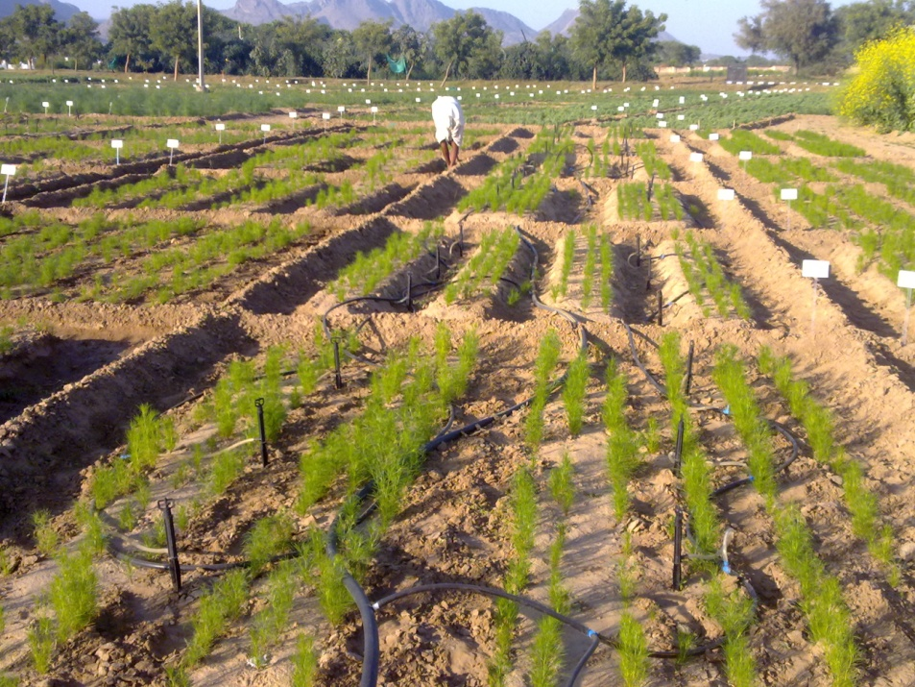
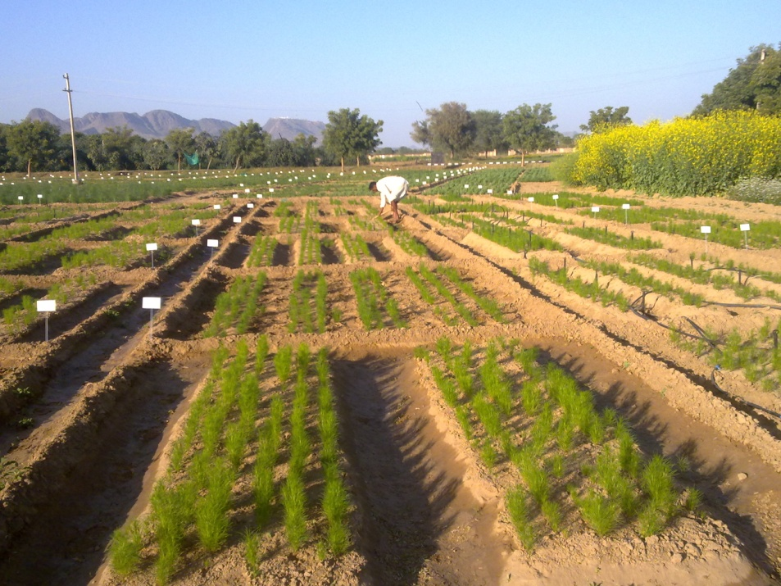

Slide 10
Treatment | Plant height at Harvest (cm) | Primary branch/ plant | Secondary branch/ plant | Umbel/ plant | umbellete/umbel | no of seeds/ umbellete | test weight (g)
Irrigation methods
Flood | 27.58 | 6.17 | 9.88 | 21.28 | 6.28 | 22.55 | 5.16
Drip | 30.78 | 6.58 | 9.78 | 20.35 | 6.48 | 22.00 | 5.86
Sprinkler | 29.80 | 5.97 | 9.20 | 19.83 | 6.20 | 22.52 | 5.22
CD at % | 1.68 | NS | NS | NS | NS | NS | NS
Land Configuration
Flat | 29.12 | 6.13 | 9.32 | 22.00 | 6.25 | 21.13 | 5.43
Normal bed | 29.33 | 6.32 | 9.97 | 18.93 | 6.25 | 22.57 | 5.48
Wider bed | 29.72 | 6.27 | 9.58 | 20.53 | 6.47 | 23.37 | 5.35
CD at % | NS | NS | NS | NS | NS | NS | NS

Slide 13
Irrigation water applied

Slide 14
 | B1 | B2 | B3 | Mean A
A1 | 178.6 | 404.8 | 392.9 | 325.4
A2 | 357.2 | 761.9 | 452.4 | 523.8
A3 | 350.0 | 523.8 | 419.0 | 431.0
Mean B | 295.3 | 563.5 | 421.4
Factors | C.D. | SE(d) | SE(m)
Factor(A) | 55.5 | 22.3 | 15.7
Factor(B) | 35.0 | 16.5 | 11.7
Factor(B)at same level of A | 65.8 | 28.6 | 27.3
Factor(A)at same level of B | 74.1 | 0.0 | 0.0

Slide 15
Grain Yield and water productivity of cumin as influenced by irrigation technique and land configuration
Treatment | Cumin Yield kg/ha | Total water applied (ha cm) | water productivity kg grain/ha cm irrigation water
Irrigation methods
Flood | 325.40 | 22.11 | 15.50
Drip | 523.81 | 7.12 | 73.58
Sprinkler | 430.95 | 9.43 | 45.70
CD at % | 55.5 | 1.13 | 6.59
Land Configuration
Flat | 295.24 | 13.57 | 31.56
Normal bed | 563.49 | 11.31 | 61.95
Wider bed | 421.43 | 13.78 | 41.27
CD at % | 35.0 | 0.55 | 4.07

Slide 16
Water productivity (cumin)

Slide 17
Salient findings:
Cumin:
Irrigation with drip and micro sprinkler not only enhanced the yield (523.8 and 430.9 kg/ha) than flood irrigation (325.4 kg/ha) but also gave higher water productivity 102.3 and 79.3 kg grain/ha cm irrigation water than flood irrigation methods (17.9 kg grain/ha cm).
Among land configuration treatments, sowing of 3 rows of cumin on raised beds (75 cm) enhanced the grain yield by 268.2 and 142.0 kg/ha and water productivity by 42.8 and 28.5 kg grain/ha cm irrigation water than flat bed and wider raised beds (150 cm).

Slide 18
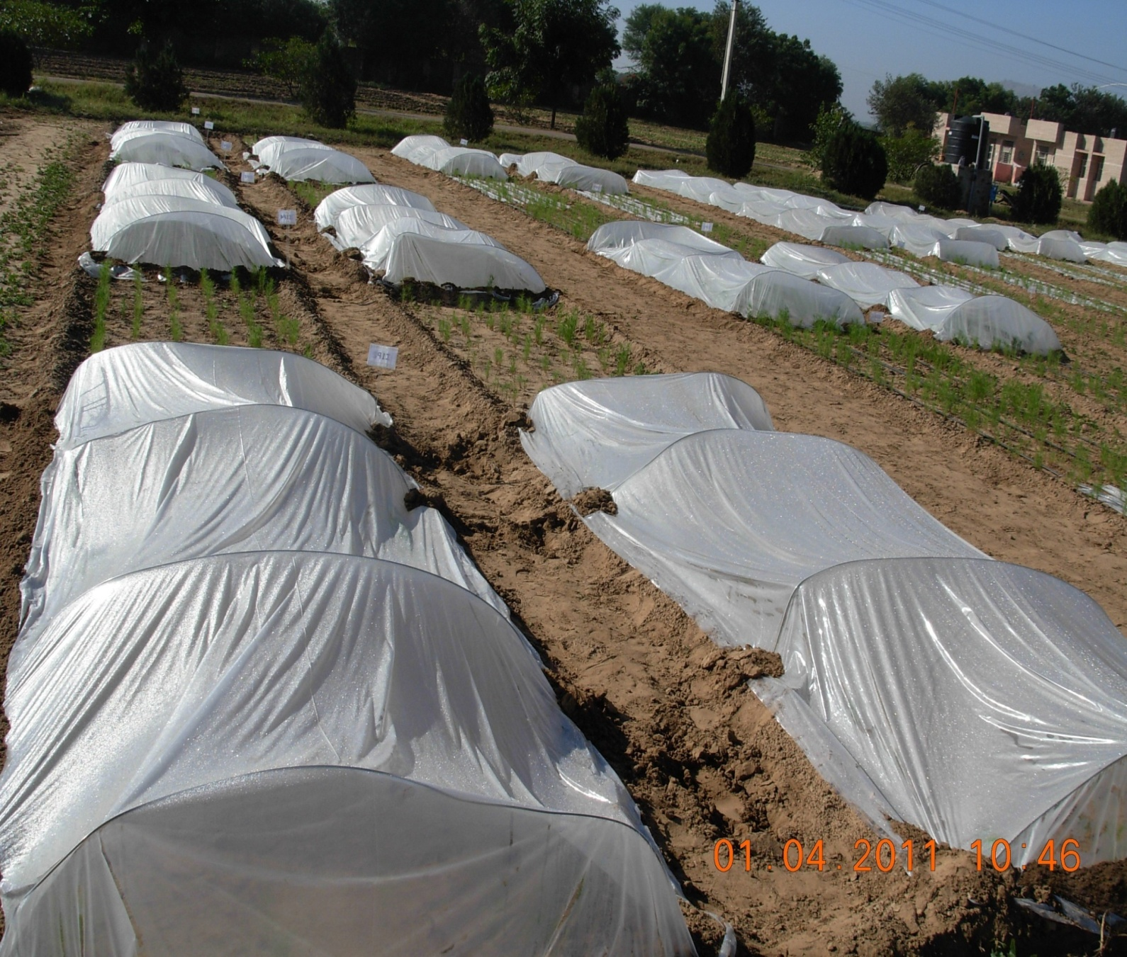
CUMIN Experiment

Slide 19
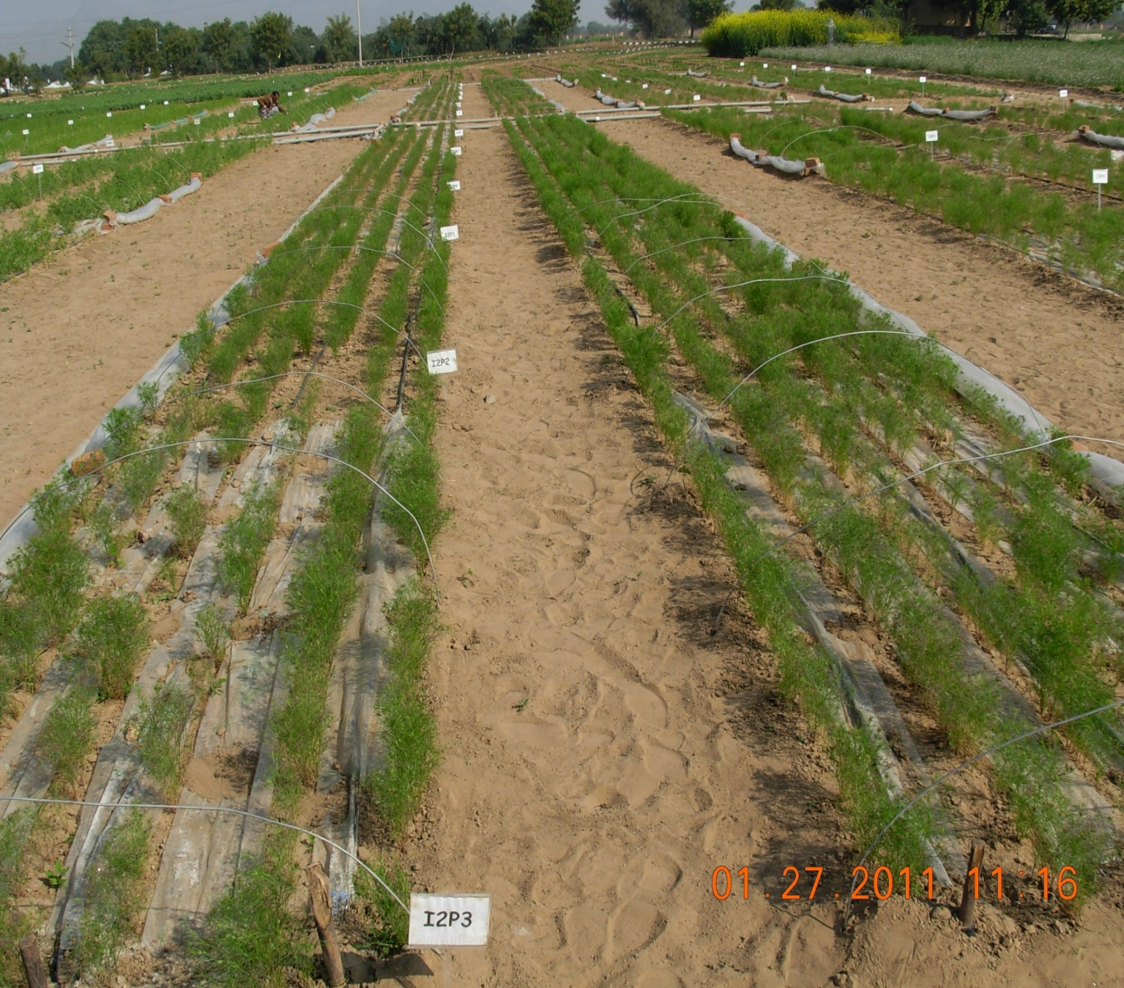
CUMIN: Flowering initiation

Slide 20
Effects of Irrigation methods and water conservation on Yield & Yield Attributes of CUMIN – Pooled Data
Treatment | Umbel/Pl | Umbellate/Pl | Seed Wt/Pl gm | Test Wt gm | Yield kg/ha
Irrigation Methods
I1 flood | 8.16 | 34.15 | 3.34 | 4.21 | 485.82
I2 Drip | 9.26 | 37.38 | 3.73 | 4.36 | 533.68
I3 Low Pr Drip | 9.68 | 39.08 | 4.25 | 4.68 | 607.52
S Em± | 0.22 | 0.90 | 0.12 | 0.08 | 8.61
CD(0.05) | 0.73 | 2.34 | 0.38 | 0.25 | 28.06
CV % | 12.07 | 9.52 | 15.00 | 8.35 | 7.77
Notes:
C

Slide 21
Irrigation water applied and water use efficiency
Treatment | Irrigation applied (mm) | Rainfall during crop season (mm) | Total water applied (mm) | Yield in kg/ha | Water use efficiency (kg/ha/mm )
CUMIN
Flood | 150 | 76 | 226 | 613.43 | 2.03
Drip | 100 | 76 | 176 | 644.29 | 2.56
Low Pr drip | 100 | 76 | 176 | 607.52 | 3.45

Slide 22
Future Thrust Areas for Cumin Production
Application of resource conserving technologies (RCTs) and conservation agriculture (CA) in seed spices
Application of micro irrigation and fertigation technology in seed spices
Application of protected cultivation technology
Off season coriander cultivation under Shade net houses /Walk In Tunnels
Insect proof net houses for safe seed spices cultivation
Modern nursery raising technology for seed spices cultivation
Mulching

Slide 23
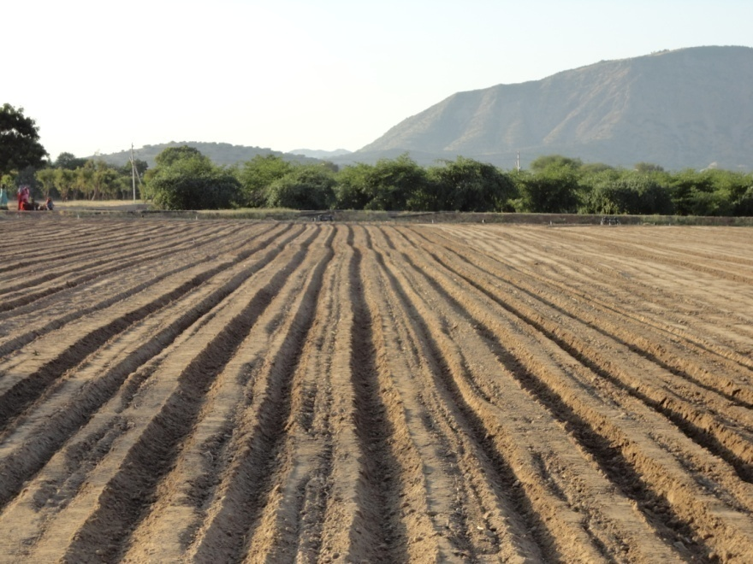
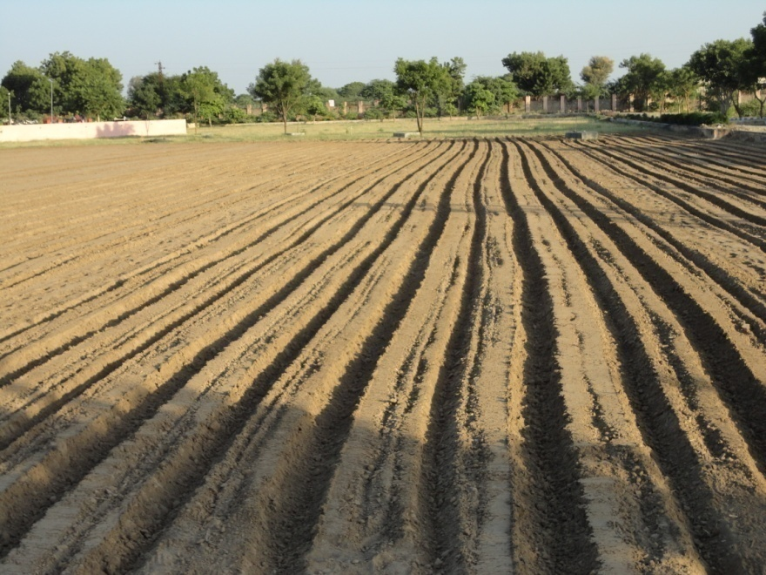
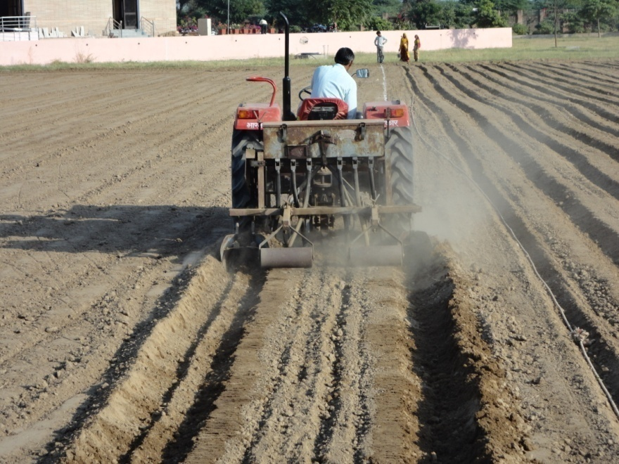
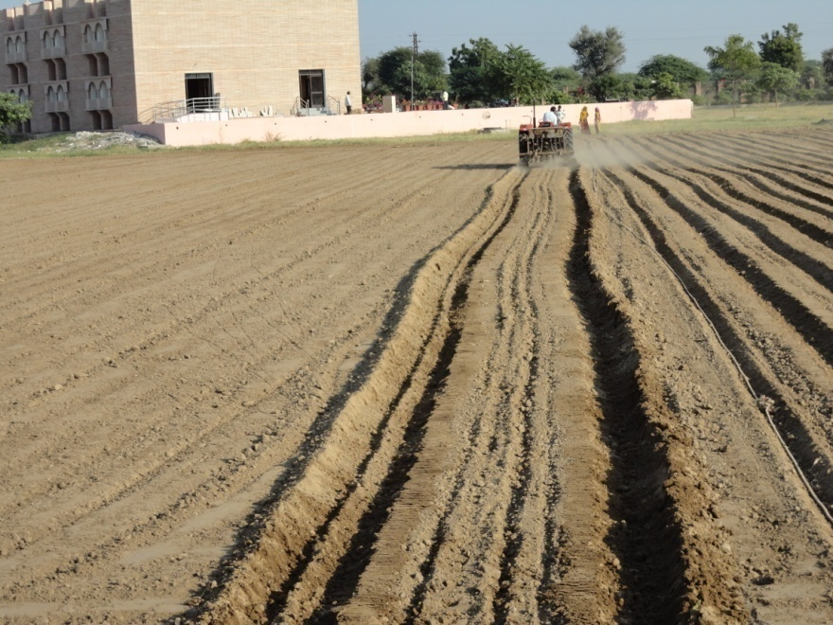
Sowing by bed planter (FIRB 75 and 150 cm)

Slide 24
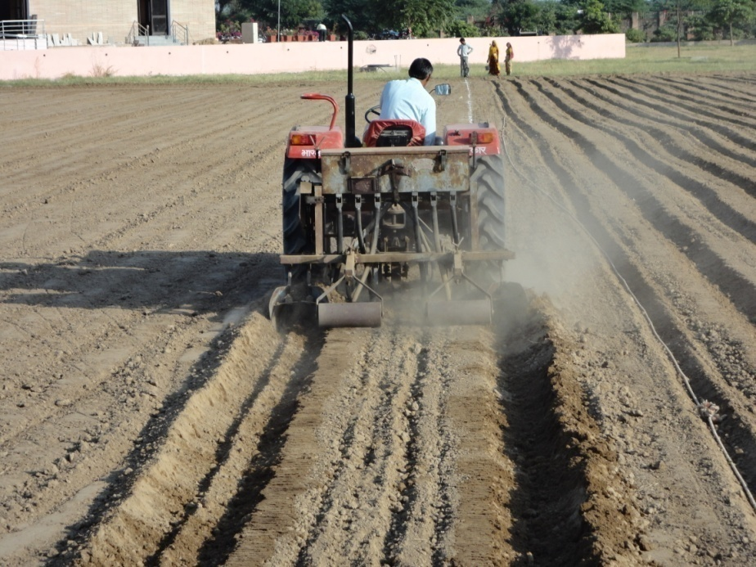
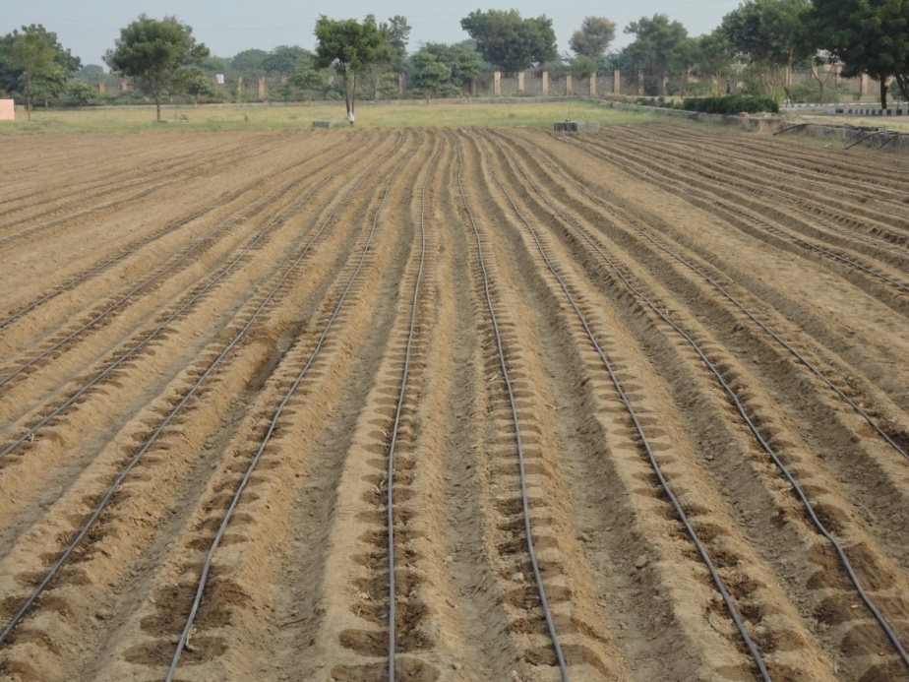
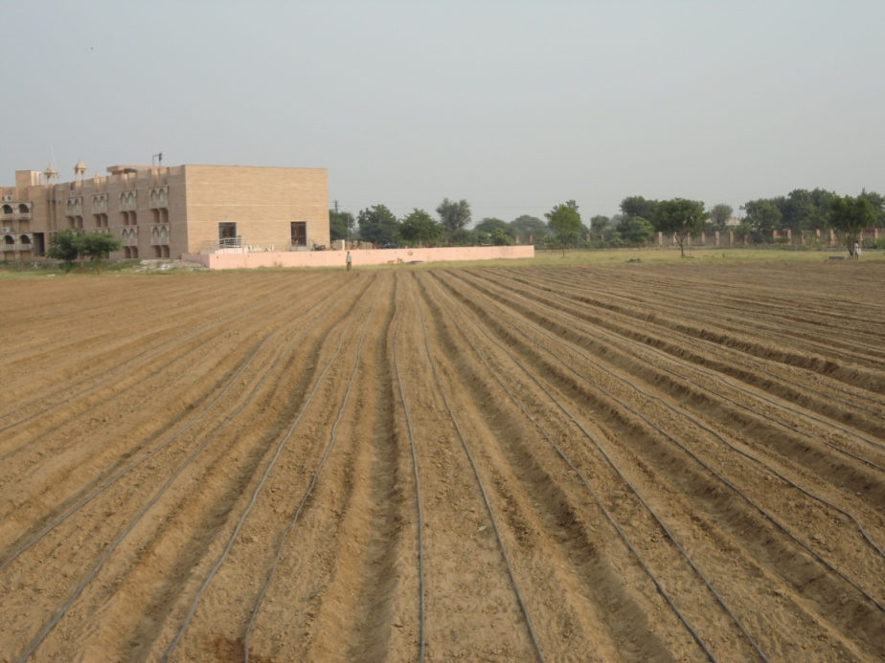
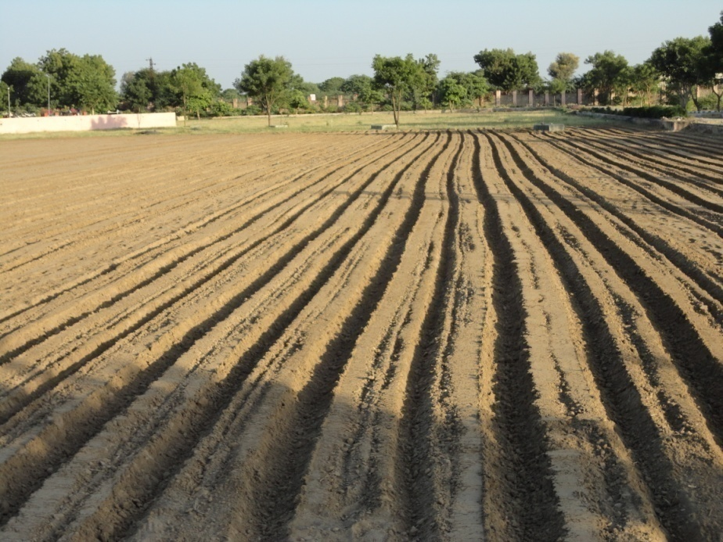
RAISED BEDS EQUIPPED WITH DRIP FERTIGATION

Slide 25
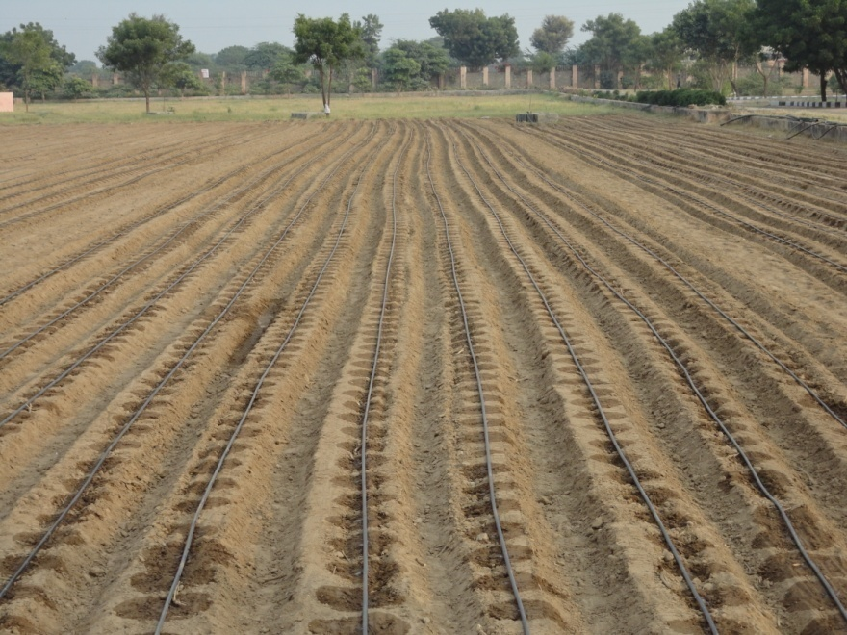
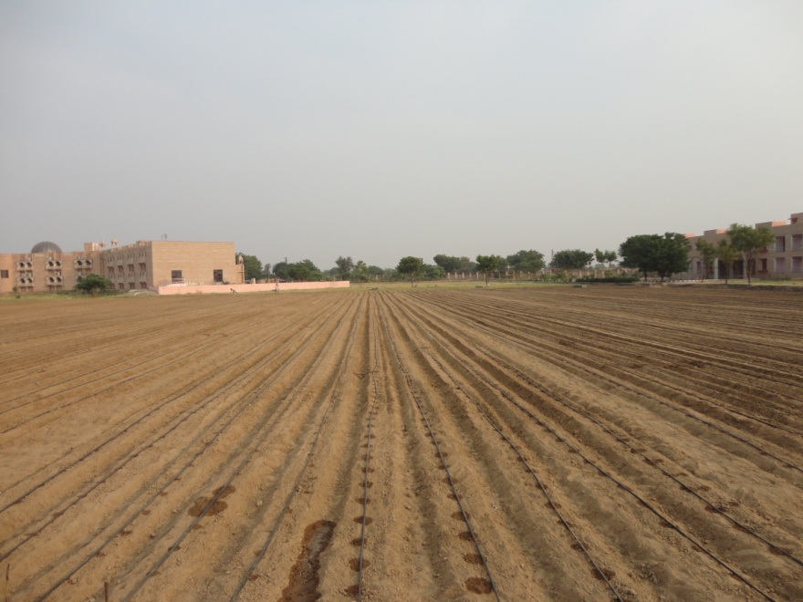
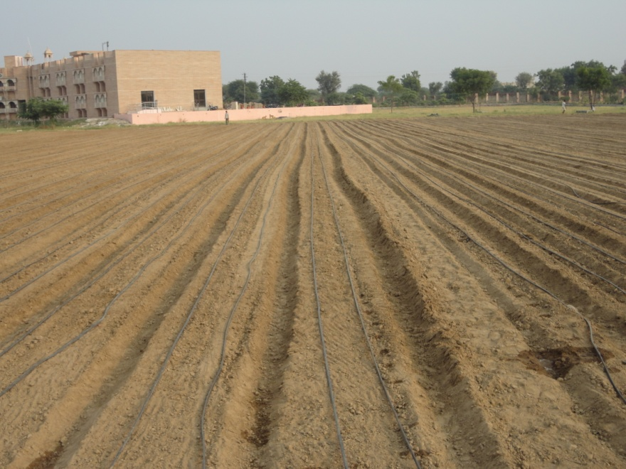
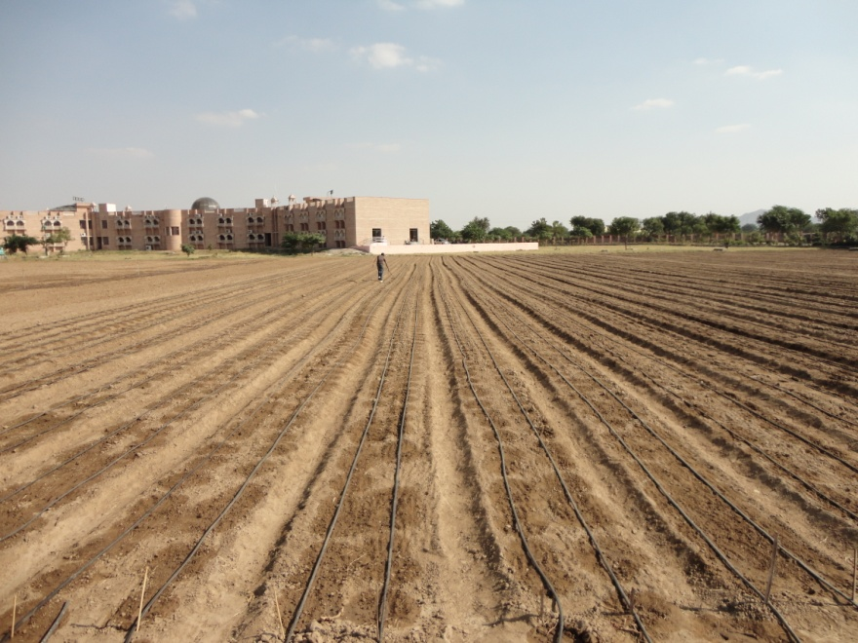
Drip installation and Irrigation

Slide 26
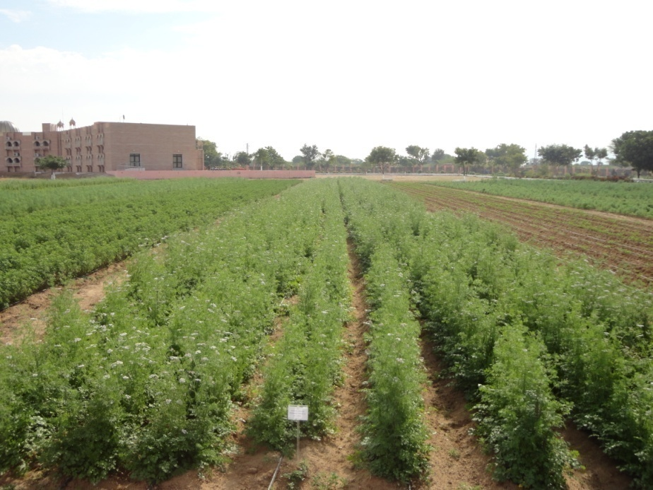
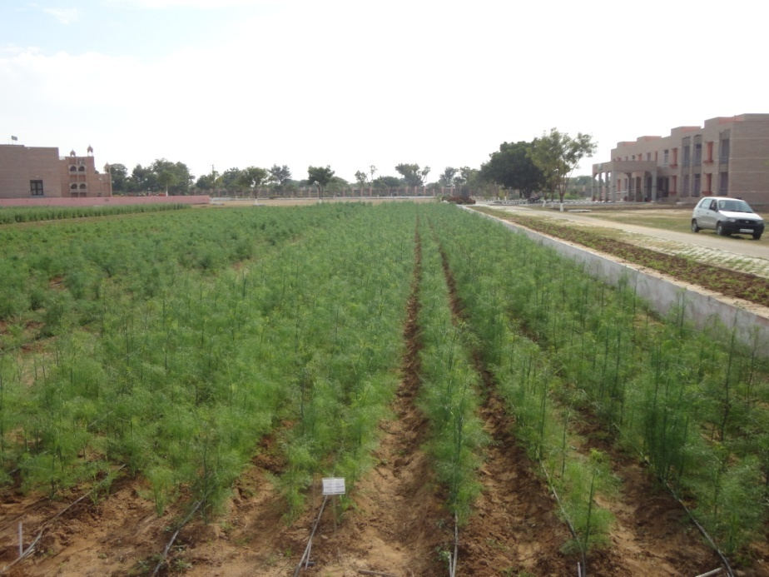
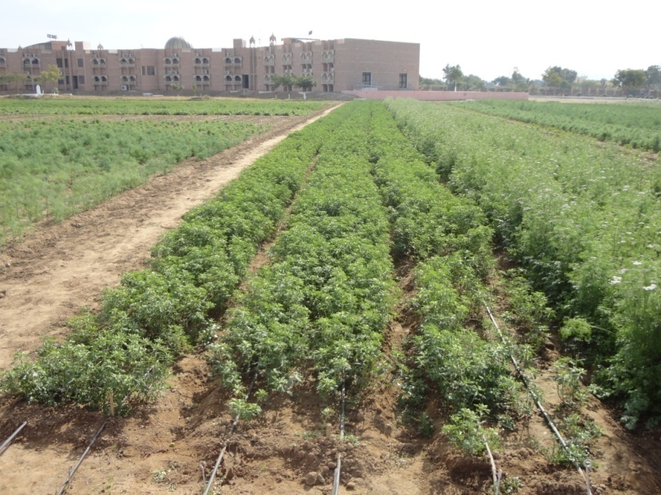
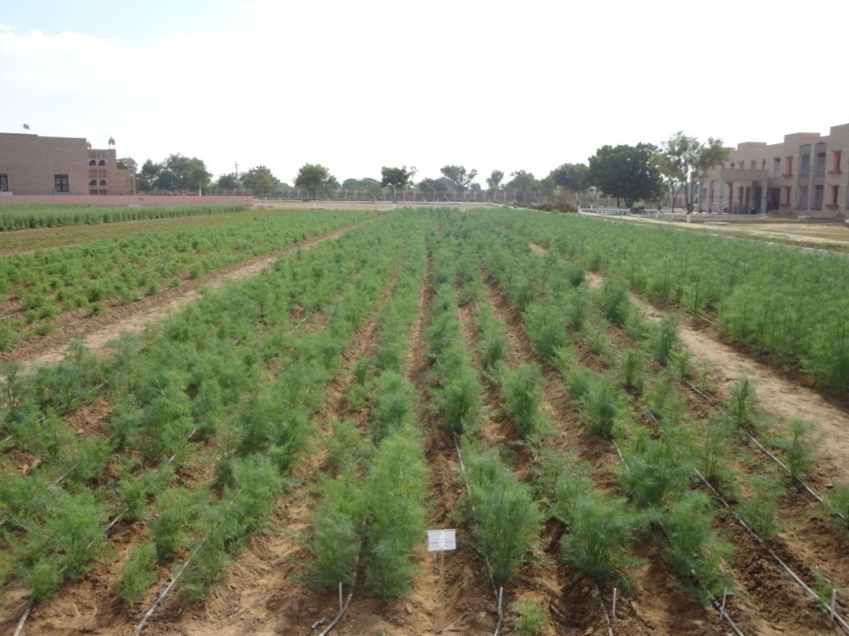
Coriander
Fennel
Fenugreek
Dill
FIRB of 75 cm with Drip Fertigation

Slide 27
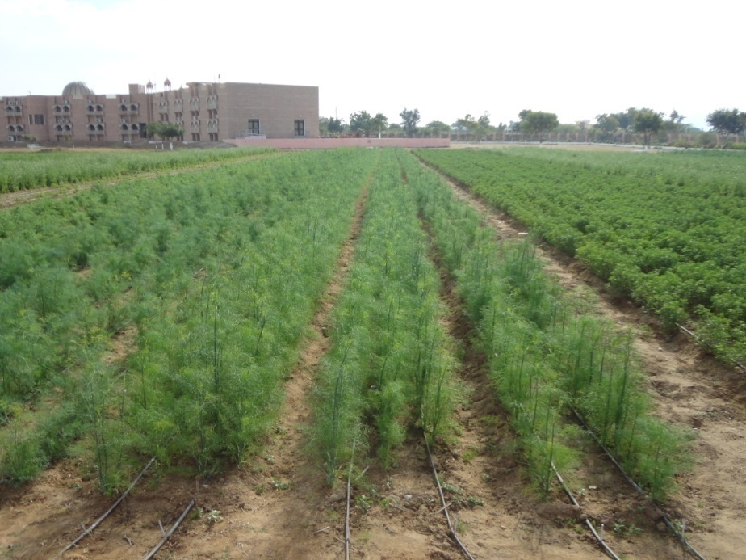
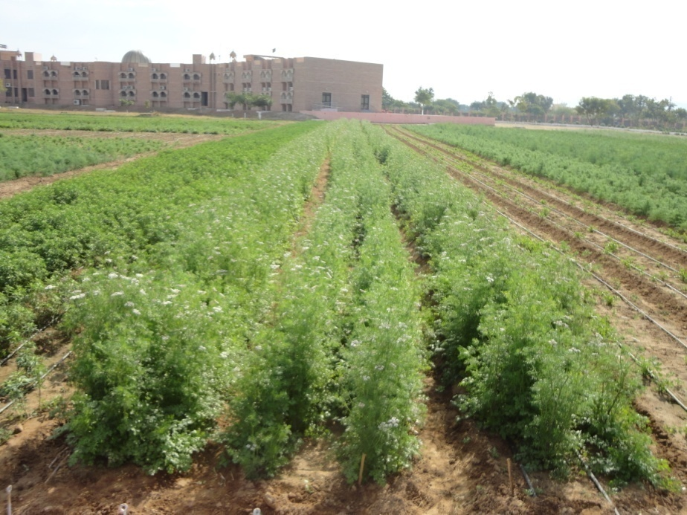
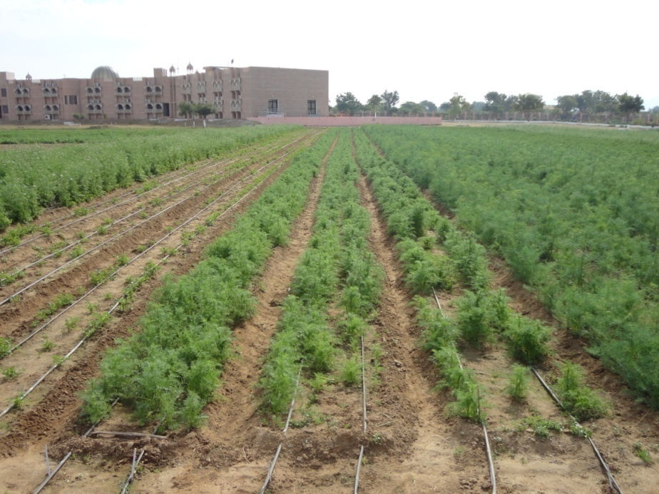
Coriander
Fennel
Fenugreek
Fenugreek
Ajwain
FIRB of 150 cm with Drip Fertigation

Slide 28
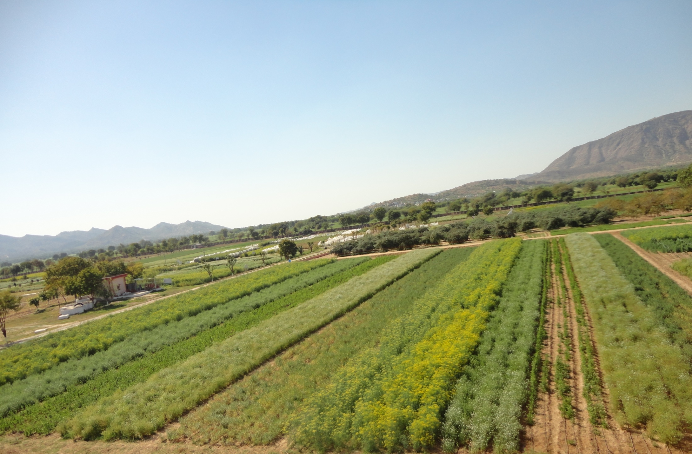
Thanks

