Slide 1
Conserving River Biodiversity in the Ganges-Brahmaputra-Meghna River Basin in the Indian Sub-continent
4th International Conference on Biodiversity, Las Vegas, USA. June 15-17, 2015
Ravindra Kumar Sinha, Ph.D
Professor and Head
University Department of Zoology
Patna University, Patna 800 005 India
Email: rksinha.pu@gmail.com

Slide 2
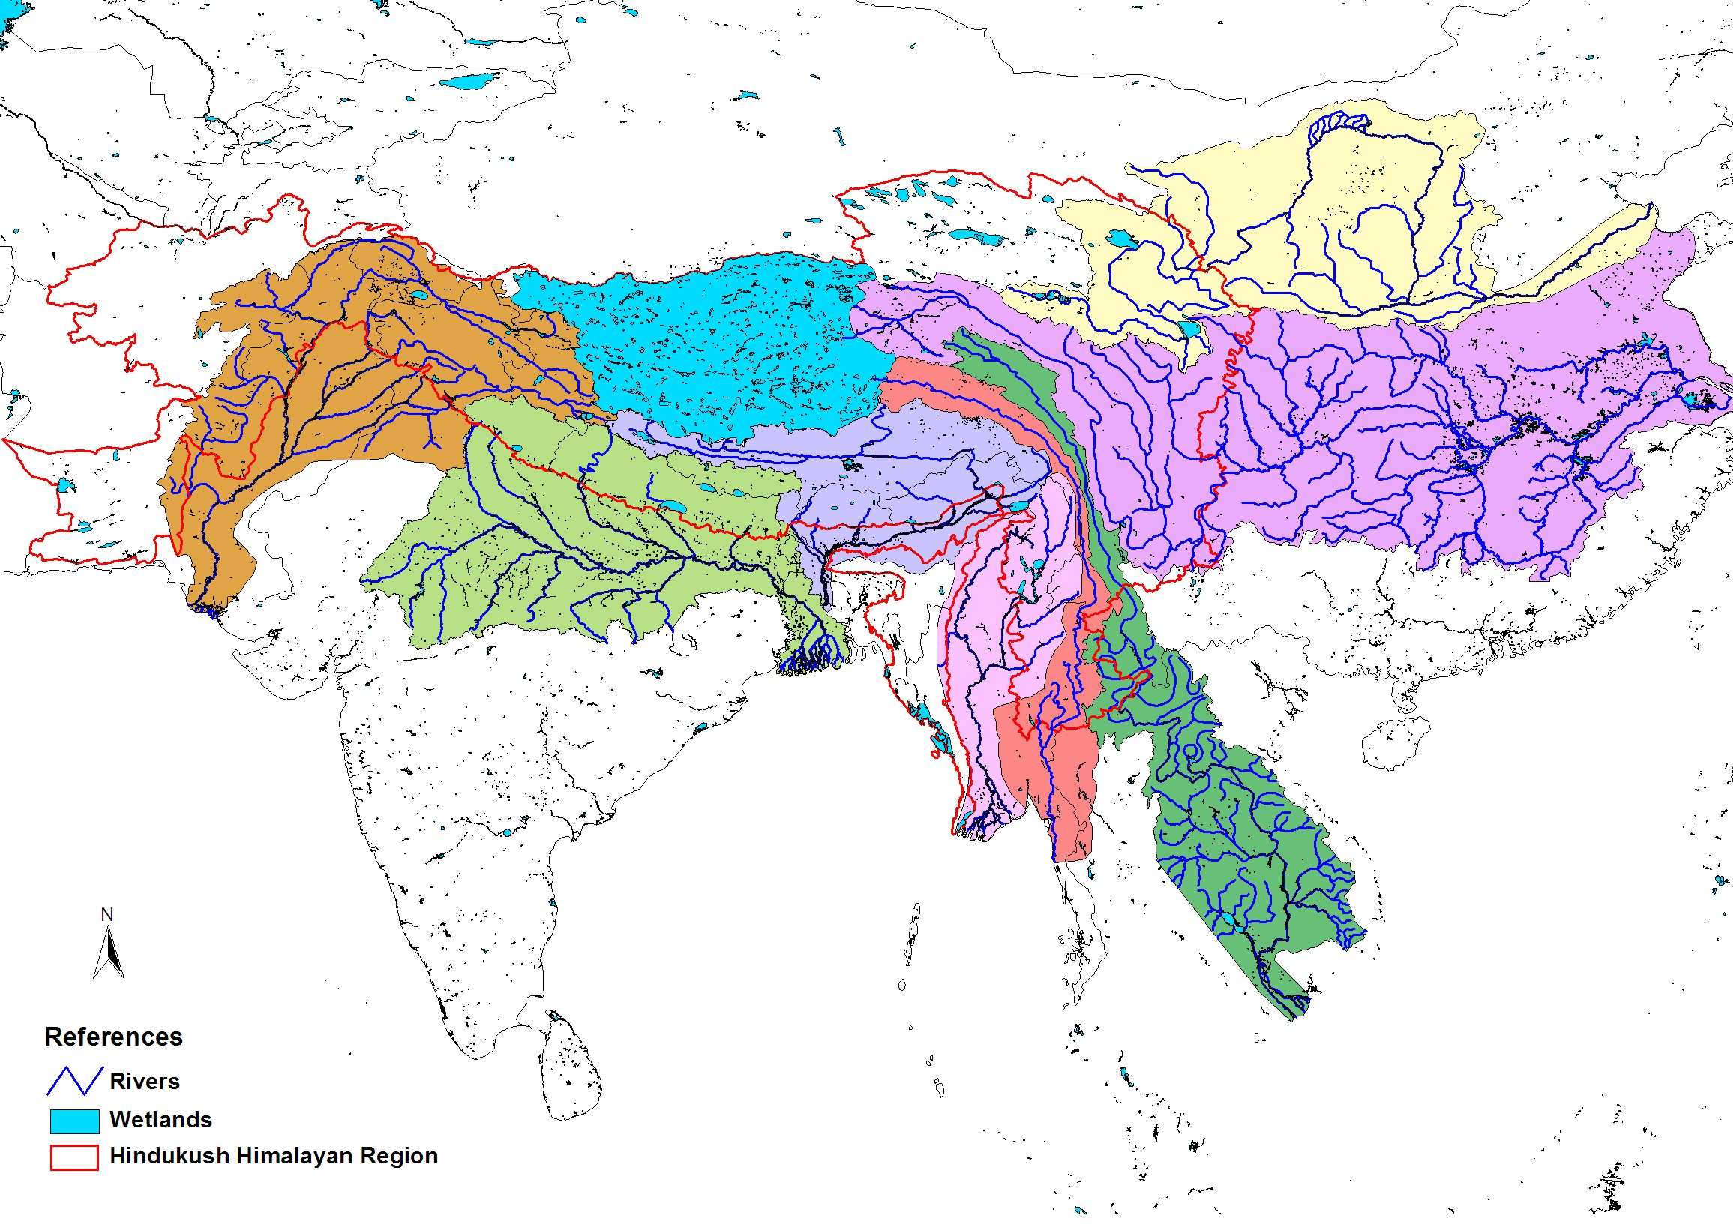
Hindu Kush Himalayan River System
Yellow
Indus
Yangtze
Ganga
Brahmaputra
Irrawaddy
Salween
Mekong
Headwaters of eight large river systems of Asia – habitat of 1/5th of world population

Slide 3
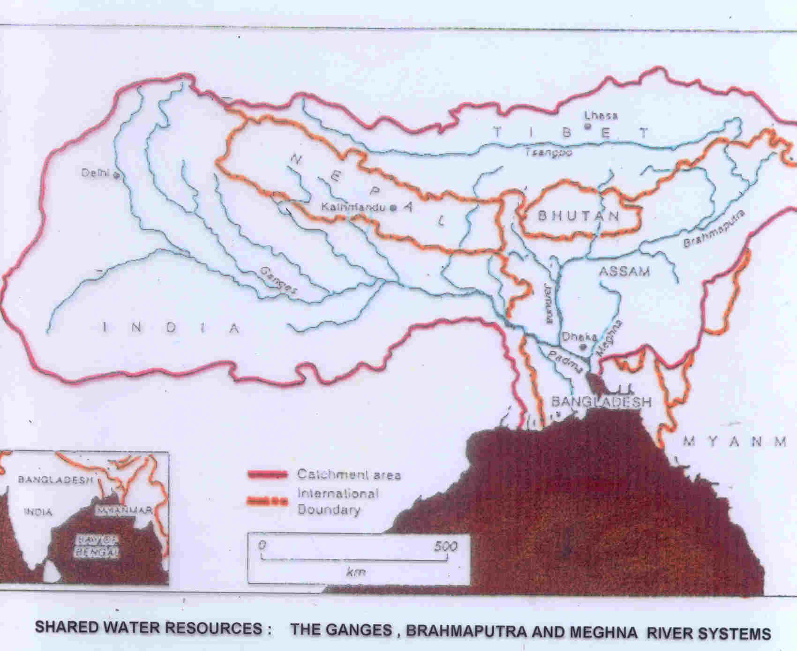
Shared water resources – Ganges, Brahmaputra and
Meghna – no single river authority

Slide 4
River Biodiversity
Rivers have played a critical role in the growth of human civilizations across the globe and have been well known as habitats of thousands of biota including many rare, endangered, threatened, endemic and charismatic species of great interest like dolphins, otters, crocodiles, turtles.
Biodiversity of rivers is characterised by high species richness disproportionate to their area.
The River Ganges has been cradle of Indian civilization.

Slide 5
Ganges-Brahmaputra-Meghna River Basin
The Ganges-Brahmaputra-Meghna River Basin is a transboundary river basin with a total area of just over 1.7 million km², distributed among India (64%), China (18%), Nepal (9%),, Bangladesh (7%) and Bhutan (3%).
Entire Nepal is in the Ganges basin whereas entire Bhutan is in the Brahmaputra basin.
These rivers have distinct characteristics and flow through different regions for most of their lengths. Each one of them have tributaries which are important by themselves in social, economic and political terms, as well as in terms of water availability and use. They join in Bangladesh only just a few hundred km upstream of the mouth in the Bay of Bengal.

Slide 6
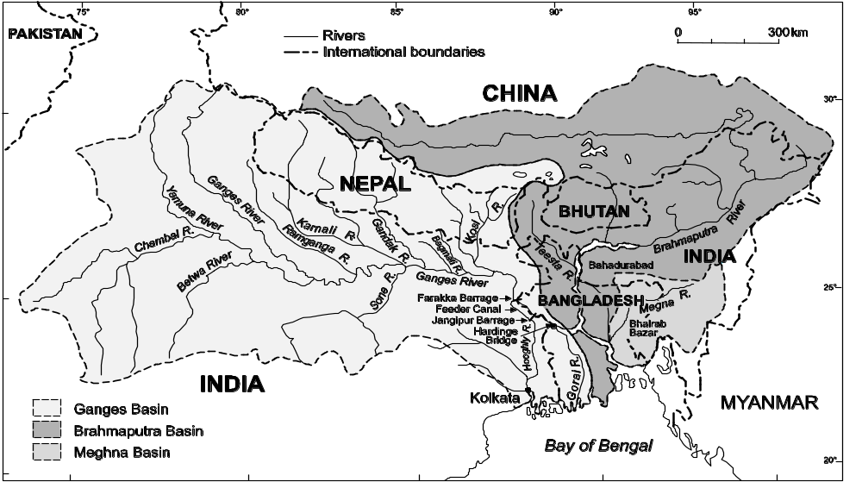
Ganges-Brahmaputra-Meghna River Basin
Ganga-Brahmaputra-Meghna basin is 0.12% of Earth’s surface where >10% of world’s
Population reside

Slide 7
Ganges-Brahmaputra-Meghna River Basin
The GBM river basin is the third largest freshwater outlet to the world’s oceans, being exceeded only by the Amazon in Latin America and the Congo river systems in Africa.
The headwaters of the Brahmaputra river originate in the Himalayan mountain range in China.
The Ganges sub-basin has the highest population density in the world and related challenges. Home to about 750 million people, the GBM basin drains significant parts of both the South and North aspects of the Himalayas which has only 0.12 per cent of the total land mass of the world.

Slide 8
GBM River Basin
The GBM river basin contains the largest number of the world’s poor in any one region.
The region is endowed with considerable natural resources that could be used to foster sustainable economic development. Water could be successfully used as the engine to promote economic development in the region.

Slide 9
GBM Basin
Ganges river basin is characterized by low precipitation in the north-west of its upper region and high precipitation in the areas along the coast.
High precipitation zones and dry rain shadow areas are located in the Brahmaputra river basin, whereas the world’s highest precipitation area is situated in the Meghna river basin.
In the Gangetic Plains annual rainfall averages 760-1 520 mm, and in the delta region 1 520–2 540 mm.
Average annual precipitation over Bangladesh is 2 320 mm, of which about 80 percent occurs in the monsoon (July-September). It varies from 1 110 mm in the extreme north-west to 5 690 mm in the northeast.

Slide 10
Ganges Basin
The Ganges originates from the ice cave at Gaumukh of the Gangotri glacier in the Garhwal Himalayas at an elevation of 4100 meter under the name of Bhagirathi. Another tributary, the River Alaknanda, originates from the Satopanth Glacier almost at the same altitude, 8 km from Badrinath shrine. Both Bhagirathi and Alaknanda flow separately for about 200 km before merging together at Devprayag and attain the name of River Ganges. The Ganges traverses for 2784 km from Gaumukh to Ganga Sagar Island where it joins the Bay of Bengal.

Slide 11

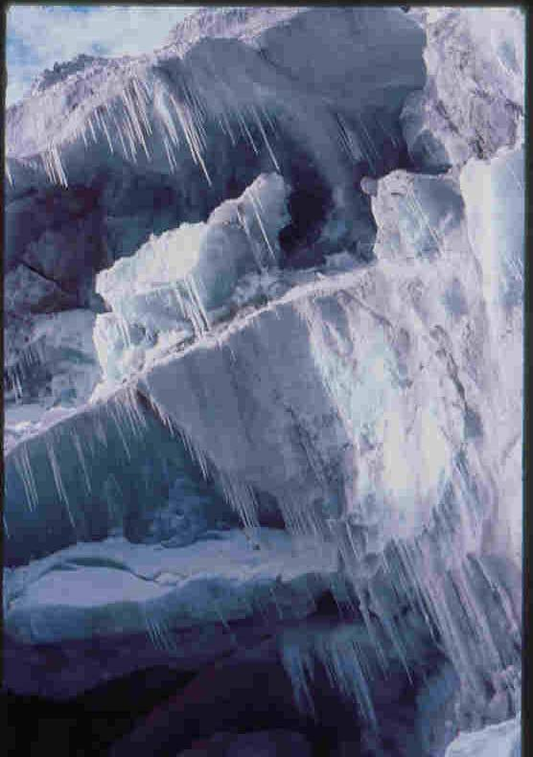
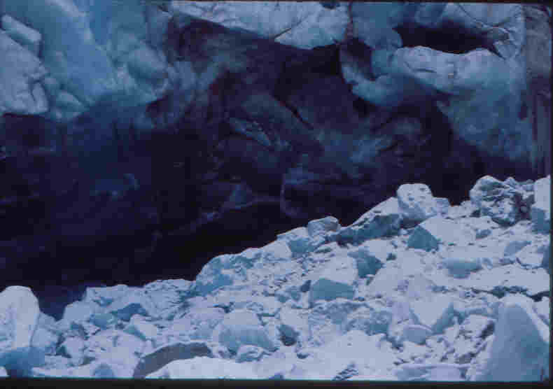
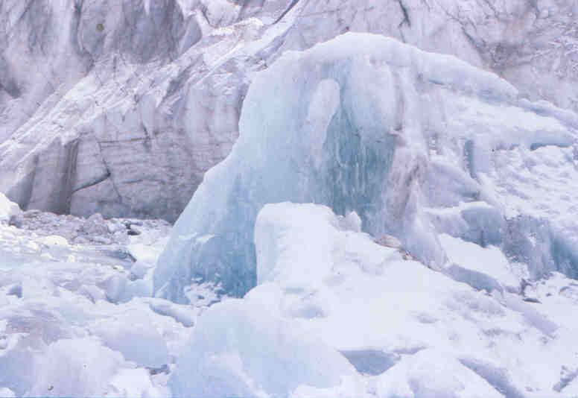
Gaumukh, the origin point of the Ganges (4100 m asl, 30⁰55’ N, 79⁰07’ E
Shiva Linga Peak behind Gaumukh
The Gangotri Glacier system is a cluster of many glaciers comprising the main Gangotri Glacier (length: 30.20 km; width: 0.20 – 2.35 km; area: 86.32 km²). It is retreating @ 28m/yr.

Slide 12
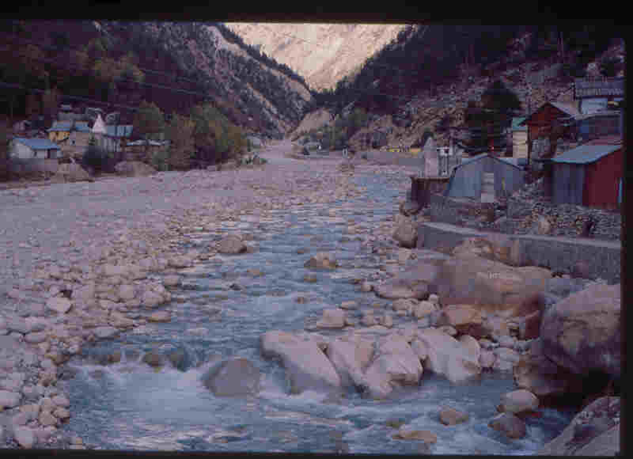
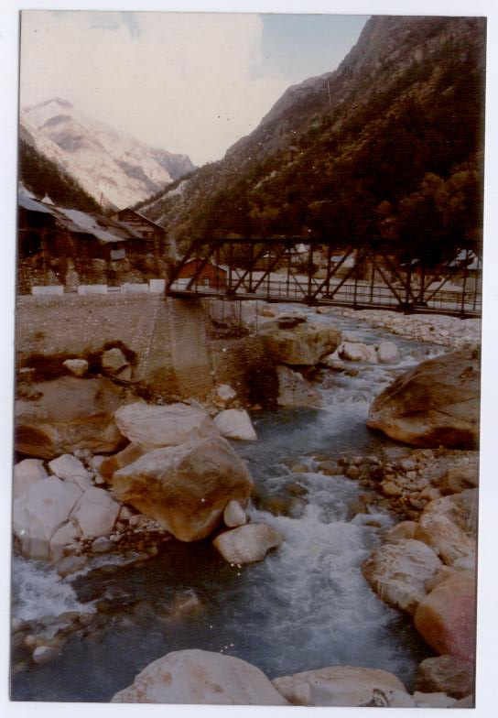
Ganges at Gangotri

Slide 13
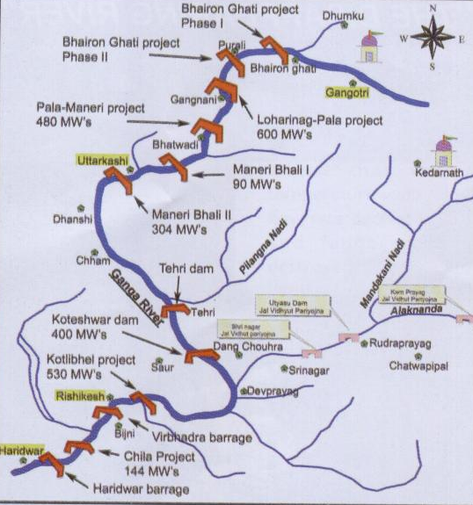
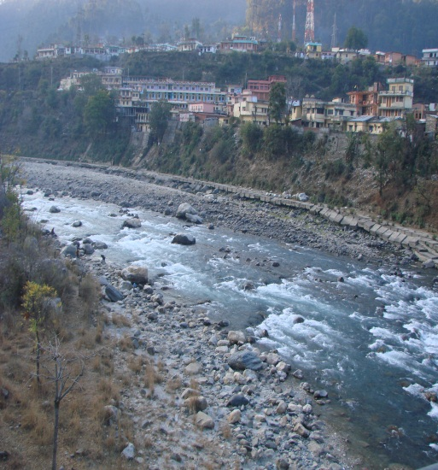
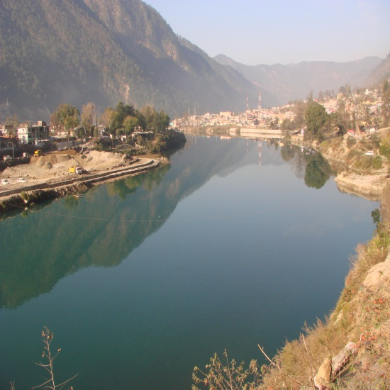
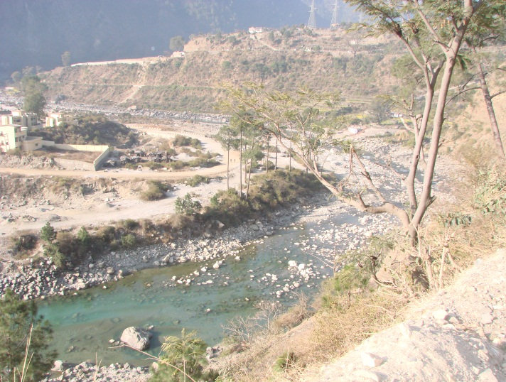
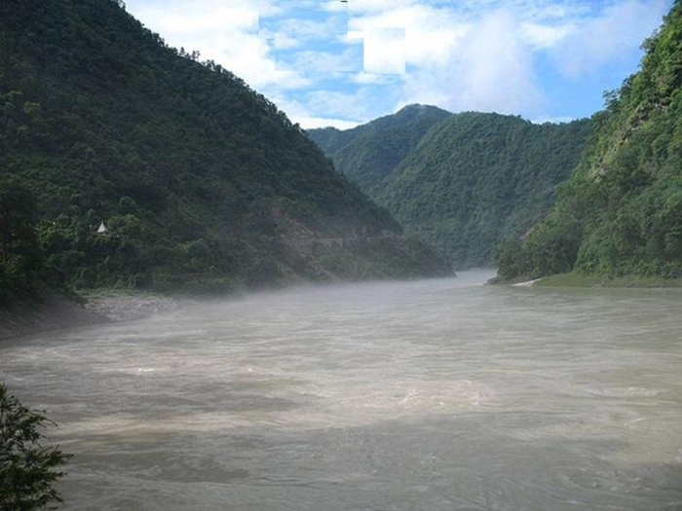
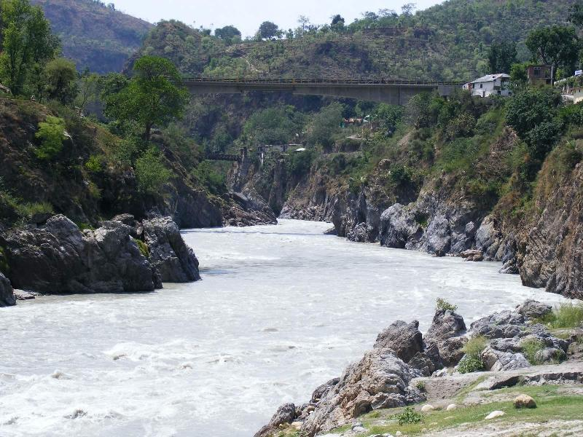
Natural and Regulated Flow in the Ganges in the Himalayas

Slide 14
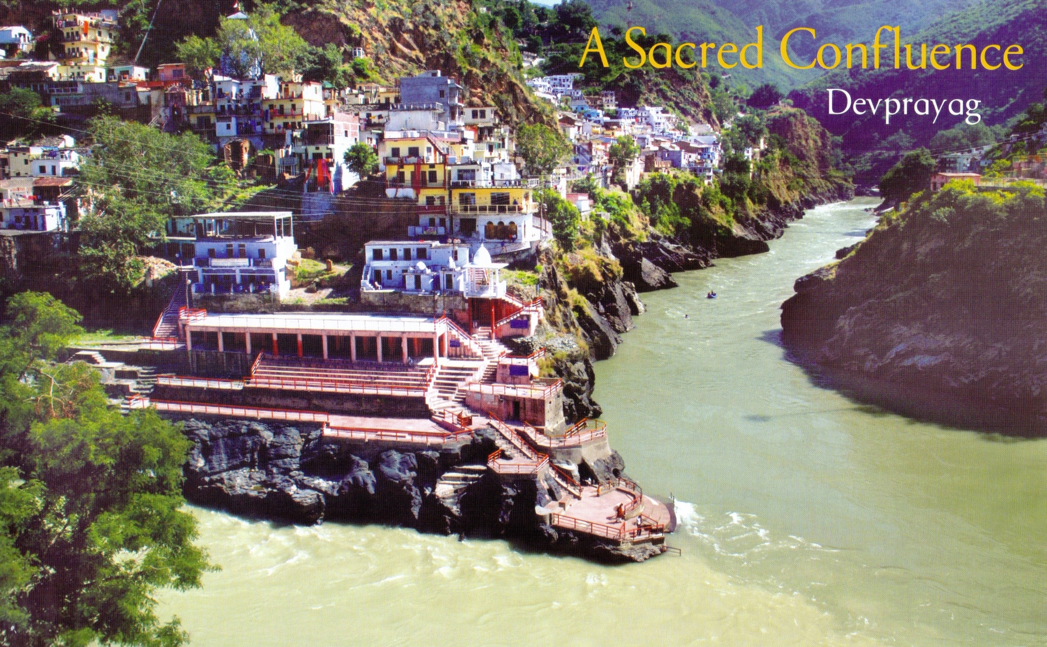
Alaknanda River
Bhagirathi River
Ganges River

Slide 15
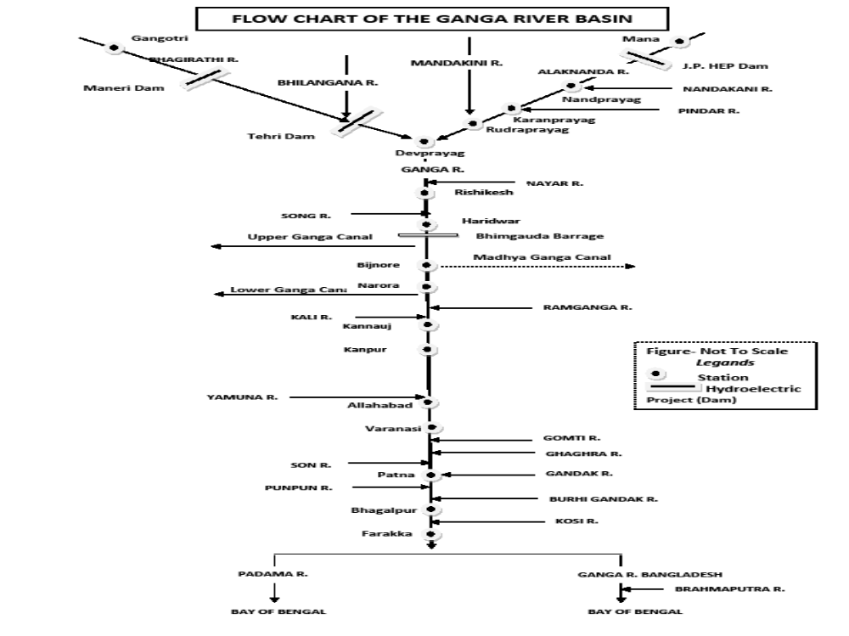
Line Diagram of Ganga River With Major Tributaries

Slide 16
Bioresources of the Ganges
Fungi
In water : 51 species
In sediment : 54 species
Dominant genera. :Aspergillus(11 sps.)
Algae
Chlorophyceae : 264 species
Cyanophyceae : 237 species
Bacillariophyceae : 240 species
Macrophytes : 79 species

Slide 17
Invertebrates
  Protozoa: 28 species
  Rotifera: 104 spesies
  Oligochaetes: 37 species
  Polychaetes: 11 species
  Hirudinea: 14 species
  Cladocera: 36 species
  Bivalves: 36 species
  Gastropods: 40 species
New records
  39 aquatic Annelids
  27 Oligochaeta
  10 Hirudinea
  2 Polychaeta
Fish: 375 species
Amphibians: 11 species
Reptiles: 27 species
Aves: 177 species
Mammals: 11 species

Slide 18
Biodiversity in the Himalayan Ganges
In the Himalayan segment from Gaumukh to Haridwar (294 km), the river flows in gorges and on steep gradient of 1 in 67.
The river bed is composed mostly of rocks, boulders intermingled with pebbles and sand, carries cold water, has less pollution sources, and is highly sensitive and has fragile ecosystem and biodiversity.
The Himalayan Ganges supports a distinct biodiversity with rich habitat diversity in terms of rapids, runs, riffles, and pools. Biodiversity in the stretch are represented by plant diversity (periphyton and phytoplankton), animal diversity (zooplankton, zoobenthos, fish and other vertebrates) and microbes (bacteria, fungi, actinomycetes). Macrozoobenthos are extremely diverse group of animals dwelling in this part of the Ganges.

Slide 19
Biodiversity in the Himalayan Ganges
Macrozoobenthos are represented by nymphs and larvae of Ephemeroptera (15 species), Plecoptera (5 species), Trichoptera (4 species), Hemiptera (3 species), Diptera (7 species), Coleoptera (8 species), Odonata (5 species), Mollusca (4 genera), and Annelida (2 genera).
As the river flows down through the plains the diversity gets richer.

Slide 20
Fish in the Himalayan Ganges
The uppermost stretch of the River Ganga is devoid of fish and is called "No fish Zone" as the fish cannot survive under the extreme environmental conditions of very low temperature and turbulent water current. The metarhithronic zone is known as "Snow Trout Zone" which provides conducive habitat for the species of Schizothorax.
Hyporhithrone is characterized by "Mahseer Zone" dominated by pools and few runs and rapids. This zone has a high volume of water and sufficient food to sustain big fish like Mahseer.
Sixty fish species belonging to 27 genera and 12 families are represented in the Ganges. Cyprinidae is the biggest family with 35 fish species

Slide 21
Upper reaches (Foothill downwards) of the Ganges
40 species of zooplankton, 4 crustaceans, 15 molluscs, 51 insects, 83 fishes, 12 turtles, 2 crocodiles, 48 aquatic birds and two mammals (Ganges River dolphin and Soft-coated otter) have been documented from the upper reaches of the Ganges between Rishikesh and Kanpur (over 850 km)

Slide 22
Ganges from foothill to Varanasi
In the segment, Haridwar to Varanasi (1081 km), the river flows in plains, meandering on bed of fine sand, has wide river bed and floodplains, and has been modified by construction of dams and barrages for diversion of water mainly for irrigation purposes.
Due to Diversion of over 80% of river water to the irrigation canals, and discharge of industrial and domestic effluents, besides non-point sources of pollution mainly from agriculture sector, the segment downstream Narora Barrage to Allahabad (600 km), especially in and around Kanpur, is grossly polluted.
The river gradient is 1 in 5000 in this segment.
Declining river flow and polluted river water are matter of serious concern in this segment.

Slide 23
Ganges---------
Besides encroachments of river bed, gravel and sand mining, farming in river bed, etc are some other concerns.
Several large and mega religious conglomerations are part of socio-cultural dimensions of the riverine systems at places like Haridwar, Allahabad, and Varanasi.
Twelve species of turtles has been documented in this stretch.

Slide 24
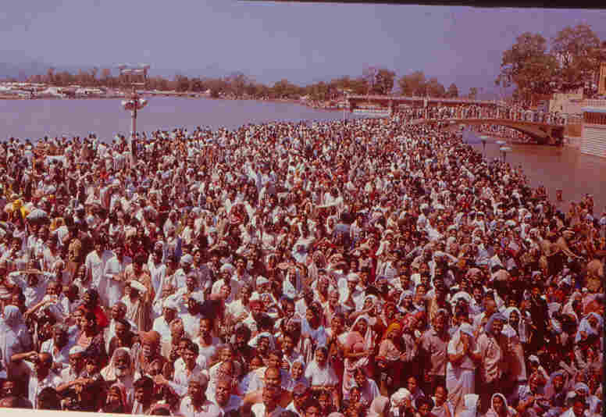
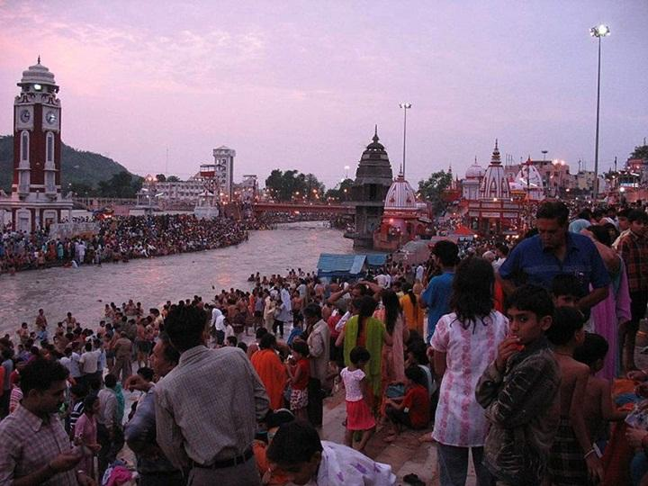
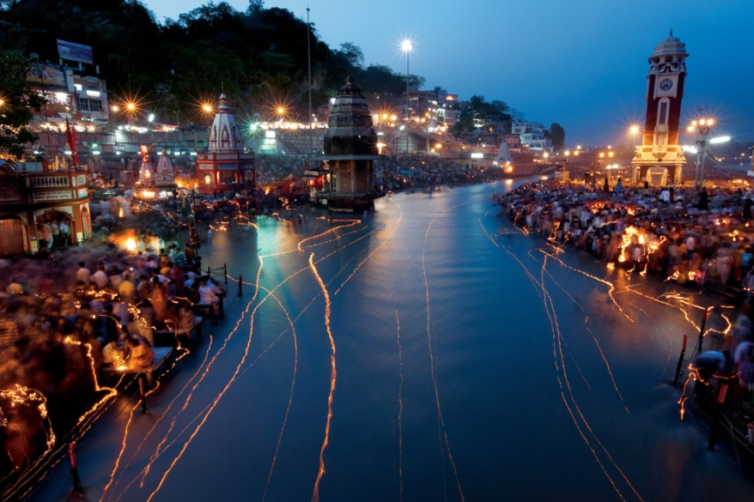
Ganga at Haridwar at Night
Mahakumbh at Haridwar
Ganges water diverted in canal
at Haridwar

Slide 25
Lower Ganges
Lower Segment of the Ganges from Varanasi to Ganga Sagar (1383 km) receives water from glacier-fed large rivers like Ghaghara (Karnali river + Mahakali river), Gandak, Kosi; rain-fed and groundwater and spring-fed rivers originating in lower Himalayas or foothill of the Himalayas like Gomati, Rapti, Bagmati, Burhi Gandak, Mechi etc.
The third category of rivers originate in the central India and are rain-fed. The gradient of the Ganges from Varanasi to Farakka is 1 in 13000 and from Farakka to Ganga Sagar is 1 in 24000.
Thus in this segment the river is almost flat and has created vast floodplains on its both banks. Annual flood is a common feature in this segment.
Very few industries are located in this stretch except near Kolkata. There is only one Farakka Barrage in this segment on the main stem of the Ganges.
The main source of pollution is urban domestic effluents from towns and cities besides non-point sources in Agriculture sectors

Slide 26
Lower Ganges
This segment offers unique biodiversity with many important wetland systems.
The Ganges river stretch in Bihar (over 500 km) and its tributaries sustains highest number (approximately 1500) of Ganges River dolphin.
The River Gandak harbors a population of over 50 Gavialis (fish eating crocodile)population.
Few families of the soft-coated otter, Lutrogale perspicillata, have been encountered in the rivers and wetlands in the segment.
Good population of soft-shell turtles, Nilssonia gangetica and Lyssemis punctata, thrived in this segment but due to rampant poaching their number is declining very fast.
After construction of Farakka Barrage in 1975, anadromous fishes like hilsa and catadromous fishes like eels, freshwater prawn etc. have been affected very badly.
Some euryhaline species like polychaetes are found in this zone.

Slide 27
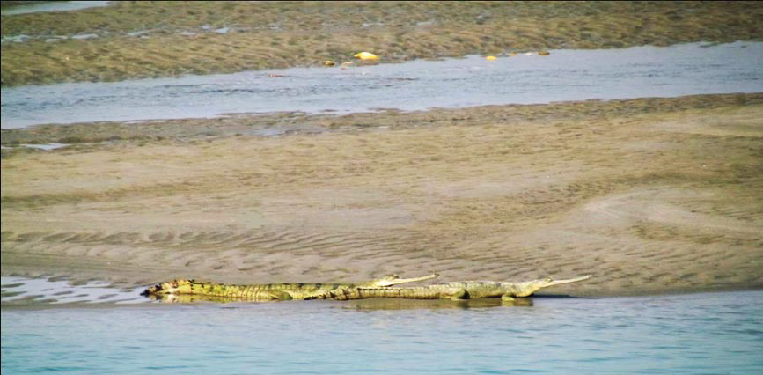
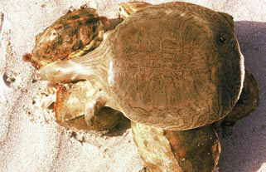
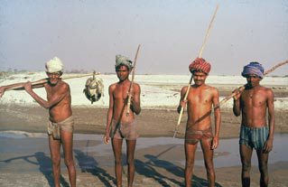
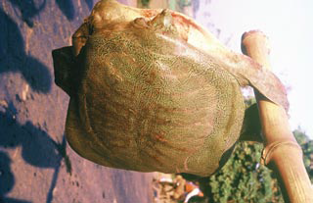
Gavialis gangeticus, a fish eating crocodile
Chitra indica, Indian narrow headed soft-shell turtle
Turtle poachers
Nilssonia hurum, Peacock soft-shell turtle

Slide 28
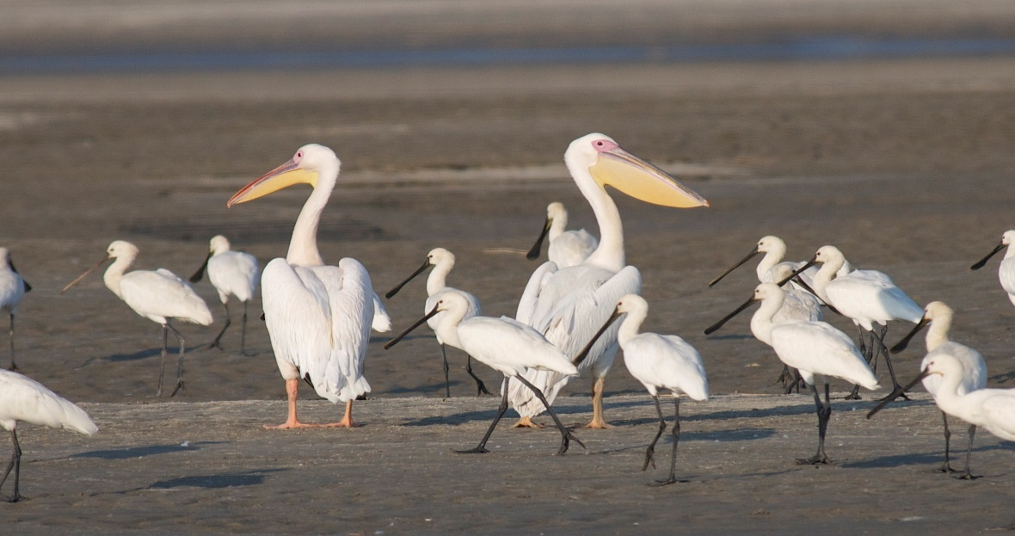
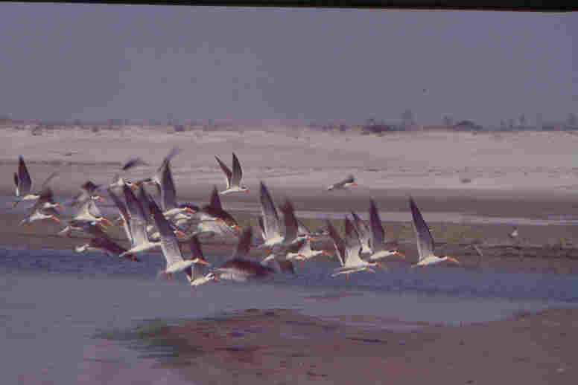
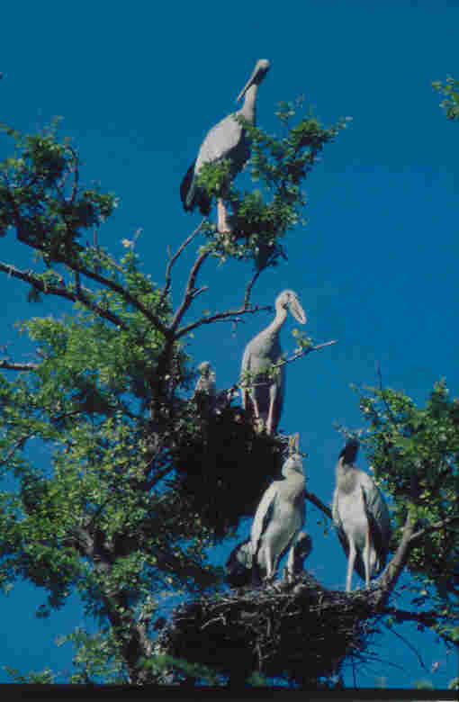
Pelicans and Spoon Bill in the Ganges in Bihar
Indian skimmers in the River Sarda
Open-billed storks along the bank of Ganga

Slide 29
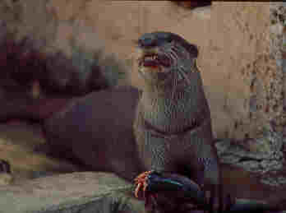
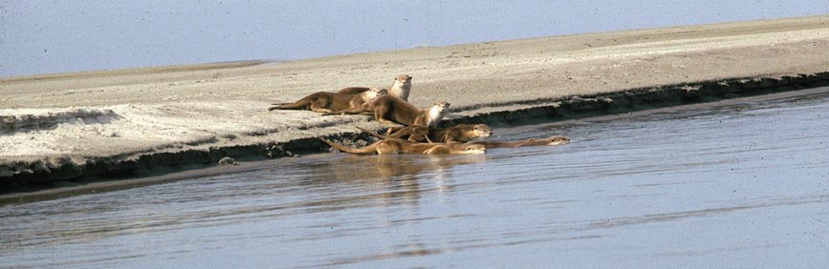
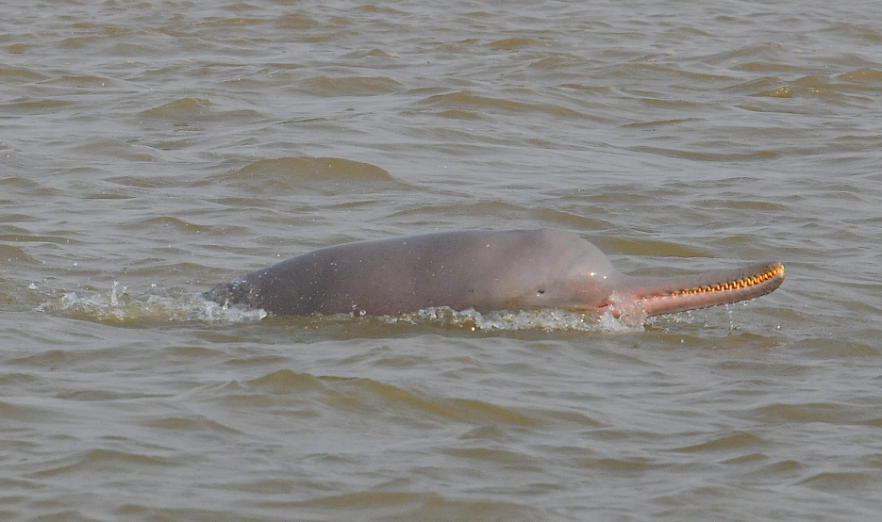
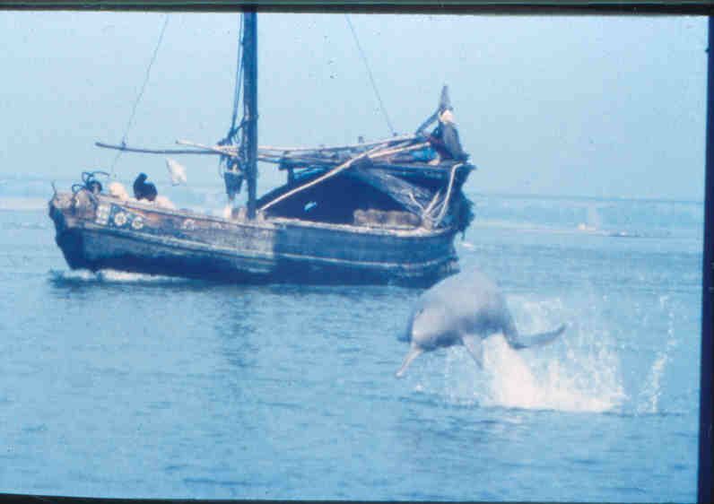
An otter feeding on a fish
Otters in Ganges near Bhagalpur
Ganges dolphins surfacing and leaping in Ganga

Slide 30
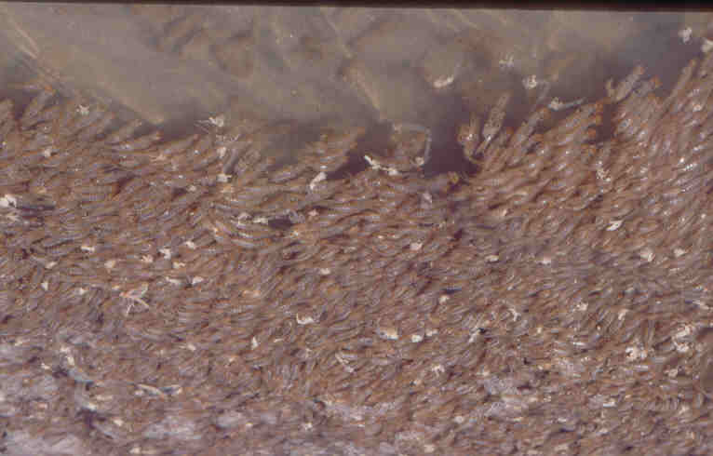
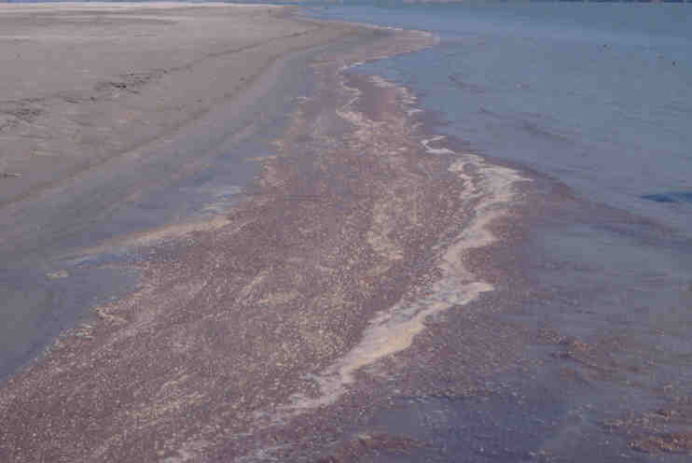
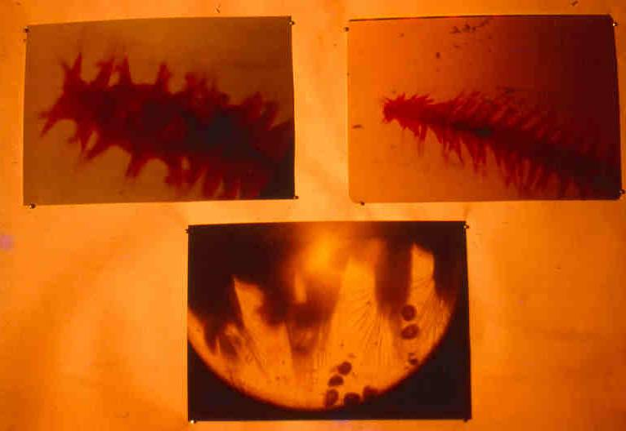
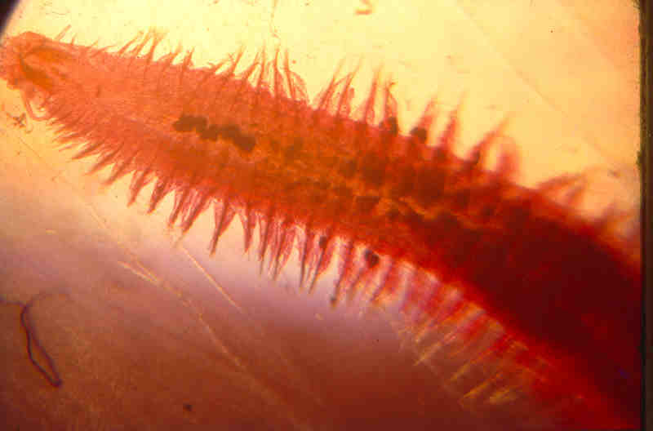
Some interesting invertebrates
Mayfly nymphs in the Ganges, an indicator species
of unpolluted water
Mayfly nymphs
Nephthys polybranchia, another marine element
In the Ganges
Namalycastic indica, a marine element in the Ganges

Slide 31
New species from the Lower Ganges
New records of thirty-nine aquatic annelids (27 Oligochaeta, 10 Hirudinea and 2 Polychaeta) from the Ganga and adjacent water bodies at Patna.
Two naidids- Nais bretscheri and Pristina acuminata were reported for the first time from the Indian sub-continent.
One leech species, Salifa biharensis is new to science.
Three species of bivalvia from the Ganga (Scaphula celox, S. deltae, Novaculina gangetica) are marine relicts of the families Arcidae and Solecurtidae

Slide 32
Economically important fishes in the Ganges
The major carp yield at Allahabad has decreased from 44.5% in 1958-66 to 8.3% in 1996-97 and Tenualosa ilisha (hilsa) from 9.7% to 4.2 in the same period, while large catfishes yield increased slightly from 22.7% to 24.1%.
The miscellaneous fishes (Setipinna phasa, Chela spp., Mastacembelus spp., Puntius spp., Eutropiichthys vacha, Clupisoma garua, Notopterus spp., Rita rita, Mystus vittatus, Ailia coila, Nandus nandus etc) yield increased from 23.1% to 63.4% at the same centre and duration.

Slide 33
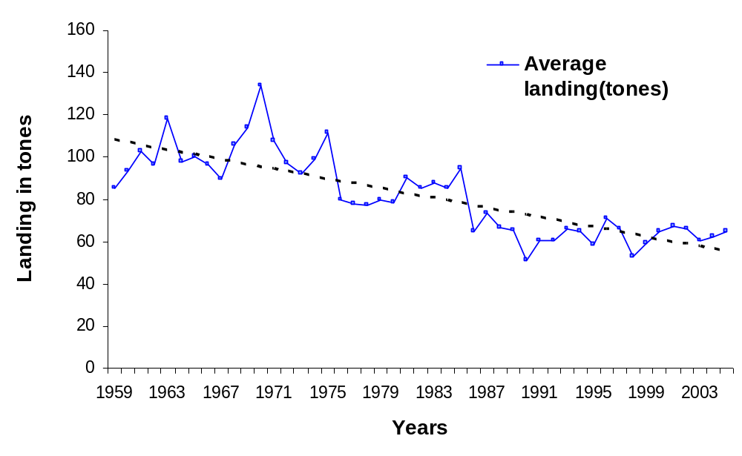
Total average fish landing in Ganga
(Kanpur-Bhagalpur) during 1959-2004
The total average
Fish landings in the
Ganga River systems
Declined from 85.21
Tones during 1959 to
62.48 tones during
2004

Slide 34
Increase in fish catch in Estuarine zone
The average annual yield of prawn and fish from the estuary increased from 9481.5 tons in pre-Farakka barrage period (1966-67 to 1974-75) to 61032 ton during 1997-2000. This is due to increased influx of freshwater in the Hooghly after commissioning of the Farakka Barrage in 1975.
Hilsa fishery increased more than five times in Hooghly from 1457.1 tons in 1975 to 9576.9 tons in 1997-2000. Freshwater species like Eutropiichthys vacha, Clupisoma garua, Rita rita, Aorichthys seenghala, A. aor, Catla catla and Labeo bata have made their appearance in the upper zone of estuary not reported prior to construction of Farakka Barrage.

Slide 35
River Brahmaputra
The Brahmaputra river originates on the northern slope of the Himalayas in China, where it is called Yalung Zangbo.
The Brahmaputra drainage system having a combined length of 2906 kilometres and a catchment area of over 50 m ha, is one of the largest river systems in the world.

Slide 36
Biodiversity in Brahmaputra Basin
Apart from 47 major tributaries, over 3000 floodplain lakes, locally called Beels, are scattered throughout the Brahmaputra basin within the Indian territory. The river system is sustained by snowmelt run-off, the ablation of glaciers and rain water.

Slide 37
Brahmaputra River
It is relatively unpolluted river as very few towns/city are located on its bank, however, it suffered a gradual decline in habitat quality due to changes in “water regime” especially the seasonality and hydrograph of the river system.
As a whole, the habitat reach of all the major tributaries and also the main river is unstable due to alluvial nature of the basin, frequent changes of river courses, high rate of bank erosion.
Deforestation in the catchments, construction of roads and embankments snap lateral connectivity with floodplain lakes reduces habitat complexity.
The adverse changes to the riparian ecotones have impacted the habitats of a variety of food and ornamental fish species

Slide 38
Climate in Brahmaputra River Basin
The Brahmaputra traverses through different climatic zones, landscapes and bio-geographic regions.
The climate of the upper Brahmaputra valley varies from tropical through sub-tropical to temperate at the higher altitudes. Temperature varies from sub-zero degrees in the upper region to 38⁰C in the plains where relative humidity ranges more than 85 per cent.
The pre-monsoon rain experienced in April-May inundates the low-lying ground and recharges the wetlands, which provide an ideal habitat and breeding ground for a large number of fishes including Indian major carps.

Slide 39
River Brahmaputra
The river is considerably fast flowing in Tibet and also
in Arunachal Pradesh (the gradient ranges from 4.3
to 16.8 m km⁻¹). Between Kobo and Dibrugarh the
gradient of the river is reduced to 0.09-0.17 m km⁻¹.
After Dibrugarh, the river basin gets flattened with an average gradient of 0.13 m km⁻¹ throughout its course of about 640 kilometres within Indian territory.
The river carries very high sediment loads of about 332 million metric tons annually. Throughout its course, Brahmaputra is continuously shifting southwards and in some places migrating at rates as high as 800 m/ yr.

Slide 40
The Brahmaputra Basin
Flood pulse and its associated sediment/ nutrients are identified as the most influencing factor for diversity and assemblage of fish fauna in the upper Brahmaputra basin including riparian zones.
70 species of ornamental fishes have been recorded from the Beels of upper Assam.

Slide 41
The Brahmaputra Basin
Altogether 167 fish species have been recorded from the upper Brahmaputra of which about 30 percent may be considered as ornamental varieties.
Usually, there are three or four high floods between May and October and fish migration is intimately related to this flood regime.
Drastic alteration of river ecosystem due to large-scale felling of trees in the catchment areas and construction of embankments and dams on the rivers resulted in heavy siltation and loss of the connectivity with the floodplain lakes adversely affecting breeding ground of fishes and other megafauna.

Slide 42
The Brahmaputra Basin
220 rotifer species (21 families and 46 genera) were recorded from the lakes of Brahmaputra floodplains in India which is the richest diversity of the taxon recorded from any part of the Indian sub-region and one of the richest known globally.
These comprise about 40 per cent of the Oriental rotifer species. Bio-geographically, interesting taxa include five Australasian and 10 Oriental endemics; fourteen Palaeotropical, one Holarctic, two Arctic-temperate and twelve Eastern hemisphere species.
A report of 171 species from Deepor Beel (a Ramsar site) assigns a globally rich rotifer ecosystem status to this important floodplain lake.
131 species of rotifers from Majuli, the largest river island, reflects rich micro-metazoan diversity of this fluvial floodplain.
The diversity pattern of rotifers is predominantly tropical, and follows the moderate endemicity model.

Slide 43
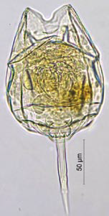
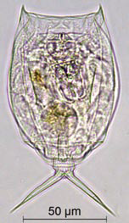
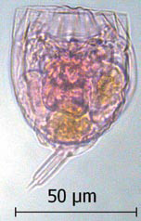
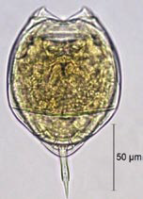
Lecane niwati
Lecane rhytida
Lecane undulata
Lecane bulla
diabolica (Hauer)
Some Zooplankton from Brahmaputra Basin

Slide 44
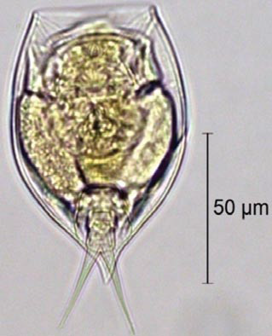
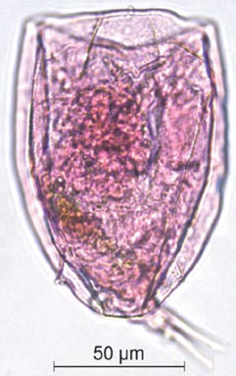
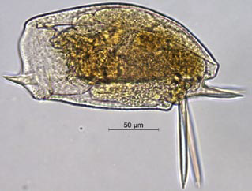
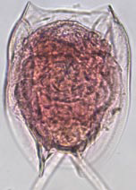
Some Zooplankton from Brahmaputra Basin
Mytilina michelangellii
Wolga spinifera
Lepadella vandenbrandei
Euchlanis meneta

Slide 45
The Brahmaputra Basin
74 species of Cladocera belonging to 41 genera were reported from the Brahmaputra Basin.
Chydoridae is the most diverse family; Chydorus and Diaphanosoma are dominating genera; and the paucity of Daphnia spp. is characteristic.
Deepor Beel is one of the richest Cladocera (58 species) “hot-spot”.
55 cladoceran species from the wetlands of Majuli island highlights its ecosystem diversity.
The diversity pattern of Cladocera of the Brahmaputra floodplains is predominantly of “tropical” nature.

Slide 46
The GBM Basin
Depore Beel or lake is choked with water hyacinth and getting reclaimed for construction of infrastructure, urbanization and industrialization.
Water in the GBM Basin is abundant during the monsoon but scarce during the dry season.
Proper utilization of water requires formulation and implementation of a framework for multidimensional cooperation in related sectors such as energy, environment, health, flood management, water quality, navigation, and trade and commerce among the basin nations

Slide 47
The GBM Basin
Of the total estimated flood prone area in India, about 68% lies in the GBM states.
The Ganges in northern India, which receives waters from its northern tributaries originating in the Himalayas, has a high flood damage potential, especially in Uttar Pradesh and Bihar.
Likewise, the Brahmaputra and the Barak (headwaters of the Meghna) drain regions of very heavy rainfall and produce floods from overbank spilling and drainage congestion in northeastern India

Slide 48
Biota of GBM Basin
The fisheries contribute and serve as the major source of protein. Apart from a good variety of fishes, crustacean and crabs, the rivers are also home to the endangered Ganges river dolphin Platanista gangetica gangetica, Smooth-coated Otter Lutrogale perspicillata, the endangered River Terrapin Batagur baska, Marsh Crocodile Crocodylus palustris, Gharial Gavialis gangeticus, many shore and migratory birds, etc.
The existence of many of these aquatic lives is under threat due to both natural and anthropogenic stresses.

Slide 49
The GBM Basin
Properly managed, and given political will in all the co-basin countries, water could act as an engine to trigger economic and social development in the region. As opportunities unfold, emphasis could shift from more irrigation to sustainable agriculture productivity, from electricity production to energy grids and industrialization, from flood control to flood management, and from inland navigation to inter-modal transport.
The ultimate goal should be to attain a mutually beneficial synergy amongst national interests, people’s well-being and regional prosperity, initiated through the best possible utilization of the huge potential of the region’s water resource.

Slide 50
Threats to the River Biodiversity of the GBM Basin
Receding glaciers: climate change and declining flow in the Ganges:
Undoubtedly, the glaciers are retreating, but not at a catastrophic rate and they are not going to disappear in the near future .
Assuming the recession rate of Gangotri glacier to be 40 m/yr, simple computations show that a glacier of 30 km length will take about 700 years to completely melt away. Further, there will be years of heavy snow fall in between which will extend the life of the glaciers.
As different glaciers in the same climatological set-up respond differently to the changing climate, long-term studies on glacier mass balance and glacier dynamics are needed to understand the impact of climate change on Himalayan glaciers.
Since global warming will have effect on other variables like precipitation intensity and quantity, cloud cover, wind etc. besides temperature change, a detailed measurement and modelling study needs to be conducted to derive useful inferences.

Slide 51
Habitat Alteration
The major causes of habitat alteration are construction of dams and barrages, embankments, drainage channels, sedimentation, etc. Three dams being constructed in Tibet region is likely to affect flow in Brahmaputra. Similarly HEPs in Garhwal Himalayas in India will adversely affect flow in the Ganges.
The Western Ganga Canal diverts more than 60% of the annual flow, and almost 100% of dry seasons flow at Haridwar.
The Lower Ganga Canal at Narora, about 264 km downstream of Haridwar, diverts even more water.
The dams and barrages act as physical barrier for migratory aquatic species and block the downstream transport of particulate matter, which replenish a delta and is an important source of nutrients and food for aquatic biota.
The Farakka Barrage traps the silt from the Ganges water and the “silt free” water is diverted through the Farakka Feeder Canal (38 km) to the Bhagirathi-Hooghly river system. The ‘silt free’ water has destroyed the hydrogeomorphological complexities in the River

Slide 52
Embankments as flood control measure
Construction of 3500 km embankments as flood control measures, increased the flood affected areas 3 times in Bihar
Wetland destruction
Wetlands are vanishing in the Ganges basin due to excessive siltation, channelization and construction of embankments
Wetlands help in maintaining water quality, recharge groundwater, provide habitat for various species and their life history stages.

Slide 53
Pollution
As per National Mission for Clean Ganga total sewage discharged in the Ganga basin is 13000 MLD (total in India 33000 MLD); treatment capacity is only for 4000 MLD (7000 MLD in India).
From 29 Class – I and 23 Class – II cities total sewage discharged along the Ganga main stem is 2600 MLD and treatment capacity is only for 997 MLD.
Delhi alone discharges 3300 MLD sewage in the Yamuna.
The agriculture sector drains about 134.8 million m³ wastes into the Ganga basin. Fertilizers used in agriculture activities in basin released about 887133 tons of Nitrogen; 137445 tons PO₄ and 91247 tons Potassium.
Similarly 2573 tons pesticides, mainly DDT and BHC-Y are applied annually for pest control.
In addition, hundreds of human corpses are released to the river each day for spiritual rebirth. Besides, thousands of animal carcasses are also dumped in the river.

Slide 54
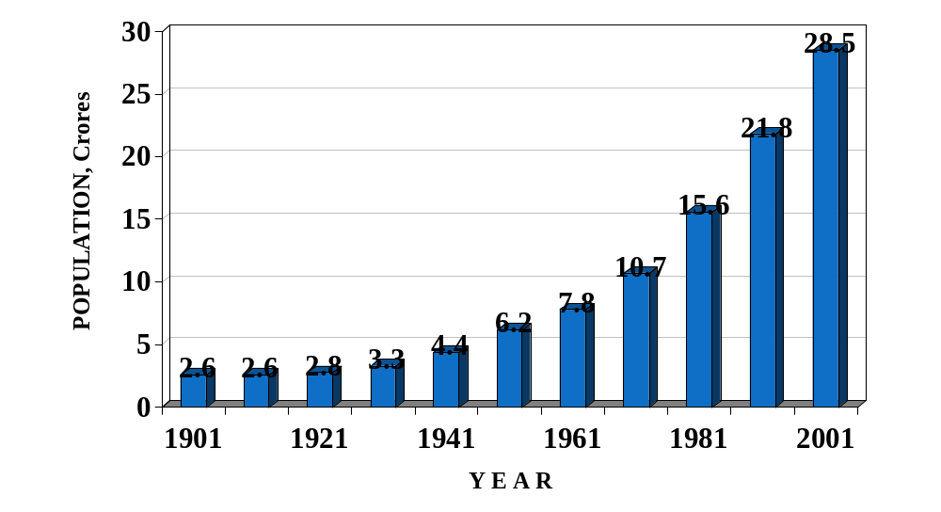
Increase in Urban Population

Slide 55
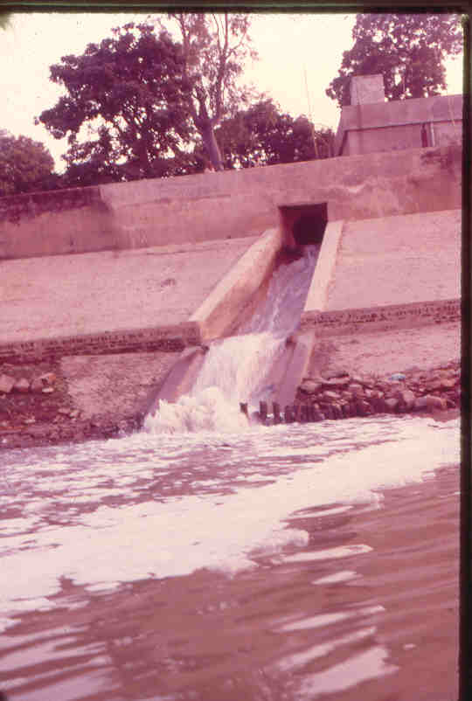
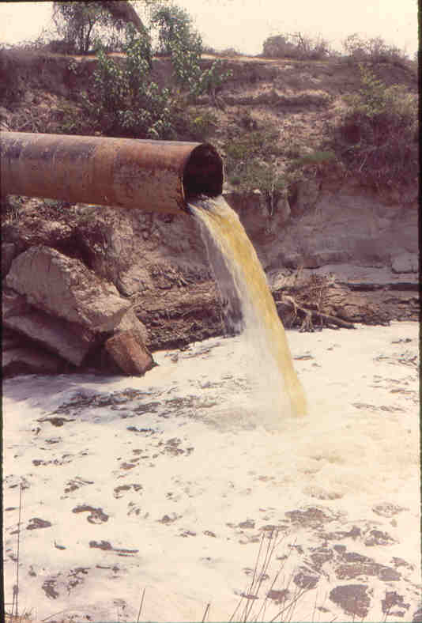
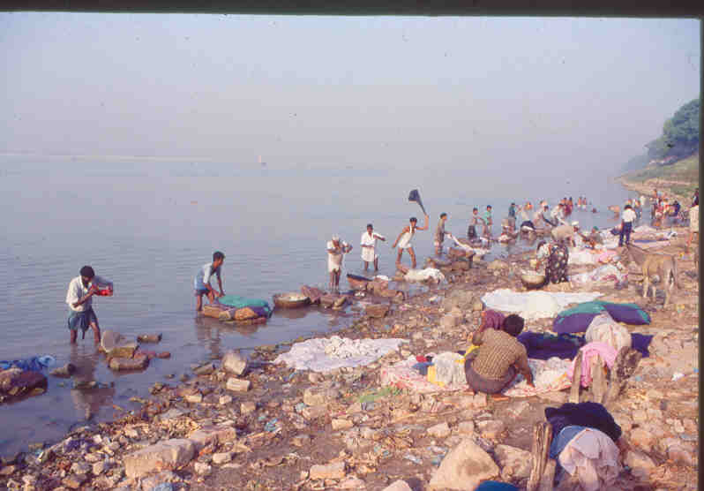
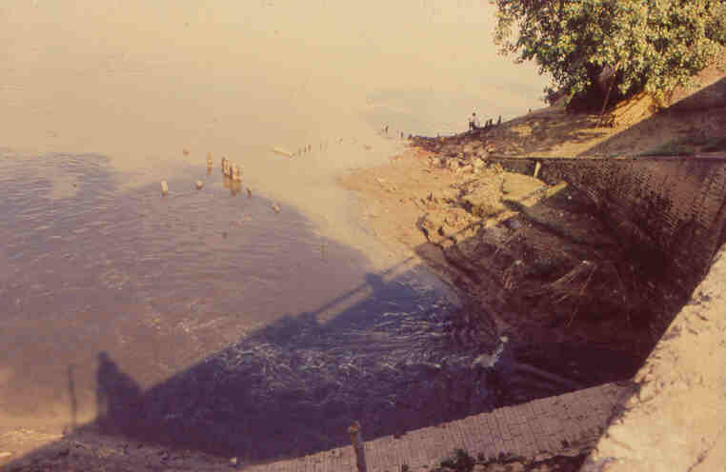
Different sources of organic pollution in Ganga

Slide 56
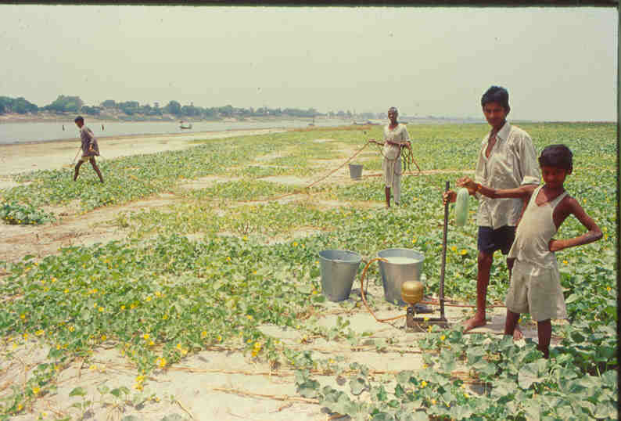
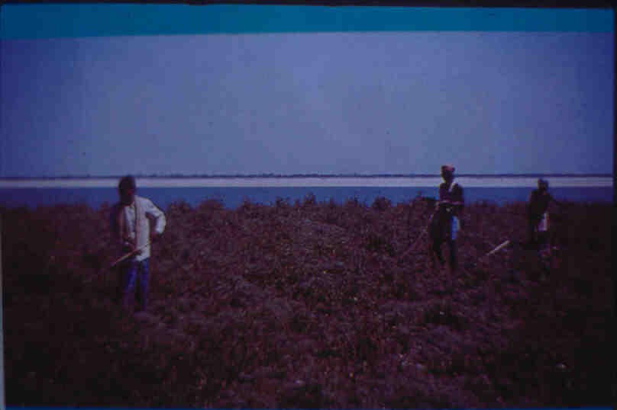
Use of organochlorines in the floodplains of the Ganges
Tissues | DDTs | HCHs | CHLs | PCBs
Blubber | 41800 | 1400 | 160 | 4000
Liver | 1200 | 117 | 3 | 285
Milk | 480 | 400 | 33 | 620
Concentrations in ng/g wet wt.

Slide 57
Introduction of exotic species in Ganges
Thai Mangur (Clarias gariepinus)
Chinese grass carp (Ctenopharyngodon idella)
Common carp (Cyprinus carpio)
Tilapia
South American ornamental aquarium cat fish (Pterygoplichthys anisitsi)
Physa (Haitia) mexicana, a snail
Eichhornia crassipes, Water Hyacinth

Slide 58
Over-exploitation of bio-resources
FISH
Fish production decreased by 22% at Allahabad and 75% at Buxar during 1958 to 1984.
During 1961 – 69 to 1980 – 86 fish production declined by 42% at Patna.
Collectively Indian Major Carps accounted for 40% in 1958 – 61; declined to 32.41% in 1972 – 79 and 22.3% in 1995.
At Patna IMC constituted 31.4% in 1958 – 61 and declined to 6.5% in 1993 – 95.
Reptiles
Soft – shell turtles (Aspideretes gangeticus), an endemic species has reduced to scarce.
> 5000 such turtles confiscated during 2006 – 08 in Bihar being smuggled to West Bengal from Uttar Pradesh state.
Gavialis and crocodiles almost exinct
Mammal
Gangetic dolphin reduced to about 3000 in the Ganga and its tributaries including Brahmputra
Smooth coated otter population has also declined to critical level

Slide 59
HOW TO CONSERVE RIVER BIODIVERSITY?
We must address the different threats the rivers are facing.
Conservation of riverine biodiversity requires adequate understanding
of the structure and functioning of particular river system.
Rivers are three-dimensional systems involving longitudinal, lateral and vertical transfers of material, energy and biota.
The flow regimes of a river play the most critical role in conservation of rivers biodiversity.
In India, there has been considerable emphasis on the treatment of domestic and industrial wastewaters for “restoring’” the water quality while the flows issues continued to be neglected.
Rivers have been perceived only as channels which could be modified at human will.

Slide 60
The floodplains have been eliminated and, in most cases, the riparian vegetation completely lost. It may be emphasised that floodplain is an integral part of rivers.
Much of the riverine biodiversity cannot be conserved without their floodplain habitats which are also allowed to interact with the river channels.
Also, the impacts of catchment degradation cannot be overlooked.
Conservation of riverine biodiversity cannot rely upon the ex-situ and protected area approaches. Fish nurseries, induced breeding and river ranching may be appropriate for a couple of endangered species but cannot substitute for the loss of populations in their natural habitats.
Rivers must be allowed to have uninterrupted quality flow.
HOW TO CONSERVE RIVER BIODIVERSITY?

Slide 61

THANKS

