Slide 1


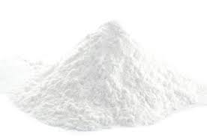
Multiferroic and Magnetoelectric properties of BCT-ZF ceramics
Rashmi Rani*, Radheshyam Raiª, Seema Sharma^{b},
Madan Lalª, Mamta Shandilyaª, Arpana Singh^{b}
a) School of Physics and Materials Science, Shoolini University, H.P, India.
b) Ferroelectric Research Laboratory, Department of Physics, A.N.College, Patna, India.
*Laboratoire des Solides Irradies, Ecole Polytechnique, Palaiseau, France .
Ceramic and composite materials , June 26-27, 2017 Madrid, Spain

Slide 2
Outline
Introduction
1) Mulitiferroic.
2) Idea of magnetoelectric effect.
3) Multiferroic magnetoelectric materials.
4) Barium calcium titanate (BCT) - Zinc ferrite (ZF).
Synthesis and preparation of BCT-ZF
1) Solid state sintering method.
2) Characterizations.
3) Measurements.
Results & discussions
1) Structural properties of BCT-ZF.
2) Magnetic properties of BCT-ZF.
3) Electrical properties of BCT-ZF.
4) Magnetoelectric properties of BCT-ZF.
Conclusions and perspectives

Slide 3
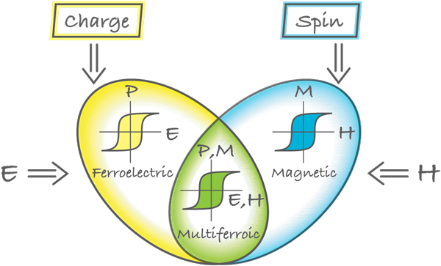
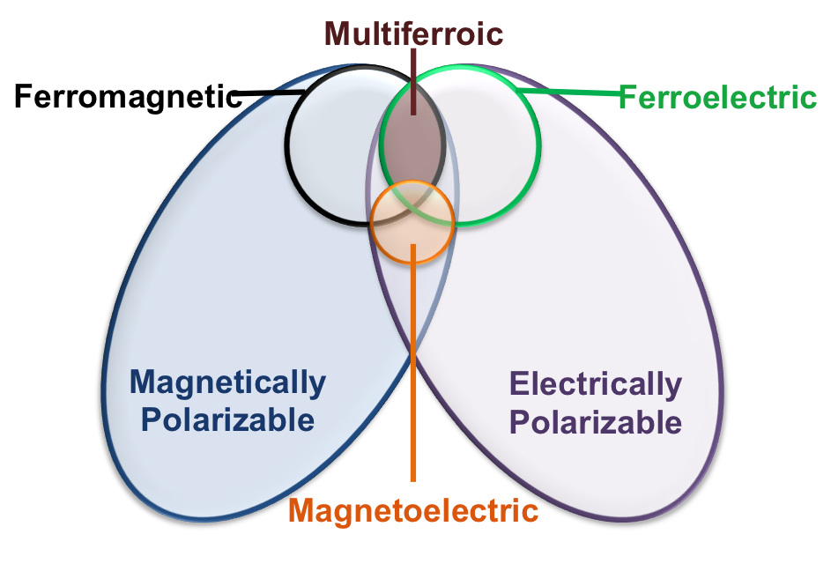
Multiferroic???
Multiferroics are defined as materials that exhibit more than one of the primary ferroic order parameters in the same phase « formation of switchable domains:
Ferromagnetism Ferroelectricity Ferroelasticity
spontaneous spontaneous spontaneous
magnetization polarization strain
N
S
+ -
+ -
+ -
+ -
Ferroelectric
Ferroelastic
Piezoelectric and electrostrictive coupling
Ferromagnetic
Ferroelastic
Piezomagnetic and magnetomechanical coupling
Ferromagnetic
Ferroelectric
Magnetostrictive and piezoelectric coupling

Slide 4


Idea of magnetoelectric effect
The magnetoelectric effect (ME) is the phenomenon of inducing magnetic (electric) polarization by applying an external electric (magnetic) field. The effects can be linear or/and non-linear with respect to the external fields. In general, this effect depends on temperature. The effect can be expressed in the following form:
P_{i} = Ʃα_{ij} H_{j} + Ʃβ_{ijk} H_{j} H_{k} +…..
M_{i} = Ʃα_{ij} E_{j} + Ʃβ_{ijk} E_{j} E_{k} +….…..
E
P
Two types
N
S
Magnetoelectric effect (ME)
1) Direct ME effect
2) Converse ME effect
ε
M
σ
H

Slide 5
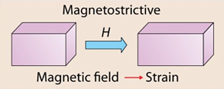
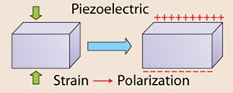
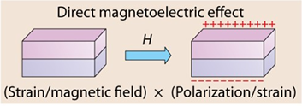
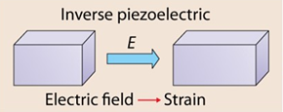
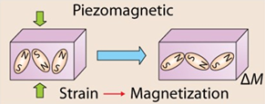
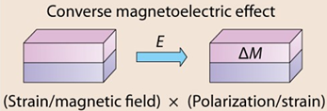
Magnetoelectric effects
1. Direct ME effect
Mechanical deformation of
the magnetostrictive phase
2. Converse ME effect
Mechanical deformation of
the piezoelectric phase

Slide 6
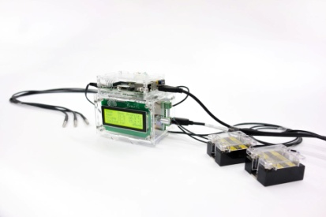
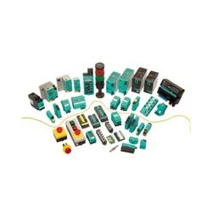
Multiferroic magnetoelectric materials:
A materials which have the coexistence of long-range ferroic orders and strong coupling between pertinent order parameters such as composites based on
Magnetic materials as well as Piezoelectric materials
Ferrites Barium titanate
Maganites Lead zirconate titanate
Ferromagnetic metals Lead zinc niobate– lead niobate
Alloys Lead magnesium niobate-lead titanate
composites
additional control to input and store data
Applications:
Sensors, multistate memories, actuators,
device applications as well as biomedical fields etc . ..
Bismuth ferrite (BiFeO₃)
In single phase, exhibits ME coupling at RT

Slide 7
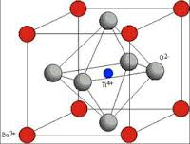
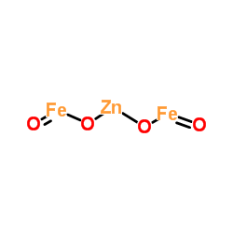
BCT-ZF
“Bilayer connectivity of ferromagnetic and ferroelectric oxides was proven to
be successful to achieve giant ME coupling’’.
[C.-S. Park, A. Khachaturyan, S. Priya, Giant magnetoelectric coupling in laminate thin film structure grown on
magnetostrictive substrate, Applied Physics Letters, 100 (2012) 192904.]
Lead-free systems: (K, Na) NbO₃ -ferrite, (Bi, Na) Ti O₃-ferrite and BaTiO₃-ferrite
BaTi O₃
ZnFe₂O₄
Ferroelectric Perovskite
Spinel structure
High dielectric & Piezoelectric properties
Paramagnet in bulk at RT
Inhance electrical properties by substitution
of ‘Ca’
Super paramagnet in nano
scale at RT
Ba_{0.96}Ca_{0.04}TiO₃
1-X
BaCaTiO₃
X
ZnFe₂O₄
Magnetoelectric
Composite
BCT
ZF

Slide 8
Synthesis and preparation of composite
Magnetoelectric composite
((1-x)Ba_{0.96}Ca_{0.04}TiO₃–(x)ZnFe₂O₄)
where x = 0.10 and 0.20
Synthesized by Solid state reaction method
BaCO₃
CaCO₃
TiO₂
ZnO
Fe₂O₃
BCT-ZF
Ferroelectric phase
Ferromagnetic phase
Wet ball-milling
Raw material taken as a stoichiometric composition mixed in nylon jar with ethanol for 4-5hrs
Calcined at 900 C for 6 hrs
Calcination
Pressing powders into cylindrical pellet of 10mm in diameter and 1-2 mm thickness using hydraulic press at 50MPa
pressing
Sintered at 950 C for 3 hrs for densification
Sintering
Characterizations…
Measurements…

Slide 9
X-Ray diffraction pattern of BCT-ZF
Cubic spinel
Tetragonal
A secondary phase of ZnFe₂O₄ is observed which confirm that successful synthesis of
magnetoelectric multiferroic material.
Debye-Scherrer formula
The calculated average crystalline size is about ~ 32 and 22 nm for BCT and ZF respectively.

Slide 10
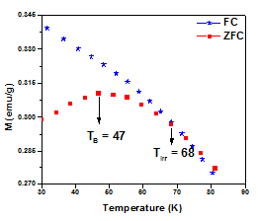
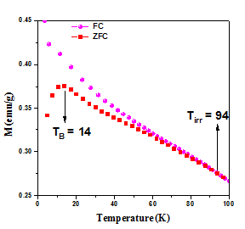
Variation of magnetic moment with temperature
Fig.1
Fig.2
x= 0.10
x= 0.20
Applied magnetic field 0.1T
Superparamagnetic
Applied magnetic field 0.1T
Presence of uncompensated anti-ferromagnetic spins (Fe³⁺ ).
FC and ZFC curves consistent with the temperature dependent magnetization of anti-
ferromagnetic magnetic structure.
The magnetization increases rapidly with decreasing the temperature confirming
that there is magnetic phase transition.
Blocking temperature shifts to lower side as the crystallite size is decreases .

Slide 11
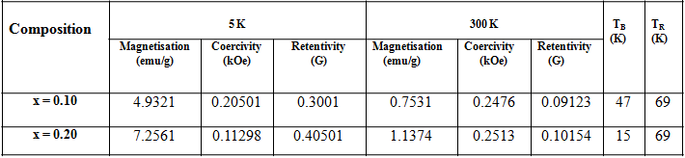
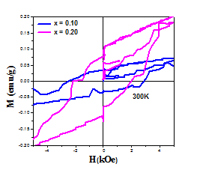
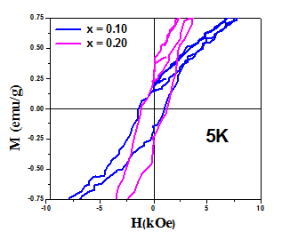
Magnetization curves of BCT-ZF ceramics
Magnetic parameters
Both composites demonstrate typical M-H loops at room temperature.
Existence of an ordered
magnetic structures in the
ceramics.
Highest magnetization
Enhancement of magnetization ???
Incomplete rotation of spins
along the direction of wave vector.
Increasing in spin canting due to
surface strain and oxygen defects.

Slide 12
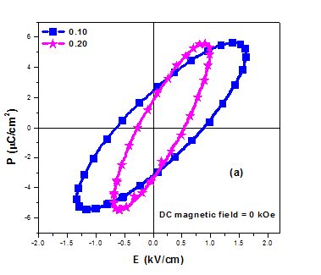
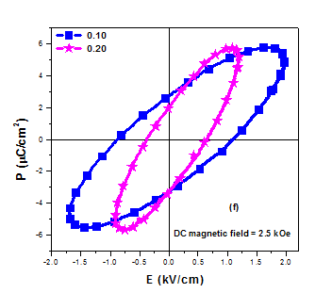
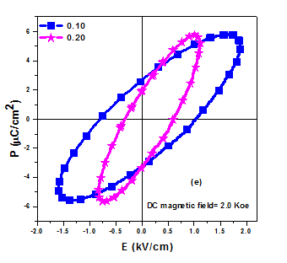
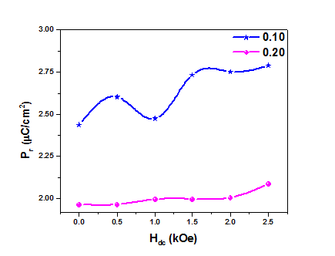
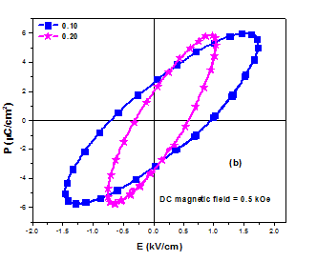
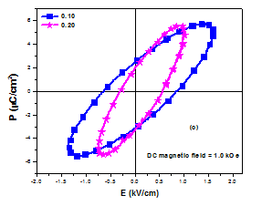
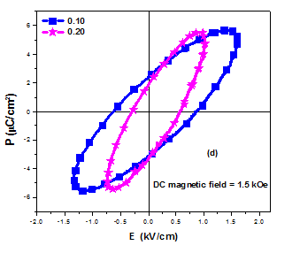
P-E field loop of BCT-ZF at different DC bias fields
Fig.1
Fig.6
Fig.5
Lossy capacitor
phenomena
Pr
Pr
Fig.2
Fig.3
Fig.4
Pr
Pr
Pr
Percentage dielectric phase has the significant effect in the polarization response.
As the applied field increases, the magnetoresistance effects become dominant.
Enhancement of Polarization beyond 1 keO may due to decrease of leakage current.

Slide 13
Dielectric constant with temperature at
different frequency
Fig.1
Fig.2
x= 0.10
x= 0.20
T_{c} ~250C
ferro to para
ferro to ferro
Two phase transitions are observed in the permittivity curve.
Dielectric constant increases gradually with the increasing temperature up to the T_{c}.
Value of dielectric constant is higher for (x= 0.10) than x= (0.20).
Space charge mechanism plays an important role at lower frequency.

Slide 14
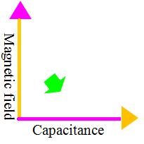
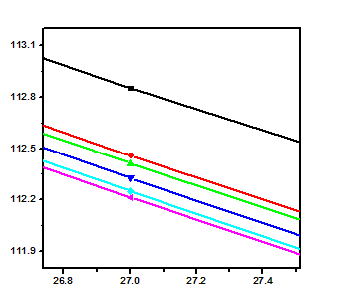
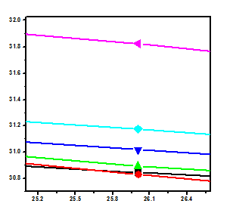
Capacitance Vs frequency at different applied
DC magnetic fields
Fig. 1
Fig. 2
δ
The overall dielectric behavior is of
Maxwell- Wanger type
δ
.
At low frequencies, the charge carriers get accumulated at the grain boundaries
resulting in a high capacitance
Dispersion can be ascribed to the phenomenon called the magnetocapacitance effect.

Slide 15
DC field dependence of MECC and ME voltage as a function of
applied AC magnetic field of BCT-ZF ceramics
Magnetoelectric coupling in BCT-ZF
A possible mechanism for magnetoelectric coupling (ME) coupling of this FE/FM
(BCT-ZF) interface is based on screening effects.
ME coupling also caused by an emergent inverse DM interaction at MF interface.
10.85
Linear dependence of AC magnetic field
6.85
Magnetoelectric coupling coefficient (MECC) increases initially due to increase in
magnetostriction of ferrite with applied DC field.
The observed MECC is quite larger than reported values, this may be due to the presence of
leakage current.

Slide 16
Conclusions
XRD pattern confirms the co-existence of two phase namely perovskite and spinel
corresponding to BCT and ZF respectively.
Much more gradual change of permittivity vs. temperature is observed in the composition
0.10 and 0.20.
The capacitance and the polarization of the sample are found to be magnetically tunable.
The composite have shown MECC of 10.85 and 6.85 Mv/(cm.Oe), and are highly sensitive to
AC magnetic field.
The influence of mutual orientation of polarization and magnetization on the ME effect
is addressed.
The presented results can thus offer applications in magnetoelectric devices especially in
magnetic field sensors and tunable devices.
Future engineering and employment of magnetoelectric materials for device applications especially in biomedical field will be carried out.
Perspectives

Slide 17
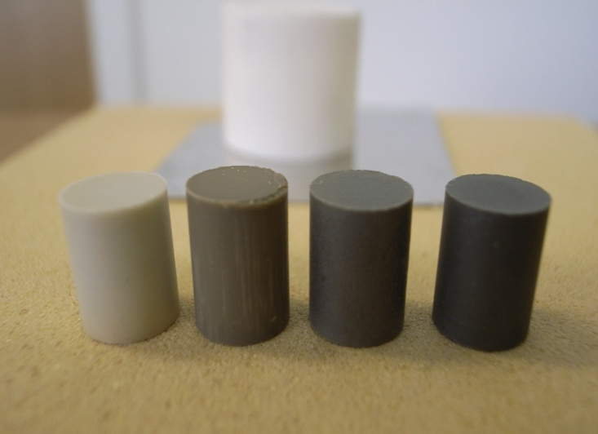
10 mm
Email id: rashmi.rani@polytechnique.edu
Thank you for your kind attention!

