Slide 1


Roadmap of stability studies for Biosimilar product development
Dr. Rashbehari Tunga
Head Biotech
Stelis Biopharma

Slide 2
Index
Introduction
Regulatory guideline related to stability
Summary of stability requirement at various stage
Get answers to questions which we face every now & then (Opinion of Experts)
FAQ
Summary of stability program for biosimilar Product development
Acknowledgement

Slide 3
Introduction
Why Stability?
Provide a evidence on how the quality of a drug substance or drug product varies with time under the influence of a variety of environmental factors such as
  Temperature
  Humidity
  and light
Establish a
  Re-test period for the drug substance or a
  Shelf life for the drug product and
  Recommended storage conditions
Because physical, chemical or microbiological changes might impact the
  Efficiency and
  Safety of the final product

Slide 4
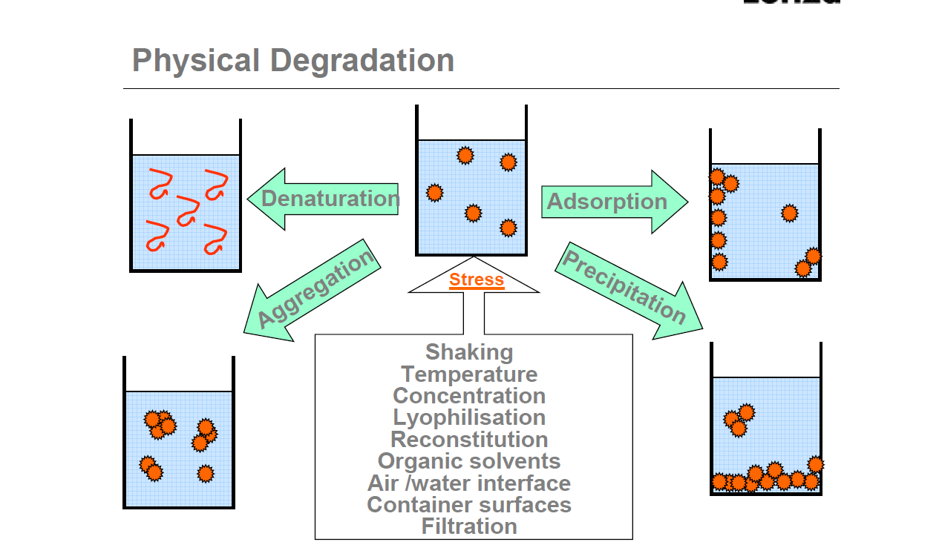

Slide 5
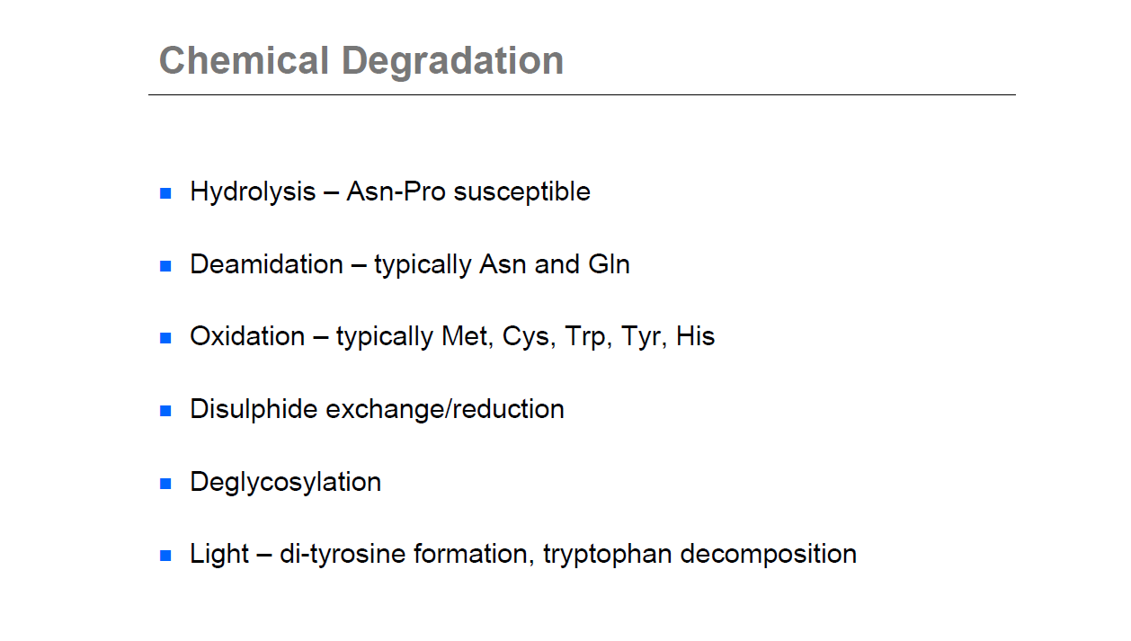

Slide 6
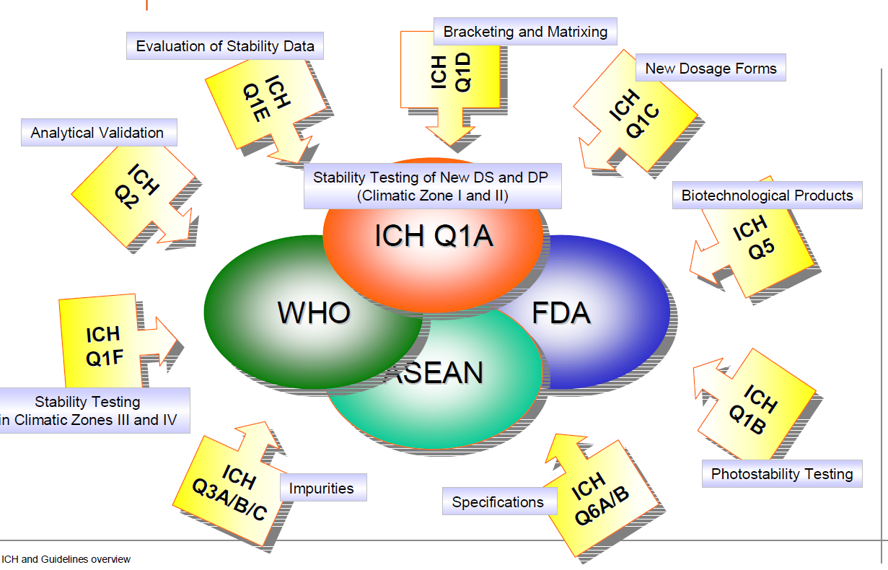
Regulatory guidelines related to stability
Dr. R. Tunga

Slide 7
Where and Why?
Stability studies are performed on
  Drug Substance (DS)
    the unformulated drug substance that may subsequently be formulated with excipients to produce the dosage form
  Drug Product (DP)
    the dosage form in the final immediate packaging intended for human use.
  Controlled and documented determination of acceptable changes of the drug substance or drug product
Stability study types shall comprise of:
Exploratory Stability Study
Real Time Real Temperature (RTRT) Stability Study
Accelerated (AT) Stability Study
Stress (ST) Stability Study
Photo-stability Study
Stability of Reconstituted Products
In-use stability multi-dose products
Stability of Diluent(s)
Shear Stress study , Freeze thaw study & Accidental freezing
Temperature Excursion Study
Dr. R. Tunga

Slide 8
Summary of stability studies conducted at critical product development stages
Particulars | Pre-consistency Stage | R&D Consistency batches | Clinical Trials | Launch Stage
Who will do | R&D | R&D | QC | QC
How many batches | 1 (both DS and DP) | 3 (both DS and DP) | DS – Upto 3 DP – All batches CT | 3 (both DS and DP)
Method status | Ready to qualify | Label claim method qualified and all other methods developed | Label claim method validated and all other methods Qualified | Validated methods
Specifications | Draft or report value | Final for R&D | Final for QC | Final after validation
Desired stability & at key stage | 2 months for regulatory submission for PCS | Minimum 6 months for CT application And Minimum 12 months for marketing application | 6 months for marketing application | Domestic requirement** Semi-regulated market ***
Dr. R. Tunga

Slide 9

Get answers to questions which we face every now & then
Dr. R. Tunga

Slide 10
What Experts Say
How many batches & how much time is required for study after process change./Scale up
Is it required to conduct stability at each change or it can be done after simulating all the changes?
Expert -1
Need to demonstrate not only the stability of post change lot, but also the comparability with pre change lots, if we want to use any of clinical or non-clinical data from pre change lots.
If these changes are during the early clinical trial, accelerated study usually is enough to address the comparability, however if these changes are after phase III, then more extensive stability study is required.
If there is any excipient change, we need to have sufficient stability data to support this change.
Expert-2
6 months stability data (under real time & accelerated condition), three batches from pre-change & post-change in parallel is required.
Expert-3
One needs to study the interaction of excipients before changing over and need minimum 3 batches for 3 months for real time. One needs to establish degradation kinetics.
Dr. R. Tunga

Slide 11
Expert-4
If the change is critical, then study should be done at real time & accelerated condition till the shelf life expires but some time points can be omitted. If there is no significant change observed during real time & accelerated study till 6 months, then data of 6 months is sufficient to show comparability.
This exercise can be compared with the data of pre-change product, the exercise need not to be done in parallel.
Expert-5
Extensive comparability exercise should be done with 3 batches & till 3 months. For stress study, one batch is sufficient.
Conclusion
Comparative stability study at real time & accelerated condition with 3 pilot scale batches till 6 months duration should be done. The stress study should be also conducted on single batch for establishing comparative degradation profile.
Dr. R. Tunga

Slide 12
If one batch fails in any of the stability indicating parameters in the formal stability program, what should be our approach to assign shelf life?
.
No. of batches | Type of Study
 | Real Time 5 ºC | Accelerated 25 °C | Stress (1 batch) 40 °C
3 | 12 months | 6 months | 7 days
1 batch failed after 6 M RT, due to increase in oxidized impurity while rest two passed till 12 months, although an increasing trend of oxidized impurities was seen (the maximum limit of oxidized impurity is 4 %).
No. of batches | Type of Study
 | Real Time (5ºC) | Accelerated (25ºC) | Stress (40ºC)
3 | 30 months | 6 months | 7 days
Two batches were observed within the specified limit till 24 months. One batch failed sterility at 24th month & 30th month time point, the batch is observed within the specified limit for all other stability indicating parameters till 24 months.
Dr. R. Tunga

Slide 13

Acceptance criteria NOT met…
Oh no !
Dr. R. Tunga

Slide 14
What Experts Say
Expert-1
One needs to identify the reason of failure. The shelf life should be based on worst lot.
Expert-3
One needs to assign the shelf life based on the batch which has failure.
Expert-2
One needs to investigate the cause of failure and may have to include the failed batch in the assignment of the shelf life.
Expert-4
It should be based considering the worst case.
If batch fails in pH, then multiple batches should be kept with different pHs for showing that failure of pH is not having any impact on quality of product.
If mammalian product fails as in bioassay, the product should be checked for isoforms pattern, sialic acid content & sialydase activity and find out the right cause of failure. Need to have at least one of these methods in stability
If sterility failed in one batch, the cause of sterility failure should be investigated. Since, it does not have direct relation to product stability ( because other tests are passing), then worst case need not be considered.
Emphasized on significance of orthogonal methods for stability testing.
Dr. R. Tunga

Slide 15
Conclusion
The reason of failure should be thoroughly investigated. If the batch failure is due to failure in test parameters for product quality and efficacy, then one need to consider worst case, but if the failure does not have direct impact on product quality (as evidenced from other test parameters), then shelf life can be based on other two passing batches.
Dr. R. Tunga

Slide 16
General Questions
Is Protein concentration a stability indicating parameter?
Expert 1
Usually it is not a stability indicating parameter but it is always done at each time point, during initial stability studies.
Expert-2
It is normally not used as a stability indicating method. However, it is still case by case dependent.
Expert-3
No, protein concentration is not stability indicating.
However, if the analysis is related with protein content then it could be one of the test but cannot be used as a stability indicating.
Expert-4
If container closure compatibility is done properly to confirm that there is no adsorption on the container surface, during container closure selection, then protein concentration need not required to be checked at each time point.
Conclusion: Protein concentration will be tested for information purpose only but will not be considered as stability indicating parameter or as pass / fail criteria
Dr. R. Tunga

Slide 17
Can we deviate from the pharmacopoeial specifications?
Sr. No. | Study Objective | Type of Study | No. of Batches | Study temp | Period of study
1 | Stability Study of Product A | Real time | 3 | -80 °C | 18 months
 |  | Accelerated | 3 | 5 °C | 18 months
 |  | Stress | 1 | 25 °C | 15 Days
The specification for free subunits is kept 5% in case of DS & 7.5% in case of DP. In European pharmacopoeia, the specifications for free subunits is 5.0 %. Is it Ok ???
Expert-4
Specifications should not be broader than the pharmacopoeial specs. It is always better to be tighter than pharmacopoeial specs, but not relaxed. If there is difference in the pharmacopoeial specifications & package insert of innovator’s product, then lower limit should be considered as finalized specifications.
Dr. R. Tunga

Slide 18
Conclusion: Stability of drug product after reconstitution should be evaluated on hourly & daily basis at 25deg C and 2-8degC.
It will help a doctor to decide on the time of usage of the drug after reconstitution if stored at 2–8ºC and till what time we can store the product at 2 – 8ºC in between the point of usage. For Multidose product In-use stability for one batch should be done.
Is stability of reconstitution solution/ diluent and reconstituted solution required and If so then for how long? What purpose it will serve?
Expert -4
Reconstitution buffer stability is required to understand the degradation of the excipient.
If the diluents or reconstitution buffer is different than WFI or saline, Reconstitution buffer stability should be checked at time interval of 6 months or 1 year for degradation of stabilizer or stabilizer content.
The reconstituted drug product stability should be checked as per innovator claim.
According to WHO guidelines :
In-use stability testing should be done on 2 batches of re-constituted or diluted FPP one of which should be investigated close to the end of the shelf life.
According to ICH Q8 guideline :
The ability of excipients (e.g., antioxidants, penetration enhancers, disintegrants, release controlling agents) to provide their intended functionality, and to perform throughout the intended drug product shelf life, should also be demonstrated.
Dr. R. Tunga

Slide 19
For lyophilized products stability, is it required to test for moisture content at each time point of stability study programme?
Expert-4
It is not required to test for moisture content at each time point. Because if it changes, it means that container closure integrity is not maintained. Before checking moisture content, it is necessary that the vial should be equilibrated at room temperature.
According to reference paper Biotechnol. Porg., 2008, vol. 24, No. 3,
The processing history of the stopper can also have impact on stability; if the stoppers are not adequately dehydrated, then moisture can desorb during storage & destabilize the drug product.
Conclusion
Moisture content should be checked on exploratory study. If container closer integrity test was completed, the moisture content can be omitted from the formal stability study.
Dr. R. Tunga

Slide 20
Photo stability of DS or DP is it required?
What Experts Say
Expert-1
Usually conducted for DP, unless you have a light sensitive product.
Expert-2
Photostabililtiy is also case by case dependent. One needs to consult with the health authorities for the study. Normally it is performed on DS & DP for Mab’s.
Expert-3
Yes, it is required for both DS & DP
Guidelines:
ICH Q1B-“The intrinsic photostability characteristic of new drug substances and products should be evaluated to demonstrate that, as appropriate, light exposure does not result in unacceptable change. Normally, photostability testing should be carried out on a single batch of material”
EMEA- “Photostability testing should be conducted on at least one primary batch of the finished product if appropriate”
Conclusion
Photo stability of DS & DP should be done for each product for one batch.
Dr. R. Tunga

Slide 21
Is preservative efficacy or preservative content required to be tested ? If yes, then when?
What Experts Say
Expert 4
Preservative efficacy can be checked but not mandatory, as manufacturers are doing sterility study. It can be done to find out the right cause in case of failure in sterility test.
According to guideline ICH Q5C,
“Additives (e.g., stabilizers, preservatives) or excipients may degrade during the dating period of the drug product. If there is any indication during preliminary stability studies that reaction or degradation of such materials adversely affect the quality of the drug product, these items may need to be monitored during the stability program.”
Conclusion
When DP is made, need to check, if preservative passes the pharmacopoeial specs.
Placebos should be charged on stability and if degradation peaks are co-eluting, then has to be subtracted
Preservative efficacy test should be done at initial & last time point, along with Sterility test.
Dr. R. Tunga

Slide 22
Is Stability indicating methods need to be qualified at preclinical stage?
Expert-4
Minimum qualification (e.g. for accuracy & precision) should be done for critical methods. E.g. If major degradation pathway is oxidation & dissociation of subunits, the methods for assessing these stability indicating parameters should be minimally qualified.
Is DS or DP analysis in triplicates required?
Expert-4
Triplicate analysis for DP needs to be done to account for variation among different PFS, vials and cartridges.
Triplicate analysis for DS is not required.
Dr. R. Tunga

Slide 23
FAQs
Is Plus One Time point required ?
Yes!
What should be the time point ?
Even if we establish stability at 30th month or 36th month, we can Claim shelf life as 24 months only, so…..
It could be 25th month, 27th month also…
No guideline found…experts say…its your choice!
Can we claim more shelf life than the Innovator?
Dr. R. Tunga

Slide 24
FAQs
What should be the DS release and Stability Spec ?
The stability data where one DS is used to make a DP & DP by pooling DS from two or more batches stability can be same??
What should be the shelf life of the excipients used in the product or diluent?

Slide 25
Summary of stability program for biosimilar Product development
Fermentation process development
Protein Purification
Prior to process freezing
When process is developed
CT stage
Validation stage
Post Change
Exploratory studies
Accelerated study
Stress study
Exploratory studies
Shear stress
Photo stability
Accidental Freezing
Method applicability
If required method development
Consistency batches (DS & DP)
Real time study
Accelerated study
Stress study
Impurity characterization
CT batches (DS & DP)
Real time study
Accelerated study
Stress study
Impurity characterization
Validation batches (DS & DP)
Real time study
Accelerated study
Stress study
Comparability studies
Accelerated study
Stress study
Dr. R. Tunga

Slide 26
Acknowledgment
Joe Thomas (Stelis)
Nadine M Ritter (Global biotech Expert)
Jun-Liu (Genentech)
Hui Zhao (Novartis)
Dhananjay Patankar ( Syngene)
Rustom Mody (Lupin)
Anand Khedkar (Biocon)
Venkat Mukku (USP)
Ivona Radic (Pliva, Croatia)
Binita S. Tunga (Stelis)
Sunil Shekar (Stelis)
Dr. R. Tunga

Slide 27
Thanks
Dr. R. Tunga

