Slide 1



Ergonomic Analysis of Professionals Reception in a private health facility
Raquel Machado Cavalca Coutinho PhD, RN
Brazil

Slide 2
INTRODUCTION
NURSING WORK
use the same methods and techniques
applied in public health
promotion of occupational health
protection against the risks arising from
their work activities
recovery from injuries, occupational diseases
or not in the maintenance of health and the physical
and mental well being and also in their
rehabilitation work

Slide 3
REGULATORY STANDARD
benches, tables, desks and panels must give the employee a position to good posture, visualization and operation
In Brazil there are 34 regulatory standard, which require companies to comply with standards for safety and medicine at work
We will use in this work the regulatory standard 17 that talks about ergonomics:

Slide 4
17 REGULATORY STANDARD
desktop easy reach and viewing by the employee
equipment used in the electronic data processing with video terminals should note the following
keyboard should be independent and be mobile, allowing the worker to adjust it according to the tasks to be performed
time and work surface features compatible with the type of activity, required distance from the eyes to the labor camp, the seat height

Slide 5
OBJECTIVES
Identify the existence of occupational disease and have skeletal muscle or joint problem, prior to the beginning of the current job;
Check whether there is a relationship between weight, height, number of pregnancy, childbirth and abortion with ergonomic problems.

Slide 6
METHODS
. exploratory,
. quantitative,
. cross-sectional,
. not-experimental,
. descriptive sought to analyze the biomechanics of professionals from a private health institution with regard to ergonomics.

Slide 7
RESULTS
Professionals profile
Working time in the company:
< 1 year 1 8%
1|----|4 years 8 61%
> 4 years |---- 4 31%
AGE:
18|----|28 4 31%
29|----|39 5 38%
40|---- 50 3 23%
> 50|---- 1 8%
Only female
n = 13 (100%)

Slide 8
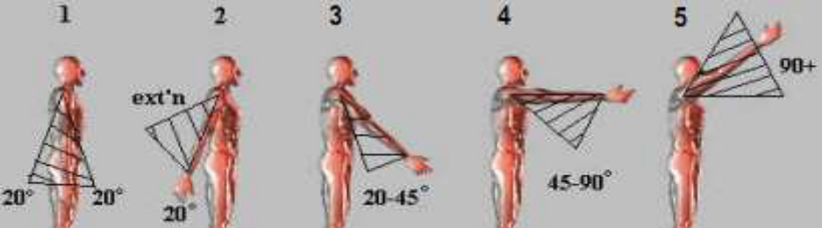
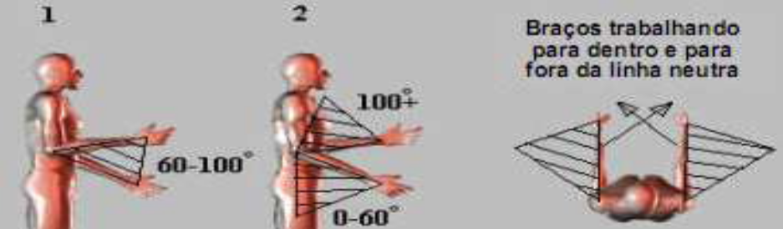
RESULTS
Upper-limb method Rapid Assessment (RULA) of postural analysis
Figure 1. Posture of the arms, as 5 scores movement angle. Brazil, 2014.
Figure 2. Posture of the forearms, as 2 scores movement angle. Brazil, 2014.

Slide 9
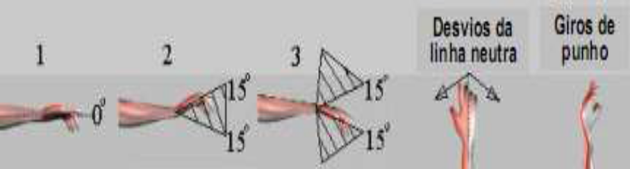
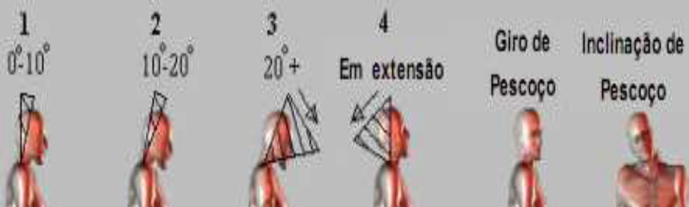
RESULTS
Upper-limb method Rapid Assessment (RULA) of postural analysis
Figure 3. Posture wrists, as 3 scores movement angle. Brazil, 2014.
Figure 4. Posture neck, as 4 scores movement angle. Brazil, 2014.

Slide 10
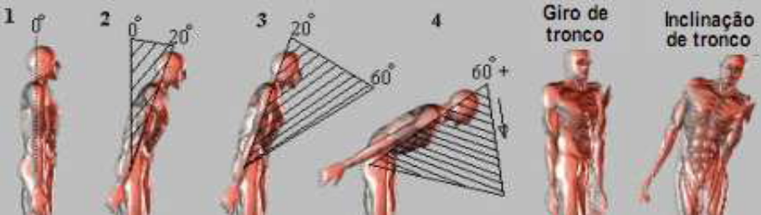
RESULTS
Upper-limb method Rapid Assessment (RULA) of postural analysis
Figure 5 posture of the trunk, as 4 scores movement angle. Brazil, 2014.

Slide 11
RESULTS
Table 1. Twitch. Brazil, 2014.
MUSCLE CONTRACTION | SCORE
Prolonged static posture for longer than 1 min. Iterative one, more than 4 times per minute Fundamentally dynamic (static posture less than 1min) and not repetitive | +1 +1 0

Slide 12
RESULTS
Table 2. Strength and applied load. Brazil, 2014.
APPLICATION TYPE | FORCE VALUE | SCORE
Intermittent Intermittent Higher static posture to 1 min or repeated more than 4 times / min | below 2 kg 2 a 10 kg 2 a 10 kg | 0 +1 +2

Slide 13
RESULTS
100%
Professionals
level 4
indicating increased ergonomic risk
investigate and change the attitude of the workers

Slide 14
RESULTS
None of the workers have muscle skeletal problems or previous articulate the beginning of the current job
they don't have occupational disease
23% of employees practicing some kind of extra work activity

Slide 15
RESULTS
Graph 2. Ratio height x weight = body mass index (BMI). Brazil, 2014.

Slide 16
RESULTS
pregnancy among female employees was 7
6 births
and
1 abortion
good practice in occupational medicine is guidance as to adapt the post and the workload to the physiological demands arising from various stages of pregnancy

Slide 17
CONCLUSION
Even sitting at the computer, lack of support for the wrists, the monitor above or below eye level and the poorly regulated seat can cause problems of ergonomic nature
no relationship was found between weight, height, number of pregnancy, childbirth and abortion with ergonomic problems, it is believed that the problem is exercised in biomechanics and organizational structure of work

Slide 18
CONCLUSION
It was identified the existence of occupational diseases nor skeletal muscle or joint problem, prior to the start of the current job.

Slide 19

THANK YOU / OBRIGADA!!!!
raquel@unip.br

