Slide 1



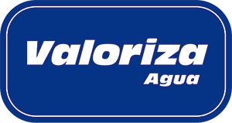
Evaluation of the ppm·h concept for end-of-life RO membrane into recycled NF and UF membranes
Raquel García Pacheco
PhD researcher
raquel.pacheco@imdea.org

Slide 2
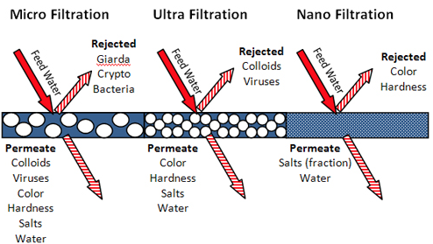
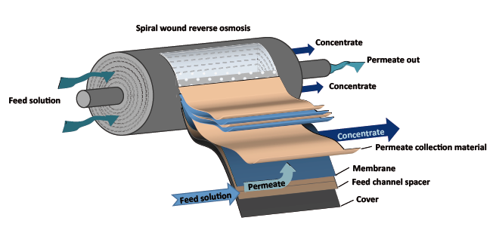
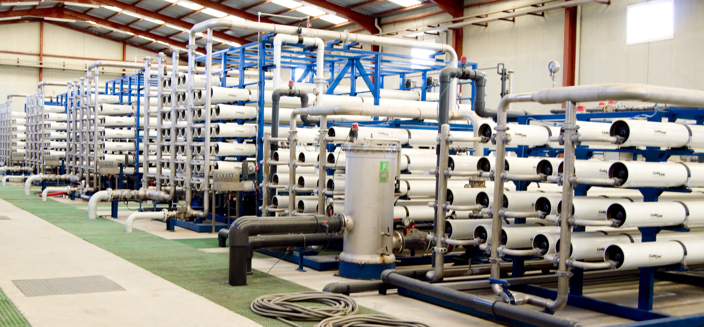


Introduction
What is a reverse osmosis membrane?
Nanofiltration and reverse osmosis
Commercial spiral wound modules.
Selective polymer: Thin film composite of polyamide → for over 95% of existing RO desalination plants
Depending on the pore size, permeability and retention capacity, polymeric membranes can be classified in: microfiltration, ultrafiltration, nanofiltration and reverse osmosis.
Suspended particles
Microfiltration
Macromolecules
Ultrafiltration
Divalent salts
Nanofiltration
Monovalent salts
Reverse osmosis
Water
Notes:
1. There has been an increasing demand for fresh water supply owing to population boom, global warming and the geography of our planet[1].
2. One of the technical solutions to solve water scarcity is by using membrane technology, which allows obtaining fresh water from the major water sources. RO is the most widely used desalination technology globally [1] (60% of the global capacity installed) and aromatic polyamide-based (PA) composite membranes currently account for over 95% of existing RO desalination plants [2].

Slide 3



Introduction
Some numbers regarding Reverse Osmosis Membrane
 | Worldwide >150 countries (data from IDA 2013) | Spain (data from AEDYR)
Total number of desalination plants | >17,000 | >700 | ≈ 4% of total plants
Global capacity of commissioned desalination plants (as of 2013) | > 80 Hm³/day | > 5.4 Hm³/day | ≈ 6.75% of global capacity
Estimated end-of-life membrane per year | 960,000 | 64,800 | Considering 100 modules to produce 1000 m³ and a 12% annual membranes replacement rate
Tonnes of end-of-life membranes per year | >12.900 | > 800
Could be recycling membranes an alternative solution?
Depending on the pore size, permeability and retention capacity, polymeric membranes can be classified in: microfiltration, ultrafiltration, nanofiltration and reverse osmosis.
Suspended particles
Microfiltration
Macromolecules
Ultrafiltration
Divalent salts
Nanofiltration
Monovalent salts
Reverse osmosis
Water
Notes:
In recent decades, the installed capacity of reverse osmosis RO water treatment plants has increased considerably world-wide
Currently, fouled membranes used in RO desalination are generally disposed via landfill

Slide 4
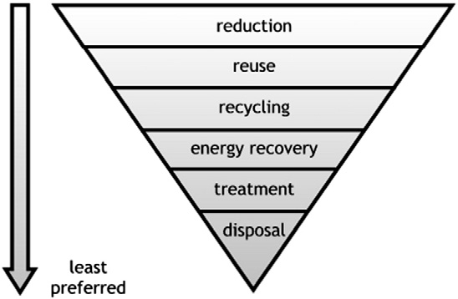
Introduction
Reverse osmosis membranes recycling and reuse experiences
Reuse: do not damage the polyamide layer
- Desalination plant experiences, used membrane in the same desalination plant (changing positiion
- Life Remembrane (cleaning and prepearing for reuse)
DIRECTIVE 2008/98/EC on waste
Recycling: polyamide oxidation
Direct recycling: do not interfere in the module structure.
Use K7MnO4 , NaOCl: Veza et al., 2002; Lawler et al., 2013
Not direct recycling: involve the deconstruction of the module
Geotextile, fabric and decoration for clothing
Waste management hierarchy from most to least preferred options.
Depending on the pore size, permeability and retention capacity, polymeric membranes can be classified in: microfiltration, ultrafiltration, nanofiltration and reverse osmosis.
Suspended particles
Microfiltration
Macromolecules
Ultrafiltration
Divalent salts
Nanofiltration
Monovalent salts
Reverse osmosis
Water
Notes:
2. One of the technical solutions to solve water scarcity is by using membrane technology, which allows obtaining fresh water from the major water sources. RO is the most widely used desalination technology globally [1] (60% of the global capacity installed) and aromatic polyamide-based (PA) composite membranes currently account for over 95% of existing RO desalination plants [2].

Slide 5
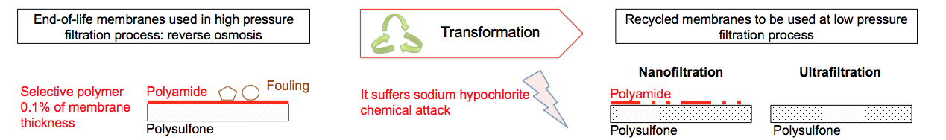
Introduction
Aim of LIFE-TRANSFOMEM european project
End-of-life RO membrane
Up to date results of the Life Transfomem
It was identify the transformation condition at passive method to achieve nanofiltration and ultrafiltration performances.
It was identified that concentration of NaOCl and exposure time are the main factor (at basic pH) affecting the transformation process.
Optimal ppm·h exposure level were identified
6,200 ppm·h to achieve NF performances
30,000 ppm·h to achieve UF performances
Reuse of the recycled NF membranes
- Brackish water
- Sacrifice membranes in RO process
Reuse of the recycled UF membranes
Pretreatment of RO process
Reclaim wastewater as tertiary treatment.
End-of-life membranes used in high pressure filtration process: reverse osmosis
Recycled membranes to be used at low pressure filtration process
End-of-life membranes used in high pressure filtration process: reverse osmosis
Recycled membranes to be used at low pressure filtration process
End-of-life membranes used in high pressure filtration process: reverse osmosis
Transformation
Recycled membranes to be used at low pressure filtration process
End-of-life membranes used in high pressure filtration process: reverse osmosis
Transformation
Recycled membranes to be used at low pressure filtration process
Transformation
Transformation
Nanofiltration
Ultrafiltration
Nanofiltration
Ultrafiltration
Nanofiltration
Ultrafiltration
Fouling
Nanofiltration
Ultrafiltration
Selective polymer 0.1% of membrane thickness
Polyamide
Fouling
It suffers sodium hypochlorite
chemical attack
Polyamide
Selective polymer 0.1% of membrane thickness
Polyamide
Fouling
It suffers sodium hypochlorite
chemical attack
Polyamide
Selective polymer 0.1% of membrane thickness
Polyamide
Fouling
It suffers sodium hypochlorite
chemical attack
Polyamide
Selective polymer 0.1% of membrane thickness
Polyamide
It suffers sodium hypochlorite
chemical attack
Polyamide
Polysulfone
Polysulfone
Polysulfone
Polysulfone
Polysulfone
Polysulfone
Polysulfone
Polysulfone
Polysulfone
Polysulfone
Polysulfone
Polysulfone
Notes:
The selectivity of PA based RO membrane, i.e. solute passage relative to water passage can be altered by halogen (e.g., Cl and Br) due reactivity towards functional groups of the PA layer (4 de Ettori et al., 2012)
Chlorine is commonly used for oxidation of organic and inorganic compounds and for disinfection (Ettori et al., 2012).

Slide 6



Objetive
Main Objective of this work
To transform end-of-life membranes into NF and UF recycled membranes at lab scale.
To optimize the concentration and exposure time of the transformation process to further scale it up to pilot systems.
Specific Objective
Evaluation of the exposure level ppm· h (concentration x time) for end-of-life RO transformation
  Does the ppm·h exposure level remain optimal when concentration and exposure time change?
  When transformed membranes achieve UF performance, do the membranes surfaces have identical properties?
  Is exposure level (ppm·h) reproducible in different end-of-life membranes brands to achieve NF range and UF range?
Notes:
The present study, as part of the LIFE+ ENV/ES/000751 TRANSFOMEM European project, investigates the transformation of end-of-life membranes to be recycled as nanofiltration (NF) and ultrafiltration (UF) membranes. Such process is a simple, low energy, surface modification technique, based on polyamide chemical attack.
As

Slide 7
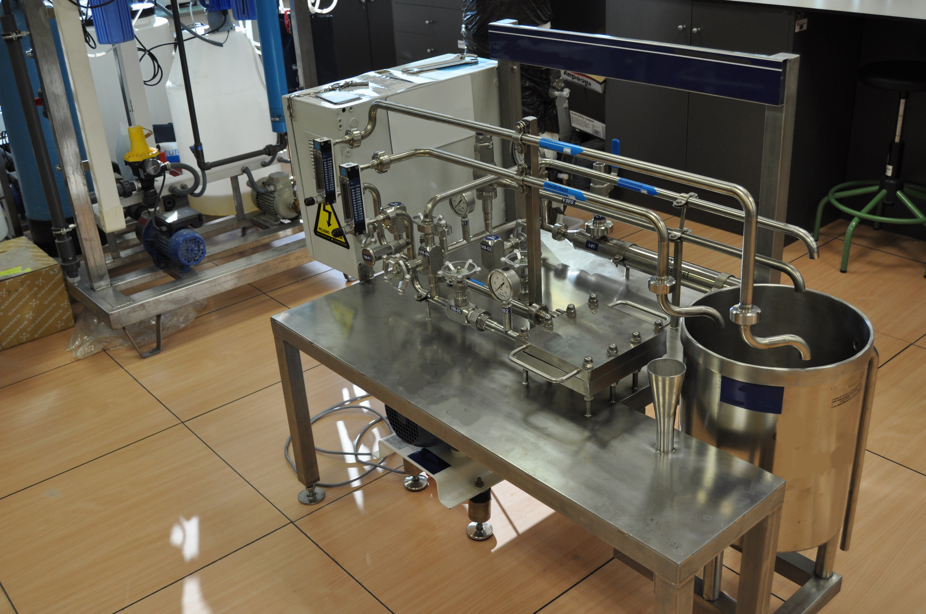
Methodology
Membrane transformation protocol and filtration test
Two exposure level were evaluated
Coupons
Extration
Membrane performance
Mix solution
Membrane performance
Mix solution
In case of UF performance. Surface characterization
Passive method
End-of-life membrane
Transformation solution
Recycled membrane
Time
- 6,200 ppm · h → To transform into NF recycled membrane
- 30,000 ppm·h → To transform into UF recycled membrane
Using a total recycling system and a mix solution (MgSO4, NaCl and dextrose) membranes performances were evaluated by
Permeability L / (h·m2·bar)
% Rejection [(C0-Cp)/C0*100]
End-of-life membranes used in high pressure filtration process: reverse osmosis
Recycled membranes to be used at low pressure filtration process
End-of-life membranes used in high pressure filtration process: reverse osmosis
Recycled membranes to be used at low pressure filtration process
End-of-life membranes used in high pressure filtration process: reverse osmosis
Transformation
Recycled membranes to be used at low pressure filtration process
End-of-life membranes used in high pressure filtration process: reverse osmosis
Transformation
Recycled membranes to be used at low pressure filtration process
Transformation
Transformation
Nanofiltration
Ultrafiltration
Nanofiltration
Ultrafiltration
Nanofiltration
Ultrafiltration
Fouling
Nanofiltration
Ultrafiltration
Selective polymer 0.1% of membrane thickness
Polyamide
Fouling
It suffers sodium hypochlorite
chemical attack
Polyamide
Selective polymer 0.1% of membrane thickness
Polyamide
Fouling
It suffers sodium hypochlorite
chemical attack
Polyamide
Selective polymer 0.1% of membrane thickness
Polyamide
Fouling
It suffers sodium hypochlorite
chemical attack
Polyamide
Selective polymer 0.1% of membrane thickness
Polyamide
It suffers sodium hypochlorite
chemical attack
Polyamide
Polysulfone
Polysulfone
Polysulfone
Polysulfone
Polysulfone
Polysulfone
Polysulfone
Polysulfone
Polysulfone
Polysulfone
Polysulfone
Polysulfone
Notes:
Membrane transformation protocolo
Membrane coupons of 216 cm² were cut from the TM720-400 end-of-life RO membrane in different places and hydrated in Milli-Q water for 24 h.
Membrane were caracterized initially and then, membranes were immersed (passive immersion) in solutions of either NaOCl. After the oxidant exposition membrane were rinsed with MQ water and characterized again. The exposure level evaluated were 2. One to achieve NF properties and other to achieve UF properties. And the cases studies were 4 for both NF and UF properties.
Cases studies consisted in increasing the NaOCl concentration and decreasing the exposure time in order to achieve 6200 ppm·h (NF) and 30000 ppm·h UF. Therefore, case A is the case with lowest concentration of NaOCL and the highest exposure time while case D is the case with highest concentration and lowest exposure time.
4 different membrane were tested. Two membrane were treating BW and other two SW so the fouling over each surface is differente and the operating condition during their life-span was also different

Slide 8
Methodology
Cases studies of concentration and exposure time were evaluated
A X Concentration Y Exposure time
B 10X Concentration Y/10 Exposure time
C 50X Concentration Y/50 Exposure time
D 100X Concentration 100Y Exposure time
✔
- 6,200 ppm · h → NF
- 30,000 ppm·h → UF
Ideal for pilot scale
4 membrane coupons for 4 different brands ( BW, SW) employed to conduct the 2 exposure level
A Total of 32 experiments
Surface characterization in case of UF recycled membrane
Scanning electron microscopy (SEM) using S-800 MODEL (HITACHI)
Attenuated total reflectance –Fourier transform infrared (ATR-FTIR)
Notes:
Membrane transformation protocolo
Membrane coupons of 216 cm² were cut from the TM720-400 end-of-life RO membrane in different places and hydrated in Milli-Q water for 24 h.
Membrane were caracterized initially and then, membranes were immersed (passive immersion) in solutions of either NaOCl. After the oxidant exposition membrane were rinsed with MQ water and characterized again. The exposure level evaluated were 2. One to achieve NF properties and other to achieve UF properties. And the cases studies were 4 for both NF and UF properties.
Cases studies consisted in increasing the NaOCl concentration and decreasing the exposure time in order to achieve 6200 ppm·h (NF) and 30000 ppm·h UF. Therefore, case A is the case with lowest concentration of NaOCL and the highest exposure time while case D is the case with highest concentration and lowest exposure time.
4 different membrane were tested. Two membrane were treating BW and other two SW so the fouling over each surface is differente and the operating condition during their life-span was also different

Slide 9
Results
  Does the ppm·h exposure level remain optimal when concentration and exposure time change?
Notes:
The present study, as part of the LIFE+ ENV/ES/000751 TRANSFOMEM European project, investigates the transformation of end-of-life membranes to be recycled as nanofiltration (NF) and ultrafiltration (UF) membranes. Such process is a simple, low energy, surface modification technique, based on polyamide chemical attack.

Slide 10
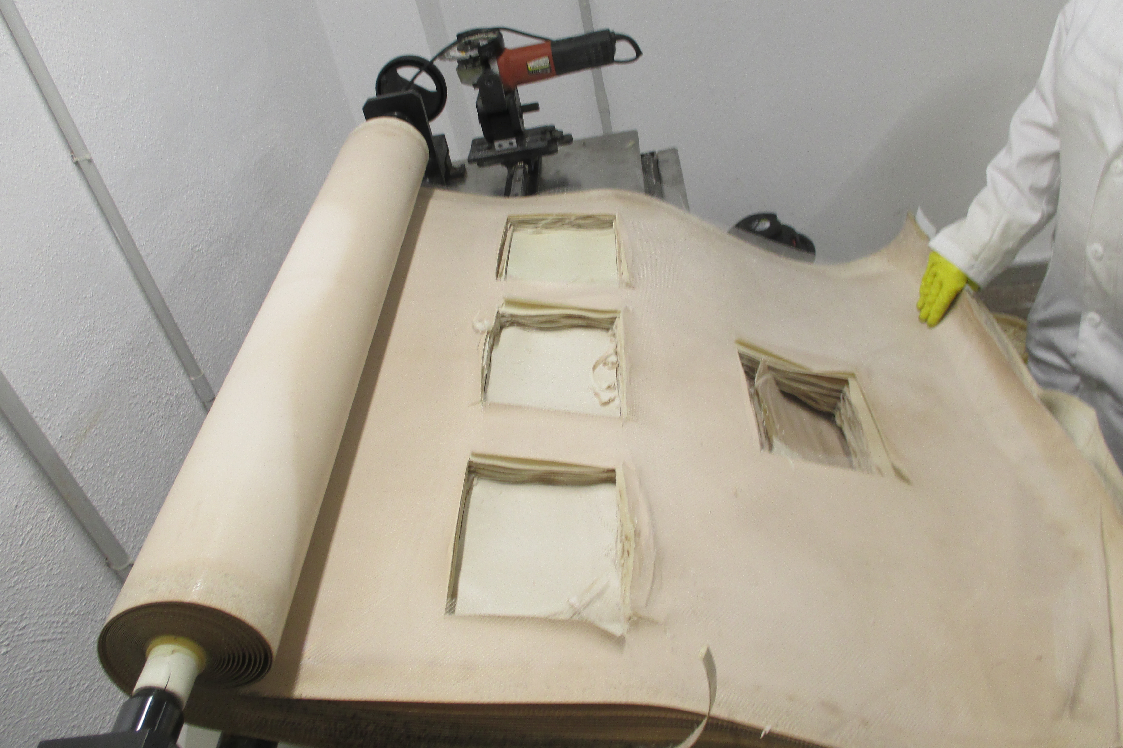
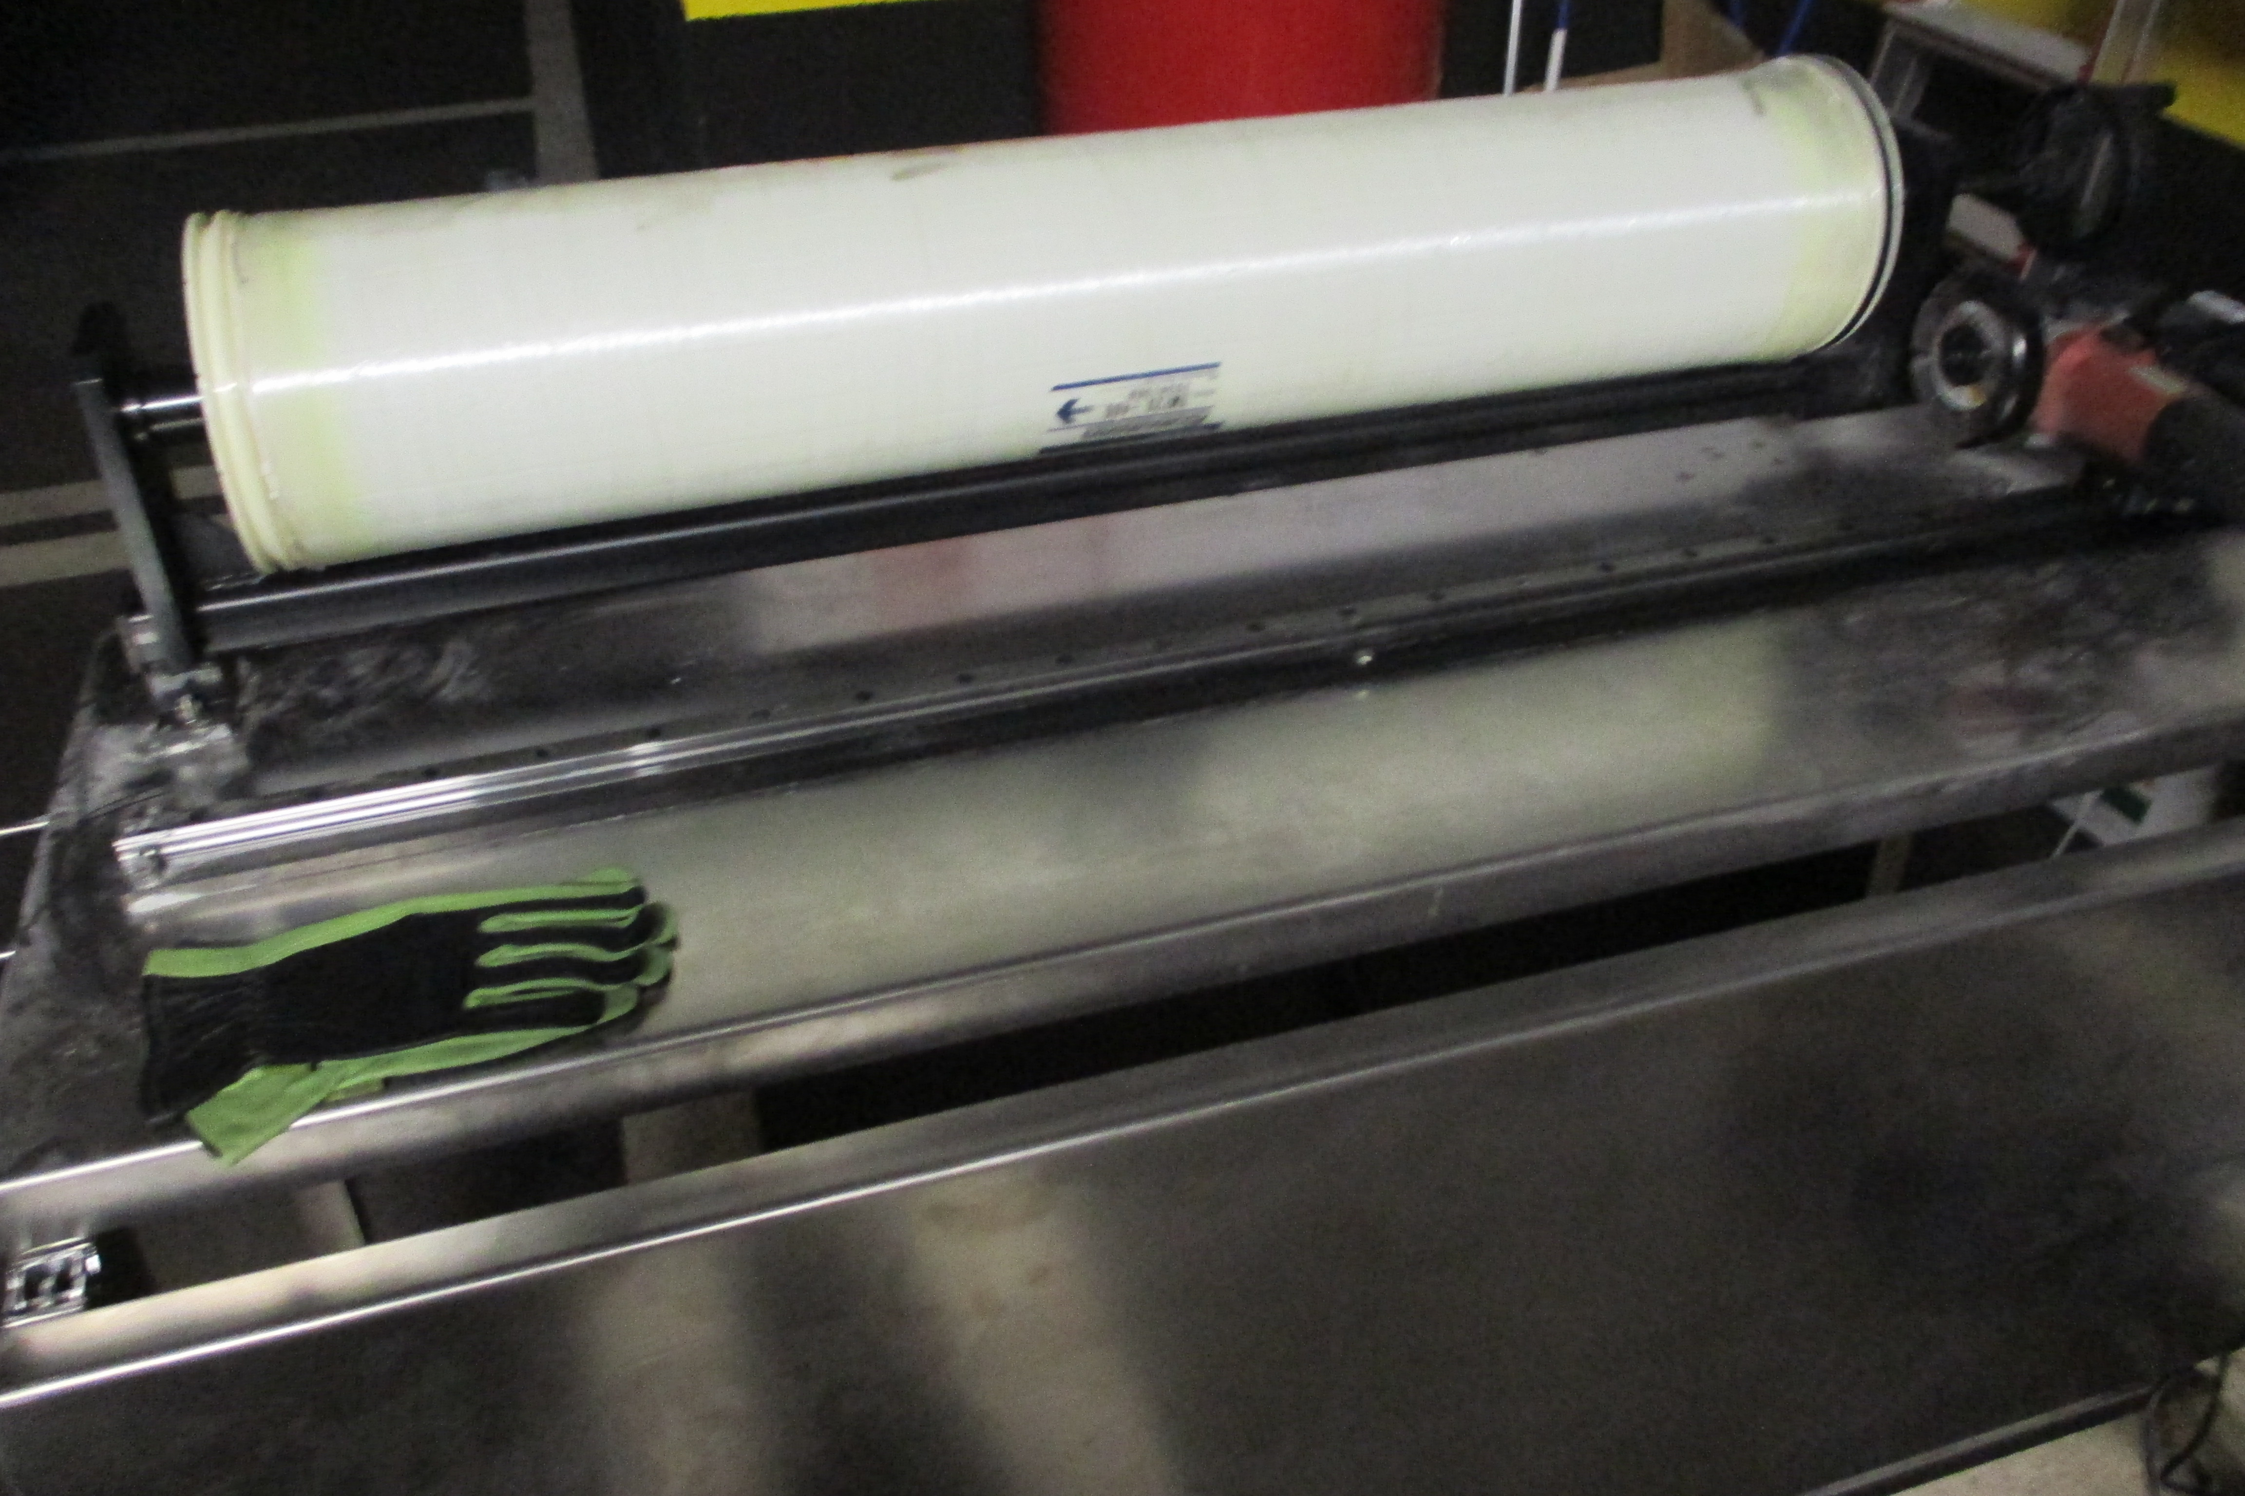
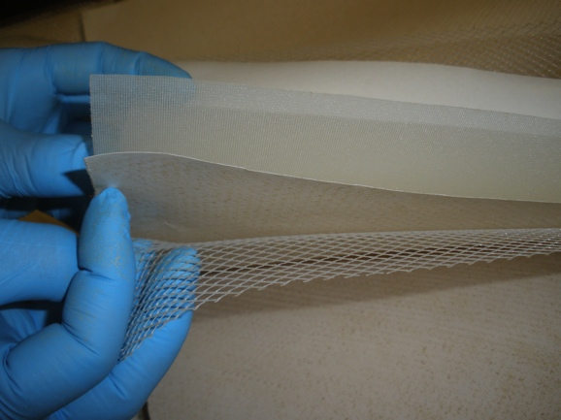
Results
  Lets see an individual case of end-of-life membrane
  TM 720-400 BRACKISH WATER
Notes:
This is an end-of-life RO membrane that arrived to IMDEA institute. In

Slide 11
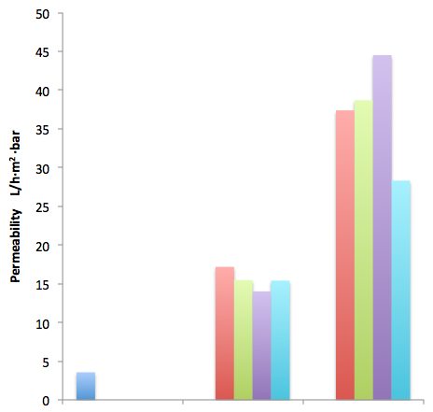

Results
Filtering test: evaluation of membrane permeability
  TM 720-400 BRACKISH WATER
Microfiltration
UF recycled membrane
End-of-life
Case study: A X Concentration · Y Exposure time
Case study: B 10 X Concentration · Y/10 Exposure time
Case study: C 50 X Concentration · Y/50 Exposure time
Case study: D 100 X Concentration · Y/100 Exposure time
Permeability L/h·m²·bar
NF recycled membrane
Membranes rejection are reproducible for transformation in NF recycled membrane. Permeability achieve is similar
Ultrafiltration
Nanofiltration
For transformation into UF recycled membrane permeability is variable
Reverse osmosis
End-of-life
6,200 ppm·h
30,000 ppm·h
Exposure level (ppm·h)

Slide 12
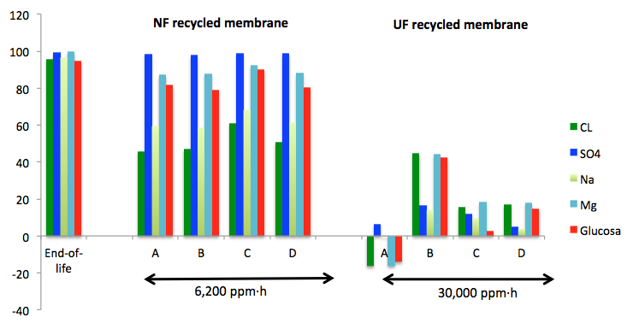
Results
Filtering test: evaluation of ionic and dextrose rejection
  TM 720-400 BRACKISH WATER
End-of-life
Case study: A X Concentration · Y Exposure time
Case study: B 10 X Concentration · Y/10 Exposure time
Case study: C 50 X Concentration · Y/50 Exposure time
Case study: D 100 X Concentration · Y/100 Exposure time
% Rejection
SO₄⁻²
Mg⁺²
Dextrose
Na⁺
Cl⁻
!
!
Membranes rejection are reproducible
Transformation into UF recycled membrane is dependent from concentration and exposure time to NaOCl

Slide 13
Results
  When transformed membranes achieve UF performance, do the membranes surfaces have identical properties?
Notes:
The present study, as part of the LIFE+ ENV/ES/000751 TRANSFOMEM European project, investigates the transformation of end-of-life membranes to be recycled as nanofiltration (NF) and ultrafiltration (UF) membranes. Such process is a simple, low energy, surface modification technique, based on polyamide chemical attack.

Slide 14
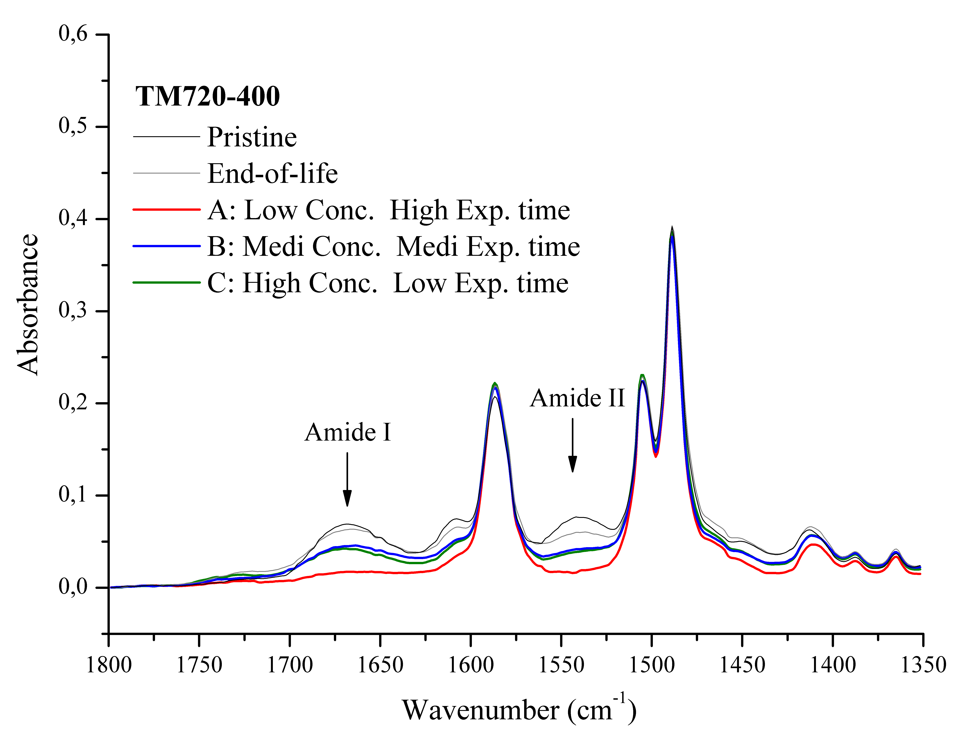
Results
Surface characterization in case of UF recycled membrane:
Attenuated total reflectance –Fourier transform infrared (ATR-FTIR)
Exposure level 30,000 ppm·h

Slide 15
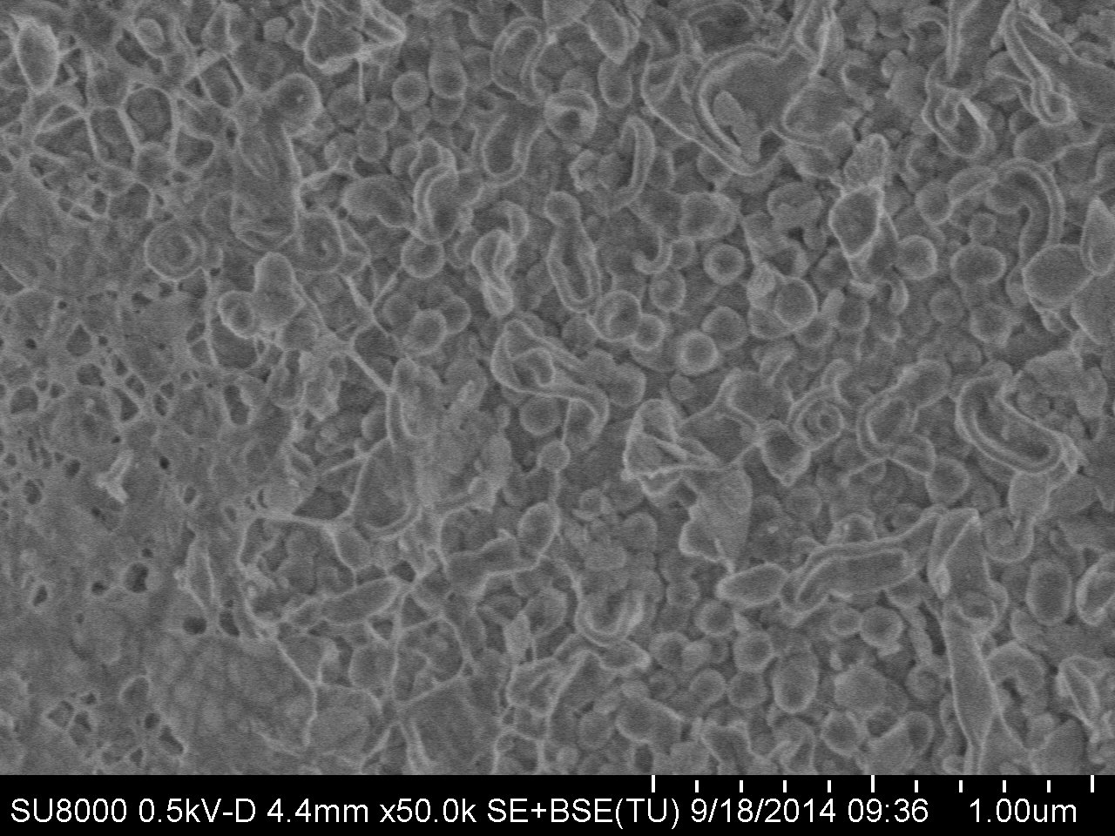
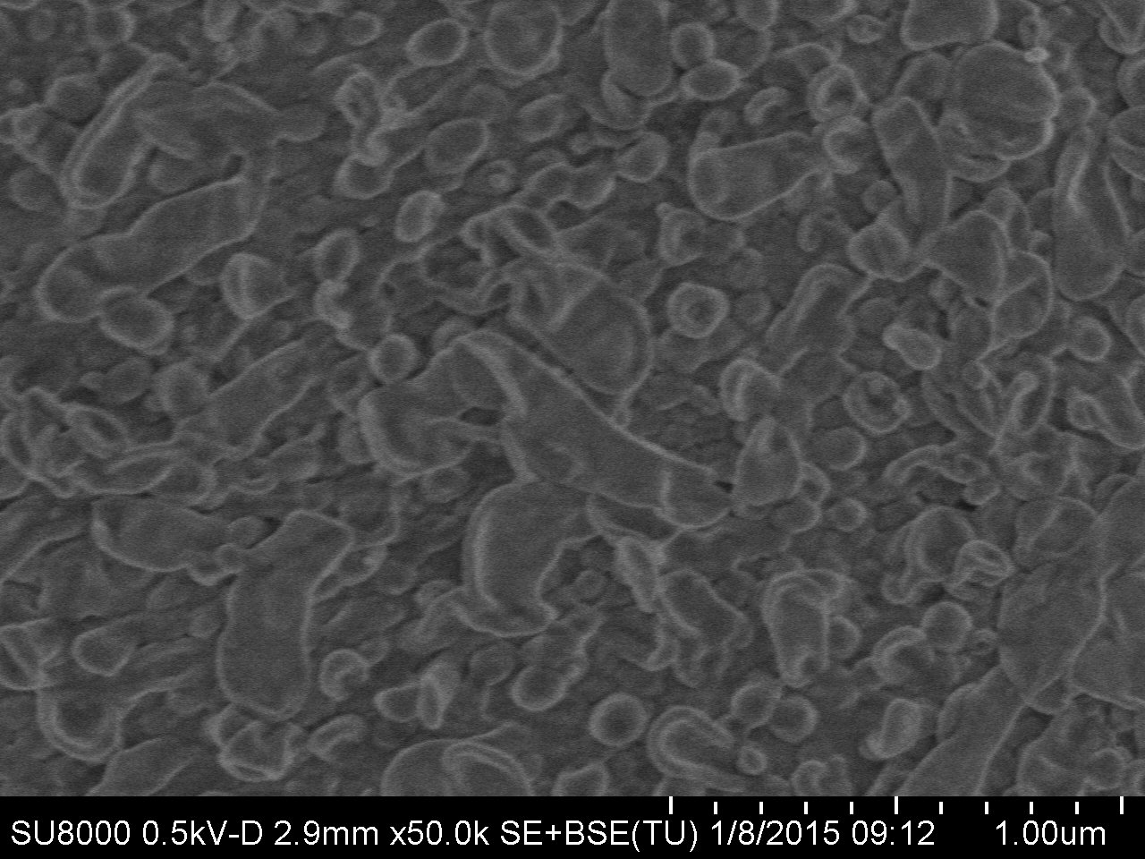
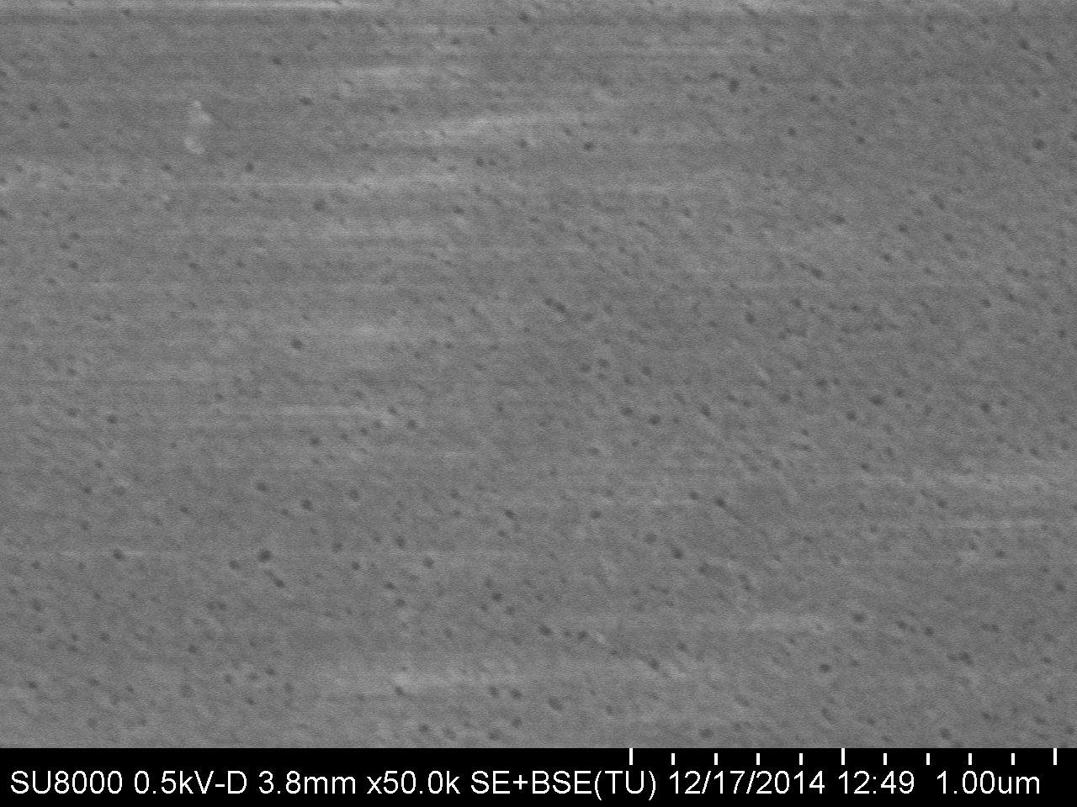
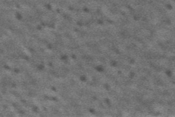
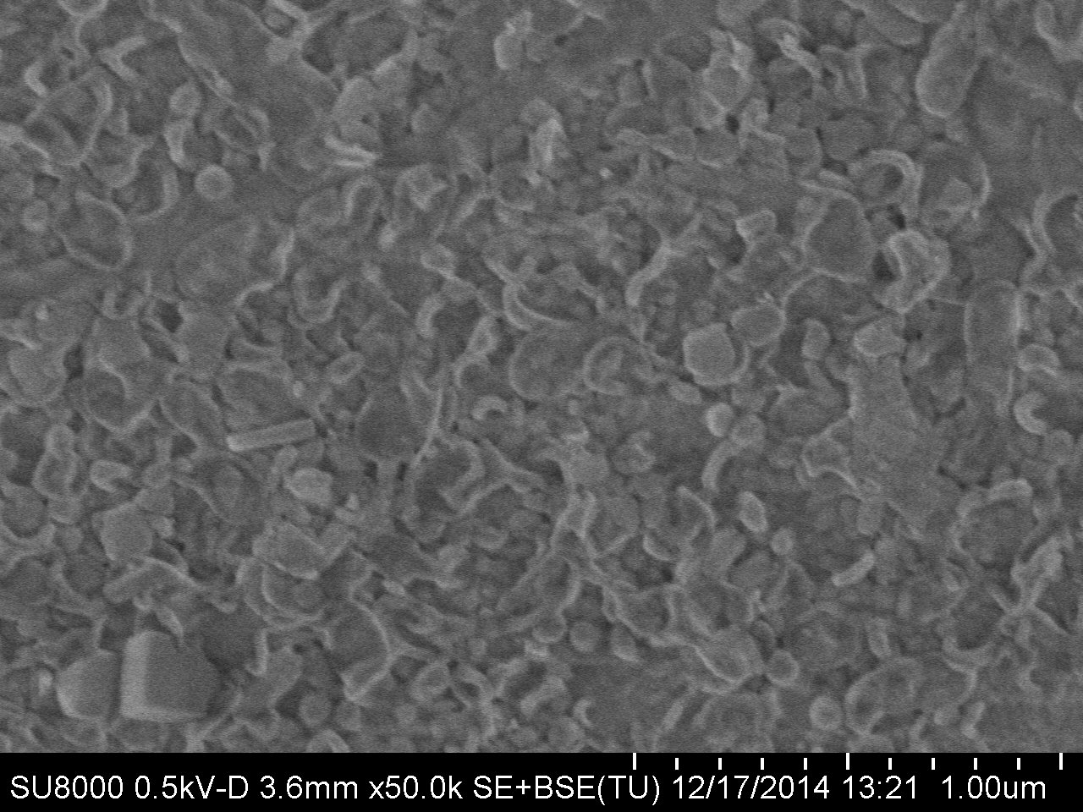
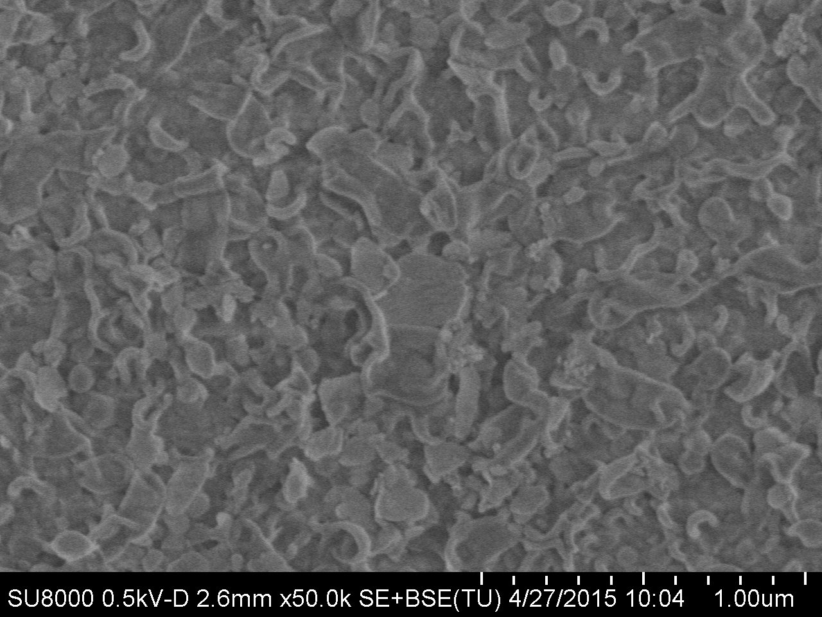
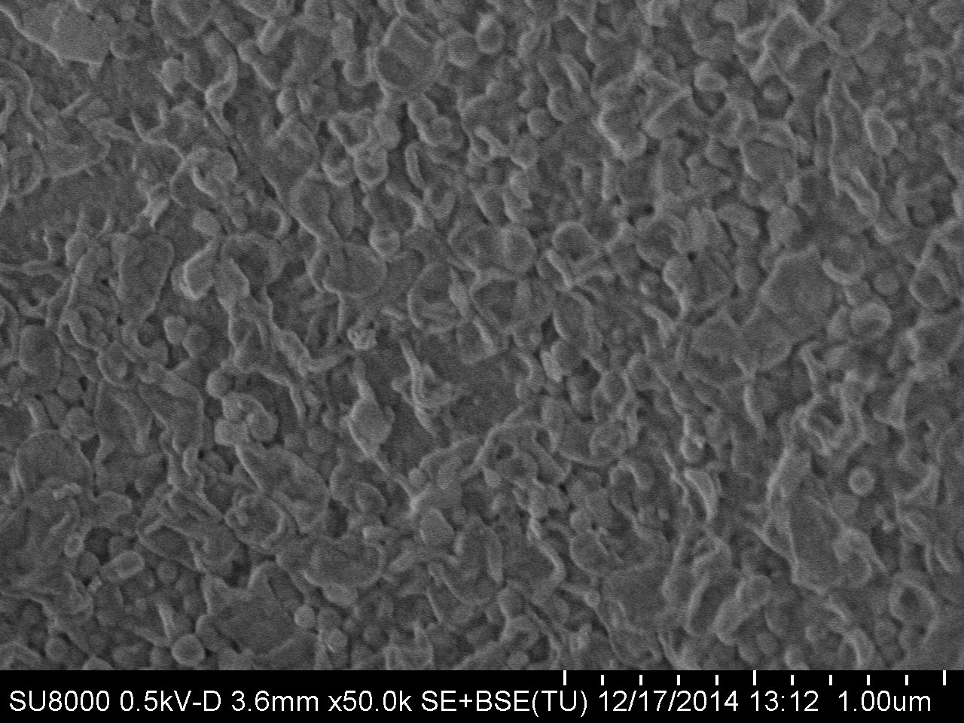
Results
Scanning electron microscopy (SEM) using S-800 MODEL (HITACHI)
TM 720-400 END-OF-LIFE
TM 720-400 PRISTINE
TM 720-400 CASE A
PORES
In all cases excepting “A” exist polyamide
TM 720-400 CASE B
TM 720-400 CASE C
HRLE-440i 242 h
TM 720-400 CASE D

Slide 16
Results
  Is Exposure level (ppm·h) reproducible in different end-of-life membranes brands to achieve NF range and UF range?
Notes:
The present study, as part of the LIFE+ ENV/ES/000751 TRANSFOMEM European project, investigates the transformation of end-of-life membranes to be recycled as nanofiltration (NF) and ultrafiltration (UF) membranes. Such process is a simple, low energy, surface modification technique, based on polyamide chemical attack.

Slide 17
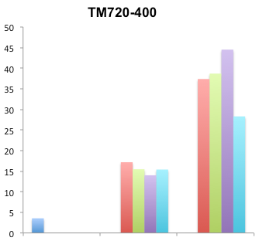
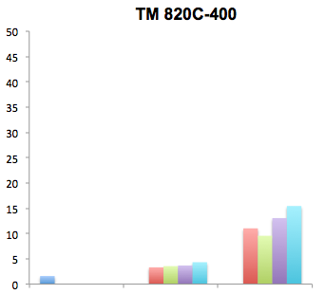
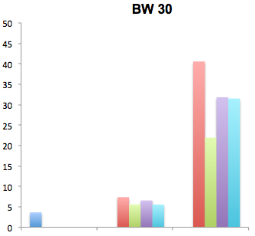
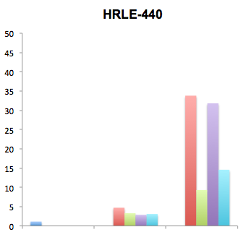
Results
Filtering test: evaluation of membrane permeability
BW
✓UF
SW
NF - low UF
✓NF
✓NF
Permeability L/h·m²·bar
End-of-life
Case study: A X Concentration · Y Exposure time
Case study: B 10 X Concentration · Y/10 Exposure time
Case study: C 50 X Concentration · Y/50 Exposure time
Case study: D 100 X Concentration · Y/100 Exposure time
BW
✓UF
SW
✓UF
✓NF
✓NF
End-of-life
6,200 ppm·h
30,000 ppm·h
End-of-life
6,200 ppm·h
30,000 ppm·h

Slide 18
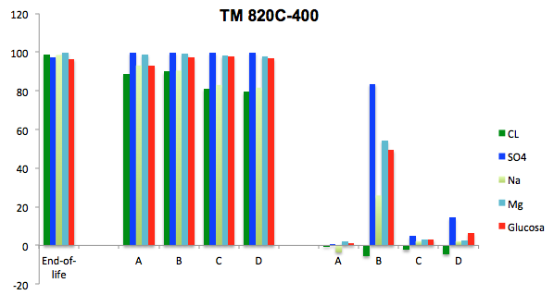
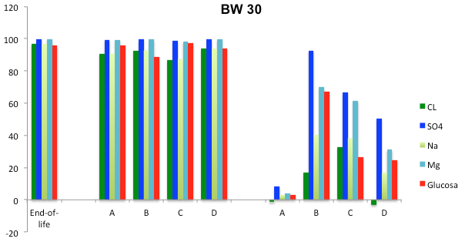
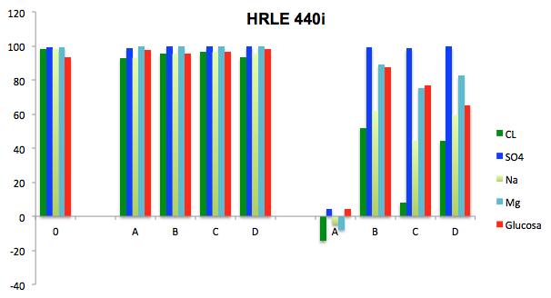
End-of-life
Case study: A X Concentration · Y Exposure time
Case study: B 10 X Concentration · Y/10 Exposure time
Case study: C 50 X Concentration · Y/50 Exposure time
Case study: D 100 X Concentration · Y/100 Exposure time
Results
Filtering test: evaluation of ionic and dextrose rejection
TM 720-400
BW
SW
% Rejection
6,200 ppm·h
30,000 ppm·h
BW
SW
!
6,200 ppm·h
30,000 ppm·h
6,200 ppm·h
30,000 ppm·h

Slide 19
Conclusion
End-of-life RO membranes were efficiently transformed into NF and UF membranes by exposing to NaOCl solution (passive inmersion)
  ¿Is there any difference on the transformation process if concentration of NaOCl and the exposure time are variable but the product of them is constant?
NF Transformed membranes achieved same permeability and rejection.
UF Transformed membranes performances are significant differences.
The most similar results were found in case A (lowest concentration, highest time)
and case C (50X concentration and Y/50 exposure time)
  When transformed membranes achieve NF and UF performances, do the membranes surfaces have identic properties?
No, UF Transformed surface have significant differences.
Polysulfone pores were only found in case A (lowest concentration, highest time), in the rest of cases rest of polyamide polymer are still present. Same occurred with ATR-FTIR analysis. Only in case A exist polyamide polymer.
  Is Exposure level (ppm·h) reproducible in different end-of-life membranes brands to achieve NF range and UF range?
All membrane achieve NF and UF range performances
The main factor for a sucsseful transformation is previous membrane fouling

Slide 20
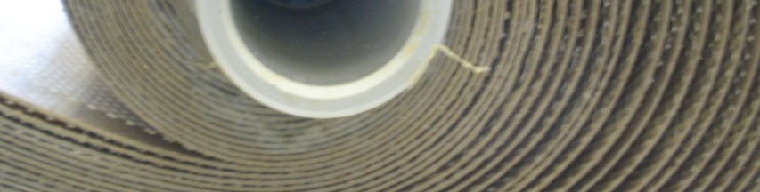




Thank you so much for your attention
Email: raquel.pacheco@imdea.org
Website: http://www.life-transfomem.eu/
Facebook:https://www.facebook.com/pages/Life-Transfomem/759314547449284?ref=hl
Twitter: https://twitter.com/transfomem
Notes:
The present study, as part of the LIFE+ ENV/ES/000751 TRANSFOMEM European project, investigates the transformation of end-of-life membranes to be recycled as nanofiltration (NF) and ultrafiltration (UF) membranes. Such process is a simple, low energy, surface modification technique, based on polyamide chemical attack.

