Slide 1
About Omics Group
OMICS Group International through its Open Access Initiative is committed to make genuine and reliable contributions to the scientific community. OMICS Group hosts over 400 leading-edge peer reviewed Open Access Journals and organize over 300 International Conferences annually all over the world. OMICS Publishing Group journals have over 3 million readers and the fame and success of the same can be attributed to the strong editorial board which contains over 30000 eminent personalities that ensure a rapid, quality and quick review process.

Slide 2
About Omics Group conferences
OMICS Group signed an agreement with more than 1000 International Societies to make healthcare information Open Access. OMICS Group Conferences make the perfect platform for global networking as it brings together renowned speakers and scientists across the globe to a most exciting and memorable scientific event filled with much enlightening interactive sessions, world class exhibitions and poster presentations
Omics group has organised 500 conferences, workshops and national symposium across the major cities including SanFrancisco,Omaha,Orlado,Rayleigh,SantaClara,Chicago,Philadelphia,Unitedkingdom,Baltimore,SanAntanio,Dubai,Hyderabad,Bangaluru and Mumbai.

Slide 3



Development of a high power coherent quantum cascade laser array mounted in extended-cavity system
R. Vallon¹, B.Parvitte¹,G.M. de Naurois², G. Maison², M. Carras², V. Zéninari¹
¹ Groupe de Spectrométrie Moléculaire et Atmosphérique, UMR 7331 CNRS, Université de Reims
² III-V lab, GIE Alcatel – Thales – CEA LETI

Slide 4
Outline
Motivations
Technical challenges
Array QCL emitters performances
Preliminary results in extended cavity
Conclusion & perspectives

Slide 5
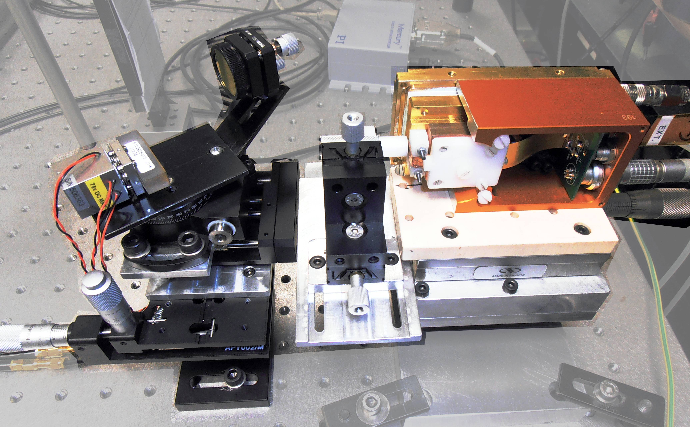
Introduction
High power technology
High power extended-cavity QCL for spectroscopic applications
  photo-acoustic,
  saturated molecular absorption
  …
Single-mode
Tunable
Wide-spectral range
Room temperature
EC-QCL

Slide 6
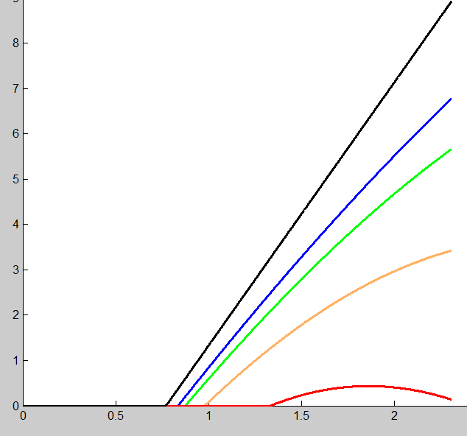
Context
Power vs current
No warming
Rth =3,5 K/W
Pulse operation
Slope
Threshold current
Rth =4 K/W
Power (W)
Rth = 5 K/W
Rth = 8 K/W
Current (A)
QCL Optical performances limited by thermal resistance

Slide 7
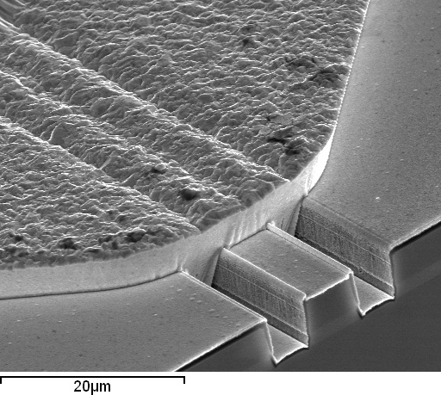
Context
Increase heat extraction
Double trench process
Buried process
Active
region
R_{th}= 10 °K/W
R_{th}= 4 °K/W

Slide 8
Context
No warming
Rth =3,5 K/W
Pulse operation
Rth =4 K/W
Power (W)
Rth = 5 K/W
Rth = 8 K/W
Current (A)
Optical performances : not limited by thermal resistance but by injection current

Slide 9
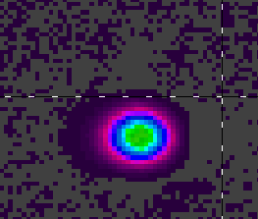
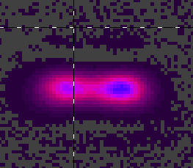
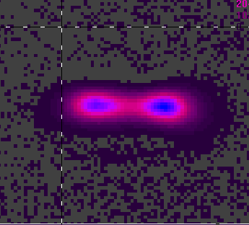
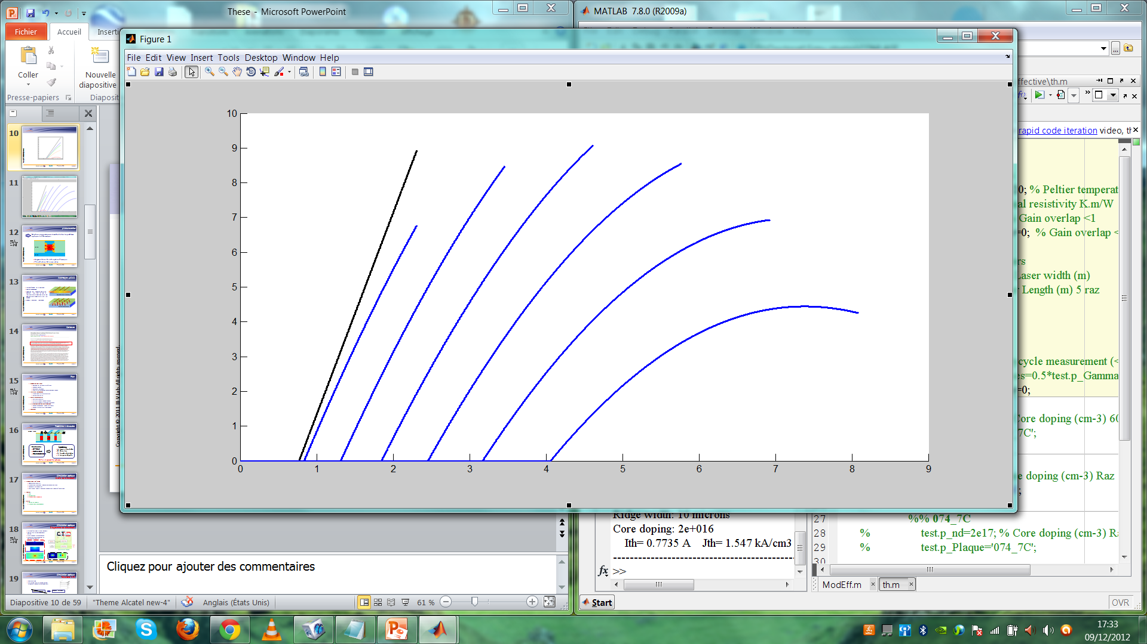

Context
Increase current
performances limited by active region size
Beam quality
warming
20µm
10µm
15µm
25µm
30µm
Pulse operation
Power (W)
35µm
Current (A) $∝$size of gain medium

Slide 10
One solution : buried + micro-structured QCL
µ-structure increase thermal surface exchange
InP:Fe
Active
region
InP:Si
Thermal dissipation enhancement

Slide 11
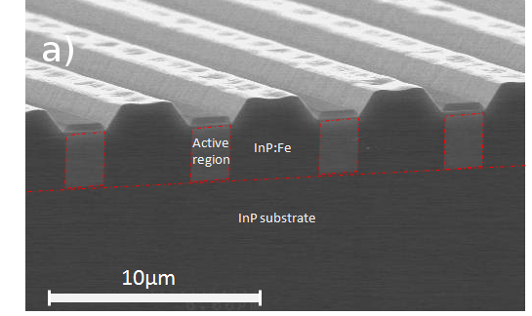
One solution : buried + micro-structured QCL
µ-structure pitch: Λ=w+D
w
D
w ~ 2µm
2 µm<D <8µm @ 8.2µm
Active
region
Λ < 3*λ/2 for dual-lobe operation (anti-symetric supermode)
Evanescent coupling

Slide 12
µ-stipes QCL
Near field
Below threshold
Above threshold
Spontaneous emission
Stimulated emission
G.M. de Naurois et al, Optics Letters, Vol. 37, No.3 (2012)

Slide 13
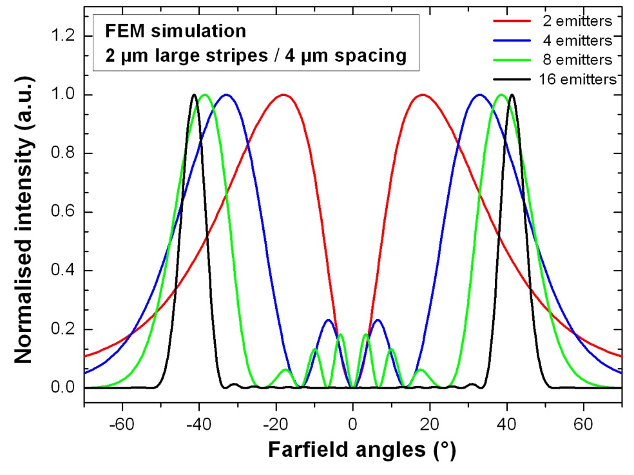
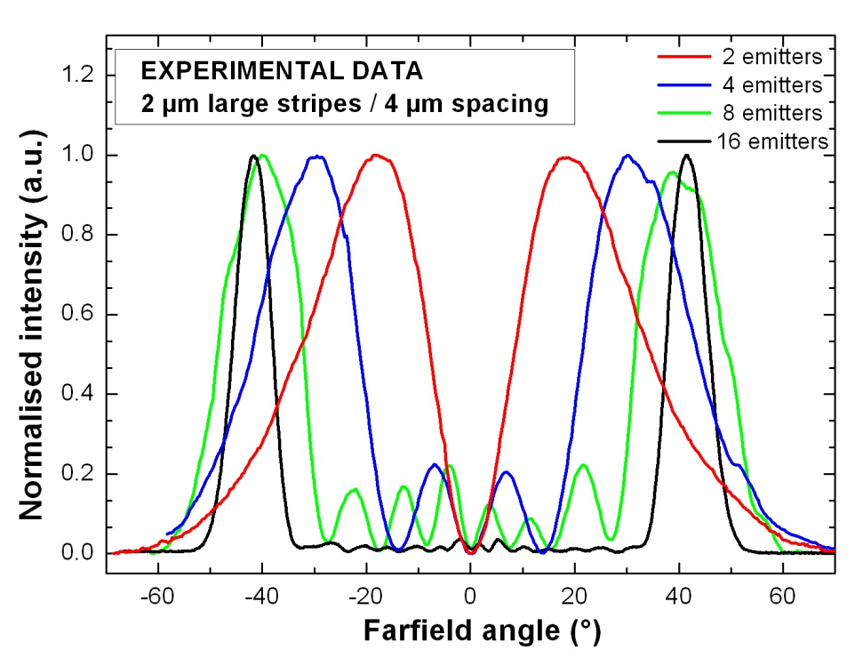
µ-stripes QCL
Far field : dual lobes emission
Simulation
Measurement
2µm width, 6µm pitch

Slide 14
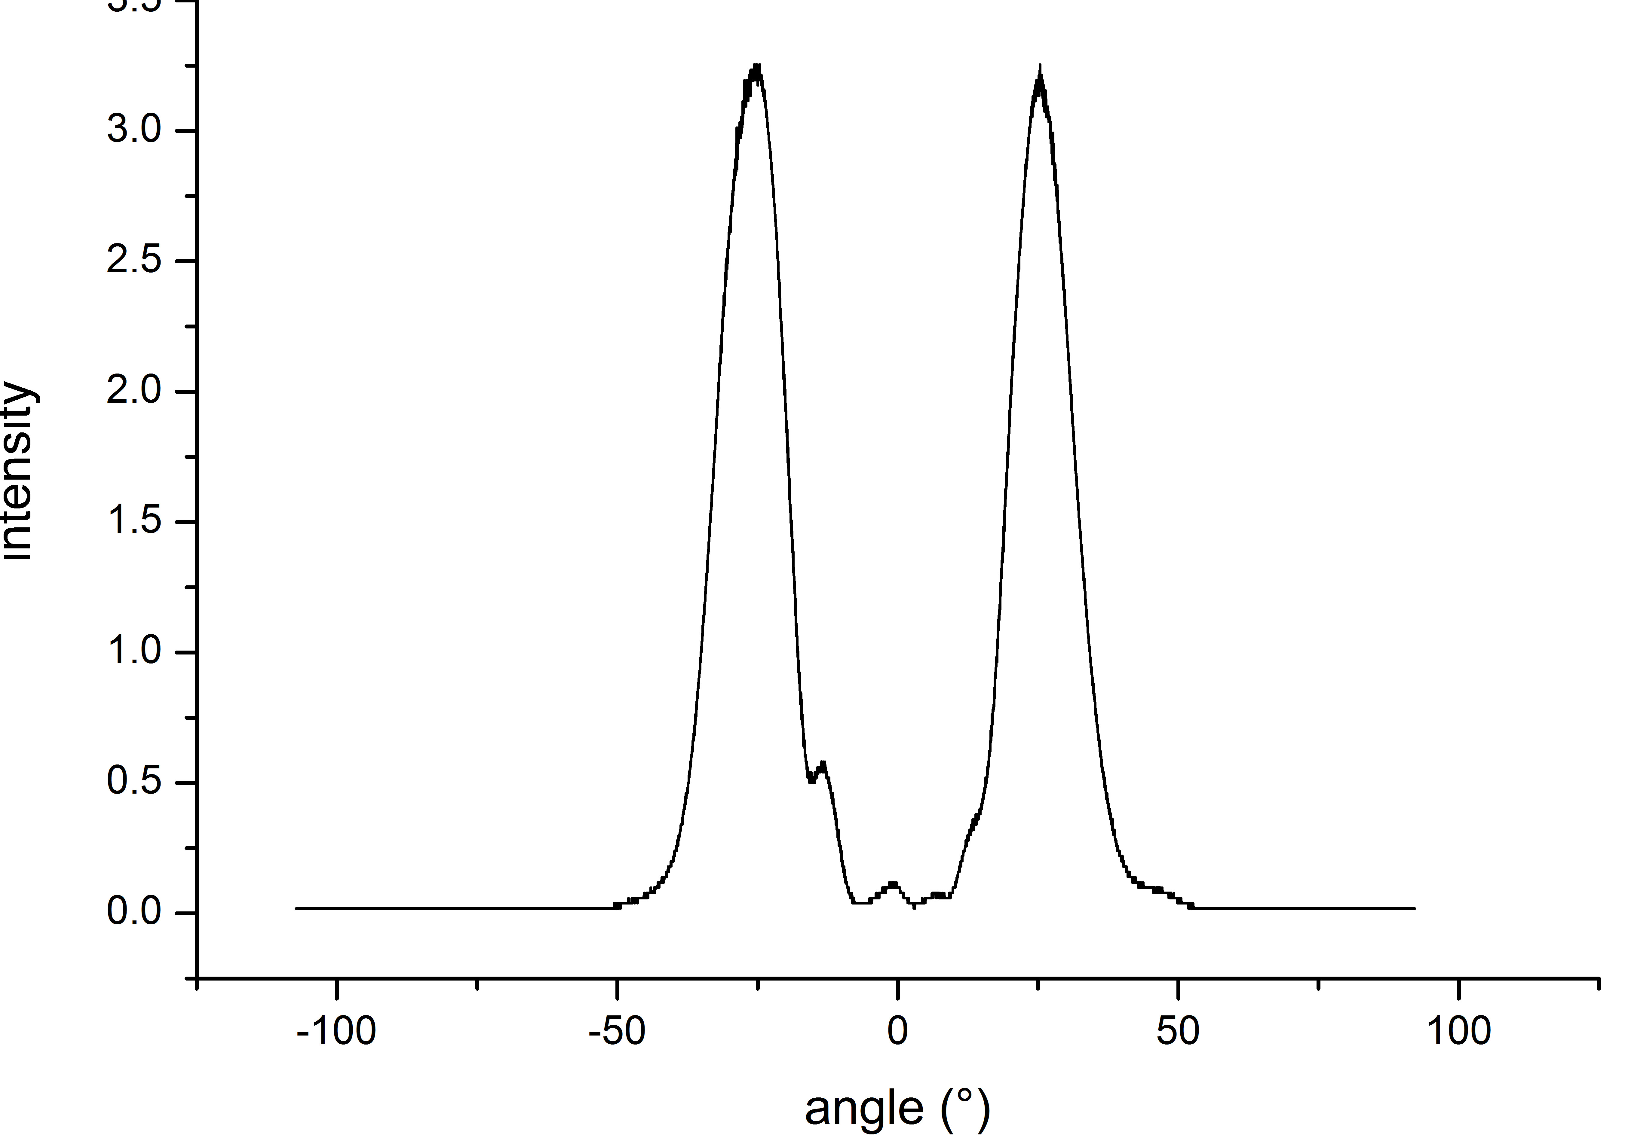
µ-stripes QCL
Far field
Simulation
Measurement
2µm width, 6µm pitch
4 emitters in extended cavity

Slide 15
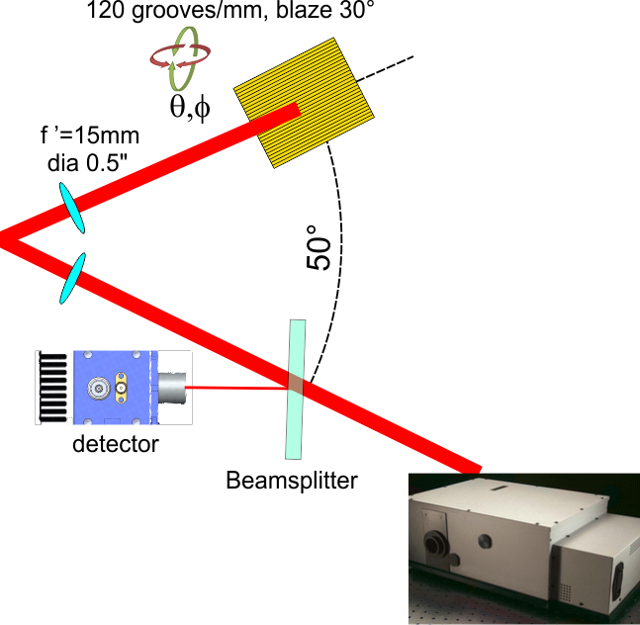
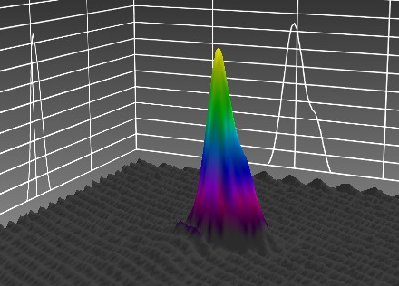
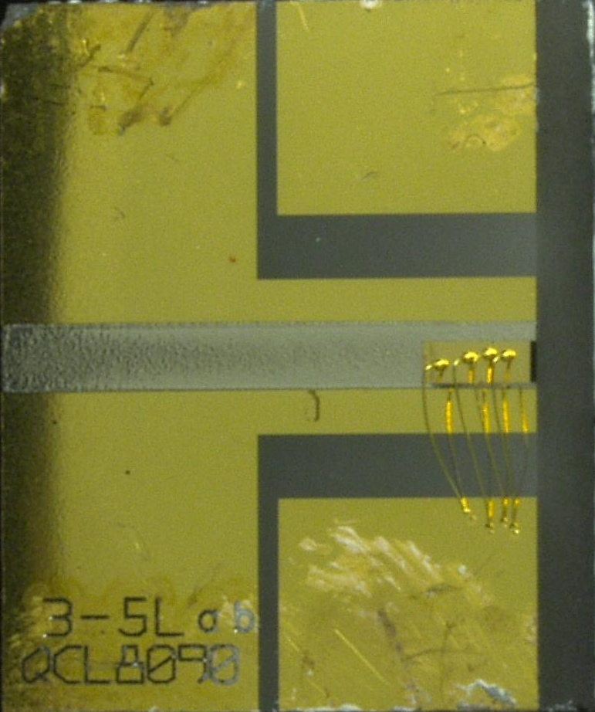
µ-stripes EC-QCL
Experimental setup
HR coated – uncoated (R=30%)
90°
FTIR
interferometer

Slide 16
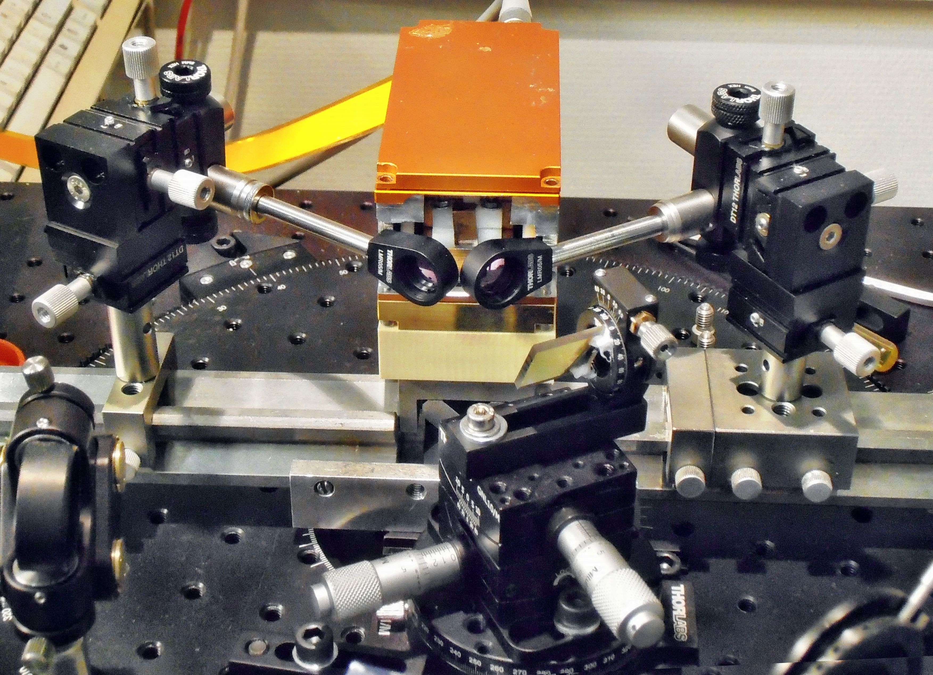
µ-stripes EC-QCL
Experimental setup
Output beam

Slide 17
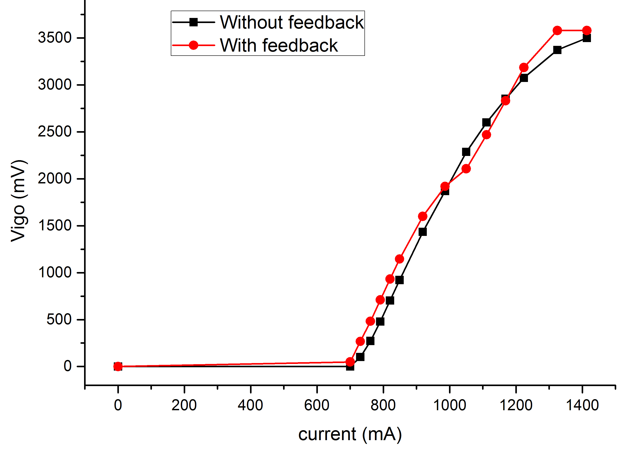
µ-stripes EC-QCL
P(I)
Pulse operation 100ns-100kHz

Slide 18
µ-stripes EC-QCL
Threshold
Threshold : 730mA
700mA

Slide 19
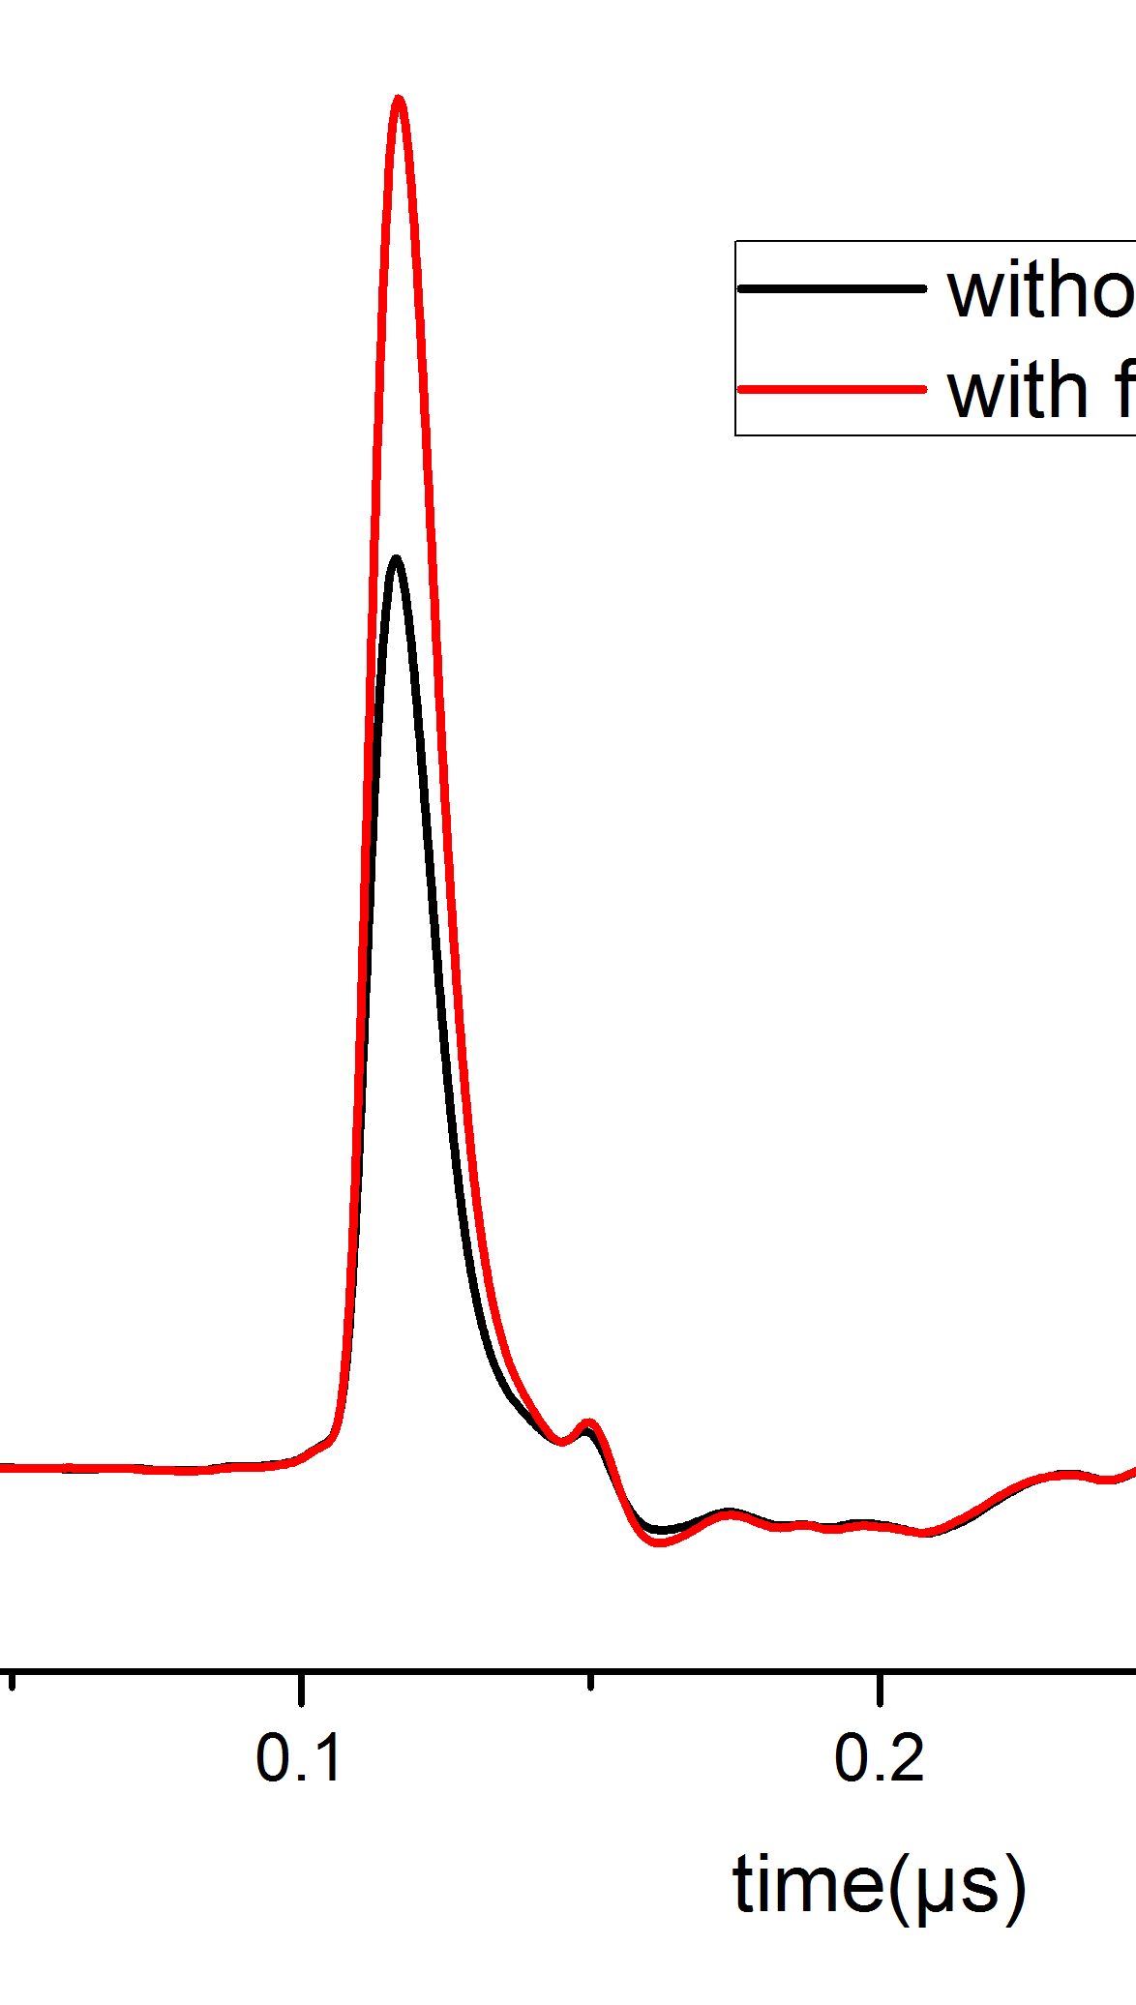
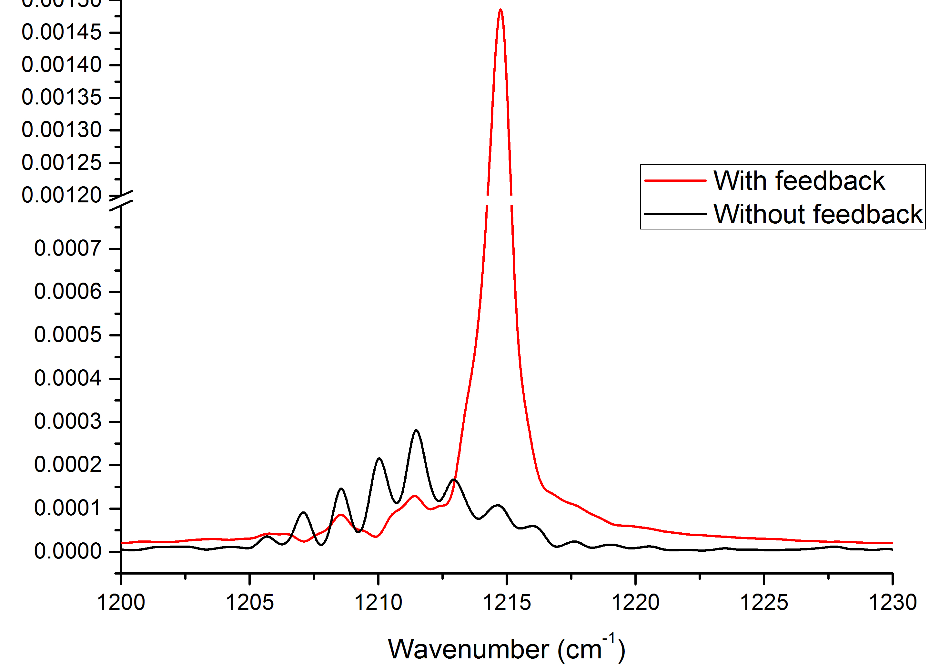
µ-stripes EC-QCL
P(I)

Slide 20
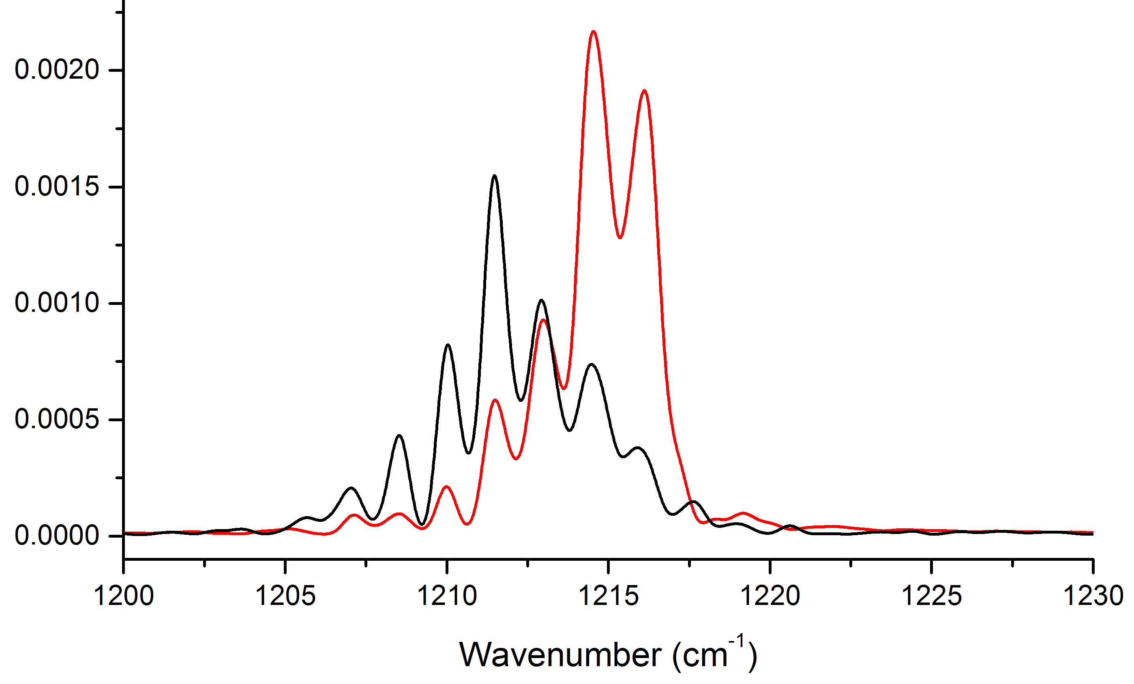
µ-stripes EC-QCL
P(I)

Slide 21
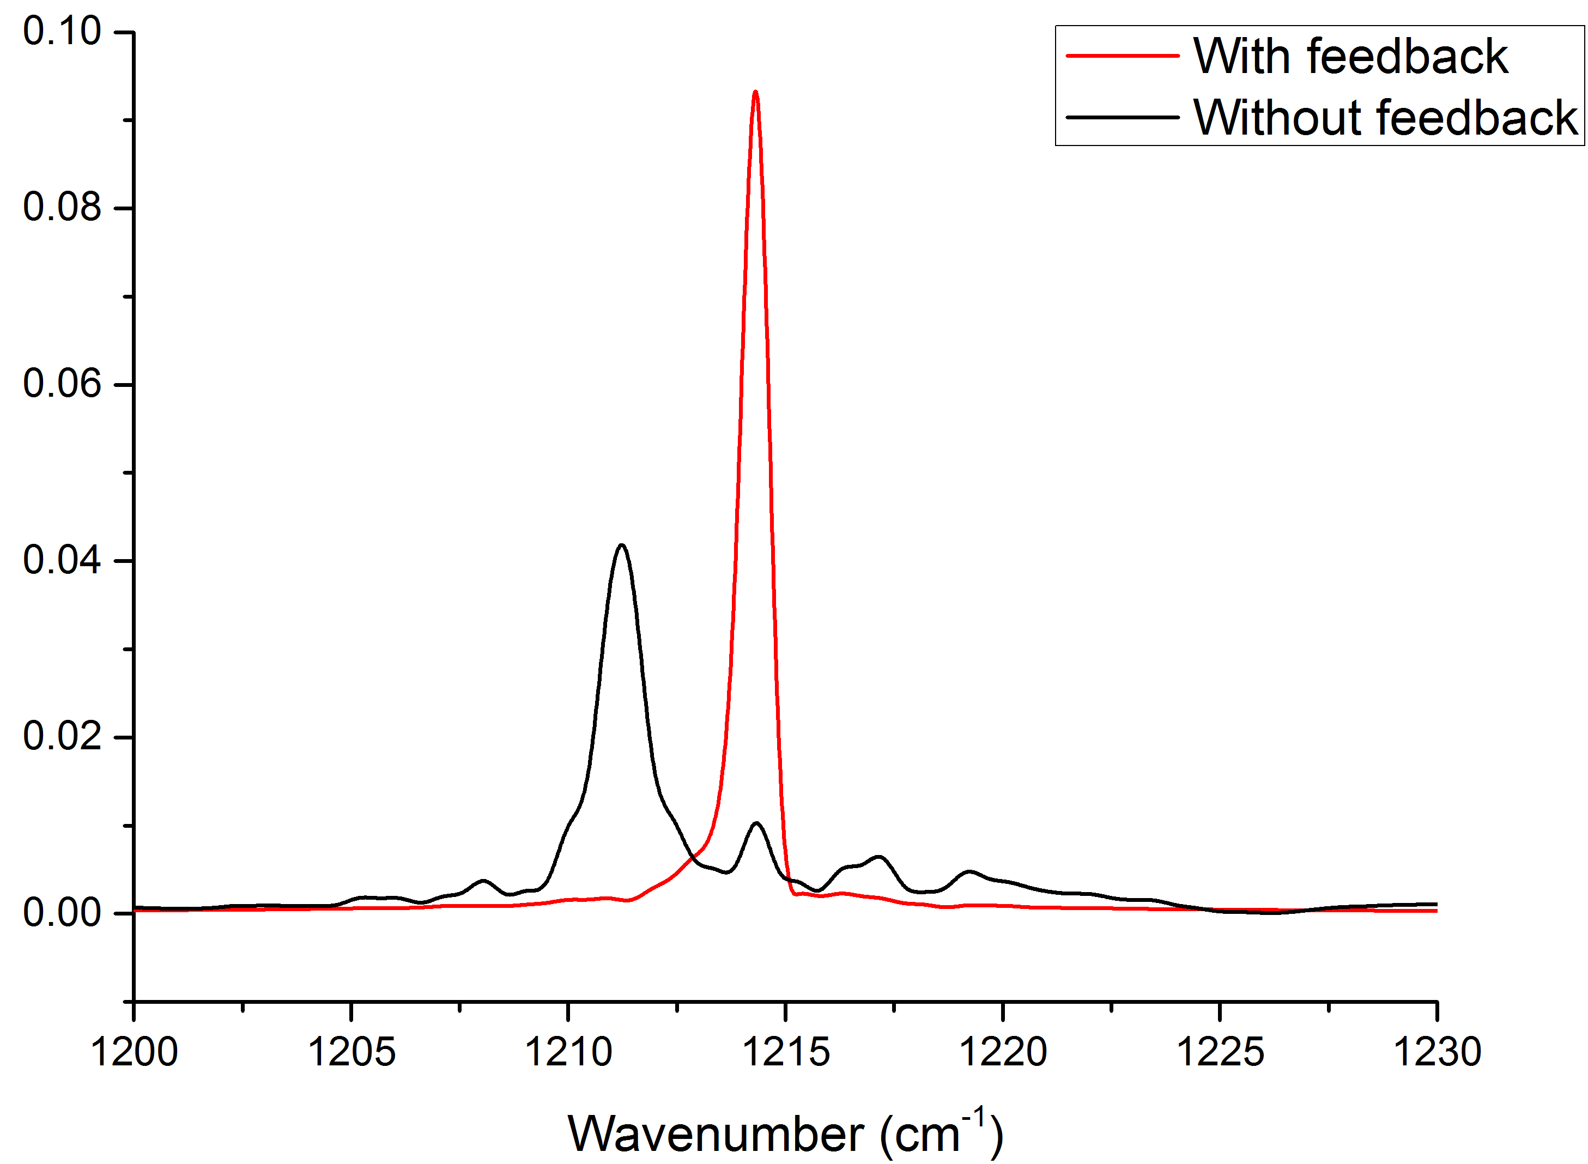
µ-stripes EC-QCL
P(I)

Slide 22
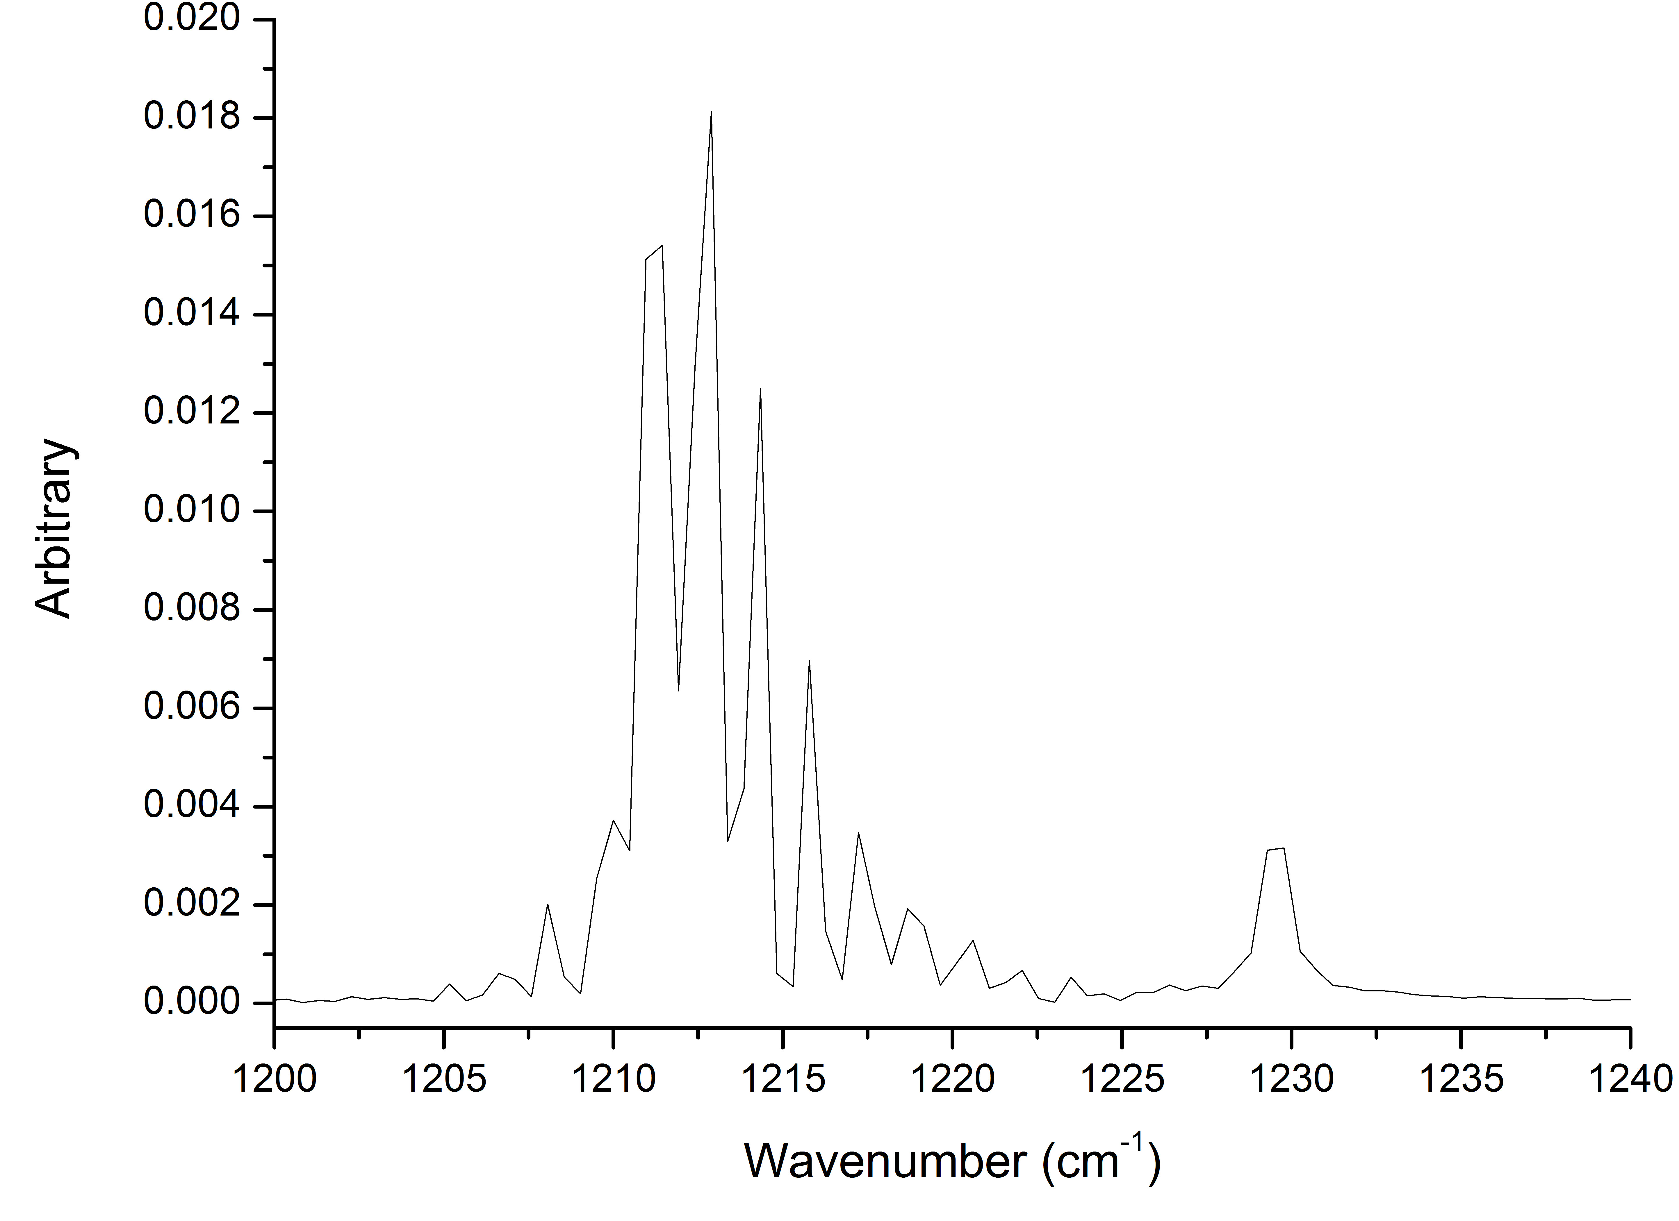
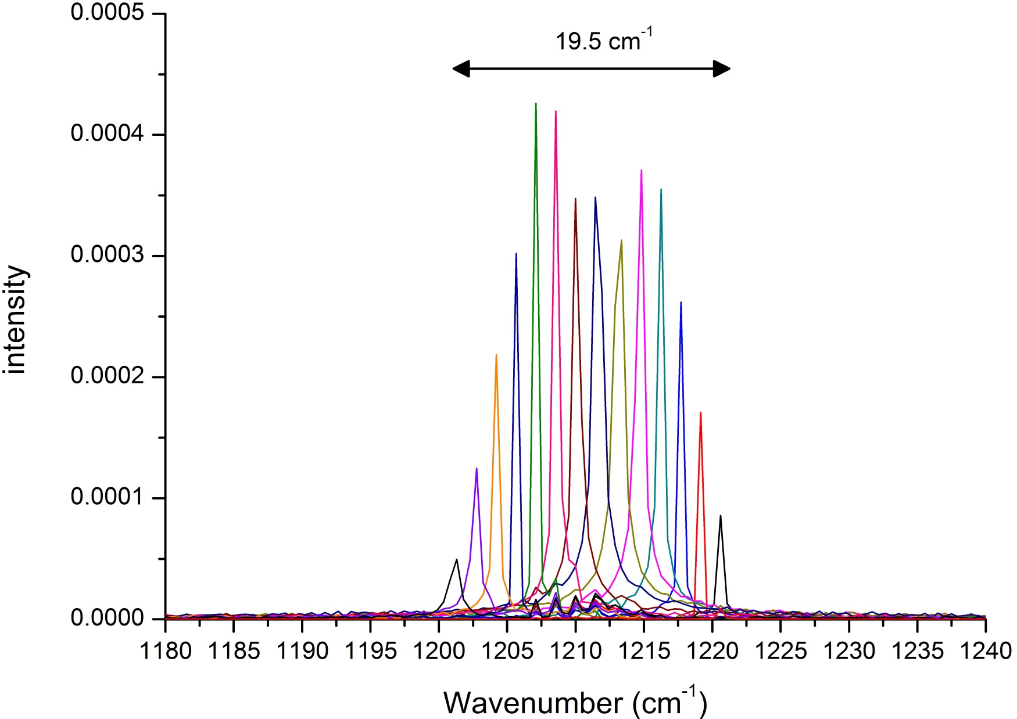
µ-stripes EC-QCL
Spectral range
Mono-mode operation : 19.5 cm⁻¹
multimode : 30 cm⁻¹
Δ : 1.45 cm⁻¹

Slide 23
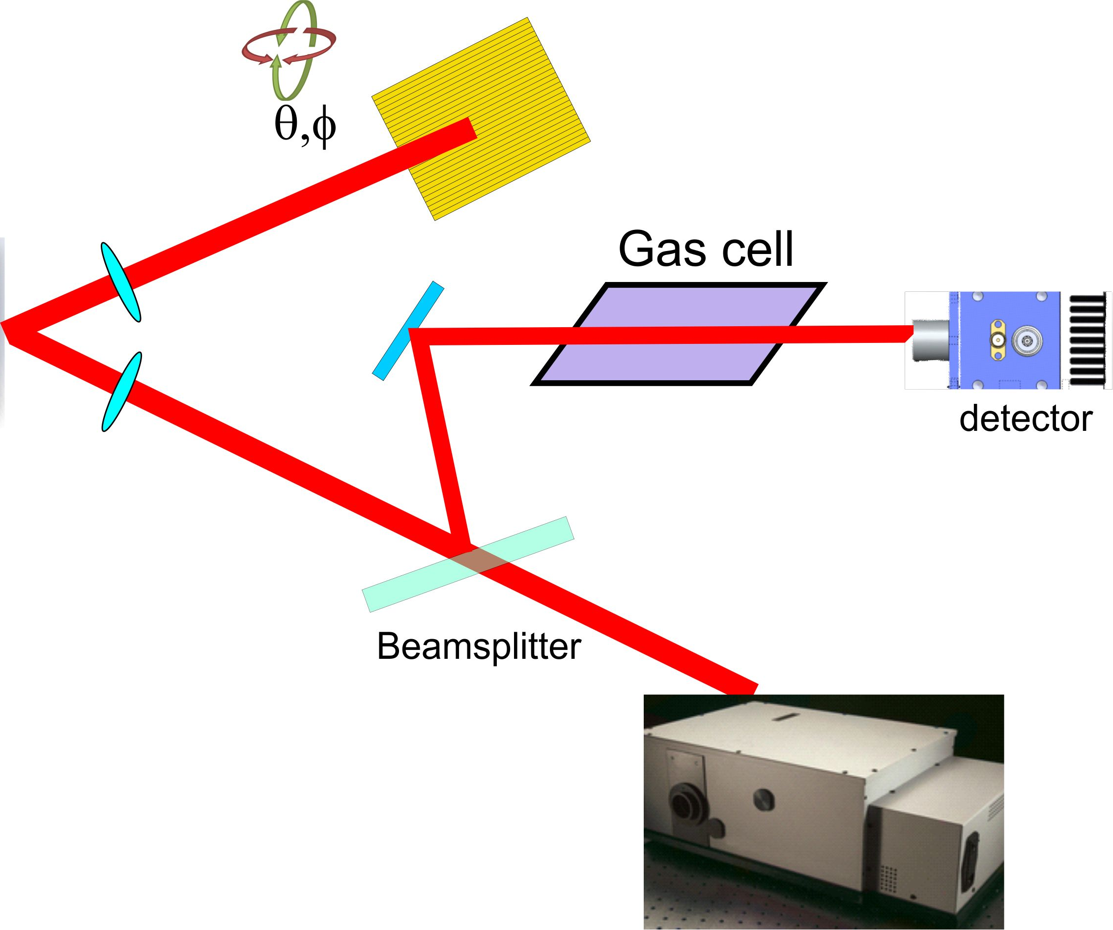
µ-stripes EC-QCL
Gas analysis : setup

Slide 24
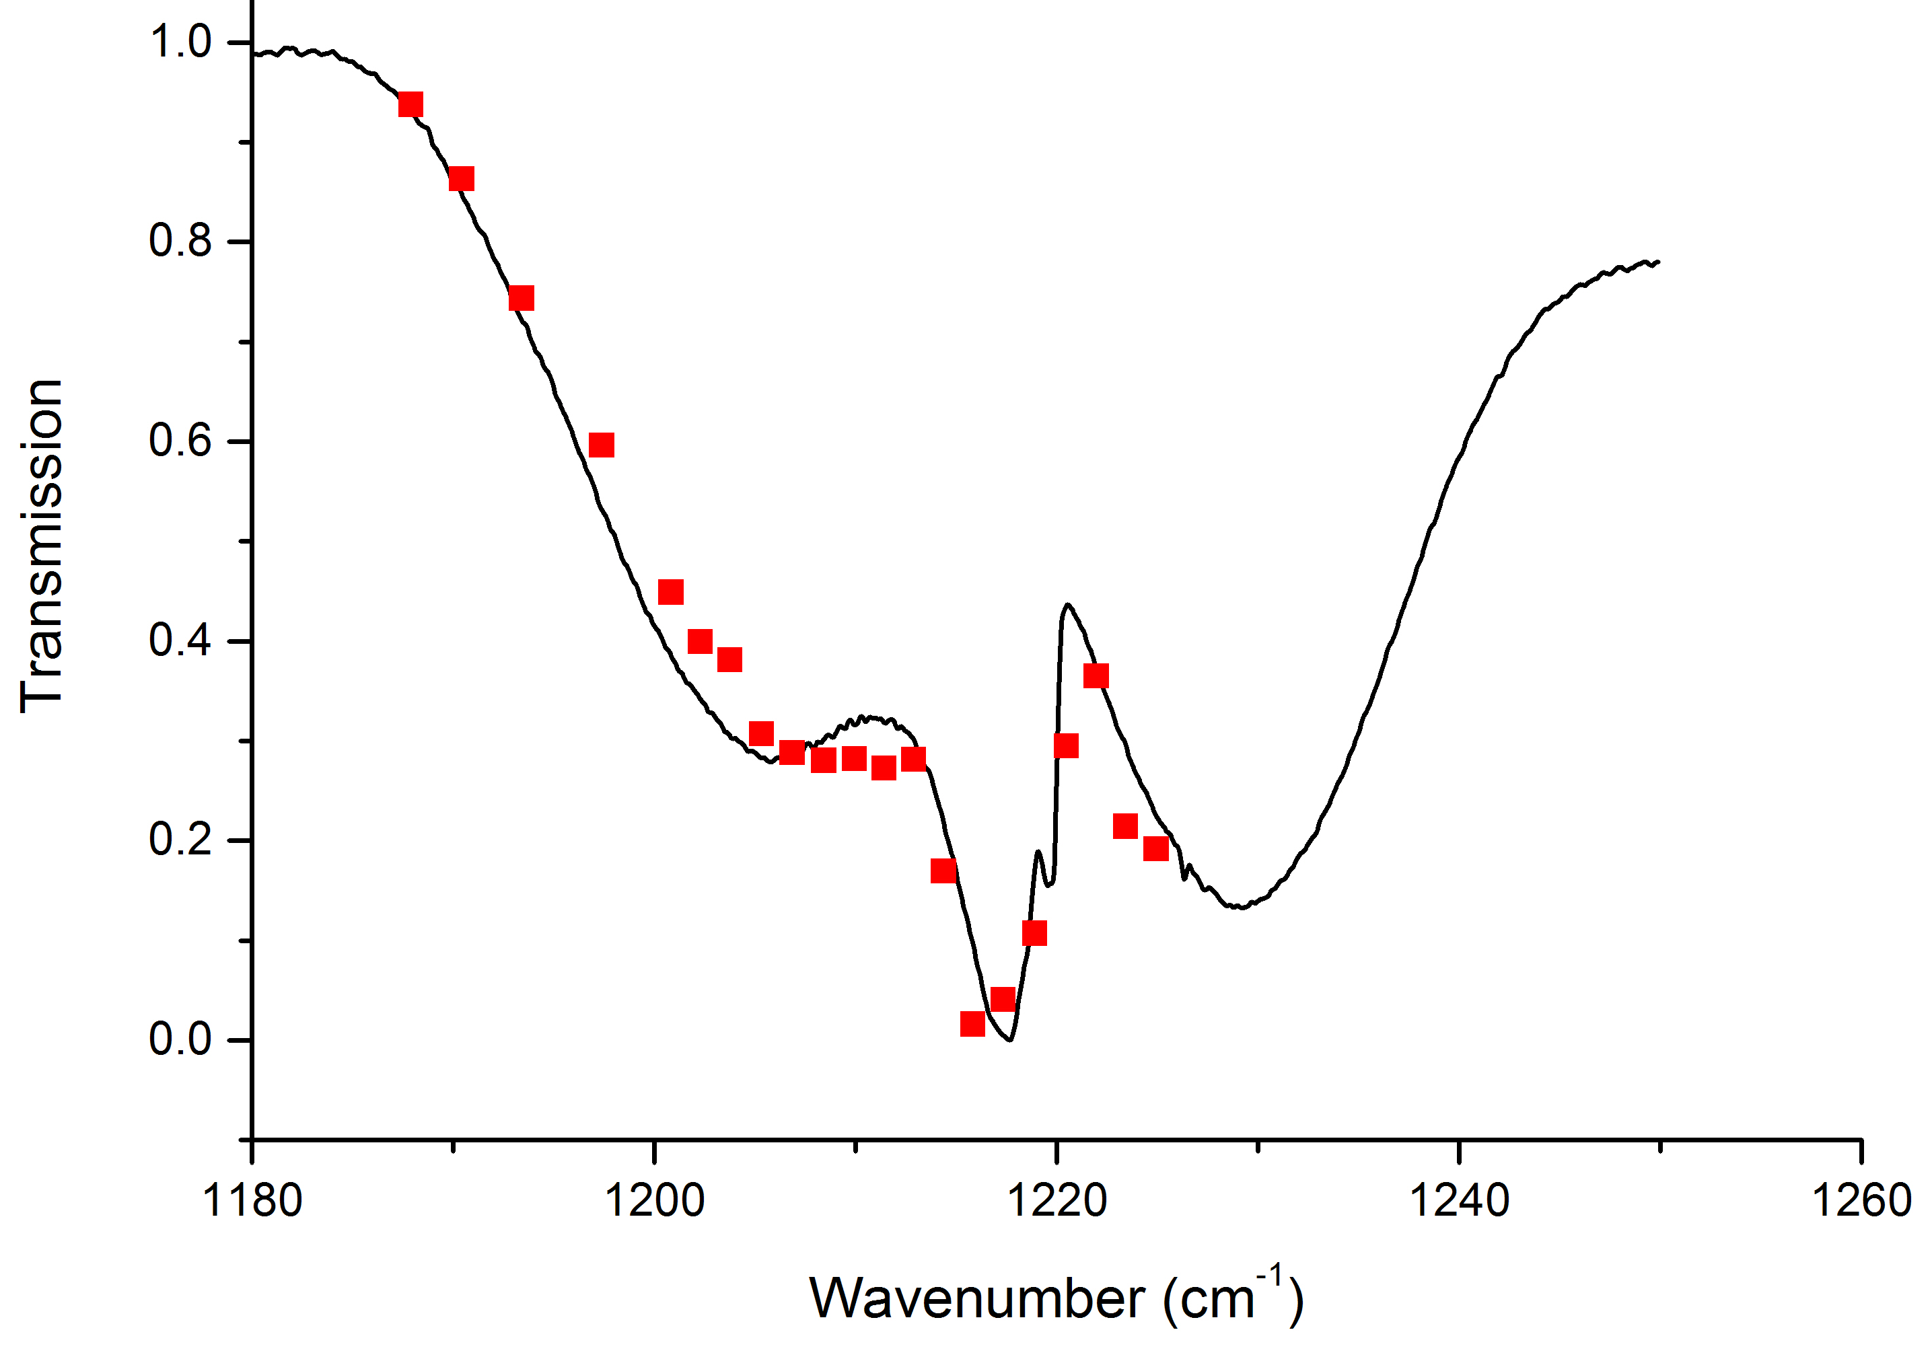
µ-stripes EC-QCL
Gas analysis : Acetone
10 Torr, 20 cm

Slide 25


Conclusion / Perspectives
Preliminary results of EC-µstripe QCL array
Perspectives :
Increase optical feedback to increase tunable spectral range
32 emitter array EC-QCL
CW operation
…
Application : photoacoustic spectrometer
…
Acknowledgement : French Research Agency

Slide 26
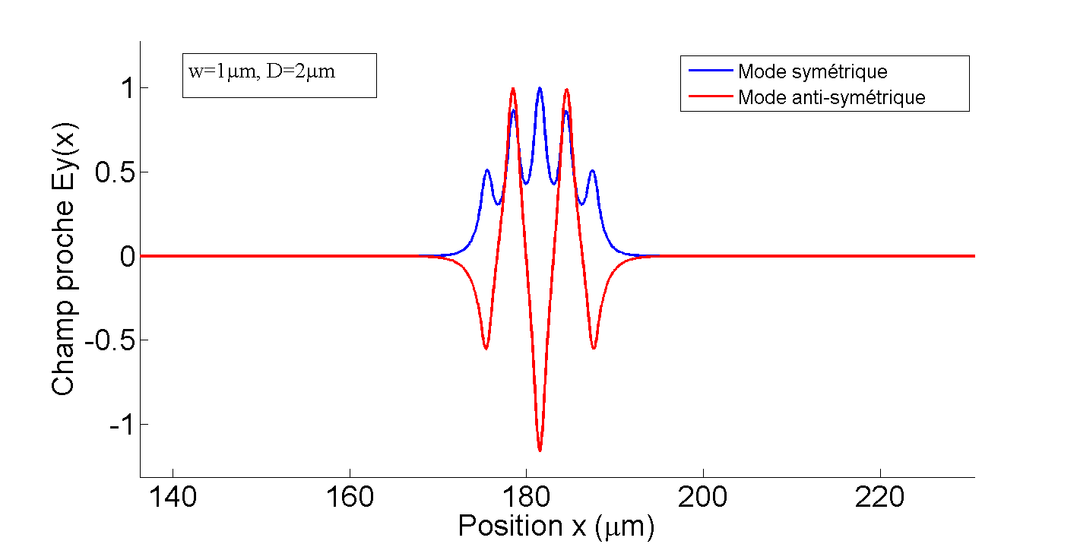
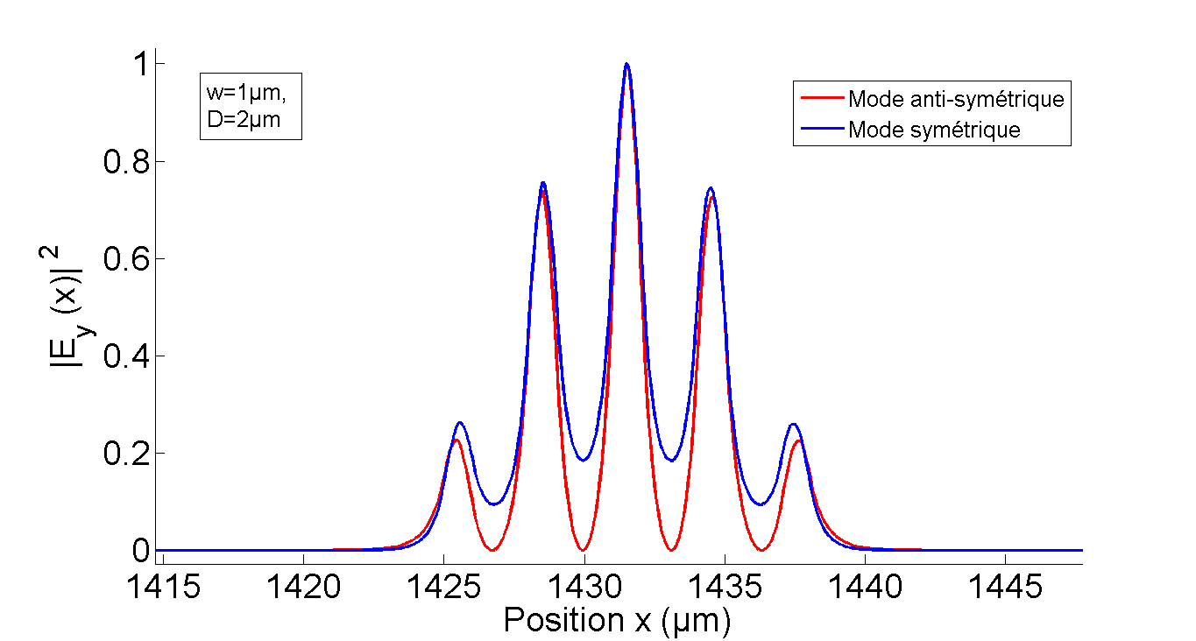
Electric Field & µ-stripe

Slide 27
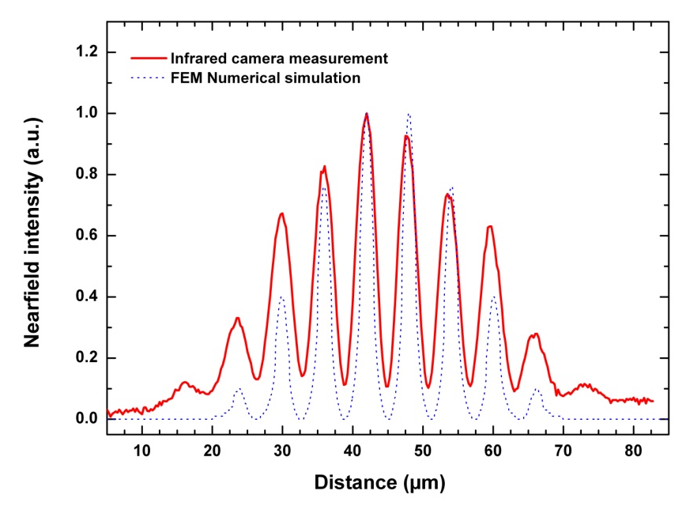

Slide 28
Let Us Meet Again
We welcome all to our future group conferences of Omics group international
Please visit:
www.omicsgroup.com
www.Conferenceseries.com
http://optics.conferenceseries.com/

