Slide 1

Hydraulic Injection Characteristics of different Biofuels
5th World Bioenergy Congress and Expo
Madrid 30th June 2017
Raphael Lechner^{1,2,4}, Nicholas O’Connell², Andreas Hornung^{3,4}
¹Center of Excellence for CHP technologies
Technical Univ. of Applied Sciences Amberg-Weiden
²Institute of Energy Technology at the
Technical Univ. of Applied Sciences Amberg-Weiden
³Fraunhofer UMSICHT, Sulzbach-Rosenberg
⁴University of Birmingham
School of Chemical Engineering

Slide 2
Index
Motivation
Test bench
Physical properties of investigated fuels
Experimental Results
Summary and Outlook

Slide 3
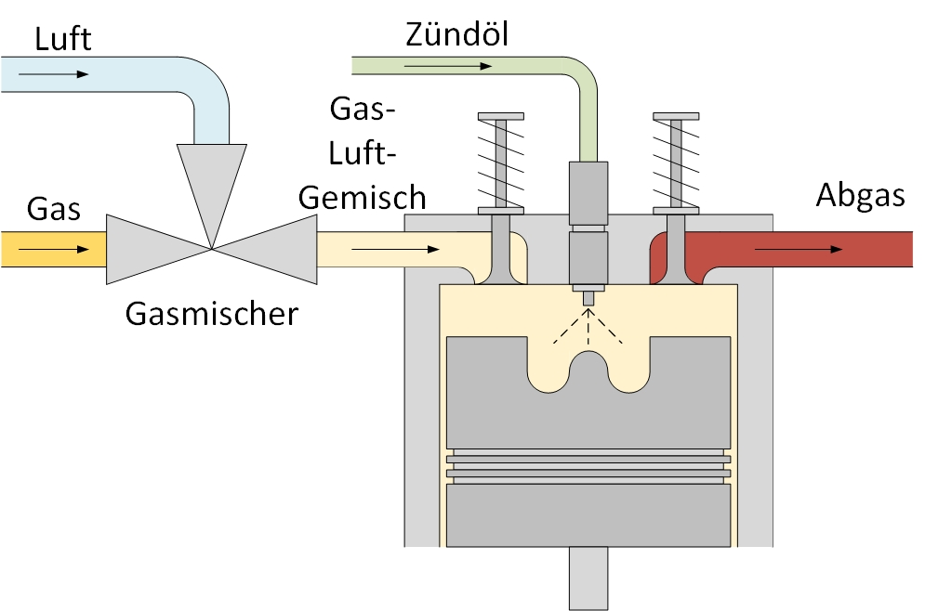
Motivation
Air
Pilot fuel
Combustible mixture of gas and air
Gas
Exhaust gas
Gas mixing valve
Utilisation of liquid biofuels as pilot fuel
in stationary Dual Fuel engines
Rape Seed Oil
Biodiesel
TCR oil
Modified picture from [1]

Slide 4
Index
Motivation
Test bench
Physical properties of the investigated fuels
Experimental Results
Summary and Outlook

Slide 5
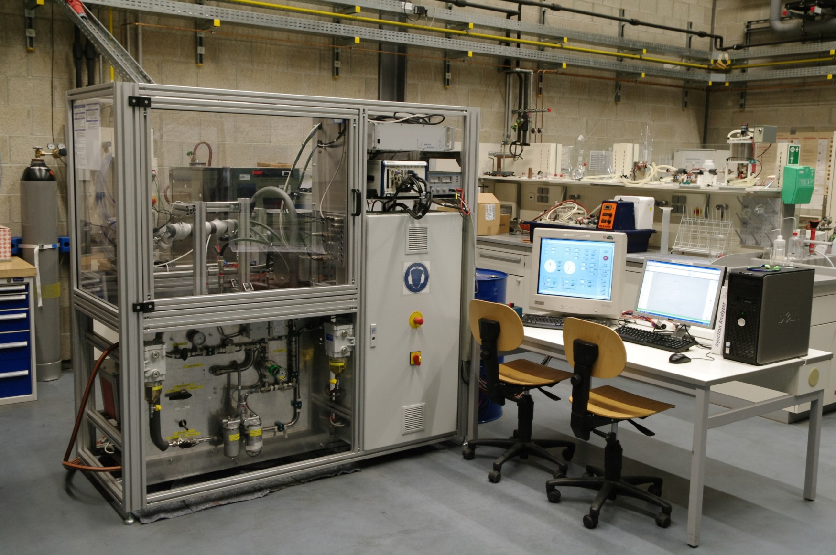
Injection Test Bench

Slide 6
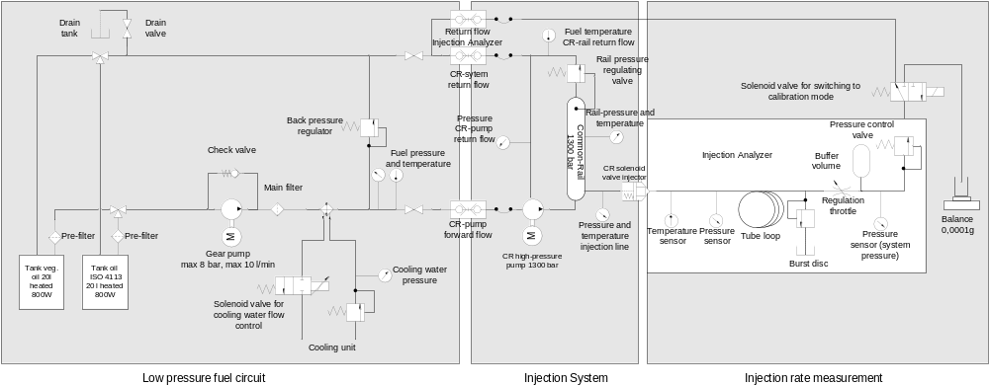
Injection Test Bench
Modified picture from [2]

Slide 7
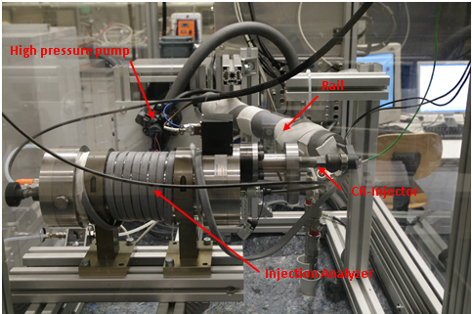
Injection Test Bench

Slide 8
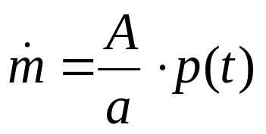
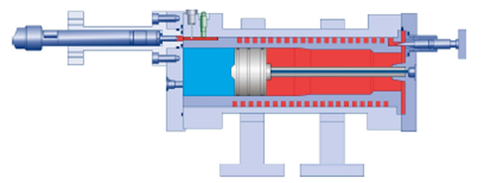
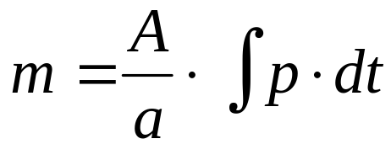
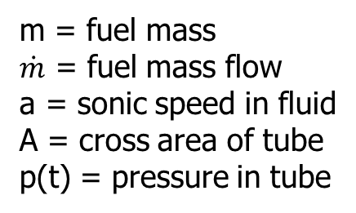
Injection Analyzer
m = fuel mass
$\dot{m}$ = fuel mass flow
a = sonic speed in fluid
A = cross area of tube
p(t) = pressure in tube

Slide 9
Index
Motivation
Test bench
Physical properties of the investigated fuels
Experimental Results
Summary and Outlook

Slide 10
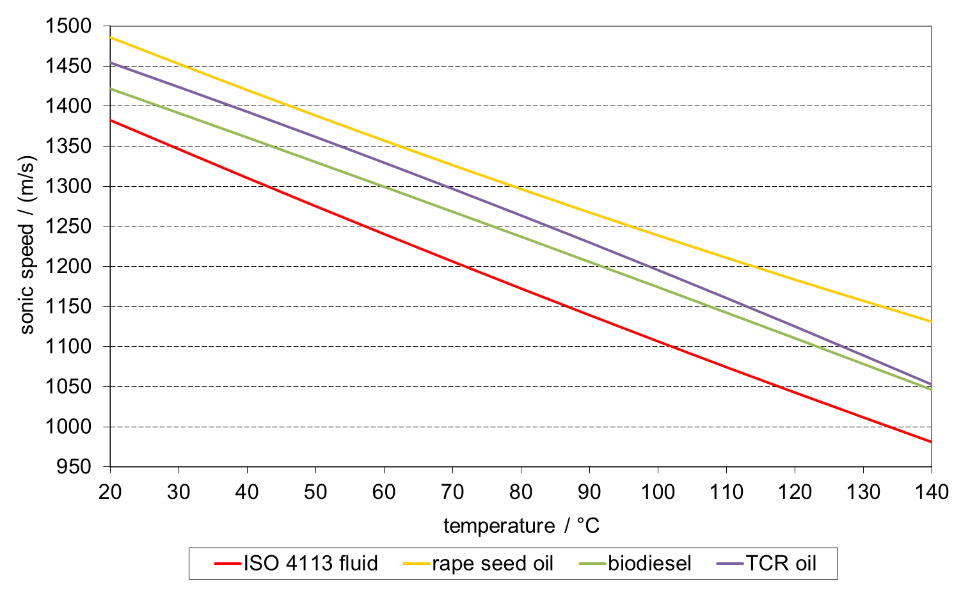
Sonic Speed in Different Fuels
Fuel pressure 50 bar

Slide 11
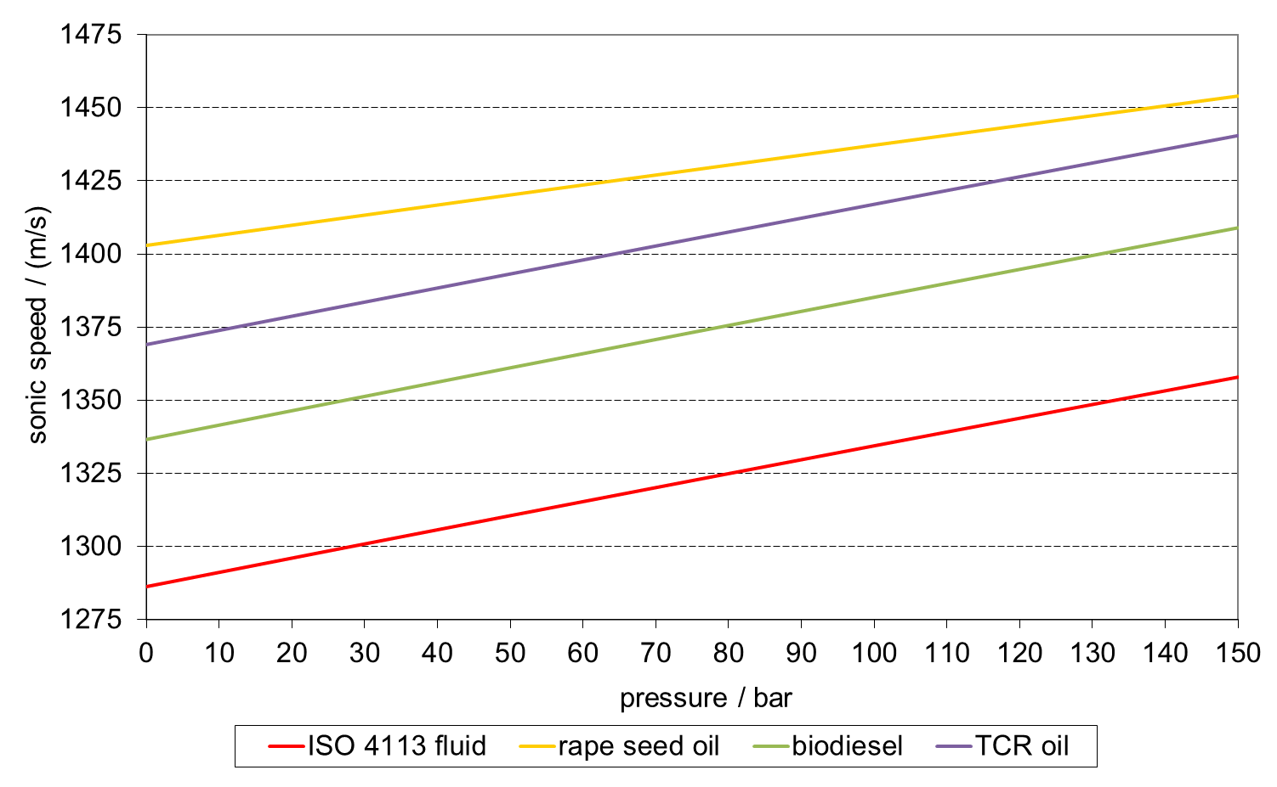
Sonic Speed in Different Fuels
Fuel temperature 40 °C

Slide 12
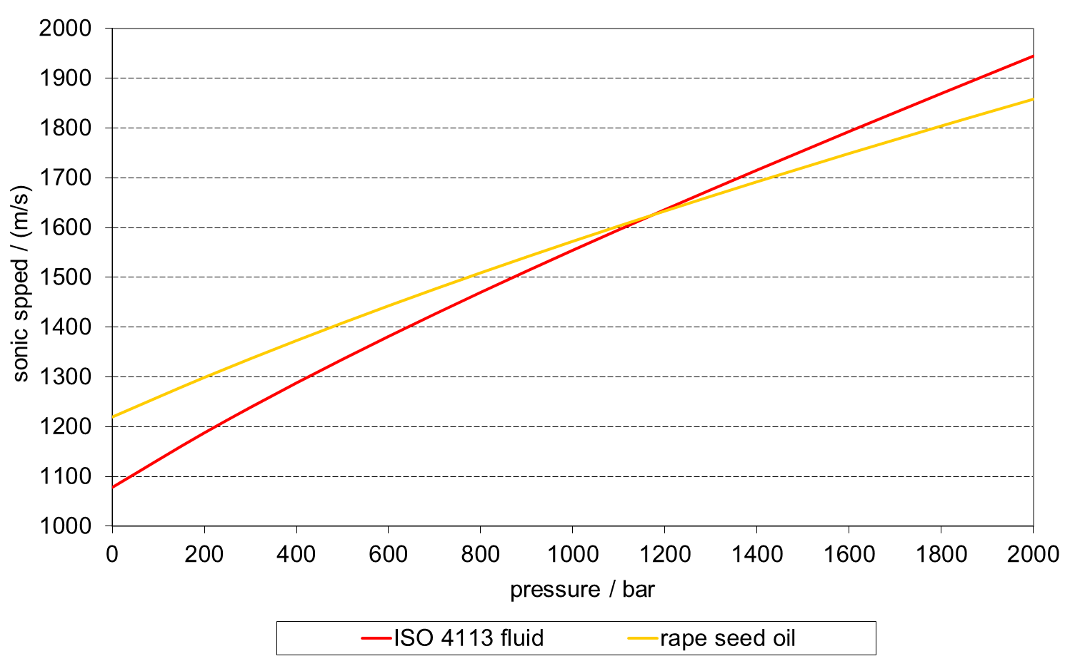
Sonic Speed at high pressures
Fuel temperature 100°C

Slide 13
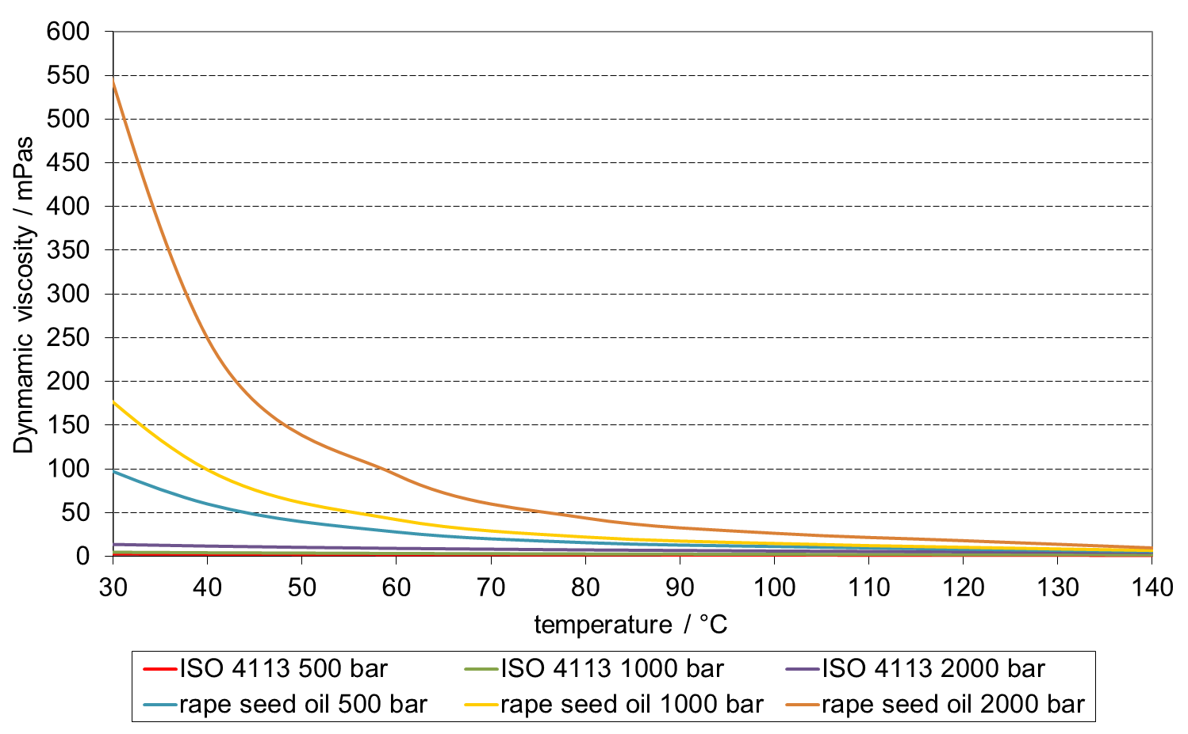
Viscosity at high pressures
Viscosity of rape seed oil is very
sensitive to temperature
and pressure

Slide 14
Index
Motivation
Test bench
Physical properties of the investigated fuels
Experimental Results
Summary and Outlook

Slide 15
Experimental setup
Bosch high pressure pump with common rail and two different solenoid valve common-rail injectors controlled by Bosch ECU
Injector 1:
  ISO 4113 calibration fluid as reference (equivalent to diesel fuel)
  Rape seed oil DIN 51605
Injector 2:
  ISO 4113 calibration fluid as reference
  Biodiesel EN 14214
  TCR oil obtained through thermocatalytic reforming, c.f. [3][4][5][6]

Slide 16
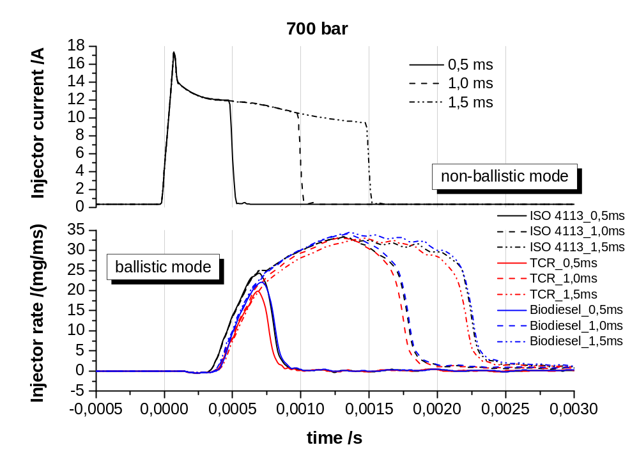
Injection rates
ISO fluid vs. biodiesel vs. TCR oil

Slide 17
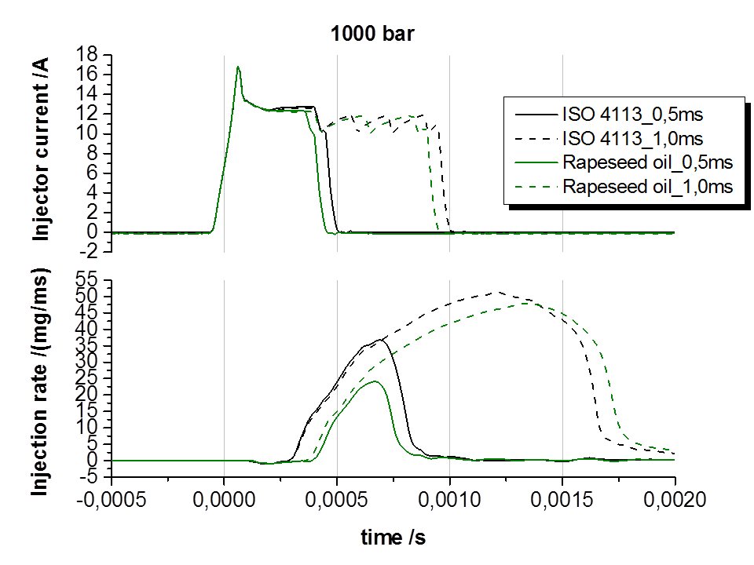
Injection rates
ISO fluid vs. rape seed oil

Slide 18
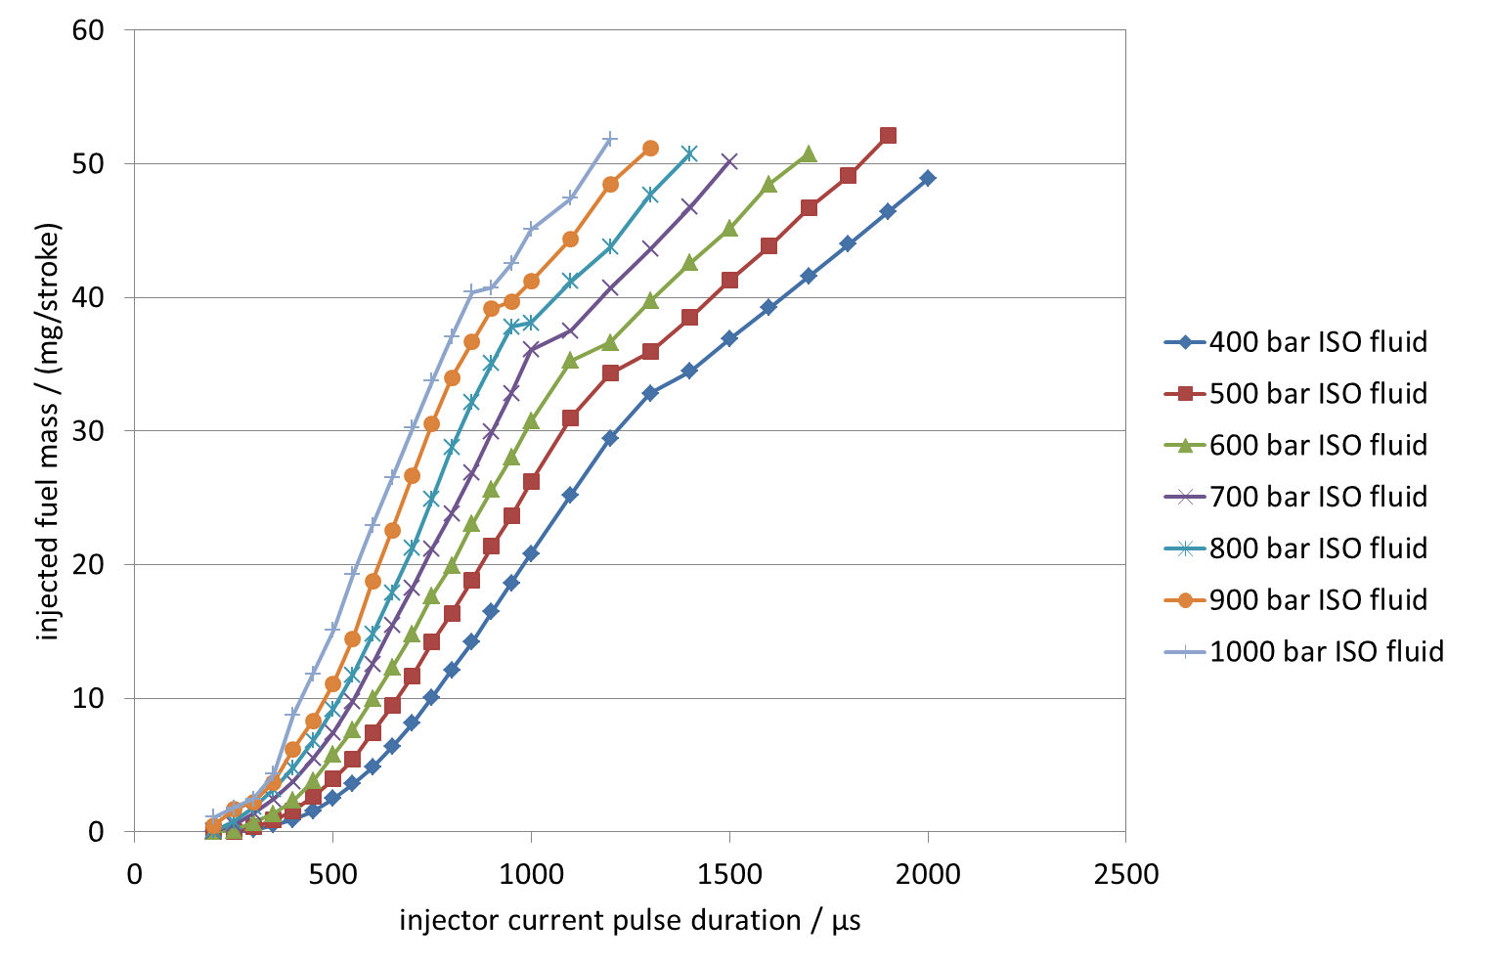
Injector map ISO 4113 fluid
Non ballistic mode
Ballistic mode
For duel-fuel operation small injection quantities are required ⇒ injector will operate in ballistic mode

Slide 19
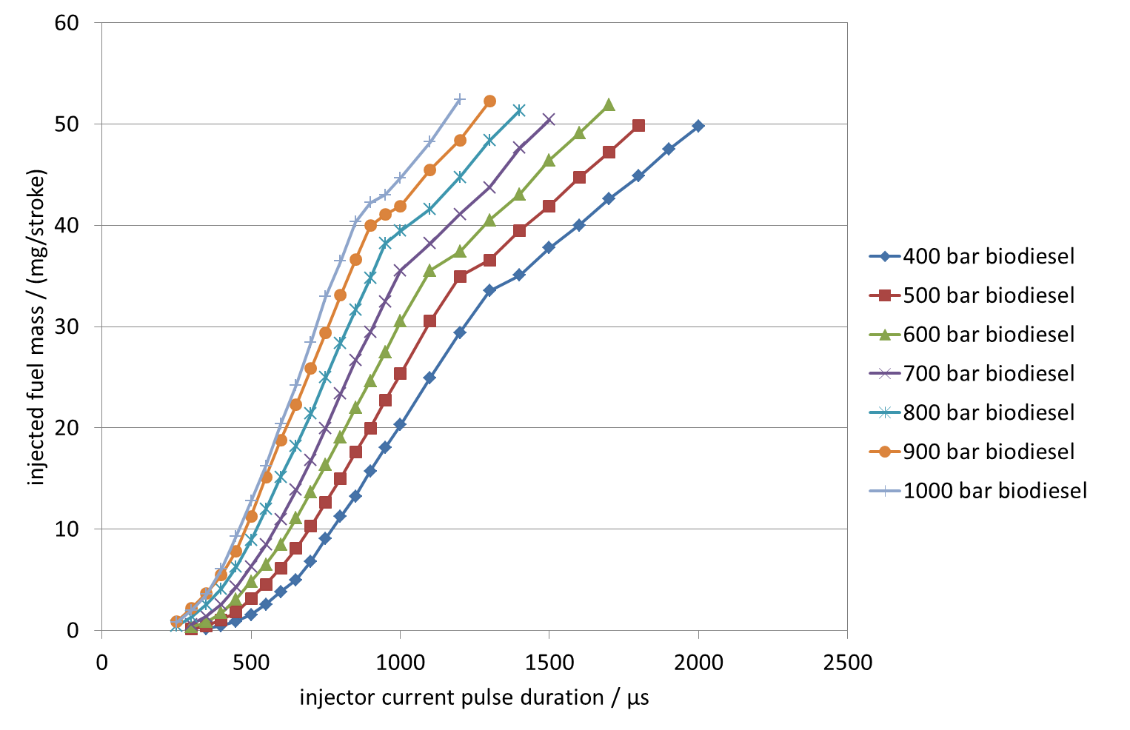
Injector map biodiesel
Non ballistic mode
Ballistic mode

Slide 20
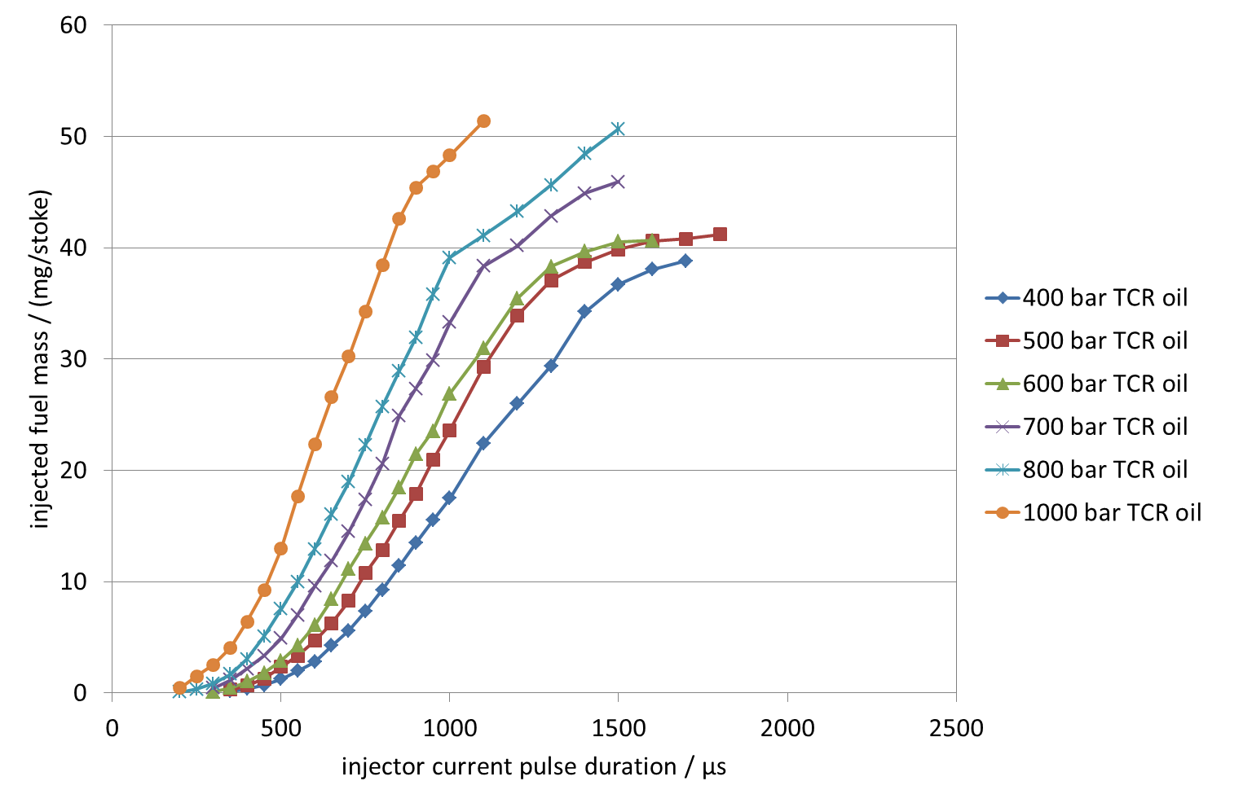
Injector map TCR oil
Non ballistic mode
At low pressures injected fuel mass does not increase linearly with increasing pulse duration
Ballistic mode

Slide 21
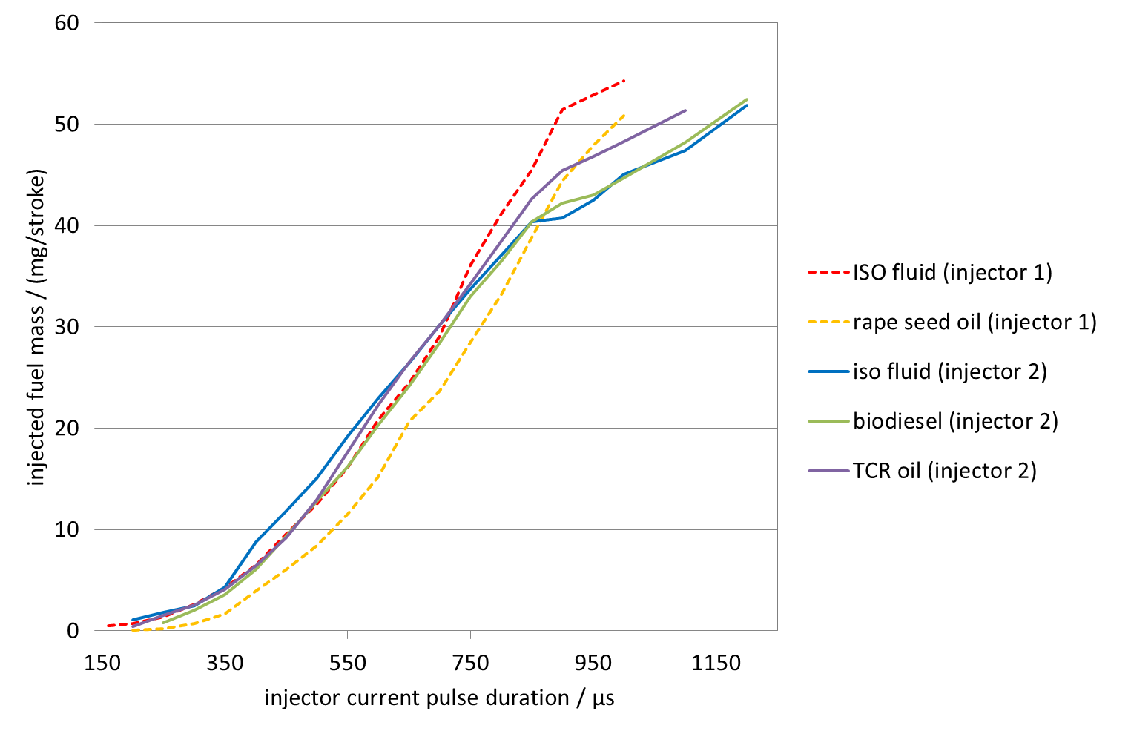
Injector characteristic at 1000 bar

Slide 22
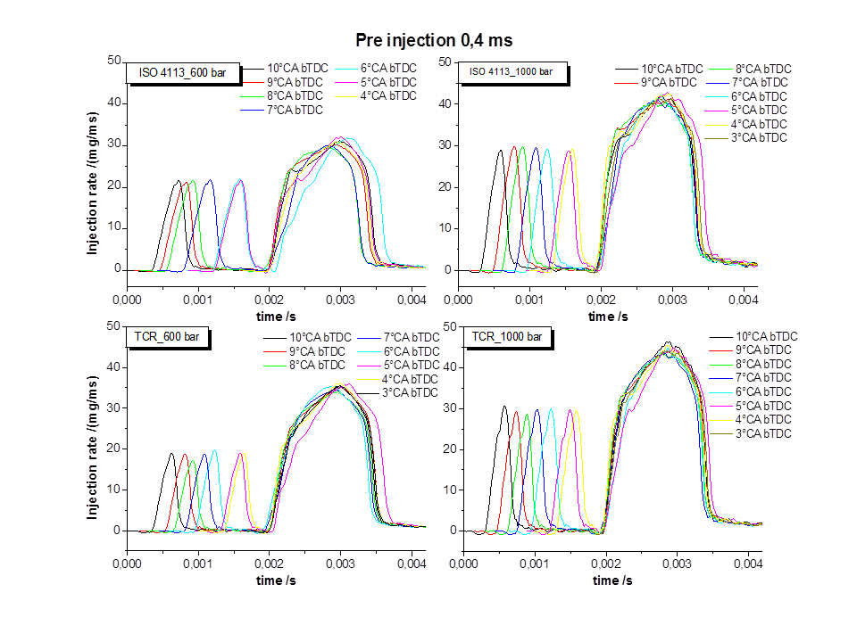
Pre injection

Slide 23
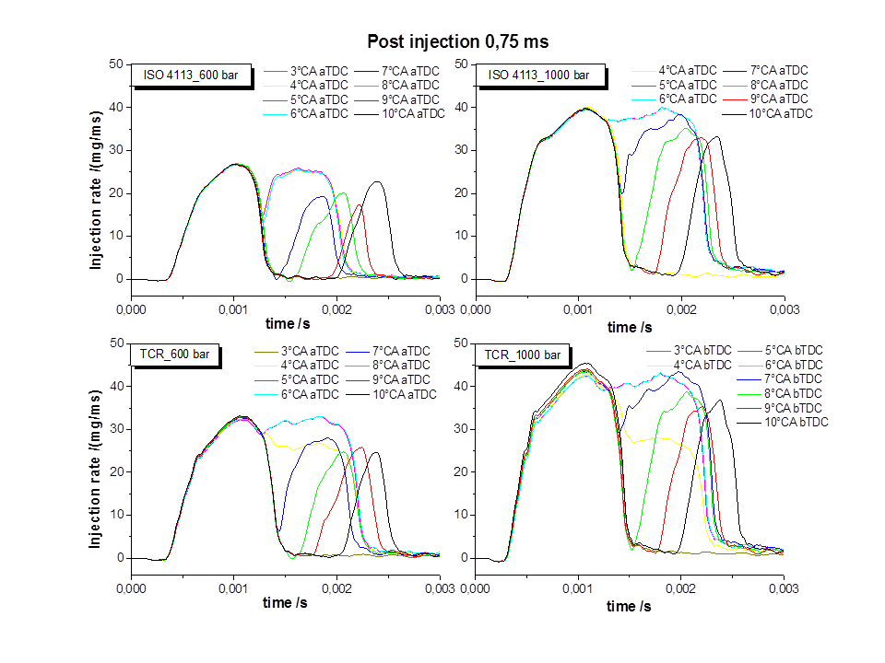
Post injection

Slide 24
Index
Introduction
Test bench
Physical properties of investigated fuels
Experimental Results
Summary and Outlook

Slide 25
Summary
Fuels with high viscosity (rape seed oil) show substantial deviations of injection rate and injection quantities compared to ISO fluid; pre-heating of fuels is required
Biodiesel and TCR oil show injection characteristics similar to ISO fluid
In non-ballistic mode with low injection pressures stagnation of injection quantities was observed with TCR oil; thus for stable operation an increase of injection pressures might be required
When applying pre and post injections the required lag times between single shots have to be observed
Based on the experiments it is expected that blends of TCR oil and biodiesel can be applied without modifying the injection system

Slide 26
Outlook
Investigation of physical properties of TCR fuel at high pressures
Tests with different TCR fuel blends
Further investigations on shot-to-shot stability especially with small injection quantities in ballistic operation mode of the injector
Ageing of injectors and investigation of the effect of internal deposits on injection characteristics
Tests with an actual common-rail injection system to be mounted on a real engine

Slide 27
Bibliography
Lechner R., O'Connell N., Brautsch M. Identifikation von Einsatzmöglichkeiten und Potentialen der Zündstrahltechnologie zur Verbesserung der Anlageneffizienz und Wirtschaftlichkeit von BHKW-Anlagen mit experimenteller Überprüfung der Vorteile an einer Pilotanlage unter realen Bedingungen im Praxisbetrieb. Stuttgart: Fraunhofer-IRB-Verlag; 2015.
Brautsch, M.; Lechner, R.: Common-Rail-Einspritzsysteme für Pflanzenöl-BHKW, University of Applied Sciences Amberg-Weiden Research Report 2008/2009, December 2008.
Neumann, J. et.al.: Upgraded biofuel from residue biomass by Thermo-Catalytic Reforming and hydrodeoxygenation. Biomass and Bioenergy 89 (2016), p. 91-97.
Neumann, J. et.al.: Production and characterization of a new quality pyrolysis oil, char and syngas from digestate – Introducing the thermo-catalytic reforming process. Journal of Analytical and Applied Pyrolysis 113 (2015), p. 137-142.
Neumann, J. et.al.: The conversion of anaerobic digestion waste into biofuels via a novel Thermo-Catalytic Reforming process. Waste Management 47 (2016), p. 141-148.
Conti, R. et.al.: Thermocatalytic Reforming of Biomass Waste Streams. Energy Technology 5 (2017), p. 104-110

