Slide 1


Geospatial Techniques for Identifying the Paddy Cultivated areas in Agro Climatic Region (ACR)-VI
Directorate of Water Management Bhubaneswar, Odisha
Dr. Ranu Rani Sethi
Senior Scientist
Directorate of Water Management (ICAR) Bhubaneswar, ODISHA

Slide 2
Introduction
Paddy occupies largest area (45 Mha) with production of 134 million tonne
Wheat area 27 Mha with production of 75.6 Million tonne
Rice-wheat cropping system covers about 10.5 Mha in Indo Gangetic Planes
Judicious water management technologies needed to enhance water productivity
Directorate of Water Management Bhubaneswar, Odisha

Slide 3
Directorate of Water Management Bhubaneswar, Odisha

Slide 4
Agro Climatic Region-VI
Directorate of Water Management Bhubaneswar, Odisha

Slide 5
Crop Period
State | Crop | Season | From | To | Period
Punjab | Rice/Paddy | Kharif | May | July | Sowing
 |  |  | September | October | Harvesting
 |  | Rabi | January | January | Sowing
 | Wheat | Rabi | October | November | Sowing
 |  |  | April | May | Harvesting
Haryana | Rice/Paddy | Kharif | January | December | Sowing
 |  | Kharif | June | July | Sowing
 |  |  | October | November | Harvesting
 | Wheat | Rabi | October | December | Sowing
 |  |  | April | April | Harvesting
Directorate of Water Management Bhubaneswar, Odisha

Slide 6
Strength
Rainfall varies from 190 mm to 1,150 mm
Important sources for irrigation: Beas, Ravi, Sutlej, Yamuna and Ghaggar rivers
Phenomenal increase in agricultural productivity referred as Green Revolution
Directorate of Water Management Bhubaneswar, Odisha

Slide 7
Emerging Issues
Declining Soil health
Over exploitation of ground water resources
Variability in climatic parameters
Falling diversity in the cropping pattern
Directorate of Water Management Bhubaneswar, Odisha

Slide 8
Objectives
To find out uniformity of information related to crop coverage.
To provide support to the field research and to assist in the decision making process
Directorate of Water Management Bhubaneswar, Odisha

Slide 9
Geospatial Analysis
“A powerful set of tools for storing, retrieving, transforming and displaying spatial data from the real world for a particular set of purposes”
Directorate of Water Management Bhubaneswar, Odisha

Slide 10
Methodology
Software | Raster Analysis | Vector Analysis
Arc GIS 10.0 | Mosaic Composing bands Supervised Classification Data used: Landsat ETM+ images | Digitization Overlay Clipping Krigging, Thematic mapping Data used : Analog Maps, Numerical values in Excel Sheet
Directorate of Water Management Bhubaneswar, Odisha

Slide 11
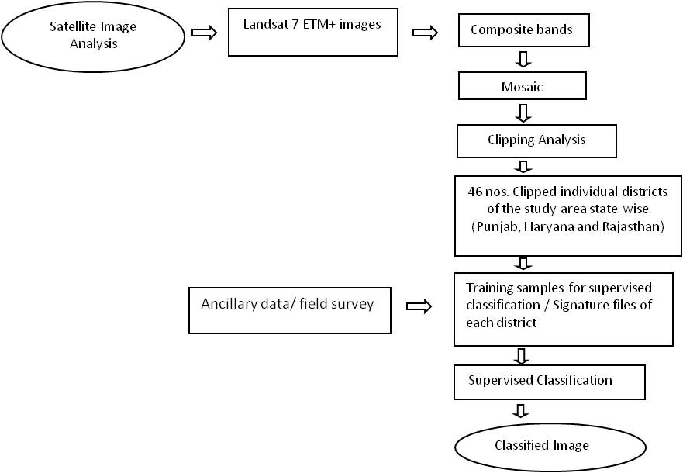
Process for Image Classification
Directorate of Water Management Bhubaneswar, Odisha

Slide 12
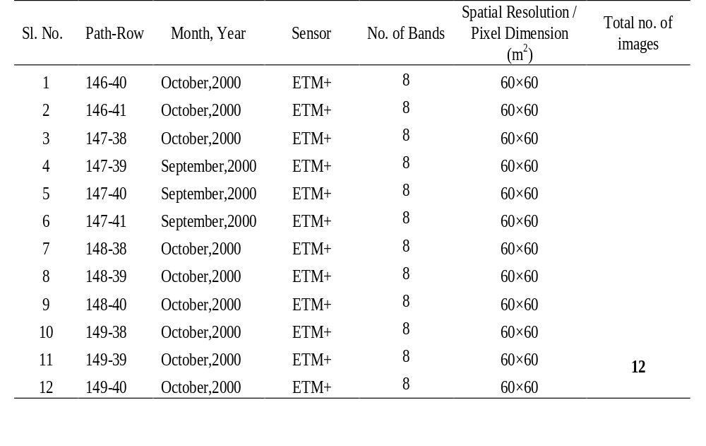
Details of Landsat data
Directorate of Water Management Bhubaneswar, Odisha
Source Site: http://glcf.umd.edu

Slide 13
Satellite Image of ACR VI
Directorate of Water Management Bhubaneswar, Odisha

Slide 14
Major Cropping Pattern
Directorate of Water Management Bhubaneswar, Odisha

Slide 15
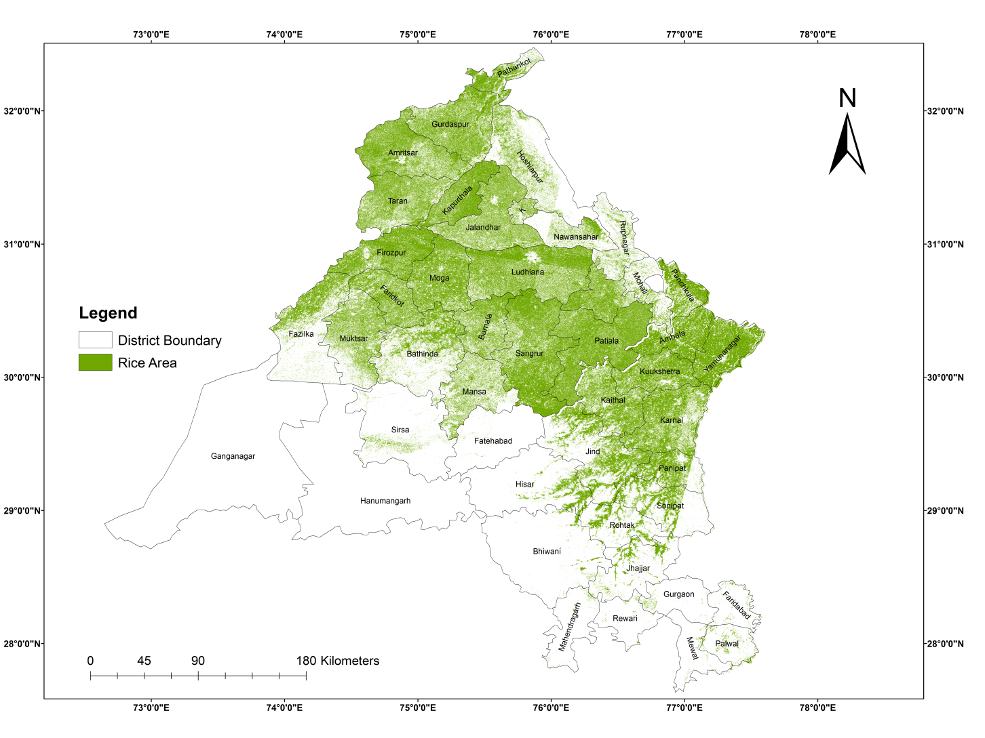
Paddy Cultivated Area (Geo spatial analysis)
Geographical Area (‘000 ha)
ACR VI | 11410.3
Punjab | 4969.3
Haryana | 4380.8
Rajasthan | 2060.2
Directorate of Water Management Bhubaneswar, Odisha
Paddy Area Remote Sensing analysis (‘000 ha)
Punjab | 2626
Haryana | 1051

Slide 16
Comparison of cropped area
State | No. of Districts in ACR VI | Area under Rice (Published reports) '000 ha | Area under Rice (Image Classification Analysis) '000 ha
Punjab | 23 | 2611 | 2626
Haryana | 21 | 1049 | 1051
Rajasthan | 2 | Nil | Nil
Directorate of Water Management Bhubaneswar, Odisha

Slide 17
Acknowledgements
National Fund for Basic, Strategic and Frontier Application Research in Agriculture (NFBSFARA), ICAR, New Delhi
Dr A.Sarangi, P.I. of DSSEWP project, WTC, New Delhi
DSS Project associates: Dr M.J.Kaledhonkar, Dr. K.G. Mandal, Dr. Bandopadhyay, Mr Amiya Sagar Sahu
Dr Ashwani Kumar, Director, DWM
Directorate of Water Management Bhubaneswar, Odisha

Slide 18
THANK YOU

