Slide 1
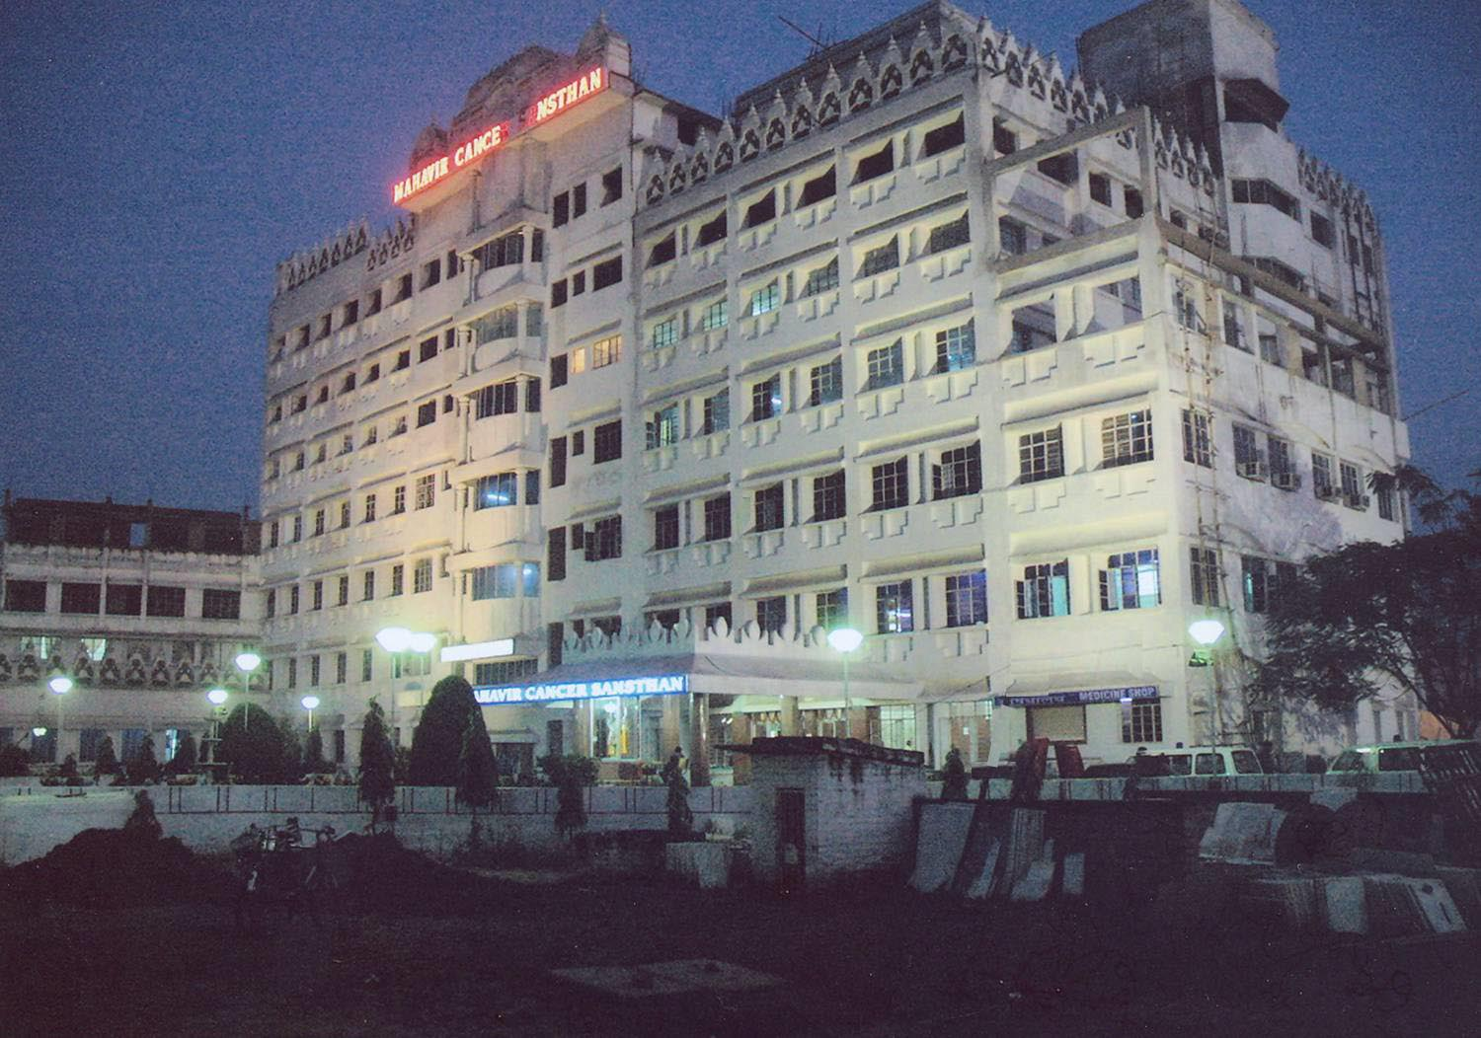

Evaluation of the Significance of CA-125 Levels in Patients of Epithelial Ovarian Cancer in Bihar, India
Dr. Ranjit Kumar
Scientist - I
Mahavir Cancer Sansthan
Patna, India

Slide 2
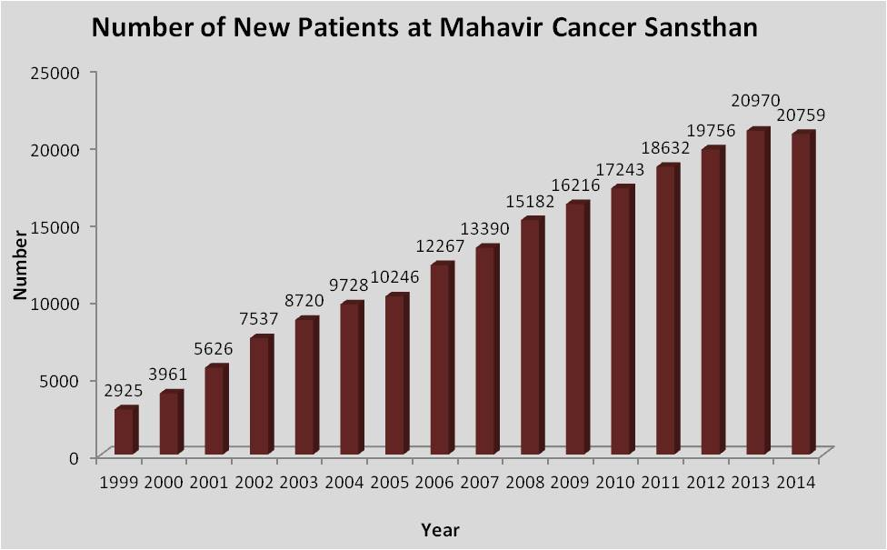

Slide 3
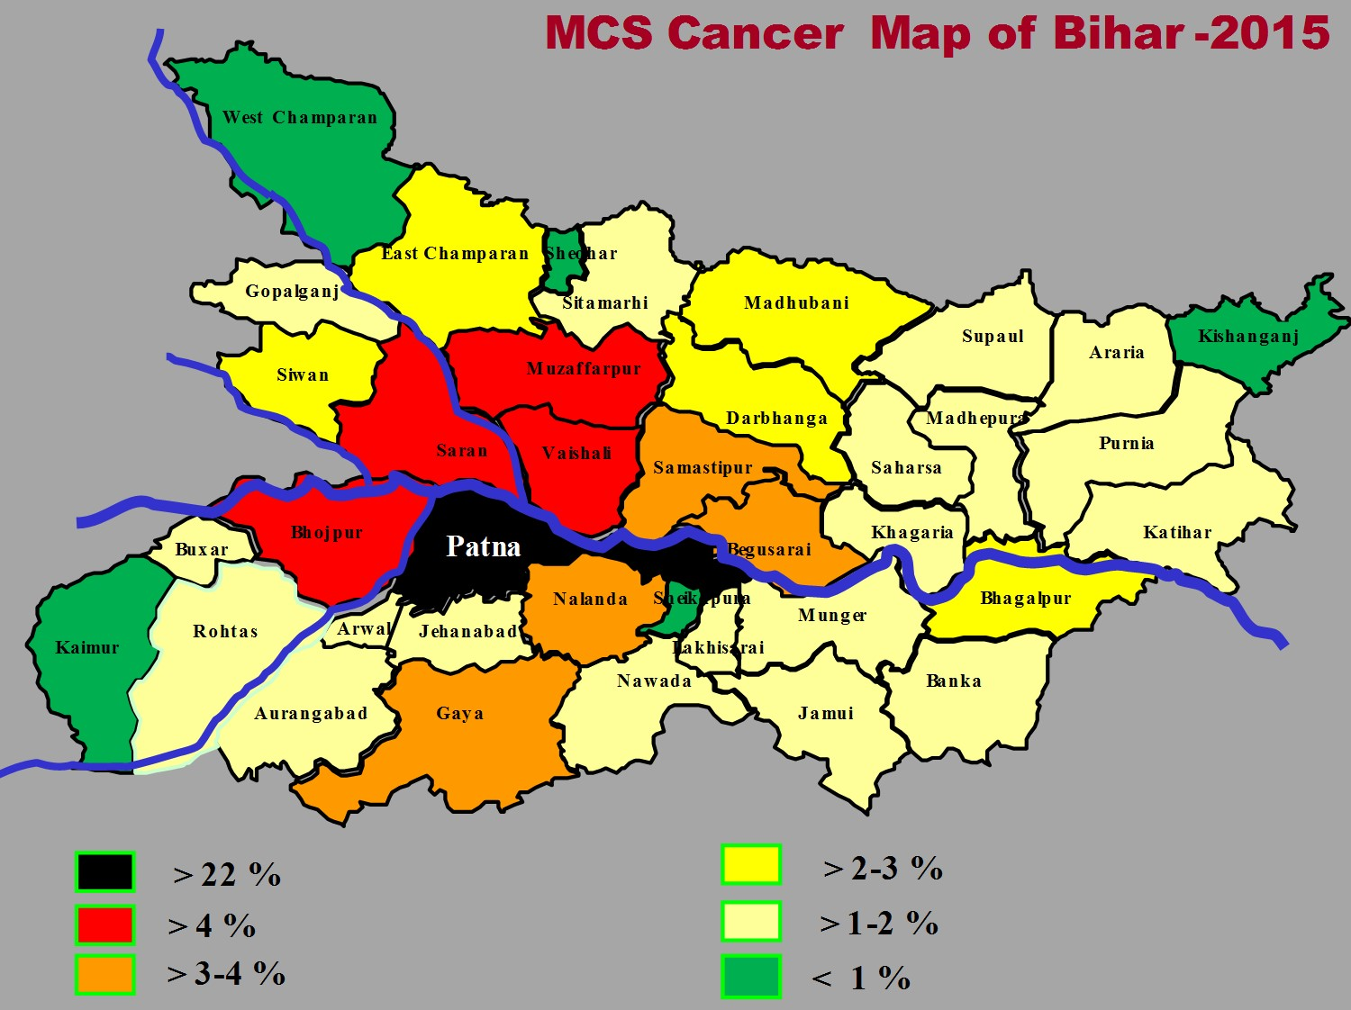
Total Patient: 1,44,556

Slide 4
Ovarian Cancer Epidemiology
9th most common cancer among women
  21,880 (3%)
5th most common cause of cancer death
  13,850 (5%)
Leading malignancies among women: Breast, Lung, Colon, cervix, gall bladder etc.

Slide 5
Epithelial Ovarian Cancer (EOC)
Most common type of ovarian cancer
  Epithelial (75%)
  Germ cell (15-20%)
  Sex-cord Stromal (5%)
Median age of presentation 65 years
Overall lifetime risk is 1 in 70
75-80% of patients are diagnosed with Stage III or IV disease

Slide 6
Clinical Tests
Ultrasound
  Size
  Consistency- solid, cystic, mixed
  Septations
  Papillary excrescences
  Pelvic fluid
Color Doppler
Other Imaging Modalities
  CT scan should be used to evaluate for metastatic lesions
Serum Markers
  CA125

Slide 7
Screening for Ovarian Cancer
There is no evidence that screening for Ovarian Cancer leads to earlier detection or improved survival…
Commonly the following have been or are being used for EOC screening
  TVS
  CA125
  Multimodal
  Symptoms
  Biomarkers

Slide 9
Screening (CA125/MUC-16)
Tumor associated antigen
  Not expressed in mucinous tumors
  Normal value in 50-70% of stage I tumors and 20-25% of advanced tumors
Associated with a variety of common, benign conditions including: endometriosis, fibroids, PID, adenomyosis, pregnancy and possibly menstruation
Better predictive value in postmenopausal patients
Abnormal
  >35 u/ml: postmenopausal
  >100 u/ml: premenopausal

Slide 10
CA 125 FOR EARLY DETECTION OF OVARIAN CANCER
Elevated 10-60 Months Prior to Diagnosis
Detects 50 - 60% of Stage I Disease
Specificity of a Single Determination is 99%, but This is Still Inadequate
Combination with Ultrasonography can increase Specificity

Slide 11
CA-125/MUC 16
The cancer antigen (CA) -125 is a high molecular mass glycoprotein produced both by ovarian cancer cells as also by normal cells of tissues derived from coelomic epithelium.
Serum CA-125 levels are used as a marker of tumor activity in patients known to have ovarian carcinoma1 and commercial tests for serum CA-125 have been available since 1983.
In women with histologically proven ovarian carcinoma, levels of serum CA-125 are elevated >35 U/ml in more than 80 per cent of cases.

Slide 12
Structure of CA-125/Mucin 16
Mucin 16 is a membrane associated mucin that possesses a single transmembrane domain.
A unique property of MUC16 is its large size.
MUC16 contains about 22,000 Amino acid , making it the largest membrane associated mucin.
MUC16 is composed of three different domains:
An N-terminal domain
A Tandem repeat domain
A C-terminal domain

Slide 13
Structure of CA-125/Mucin 16 Contd…..
The N-terminal and tandem repeat domains are both entirely extracellular and highly O-Glycosylated.
All mucins contain a tandem repeat domain that has repeating amino acid sequences high in serine, threonine and proline.
The C-terminal domain contains multiple extracellular SEA (sea urchin sperm protein, enterokinase, and agrin) modules,a transmembrane domain, and a Cytoplasmic tail.
The extracellular region of MUC16 can be released from the cell surface by undergoing Proteolytic cleavage.
MUC16 is thought to be cleaved at a site in the SEA modules.

Slide 14
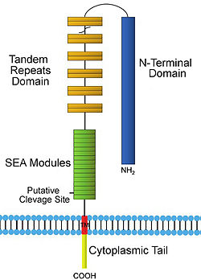
Mucin 16 (CA-125), cell surface association

Slide 15
Immune system evasion
One way that MUC16 helps the growth of tumors is by suppressing the response of Natural Killar cells, which protects the cancer cells from the immune response.
MUC16 can protect tumor cells from the immune system is the discovery that the heavily glycosylated tendem repeat domain of MUC16 can bind to galectin-1 (an immunosuppressive protein).

Slide 16
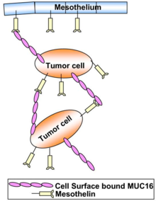
Tumor metastasis initiated by interactions between MUC16 and mesothelin

Slide 17
This study is designed to finds out significance of CA-125 for ovarian cancer patients residing near rivers.

Slide 18
Materials and Methods
The medical records of 80 patients treated at the Mahavir Cancer Institute and research Centre for ovarian cancer between 2005 and 2007 with preoperative serum CA 125 levels were reviewed.
Only patients with epithelial ovarian cancer were included in this study.
Patients were evaluated for their preoperative CA 125 level, age, histology, grade, International Federation of Gynecologists and Obstetricians (FIGO) stage.

Slide 20
Results

Slide 21
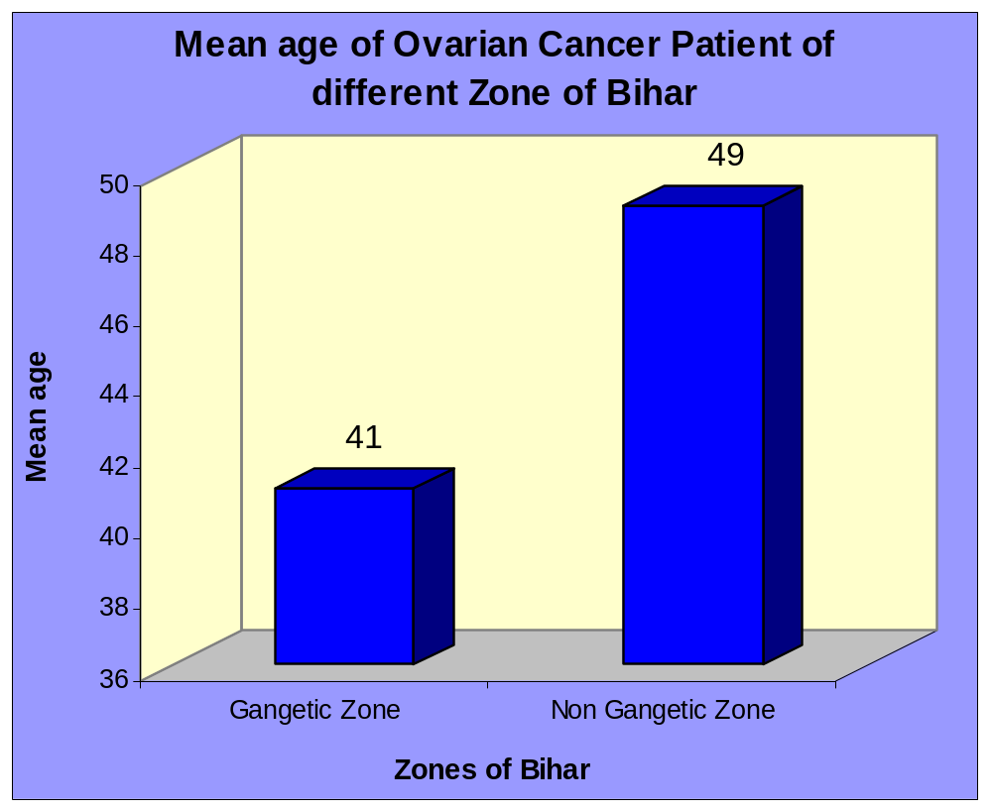
Mean Age of Ovarian Cancer Patients was 45 years

Slide 23
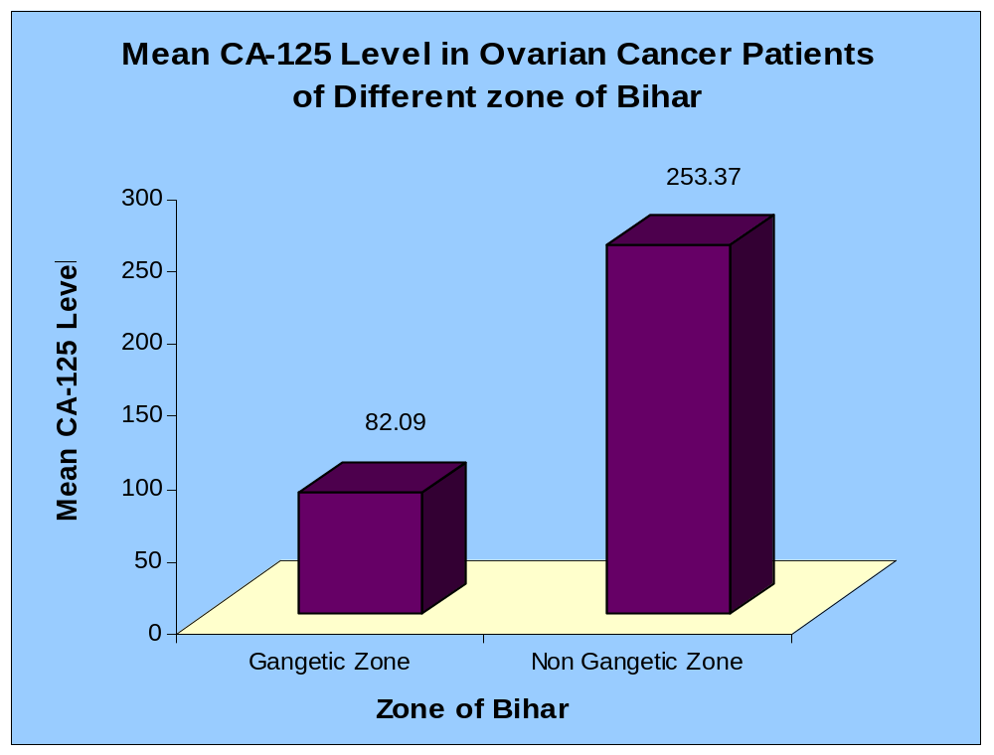

Slide 24
Zones of | Number of Subjects | Mean Ca 125 Level | Standard Deviation
Gangetic Zone | 40 | 82.09 | 177.18
Non Gangetic Zone | 40 | 353.37 | 350.23
Total | 80 | 217.73 | 307.71

Slide 25
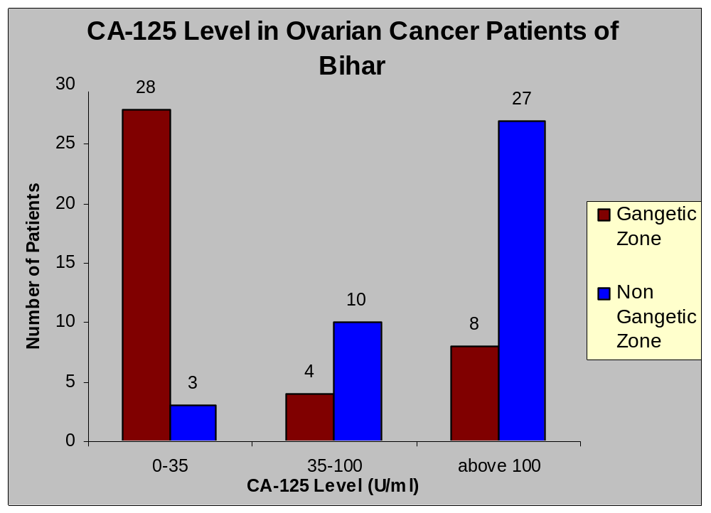

Slide 27
CA-125/MUC 16 non expression
MUC16 is a component of the female reproductive tract epithelia.
Since MUC16 is highly Glycosylated it creates a hydrophilic environment that acts as a lubricating barrier against foreign particles and infectious agents on the apical membrane of epithelial cells.
This hydrophilic environment facilitate its interaction with Arsenic or heavy Metals
The cytoplasmic tail of MUC16 has been shown to interact with cytoskeleton by binding members of the Protein family.
Arsenic also acts in depolymerisation of microtubules and adversely affects its interaction with membrane protein.

Slide 28
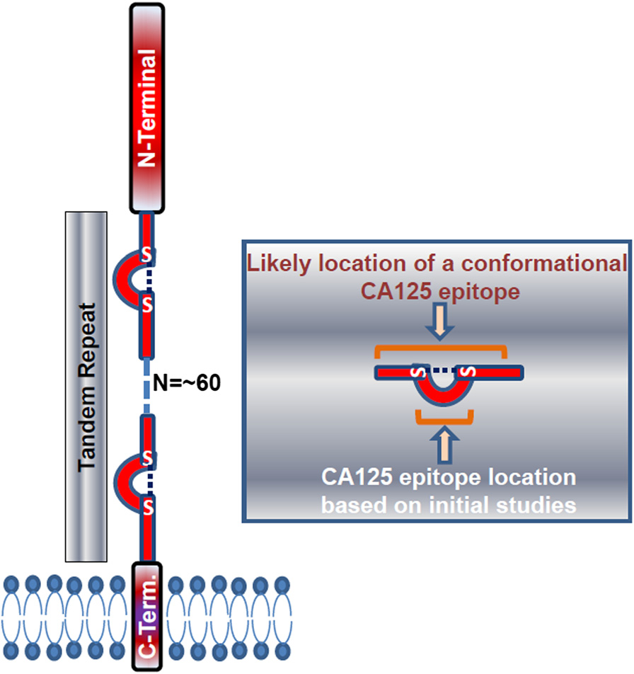
MUC16 structure. Model shows the three domains of
MUC16 and potential location of the CA125 epitope in a tandem repeat.

Slide 29
Conclusion
Although CA 125 is the best available single marker for ovarian cancer, its sensitivity and specificity may not be sufficient for screening of epithelial ovarian cancer patients of Bihar residing in Gangetic zone.
While it is find significant for patients residing in non Gangetic region.
It is found that Arsenic level is very high in water of Gangetic zone that may bind with Cancer Antigen – 125 glycoprotein and increases its molecular weight.

Slide 30
Conclusion
CA-125/MUC-16 has four negatively charged binding site at its tendem repeat on which positively charged contaminant (Arsenicale) binds and increases its molecular weight.
Due to increased molecular weight of CA-125 it is not detected.
That’s why even in Advanced stage of ovarian cancer many patients has CA-125 level 0.1 U/ml.
Heavy metal estimation is also recommended with CA-125 to get accuracy in patients residing near river zones.

Slide 31
This Paper
Published in
Clinical Ovarian Cancer
Elsevier, USA (2009)

Slide 32
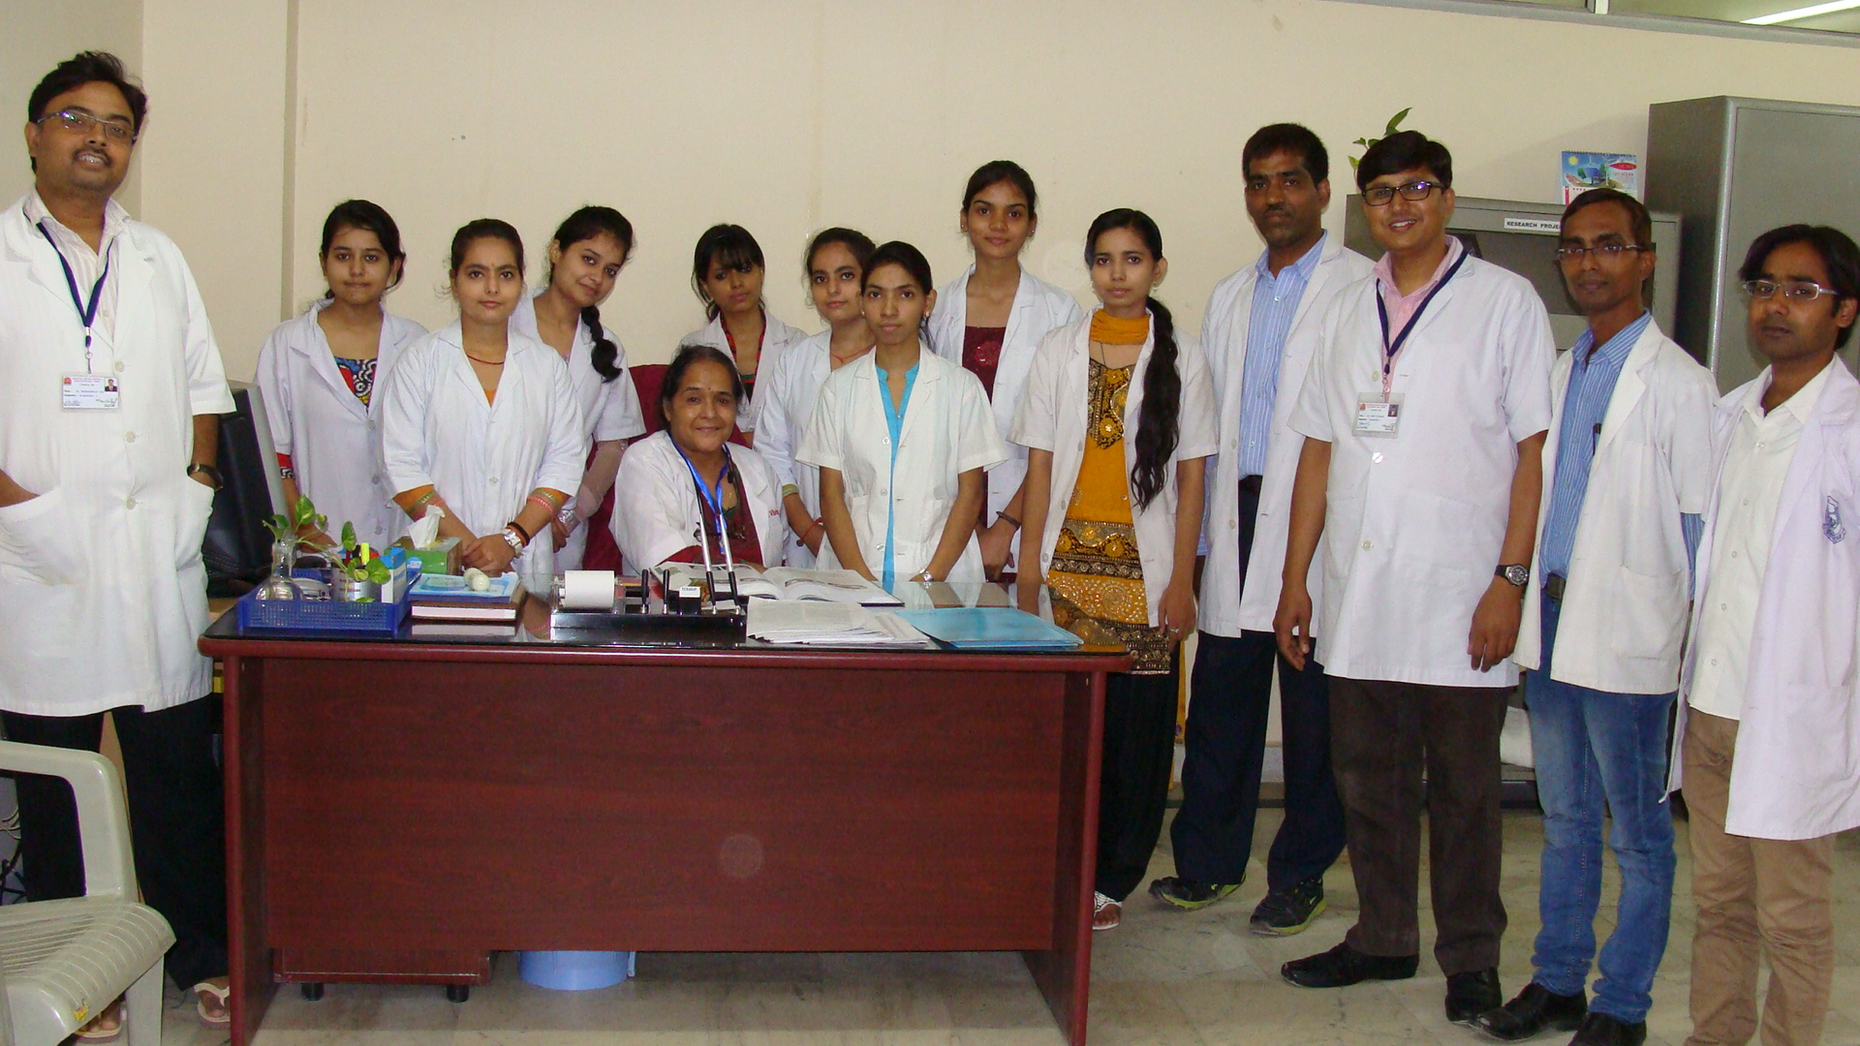
Acknowledgement

Slide 33


