Slide 1

Preparation and Bioactivity evaluation of bioresorbable biphasic calcium phosphate microspheres for hard tissue engineering
Rana Assadi¹, Hanieh Nojehdehian²*
1. Biomaterials Depatment; Biomedical Engineering Faculty; Science and research Branch;Islamic Azad University, Tehran,Iran
2. Dental Materials; Dental School of Shahid Beheshti University of Medical Sciences, Tehran,Iran

Slide 2
Outline of Presentation
Introduction
Materials and Methods
Result and Discussion
Conclusion

Slide 3
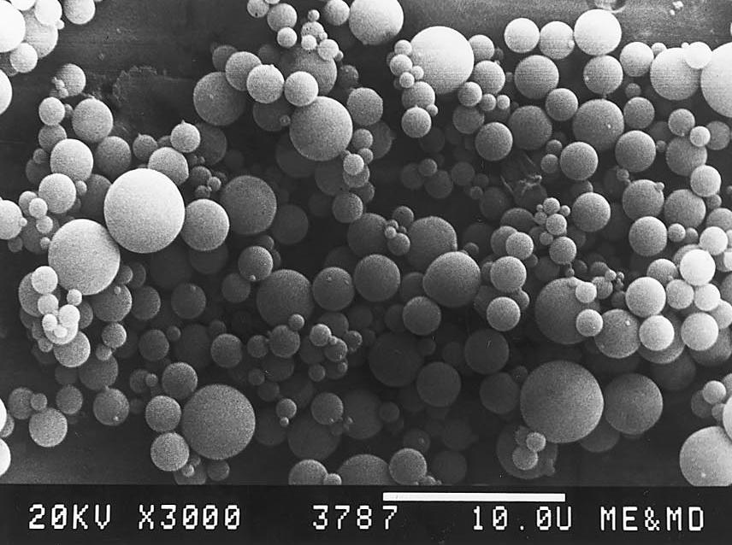
Microspheres
One of the most effective approaches for
achieving novel drug delivery dosage forms
such as sustained release, controlled release is
microencapsulation.
advantages over traditional methods:
First, drug release rates can be tailored to the needs of a specific application.
Second, controlled release systems provide protection of drugs, especially proteins, that are otherwise rapidly destroyed by the body.
Finally, controlled release systems can increase patient comfort and compliance by replacing frequent (e.g., daily) doses with infrequent (once per month or less)injection.
Notes:
A number of techniques are available for the preparation of microspheres and the goal is to achieve reproducibility and consistency with good entrapment efficiency.
Controlled release drug delivery systems are being developed to address many of the difficulties associated with traditional methods of administration.

Slide 4
Polymerics microspheres
Polymers microspheres, such as poly(lactideco-glycolide) (PLGA) is resorbable but their bioactivity is compromised.
A number of techniques are available for the preparation of microspheres:
techniques
co-acervation phase
separation (CAP)
solvent evaporation
(SET),
TYPES OF MICROSPHERES
Bioadhesive microspheres
Floating microspheres
multiorifice centrifugal process
(MCP)
spray drying and spray
congealing (SPR)
polymerization
(PM)
pan coating (PAN)
Magnetic microspheres
Radioactive microspheres
Polymeric microspheres
Biodegradable polymeric microspheres
Synthetic polymeric microspheres

Slide 5
Bioceramic microspheres
Ideal bioceramic microspheres for bone regeneration need to be bioactive and degradable, but at the same time possess a controlled drug-release ability. The main disadvantage of the currently available microspheres is their failure to combine these properties.
ceramic microspheres, such as hydroxyaptite (HAp) ceramics, are bioactive, but they lack the controlled porosity, which to some extent influences the controlled drug release.

Slide 6
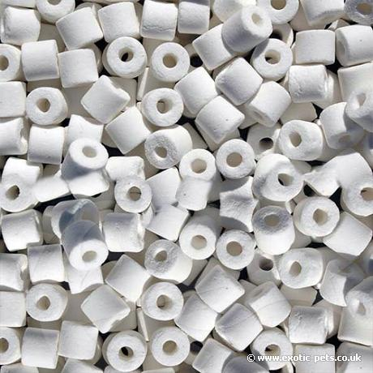
Bioceramics
Ceramics used for the repair and reconstruction of diseased or damaged parts of the musculo-skeletal system, termed bioceramics, may be bioinert (alumina, zirconia), resorbable (tricalcium phosphate), bioactive (hydroxyapatite, bioactive glasses, and glass-ceramics), or porous for tissue ingrowth (hydroxyapatite-coated metals, alumina).
The mechanisms of tissue bonding
to bioactive ceramics are beginning
to be understood, which can result
in the molecular design of bioceramics
for interfacial bonding with
hard and soft tissues.

Slide 7
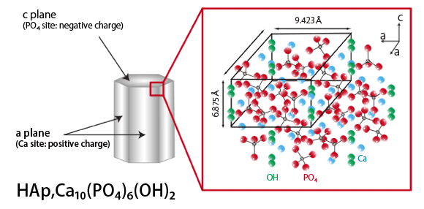
Hydroxyapatite
Ca₁₀(PO₄)₆(OH)₂
The greatest potential for bone substitution
can develop tight bonding with bone tissue
exhibits osteoconductive behavior
Bioresorption
has no adverse effects on
the human organism
High biocompatible ceramic

Slide 8
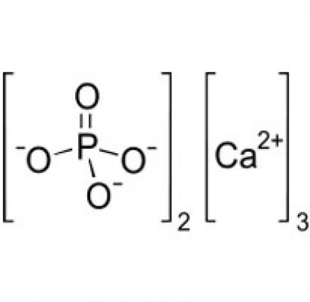
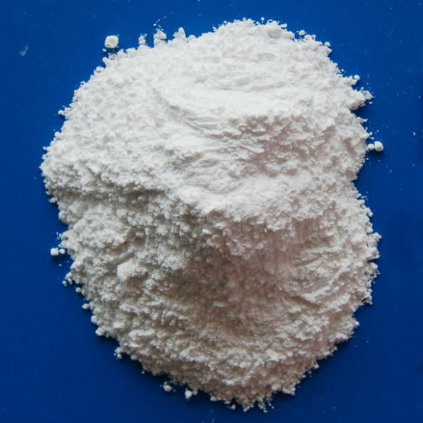
tricalcium phosphate
Ca₃(PO₄)₂
used in the clinical field
for the repair and reconstruction of diseased or damaged parts of human body
It serves as a rich source for calcium and phosphorus, which can be easily assimilated and absorbed
Beta-tricalcium phosphate is highly biocompatible and creates a resorbable interlocking network within the defect site to promote healing

Slide 9
In our project
We got to the bottom of the resorbable ceramics microspheres such as biphasic calcium phosphate, which are ideal condidates as drug delivery system.

Slide 10
Materials and method

Slide 11
Preparation of BCP microspheres
Homogenisation
BCP
ceramic microspheres
1 Hour
550 c
HA
High purity TCP, HA and nHa powder used for preparation of microspheres
TCP
Dispersed in light paraffin oil
nHA
MS were washed in acetone
65HA:35nHA
65HA:35TCP/nHA
65HA:35TCP
Gelatin
4%,6% or 8%
Washed in distilled water
Dried in an oven
Dried in air

Slide 12
The in vitro bioactivity of the microspheres was assessed by incubating the microspheres in a simulated body fluid.
The synthesised BCP powder and microsphere samples were characterised by X-ray powder diffraction (XRD) method.
The morphology of the BCP granules and microspheres were observed under a scanning electron microscopy .

Slide 13
Result and Discussion

Slide 14
SEM result
The shape and surface morphology of the microspheres, as observed by SEM are shown in an image.
BCP microspheres that formed in 6% gelatine is shown in Fig.1. show considerable agglomeration and are uniformly spherical with smooth surface.
The BCP microspheres that formed in 4% gelatine have sharp corners and are irregularly shape as shown in Fig.2.
The BCP microspheres that formed in 8% gelatine to be highly agglomerated as shown in Fig.3.

Slide 15
Fig.1 SEM micrographs of 6BCPMS Fig.2 SEM micrographs of 4BCPMS
Fig.3 SEM micrographs of 8BCPMS

Slide 16
The hydroxyapatite microspheres: 6%: The microspheres appeared spherical in shape. Most of the microspheres had quite uniform surface morphology, 8%:seem to be agglomerated.
Fig.4 SEM micrographs of 6HAMS Fig.5 SEM micrographs of 8HAMS
tricalcium phosphate microspheres: 6%:appeared spherical in shape but not as good as 6HAMS,8%:have sharp corners and are irregularly shaped

Slide 17
6 SEM micrographs of 6TCPMS Fig.7 SEM micrographs of 8TCPMS
The nanohydroxyapatite microspheres that formed in 6% and 8% gelatin appeared spherical in shape and quite uniform surface morphology
Fig.8 SEM micrographs of 6nHAMS Fig.9 SEM micrographs of 8nHAMS

Slide 18
The nHA:HA=65:35 that formed in 6% and 8% gelatine, are uniformly spherical with smooth
Fig.10 SEM micrographs of 6nHA:HAMS Fig.11 SEM micrographs of 8nHA:HAMS
The combination of HA, nHA and TCP make the last group microspheres of this study. The image shows the most perfect spherical microspheres with fairly uniform surface morphology.

Slide 19
Fig.12 SEM micrographs of 6nHA:HA:TCPMS Fig.12 SEM micrographs of 8nHA:HA:TCPMS

Slide 20
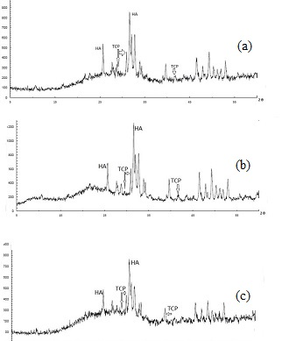
XRD result
The XRD pattern of the BCP microspheres formed with various amounts of gelatin is shown in Figs.15. patterns look similar to that of the starting BCP powder as also shown in the same figure for comparison and consists of both the peaks of HA and TCP phases but without other impurities.
Fig.15XRD of BCP65 powder (a)
4BCP65 (b) 6BCP65 (c) 8BCP65

Slide 21
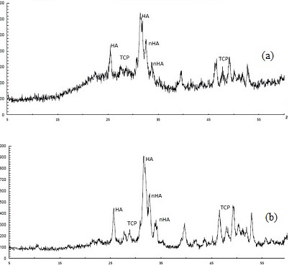
The XRD pattern of as synthesised
(The combination of HA, nHA and TCP)
This pattern same as BCP, show broad bands,
the heated HA:nHA:TCP sample consists
of all three the peaks of HA, nHA and TCP
phases and without any impurities.
Broad peaks around the characteristic
peak regions indicate that the HA:nHA:TCP
is microcrystalline in nature.
Fig.16 XRD of nHA:HA:TCP powder (a) 6 nHA:HA:TCP
(b) 8 nHA:HA:TCP

Slide 22
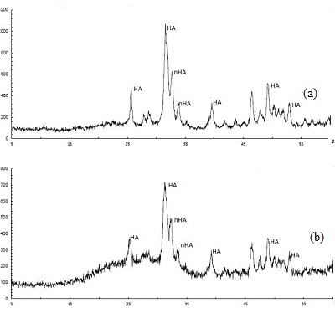
The XRD pattern of the nHA:HA sample
s is shown in Fig.17.
this samples follow the same rule
as the other ones. They consists
of both the peaks of nHA and HA
phases and without any impurities.
Fig.17 XRD of nHA:HA powder
(a) 6 nHA:HA
(b) 8 nHA:HA

Slide 23
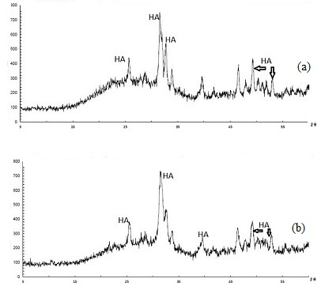
The XRD pattern of HA, nHA and TCP
microspheres are shown in Figs.18,19,20.
Their pattern are as same as synthesised of pour
HA, nHA and TCP, gelatine and paraffin oil
have no effect on them.
All the patterns look similar except with the difference
in the relative intensities of the HA and TCP phases.
Fig.18 XRD of HA powder (a) 6HA (b) 8HA

Slide 24
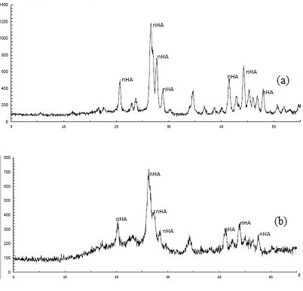
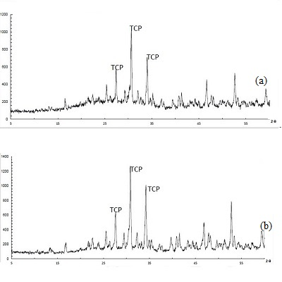
Fig.19 XRD of nHA powder (a) 6nHA (b) 8nHA Fig.20 XRD of TCP powder (a) 6TCP (b) 8TCP

Slide 25
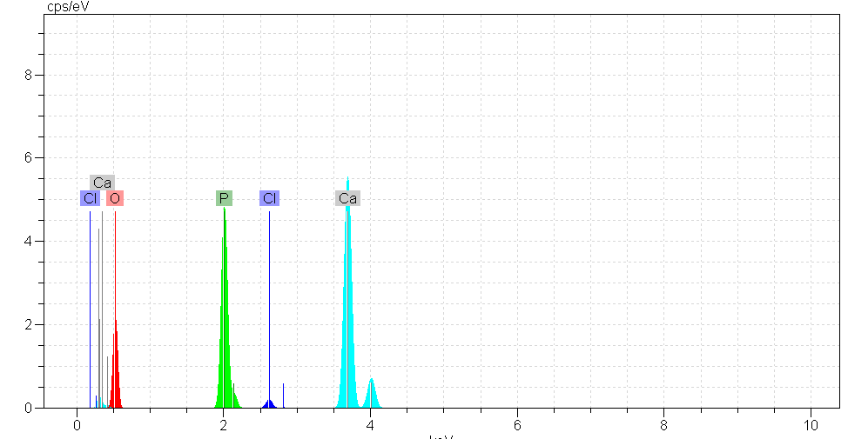
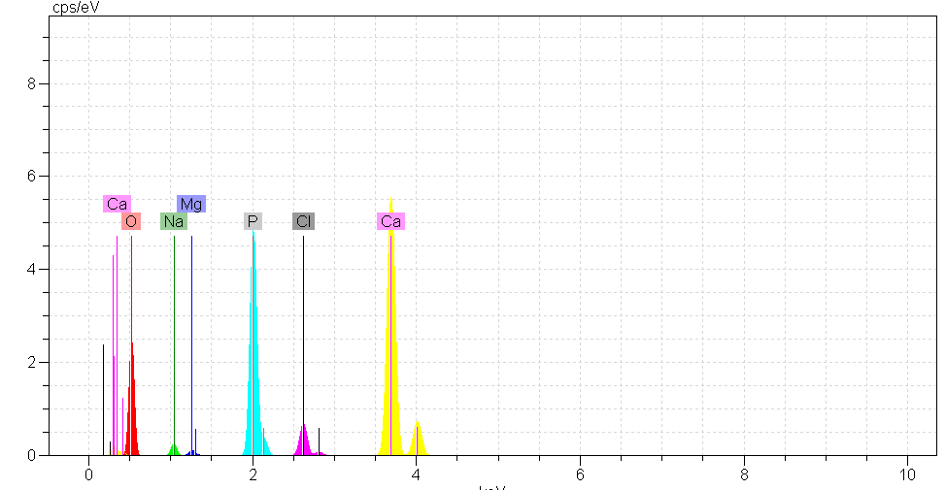
The EDXA spectrum in Figs.21,22 for BCP microspheres which formed in 6% gelatine shows the atomic composition of the precipitates after one day and 14 days of immersion. The Ca/P ratio was measured to be one day 2.38, 14 days 2.14, which is similar but slightly (one day: lower, 14 days: higher) than that of stoichiometric HA (2.15)
Fig.21. The EDXA analysis of the SBF sample immersed Fig.22. The EDXA analysis of the SBF sample immersed
for one days (6BCP65 ) for 14 days (6BCP65)

Slide 26
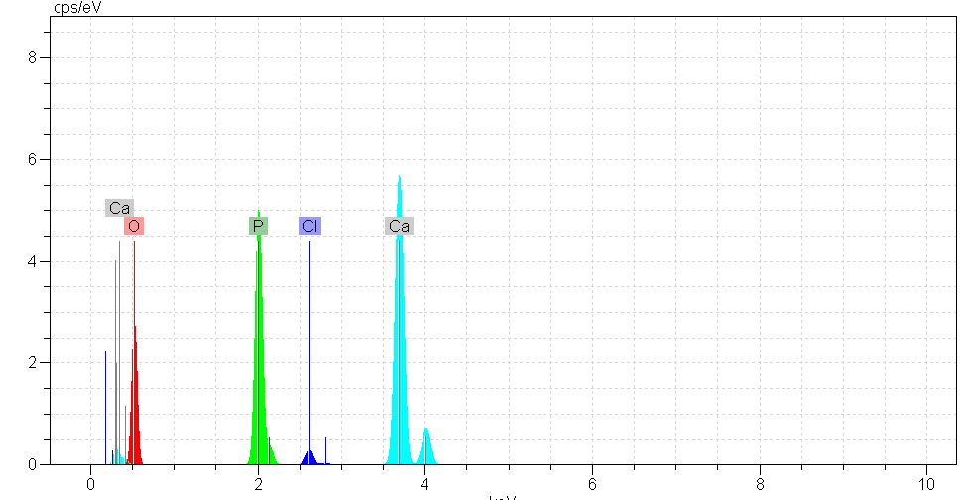
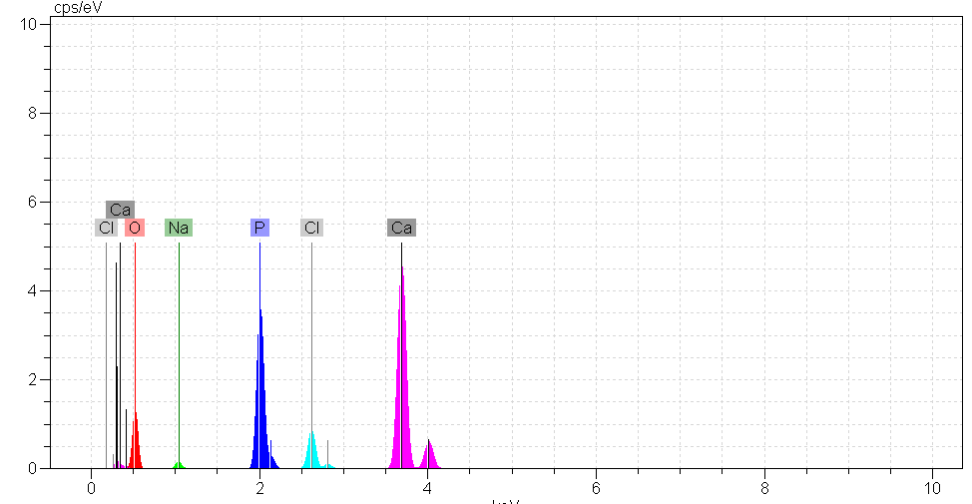
The EDXA spectrum in Figs.23,24 for combination of HA, nHA and TCP microspheres which formed in 6% gelatine shows the atomic composition of the precipitates after one day and 14 days of immersion. The Ca/P ratio was measured to be one day 2.40, 14 days 2.24 which is similar but slightly higher than that of stoichiometric HA.
Fig.23. The EDXA analysis of the SBF sample immersed for one day Fig.24. The EDXA analysis of the SBF immersed (6HA:nHA:TCP) for 14 days (6HA:nHA:TCP)

Slide 27
conclusion
The present study develop bioactive ceramic microspheres for applications in hard tissue regeneration.
Best morphology observed in the case of microspheres formed using 6% gelatin.
Due to the high surface to volume ratio, have a high potential as cell carrier.
Microspheres property are Osteoinductive and Osteoconductive simultaneously.
Spherical and smooth surface of the microspheres make them good condidate for drug release.

Slide 28
Thank you for your attention

