Slide 1
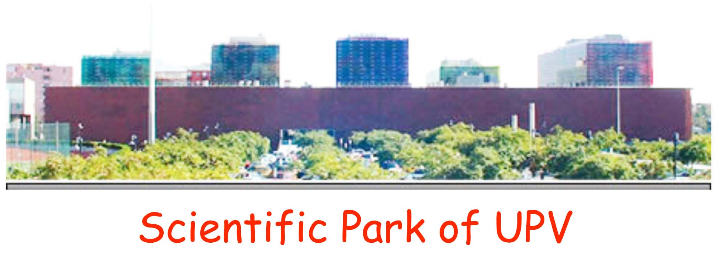

5th World Congress on BIOTECHNOLOGY
June 25-27, 2014, Valencia, Spain
Track 2: Biotechnology in Agriculture (June 25)
Symposium on:
GM crops to feed the world in the XXI century and the risks posed by the irrational oposition of radical ecologists
Ramón Serrano
Institute of Plant Molecular and Cellular Biology (IBMCP)
Polytechnic University of Valencia (UPV)-
High Council for Scientific Research (CSIC)
Valencia, Spain
≈ 3,000 researchers, 45 institutes, 25 M euro/year

Slide 2
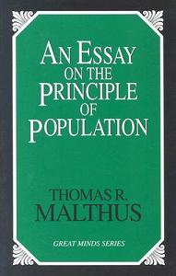
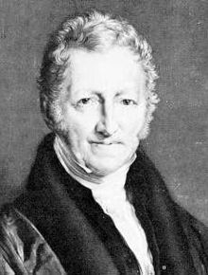
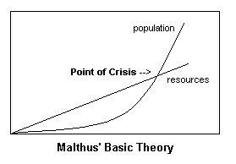
Thomas R. Malthus
1766-1834

Slide 3
EVOLUTION OF WORLD POPULATION AND AVAILABILITY OF LAND
Year Million people
10000 BC 0.1-1
1000 BC 50
1 AD 200
1000 AD 300
1800 AD 1,000
1900 AD 1,500
2000 AD 7,000
2100 AD 10,000 FINAL LEVEL?
Millions hectares
Planet surface 51,000
Land surface 15,000
Conventional farming 1,400
Organic farming 37
Forest and grasslands 2,100

Slide 4
Evolution of grain production during the second part
of XX century (Mann, 1999, Science 283: 310-314)
Kg per person
Total Kg (x10¹²)
360
Green Revolution
2
1
0
A new revolution
Is needed
310
1965 1975 1985 1995

Slide 5
CRUDE REALITY OF THE END OF XXI CENTURY
Food production should be doubled
With present yields of conventional farming
it is possible but it implies almost complete
destruction of forests and grasslands
With organic farming (yields less than 50%
of conventional), it would be impossible to
produce enough food for all population of Earth
With transgenic crops and modern technologies
of water management, fertilizers and pesticides
forests could be preserved and enough food produced

Slide 6
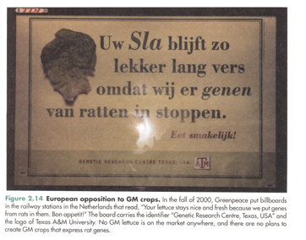
But in 1997 a very powerful organization, Greenpeace, promoted the GM
issue to the top of campaign priorities.The strategy was to tell false stories
about GM plants.
GM plants are:
Toxic to persons
Damage environment
Exploit farmers
Only good for multinationals
Etc.
ALL IS FALSE!!!!!!
(but they have succeeded in
creating a rejection in society
because of fear to transgenesis)

Slide 7
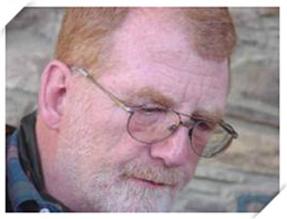
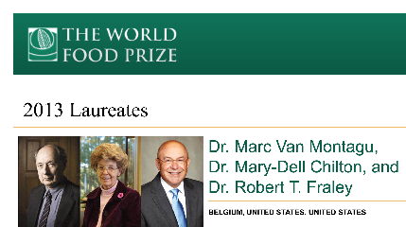
The technology to make transgenic plants was developed in 1983
by the scientists who received the World Food Prize 30 years latter
Jeff Schell
(1935-2003)

Slide 8
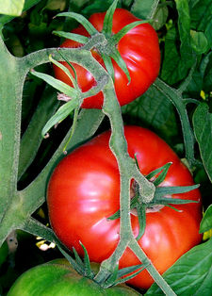
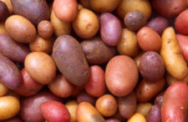
Rejection in Europe has practically stop development of GM crops
Two genes (traits; insect resistance, herbicide resistance)
Four crops (corn, soy, cotton and canola)
Ramón Luis Nogales Rangel
BUT IT TOOK TWO CENTURIES FOR THE EUROPEANS TO EAT TOMATO AND POTATO
BROUGHT BY THE SPANISH IN THE XVI CENTURY

Slide 9
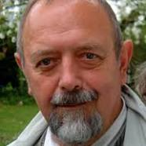
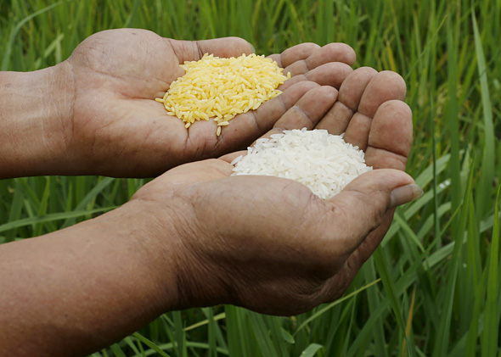
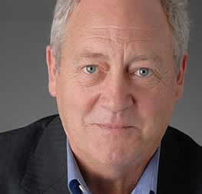
Ingo Potrykus, inventor of golden rice
Patrick Moore, one of the founders of Greenpeace who quit the organization because its rejection of golden rice

Slide 10
ANOTHER URGENT DEVELOPMENTS MAY BE CROPS MORE
TOLERANT TO DROUGHT STRESS, TO POOR SOILS, TO
EXTREME TEMPERATURES …
(TO ALLOW CULTIVATION OF MARGINAL LANDS)
Symposium on:
GM crops to feed the world in the XXI century
and the risks posed by the irrational oposition of radical ecologists
Oscar Vicente
Alain Goossens
Eduardo Bueso
Roberto Gaxiola

