Slide 1

About OMICS Group
OMICS Group International is an amalgamation of Open Access publications and worldwide international science conferences and events. Established in the year 2007 with the sole aim of making the information on Sciences and technology ‘Open Access’, OMICS Group publishes 400 online open access scholarly journals in all aspects of Science, Engineering, Management and Technology journals. OMICS Group has been instrumental in taking the knowledge on Science & technology to the doorsteps of ordinary men and women. Research Scholars, Students, Libraries, Educational Institutions, Research centers and the industry are main stakeholders that benefitted greatly from this knowledge dissemination. OMICS Group also organizes 300 International conferences annually across the globe, where knowledge transfer takes place through debates, round table discussions, poster presentations, workshops, symposia and exhibitions.

Slide 2
About OMICS Group Conferences
OMICS Group International is a pioneer and leading science event organizer, which publishes around 400 open access journals and conducts over 300 Medical, Clinical, Engineering, Life Sciences, Pharma scientific conferences all over the globe annually with the support of more than 1000 scientific associations and 30,000 editorial board members and 3.5 million followers to its credit.
OMICS Group has organized 500 conferences, workshops and national symposiums across the major cities including San Francisco, Las Vegas, San Antonio, Omaha, Orlando, Raleigh, Santa Clara, Chicago, Philadelphia, Baltimore, United Kingdom, Valencia, Dubai, Beijing, Hyderabad, Bengaluru and Mumbai.

Slide 3


Shape Optimization of a Reentry Body in Reacting Hypersonic Flow in Chemical Non-Equilibrium for Reducing both Drag and Heat Transfer
Computational Fluid Dynamics Laboratory
Ramesh K. Agarwal
Washington University in St. Louis, USA
3rd International Conference on Mechanical & Aerospace Engineering
San Francisco, 5-7 October 2015

Slide 4
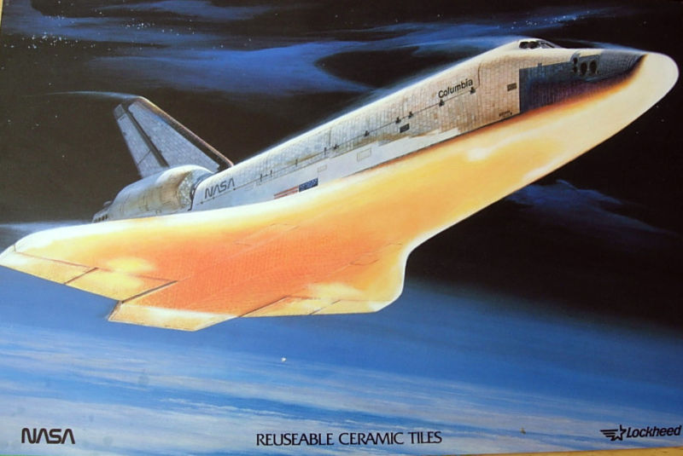
Hypersonic Flow Characteristics
Computational Fluid Dynamics Laboratory
Hypersonic flow characteristics differ from those at subsonic and even at supersonic speeds
Shockwave standoff distance decreases
Shock and boundary layer interactions
Transitional and Turbulent Flow
Large drag coefficient
High rates of heat transfer
Molecular dissociation of air
Notes:
Main point is that hypersonic flow has unique challenges, such as the things listed. Especially important is the relationship between drag and heat transfer. Typically, as the leading edge radius increases drag increases, while heat transfer decreases. This is why optimization of both parameters is difficult.

Slide 5
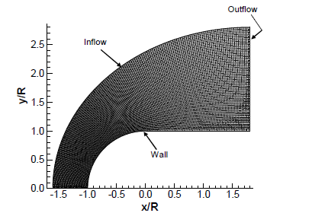
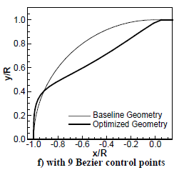
Objectives
Computational Fluid Dynamics Laboratory
Simulate blunt body shapes in dissociating hypersonic flow
Use a dual objective genetic algorithm to optimize a blunt body shape for minimizing both drag and heat transfer
Fine Grid (200x80 cells) around Lobb’s Sphere
Baseline and Optimized Geometry Mach number = 7.1
Notes:
Based on previous work by yumusak and sinan where they optimized a half inch diameter sphere for minimum drag in Mach 7 flow. This study aims on optimizing the same size sphere at the same Mach number, but adds complexities such as turbulence and heat transfer to the process.

Slide 6
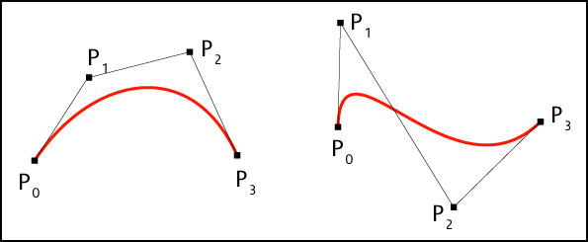


Computational Procedure
Computational Fluid Dynamics Laboratory
I) Shape Generation
II) Mesh Generation
Bezier Curve
ICEM
IV) Optimization
III) CFD Simulation
Genetic Algorithm
ANSYS FLUENT
Notes:
No detail here. Just state the order they will be presented, and that they will each be explained in detail. A more comprehensive flow chart will be presented following these descriptions as everyone will be more familiar with them.

Slide 7
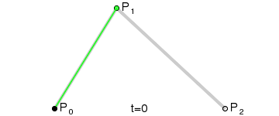
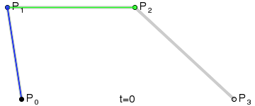
Shape Generation
Computational Fluid Dynamics Laboratory
Bezier Curves
Fix initial and end points
Fix initial and final slope
Control point information is
  Easily stored
  Easily swapped between curves
Changes in control points result in similar changes to the curve
Notes:
Introducing Bezier Curves: Bezier curves are a function of their control points. The curve starts at the first control point and ends at the last, while being influenced by the position of the points in between. This first gif shows a simple curve with 3 control points, while this shows one with four. The resulting red curve is our generated body profile shape. The benefits for a control point for use in a genetic algorithm are that you can (the list). Reference the pictures for the starting and ending positions and slopes.

Slide 8
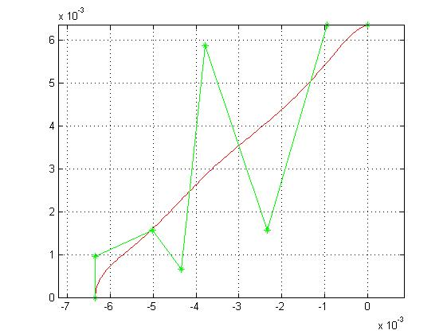
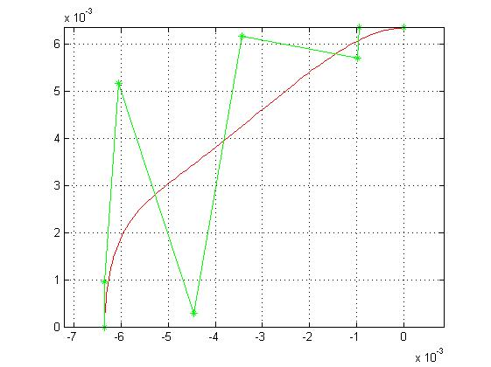
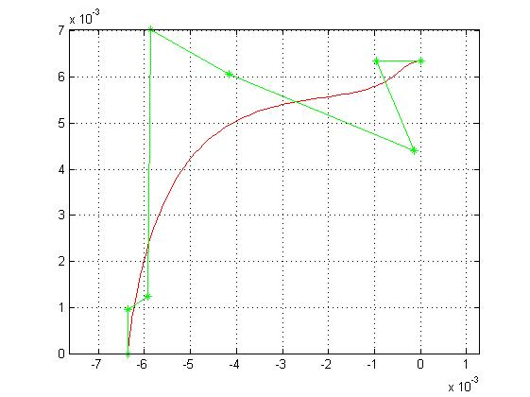
Shape Generation (contd.)
Computational Fluid Dynamics Laboratory
Random Shapes -- Generated
Fixed first two and final two control points
Remaining four are randomly generated
Case 1
Case 2
Case 3
Notes:
We can manually generate shapes by inputting control points, but the genetic algorithm uses randomly generated shapes. Randomness is a recurring theme, and in my opinion is one of the beauties of the GA. The red curve is our resulting body profile. The green stars are the control points. You can see the first two and last two control points are fixed in each case, this ensures our starting and ending position and slopes to be consistent. The remaining points are randomized, they are generated using a random number generator and are constrained to a specified range of values. The only other constraint on them is that the resulting curve must never have a negative slope. This is based on the assumption that an optimized shape will not bend back on itself, which does seem to be a plausible assumption, and also that in cases where the shape doesn’t bend back on itself our simulations could not converge correctly and would lead to error in the optimization process. Remember these cases, they’ll be referenced a few more times.

Slide 9
Mesh Generation
Computational Fluid Dynamics Laboratory
ICEM Meshing Software
Automated via calling a script
  Loads the shape profile (red curve)
  Same mesh except for the shape profile portion
  Segmented mesh most accurate and efficient

Slide 10
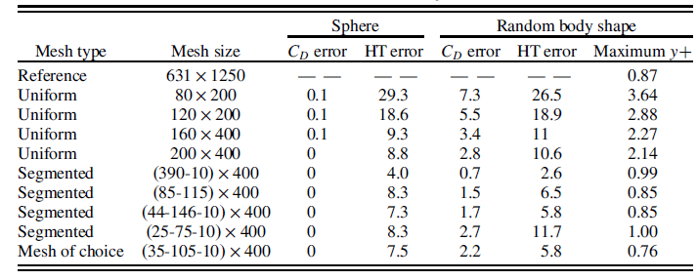
Mesh Study
Computational Fluid Dynamics Laboratory

Slide 11
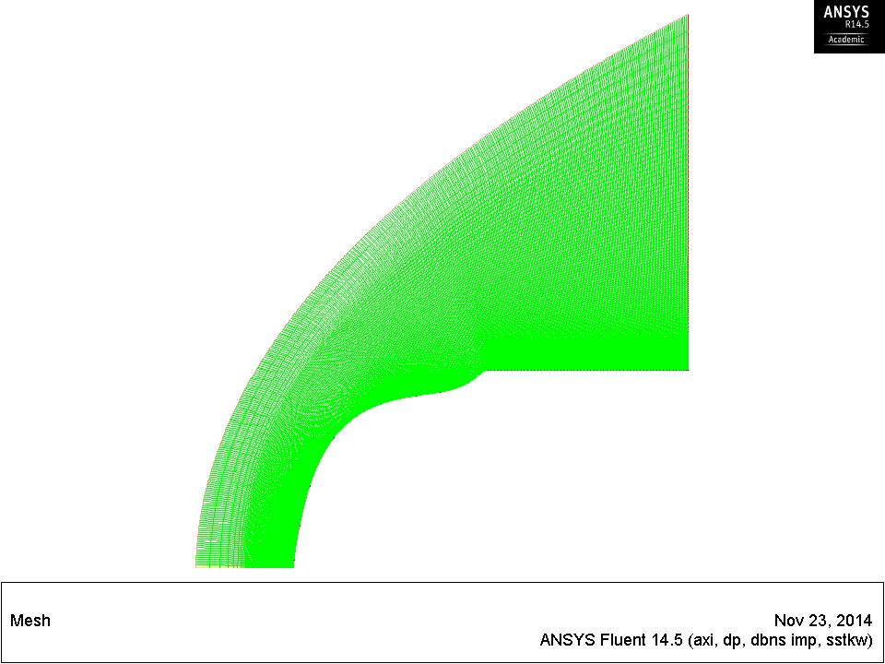
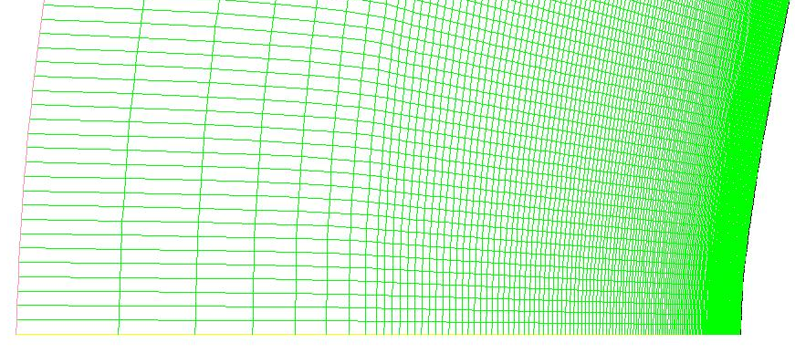
Mesh Generation (contd.)
Computational Fluid Dynamics Laboratory
Segmented Mesh
Pressure Far-Field
Pressure Outlet
Wall
(400 Uniformly Spaced Cells)
Axis
10 cells outside of shock region
105 exponentially spaced cells
35 uniformly spaced cells
Notes:
Virtually no error in drag coefficient, and only 7% error in maximum wall flux

Slide 12
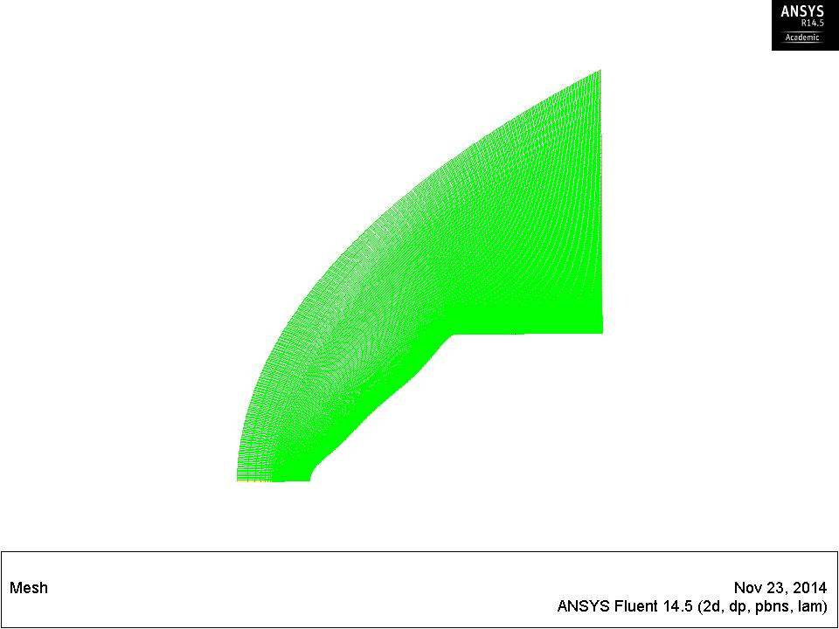
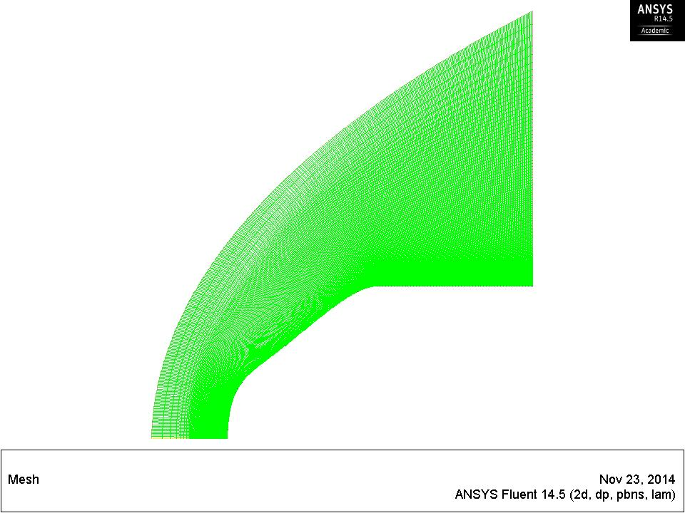
Mesh Generation (contd.)
Computational Fluid Dynamics Laboratory
Random Shape Examples – Mesh Generation
Case 1
Case 2
Case 3

Slide 13
CFD Simulation
Computational Fluid Dynamics Laboratory
ANSYS FLUENT
Automated via calling a script
  Loads the mesh
  Solves for the flow field
    Finds quantities such as pressure and skin friction coefficient, along with drag and maximum heat flux
  Outputs design objectives (drag and maximum heat flux)
Converged solution
  Extremely important to ensure that solutions have converged
    All residuals must be below 1E-4
    Drag and heat flux must be converged to a steady state value
  The simulation must be grid independent, accurate and efficient

Slide 14
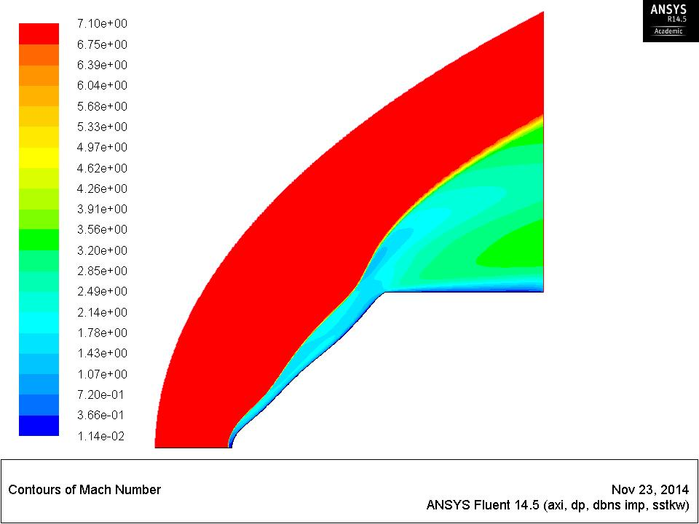
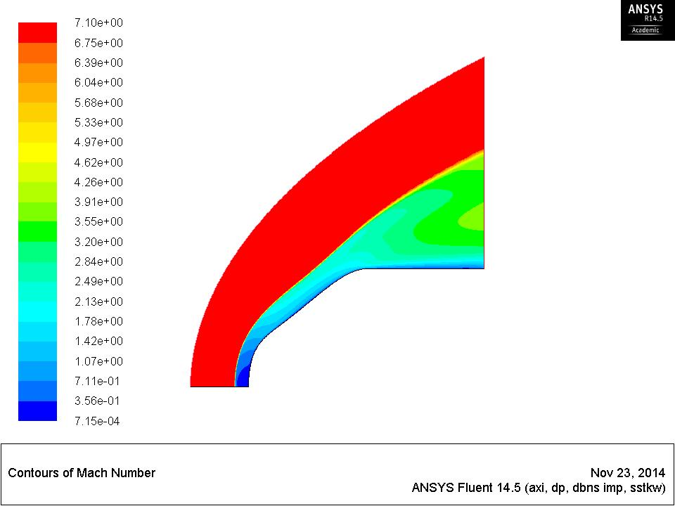
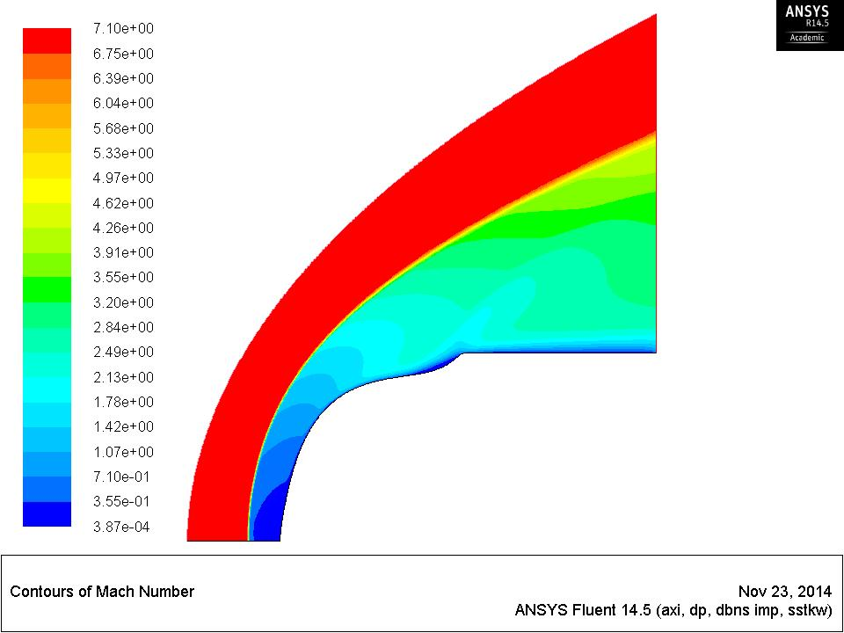
CFD Simulation (contd.)
Computational Fluid Dynamics Laboratory
Random Shape Examples -- Simulations
Mach Contours
Curve 1
High Drag
High Heat Transfer
Curve 2
Low Drag
Medium Heat Transfer
Curve 3
High Drag
Low Heat Transfer

Slide 15
Optimization
Computational Fluid Dynamics Laboratory
Genetic Algorithm (GA)
Stochastic optimization algorithm inspired by biological evolution
  Individual cases are iterated over, combining traits of the best individuals until convergence is achieved
Generally employs the following steps:
  Initialization
  Evaluation
  Natural Selection
  Reproduction
  Check for Convergence

Slide 16
Genetic Algorithm
Computational Fluid Dynamics Laboratory
Initialization
  Random generation of individuals (body shapes) is simulated
Curve 1
High Drag
High Heat Transfer
Curve 2
Low Drag
Medium Heat Transfer
Curve 3
High Drag
Low Heat Transfer

Slide 17
Genetic Algorithm (contd.)
Computational Fluid Dynamics Laboratory
Evaluation and Natural Selection
  Objective values (drag and heat transfer) of each curve are compared
  Values are sorted from best to worst
  Worst half of the individuals are discarded
Curve 1
High Drag
High Heat Transfer
Curve 2
Low Drag
Medium Heat Transfer
Curve 3
High Drag
Low Heat Transfer

Slide 18
Genetic Algorithm (contd.)
Computational Fluid Dynamics Laboratory
Reproduction
  Involves Parent Selection, Crossover, and Mutation
    Parent selection
      Pairs of parent shapes are selected using a skewed random draw
      Higher fitness means higher probability of selection
    Crossover
      Paired curves randomly exchange Bezier point information
    Mutation
      Randomly selected Bezier points of randomly selected curves are randomly altered

Slide 19
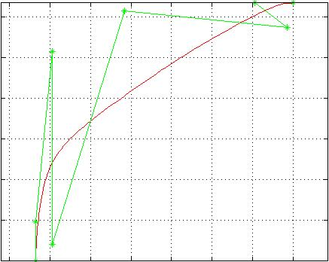
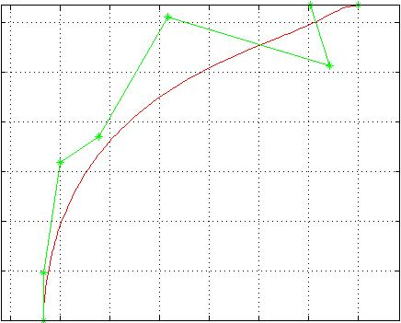
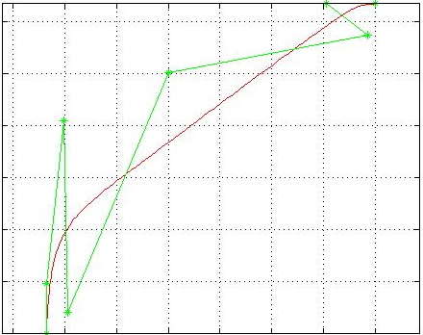
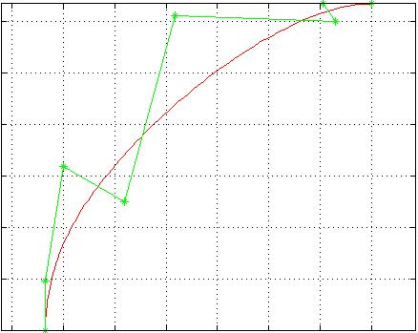
Genetic Algorithm (contd.)
Computational Fluid Dynamics Laboratory
Curve 1
High Drag
High Heat Transfer
Curve 2
Low Drag
Medium Heat Transfer
Curve 3
High Drag
Low Heat Transfer

Slide 20
Genetic Algorithm (contd.)
Computational Fluid Dynamics Laboratory
Check for Convergence
  If convergence criteria is met, the fittest profile is output as the solution
  Criteria include
    Similarity between individuals in the current generation
    Similarity between current and previous generations
    Number of generations simulated
Notes:
Similarity of shape, and drag and maximum heat transfer values

Slide 21
Overview of Optimization
Computational Fluid Dynamics Laboratory
Begin Optimization Program
Generate N random shapes for initial generation
Mesh shapes
Simulate Shapes
Generate shapes of new generation
NO
Evaluation
Converged?
Natural Selection
Output:
fittest individual
Reproduction
YES
MOGA

Slide 22
Results
Computational Fluid Dynamics Laboratory
Weighted Objective Values
  Multi-objective optimization does not necessarily has a single solution
  Changes in importance of objective values gives different results
  Current cases considered
    Evenly weighted drag and heat transfer
    0.75 drag vs. 1.0 heat transfer (HT) as relative weights
    0.5 drag vs. 1.0 HT as relative weights

Slide 23
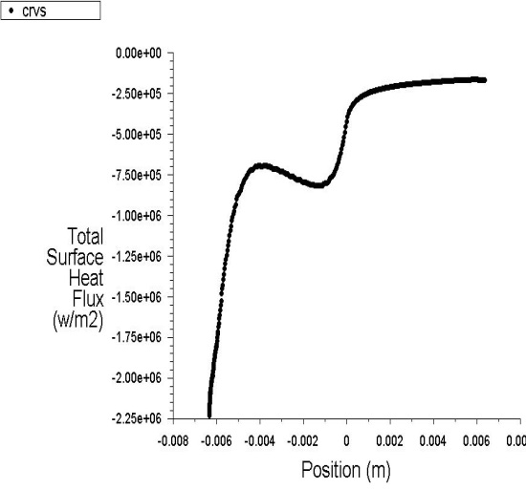
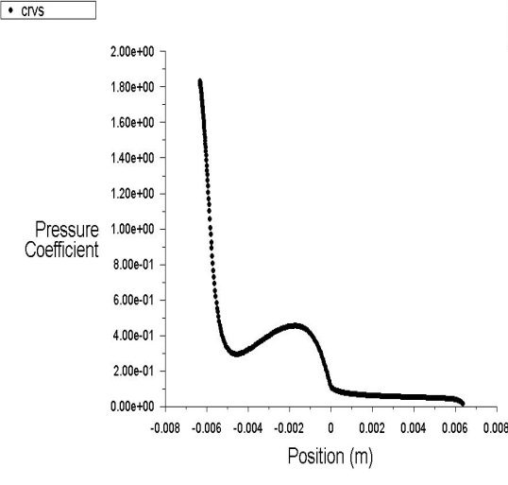
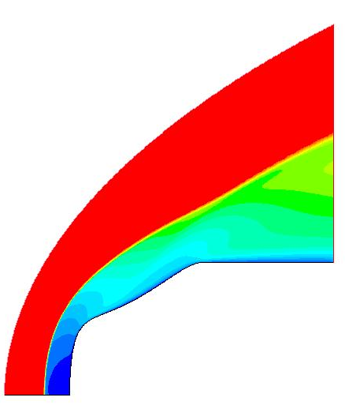
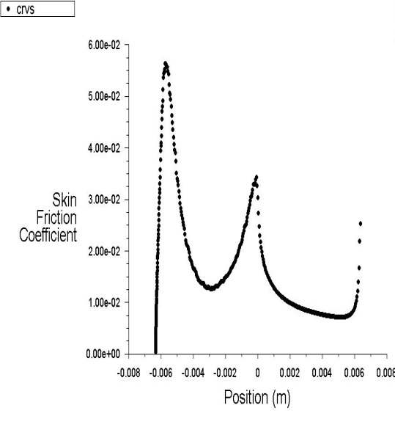
Results (contd.)
Computational Fluid Dynamics Laboratory
Evenly Weighted Drag vs. HT
CD reduced by 22%
Max-HT reduced by 13%
Fig. 6 Results for an optimized body with equal weighting of drag and heat transfer : Static pressure contours, wall skin friction, pressure coefficient, and wall heat flux, and convergence graphs.
Drag Coefficient: 0.745 (22% reduction relative to spherical nose)
Maximum Heat Transfer: 2230000 W/m­² (13% reduction relative to spherical nose)

Slide 24


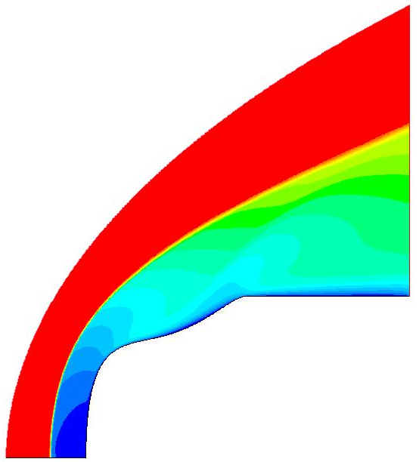
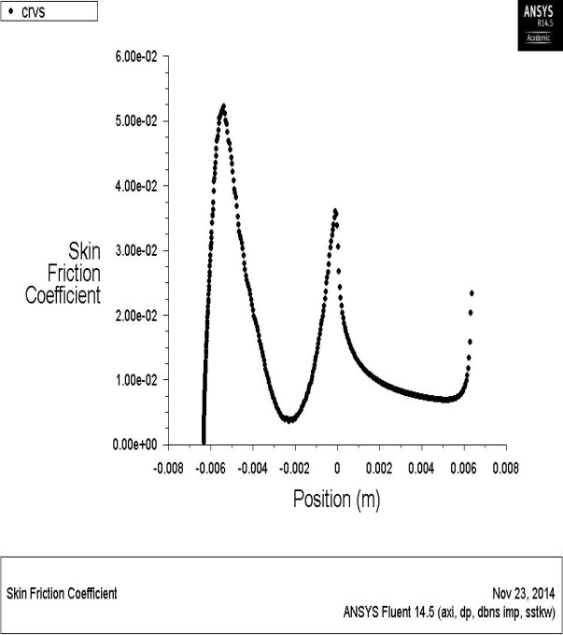
Results (contd.)
Computational Fluid Dynamics Laboratory
0.75 vs. 1.0 weighted
Drag vs. Heat Flux
CD increased by 13%
Max-HT reduced by 19%

Slide 25


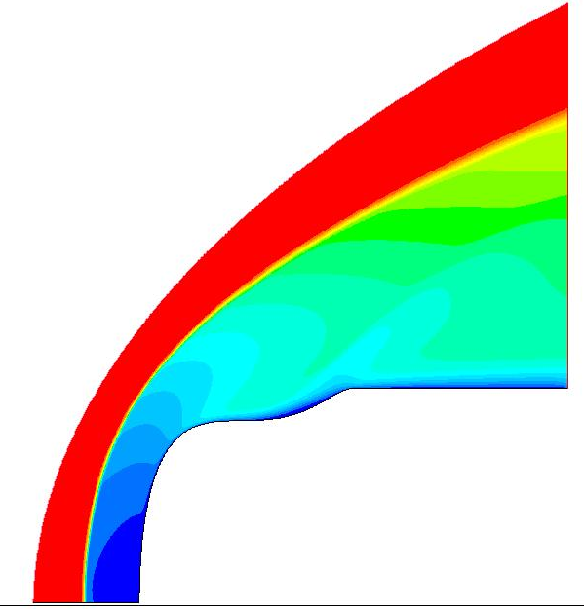

Results (contd.)
Computational Fluid Dynamics Laboratory
0.5 vs. 1.0 weighted
Drag vs. Heat Flux
CD increased by 1%
Max-HT reduced by 26%

Slide 26
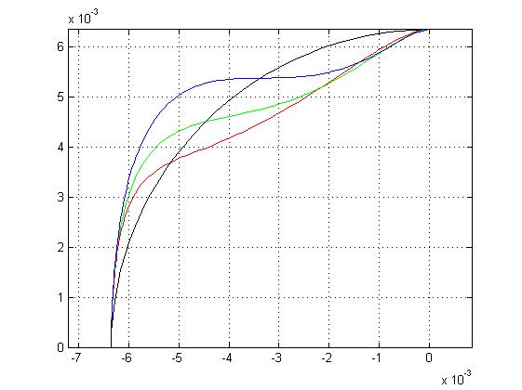
Results (contd.)
Computational Fluid Dynamics Laboratory
Combined Results and Pareto-Optimal Front

Slide 27
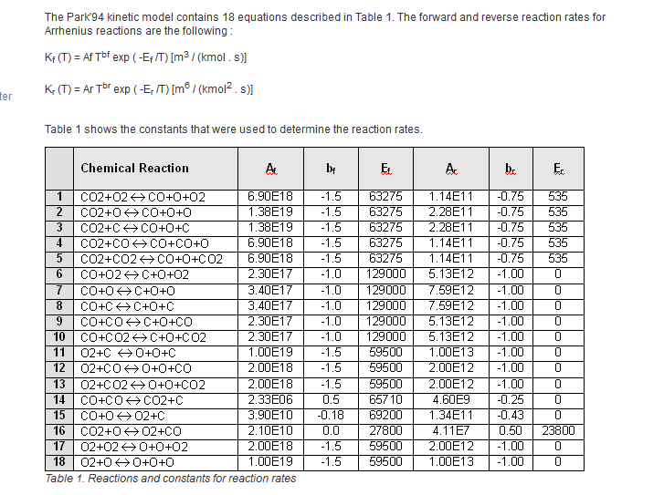
Flow in Chemical Non-Equilibrium Results (DLR Case)
Computational Fluid Dynamics Laboratory
Park’s Five Species (C, O, O₂, CO, CO₂)Model

Slide 28
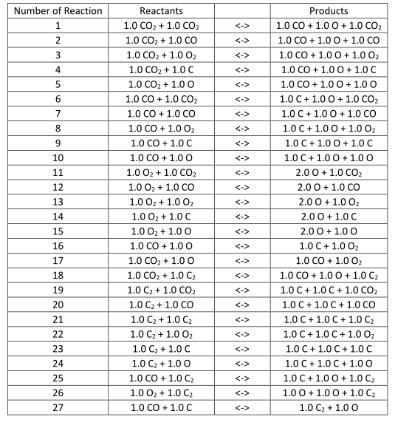
Flow in Chemical Non-Equilibrium Results (DLR Case)
Computational Fluid Dynamics Laboratory
CFD++ Six Species (C, C₂, O, O₂, CO, CO₂)Model

Slide 29
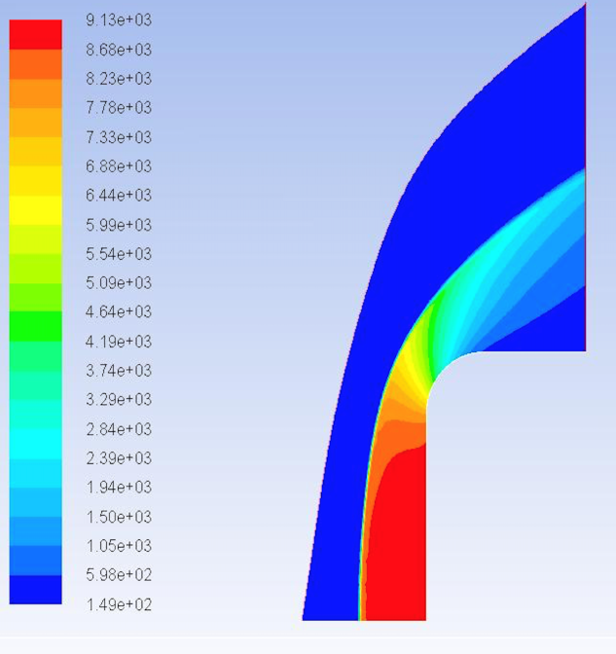
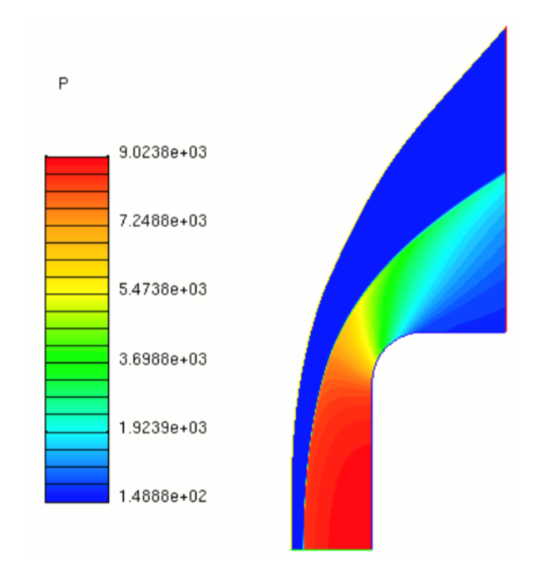
Flow in Chemical Non-Equilibrium Results (DLR Case)
Computational Fluid Dynamics Laboratory
Validation Case
  Experimental Data from the DLR case was used to validate the species model.
  The results showed that for the DLR case, the current chemical reaction model is not suitable. Pressure is calculated correctly, but not heat flux.
  Pressure contours are shown below
Fluent Pressure Contours CFD++ Pressure Contours

Slide 30
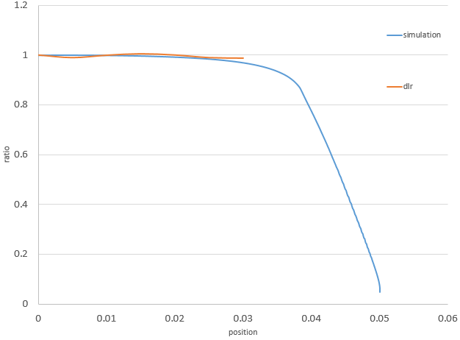
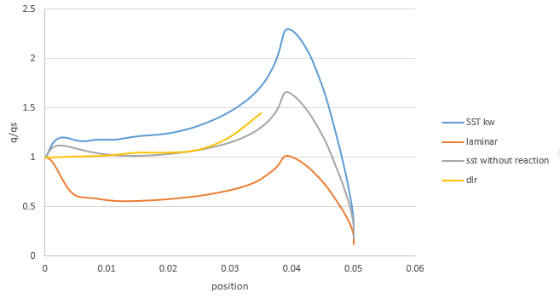
Results (DLR Case)
Computational Fluid Dynamics Laboratory
Validation Case
Simulation vs. Experimental Pressure
Ratio of Heat Flux on the Body and Stagnation Point Heat Flux

Slide 31
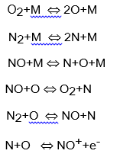
Flow in Chemical Non-Equilibrium (Optimization Case)
Computational Fluid Dynamics Laboratory
Air Dissociation Five Species (N, N₂, NO, O, O₂)Model

Slide 32
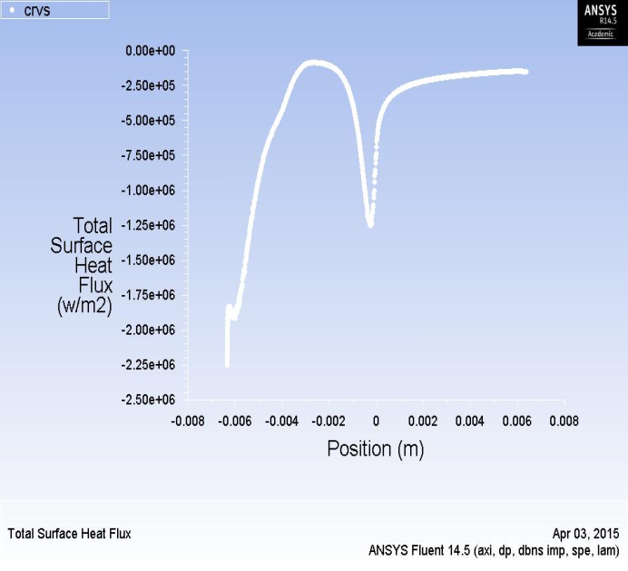
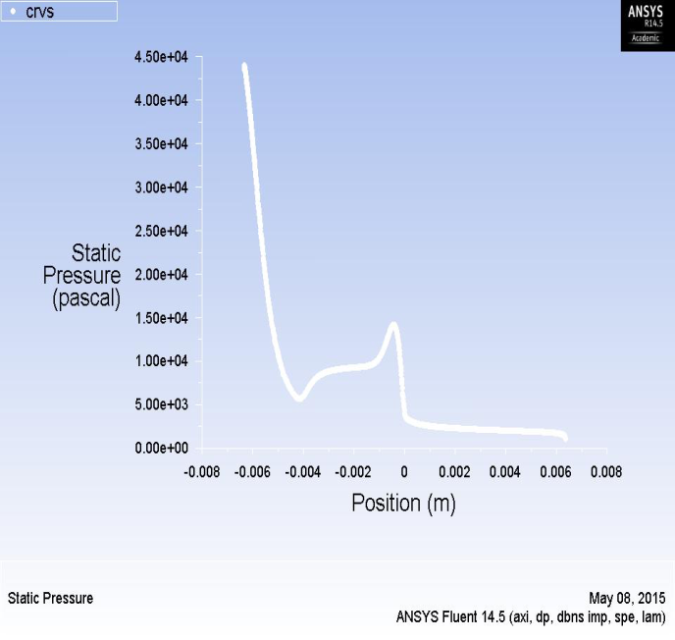
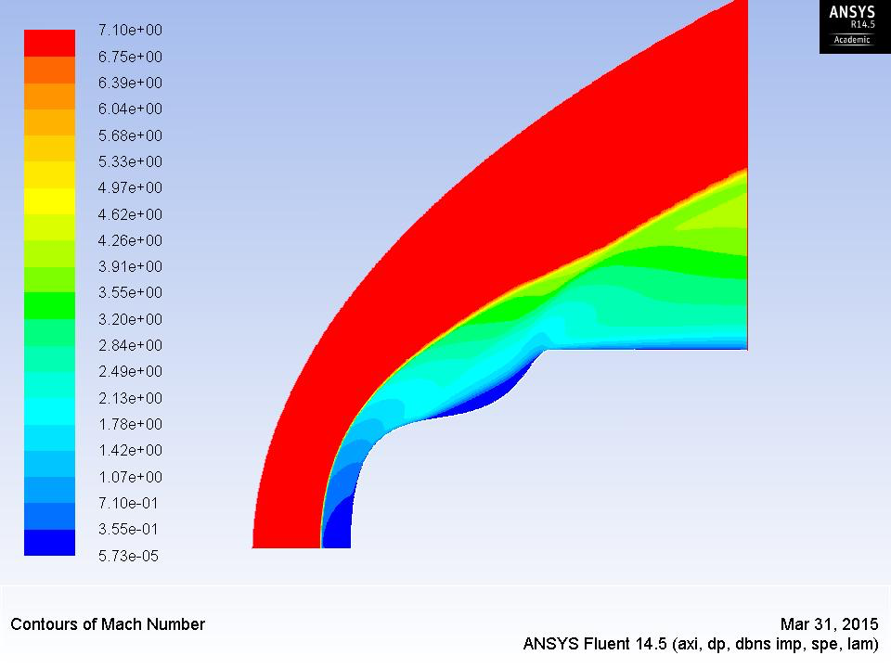
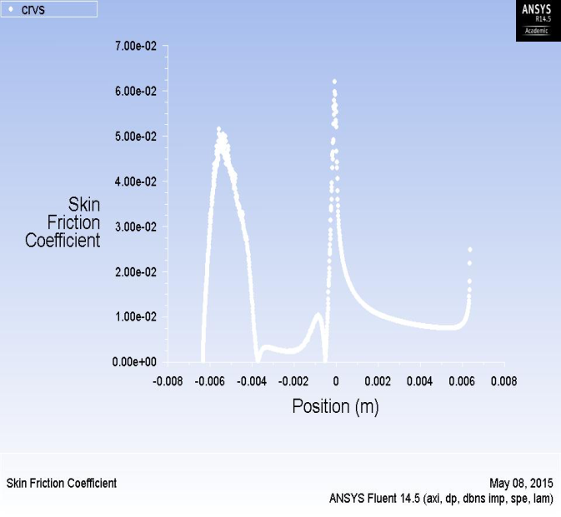
Results
Computational Fluid Dynamics Laboratory
Evenly weighted HT and Drag
CD reduced by 14%
Max-HT reduced by 11%
Fig. 6 Results for an optimized body with equal weighting of drag and heat transfer : Static pressure contours, wall skin friction, pressure coefficient, and wall heat flux, and convergence graphs.
Drag Coefficient: 0.745 (22% reduction relative to spherical nose)
Maximum Heat Transfer: 2230000 W/m­² (13% reduction relative to spherical nose)

Slide 33

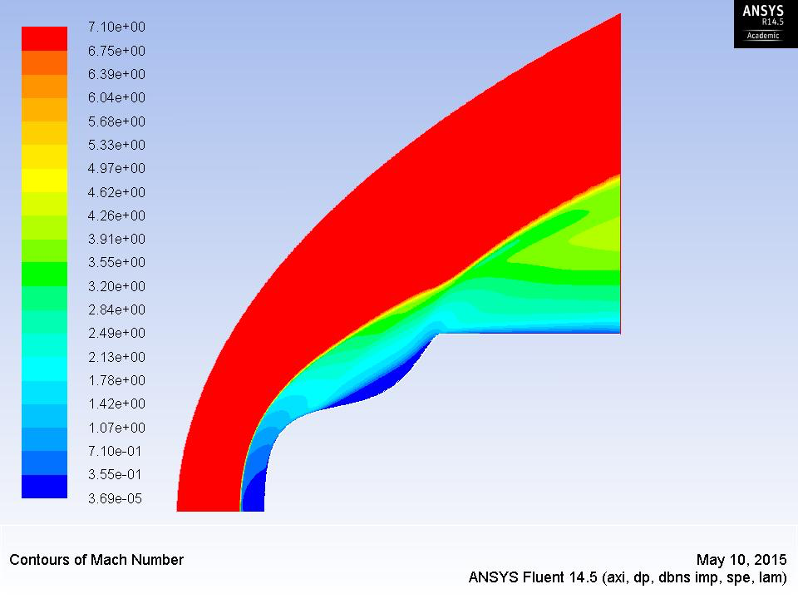

Results (contd.)
Computational Fluid Dynamics Laboratory
0.5 vs. 1.0 weighted
Heat Flux vs. Drag
CD reduced by 16%
Max-HT reduced by 8%

Slide 34
Conclusions
Computational Fluid Dynamics Laboratory
Accomplishments
  Successful simulation of blunt body shapes in dissociating hypersonic flow
  Validation of CFD results against experimental data and other CFD code
  Optimization of a blunt body shape for specified relative objectives of minimizing the drag and heat transfer
Current Work
  Simulations with more Bezier Points
  Simulations at various Mach numbers
  Simulations of 3D complex shapes

Slide 35
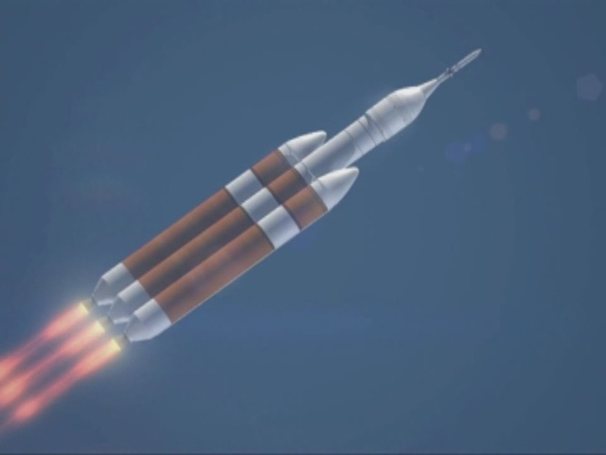
Thank you!
Computational Fluid Dynamics Laboratory
Questions?

