Slide 1
Characterization of exopolymeric substances from Bacillus flexus S15 isolated from southeast coast of Tamilnadu, India
Dr. R.Thirumurugan^{1,2} &K .Parthiban¹
¹Department of Animal Science, School of Life Sciences,
Bharathidasan University,Tiruchirappalli - 620024,
Tamilnadu, India.
²School of Fisheries, Aquaculture & Aquatic Sciences, Auburn University, Auburn, Alabama 36849 -5419 USA

Slide 2
“Where observation is concerned,
chance favors only for the prepared mind”
- LOUIS PASTEUR

Slide 3
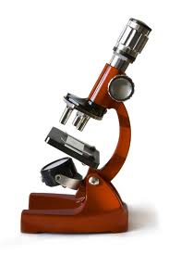
INTRODUCTION
The term “Exopolymer” was coined by Sutherland in 1974, a major component secreted by most of the bacteria.
The exopolymer was generally composed of sugar residues and non sugar residues like proteins, sulphates, fatty acids etc.
The exopolymer enable the bacteria to survive in deleterious environment like high temperatures, salt concentrations, low pH or temperature, and high radiation.
On compared with terrestrial organism, marine bacteria likely to secrete exopolymeric substances.

Slide 4
The assorted environment forces the bacteria to secrete exopolymeric substances.
In marine environment, most of the bacteria appear as aggregates since of extracellular polymeric substances, essential for their survival.
These exopolymer have antagonistic activity, antiviral, anti tumor, flocculating, emulsifying activity etc.

Slide 5

OBJECTIVES
To isolate and characterize the exopolymer producing bacteria.
To study the characteristic features of exopolymer.
To screen cytotoxic and anti bacterial activity

Slide 6
Isolation and characterization of exopolymer producing bacteria

Slide 7
Sample collection
Screening and Isolation of exopolymer producing bacteria
Morphological and Physiological characterization
16S rRNA sequencing
Phylogenetic analysis

Slide 8
Extraction and purification of exopolymer
The isolated strains were grown in Zobell Marine Broth for 5 days.
The exopolymer was extracted by ethanol precipitation at 4⁰C followed by centrifugation.
The exopolymer was purified by dialysis against distilled water to remove salt.
The exopolymer was dried at 45⁰C and used for further studies

Slide 9
Characterization of Exopolymer
Estimation of Total sugar - Orcinol sulphuric acid method. (Bruckner et al 1955)
Estimation of Protein - Lowry’s method. (Lowry et al 1951)
Estimation of sulphate - BaCl₂ gelatin method.
Estimation of Uronic acid - Meta di hydroxyl phenyl method
                (Filisetti-Cozzzi et al 1991)

Slide 10
FT-IR Analysis (Lijour et al 1994)
3 mg of sample was grinded with potassium bromide (KBr) and pelleted. Finally, pelleted sample was analyzed on a FTIR Bruker IFS 85.
HPLC Analysis of monosugars (Freitas et al., 2009)
10 mg of lyophilized sample was hydrolyzed in 4M tri fluoro acetic acid (TFA) and heated at 100° C for 15 min, resulting the residual acid was removed by distillation with methanol for three times.
Column : CarboPac PA10
Detector : RI detector

Slide 11
NMR (Guokui Qin et al 2007)
  Proton nuclear magnetic resonance was recorded by dissolving 20 mg of pure exopolymer in 1ml of D₂O at room temperature and mixed thoroughly; resulting solution was recorded on NMR spectrometer (Bruker Avance III 500 MHz (AV 500).
  Diffraction scanning colorimetry (DSC) (RP singh et al 2011)
  5 mg of purified exopolymer was scanned in DSC at the range of 40–450⁰C (10⁰C/min) under a nitrogen atmosphere.

Slide 12
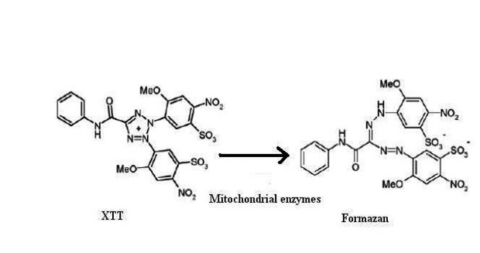
Assessment of Cytotoxic activity
XTT Assay: (2,3-Bis(2-methoxy-4-nitro-5-sulfophenyl)-2H-tetrazolium-5-carbox-anilide)
An In vitro cell-based colorimetric assay for the screening of a compound and drugs for anticancer activity.
An enzyme named succinate tetrazolium reductase present in the mitochondria of metabolically active cells involved in the reduction of XTT to formazon.

Slide 13
This reduction leads to colour change (Yellow to orange) and breaking a part of positively charged quaternary tetrazole ring in XTT to form formazan.
This enzyme becomes inactivated shortly after cell death; hence, it affects the basic functions of the cells.
A549 lung cancer cell lines were used for this study.
Different concentrations (12.5, 25, 50, 100, and 200 µg/ml) of exopolymer and cisplatin (an anticancer drug as standard) was prepared in dimethyl sulfoxide and 1 ml was added to the wells of microtiter plates separately containing A549 cancer cells.

Slide 14
Finally, 50 µL of fresh XTT (1mg/0.9 ml RPMI along with XTT activating reagent) was added to the wells and incubated for 2 hours at 37⁰C.Then, the plates were mixed for 15 sec and the absorbance was recorded at 630 nm
Anti bacterial activity of bacterial exopolymer
Antibacterial activity of bacterial exopolymer was assayed by Well diffusion method.
Bacterial exopolymer was prepared in various solvents such as Acetone, Butanol, DMSO and Ethyl acetate by dissolving 1mg/1ml.

Slide 15
Results and Discussion
The exopolymer producing bacterial strain was Gram^{+ve} rod shaped and their biochemical and 16S rRNA sequence revealed the isolate was Bacillus flexus (Accesion Number JX569797).
In Zobell marine media it produce 478 mg/l of exopolymer, then it was extracted and purified for further studies.
The analysis revealed that the exopolymer consist of about 65 % sugars, 3.1 % proteins, 0.24 % uronic acids and 12.7 % sulfate

Slide 16
The presence of proteins, uronic acids and sulphate contributed polyanionic nature of exopolymer.
The presence of high sulfate contents (12.7%) was especially interesting, which was an unusual components of bacterial exopolymeric substances.
Sulfated polysaccharides were known to inhibit the growth of some viruses and tumors.
Previously Osama et al., 2015 reported 20.2% sulfate in Bacillus marinus, Quesada et al.1993 and Victoria Bejar et al.,1998 reported in H.eurihalina (11.2%), H.eurihalina (24%) for presence of sulfate in exopolymer.

Slide 17
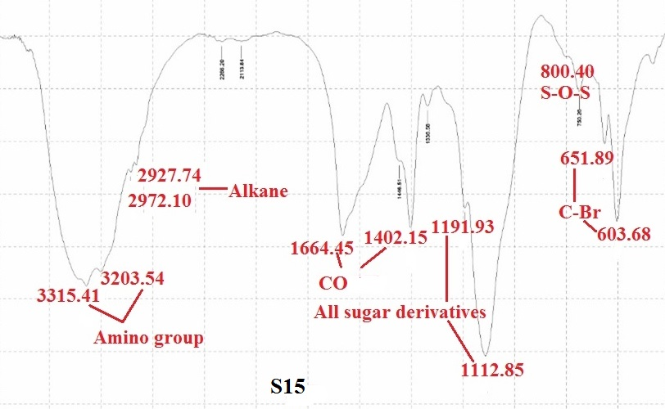
FT-IR Analysis of exopolymer

Slide 18
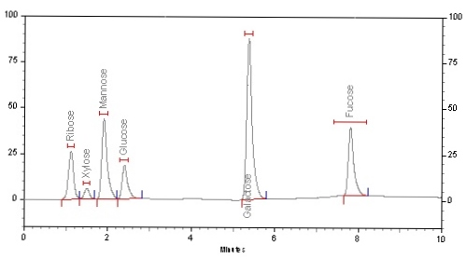
Isolate | Distribution of sugars in exopolymer
Bacillus flexus S15 | Glu (2.325) | Man (1.989) | Fuc (7.878) | Xyl (1.689) | Gal (5.370) | Rib (1.237) | Rham (3.447)
Retention time
HPLC analysis of Mono sugars in exopolymer

Slide 19
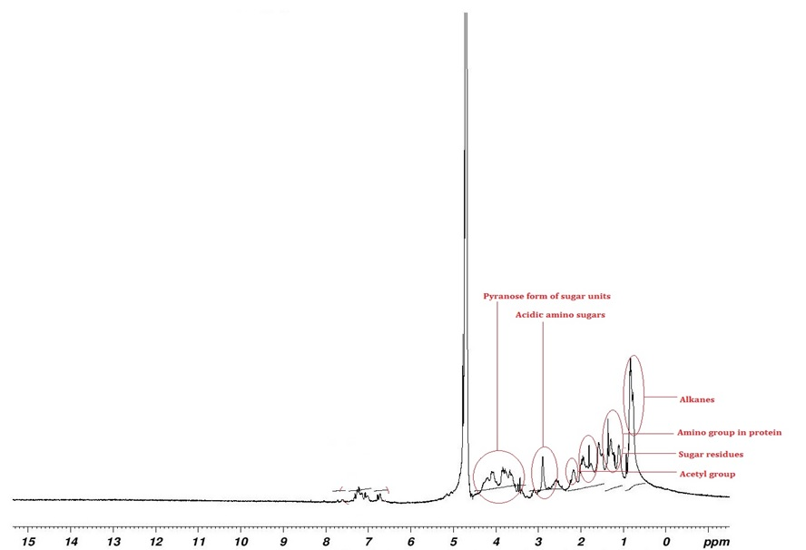
₁H NMR analysis of exopolymer

Slide 20
₁H NMR analysis of exopolymer
The signals obtained between 0.776-0.942 ppm corresponds for the alkane.
The proton signals arising from the methyl protons of the 6-deoxy sugars were seen at 1.109 -1.252 ppm.
The stretching of N-H group of protein was observed at 1.301-1.375 ppm.
The finger print region of sugar moieties was observed at 3.397- 4.291 ppm due to the protons attached to C2-C6 and were poorly resolved because of the overlapping chemical shifts.

Slide 21
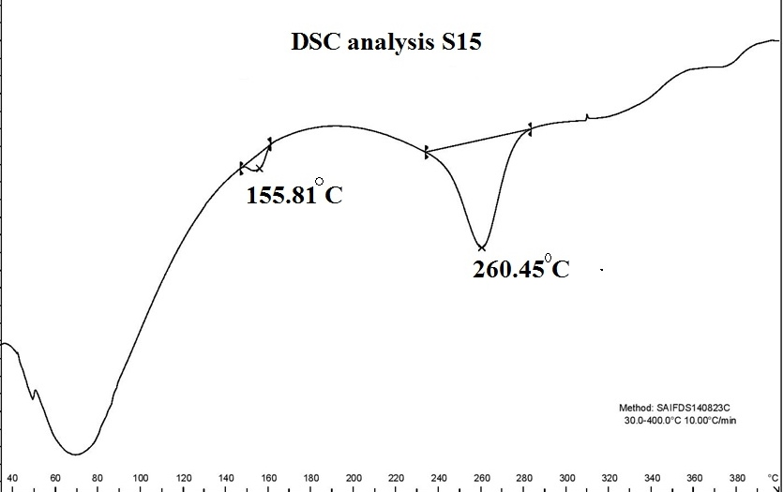
Differential Scanning Colorimetry

Slide 22
DSC
DSC analysis show a exothermic curve profiles. It exhibited a single narrower peak with a maximum melting temperature (T_{M}) of 155.81°C & 260.45 °C.
The onset transition temperature was found at 148.53°C & 242.84 °C.
In DSC analysis 16.48 %, weight loss was observed at 50⁰C-95⁰C during I phase of degradation. Thereafter, 38.95 % of second phase of degradation was observed as at 160⁰C
Phase 1 degradation was due to the evaporation of water during heating process while second phase of degradation was attributable to thermal decomposition

Slide 23
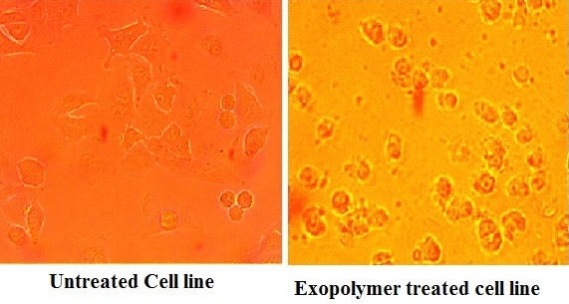
Screening of Cytotoxic activity
The cytotoxic behaviour of the exopolymeric substance where the untreated cell lines multiplies and effectively reduce the XTT into formazon. However, the exopolymer treated cells fails to reduce/weakly reduce the XTT and shows apoptotic bodies.

Slide 24
The XTT assay revealed the anticancer property of bacterial exopolymer and the IC 50 estimate as 120.36µg /mL.
The cancer cells reduce the dye XTT by producing mitochondrial oxidoreductases to highly pigmented formazan product. However, the exopolymer treated cells were found to be damaged at increasing concentration indicating cytotoxic effect against A549 lung cancer cells and fails to effectively reduce XTT.

Slide 25
Antibacterial activity
Zone of Inhibition (mm)
Test Organism | A* | A | B* | B | C* | C | D* | D
E.coli | 7.6 ± 0.5 | - | 5.3 ± 0.5 | - | 4.3 ± 0.5 | - | 4.6 ± 0.5 | -
S.dyssentriae | 8.3 ± 0.5 | - | 7.3 ± 0.5 | - | 6.3 ± 0.5 | - | 5.6 ± 0.5 | -
S. aureus | 14.3 ± 0.5 | - | 12.3 ± 0.5 | - | 12.6 ± 0.5 | - | 10.6 ± 0.5 | -
S.pyogens | 9.6 ± 0.5 | - | 6.3 ± 0.5 | - | 8.6 ± 0.5 | - | 6.3 ± 0.5 | -
A*=Acetone+exopolymer,A=Acetone,B*=Butanol+exoplymer,B=Butanol,C*=DMSO+exopolymer, C=DMSO,D*=Ethylacetae+exopolymer,DMSO=Ethylacetate,(-)=No activity

Slide 26
The antibacterial activity of exopolymer differs based on the test strains and the solvents used.
The exopolymer dissolved in acetone showed better antibacterial activity than other solvents.
The highest activity was noticed against Staphylococcus aureus (14.3 ± 0.5 mm) followed by Streptococcus pyogens (9.6 ± 0.5mm), Shigella dyssentriae (8.3 ± 0.5 mm) and E.coli (7.6 ± 0.5 mm).

Slide 27
Conclusion
This study advances our understanding of bacterial exopolymer in anticancer studies.
The present study confirmed that the exopolymer of B.flexus was primarily composed of sugars and non-sugar components like protein, sulphate, uronic acids.
Hence, the existence of non-sugar molecules along with sugar molecules in exopolymeric substances are responsible for the cytotoxicity against cancer cells.

Slide 28
The presence of various sugars such as galactose,, xylose, mannose, etc. and amino acids (proteins) showed higher anti-tumor activity.
It is possible to hypothesize that the sulphated sugars could be responsible for the fibrinolytic and other bioactivities like antiviral and anti tumor activity of exopolymer.
Further, explorations of these exopolymeric substances are likely to be exploited in various fields as emulsification, drug delivery, and heavy metal absorption. This study advances to understand the applications of bacterial exopolymer in a better way.

Slide 29
THANK YOU

