Slide 1
INNOVATIONS in
DESIGN, MATERIALS and MANUFACTURING of
TURBINE BLADES for JET ENGINES
R. Prabhakaran
Professor
Department of Mechanical and Aerospace Engineering
Old Dominion University
Norfolk, VA 23529

Slide 2
ACKNOWLEDGEMENTS
The following material is taken from innumerable sources-
too numerous to list
I thank all the contributors for the valuable material

Slide 3

OUTLINE
Gas Turbine Engine
Turbine Blade Loading Conditions
Innovations in Materials
Super Alloys
Intermetallics
Reinforced Intermetallics
CMCs
Innovations in Design
Blade Cooling Channels

Slide 4
OUTLINE (contd)
Innovations in Manufacture
Directional Solidification
Single Crystal Solidification
Investment Casting
Centrifugal Casting
Vacuum Casting
Additive Manufacturing
Drilling Blade Cooling Channels

Slide 5
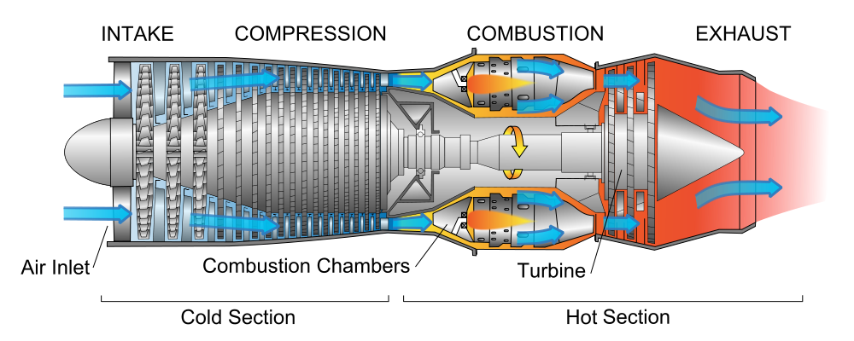
GAS TURBINE ENGINE

Slide 6
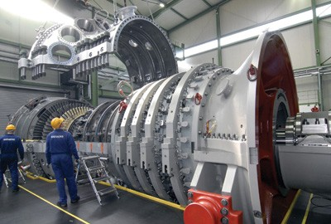
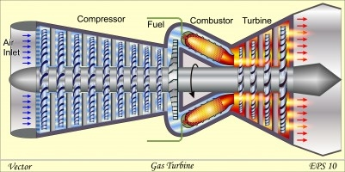
GAS TURBINES
GENERATORS
2. JET ENGINES

Slide 7
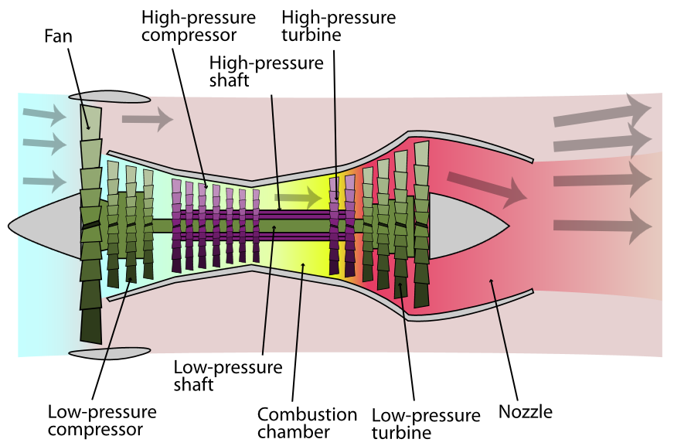
3. TURBINE BLADE LOADING CONDITIONS
CRITICAL COMPONENT: HIGH PRESSURE TURBINE BLADE

Slide 8
2. HISTORY OF THE GAS TURBINE ENGINE
1930 Sir Frank Whittle patented his design for jet engine
Hans von Ohain patented his own design
Ernst Heinkel Aircraft flew Ohain’s design, He 178
National Science Academy (USA) Committee on Gas Turbines: “there is no
future for aircraft gas turbine engines” !!!!!
Sir Frank Whittle flew his turbojet, Gloster Meteor
Chuck Yeager broke the sound barrier in X-1, a turbo-jet
First flight of a turbo-jet in commercial service, de Havilland DH 106 Comet
Meanwhile……….
4MW gas turbine for power generation in Switzerland by Brown Boveri.
It was operational until 2002!

Slide 9
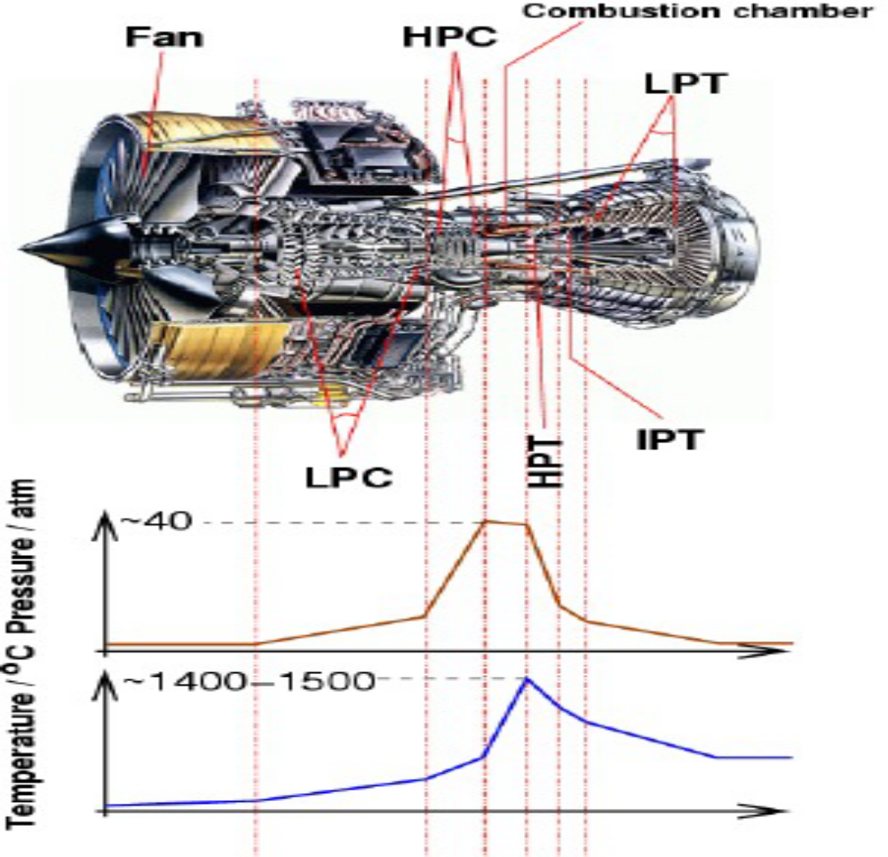
Temperature and pressure profile in gas turbine.

Slide 10
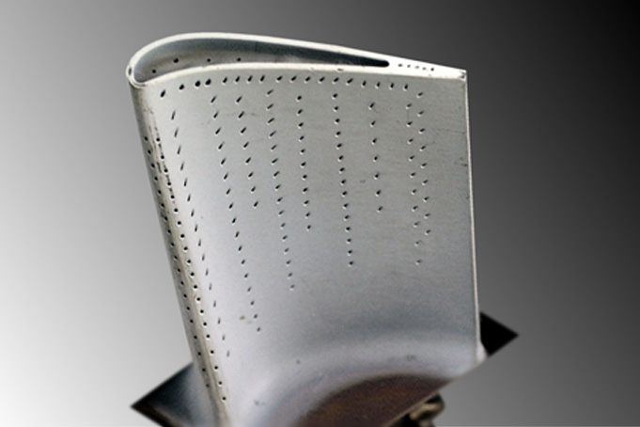
TURBINE BLADE LOADING CONDITIONS
HIGH TEMPERATURES
HIGH CENTRIFUGAL STRESSES

Slide 11
LOADING ON THE BLADES
1. Centrifugal load
2. Thermal loads
3. Aerodynamic loads
  4. Vibratory loads

Slide 12
CAUSES OF BLADE FAILURE
1. Creep
2. Yielding
3. Thermal-mechanical fatigue:
(a) Low-cycle fatigue
(b) High-cycle fatigue
4. Fracture
5. Fretting
6. Oxidation
7. Corrosion
8. Erosion
9. Foreign object damage
10. Wear

Slide 13
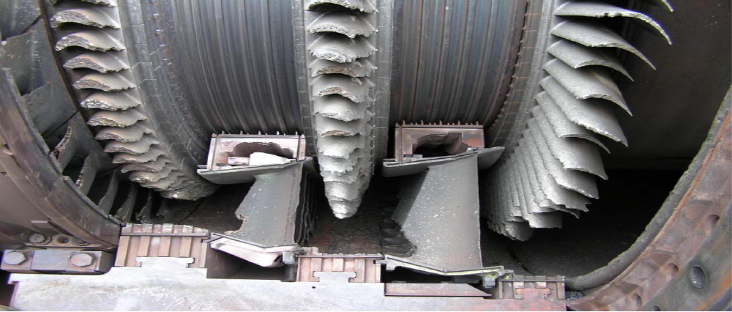
Potential failure considerations:

Slide 14
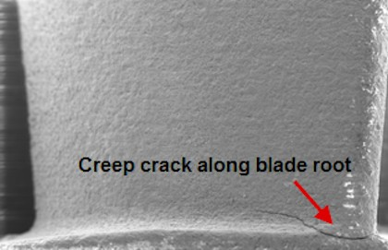

Slide 15
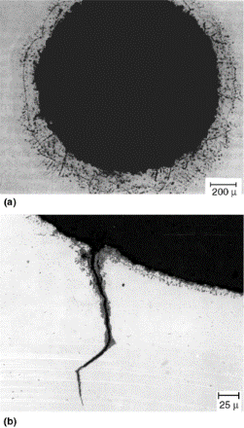
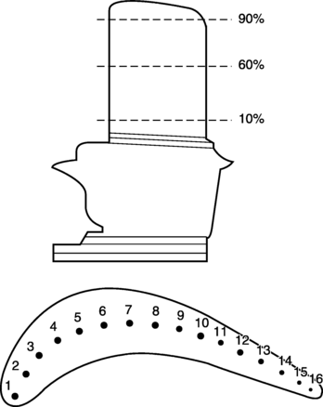
Oxidation and cracking at cooling holes in a turbine blade. (a) Trailing edge cooling hole surface showing oxidation and nitridation attack on the surface after 32,000 h of operation. (b) Crack found on the surface of No. 5 cooling hole. Oxidation on the crack surface and hole surface can be noticed

Slide 16
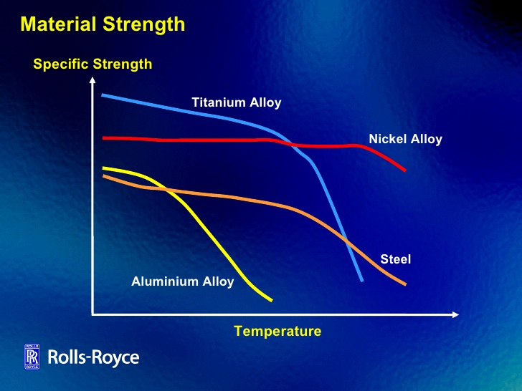
4. BLADE MATERIALS

Slide 17
SUPERALLOYS
Superalloys: ‘aristocrats of the metallurgical world’
1940s First superalloy, Nimonic 75, was made
1951-1952 Confirmation of age-hardening due to Ni₃Al, Ni₃Ti
(γ’) in γ matrix
1957 Discovery that γ’ becomes stronger with increasing
temperature
1970s 1980s Introduction of DS process
Mechanical Alloying
SC superalloys

Slide 18
SUPERALLOY COMPOSITION
Modern Ni-based superalloys contain more than 10 alloying elements!
Solid solution strengthening: Co, Cr, Fe, Mo, W, Ta, Re
Grain boundary strengthening: W, Ta, Ti, Mo, Nb, Hf, Cr
γ’ precipitate formers: Al, Ti
Oxidation resistance: Al, Cr, Y, La, Ce
Hot corrosion resistance: Cr, Co, Si, La, Th
Grain boundary refinement: B, C, Zr, Hf

Slide 19
SUPERALLOY CHEMISTRY
Additions of Re and other refractory elements such as W and Mo have led to the development of multiple generations of superalloys
Refractory alloys provide high degrees of solid solution strengthening
But, these elements can also promote the formation of TCP phases, which are detrimental to mechanical properties at elevated temperatures
Oxidation resistance is also compromised due to Mo, Re, Ru, etc.
Additions of refractory elements increase cost and density
,, decrease castability and microstructural stability
Superalloy chemistry: logic + magic
Similar to cooking: an art!

Slide 20
DS, SC, and MA SUPERALLOYS
EQUI-COHESIVE TEMPERATURE
ABOVE ECT, DS IS BETTER
ABOVE ECT, SC IS BETTER
Directionally solidified Superalloys vs Directionally solidified eutectic Superalloys

Slide 21
SC SUPERALLOYS
First Generation: no Re or Ru (Rene N4, PWA 1480,…..)
Second Generation: ~3% Re and no Ru (Rene N5, PWA 1484…..)
Third Generation: ~6% Re and no Ru (Rene N6, CMSX 10,…..)
Fourth Generation: ~6% Re and ~3% Ru (EPM 102, TMS 138,…. )
Fifth Generation: ~6% Re and ~6% Ru ( TMS 162, TMS 196…...)
Sixth Generation: ~6% Re and ~6% Ru ( TMS 238,……………...)
(but other refractory elements reduced)

Slide 22
t

Slide 23
DS or MA SUPERALLOYS
These composites are metal-matrix composites
These composites have a sub-micron sized particle reinforcement, called a ‘dispersoid’
The matrix (a metal) is the principal load bearer
The dispersed phase impedes the motion of dislocations
Matrix (a metal) work-hardening is the major strengthening mechanism
The resulting composite is isotropic

Slide 24
Dispersoids
Various materials that can be used as dispersoids are:
Oxides
Carbides
Nitrides
Borides
Intermetallic compounds

Slide 25
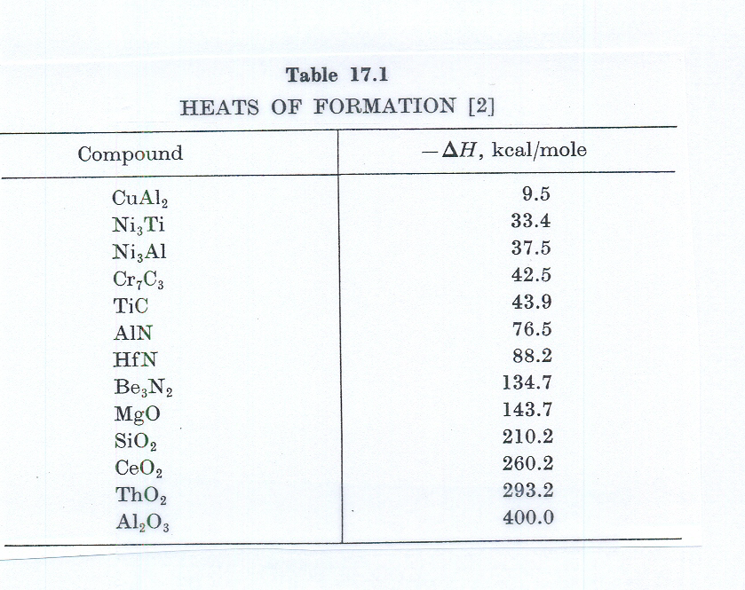
Dispersoids

Slide 26
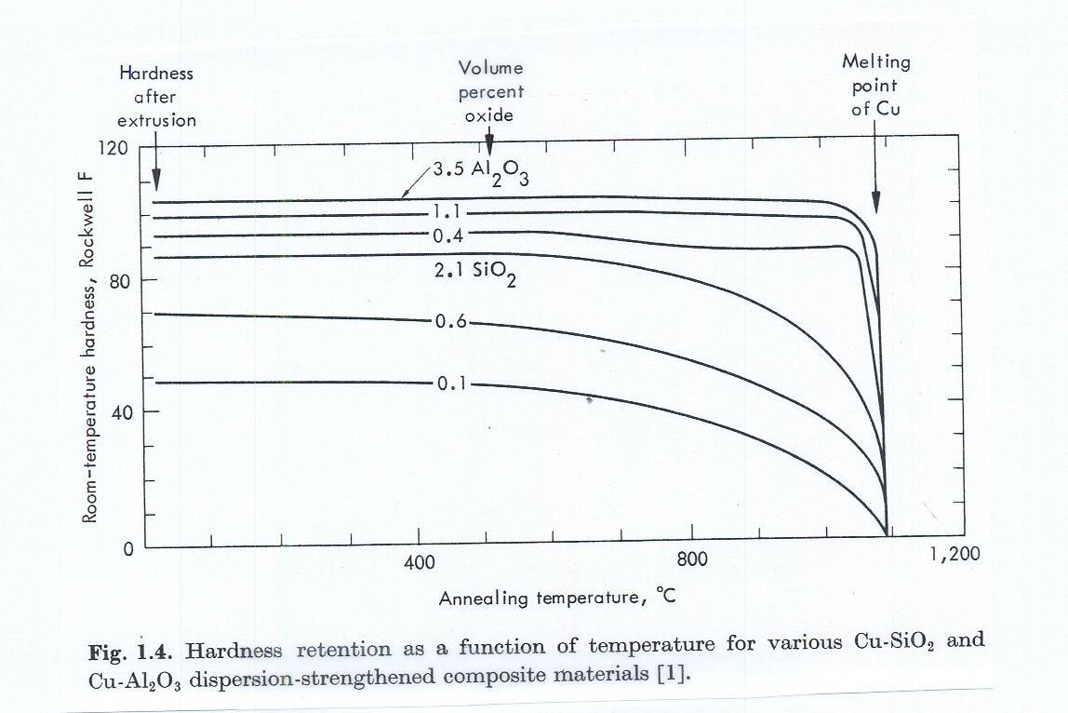
Advantages of Dispersion-strengthened Alloys
Retention of strength at high temperatures
Increase in creep resistance
The effectiveness of the dispersoid is determined by its insensitivity to temperature increase

Slide 27
Dispersion Strengthened Superalloys
ODS Alloys: Oxide-dispersion-strengthened superalloys
Inconel MA 754, Inconel MA 6000, Alloy 51,etc.
These alloys have Y₂O₃ as dispersoid, about 1 % by weight
They have much better high temperature properties.
But….. ODS superalloys have not become popular as blade materials, due
to processing, cost, and other difficulties.

Slide 28
BLADE MANUFACTURE
When the turbine blade design was simple: forging
Blade roots are shot-peened
With the increasing complexity of blade geometry: casting
Cast components tend to have porosity: HIPping (Hot Isostatic Pressing)
(HIPping: simultaneous application of high temperature and high pressure via argon)
1950s : first turbine blade by Investment Casting

Slide 29
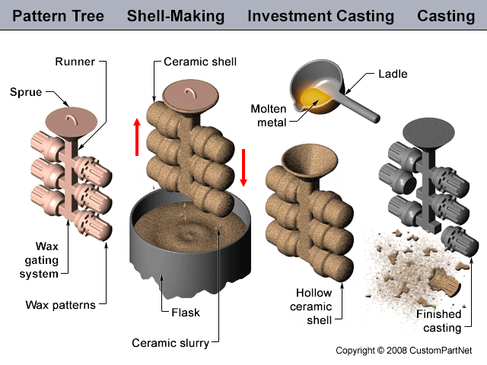

Slide 30
BLADE COOLING CHANNELS
(a) Why blade cooling?
(b) Different cooling techniques
(c) Methods of machining the cooling channels

Slide 31
Why blade cooling?
Improvements in blade materials and blade coating materials alone are not enough.
Blade cooling allows a greater Turbine Inlet Temperature or Turbine Entry Temperature.
Air is bled from the compressor and introduced into the turbine blades through their roots.
The coolant is extracted from the compressor and so the mass flow of air available for combustion is reduced.
Also, the air coming out of the blades (after cooling the blades) joins the mainstream of gases and contributes to aerodynamic inefficiencies.

Slide 32
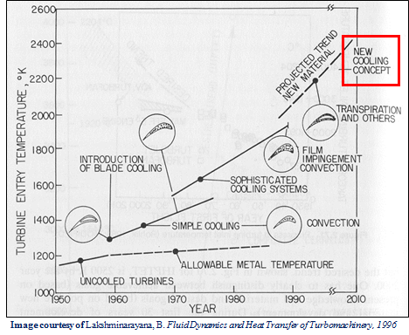

Slide 33
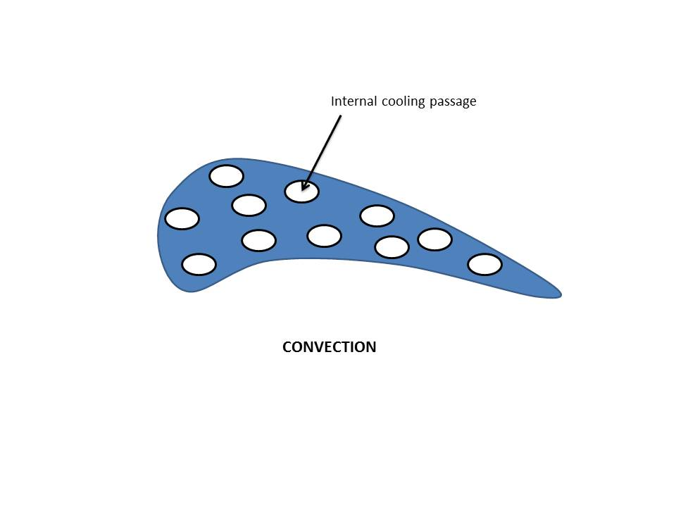
DIFFERENT COOLING TECHNIQUES
(i) Blade cooling by convection
Cooling air passes through internal passages in the blade.

Slide 34
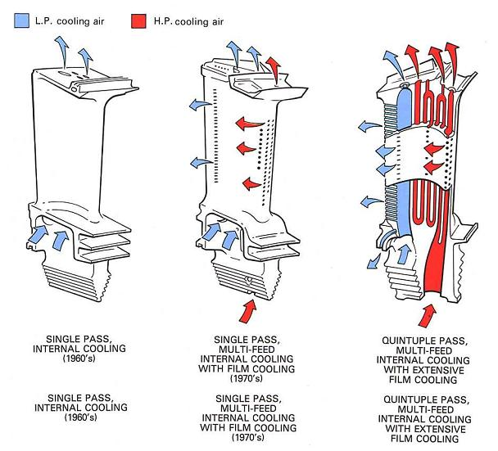
Cooling channels are single-pass (radial outward flow) or multi-pass (both radial outward and radial inward flow).

Slide 35
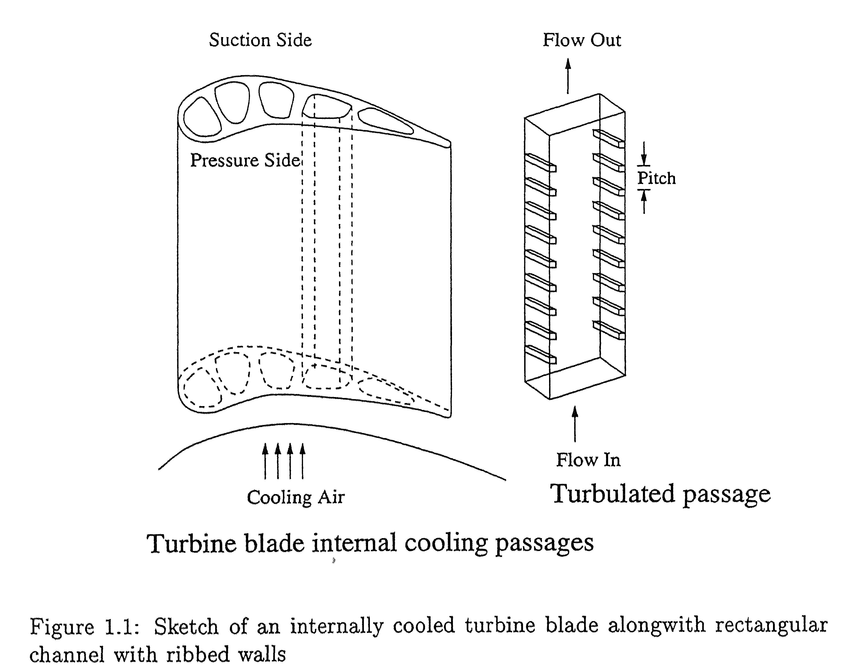

Slide 36
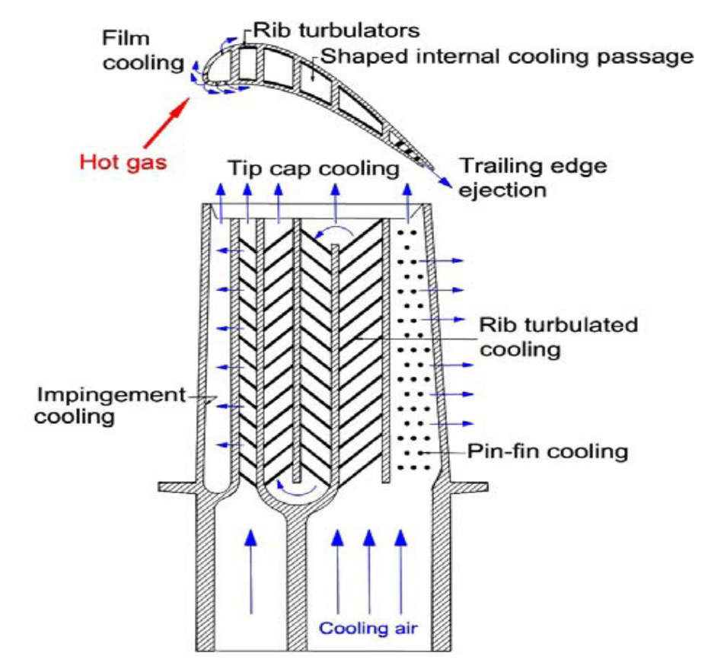
Typical Blade Cooling (Courtesy of Han et al [1])
1. J.C. Han, S. Dutta, and S.V. Ekkad, “Gas Turbine Heat Transfer
and Cooling Technology,” Taylor & Francis, Inc., New York
(2000).

Slide 37
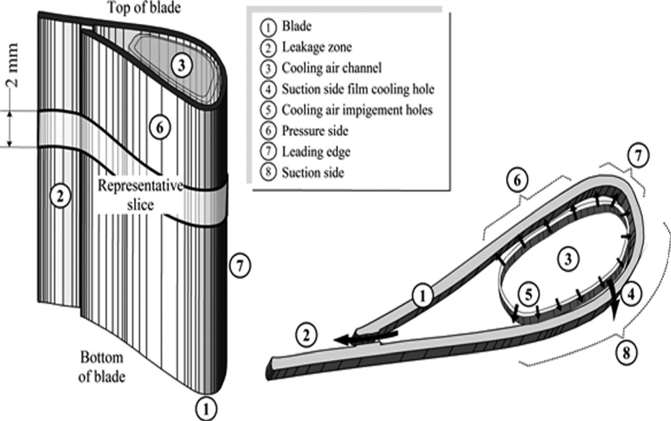
(ii)Blade cooling by impingement

Slide 38
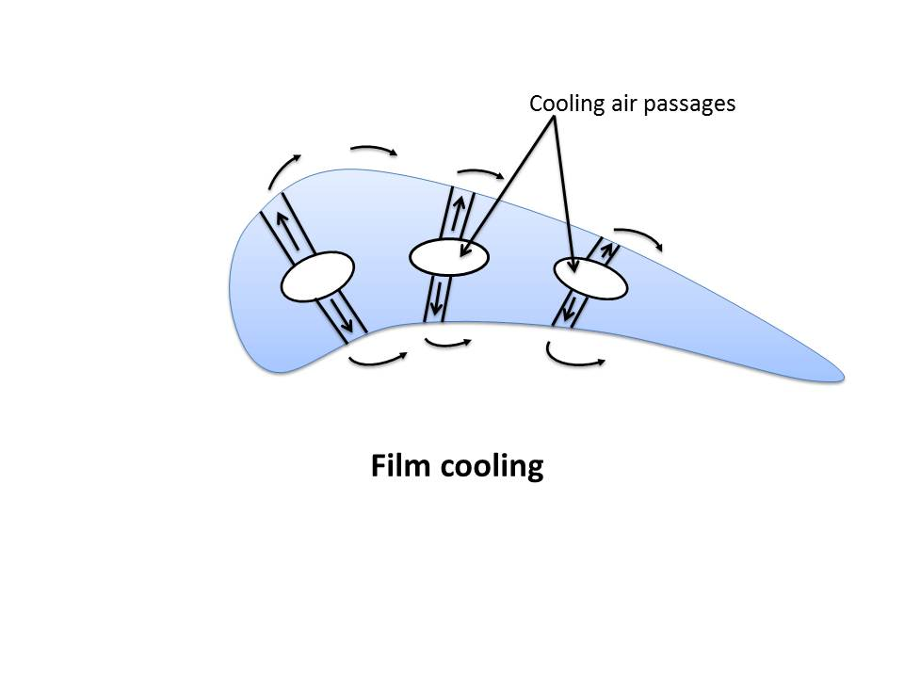
(iii) Film cooling

Slide 39
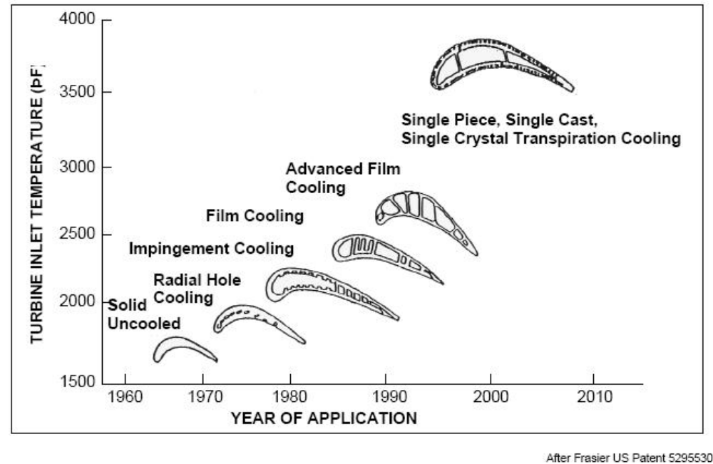

Slide 40
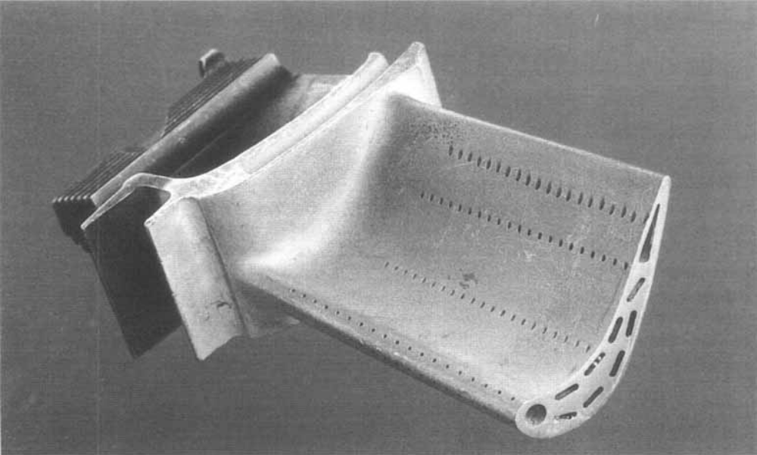
A section through a 2-inch long high-pressure turbine blade exposing the internal network of air cooling channels

Slide 41
BLADE COOLING HOLES ARE DESIGNED AND OPTIMIZED
Optimizing Cooling Passages in Turbine Blades
by Robert Yancey, Michael Dambach, J.S. Rao and Marc Ratzel, Altair Engineering, Inc.; David Corson, Acusim Software
OPTIMIZATION OF TURBINE BLADE COOLING USING
COMBINED COOLING TECHNIQUES
Mohammad Mehdi Zolfagharian, Mehran Rajabi-Zargarabadi, AS Mujumdar
MS Valipour and Mojtaba asadollahi
Multidisciplinary design optimization of film-cooled gas turbine blades
Shashishekara S. Talya, J. N. Rajadas, and A. Chattopadhyay
Etc., etc.

Slide 42
METHODS MACHINING COOLING CHANNELS
There are many methods
Question: Drill and coat or coat and drill?
Water jet drilling
Abrasive water jet drilling
Electro chemical machining
Electric discharge machining
Electro chemical discharge machining
Electron beam machining
Laser drilling: Single pulse
Percussion
Trepanning
Laser micro jet
Laser ablation
etc.

Slide 43
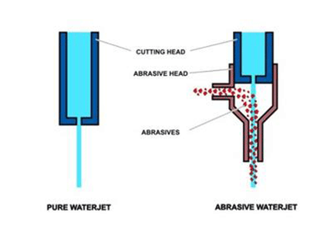
Water jet & Abrasive water jet drilling
Water jet velocity = up to three times the velocity of sound
Silica or garnet is added to the water to make the abrasive water jet
Very small, precise holes can be drilled
Coated or uncoated blades can be drilled

Slide 44
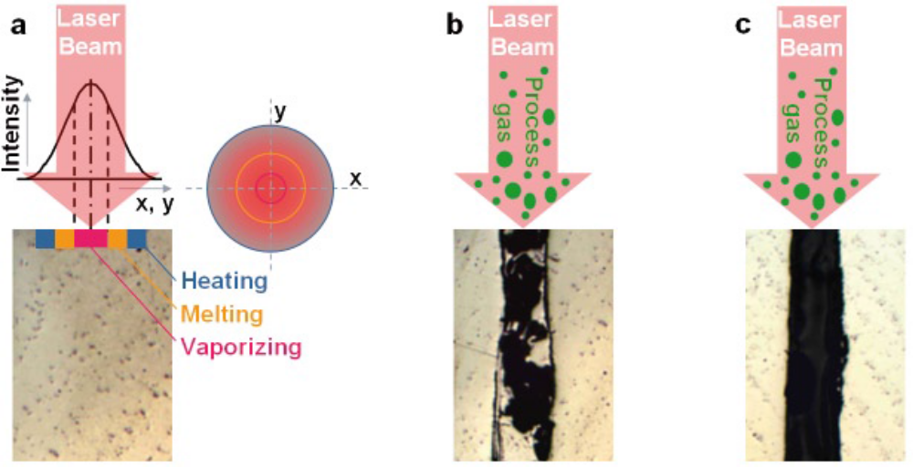
Laser drilling
Schematic diagram of cylindrical laser drilling: (a) Processes occurring upon
interaction of the laser beam with the material. The hole is generated (b) with a typical recast on the bore wall and cleaned (c) by a few laser pulses assisted by process gas.

Slide 45
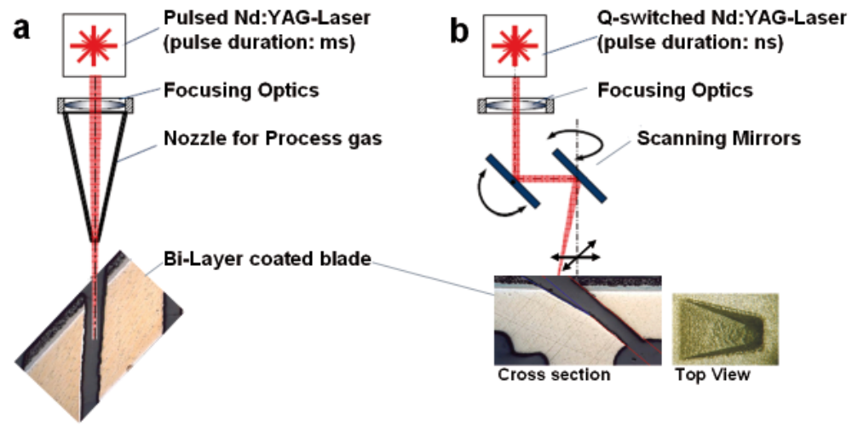
This diagram illustrates the combination of drilling process: (a) cylindrical
drilling and (b) shape hole drilling.

Slide 46
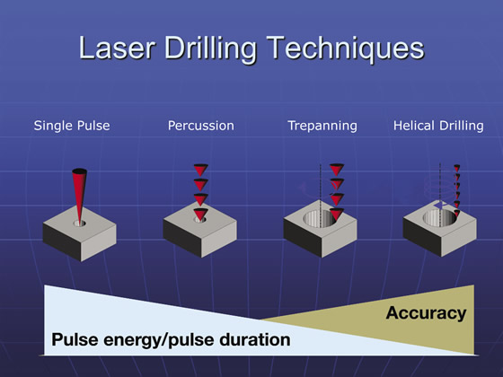
Single pulse, percussion, trepanning and helical microhole lasing methods; diagrams of the techniques used to produce them; and the tradeoff between material removal speed and precision. Image courtesy University of Stuttgart

Slide 47
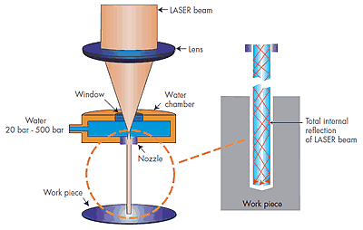
Laser micro jet machining

Slide 48
TBCs
Why TBCs?
TBC materials
Application methods
Why TBCs? Improvements in blade alloys (superalloys) has almost reached a saturation point. Further increases in TIT possible only with:
(a) blade cooling
(b) TBCs
Originally introduced to stationary engine parts, in the late 1980s, TBCs were used on rotating blades.
About 1 to 1.5 million kgms of YSZ was APS onto engine components in 2011!

Slide 49
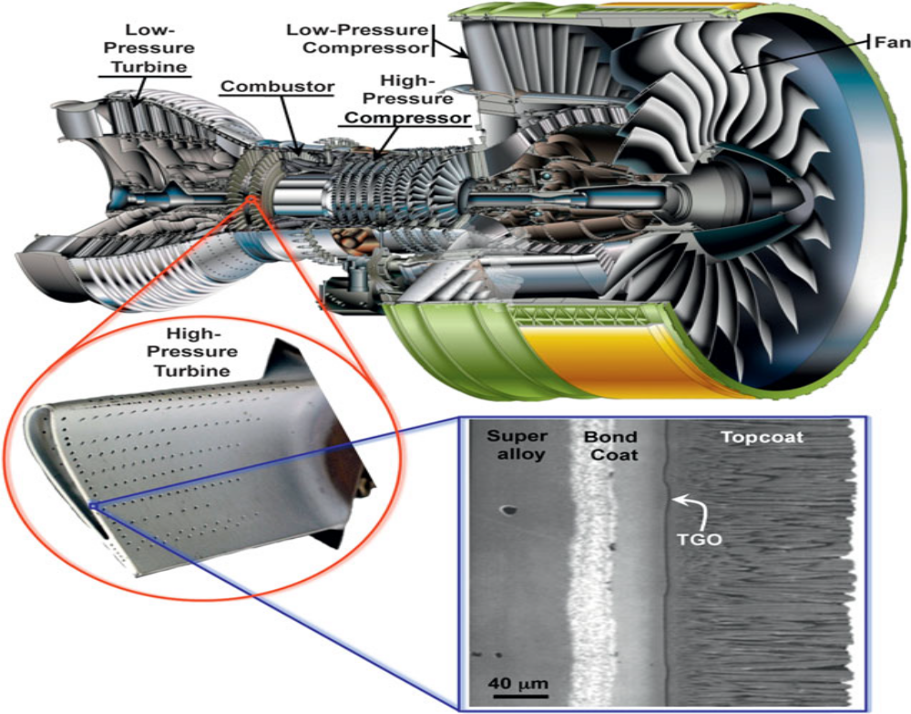

Slide 50
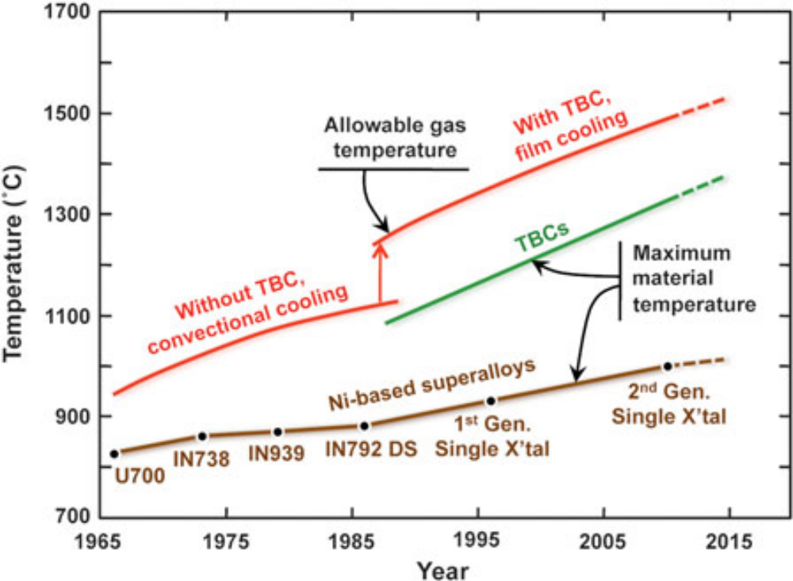
Progression of temperature capabilities of Ni-based
superalloys and thermal-barrier coating (TBC) materials
Over the past 50 years. The red lines indicate progression of maximum allowable gas temperatures in engines, with the large increase gained from employing TBCs.

Slide 51
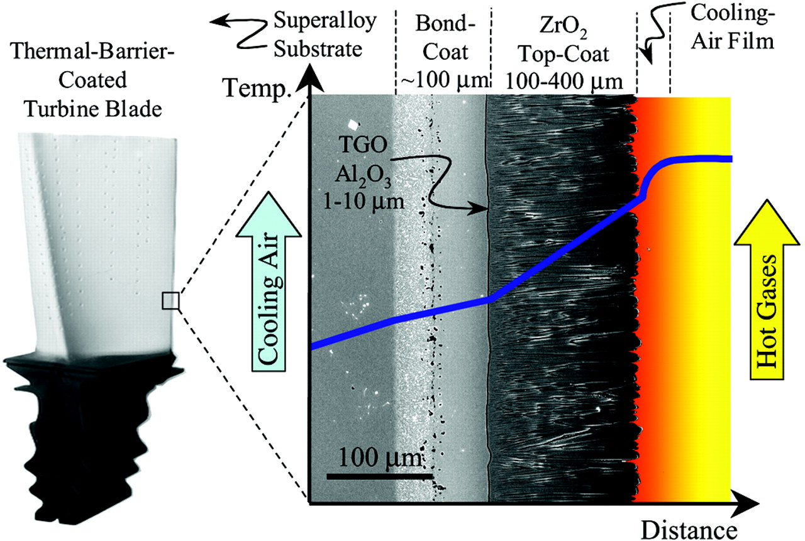
Cross-sectional scanning electron micrograph (SEM) of an electron-beam physical-vapor deposited (EB-PVD) TBC, superimposed onto a schematic diagram showing the temperature reduction provided by the TBC. The turbine blade contains internal hollow channels for air-cooling, whereas the outside hot-section surface is thermal barrier–coated, setting up a temperature gradient across the TBC.

Slide 52
Specific Gravities of Some Important Metals for Turbine Blade Materials
Metal | Specific Gravity
Nickel (Ni) | 8.9
Cobalt (Co) | 8.9
Chromium (Cr) | 7.2
Molybdenum (Mo) | 10.2
Niobium (Nb) | 8.6
Rhenium (Re) | 21.0
Ruthenium (Ru) | 12.2
Tantalum (Ta) | 16.6
Tungsten (W) | 19.3
Aluminum (Al) | 2.7
Titanium (Ti) | 4.5

Slide 53
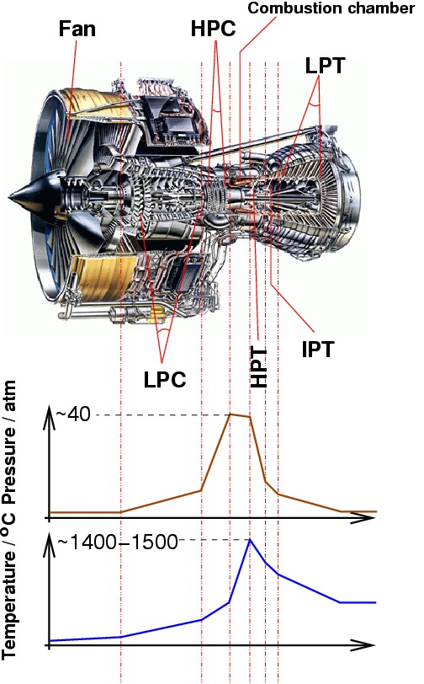
Pressure and Temperature Variation Across a Rolls Royce Trent 800 Engine (Ref. 3)

Slide 54
INTERMETALLIC COMPOUNDS
A Compound formed by Two or More Metallic Elements
The bonding is by Metallic and Ionic Bonds
Similar to Ceramics in Mechanical Properties
Very Hard and Brittle
Present as Dispersoids in Dispersion-Strengthened Alloys
Stand-Alone Materials due to High Temperature Resistance
Stoichiometric Intermetallic Compounds have a Fixed Composition
Nonstoichiometric Compounds have a range of Compositions
Maintain Strength, Develop Ductility at High Temperatures
But Low Ductility at Room Temperature has Impeded Applications

Slide 55
Titanium Aluminides
Developed since 1970
Three major intermetallic compounds:
γ TiAl
α₂ Ti₃Al
TiAl₃

Slide 56
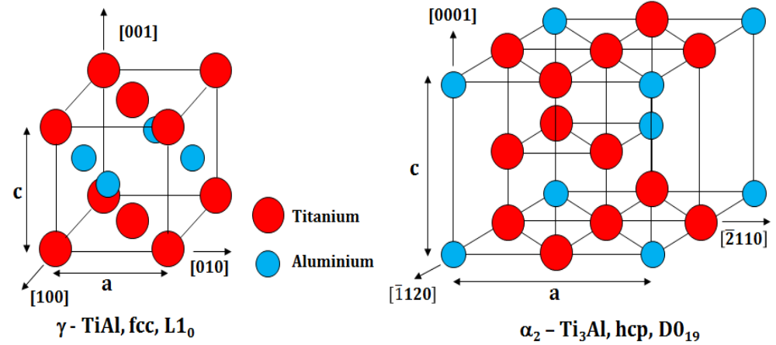
Crystal structures of tetragonal γ-TiAl phase (left) and hexagonal α2 -Ti3Al phase (right). (Ref. 5)

Slide 57
Comparison of titanium aluminides and super alloys (Ref. 6)
Property | Alpha-2 | Gamma | Super alloys
Specific gravity | 4.84 | 4.04 | 8.3
Stiffness (GPa) | 145 | 176 | 207
Max Temp (oxidation) | 705 | 815 | 1090
Room Temp ductility (%) | 2-4 | 1-3 | 3-10
High Temp ductility (%) | 5-12 | 5-12 | 10-20

Slide 58
Alloying Elements for Titanium Aluminides:
Cr, Mn, V (ductility)
Cr, Nb, Ta, Zr (oxidation resistance)
Cr, Ta, W, B (Tensile strength)
Cr, W, Ta, C, Si (creep resistance)
Mo, B (processability).

Slide 59
Depending on the heat treatment and chemical composition, TiAl alloys can exhibit four types of microstructures:
Near-gamma
2. Duplex
3. Near lamellar
4. Fully lamellar

Slide 60
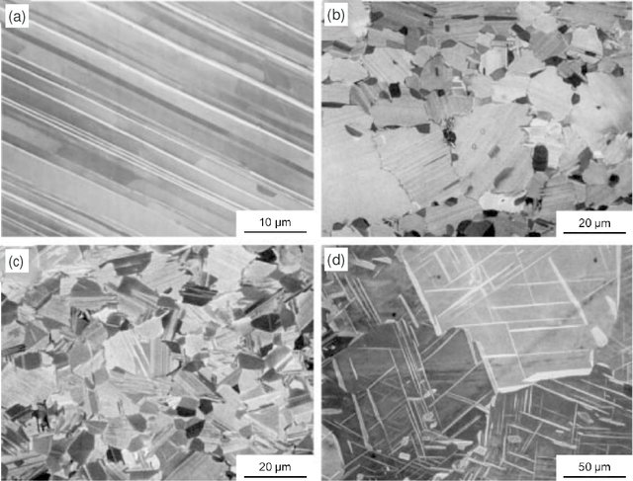
Typical microstructures of TiAl-based alloys: full-lamellar microstructure (a), near-lamellar microstructure (b), duplex microstructure (c), single γ-phase (d) (Ref. 9)

Slide 61
NICKEL ALUMINIDES
The NiAl intermetallic has several advantages over super alloys:
The density is lower.
Thermal conductivity is 4 to 8 times higher.
The melting point is significantly higher.
Excellent oxidation resistance.
The simple ordered BCC derivative crystal structure offers potentially easier plastic deformation compared to many other intermetallics
Lower DBTT (Ductile Brittle Transition Temperature) compared to other intermetallics
Easy processability by conventional melting, machining and powder processing.

Slide 62
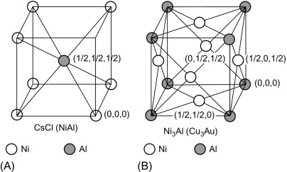
Crystal Structures of NiAl (Body centered) and Ni₃Al (Face Centered) (Ref. 12, 13).

Slide 63
Composites with Intermetallic Matrices
Two Approaches:
Matrix toughening by adding a ductile refractory metal
Adding ceramic particles or fibers, increasing the fracture toughness and high temperature creep strength

Slide 64
Reinforced Titanium Aluminides
Molten TiAl is very reactive. The reaction products act as contaminants.
Al₂O₃, Y₂O₃, ZrO₂ : oxide particle reinforcements
High strength, high modulus SiC fiber reinforcements
Titanium carbide, Titanium boride: dispersion strengthening
Carbon fibers coated with graphene: strengthening and toughening
Laser Engineered Net Shaping (LENS) process: layered manufacturing process; laser processing fine powders into 3-D components directly from a CAD design. Manufacturing Innovation!

Slide 65
Reinforced Nickel Aluminides
Single crystal NiAl have very high creep strength but they lack toughness.
Composites with NiAl matrix can achieve a proper balance between strength and toughness.
(a) NiAl based DSU (Directionally Solidified Eutectics) with Cr-Mo
(b) AlN strengthening of NiAl by ‘cryomilling’
Ni₃Al dispersion-strengthened with 2.5% Al₂O₃

Slide 66
Ceramic Matrix Composites (CMC)
Seishi Yajima invented SiC fiber in the 1970s
Takemi Yamamura commercialized the process at Ube Industries.
Hiroshi Ichikawa commercialized it at Nippon Carbon
Several ‘generations’ of SiC fibers have been developed.
CVD-derived fibers: depositing SiC from gaseous precursors on a C or W monofilament core, good for metal matrices
Pyrolysis of organosilicon precursor filaments: good for fabrics
‘Tyranno’: UBE Industries
‘Nicalon’ : COI Ceramics
‘Sylramic’ :Developed by Dow Corning, made by COI Ceramics

Slide 67
CMC Preparation
(1) CVI ( Chemical Vapor Infiltration)
(2) SPI ( Solid Phase Infiltration)
(3) PIP (Polymer Impregnation and Pyrolysis)
(4) MI (Melt Infiltration)

Slide 68
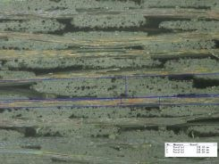
Optical microscope image of a SiC/SiC composite showing the arrangement of the woven fiber bundles and the matrix (Ref. 44).

Slide 69
Environmental Barrier Coatings
An Environmental Barrier Coating (EBC), developed (Ref. (46) to protect the CMC component surface from recession, consists of three layers:
A silicon layer adjacent to the CMC
A transition layer composed of a mixture of mullite (2 Al₂O₃ + 3 SiO₂) and barium strontium alumino-silicate (BSAS)
A protective layer of stoichiometric BSAS (25 mole% BaO + SrO, 25 mole% Al₂O₃, 50 mole% SiO₂).

Slide 70
Concluding Comments
Material Innovations: Super Alloys (DS, SC, MA, TBC, etc.)
Intermetallics (Titanium Aluminides, Nickel Aluminides)
CMCs
Design Innovations: Blade Cooling Channels
Manufacturing Innovations: DS, SC alloys
Machining Blade cooling channels

