Slide 1

Greetings & Hello to everyone!
Welcome to my presentation!
I am Ram Shanmugam
Please send comments to:
  Dr. Ram Shanmugam
  Professor, School of Health Administration
  Texas State University, 601 University Drive
  San Marcos, TX 78666, USA
  E-mail: rs25@txstate.edu
  Office phone: (512) 245 9772 Fax: (512) 245 8712

Slide 2
Topic of my presentation is Shortage, Illegal Trade, and Unmet Demand of Organ or Tissue Transplant
Some of these are published in an article:
Ramalingam Shanmugam (2015) Journal of Epidemiology & Community Medicine, 1, 1, page 1-9.
What is organ or tissue transplantation?
It is replacing a person’s damaged or absent organ by an organ from a living or deceased person.
The regenerative medicine allows sometimes to grow tissue from the person’s own stem cells.
Organs or tissues that are transplanted within the person’s body are called auto grafts.
Transplants that are performed between two subjects of the same species are called allografts.

Slide 3
A selective history
The first and earliest historical transplant was auto grafted skin in nose reconstruction called rhinoplasty by an Indian surgeon Sushruta in the 2nd century B. C.
Other noteworthy transplants and their time are now summarized.
In 1905, a Czech Surgeon, Eduard Zirm performed the first successful cornea transplant.
In 1950, an US surgeon, Richard H. Lawler performed the first successful kidney transplant.
In 1967, the first successful heart transplant was done by a South Africa’s surgeon Christian Barnard.
In 2005, an Indian surgeon, P. N. Mhatre did the first successful ovarian transplant.
In 2008, the first baby was born from a transplanted ovary by US gynecologist Sherman Silber. The donor was her twin sister.

Slide 4
What are popular transplants?
Popularly transplanted organs are heart, kidneys, liver, lungs, pancreas, intestine, and thymus.
Commonly transplanted tissues are bones, cornea, skin, heart valves, nerves and veins.
Tissue is procured from those who experienced brain death or cessation of heartbeat.
Unlike organs, tissues are stored for a short duration, up to five years.
The American Association of Tissue Banks estimates that a million tissue transplants occur each year in the United States of America (USA).
Bone marrow is a flexible tissue in the interior of bones. Bone marrow constitutes a four percent of the total body mass of humans, supporting the body’s immune system.

Slide 5
A selective history (continues)
There are about 25 million people are listed as bone marrow donors worldwide.
A practical difficulty in transplants is the recipient’s body rejection of organ/tissue due to antigens.
This is resolved using a technique called serotyping, which checks the matching between the recipient and the donor.
The World Health Organization (WHO) announced that about 66,000 kidney transplants, 21,000 liver transplants and 6,000 heart transplants were performed globally in 2005.
Still, there is a severe shortage of organs or tissues. A purchase or sale of illegal organs from live donors is prohibited in many countries.

Slide 6
Stumbles for transplant
For a variety of reasons, thousands of persons are waiting for organ transplant.
This number has been rising globally over the years, while the number of donors is quite stable.
The supply of organs comes from the living or dead persons on voluntarily basis. Of course, the number of donors is trailing far behind the demand for organ transplant.
The awareness to donate organs to use ought to increase so that their gap narrows.
There might be cultural, religious, ethnic, or economic stumbles for not many donated organs for transplant.
At the same time, one wonders whether the demand for organ increases due to deteriorating health among world citizens due to environmental, genetic, or poor quality life practices.
A promotion of healthy living might reduce the need for organ transplant.

Slide 7
Facts
For a lack of organs, about 22 people die every day.
An average of 81 transplants occurs every day in USA. Another person is added to the waiting list in every 10 minutes.
About 123,000 people are waiting for an organ transplant. The year 2014 was a record- breaking year for the number of transplants performed and the number of deceased donor transplants.
In 2014, about 29,532 transplants occurred.
Only 23,715 transplants were from deceased donors.
About 3,500 heart transplants are performed annually worldwide. The majority of these (about 2,300) are performed annually in the USA.

Slide 8
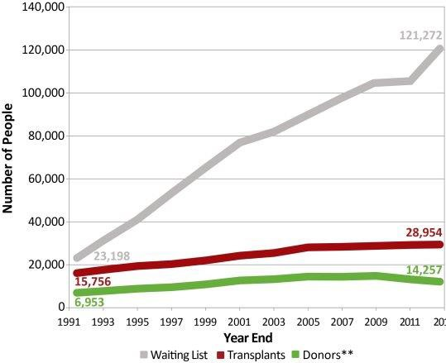
Additional facts and interpret
A single lung transplant takes about eight hours, while a double lung transplant takes about twelve hours to complete.
A heart-lung transplant is carried out to replace both heart and lungs in a single operation.
The figure 1 illustrates that there is a wider gap between the number waiting for organ and the number donors of organ.

Slide 9
An explanation
The number of persons who received transplants is more than the number of donors.
Does this hint out the under-reporting of data occasionally, family members or friends to alleviate the suffering of loved ones donate organs and it may be not reported.
The number waiting for organ transplant is much higher than the number of organ donors and it suggests a shortage for organ transplant.
The number of organ donors is lesser than the number of recipients and it suggests that there must have been illegal organ trade [2].
The number waiting for organ transplant is higher than the number of recipients and it suggests the existence of unmet demand.

Slide 10
Hence,
We develope a statistical methodology to extract and interpret data information and then compute a confidence interval for
  shortage,
  illegal trade, and
  unmet demand
  with respect to organ transplantation.
About 80 percent of all organs are donated and used in the same geographic area.
Many patients travel to countries, where organs are obtainable through commercial transactions.
The unlicensed international organ trade is forbidden.

Slide 11
What does WHO mention?
World Health Organization (WHO) urges nation to protect poor and vulnerable groups from undue exploitation of organ/tissue theft.
Medical tourists travel to poor countries seeking cheap and illegal organ purchase.

Slide 12
Evidences
The number waiting for organ is about 700 percent more than the number of donors, which is only 46 percent of the number of recipients.
How is that more recipients exist than the number of donors.
The number of donors must have been under- reported.
Close relatives or friends could have donated organ to wipe out the suffering of those recipients. Such a donation is legal but should be reported.
Questions:
  Q1: The gap between the number of donors and the number of recipients is the data evidence for the existence of illegal transactions of organ trade. Is the gap statistically significant?
  Q2: The gap between the number waiting for organ and the number of donors is shortage of organs for transplant. Is it statistically significant?
  Q3: The gap between the number waiting for organ and the number of recipients indicates an unmet demand for organ transplant. Is the gap statistically significant?
  Q4: Conditional on the removal of illegal organ trade (that is, YR = YD ), what might be the expected and volatility of organ shortage?

Slide 13
To understand data information,
First step is an appropriate model for the data.
What is a model?
Model is an abstraction of reality.
Statistical methodology is constructed based on the model.
Benefits are:
  For the importance of policy changes to encourage organ transplantation.
  The beneficiaries of organ transplantation would certainly have a higher quality life.

Slide 14
Notations & model
YW , YR , and YD represent the number of persons waiting, the number of recipients, and the number of donors respectively.
Because of the large data size and the well-known central limit theorem, the random vector Y follows a trivariate Gaussian distribution

Slide 15
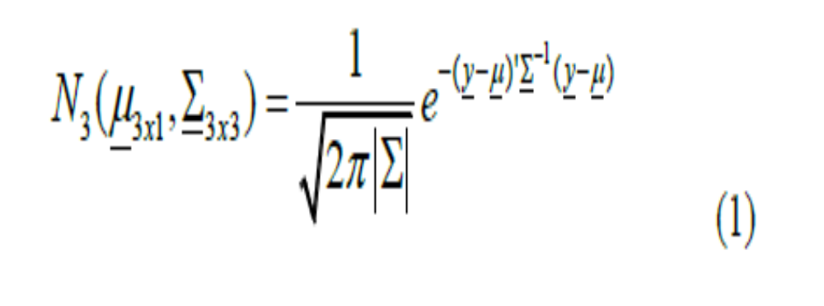
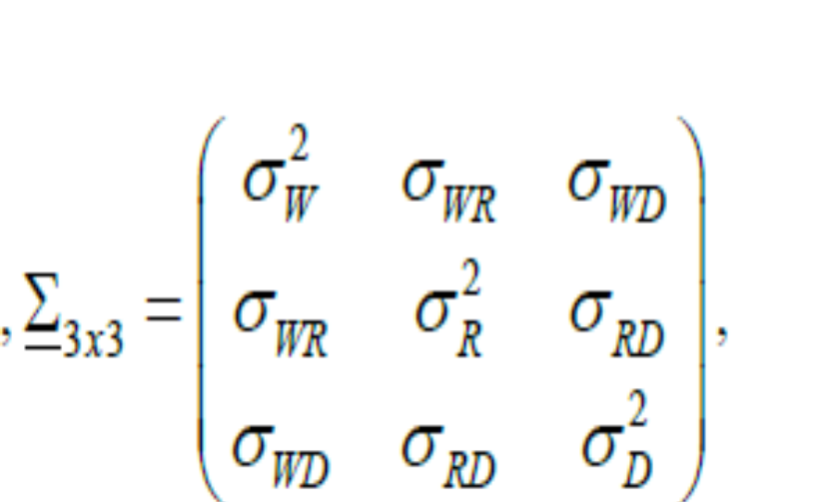
Trivariate Normal

Slide 16
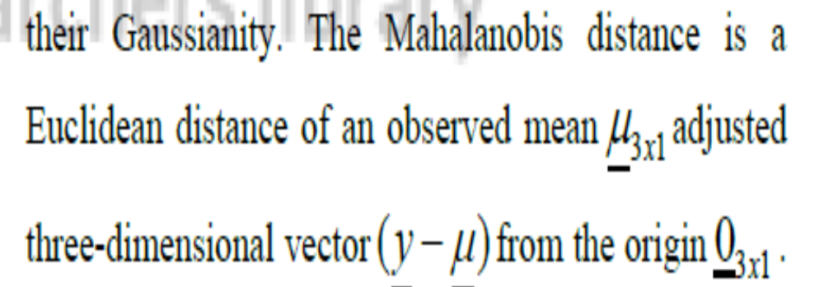
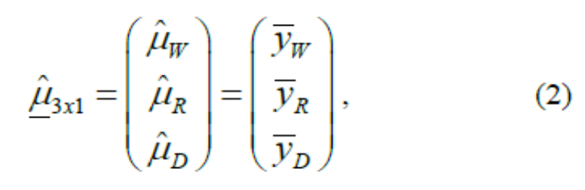
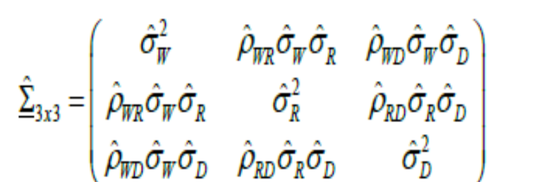
Mahalanobis distance
MLEs

Slide 17
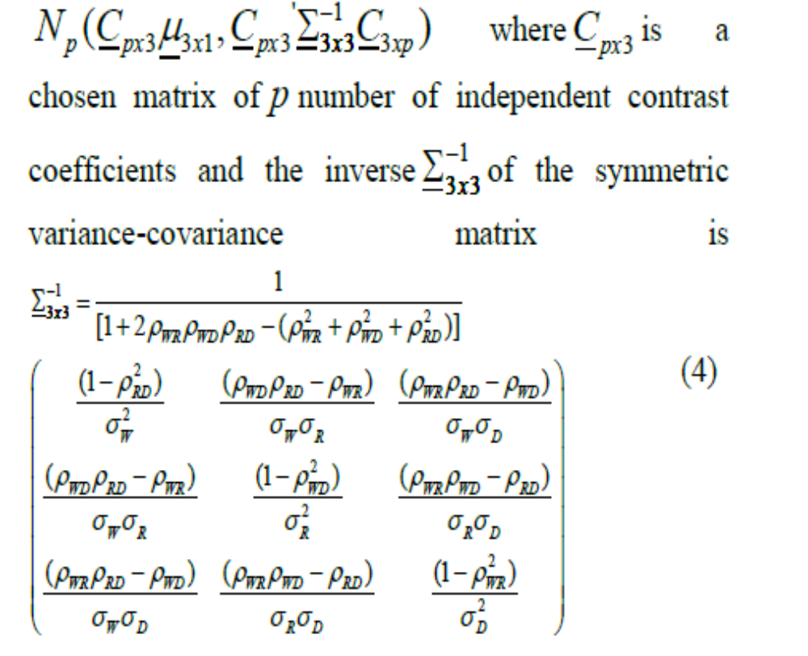
How to answer the questions?
To answer the questions, we need to develop a new statistical methodology.
For this purpose, let us provoke a statistical property of multivariate Gaussian distribution.
That is, a contrast transformation, G = CY follows a multivariate Gaussian,

Slide 18
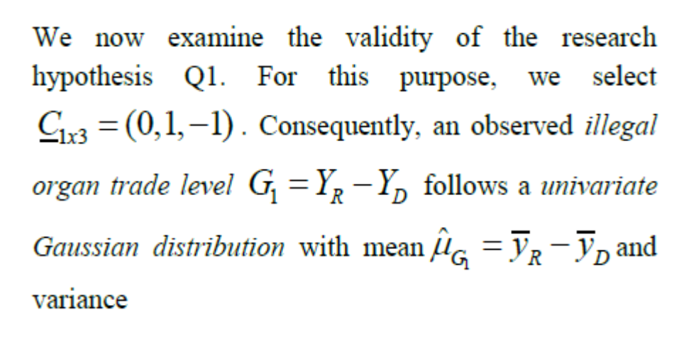
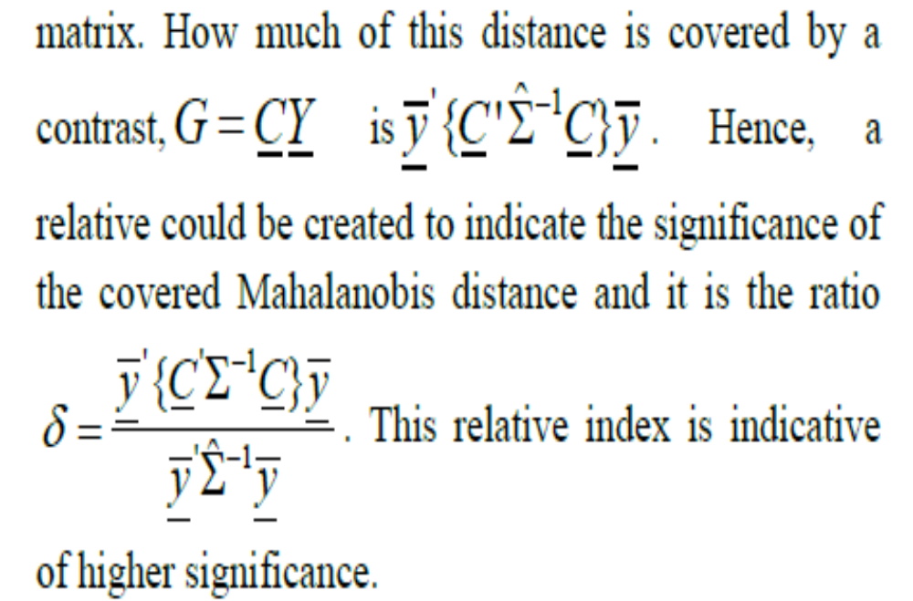
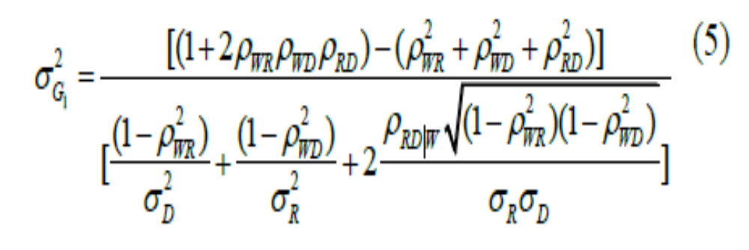
Making results for the gaps

Slide 19
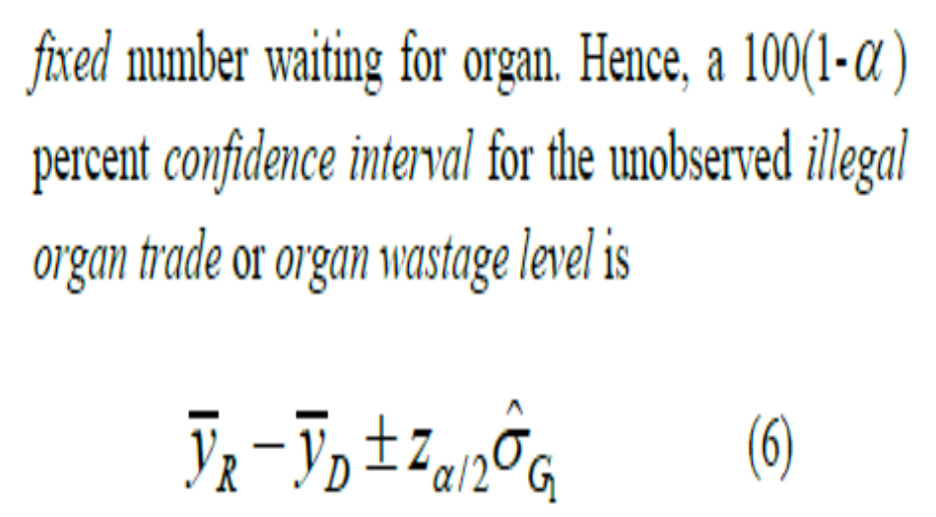
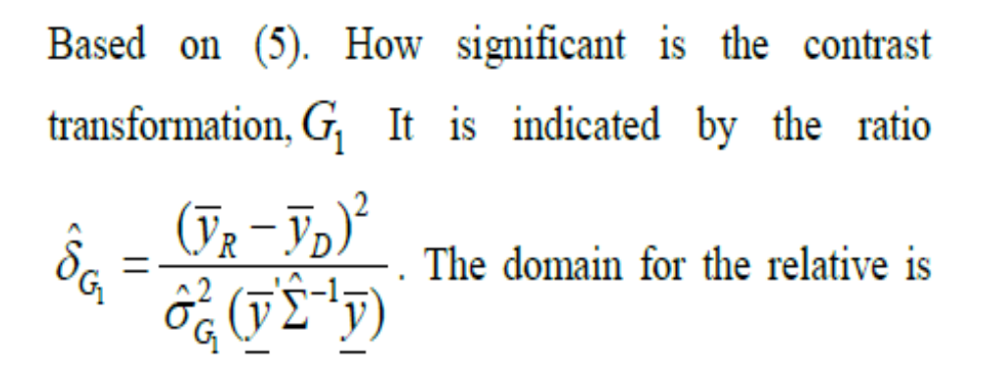
Confidence interval for illegal organ trade

Slide 20
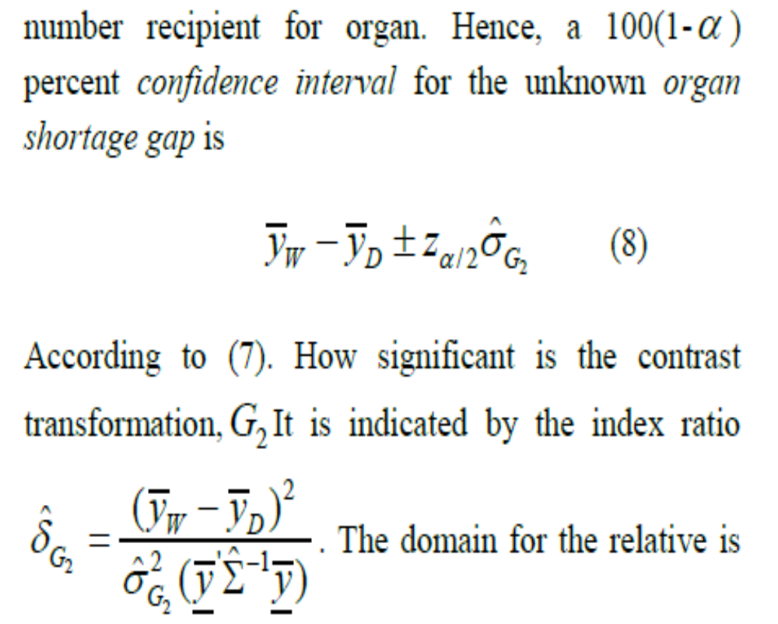
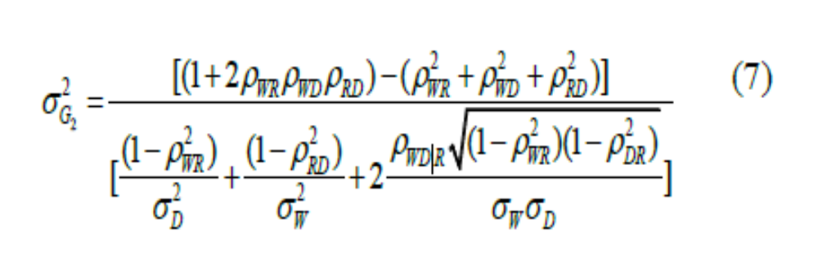
Organ shortage
Where

Slide 21
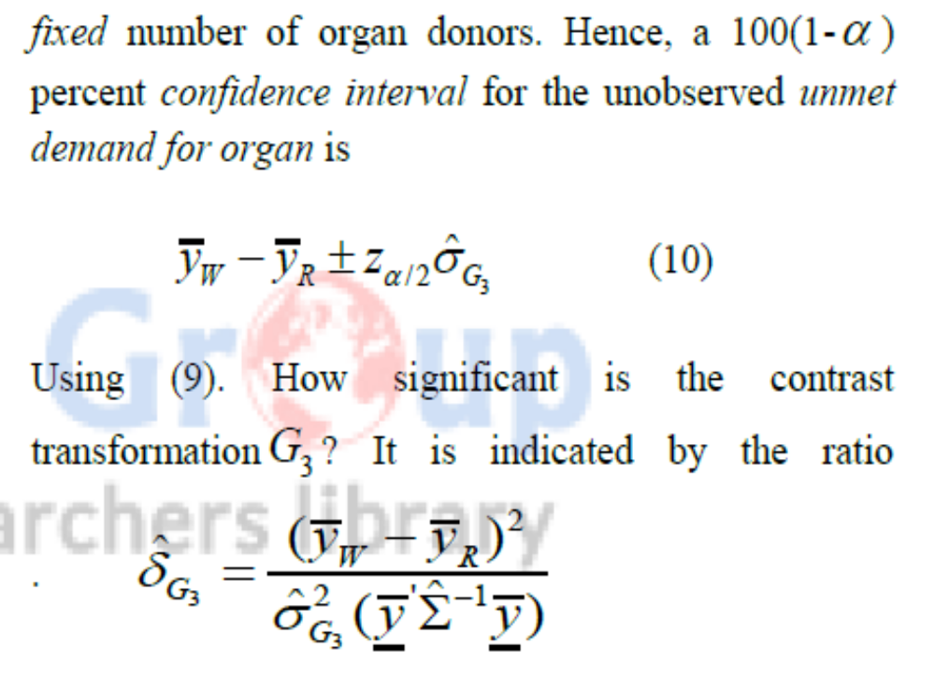
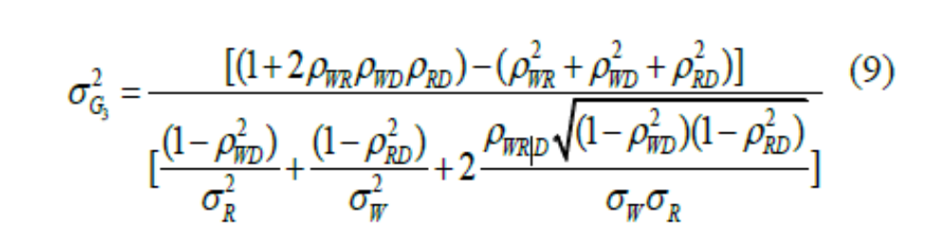
Unmet organ demand
Where

Slide 22
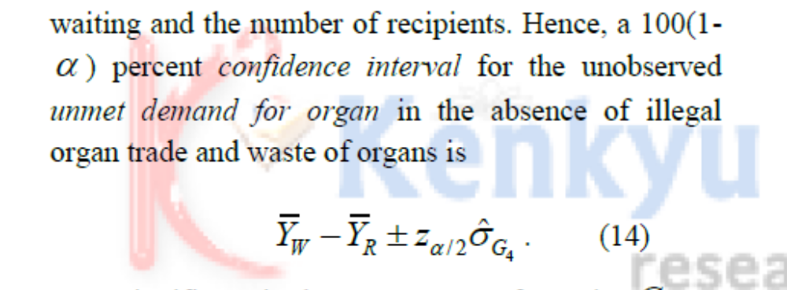
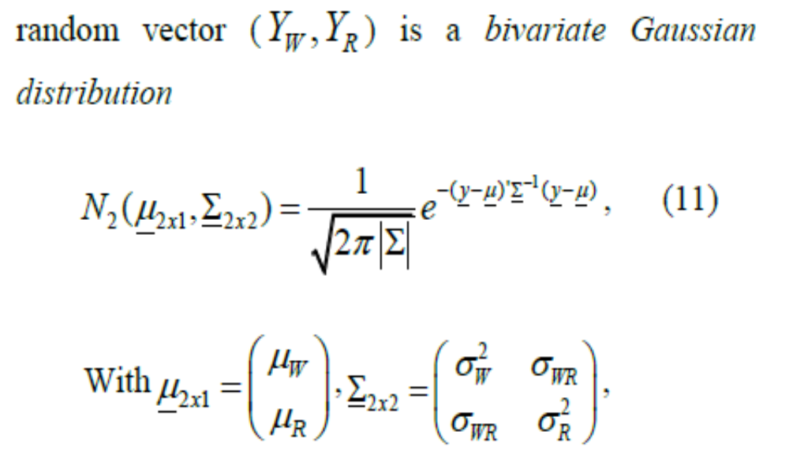
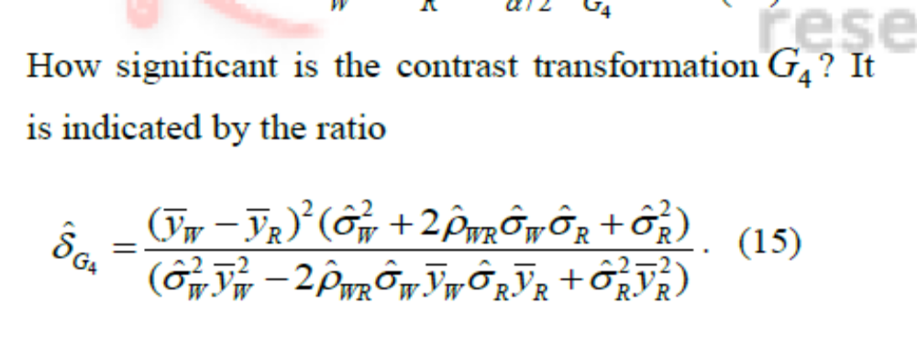
To answer Q4, when

Slide 23
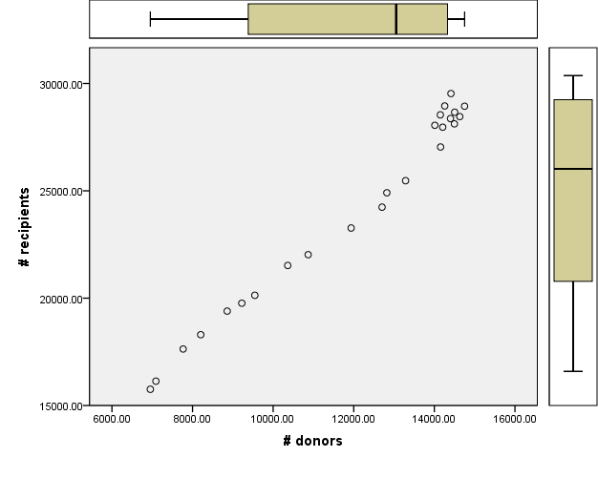
Illustration using WHO data on worldwide transplants during 1991-2013

Slide 24
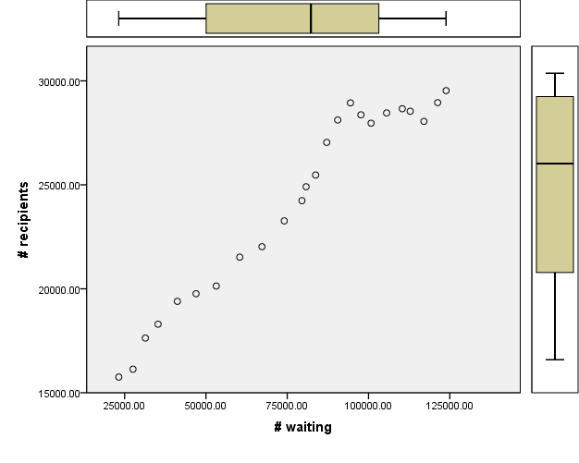
Continues
Correlation | Waiting number, YW | Number of recipients YR | Number of donor, YD
Waiting number, YW | rWW = 1 | rWR = 0.97 | rWD = 0.95
Number of recipients YR | rRW = 0.97 | rRR = 1 | rRD = 0.99
Number of donor, YD | rDW = 0.95 | rDR = 0.99 | rDD = 1

Slide 25
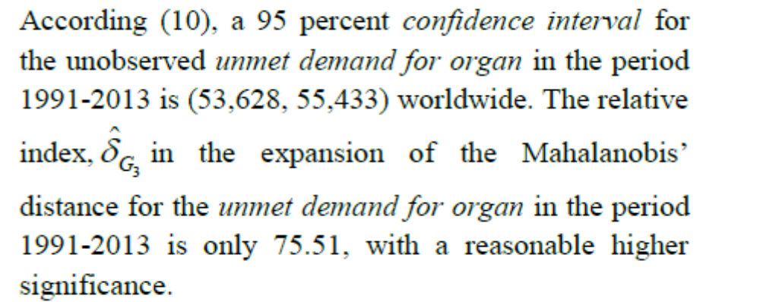
Unmet organ demand

Slide 26
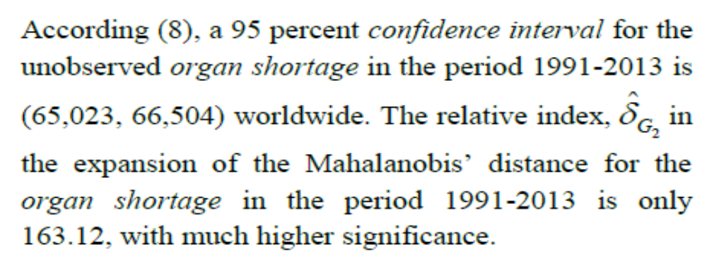
Organ shortage

Slide 27
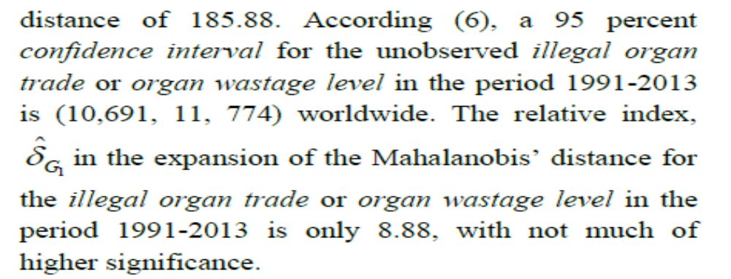
Illegal organ trade

Slide 28
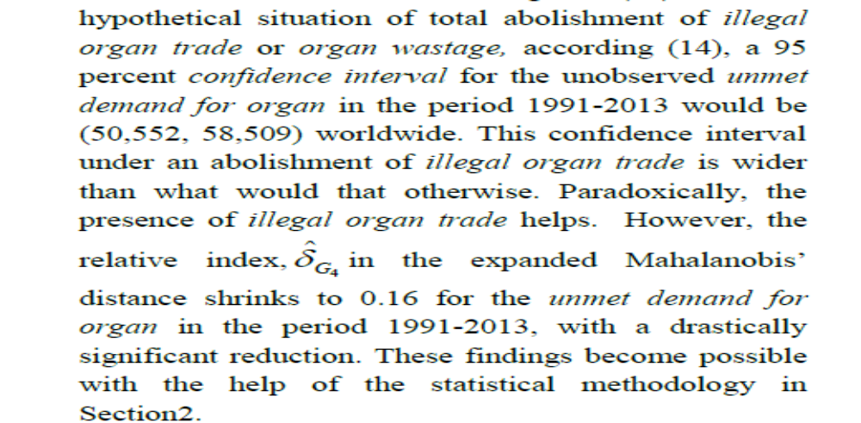
If illegal organ trade is abolished,

Slide 29
In conclusion,
More awareness needs to me made among the potential organ donors about the importance of donating organs.
Worldwide facilities ought to be established and supported to procure organs soon enough from those who unexpectedly die due to accidents or heart attack.
Priorities should be given to air transport the procured organs to the correct destination for transplanting them in those waiting for organs in a world of heavy traffic with congestions.
In addition, stocking and preservation of unutilized organs should be encouraged for future implantation.
The WHO ought to provide a leadership to promote and implement the above mentioned incentives among the nations.

Slide 30
Conclusion continues
Times of India, on 31 July 2015 announced that the Indian Air Force (IAF) allowed its special aircraft, an Embraer, for a unique operation for transporting a kidney and a liver from Pune to Delhi to save the life of two critically-ill patients.
This incidence cites the importance of promoting the importance of a quick air transporting organ or tissue from a remote place to a destination place worldwide.
No forced donation must be allowed.
Humans have a pair of organs. A human can live with just one organ. An illusionary tendency might exist to sell off one of the organ pairs for a high price.
The market value of a kidney, a liver, and a heart are $100,000, $250,000, and $860,000 respectively.

Slide 31

Conclusion continues
Thank you for your attention!
I appreciate your comments!
Please send me your thoughts via e-mail rs25@txstate.edu .
Bye now!!

