Slide 1

IGF-1R: A key linker between chemoresistance and cancer stem cells in epithelial ovarian cancer cells
Ram Kumar Singh, Ankit Jinager, Ajit Dhadwe, Abhijit De and Pritha Ray*
Advanced Centre for Treatment Research and Education in Cancer,
Tata Memorial Centre, Navi Mumbai, India
5th Asia Pacific Summit on Cancer Therapy, 20th – 22nd July 2015

Slide 2
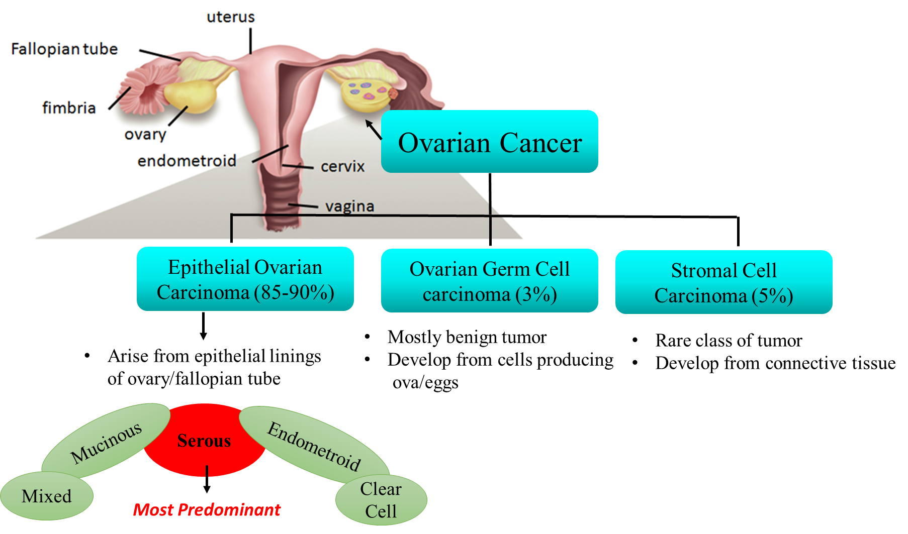
Ovarian Cancer
Ovarian cancer (OC) is the 4th leading cause of gynecological deaths around the world. (Siegel et al., Cancer J Clin, 2012)
As per the Tata Memorial Center, Mumbai’s registry India, it is the third most lethal cancer amongst women.
Types
Germ cell OC (3-5%)
Epithelial OC (85-90%)
Sex-cord stromal cell OC (5-7%)
Subtypes: Epithelial Ovarian Carcinoma
Chemotherapy
Platinum (cisplatin and carboplatin)
Taxane (paclitaxel)
Though the patients show response to 1st line therapy, 50-60 % ultimately exhibit recurrence and finally succumb to the disease.

Slide 3
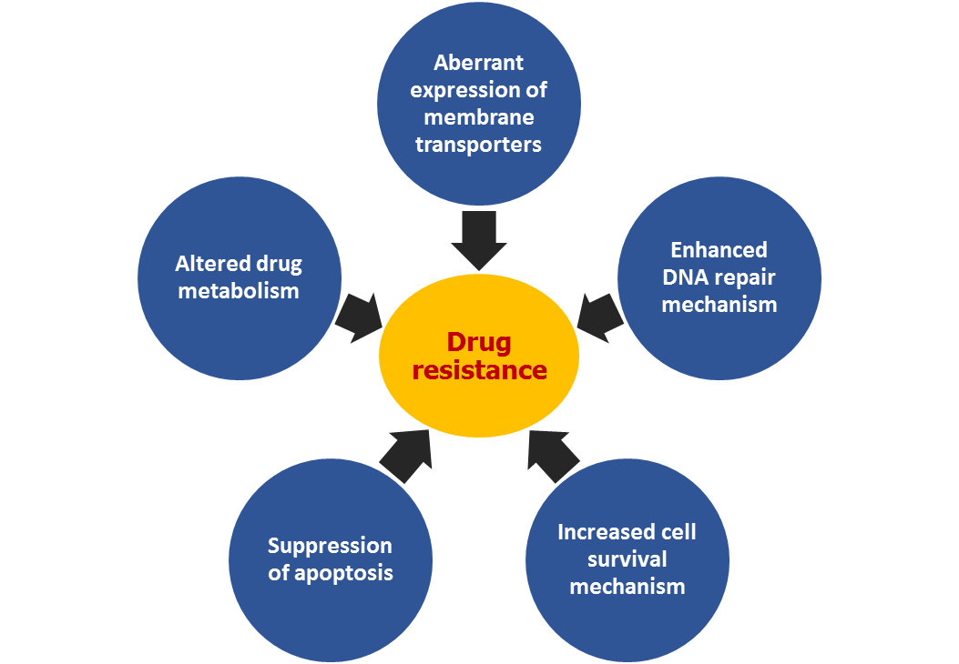
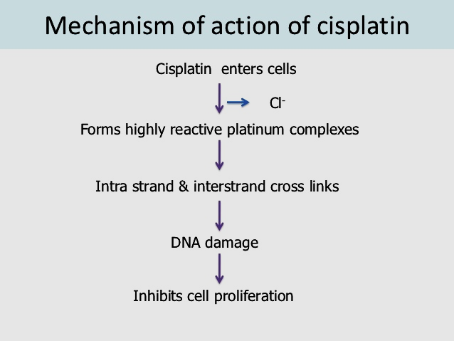
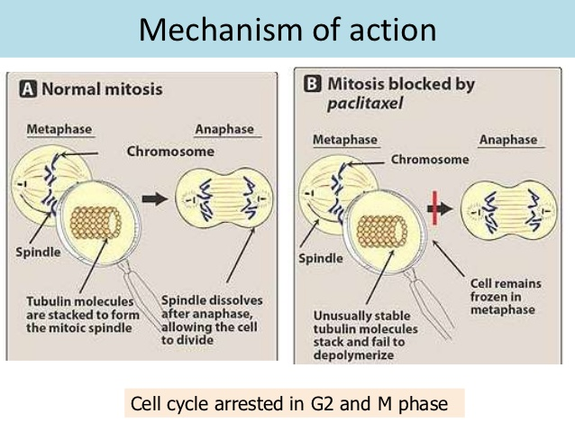
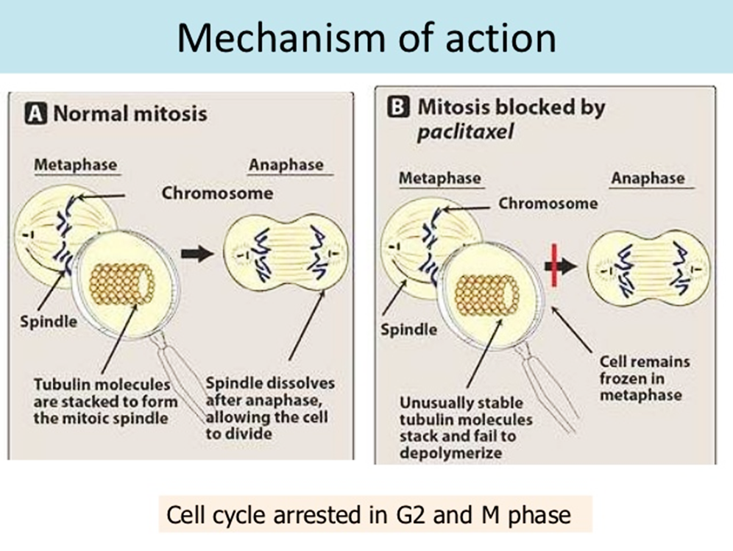
Key players behind drug resistance
There are subset of cells within the heterogeneous tumor designated as cancer stem cells.
These CSCs have high DNA repair efficiency and chemo resistance property.

Slide 4
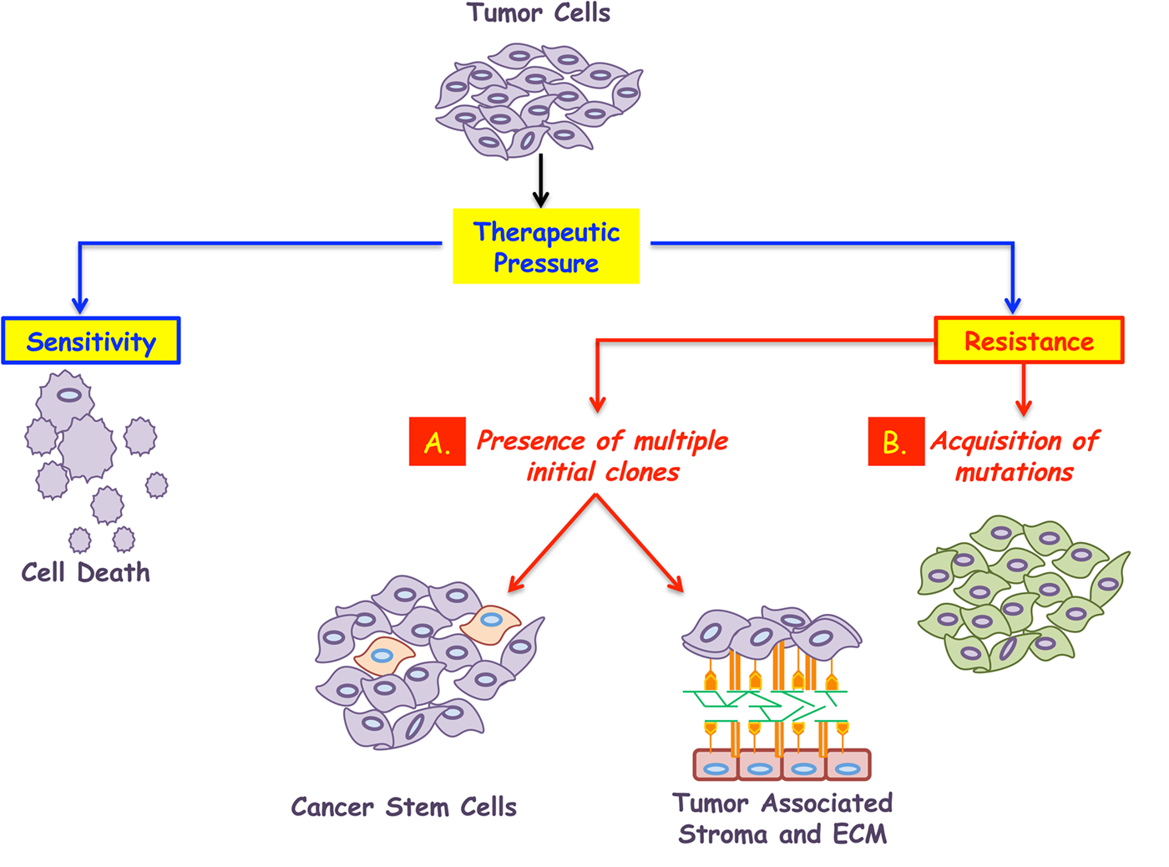
Ovarian cancer and chemoresistance
Ovarian cancer-stem-like side population cells are tumorigenic and chemoresistant.
(Hu et. al., British Journal of cancer, 2010)
In vivo and in vitro studies have showed the role of Insulin Growth Factor -1Receptor (IGF-1R) cross-talk in chemoresistance and have proven that IGF-1R inhibitors can overcome cytotoxic resistance. (Wong et. al., Gynecologic Oncology, 2012).

Slide 5
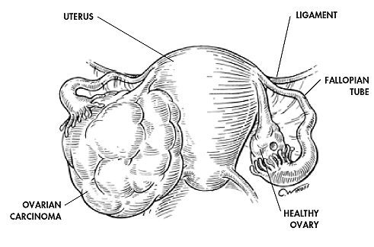
Neoadjuvent therapy
Debulking Surgery
Tumor Relapse
Chemo resistance
Adjuvant Chemotherapy
Tumor Relapse
Early detection of
Chemo resistance
Chemo resistance
Targeting Right population
Cancer Stem Cells
IGF-1R Axis

Slide 6
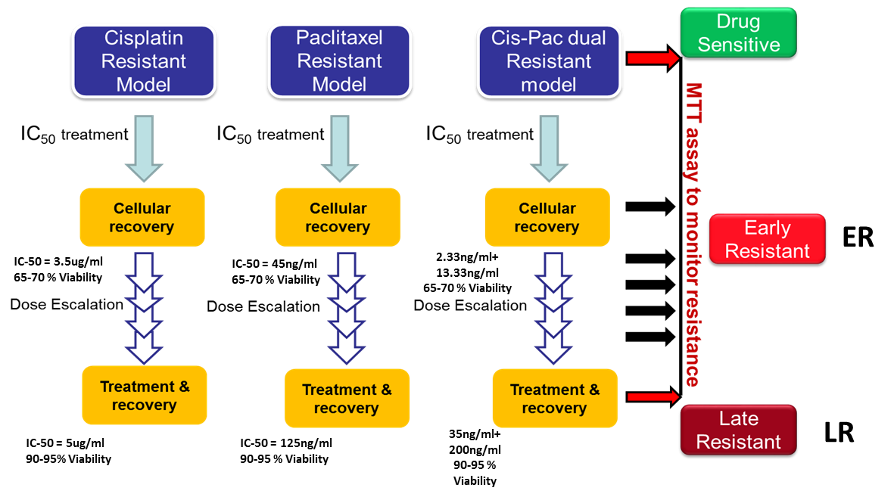
Schematic representation of development of cellular resistant models in A2780 cells

Slide 7
Understanding the role of the biological and molecular players during induction of drug resistance
CSC characterization
SP assay
Biomarker assay
Spheroid assay
Tumor xenograft assay
Cell line used
A2780/APFT
OAW42
SKOV3
Hey

Slide 8
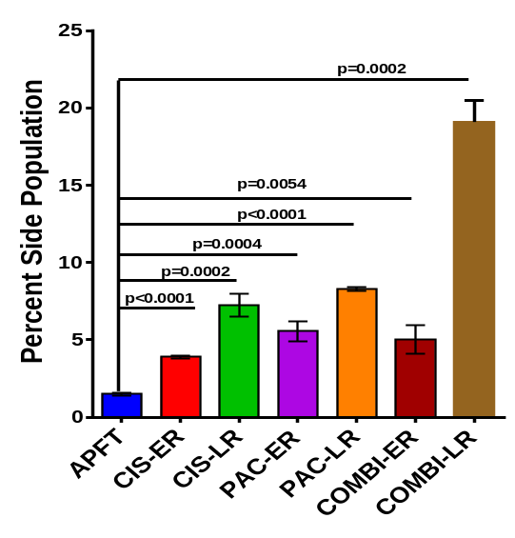
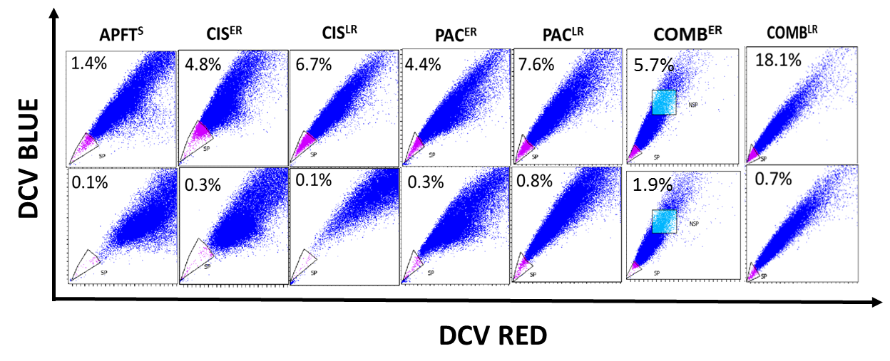
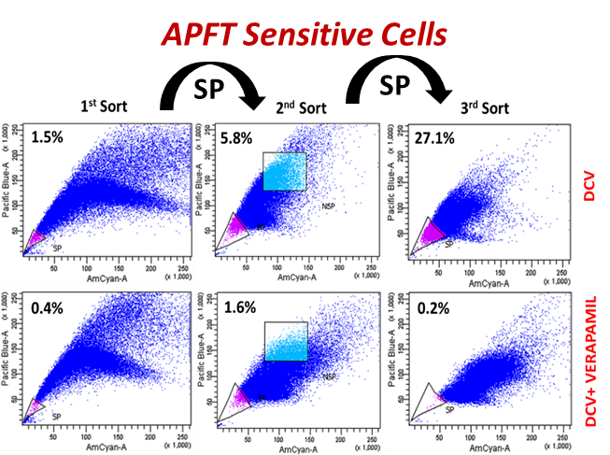
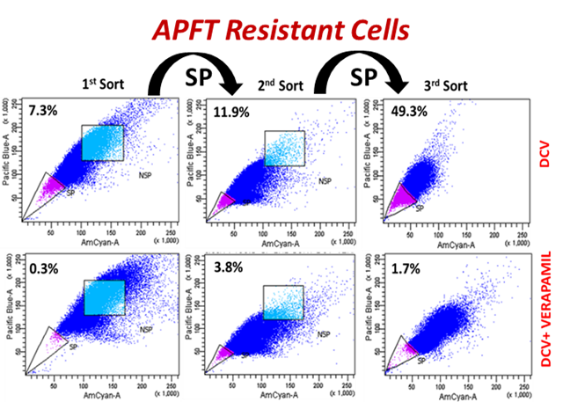
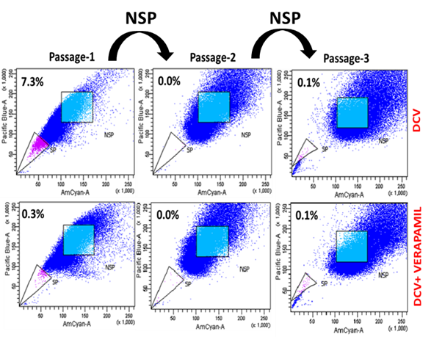
Side population assay
Cisplatin Model
Paclitaxel Model
Combination Model

Slide 9
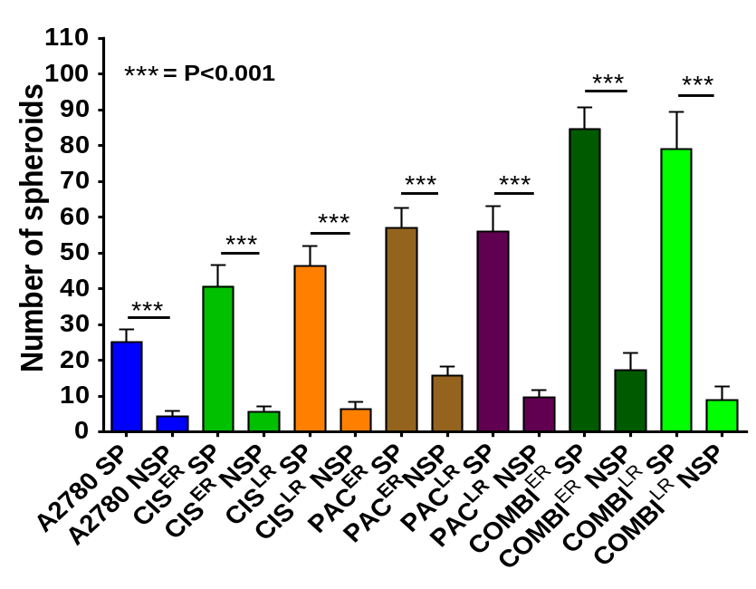
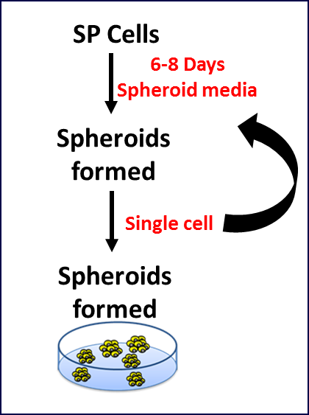
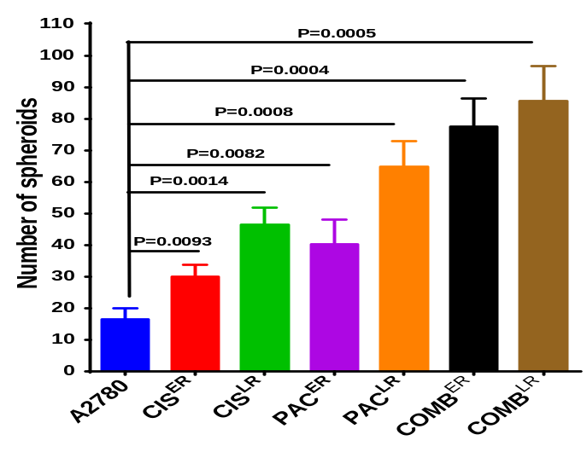
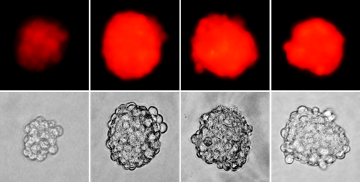
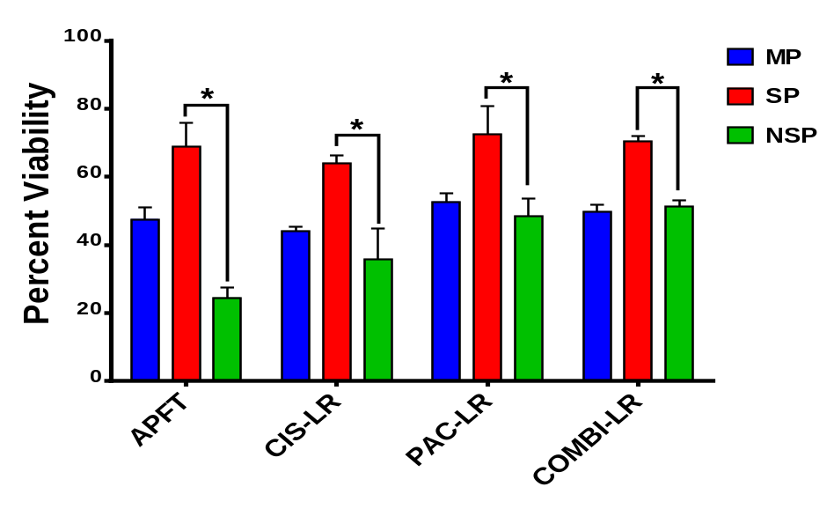
Self Renewal and Chemoresistance Property
A
B
C

Slide 10
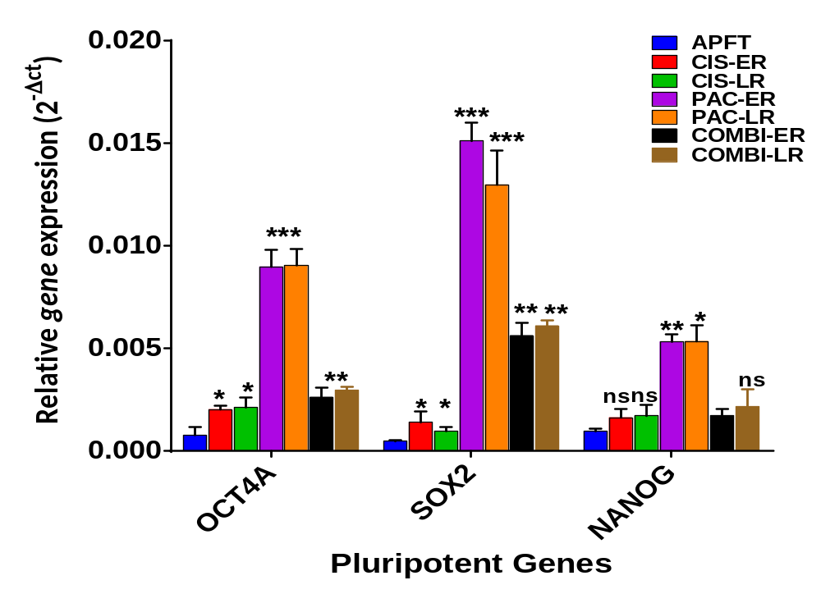
Stemness gene expression across the resistant models

Slide 11
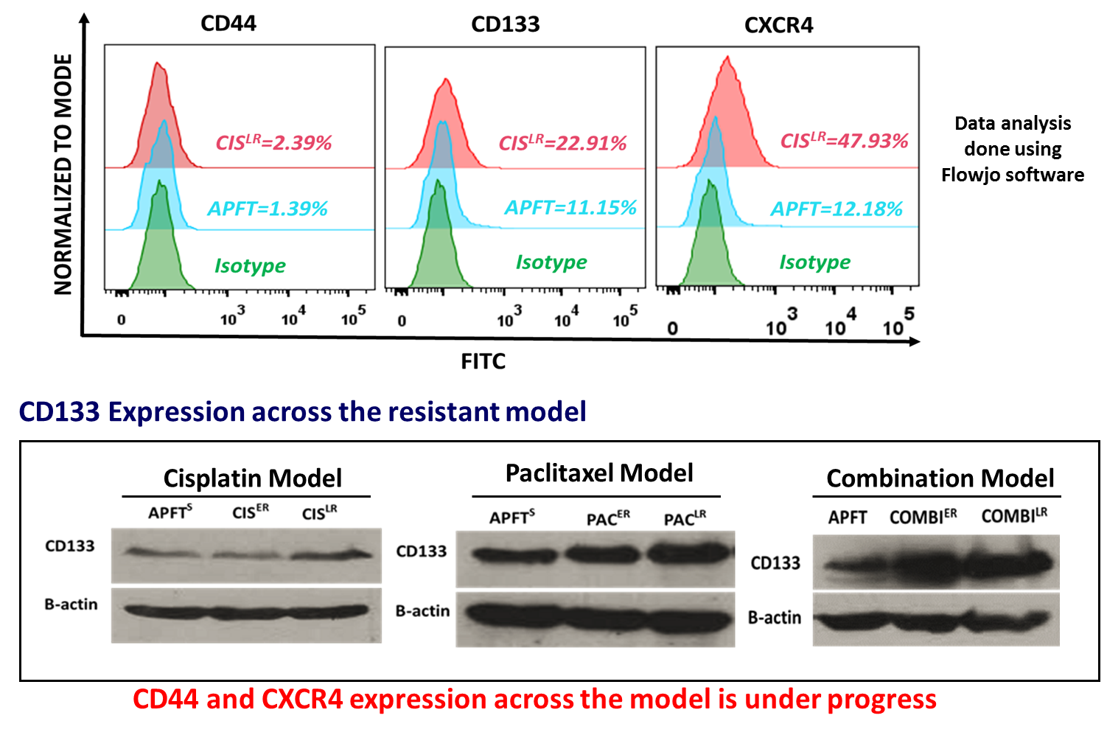
Biomarker analysis across the resistant models

Slide 12
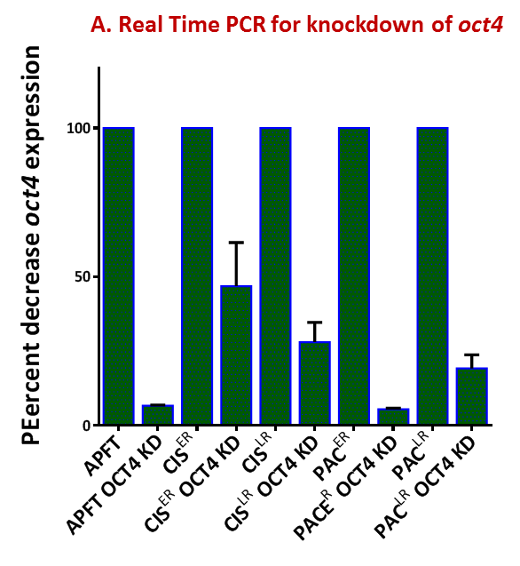
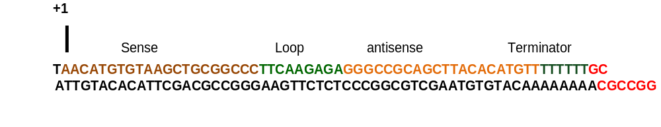
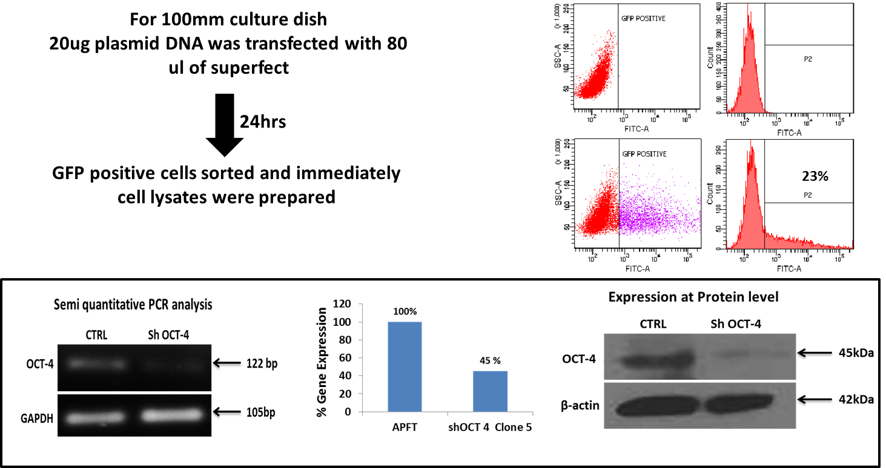
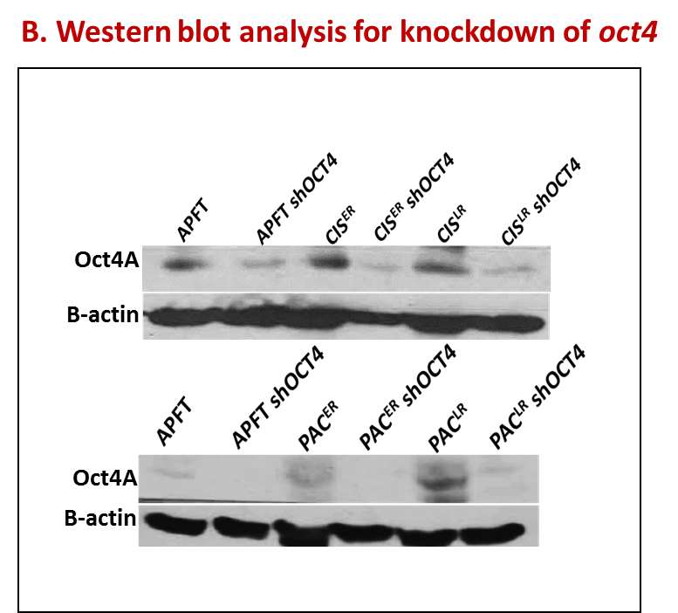
Knock down of Oct4 gene using pll3.7 lentilox vector
Oct4 target Sequence adapted from Zaheres et al, Stem Cells, 2005

Slide 13
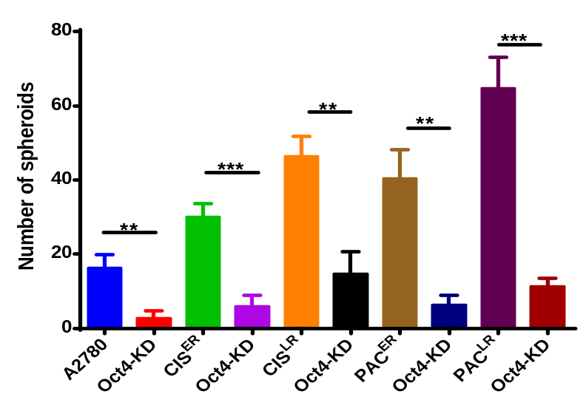
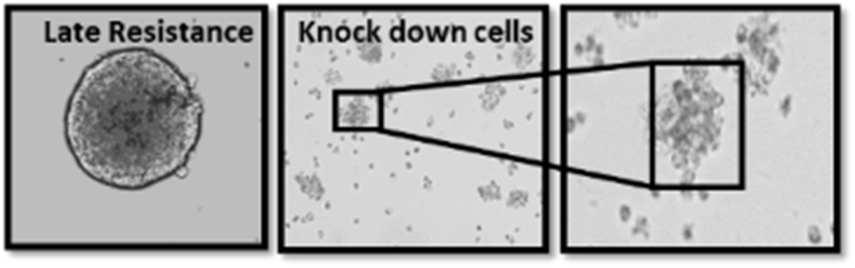
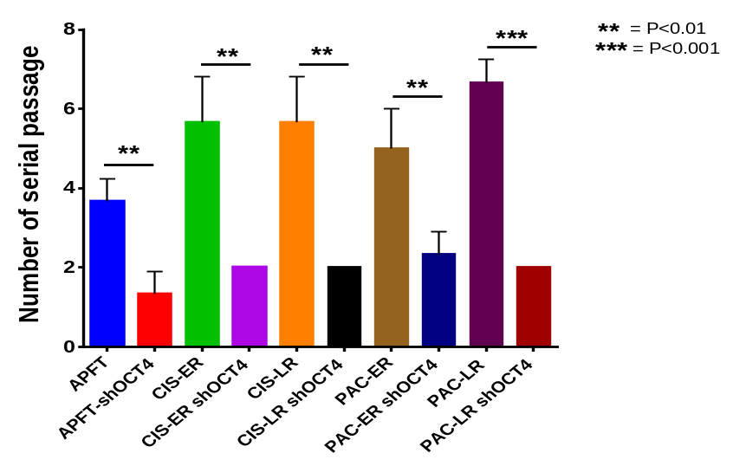
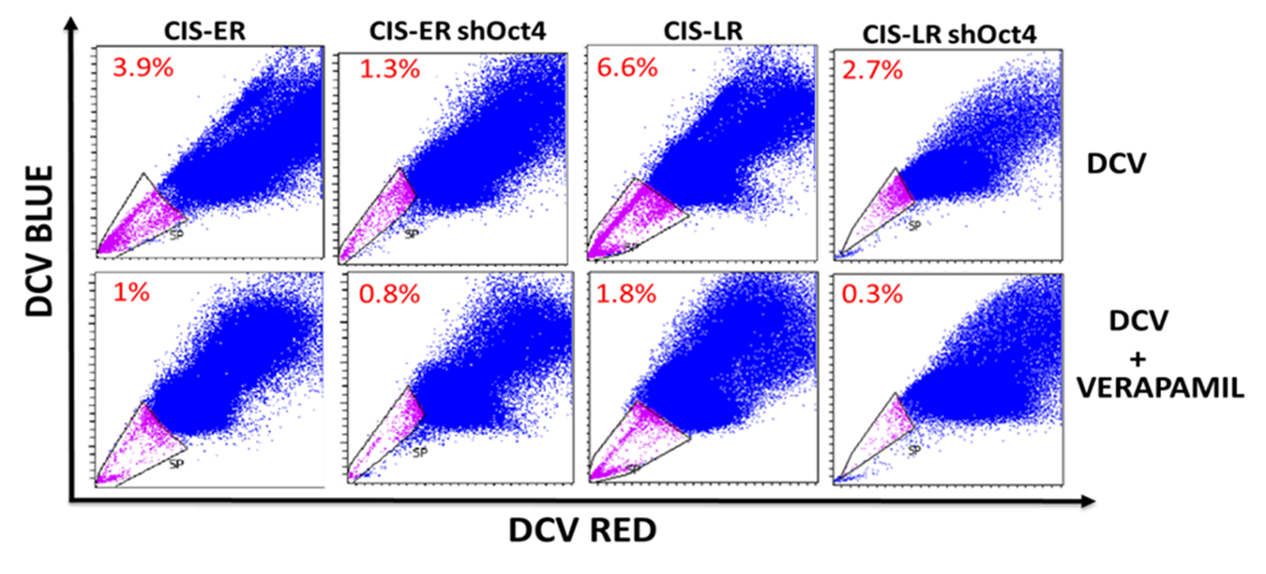
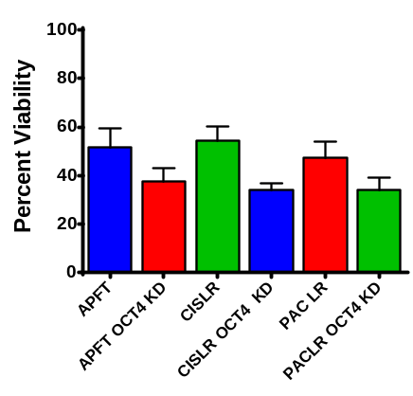
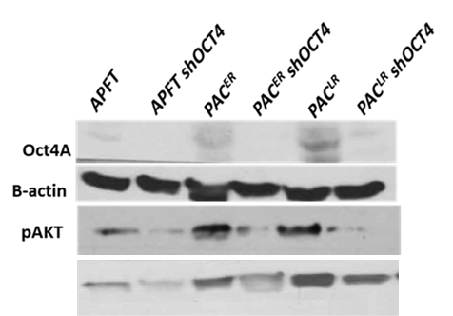

Effect of oct4 KD on its self renewal and drug resistance
A Spheroid formation assay
B Spheroid formation at multiple passage
* P<0.05
** P<0.005
*** P<0.0005
C Oct4 KD and SP phenotype
D MTT assay to monitor drug resistance
E Oct4 KD and P-AKT

Slide 14
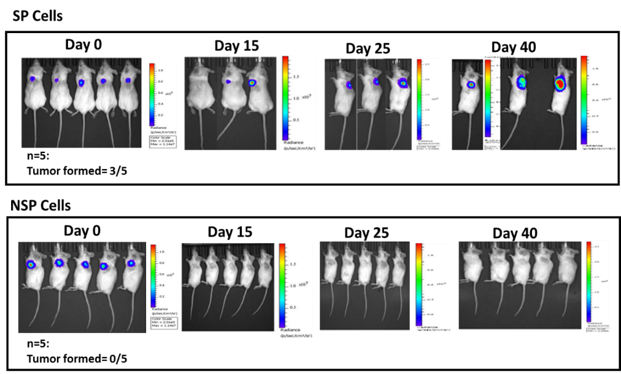
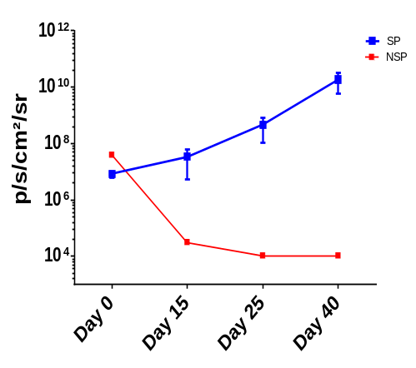
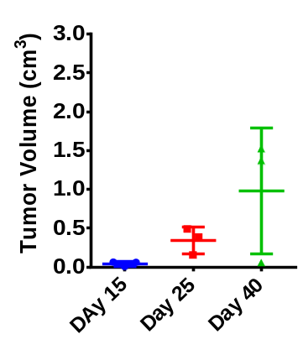
In vivo imaging of PACER SP/NSP cells for tumor formation

Slide 15
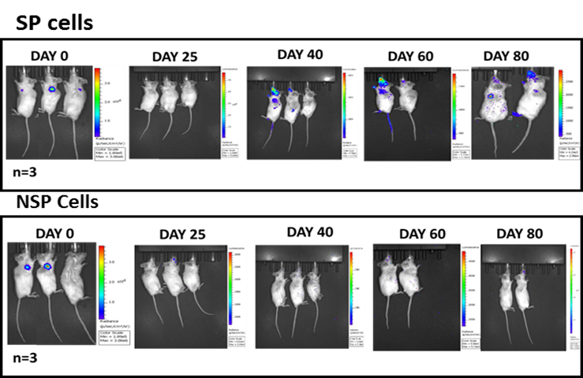
In vivo imaging of PAC^{LR} SP/NSP cells for tumor formation
SP Tumor Xenograft
NSP Tumor Xenograft
p/s/cm²/sr
p/s/cm²/sr

Slide 16
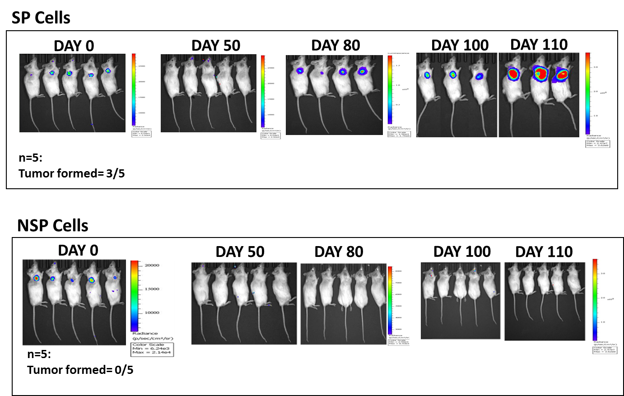
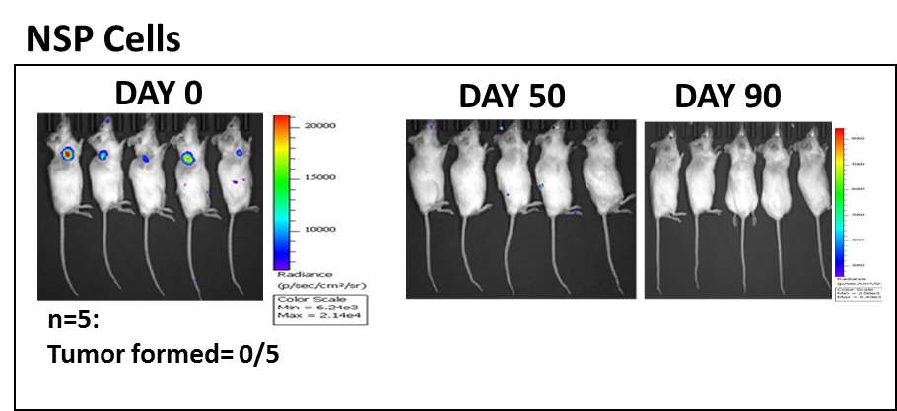
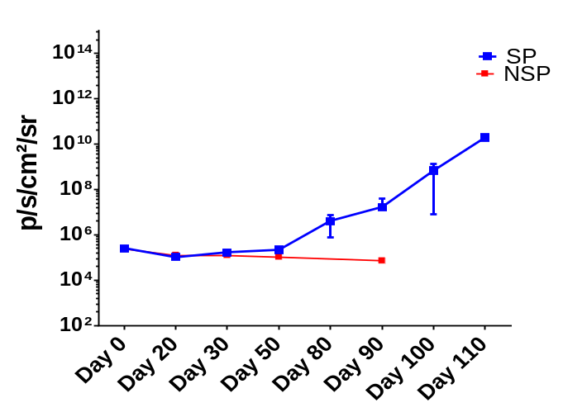
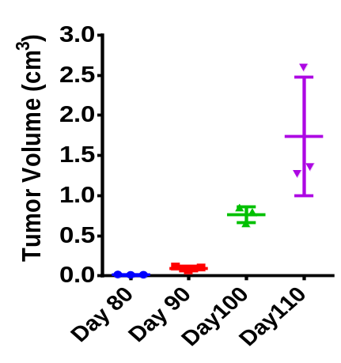
In vivo imaging of CIS^{LR} SP/NSP cells for tumor formation
SP

Slide 17
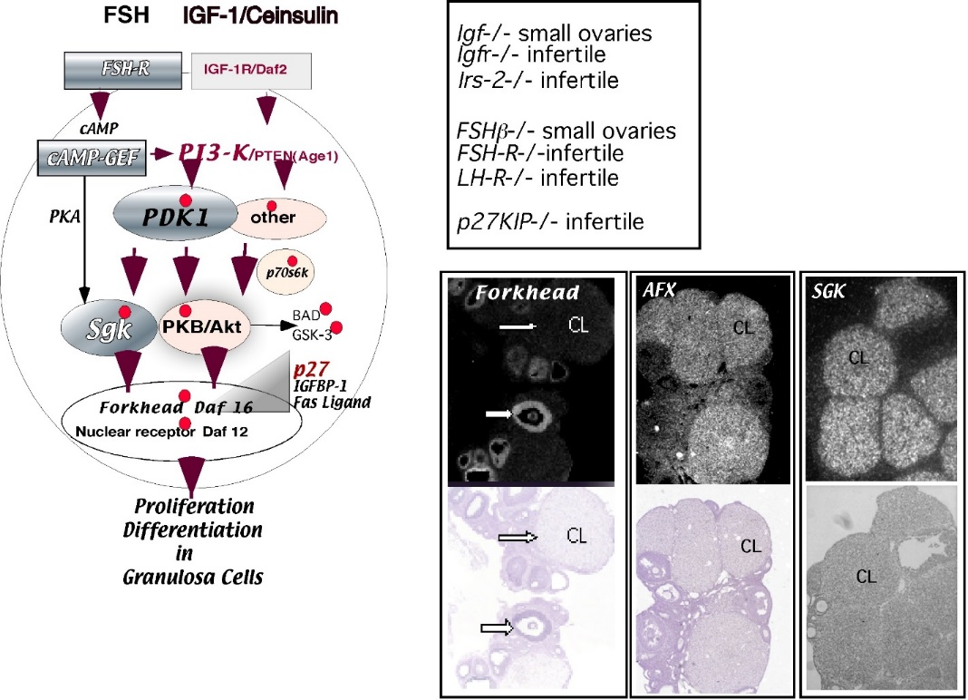
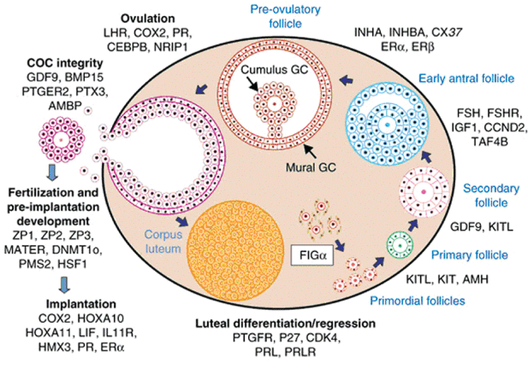
IGF Signaling in ovarian follicular development
Joanne s. Richards et al., Recent Prog Horm Res. 2002
IGF-1 -/- : Small Ovaries
IGF1-R -/- : Infertile
The insulin-like growth factor (IGF) family is an essential growth factor system in the development of tissues or organs and postnatal growth, and maintenance of normal function of many cell types of the body (Li and Geng, 2010).
IGF may sustain the stem cell's capacity of self-renewal and differentiation, promote their survival and migration, and prevent senescence acting downstream to PI3K pathway (Li and Geng, 2010).
Is IGF-1R crucial for initiation and maintenance of resistance
and stemness phenotype in ovarian cancer?

Slide 18
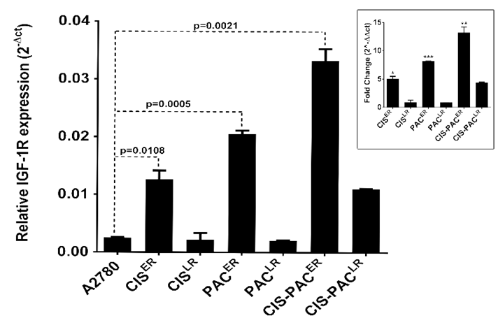
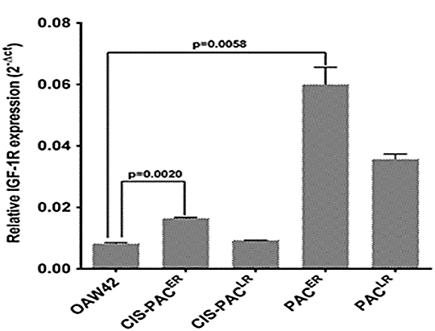

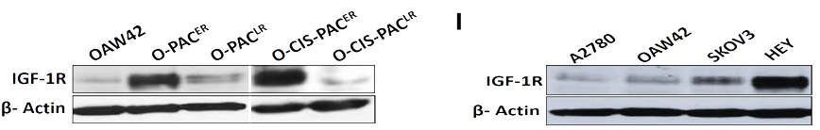
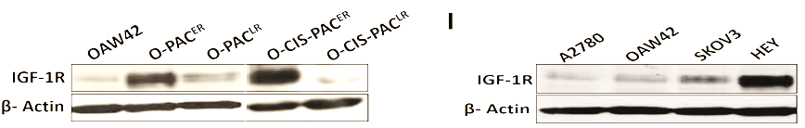
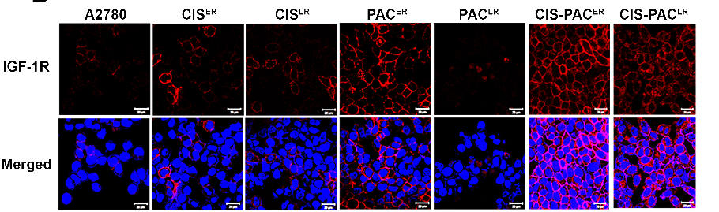
Elevated expression of IGF-1R at early stages of drug resistance
A
B
C
D
Singh et. al., Cancer Letters, 2014

Slide 19
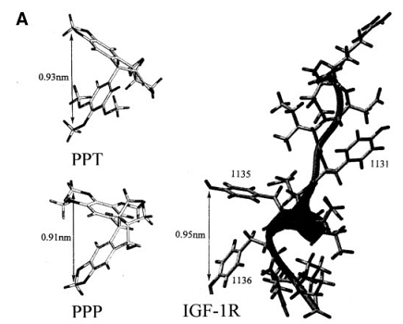
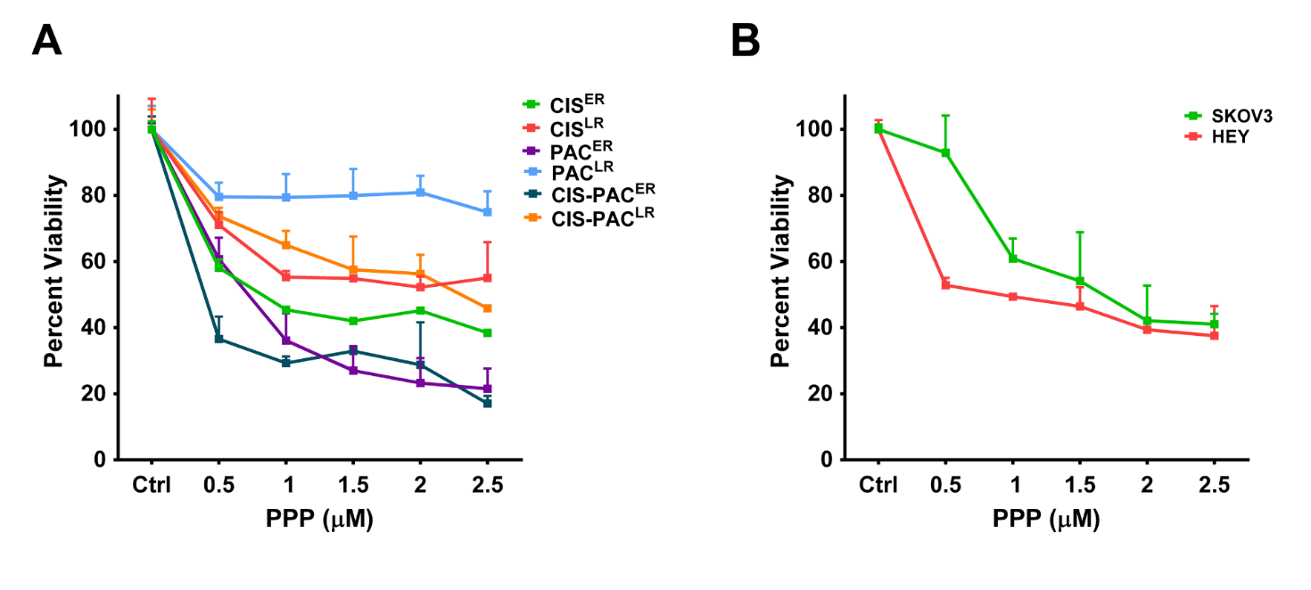
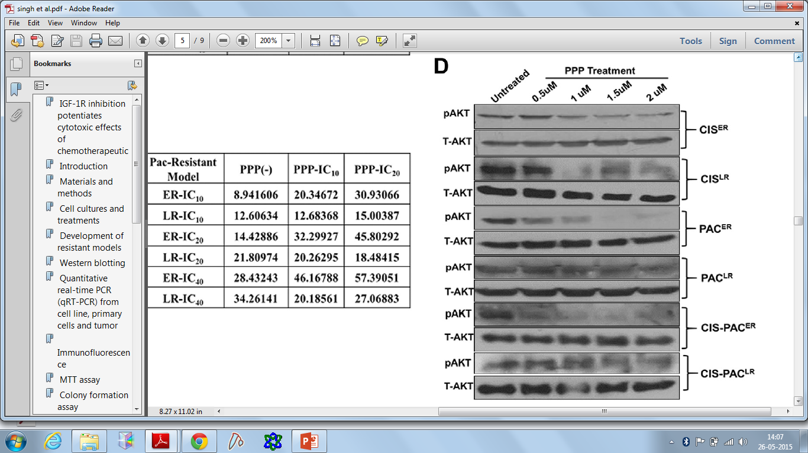

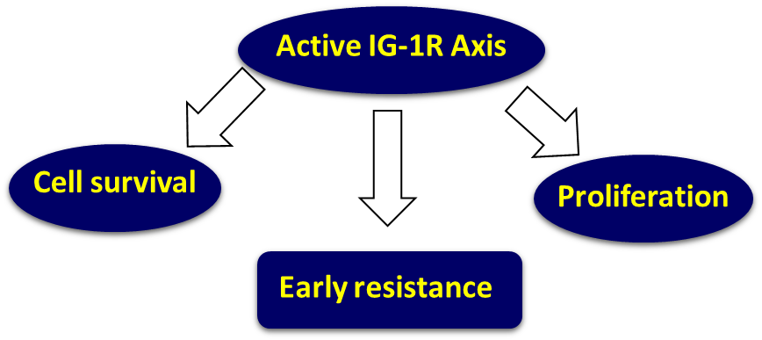
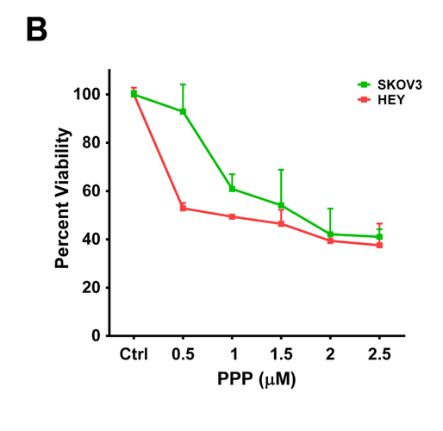

Inhibition of IGF-1R signaling with PPP
C
PPP is a small molecule that selectively inhibits IGF-1R kinase activity without showing any effect against Insulin receptor and other RTKs.
Singh et. al., Cancer Letters, 2014

Slide 20




Potentiation of cytotoxicity using picropodophylin (PPP)
Cisplatin Model
Paclitaxel Model
Combination Model
Singh et. al., Cancer Letters, 2014

Slide 21


Effect of IGF-1R inhibition on long term survival of cells
through clonogenic assay
A
B
Singh et. al., Cancer Letters, 2014

Slide 22




Correlation between IGF-1R signaling and stemness phenotype
How do late resistant cells maintain their resistant and stemness phenotype?

Slide 23

Effect of AKT inhibition on stemness property

Slide 24






Regulation of stemness and chemoresistance at early and late resistant stage
Early resistant stage
Late resistant stage
IGF-1R
IGF-1R
Active IGF-1R signalling
Suppressed IGF-1R signalling
AKT
AKT
P
Oct4 mRNA
Stemness/Chemoresistance
Stemness/Chemoresistance

Slide 25


Acknowledgement
ACTREC and UGC for Funding
UGC Fellowship

