Slide 1


Synthetic jet fuel from renewable energy sources for sustainable aviation
Friedemann Albrecht, Stefan Estelmann,
Ralph-Uwe Dietrich
German Aerospace Center (DLR e.V.)
Petroleum Engineering 2017
29.06.2017, Madrid, Spain

Slide 2
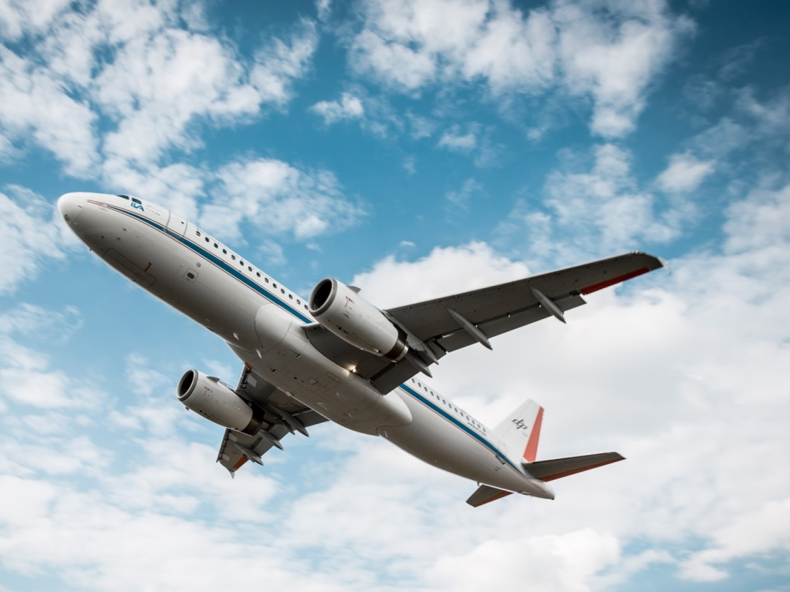
Agenda
Current developments within the Aviation sector
  Growth rates
  CO₂-reduction targets (IATA)
  Expected future demand on alternative fuels
  “Green” jet fuel options
  Certified fuels by ASTM
  Potential fuel yields for Germany/Europe
  Introduction to Fischer-Tropsch fuels
  Case study on green Fischer-Tropsch fuels
  Techno-economic evaluation
  CO₂-Abatement costs
  Summary and outlook

Slide 3
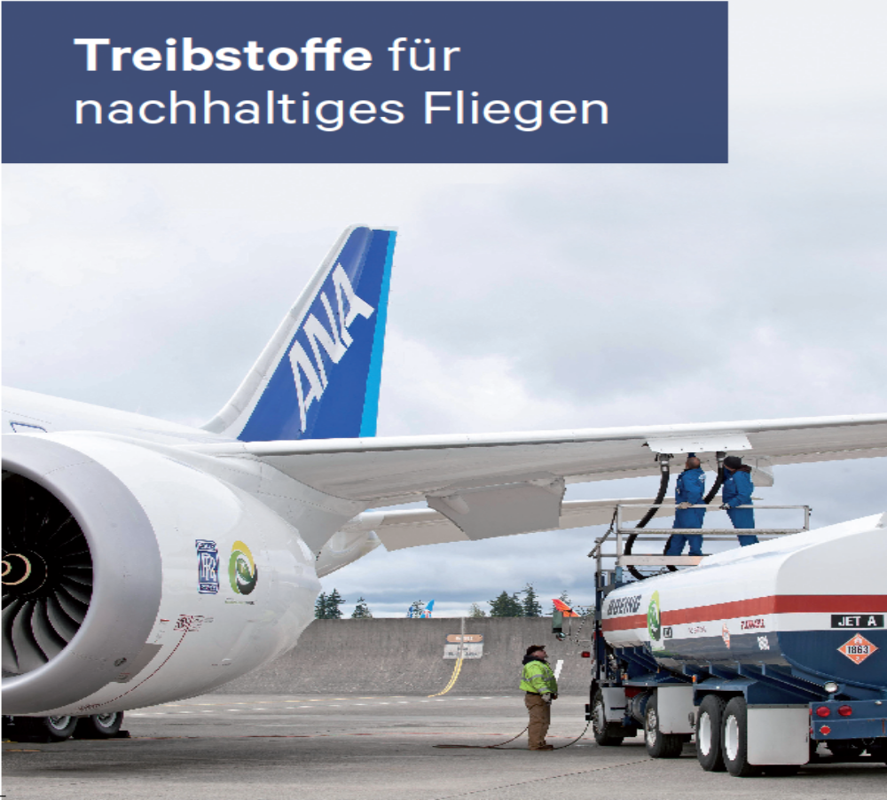
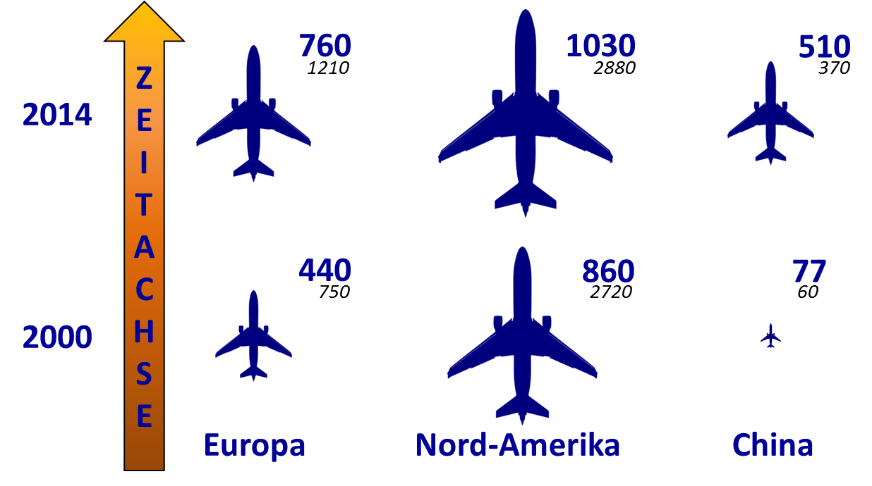
Growth sector aviation
Aviation mileage within three world regions
Fuel for sustainable
aviation
+ 73 %
+ 20 %
+ 560 %
Time axis
Europe
North America
China
(in billion passenger kilometers /a)
Source: Thess et al., DGLR-Mitgliedermagazin „Luft- und Raumfahrt“ edition 2/2016, p.20 et seq.

Slide 4
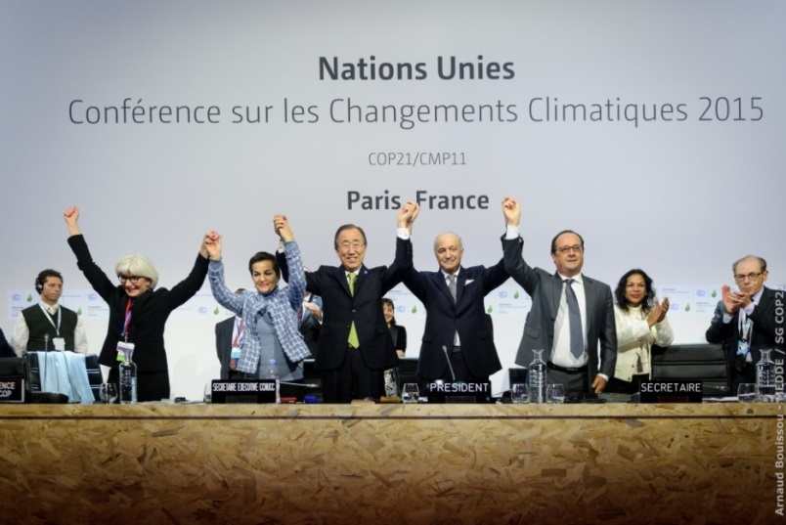

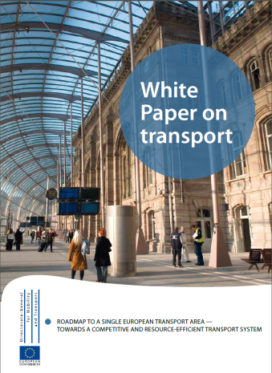
Political paradigm shift rises the pressure
COP21 Main agreements
Hold global temperature increase below 2 ^{ᵒ}C
De-carbonization of global economy in this century
Main targets: EU Roadmap 2050 – White paper
40% use of sustainable low carbon fuels in aviation
COP21: 12.12.2015, Paris
What does this mean for the aviation sector?

Slide 5
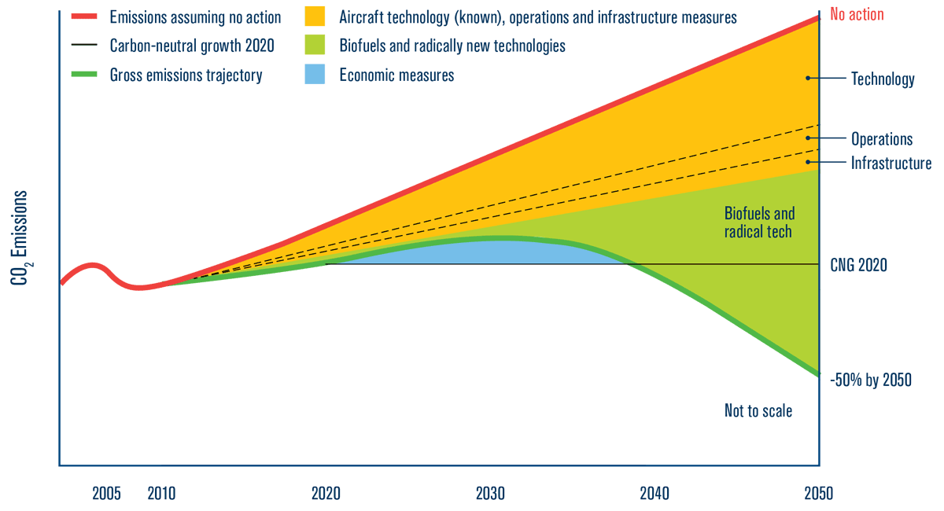
IATA Technology Roadmap
4. Edition, June 2013
Expected demand for Europe 2050:
≈ 56 - 60 Mt green kerosene equivalent
Forecasted CO₂ emissions without reduction measures
No action
Main aims:
Improvement of fuel efficiency about 1,5 % p.a. until 2020
Carbon-neutral growth from 2020
Potential CO2 emissions reductions by 2050
Technology
European Aviation energy demand in 2010: ca. 56.5 Mt^{[1]}
1
Operations
Infrastructure
CO₂ emissions
2
1
2
Planned Measures:
3
Improvement of technologies, operations and airport
-50 % CO₂ by 2050
CO₂-certificates and other economic measures
3
Radical technology transitions and alternative fuels
2010 2020 2030 2040 2050
[1] FuelsEurope “Statistical Report“ 2010
Quelle: iata.org

Slide 6
Certified sustainable jet fuels: ASTM D7566 – 14c ^{[1]}
AtJ in Europe (EU28)? – For example wheat
  Wheat area₂₀₁₄^{[2]}: 26.7 Mio.ha ↓ Ethanol yield: 2.2 t/ha^{[3]} (range -30 % European yield average[])
  Conversion to fuel^{[4]}: 0.56 t_{kerosene}/t_{ethanol}
  Kerosene wheat based: 23.0 to 32.9 Mt/a (≈ 40.1 – 58.2 % of the aviation demand)
Feedstock | Synthesis technology | Fuel
Coal, natural gas, biomass, CO₂ & H₂ | Fischer-Tropsch (FT) synthesis | Synthetic paraffinic kerosene
Lipids from Biomass (e.g. algae, soya, jatropha) | Hydroprocessed esters and fatty acids (HEFA) | Synthetic paraffinic kerosene
Sugar from Biomass | Direct Sugars to Hydrocarbons (DSHC) | Synthetic iso-paraffins / Farnesane
Bioethanol (-propanol, -butanol) | dehydration+oligomerization+hydration (Alcohol-to-Jet, AtJ) | AD-SPK
[1] ASTM International, „ASTM D7566 - 14C: Standard Specification for Aviation Turbine Fuel Containing Synthesized Hydrocarbons“, 2015
[2] Eurostat „Crop statistics“ 2014
[3] Specialist agency renewable raw materials e. V., „Introduction of fuel ethanol”, 2016
[4] NREL, „Review of Biojet Fuel Conversion Technologies”, Golden, 2016

Slide 7
Certified sustainable jet fuels: ASTM D7566 – 14c ^{[1]}
DSHC in Europe (EU28)? – For example sugar beets
  Sugar beet area₂₀₁₄^{[2]}: 1.6 Mio.ha ↓ sugar beet yield: 131 Mt^{[2]} ↓ sugar content_{average} ≈ 18 %^{[3]}
  Conversion to fuel^{[4]}: 0.168 t_{kerosene}/t_{sugar}
  Kerosene sugar based: 3.96 Mt/a (≈ 7.0 % of the Aviation demand)
Feedstock | Synthesis technology | Fuel
Coal, natural gas, biomass, CO₂ & H₂ | Fischer-Tropsch (FT) synthesis | Synthetic paraffinic kerosene
Lipids from Biomass (e.g. algae, soya, jatropha) | Hydroprocessed esters and fatty acids (HEFA) | Synthetic paraffinic kerosene
Sugar from Biomass | Direct Sugars to Hydrocarbons (DSHC) | Synthetic iso-paraffins / Farnesane
Bioethanol (-propanol, -butanol) | dehydration+oligomerization+hydration (Alcohol-to-Jet, AtJ) | AD-SPK
[1] ASTM International, „ASTM D7566 - 14C: Standard Specification for Aviation Turbine Fuel Containing Synthesized Hydrocarbons“, 2015
[2] Eurostat „Crop statistics“ 2014
[3] Specialist agency renewable raw materials e. V., „Introduction of fuel ethanol”, 2016
[4] NREL, „Review of Biojet Fuel Conversion Technologies”, Golden, 2016

Slide 8
Fuels for a sustanable aviation sector
Synthetic jet fuels (ASTM D7566 – 14c)^{[1]}
HEFA in Europe (EU28)? – For example rape oil
  Rapeseed area₂₀₁₄^{[2]}: 12.9 Mio.ha ↓ rape yield: 24.1 Mio.t ↓ oil content_{average} ≈ 42 %^{[3]}
  Conversion to fuel^{[4]}: 0.49 t_{kerosene}/t_{rape oil}
  Kerosene sugar based: 7.3 Mio.t/a (≈ 12.9 % of the Aviation demand)
Feedstock | Synthesis technology | Fuel
Coal, natural gas, biomass, CO₂ & H₂ | Fischer-Tropsch (FT) synthesis | Synthetic paraffinic kerosene
Lipids from Biomass (e.g. algae, soya, jatropha) | Hydroprocessed esters and fatty acids (HEFA) | Synthetic paraffinic kerosene
Sugar from Biomass | Direct Sugars to Hydrocarbons (DSHC) | Synthetic iso-paraffins / Farnesane
Bioethanol (-propanol, -butanol) | dehydration+oligomerization+hydration (Alcohol-to-Jet, AtJ) | AD-SPK
[1] ASTM International, „ASTM D7566 - 14C: Standard Specification for Aviation Turbine Fuel Containing Synthesized Hydrocarbons“, 2015
[2] Eurostat „Crop statistics“ 2014
[3] UFOP “Rapeseed the Power Plant“ 2017
[4] DBFZ, „Abschlussbericht Projekt BurnFAIR”, 2014

Slide 9
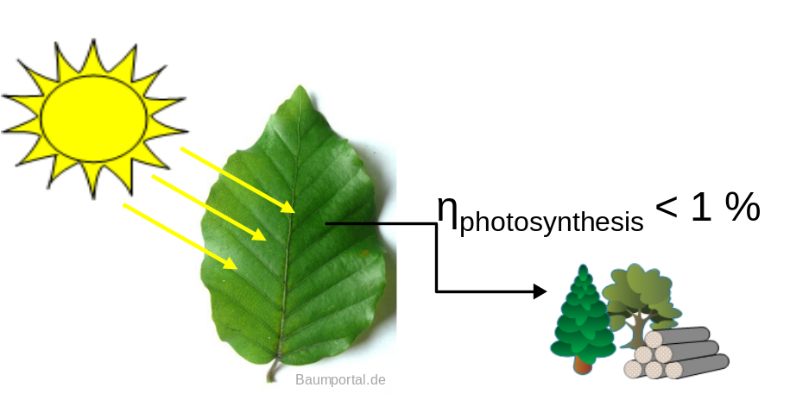
Biomass potential from agricultural products in Europe
Kerosene from | Production [Mt/a] | [%] | Cultivation area [Mha] | EU28 [%]
Wheat | 23.0 – 32.9 | 40.1 – 58.2 | 26.7^{[1]} | 30.2
Sugar | 3.9 | 7.0 | 1.6^{[1]} | 1.8
Rapeseed | 7.3 | 12.9 | 12.9^{[1]} | 13.3
Σ | 34.3 – 44.2 | 60.7 – 78.2 | 39.9 | 45.2
Direct competition to food markets
Ineffective conversion of sun light to biomass
[1] Eurostat „Crop statistics“ 2014

Slide 10
Fuels for a sustanable aviation sector
Synthetic jet fuels (ASTM D7566 – 14c)^{[1]}
Feedstock | Synthesis technology | Fuel
Coal, natural gas, biomass, CO₂ & H₂ | Fischer-Tropsch (FT) synthesis | Synthetic paraffinic kerosene
Lipids from Biomass (e.g. algae, soya, jatropha) | Hydroprocessed esters and fatty acids (HEFA) | Synthetic paraffinic kerosene
Sugar from Biomass | Direct Sugars to Hydrocarbons (DSHC) | Synthetic iso-paraffins / Farnesane
Bioethanol (-propanol, -butanol) | dehydration+oligomerization+hydration (Alcohol-to-Jet, AtJ) | AD-SPK
Fischer-Tropsch synthesis
  Large scale, commercial technology
  Based on synthesis gas, which can be produced from almost any carbon and hydrogen source
  Fully synthetic kerosene achievable^{[2]}
[1] ASTM International, „ASTM D7566 - 14C: Standard Specification for Aviation Turbine Fuel Containing Synthesized Hydrocarbons“, 2015
[2] UK Ministry of Defense, „DEF STAN 91-91: Turbine Fuel, Kerosene Type, Jet A-1,“ UK Defense Standardization, 2011.

Slide 11



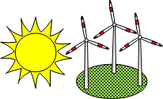






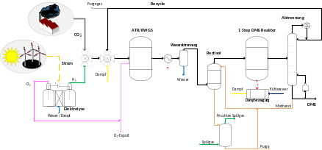
Production routs of alternative Kerosene
- Too large CO₂ footprint
- Low usable raw material potential
CO₂
Cultivated plants
(wheat, rape, beets etc.)
Biomass
(straw, organic waste, residues forest wood etc.)
Green electricity
(wind, sun, water)
Conventional electricity generation
CO₂-source
(air, industrial flue gas)
Waste
Coal, natural gas
Biofuel 1. Gen.
Biomass-to-Liquid (BtL)
Power and Biomass-to-Liquid (PBtL)
Power-to-Liquid (PtL)
Power and Coal/Gas/Waste-to-Liquid
Waste-to-Liquid (WtL)
Coal/Gas-to-Liquid (CtL/GtL)
Optional production route
The supply of large quantities of alternative kerosene within low GHG emissions is possible by coupling the sectors electricity generation and fuel markets (without biomass imports).
Biodiesel, HEFA, Methanol, Ethanol, etc.
Fuel synthesis (2nd generation):
Fischer-Tropsch / Methanol-to-Gasoline / Mixed Alcohol / etc.

Slide 12
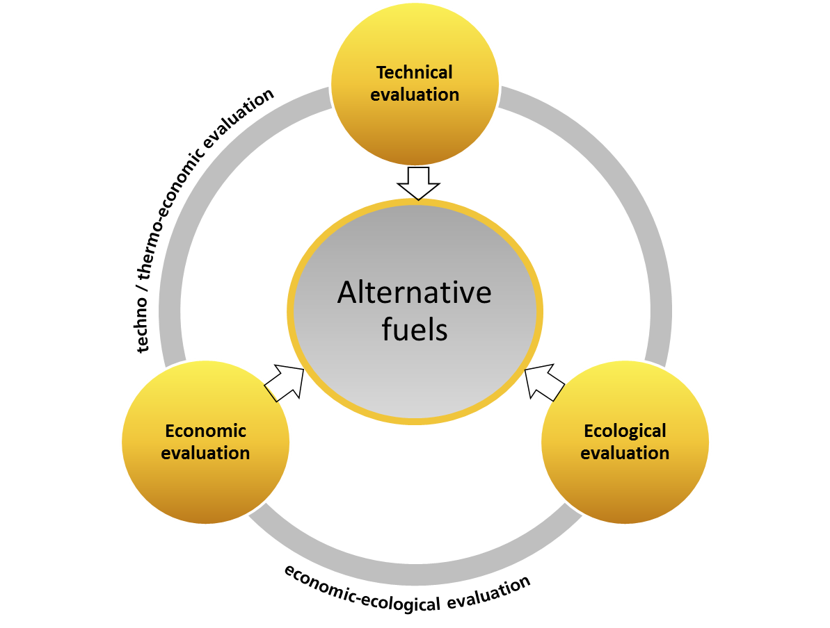
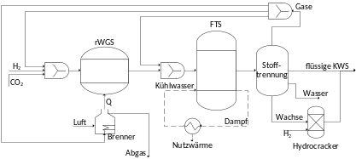
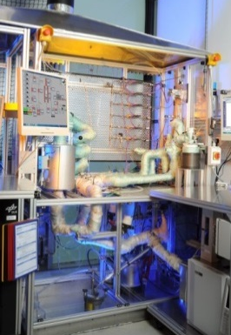


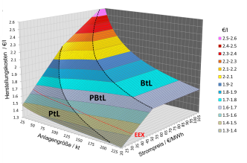
2. Applied methodology for fuel evaluation
production costs
CO₂-footprint
DLR-Sfotwaretool:
Results calculated with TEPET:
CO₂-abatment costs

Slide 13
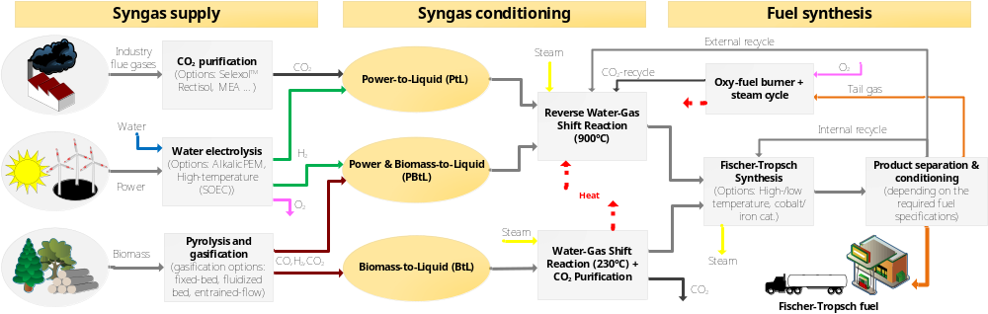
Investigated Fischer-Tropsch concepts
-From biomass (Biomass-to-Liquid, BtL)

Slide 14
Investigated Fischer-Tropsch concepts
-From power and CO₂ (Power-to-Liquid, BtL)

Slide 15
Investigated Fischer-Tropsch concepts
-From power and biomass (Power&Biomass-to-Liquid, BtL)

Slide 16
Investigated Fischer-Tropsch concepts
Overview of concepts
More information available in recent publication:
F. G. Albrecht, D. H. König, N. Baucks und R. U. Dietrich, „A standardized methodology for the techno-economic evaluation of 1 alternative fuels,“ Fuel, Bd. 194, pp. 511-526, 2017.

Slide 17
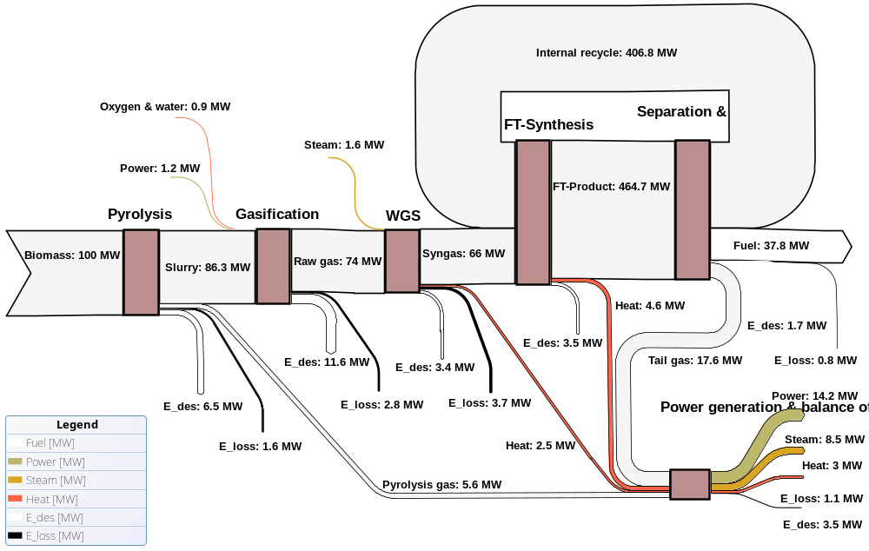
Exergy flows - Biomass-to-Liquid
Largest exergy destruction during gasification
Exergy input:
100 MW (Biomass)

Slide 18
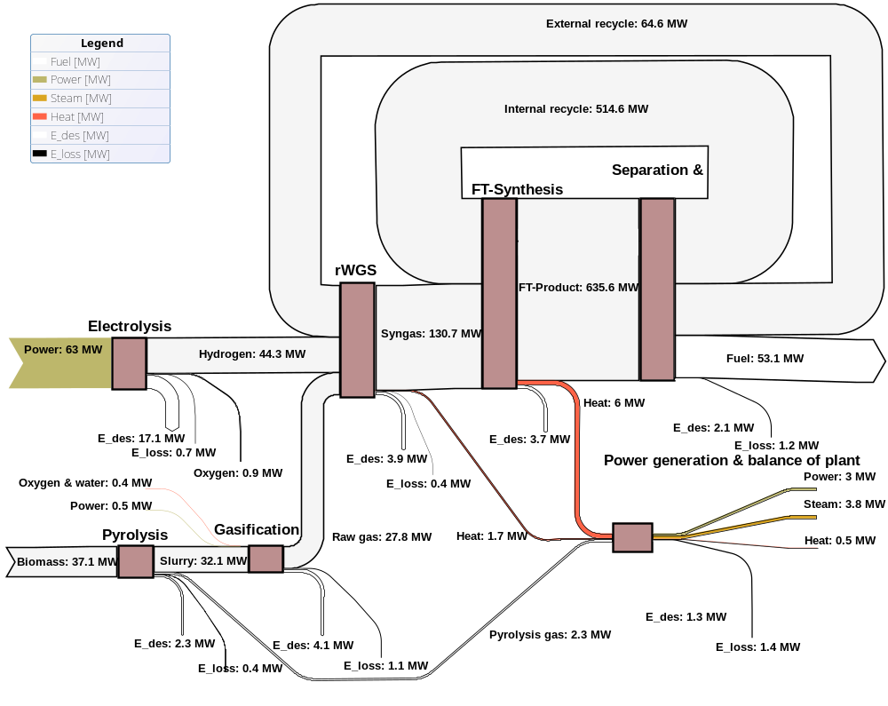
Exergy flows - PBtL
Exergy input:
37 MW (Biomass)
63 MW (Power)
Largest exergy destruction during electrolysis!

Slide 19
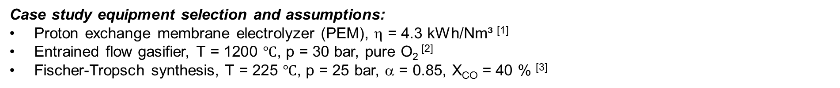
Technical process assessment
Case study equipment selection and assumptions:
Proton exchange membrane electrolyzer (PEM), η = 4.3 kWh/Nm³ ^{[1]}
Entrained flow gasifier, $\text{T}\text{ = 1200 ℃}$, p = 30 bar, pure O₂ ^{[2]}
Fischer-Tropsch synthesis, $\text{T}\text{ = 225 ℃}$, p = 25 bar, α = 0.85, X_{CO} = 40 % ^{[3]}
Process parameter | BTL | PBTL | PTL
Energy efficiency η_{XTL} | 36.3 % | 51.4 % | 50.6 %
Power consumption | - 4.2 kWh/kg_{fuel} | 15.8 kWh/kg_{fuel} | 24.4 kWh/kg_{fuel}
Biomass/CO₂ demand | 7.5 kg_{BM}/kg_{fuel} | 2.0 kg_{BM}/kg_{fuel} | 3.1 kg_{CO2}/kg_{fuel}
Carbon efficiency η_{C} | 24.9 % | 97.7 % | 98.0 %
BTL fuel yield can be increased by the factor 3 – 4 by the PBTL concept
Approximately full carbon conversion for PBTL and PTL applying oxy-fuel combustion and recycle concept
PBTL XTL-efficiency comparable high as for PTL with reduced power consumption
[1] T. Smolinka, M. Günther and J. Garche, „Stand und Entwicklungspotenzial der Wasserelektrolyse zur Herstellung von Wasserstoff aus regenerativen Energien,“ NOW GmbH, 2011, in German
[2] K. Qin, „Entrianed Flow Gasification of Biomass, Ph. D. thesis,“ Technical University of Denmark (DTU), Kgs. Lyngby, 2012.
[3] P. Kaiser, F. Pöhlmann and A. Jess, "Intrinsic and effective kinetics of cobalt-catalyzed Fischer-Tropsch synthesis in view of a Power-to-Liquid process based on renewable energy," Chemical Engineering Technology, vol. 37, pp. 964-972, 2014.

Slide 20
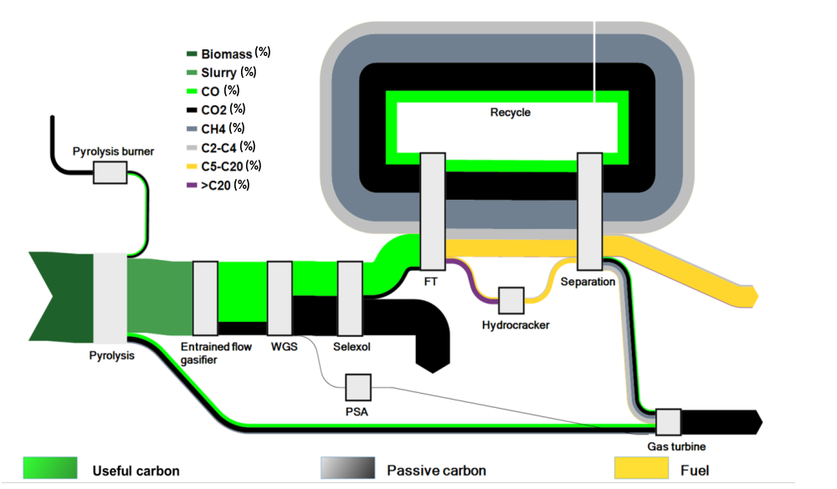
Biomass-to-Liquid – Carbon flow diagram
CO₂
5 %
Molar ratio of H₂/CO > 2 required for FT
100 kW_{th}
36 kW_{th}
C-Biomass
100 %
Fuel
25 %
CO₂
41 %
CO₂
29 %
75 % of biomass carbon lost as CO₂

Slide 21
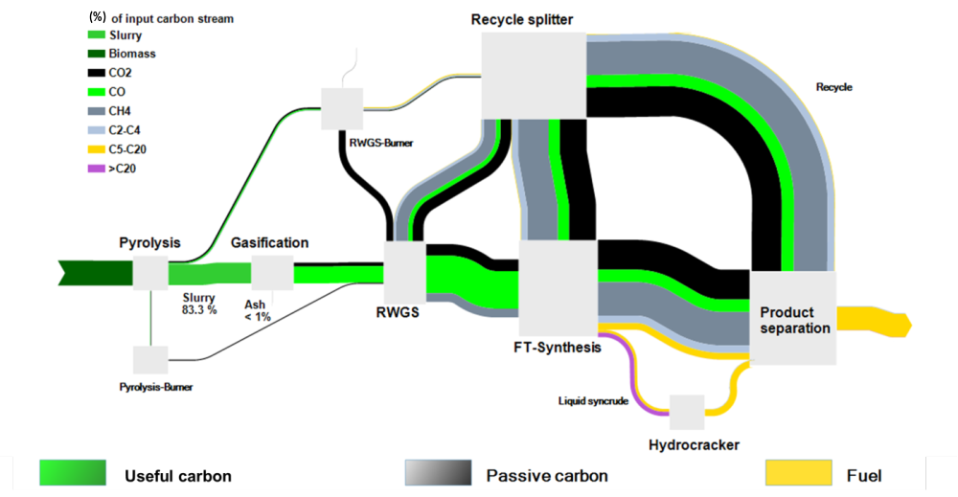
Power&Biomass-to-Liquid – Carbon flow diagram
CO₂
2 %
Molar ratio of H₂/CO > 2 required for FT
100 kW_{th}
C-Biomass
100 %
137 kW_{th}
Fuel
98 %
H₂
Electrolysis
167 kW_{el}
98 % of biomass carbon used in fuel

Slide 22
2. Applied methodology for fuel evaluation
production costs
CO₂-footprint
DLR-Sfotwaretool:
Results calculated with TEPET:
CO₂-abatment costs

Slide 23

Techno-economic assessment (TEA)
Step 6
Step 5
Definition of optimal operating conditions
Experiments at DLR
Step 1
Step 2
Step 3
Control and economic optimization
Literature survey
Process simulation
Techno-economic assessment
TEPET-ASPEN Link
Step 4
Identification of critical process steps
Identification elementary process steps
Rough material and energy balance
Transfer of process parameters
Aspen Plus®
Detailed process model
First optimization (process layout and heat integration)
Determination of specific product costs (CAPEX, OPEX, etc.)
Sensitivity analyses
Exchange with project partners
Iteration

Slide 24
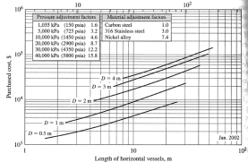


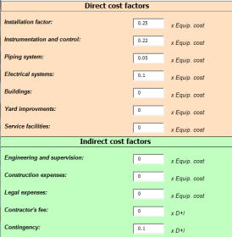

Methodology applied for TEA
Meets AACE class 3-4 Accuracy: +/- 30 %
Process simulation results
Plant and unit sizes
material and energy balance
Aspen Plus®
Capital costs
TEPET-ASPEN Link
Operational costs
Equipment costs
Raw materials
Piping & installation
Operating materials
Factory buildings
Maintenance
Engineering services …
Wages …
Production costs
€/l , €/kg , €/MJ

Slide 25
Assumptions dictate results of TEA
Plant size: 100 MW_{th} (Biomass input LHV)
Investitionskosten:
PEM-Elektrolyszer: 640 €/kW ^{[1]} (installed capacity)
Entrained flow gasification: 103.650 €/(kg_{Slurry}/h) ^{[2]} (scale-factor 0.7)
Raw material prices:
Power: 105 €/MWh ^{[3]} (industrial consumer)
Biomass (35% moisture): 97.4 €/t ^{[4]}
General economic assumptions:
Reference year: 2014 System operation: 30 a Operating hours: 8,260 h/year Capital interest: 7 %
[1] G. Saur, Wind-To-Hydrogen Project: Electrolyzer Capital Cost Study, Technical Report NREL, 2008
[2] P. Kerdoncuff, Modellierung und Bewertung von Prozessketten zur Herstellung von Biokraftstoffen der zweiten Generation, Dissertation, KIT, Karlsruhe, 2008
[3] Eurostat, Êlectricity prices for industrial consumer, 2014
[4] C.A.R.M.E.N. – Preisentwicklung bei Waldhackschnitzel (Energieholz-Index)

Slide 26
Comparison of Costs BTL / PBTL / PTL
Plant size: “100 MW_{th}”
Electrolyzer
Fischer-Tropsch
Power^{[3]}
Maintenance
Entrained flow gasification
Selexol
Biomass^{[4]}
Labor costs
Pyrolyse
Remaining (CAPEX)
Remaining (Utilities)
Remaining (OPEX)
Biomass-to-Liquid (BTL)
Power&Biomass-to-Liquid (PBTL)
Power-to-Liquid (PTL)
Investment: ca. 395.2 mio. €
Fuel production: 24.17 Mt
Fuel costs: ca. 2.34 €/l
Investment: ca. 751 mio. €
Fuel production: 91.27 Mt
Fuel costs : ca. 2.24 €/l
Investment: ca. 672.5 mio. €
Fuel production: 91.27 Mt
Fuel costs : ca. 2.74 €/l
CAPEX:
40.4 %
CAPEX:
21.3 %
CAPEX:
15.6 %
20 %
6 %
51 %
67 %
19 %

Slide 27
Sensitivity analysis for PBTL
OPEX are the main cost driver for PBTL
Power price mostly defines the net production costs
Minor influence of CAPEX

Slide 28
Techno-economic assessment
PTL (Example)
“optimal” production concept depends on boundary conditions!
BTL (Example)
PBTL (Example)
Cost-efficient fuel production depends mainly on the boundary conditions e.g. plant size and power price

Slide 29
2. Applied methodology for fuel evaluation
production costs
CO₂-footprint
DLR-Sfotwaretool:
Results calculated with TEPET:
CO₂-abatment costs

Slide 30

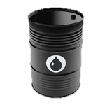
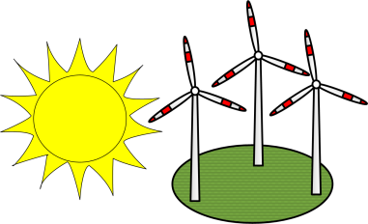
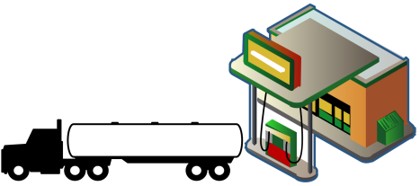
CO₂-Footprint - Methodology
Biomass
Carbon footprint of used raw materials and energy sources defines carbon footprint of produced fuel!
Fuel
Black box
Power
Fuel Production plant
Carbon dioxide
$${CO}_{2}−Abatement costs \left[\frac{€}{t_{{CO}_{2}}}\right] = \frac{Difference in fuel costs}{{CO}_{2}−emission reduction}$$
Oxygen
O₂

Slide 31
CO₂ Footprint – Basics
Biomass
Power
Carbon dioxide
Oxygen
O₂
Functional unit | [kg_{CO2eq}/t]ª | [kg_{CO2eq}/MWh]^{b} | [kg_{CO2eq}/t]^{c} | [kg_{CO2eq}/t]^{d}
Low boundary | 13.6 | 10 | 5 | 10
Average | 134.3 | 272.5 | 77.5 | 75
High boundary | 255 | 535 | 150 | 140
ª Taking into account biomass type (forest residues, straw etc.) and transport distances. CO₂-emissions during cultivation and harvesting are accounted for.
^{b} Low boundary value for pure wind electricity taken from [1]. High value corresponds to the actual CO₂-footprint of the German electricity sector [2].
^{c} Representing emissions arising from sequestration of CO₂ from flue gas (cement industry and coal fired power plants). The probably fossil nature of the flue gas was not taken into account.
Low/high value: energy demand of CO₂-sequestration is covered with wind energy/German electricity mix.
^{d} ProBas databank [1]. Low/high value due to different electricity sources.
[1] Umweltbundesamt, “Prozessorientierte Basisdaten für Umweltmanagementsysteme,” http://www.probas.umweltbundesamt.de/php/index.php.
[2] Umweltbundesamt, “Entwicklung der spezifischen Kohlendioxid-Emissionen des deutschen Strommix in den Jahren 1990 – 2016,“ Dessau-Roßlau,2017.

Slide 32
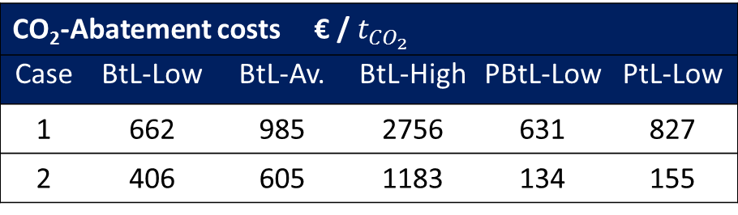
CO₂ Footprint – Calculation
CO₂-Abatement costs:
Case1:
Price of fossil kerosene: ca. 0.5 €/l
Power price: 105 €/MWh
Biomass price: 100 €/t
Fossil fuel reference:
Ca. 83.8 g_{CO2}/MJ
Case2:
Price of fossil kerosene: ca. 1 €/l
Power price: 30 €/MWh
Biomass price: 60 €/t
CO₂-Abatement
CO₂-Abatement costs € / $t_{{CO}_{2}}$
Case | BtL-Low | BtL-Av. | BtL-High | PBtL-Low | PtL-Low
1 | 662 | 985 | 2756 | 631 | 827
2 | 406 | 605 | 1183 | 134 | 155
PtL-concepts only viable
when using renewable power!
Current Price of CO₂ - European Emission Allowances:
ca.5 €/t_{CO2}

Slide 33
Required: Feedstock shift for sustainable aviation
Raw materials and energy requirements for 60 Mt of green jet fuel:
European jet fuel consumption (2010)
ca. 56.5 Mt/a
EU target (2050):
40 % sustainable low carbon fuels
Expected “green” jet fuel demand in 2050:
55-60 Mt/a
Demand | Unit | BtL | PBtL | PtL
Powerª | TWh | - | 890 | 1450
Biomass^{b} | Mt | 451 | 119 | -
CO₂^{c} | Mt | - | - | 186
To be compared with:
ª Total produced renewable electricity in EU (2015): 930 TWh¹
Expected development potential wind: ≈ 40,000 TWh²
^{b} Total bioenergy consumption in EU (2014): 105.5 Mt³
Expected wood potential (2030 EU): 146 Mt⁴
^{c} Total CO_{2,eq.} emissions (2015 EU): 4,451.1 Mt⁵
Six fully “green” refineries!
Just for aviation!!
[1] Eurostat database, “online data codes: nrg_105a and tsdcc330,” 2017
[2] EEA Technical report, “Europe's onshore and offshore wind energy potential”, No 6/2009
[3] AEBIOM „Statistical Report 2016 - Key findings“
[4] European Commission, Agriculture and rural development, „Biomass potential“
[5] Eurostat „Total greenhouse gas emissions by countries”

Slide 34

Summary
EU aviation emission targets ➔ large demand for green jet fuel
Mass production of green jet fuel ➔ renewable power-based fuel production concepts (Fischer-Tropsch)
Syncrude from Fischer-Tropsch synthesis has to be upgraded ➔ Update existing refinery infrastructure
Alternative fuel costs are currently not competitive compared to fossil jet fuel ➔ political demand
➔ Identify the most viable fuel options in terms of fuel costs / CO₂-abatement costs
Use the standardized DLR methodology for the evaluation of alterative jet fuels with respect to technical, economic and ecological key performance parameters
(CAPEX, OPEX, net production costs, CO₂-Abatement costs)
Think of a Time beyond Oil – Start Now!

Slide 36
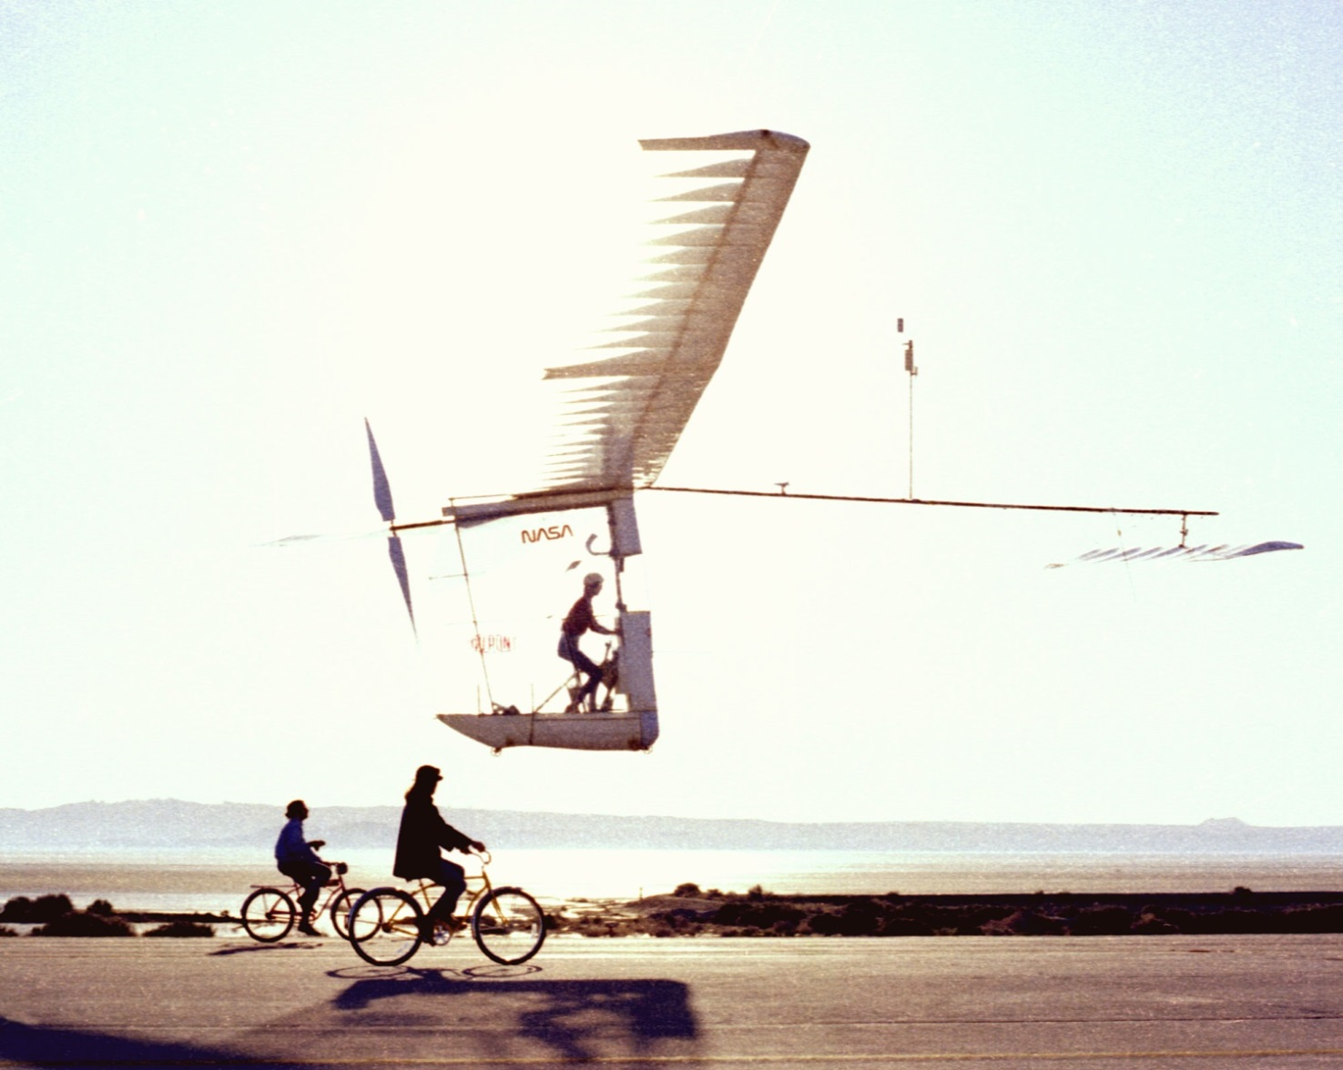
Otherwise? – How about biking?
The Gossamer Albatross crossed the English Channel between Folkestone and Cap Gris-Nez
Bryan Allen on June 12, 1979
Distance: 35,8 km
Travel time: 2:49 hours
This corresponds to:
Flight from Frankfurt am Main (FRA)
↓ Madrid (MAD): 1.450 km
Calculated flight time: 114 hours
Quelle: https://de.wikipedia.org/wiki/Gossamer_Albatross

Slide 37
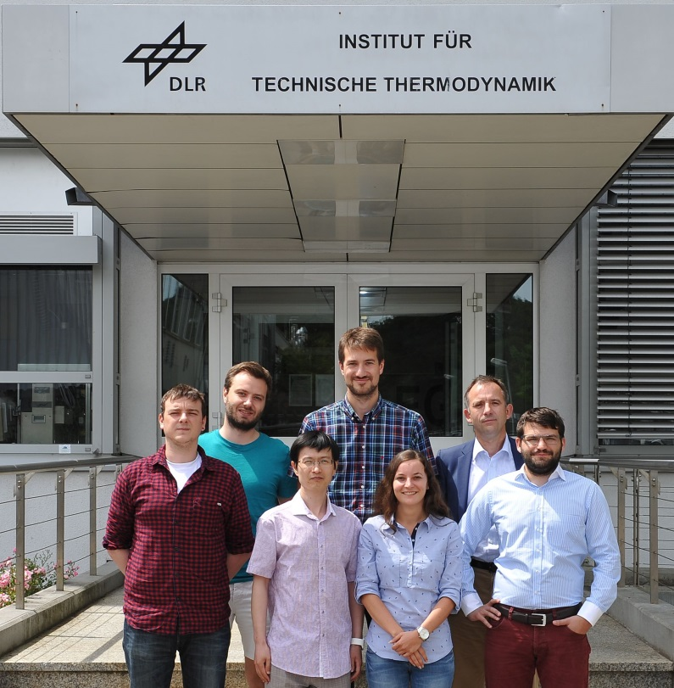
THANK YOU FOR YOUR ATTENTION!
German Aerospace Center (DLR)
Institute of Engineering Thermodynamics, Stuttgart
Research Area Alternative Fuels
ralph-uwe.dietrich@dlr.de
http://www.dlr.de/tt/en

